Slide 1
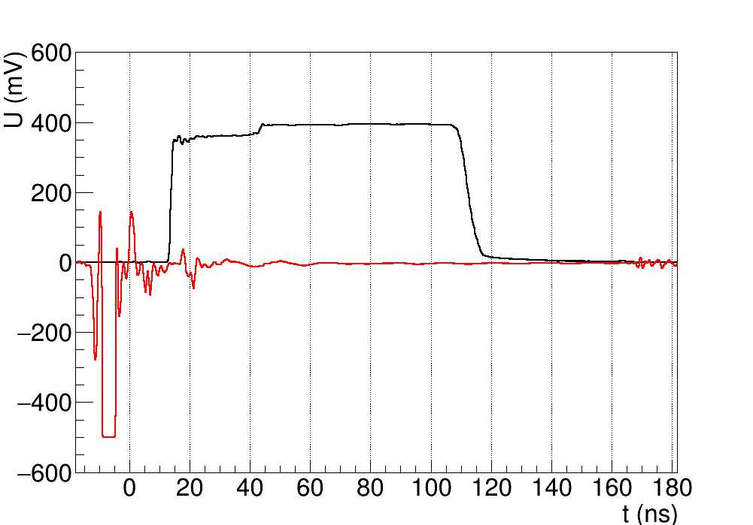
Edge-TCT with active pixels
Motivation:
Passive devices enable measurement of charge collection efficiency (CCE), but in-time efficiency is also important for real application
Smaller signals on pixel edges → larger time walk
Edge-TCT with active devices allows measurement of time walk dependence on position within pixel
Method:
Acquisition triggered by laser driver output, adjustment for cable and fibre length, light hits the sample at t=0
Measure Time of Arrival (ToA) and Time over Threshold (ToT) of the in-pixel comparator output
ToT – signal size
ToA – time walk information
Change signal size by varying laser power
Samples
RD50-MPW2 W11 (1.9 kOhm cm)
Unirradiated and 5e14 neutrons (TID 0.5 MRad)
CabL
ToT
ToA
light enters sample
laser trig

Slide 2
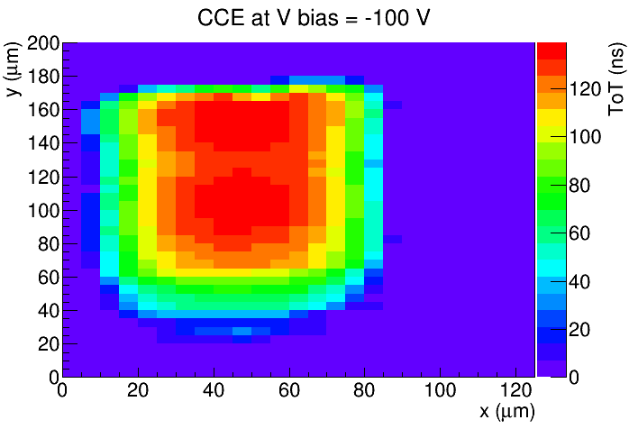
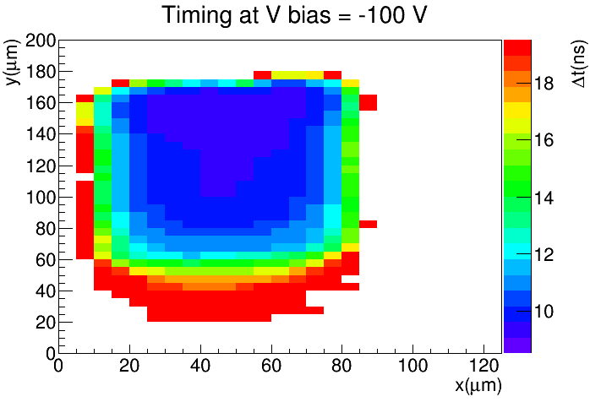
Edge-TCT example
chip surface
ToT = 126 ns
ToA = 9.8 ns
depth
Example of CCE and timing measurement
Evaluate average ToT (left) and ToA (right) in a volume 50 μm x 80 μm (W x H), starting 20 μm below surface

Slide 3
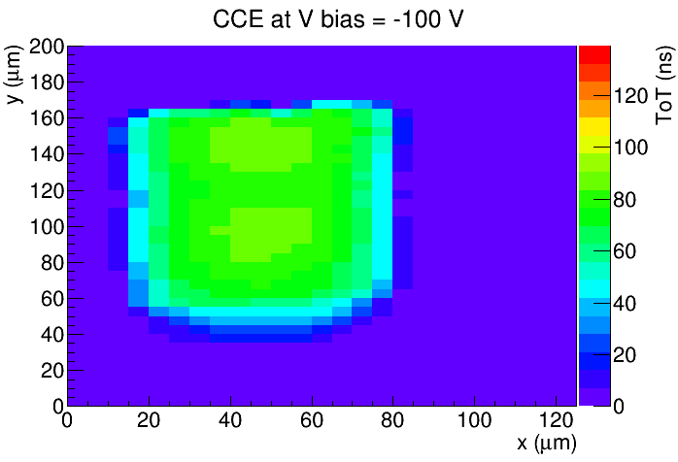
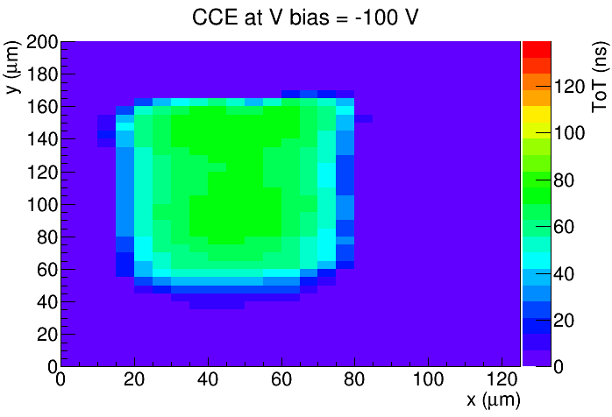
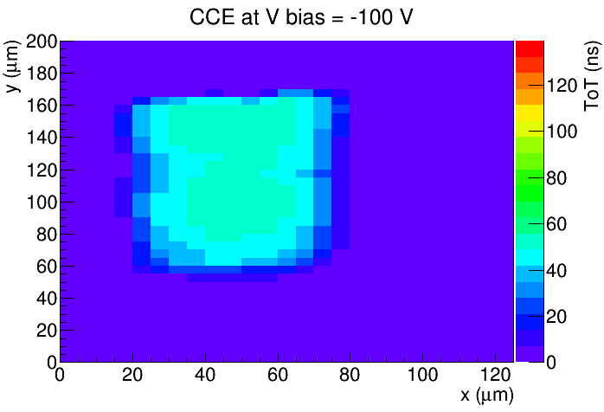
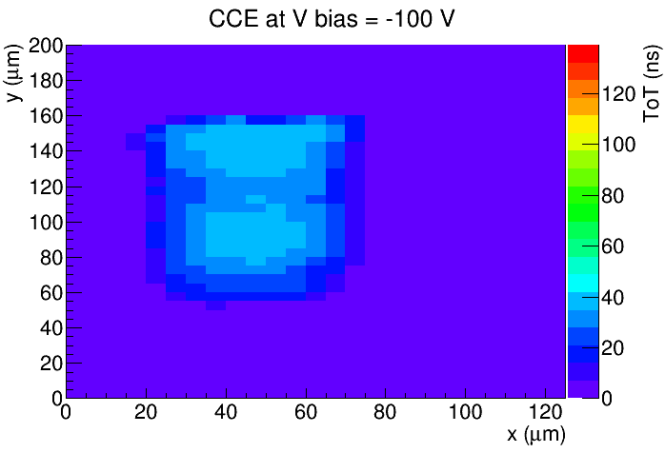
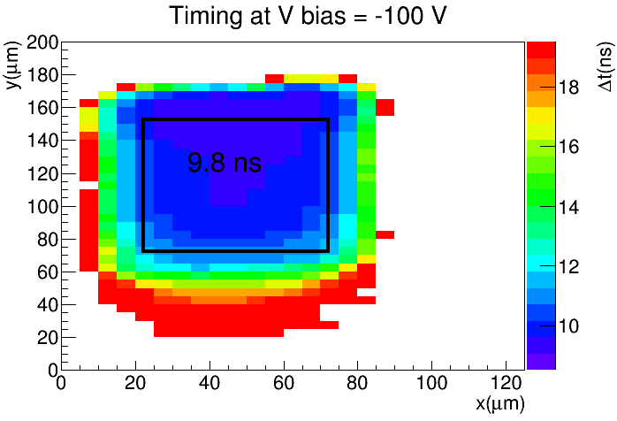
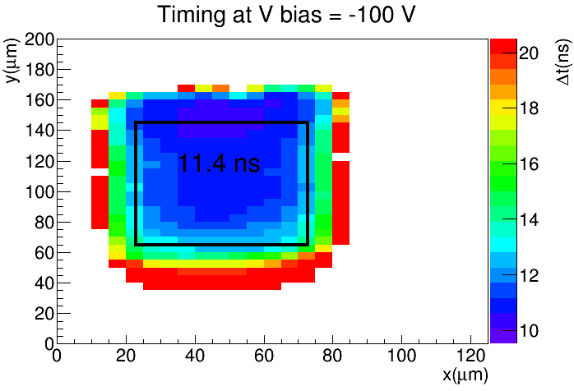
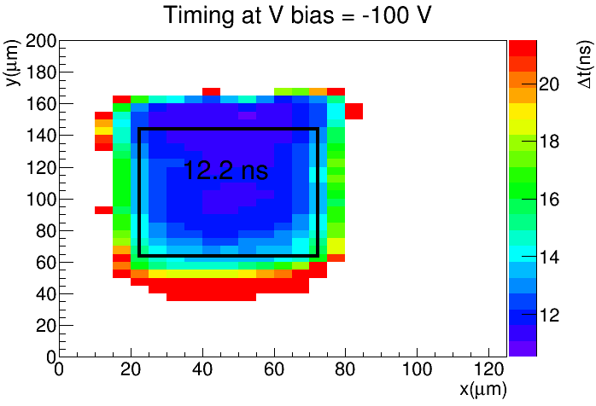
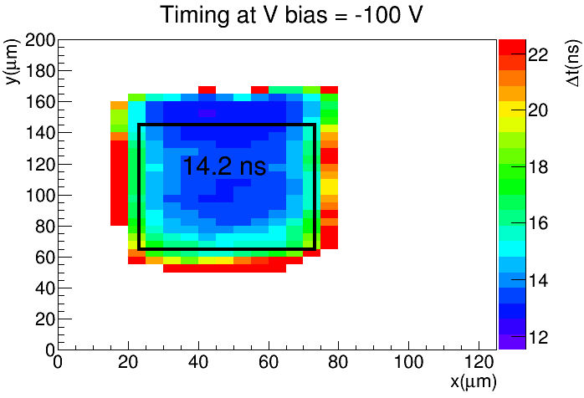
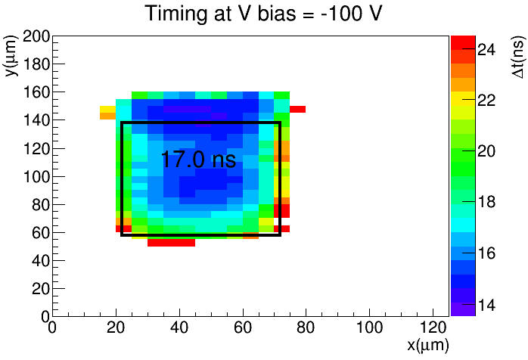
CCE and timing for different laser power (5e14)
Reducing laser power
(same z-scale for all measurements)
ToT (charge)
ToA (time walk)
Reducing laser power

Slide 4
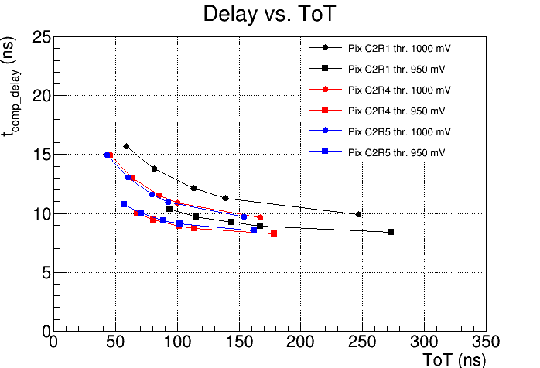
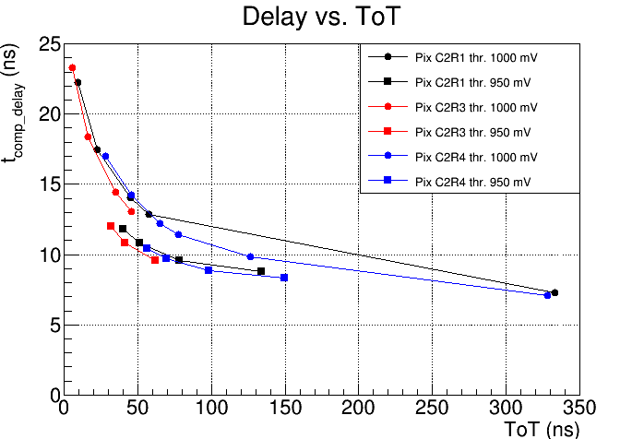
Time walk Edge-TCT
ToT 50 ns
≈ 3500 e⁻
ToT 50 ns
≈ 3500 e⁻
unirrad.
5e14
Edge-TCT time walk measurement in three different pixels before and after irradiation
Time walk increases with higher threshold (as expected)
Significant pixel-to-pixel variations (manufacturing variations)
Time walk similar before and after irradiation
Measurements in low ToT range limited by noise level

Slide 5
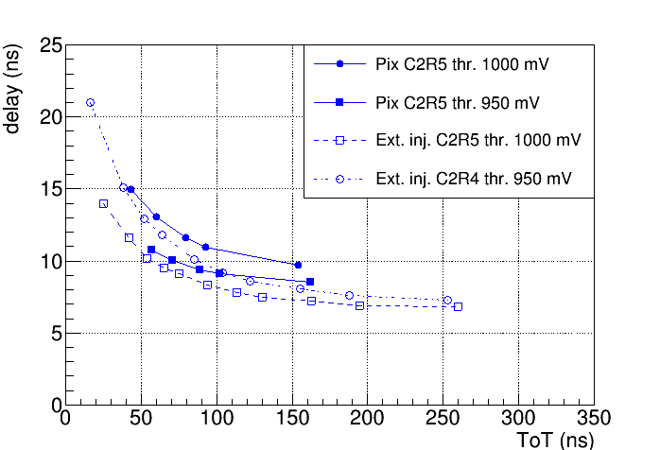
Time walk – comparison between Edge-TCT and external injection
Cross check – direct charge injection into front-end via 2.8 fF injection capacitance
Both methods in agreement within 1– 2 ns
unirradiated

Slide 6
Backup

Slide 7
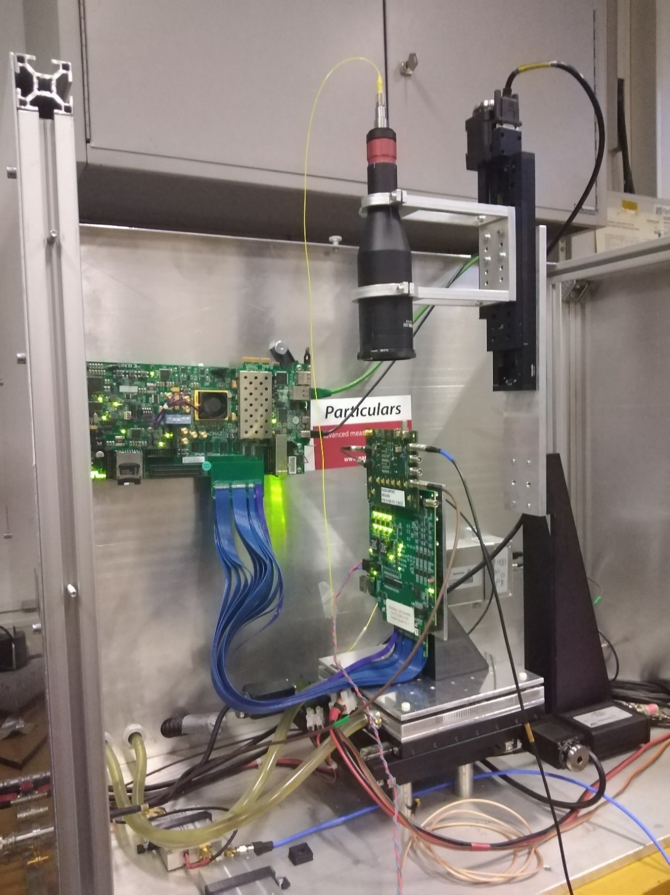
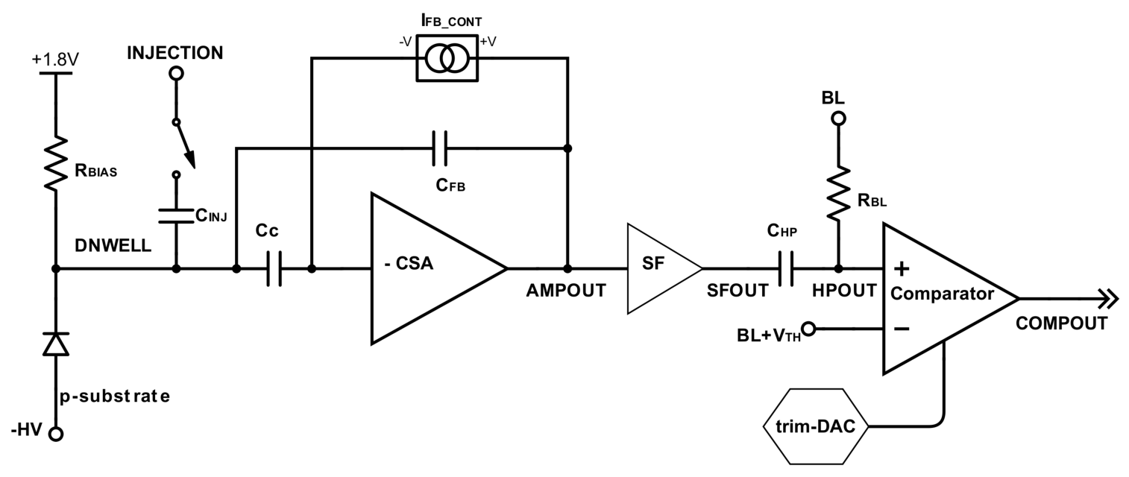
Edge-TCT measurement setup
Edge-TCT setup by Particulars, spatial resoultion 5 μm
Chip configuration with ZC706 + CaRibou
Analogue COMPOUT signal read out by oscilloscope (DRS 4)

Slide 8
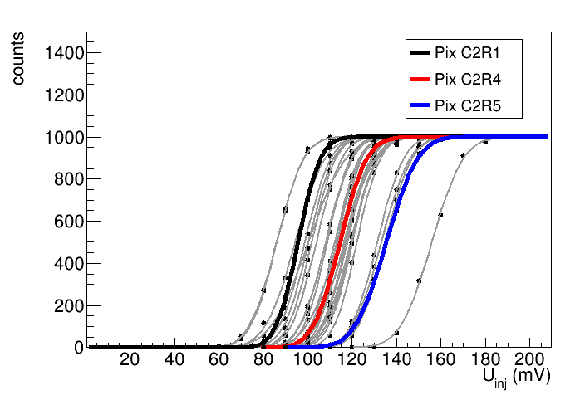
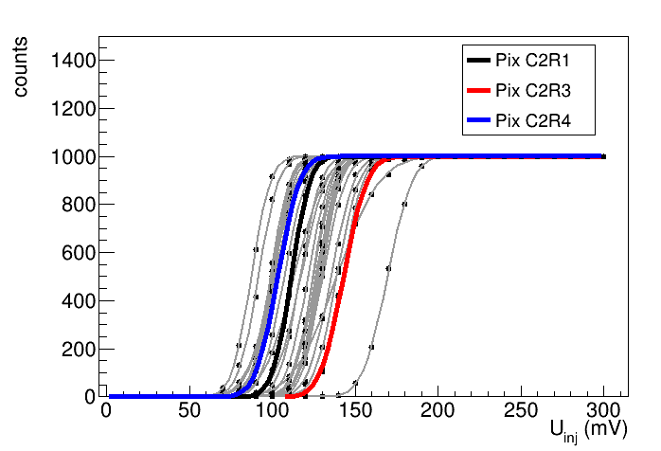
S-curve (threshold 1000 mV)
unirradiated
5e14 neutron irradiated
beam direction
(≈ 17 e⁻/mV)
Selected three pixels with low, medium and high threshold
No pixel-level Trim-DAC tuning
Baseline 900 mV + U_{inj} compared to threshold (1000 mV)

Slide 9
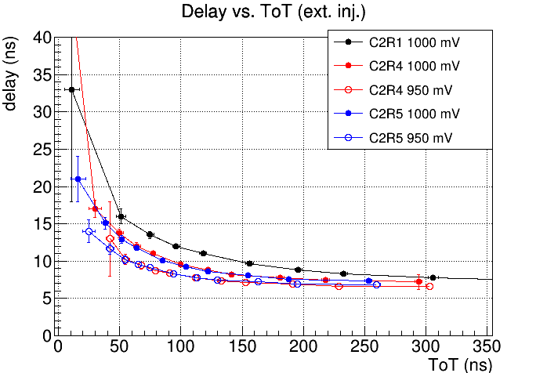
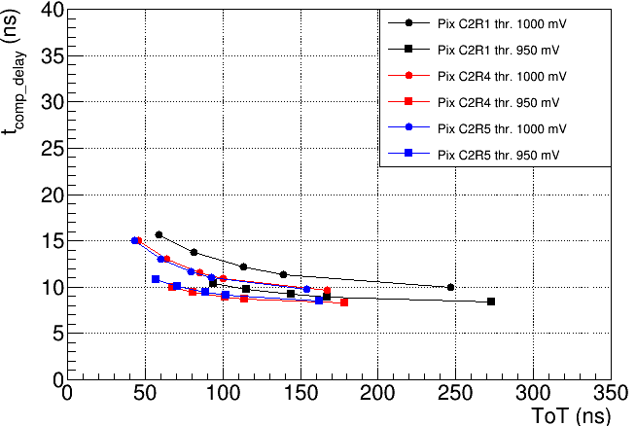
Time walk – external injection
Charge injected via 2.8 fF injection capacitance – unirradiated sample
Edge-TCT

Slide 10
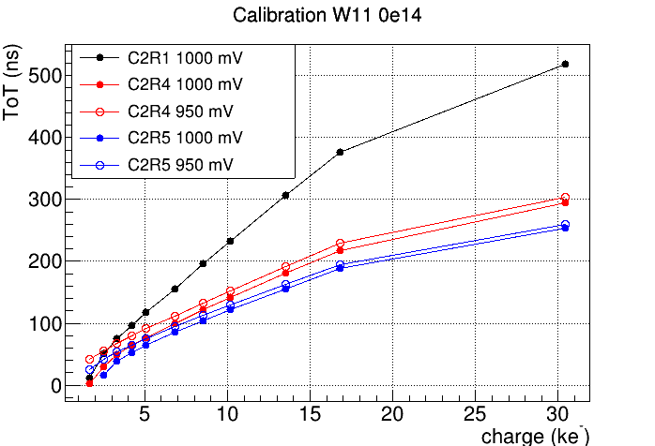
Charge – ToT calibration
Calibration (ToT → charge) by charge injection with pulse generator (allows reaching lower Uinj than Car)
C_{inj} = 2.8 fF, Thresholds 950 mV and 1000 mV, no TrimDACs
Measure ToT of COMPOUTBUFF signal on oscilloscope
Pulse Gen.
(Ext. Inj.)
Significant differences in calibration of different pixels
- Apparently due to manufacturing variations

Slide 11
External injection 5e14
Significant difference in calibration of different pixels (up to 50 %)
Probed pixels slightly below simulation values
Approx. 5 % difference within pixel between thresholds 50 mV and 100 mV

