Slide 1

ATLAS DBM a Diamond based luminosity and Beam spot Monitor
Marko Mikuž
For the DBM project
IBL GM, CERN, October 19th, 2011

Slide 2






DBM Institutes
  Bonn CERN Göttingen Ljubljana OhioS Toronto
New Mexico expressed interest to join – irradiations, testing
Bologna expressed interest (t.b.c.) to join – DAQ and off-line

Slide 3
DBM – purpose and specs
Purpose
  Bunch-by-bunch luminosity monitor (aim < 1 % per BC per LB)
    Finer segmentation and larger acceptance than BCM
    Never saturates
    Internal stability monitoring
  Bunch-by-bunch beam spot monitor
    Need triple-module telescopes for tracking
    Can distinguish hits from beam halo tracks
    Unbiased sample, acceptance extends far along beam axis
Design considerations
  Baseline: four telescopes of 3 IBL modules per side → 24 total
  Avoid IBL insertion volume and ID acceptance (η>2.5)
    In front of BCM (η~4.2); limited overlap
  Place in pixel support structure close to detector and beam pipe
Clear caveat: Possible only if nSQP brings pixels out in 2013

Slide 4
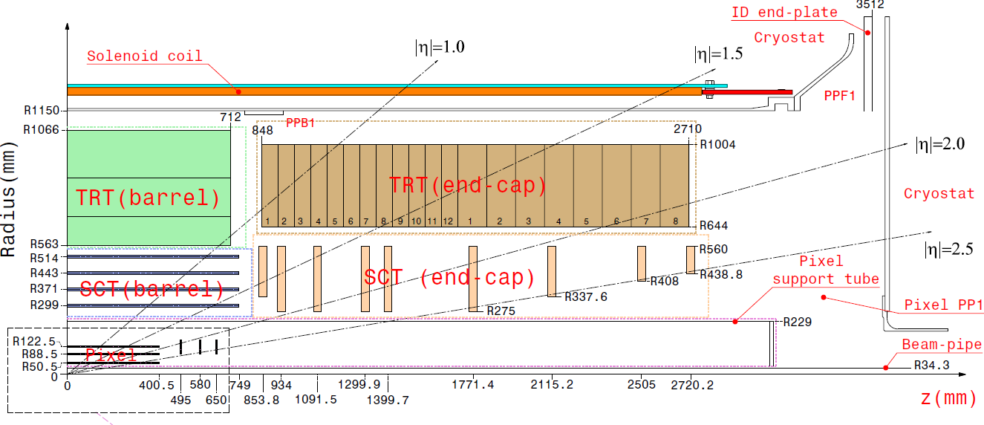
DBM - geometry
Part of pixel volume, but needs IBL-type services
  e. g. 1000 V for detector bias
  Services inventory being included in nSQP
nSQP sets installation date – February 2013
DBM: 3.2<η<3.5

Slide 5
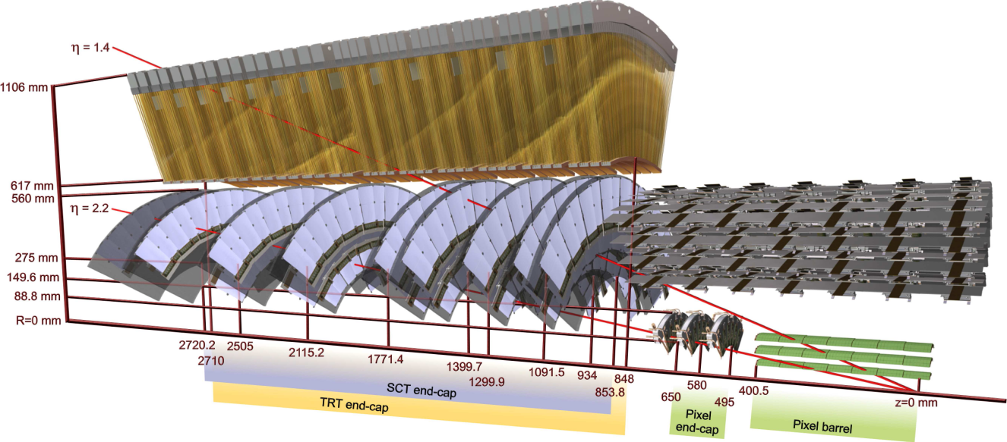
DBM - installation
DBM

Slide 6
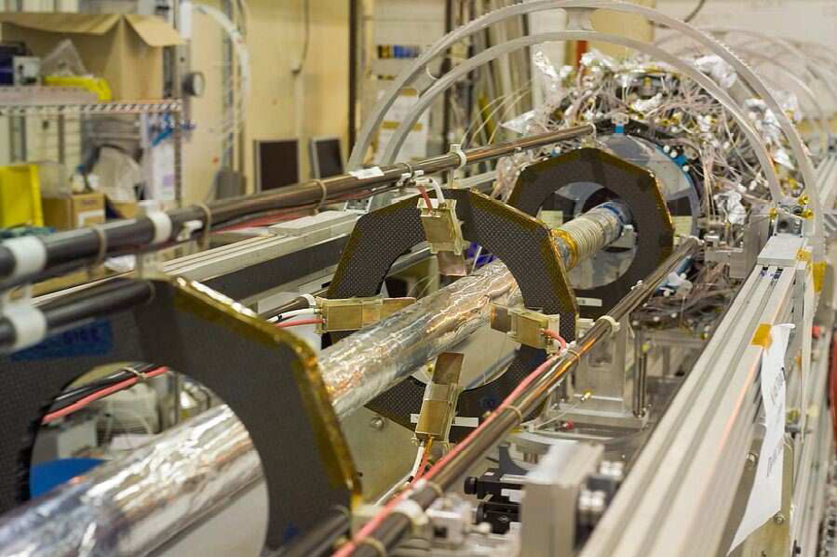
DBM - installation
Pixel
DBM
BCM
BPSS

Slide 7
DBM within IBL
Apart from sensors, mechanics and read-out modifications DBM just adds 24 IBL single chip modules to the existing 448
  Services: two half-staves in addition to 2x14 of IBL
  Requires an additional ~5 % of most IBL components
Resources partly available under detector-specific part of IBL MoU
Resources of DBM partners require approval and monitoring by ATLAS RRB
DBM is now included as one of IBL WP
  LHCC follow-up still pending, not reported at LHCC in Sep
LHCC notification and approval critical for some partners

Slide 8
DBM work sharing
Agreed work sharing between DBM institutes
Additional collaborators welcome, expected to cover critical tasks
  UNM irradiations/testing
  Bologna (?) DAQ/off-line

Slide 9
IBL generic parts - progress
Nice compilation thanks to Susanne Kersten
  https://indico.cern.ch/conferenceDisplay.py?confId=153008
  HV
    IBL HV crate completely filled
    Need 1 HV crate + 1 HV module
  LV
    WIENER + LV-PP4 has each 12 channels/crate
    Nothing required
    PP2
    To be discussed with Mauro and Sebastian
  SCOL
    Nothing required
  Temperature monitoring and interlock
    DBM should have separate interlock crate
    Need: 1 crate partly populated

Slide 10
DBM production
Baseline: 24 modules to be installed
Production model: aim for 30 good modules
Loss of 25 % during module assembly
  Need parts to assemble 45 modules
    45 sensors, FE-I4’s, flip-chippings, flexes etc.
    5 for irradiation studies
  After testing with 1st version of FE-I4 can re-use diamond for final modules

Slide 11
DBM sensor specifications

Slide 12
DBM sensors
Produced sensor inventory
  34 sensors in hand for DBM production
    Most of them need thinning,
    5 FE-I3 parts need cutting, yielding 15 I4 size sensors
    4 DBM ready @ IZM
    4 (thick) built into I4 modules
  Envisage nearly all will pass the DBM spec
Ordered 10 sensors to DBM specs from DDL
  Order placed 18/10
Plan ordering 10 sensors from II-VI
  II-VI will quote in Jan 12

Slide 13
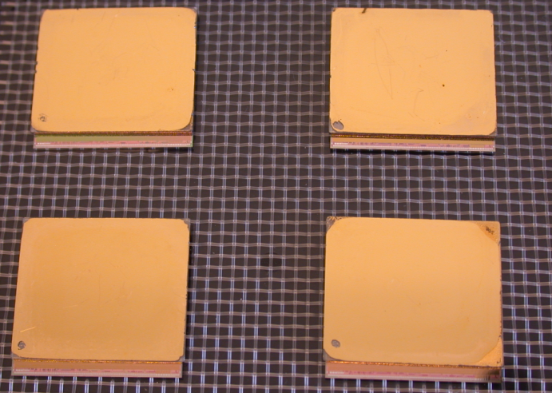
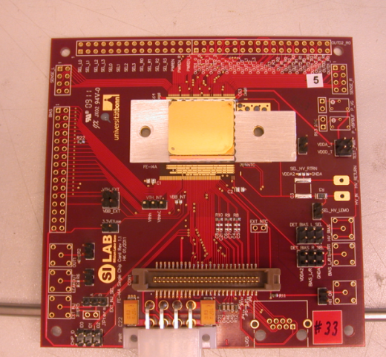


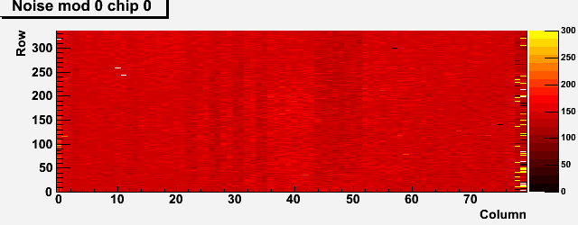
First four DBM modules
Four DBM modules built at IZM
  21x18 mm² pCVD from DDL
  FE-I4 ATLAS IBL pixel chip
  336x80 = 26880 channels, 50x250 μm²
Largest ASIC/diamond flip chip assembly
4 modules after flip-chipping
X-ray perfect
Noise map uniform
  Indication of success
HV issue due to IZM metallization up to edge
Module on test board
Diamond + I4
X-ray after
bump bonding
I4 only
First noise map of a DBM module

Slide 14
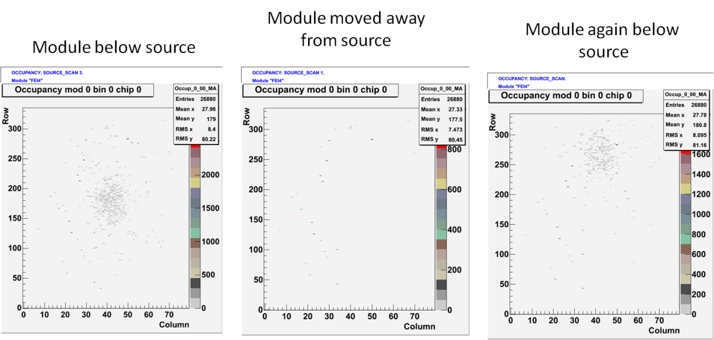
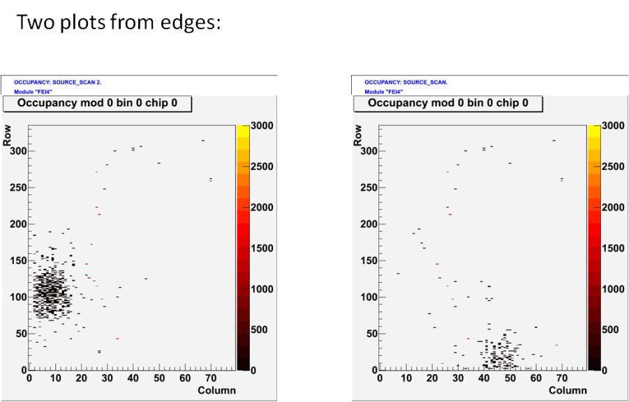
Source test: 1st DBM modules
Modules tested with ⁹⁰Sr in Ljubljana using USBPix
Hits are beyond any doubt source-correlated
The edges are alive despite the couple of ppm CTE mismatch between diamond and Si !

Slide 15
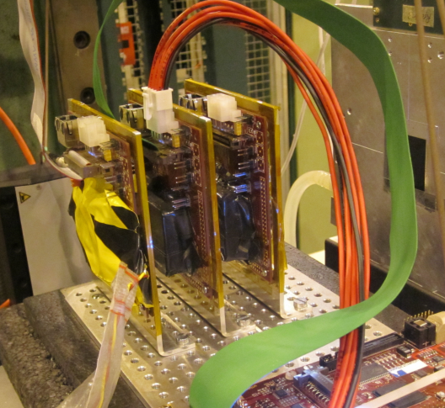
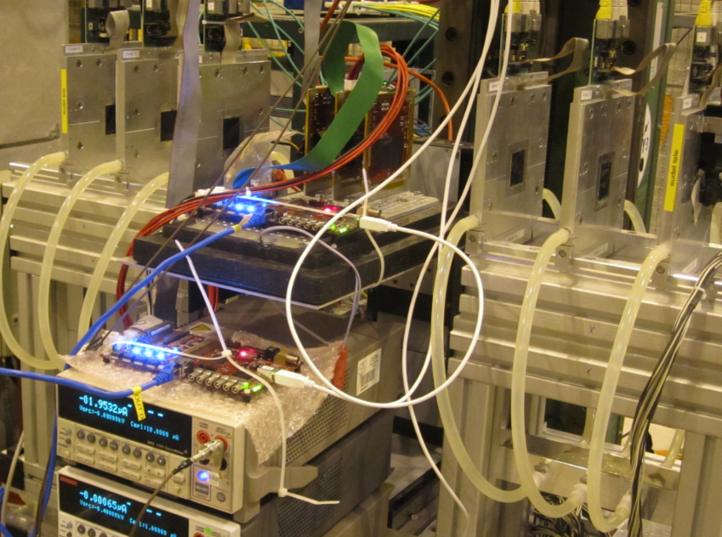
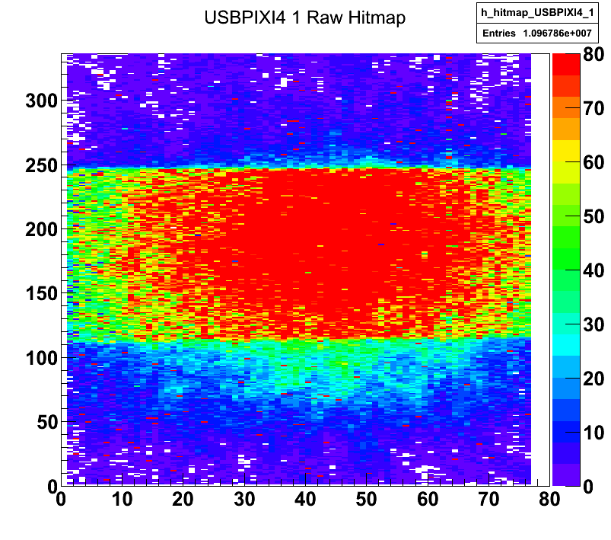
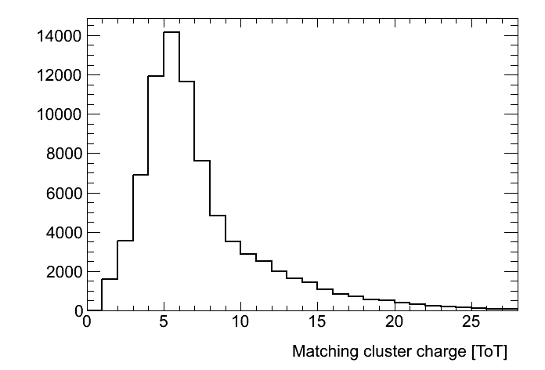
DBM modules: test beam
Run1394 SCC33 500e Threshold 8ToT5ke Hitmap
Yesterday 9 pm
3 TB campaigns
  Jul, end Aug, now
Child diseases, just like any TB
  PS compliance in Jul, low HV, data useless
  Understanding I4
    including calibration
I4 tuning accomplished @ 500 e
  With 8ToT5ke
  Is probably ~1000 e because of offset
Results emerging slowly
  Lots of hard work going on
  https://twiki.cern.ch/twiki/bin/viewauth/Atlas/TBOctober2011
Suffer from low field in thick diamond
  (much) less than 1 V/µm
  d >> CCD → charge spreads over pixels

Slide 16
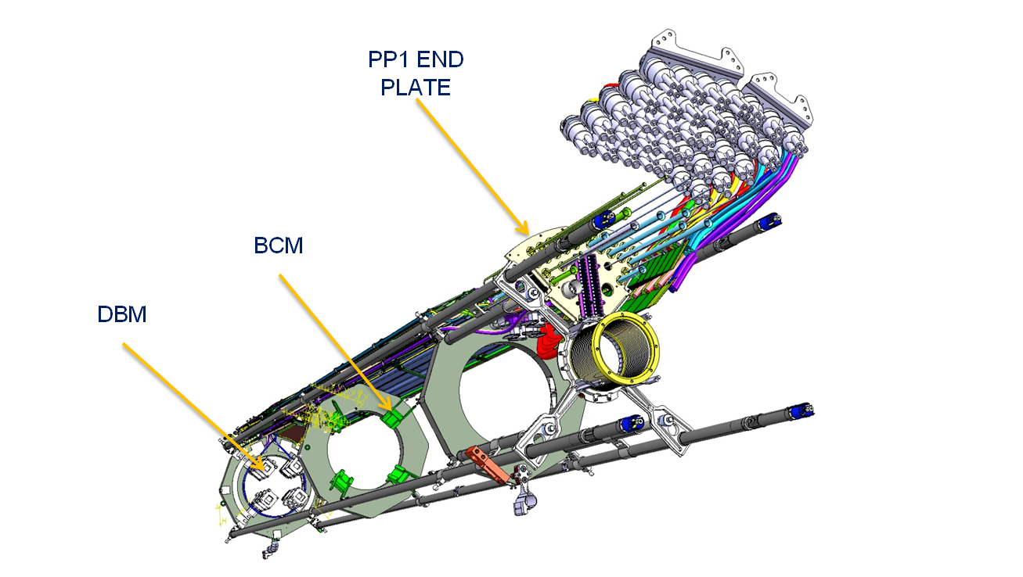
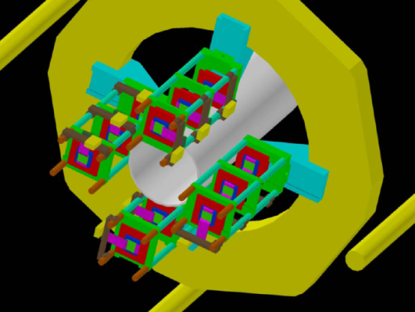
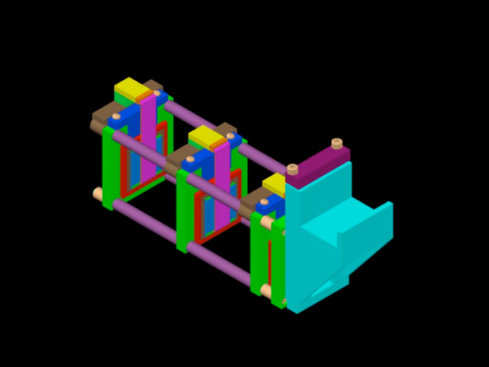
DBM services
Meeting with nSQP to define interfaces
  https://indico.cern.ch/conferenceDisplay.py?confId=156391
No showstoppers, agreed to work sharing
  Services routing done, big thanks to nSQP team
  DBM is treated as (half)stave 15 of IBL

Slide 17
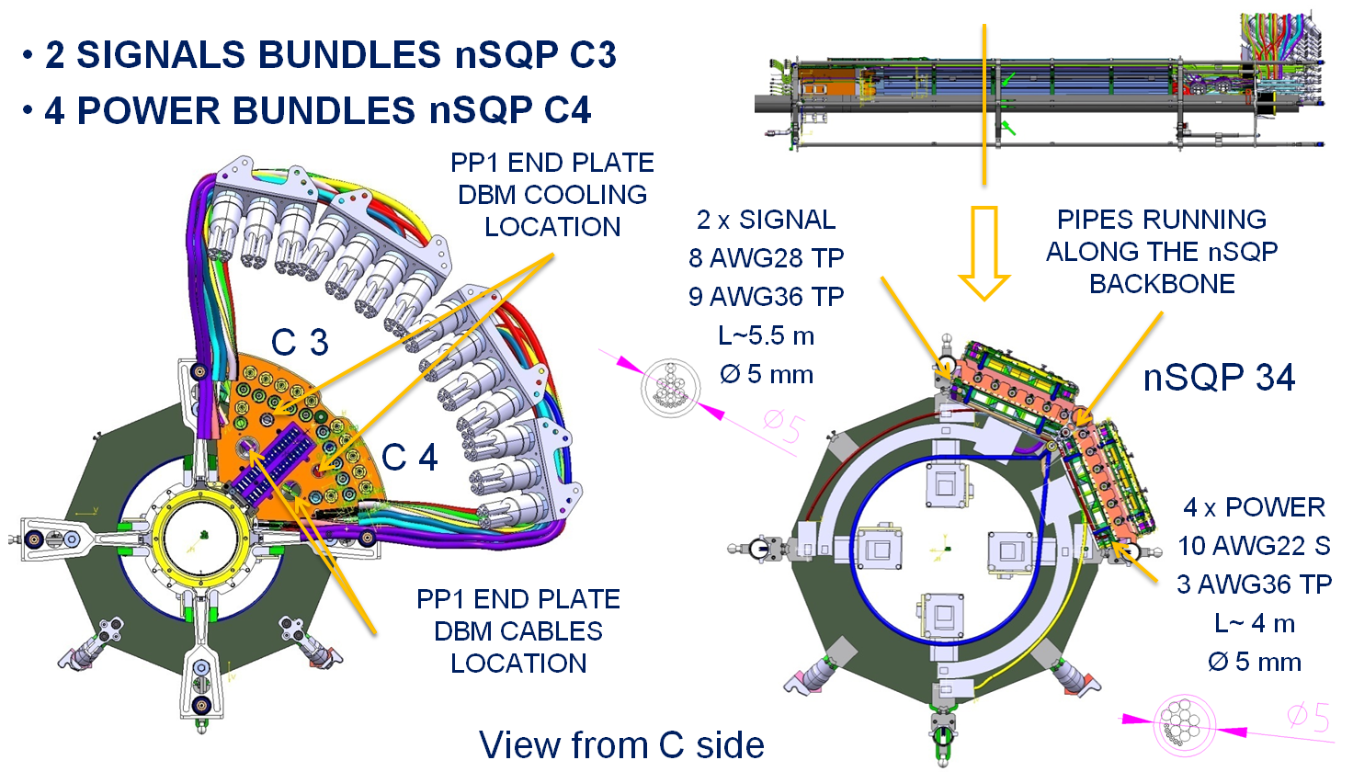
DBM services: electrical

Slide 18
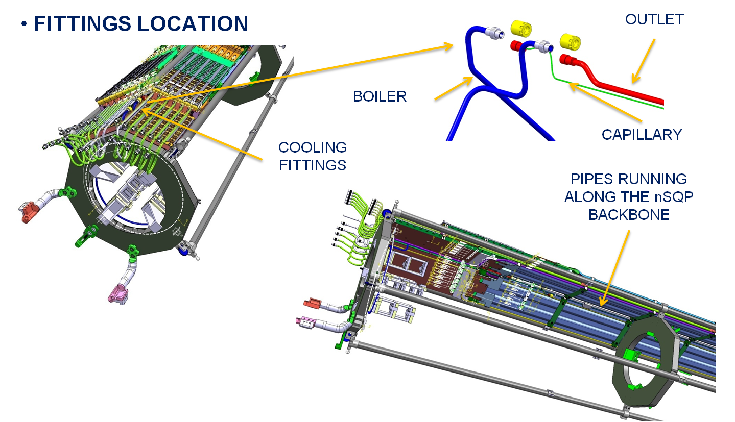
DBM services: cooling

Slide 19
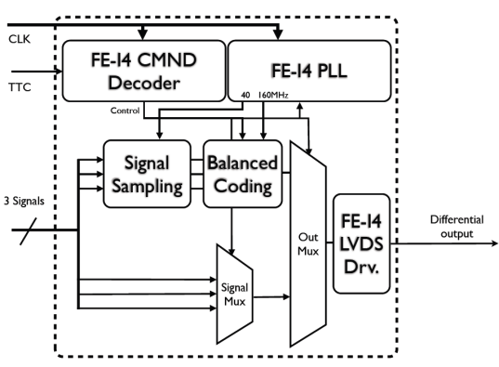
DBM DAQ
Two DAQ modes in parallel
  Quasi-random trigger sampling all bunches
    Running at bandwidth limit of the readout 160 MB/s
      320 MB/s achieved on the bench
    In ROD count e.g. 0, 1, >2 hits/plane (up to 26880 possible) in counters per BCID to assess luminosity
      Pattern matching (IP/halo) in ROD to correct for background
    Write data-rich event sample (e.g. >1 hit on all planes) to private stream
      Tracking algorithms to provide beam spot
      Restricted to multiple track events when µ»1 - vertexing
  ATLAS L1 trigger
    Provide DBM data to ATLAS data stream
Met ROD designers in Bologna on Oct 10
  No showstoppers, very cooperative attitude
Brainstorming on hitbus usage last DBM-biweekly (Oct 11)
  Extra chip to drive signals (CERN&OSU), data ok, CLK&TTC ?

Slide 20
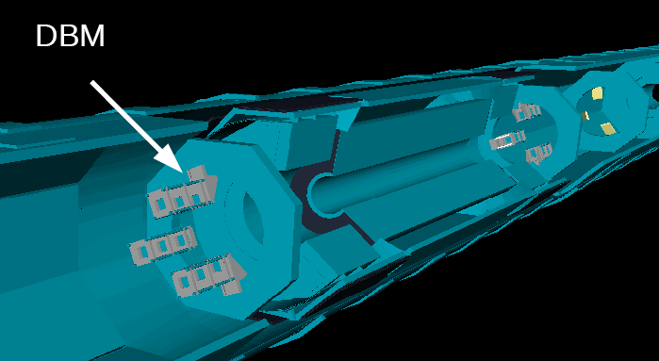
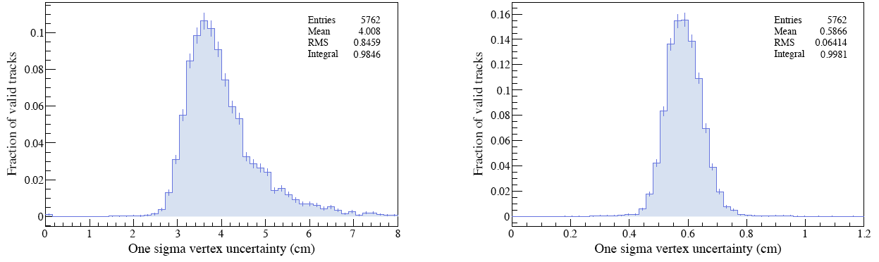
DBM off-line
Simulation studies underway in Toronto
Decided to focus on z of vertex, momentum resolution bad anyway => turn precise pixel side in r
50 µm in Φ
σ_{z} ~4 cm
50 µm in r
σ_{z} ~0.6 cm

Slide 21
Schedule
Schedule very tight – already spent 10 of the 24 months available !
  Went quite a way on project structure & schedule
    Approval by extended PixIB in July
    Prepared DBM description as an add-on IBL TDR chapter
    Prepared WBS
    IZM bump bonding schedule includes diamond
    Clarified integration in nSQP
  Designing, building and testing the system basically at the same time
    Built first modules, starting to get familiar with them
  Following closely and copying IBL developments
    Very helpful attitude of IBL and nSQP teams. Thank you !
We plan for success
  Small project – 2 modules/month
We need LHCC approval
  They got to know of us first
Showstopper:
 nSQP project gets canceled and pixel package stays in the pit 

Slide 22
Summary
DBM picking up momentum
IBL and nSQP integration well under way thanks to helpful colleagues
Components being procured
Modules produced and exercised
Need to speed up LHCC recognition

