Slide 1
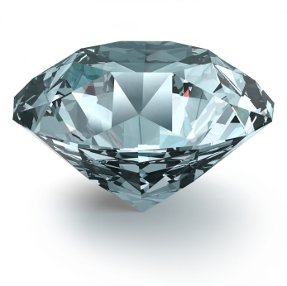
Diamond Sensors
Recent Highlights
Marko Mikuž
University of Ljubljana & Jožef Stefan Institute
for the DPix Collaboration
The 5th "Trento" Workshop on Advanced Silicon Radiation Detectors
Manchester, February 26, 2010

Slide 2
Outline
Diamond as sensor material
Radiation hardness: RD-42
Pixel modules: ATLAS DPix project
Diamond application: ATLAS BCM/BLM

Slide 3
Diamond as sensor material
Property | Diamond | Silicon
Band gap [eV] | 5.5 | 1.12 | ☺ Low leakage
Breakdown field [V/cm] | 10⁷ | 3x10⁵
Intrinsic resistivity @ R.T. [Ω cm] | > 10¹¹ | 2.3x10⁵
Intrinsic carrier density [cm⁻³] | < 10³ | 1.5x10¹⁰
Electron mobility [cm²/Vs] | 1900 | 1350
Hole mobility [cm²/Vs] | 2300 | 480
Saturation velocity [cm/s] | 0.9(e)-1.4(h)x 10⁷ | 0.82x 10⁷
Density [g/cm³] | 3.52 | 2.33
Atomic number - Z | 6 | 14
Dielectric constant - ε | 5.7 | 11.9 | ☺ Low capacitance
Displacement energy [eV/atom] | 43 | 13-20 | ☺ Radiation hard
Thermal conductivity [W/m.K] | ~2000 | 150 | ☺ Heat spreader
Energy to create e-h pair [eV] | 13 | 3.61
Radiation length [cm] | 12.2 | 9.36
Spec. Ionization Loss [MeV/cm] | 6.07 | 3.21
Aver. Signal Created / 100 μm [e₀] | 3602 | 8892 | ☹ Low signal
Aver. Signal Created / 0.1 X₀ [e₀] | 4401 | 8323

Slide 4
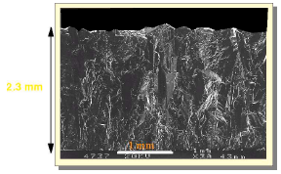
Sensor types - pCVD
Polycrystalline Chemical Vapour Deposition (pCVD)
  Grown in μ-wave reactors on non-diamond substrate
  Exist in Φ = 12 cm wafers, >2 mm thick
  Small grains merging with growth
  Grind off substrate side to improve quality
  → ~500-700 μm thick detectors
  Base-line diamond material for pixel sensor
Surface view of growth side
Photo HK@OSU
Side view
Test dots on 1 cm grid
Photograph courtesy of E6

Slide 5
Sensor types - scCVD
Single Crystal Chemical Vapour Deposition (scCVD)
  Grown on HTHP diamond substrate
  Exist in ~ 1 cm² pieces, max 1.4 cm x 1.4 cm, thickness > 1 mm
  A true single crystal
    Fall-forward for sLHC pixel upgrade (single chips, wafers ?)
      Needs significant improvement in size & price
      After heavy irradiations properties similar to pCVD, headroom ~3x10¹⁵ p/cm²

Slide 6
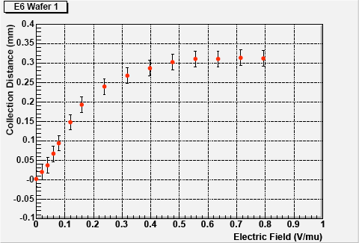
Signal from pCVD diamonds
No processing: put electrodes on, apply electric field
Trapping on grain boundaries and in bulk
  much like in heavily irradiated silicon
Parameterized with Charge Collection Distance, defined by
CCD = average distance e-h pairs move apart
Coincides with mean free path in infinite (t ≫ CCD) detector
 mean not
most probable
CCD measured on 1.4 mm
thick pCVD wafer from E6
CCD of BCM 0.5 mm
thick pCVD detectors
@ 2 V/ μm

Slide 7
Charge collected in pCVD diamonds
Electrodes stripped off and reapplied at will
  Test dot → strip → pixel on same diamond
  Charge collection usually done with strip detectors and VA chips
⁹⁰Sr source data well separated from pedestal
  <Q_{col}> = 11300 e
  <Q_{MP}> ~ 9000 e
  99% of events above 4000 e
FWHM/MP ~ 1 (~ 0.5 for Si)
  Consequence of large non-homogeneity of pCVD material
Q_{col} measured @ 0.8 V/μm

Slide 8
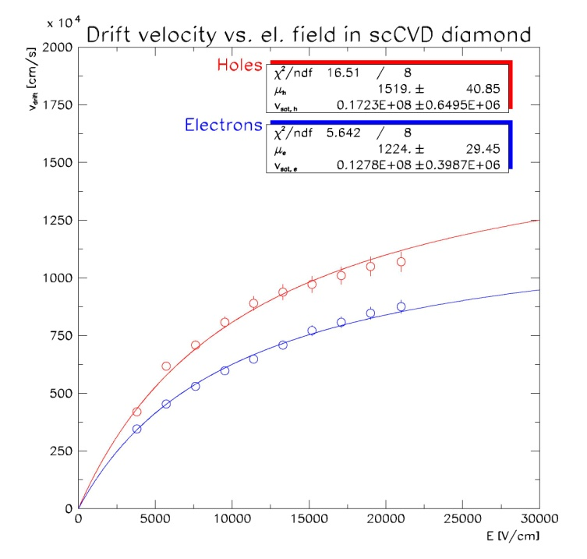
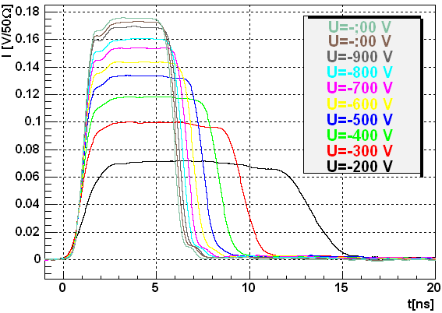
Charge collected in scCVD diamonds
CCD = thickness at E > 0.1 V/μm
  Collect all created charge
  “CCD” hardly makes sense
FWHM/MP ~ 1/3
  scCVD material homogenous
  Can measure diamond bulk properties with TCT
~ same CCD
as pCVD
scCVD measured in Ljubljana
e-injection with α-particles
Current
Transient time

Slide 9
Radiation damage in diamond
Radiation induced effect | Diamond | Operational consequence | Silicon | Operational consequence
Leakage current | small & decreases | none | I/V = αΦ α ~ 4x10⁻¹⁷ A/cm | Heating Thermal runaway
Space charge | ~ none | none | ΔN_{eff} ≈ -βΦ β ~ 0.15 cm⁻¹ | Increase of full depletion voltage
Charge trapping | Yes | Charge loss Polarization | 1/τ_{eff} = βΦ β ~ 4-7x10⁻¹⁶ cm²/ns | Charge loss Polarization
Charge
multiplication
Charge trapping the only relevant radiation damage effect
  NIEL scaling questionable a priori
E_{gap} in diamond 5 times larger than in Si
  Many processes freeze out
  Typical emission times order of months
Like Si at 300/5 = 60 K – Boltzmann factor
  Lazarus effect ?
  Time dependent behaviour
A rich source of effects and (experimental) surprises !

Slide 10
Radiation damage studies: RD-42
M. Artuso²⁵, D. Asner²², M. Barbero¹, V. Bellini², V. Belyaev¹⁵, E. Berdermann⁸, P. Bergonzo¹⁴, S. Blusk²⁵, A. Borgia²⁵, J-M. Brom¹⁰, M. Bruzzi⁵, D. Chren²³, V. Cindro¹², G. Claus¹⁰, M. Cristinziani¹, S. Costa², J. Cumalat²⁴, R. D’Alessandro⁶, W. de Boer¹³, D. Dobos³, I. Dolenc¹², W. Dulinski¹⁰, J. Duris²⁰, V. Eremin⁹, R. Eusebi⁷, H. Frais-Kolbl⁴, A. Furgeri¹³, K.K. Gan¹⁶, M. Goffe¹⁰, J. Goldstein²¹, A. Golubev¹¹, A. Gorisek¹², E. Griesmayer⁴, E. Grigoriev¹¹, D. Hits¹⁷, M. Hoeferkamp²⁶, F. Huegging¹, H. Kagan^{16,t}, R. Kass¹⁶, G. Kramberger¹², S. Kuleshov¹¹, S. Kwan⁷, S. Lagomarsino⁶, A. La Rosa³, A. Lo Giudice¹⁸, I. Mandic¹², C. Manfredotti¹⁸, C. Manfredotti¹⁸, A. Martemyanov¹¹, D. Menichelli⁵, M. Mikuz¹², M. Mishina⁷, J. Moss¹⁶, R. Mountain²⁵, S. Mueller¹³, G. Oakham²², A. Oh²⁷, P. Olivero¹⁸, G. Parrini⁶, H. Pernegger³, M. Pomorski¹⁴, R. Potenza², K. Randrianarivony²², A. Robichaud²², S. Roe³, S. Schnetzer¹⁷, T. Schreiner⁴, S. Sciortino⁶, S. Seidel²⁶, S. Smith¹⁶, B. Sopko²³, K. Stenson²⁴, R. Stone¹⁷, C. Sutera², M. Traeger⁸, D. Tromson¹⁴, W. Trischuk¹⁹, J-W. Tsung¹, C. Tuve², P. Urquijo²⁵, J. Velthuis²¹, E. Vittone¹⁸, S. Wagner²⁴, J. Wang²⁵, R. Wallny²⁰, P. Weilhammer^{3,t}, N. Wermes¹
Spokespersons
87 Participants
1 Universitat at Bonn, Bonn, Germany
2 INFN/University of Catania, Catania, Italy
3 CERN, Geneva, Switzerland
4 Wiener Neustadt, Austria
5 INFN/University of Florence, Florence, Italy
6 Department of Energetics/INFN, Florence, Italy
7 FNAL, Batavia, USA
8 GSI, Darmstadt, Germany
9 Ioffe Institute, St. Petersburg, Russia
10 IPHC, Strasbourg, France
11 ITEP, Moscow, Russia
12 Jozef Stefan Institute, Ljubljana, Slovenia
13 Universitat at Karlsruhe, Karlsruhe, Germany
14 CEA-LIST, Saclay, France
15 MEPHI Institute, Moscow, Russia
16 Ohio State University, Columbus, OH, USA
17 Rutgers University, Piscataway, NJ, USA
18 University of Torino, Torino, Italy
19 University of Toronto, Toronto, ON, Canada
20 UCLA, Los Angeles, CA, USA
21 University of Bristol, Bristol, UK
22 Carleton University, Ottawa, Canada
23 Czech Technical Univ., Prague, Czech Republic
24 University of Colorado, Boulder, CO, USA
25 Syracuse University, Syracuse, NY, USA
26 University of New Mexico, Albuquerque, NM, USA
27 University of Manchester, Manchester, UK
27 Institutes
RD42 Collaboration 2010

Slide 11
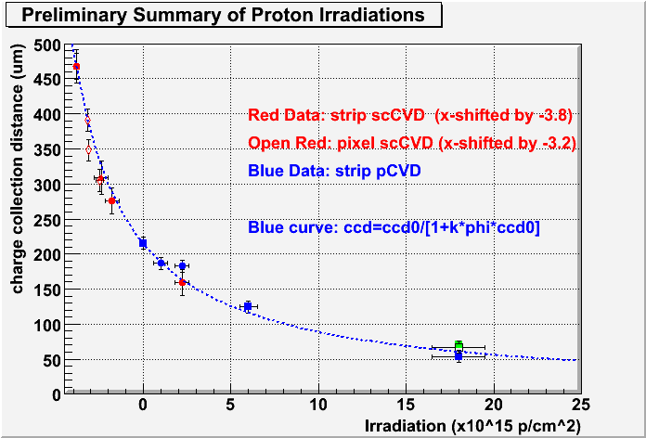
PS protons
For mean free path in infinite detector expect
With CCD₀ initial trapping on grain boundaries, k a damage constant
  Larger CCD₀ performs better (larger collected charge) at any fluence
  Can turn 1/ CCD₀ into effective “initial” fluence, expect CCD₀ ~ ∞ for SC
  pCVD and scCVD diamond follow the same damage curve
  k ~ 0.7x10⁻¹⁸ μm⁻¹cm⁻²
Test beam results

Slide 12
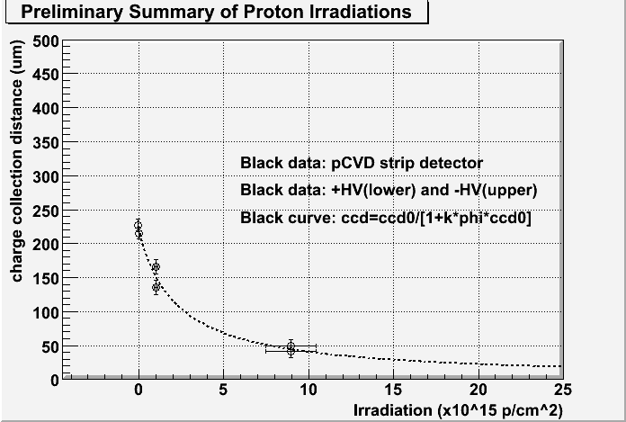
70 MeV protons (Sandai)
Recent irradiations with 70 MeV protons in Japan
3x more damaging than PS protons
  k ~ 2x10⁻¹⁸ μm⁻¹cm⁻²
NIEL prediction
  factor of 6
  NIEL violation ?!
Test beam results

Slide 13
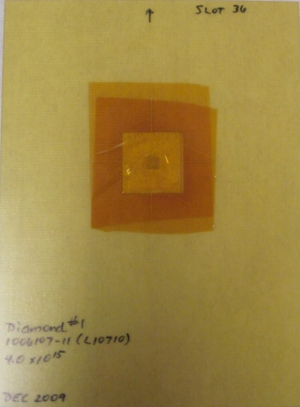
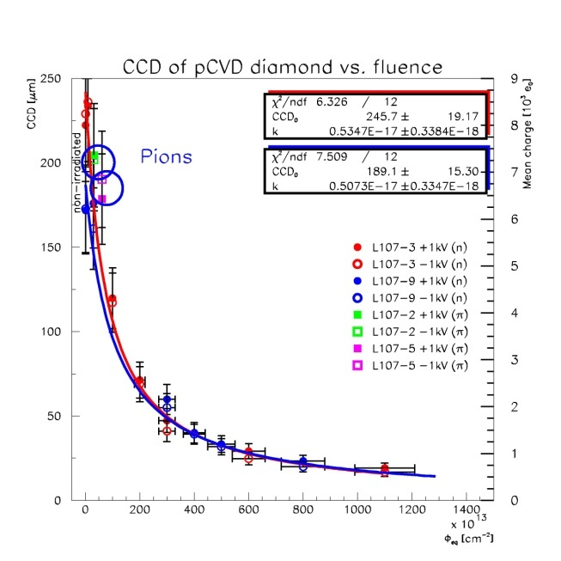
More irradiations
800 MeV protons in LANL, not analyzed yet
pCVD (2) with reactor neutrons up to 1.3x10¹⁶ n_{eq}/cm² (in 6 steps); k ~ 3-5x10⁻¹⁸ μm-¹cm⁻²
  discrepancy between source and test-beam
pCVD with PSI 200 MeV pions up to 6x10¹⁴ π/cm²; k consistent with ~1-3x10⁻¹⁸ μm⁻¹cm⁻²
No time left to disentangle, no headroom
Need pions in the n x 100 MeV ballpark
  Apply for beam at PSI (with RD-50)
    Use scCVD to maximize damage effect
  Negotiate very simple pion line at LANL
    If approved, could reach sLHC fluences
    Quick evaluation with strip detectors in 800 MeV proton beam
800 MeV sample irradiation
in Los Alamos Dec. 2009
NSS 2007: n, π

Slide 14
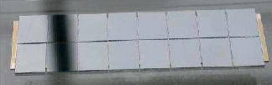
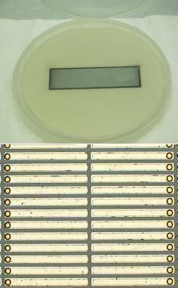
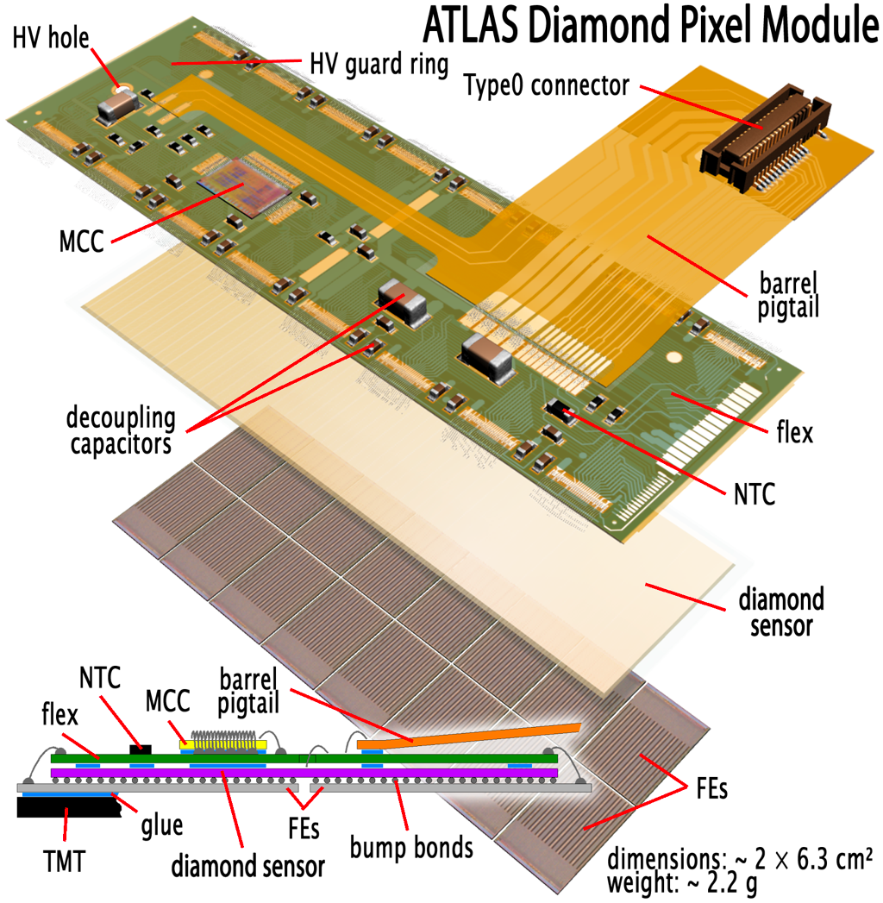
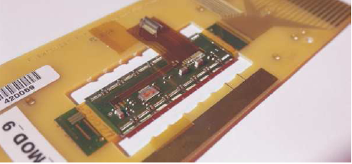
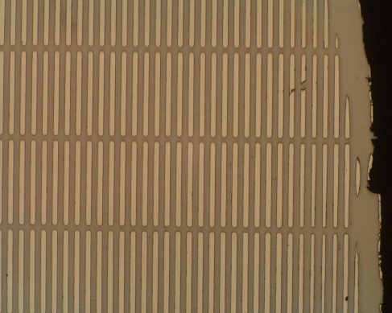
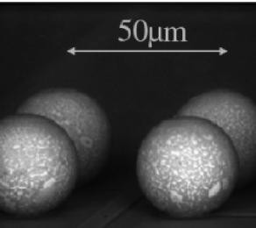
Diamond pixel modules
Full module built with I3 pixel chips @ OSU, IZM and Bonn
Module after bump bonding
C-sensor in carrier
Complete module under test
Pattern with In bumps
scCVD module
Edgeless
scCVD module pattern
Bump bonds

Slide 15
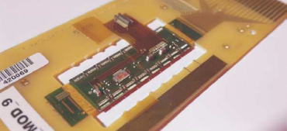
Diamond pCVD Pixel Module – Results
pCVD full module
  Tests show no change of threshold and noise from bare chip to module – low sensor C & I
    Noise 137 e, Threshold: mean 1450 e, spread 25 e, overdrive 800 e, reproduced in test beams
    Many properties (e.g. resolution, time-walk) scale with S/N and S/T
  Data from DESY test beam plagued by multiple scattering
    Silicon telescope resolution 7 μm (CERN) → 37 μm (DESY)
    Efficiency of 97.5 % a strict lower limit because of scattered tracks
  Data from 2006 CERN SPS test beam (not fully analyzed)
    Preliminary residual 18 μm, unfolding telescope contribution of 11 μm yields 14 μm, consistent with digital 50/√12 = 14.4
Bare chip
Full module
Thr = 1450 e
Noise = 137 e
CERN
DESY
σ = 18 μm
Eff = 97.5 %

Slide 16
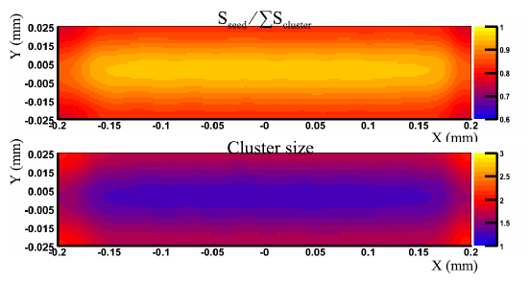
Diamond scCVD Pixel Module – Results
scCVD single chip module
  Analysis (M. Mathes PhD, Bonn) of SPS test beam data exhibits excellent module performance
    Cluster signal nice Landau
    Efficiency 99.98 %, excluding 6/800 problematic electronic channels
    Unfolded track resolution using η-algorithm from TOT exhibits s ≈ 8.9 mm
    Charge sharing shows most of charge collected at high voltage on single pixel – optimal for performance after (heavy) irradiation
100 V
400 V
Cluster signal
Track distribution
σ = 8.9 μm
Long side
TOT - η
Track resolution
binary

Slide 17






Diamond tracker upgrade proposal
DPix Collaboration
  Bonn
  Carleton
  CERN
  Ljubljana
  Ohio State
  Toronto
Approved by ATLAS EB Mar’08
  EDMS: ATU-RD-MN-0012

Slide 18
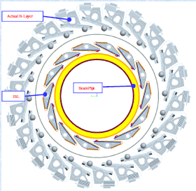
Original R&D proposal goals
Industrialize bump bonding to diamond sensors (make 5-10 modules)
Quantify radiation tolerance of full ATLAS pixel modules
Optimisation of front-end electronics
Lightweight mechanical support – exploit minimal cooling requirement
Financial resources to make 10 parts:
  Diamond sensors
  Bump-bonding contracts
  200 FE-I3 + 25 MCC’s
  Module support prototypes
  Three year beam-test program (2008-2010)
Aimed at tracker upgrade, bidding for IBL

Slide 19


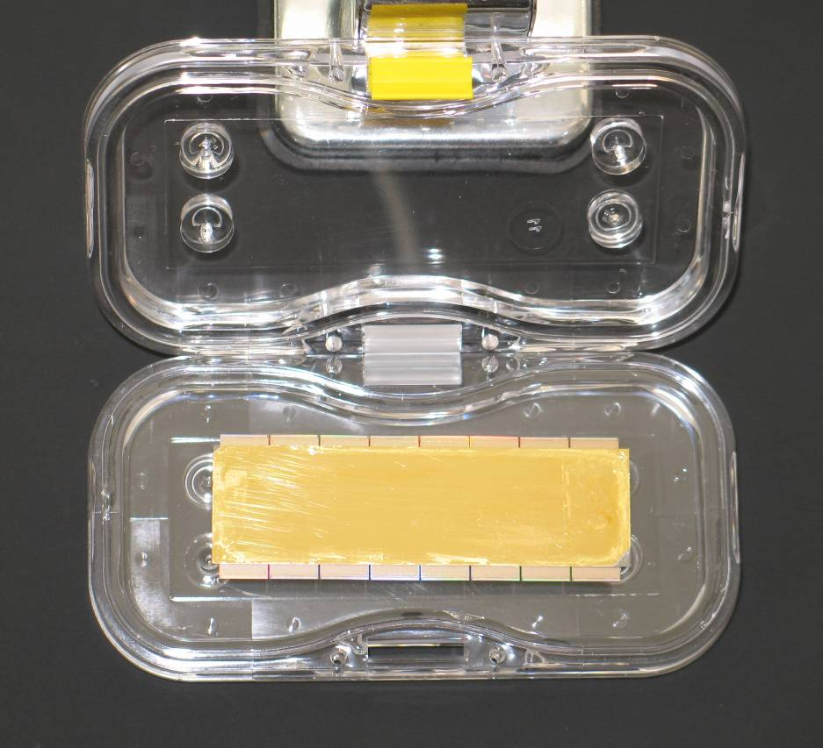
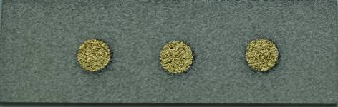
Industrialization: 2nd full pixel pCVD module
1st module to be built in industry
All steps from polished sensor to bump-bonding performed at IZM Berlin
Embedding in a ceramic wafer
Wafer scale metallization & UBM process
Removal from the ceramics
Backside metallization & cleaning
Flip chip

Slide 20
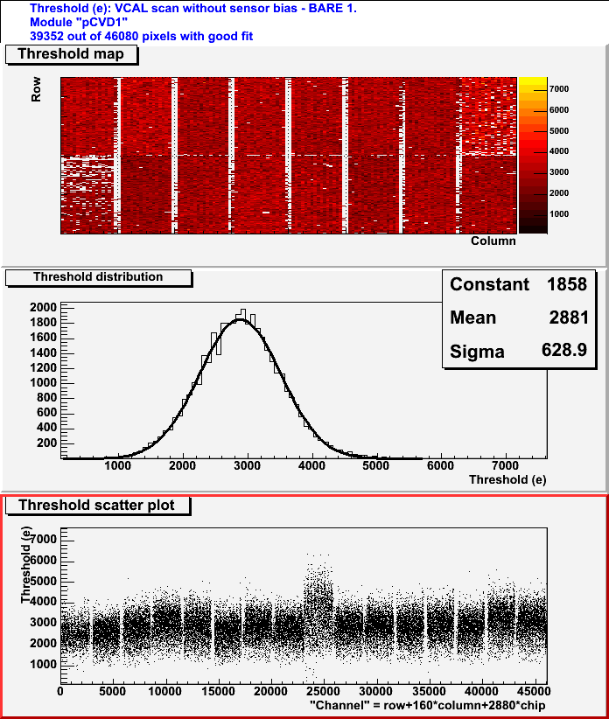
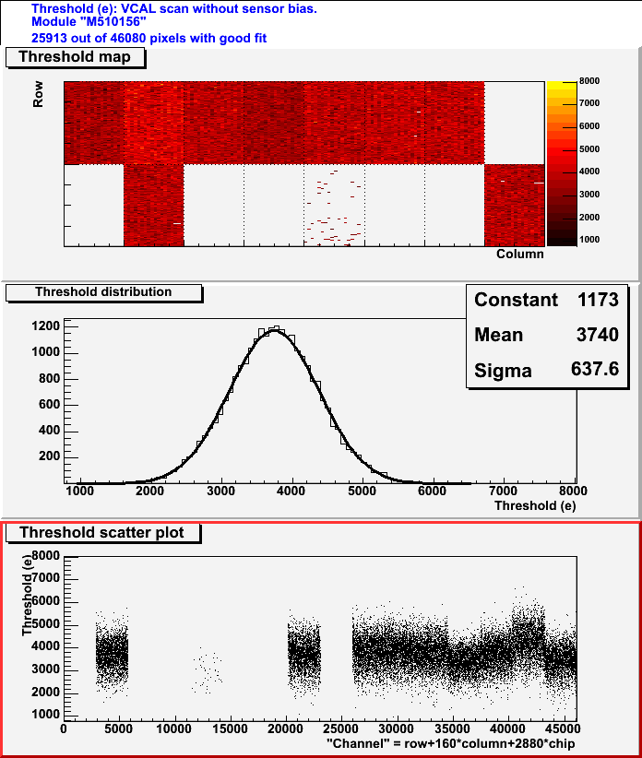
Industrialization hic-up
Edge of diamond left metallized – module damaged
    Voltage short across edge
Before applying 10 V
After applying 10 V

Slide 21
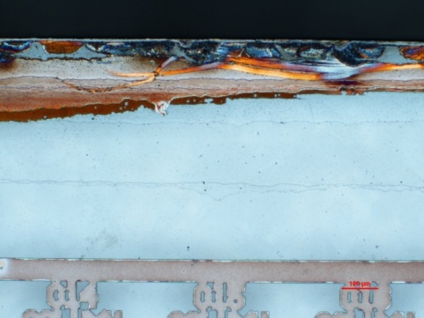
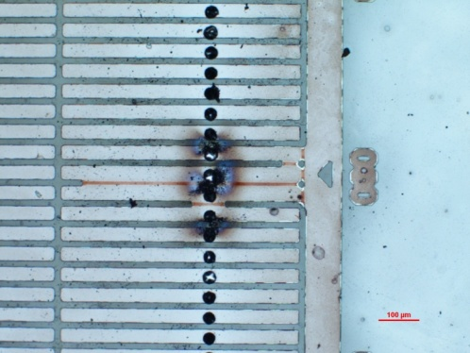
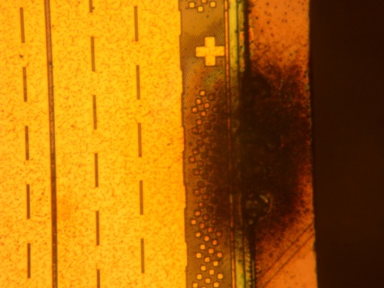
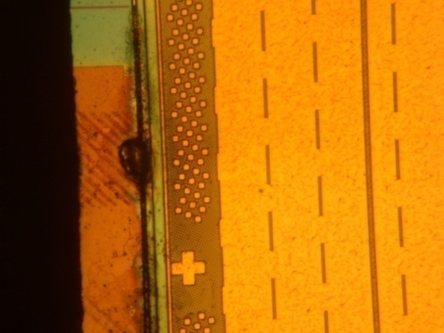
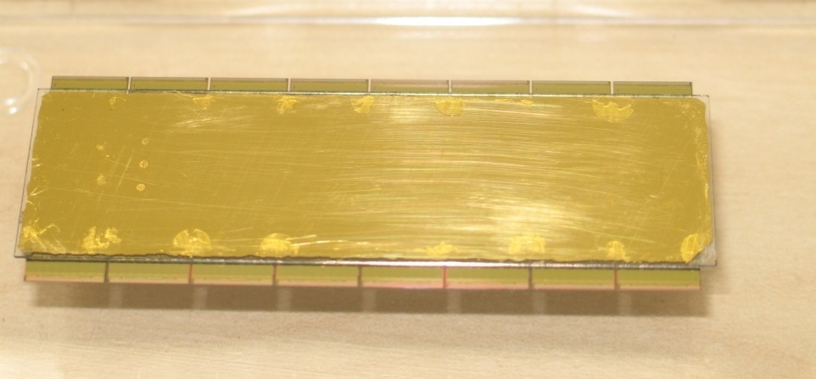
Industrialization: repair @ IZM
7/16 chips stopped functioning
Back to IZM for re-build
  Module taken apart – visual damage to sensor and chips
  Backside metallization redone
  Improved cleaning of the module rim by using plasma etching
  All FE chips replaced
Successful re-build proves concept of diamond sensor recycling in case of module QA failure !
  Successfully done before on single-chip assemblies
Reworked module

Slide 22
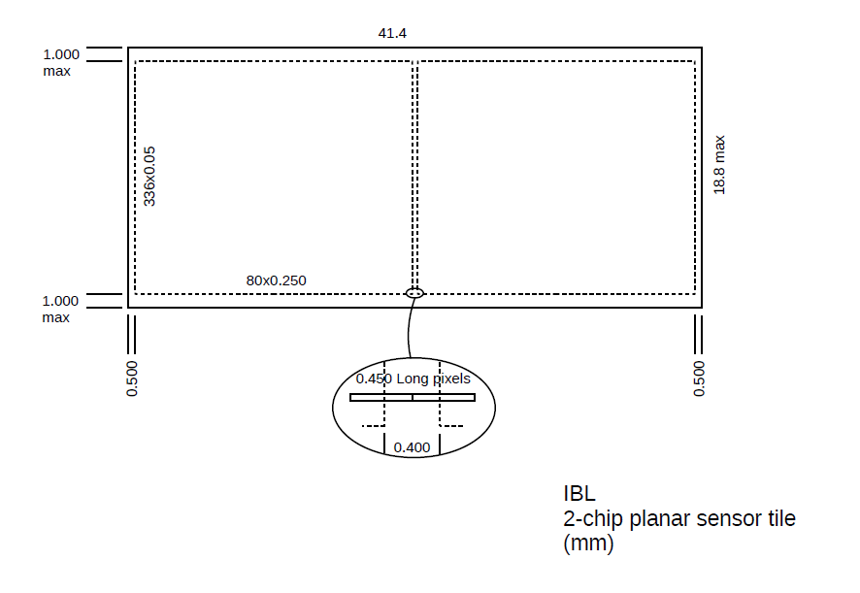
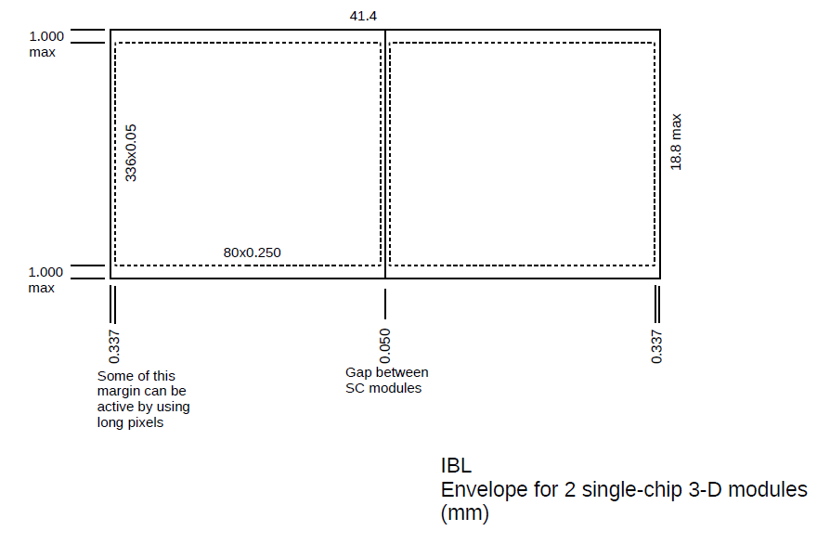
Module plans towards IBL qualification
Double-chip modules preferred for IBL bulk production
  Seems good compromise between sensor cost and ease of production/mounting
Single chip I4 assemblies good for module tests and qualification
  Secured 10-20 sensors for that purpose this year
Different production model as Si
  Sensors major cost driver
  Single vendor so far
Suggest rolling production with sensor recycling from failed modules
  O(20%) spare sensors
  No recycling cost estimate yet

Slide 23
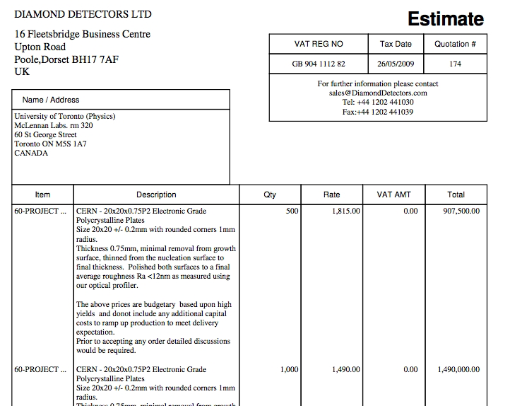
IBL pCVD diamond sensor cost estimate
IBL = 14 staves of 32 (= 448) single-chip sensors
Active sensor: 16.8 mm x 20 mm
Count on 20 % loss during production (recycling)
=> need ~0.2 m² of diamond
Budgetary estimate – DDL quote for 500,1000 20x20 mm² pCVD diamond sensors
  Cost 900 kGBP for 500 pcs
    1.5 MGBP for 1000 pcs

Slide 24
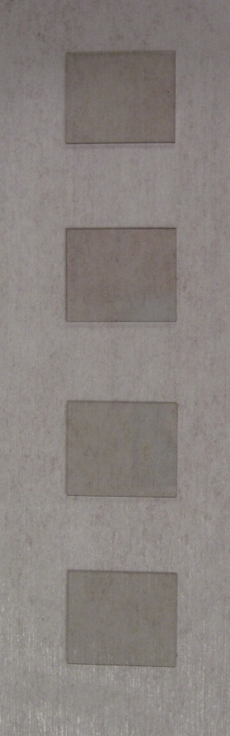
Recent sensor work with DDL (E6)
Our (and RD-42) long-term supplier – considered qualified
  Reproducible material
  Quote for 500 pcs (900 kGBP)
Have 4 I4 shaped sensors at hand
  Ordered as 17.4 mm x 20.6 mm
  Measured at 17.5 mm x 20.7 mm
    10-20 um RMS spread = cutting precision
    Can be thinned & trimmed to envelope
  Measured CCD between 240 and 260 µm
Ordered 2 more, possibly another 2

Slide 25
Sensor work - DDL (cont.)
Have 4 18 mm x 64 mm sensors for the original dPix programme based on I3
CCD was guaranteed above 275 µm
  Achieved on one part only
  Others 250-270 µm, rejected,
  Refurbished, not a big change (235-250 µm)
Cutting those would yield 12 I4 sensors
  Suitable for double-I4 modules – wait with cutting ?
Caveat – DDL seems to have exhausted the stock of good wafers, needs E6 to start growing fresh wafers
Anyway, could have up to ~20 sensors in hand for IBL pre-production

Slide 26
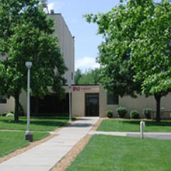
Sensor work with II-VI
New US producer
  Large company (sold eV products to EI recently) based in Saxonburg, PA
  Interested in electronic grade diamonds to enrich their product line
  Working closely with OSU on development for HEP
  Produced a 1.5 mm thick 5” wafer in their “normal” process
    Not tailored to HEP applications at all
  4 I4-shaped pieces delivered to OSU for testing
    As grown – no processing at all

Slide 27
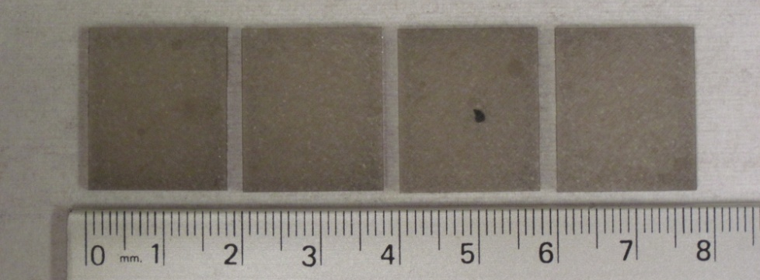
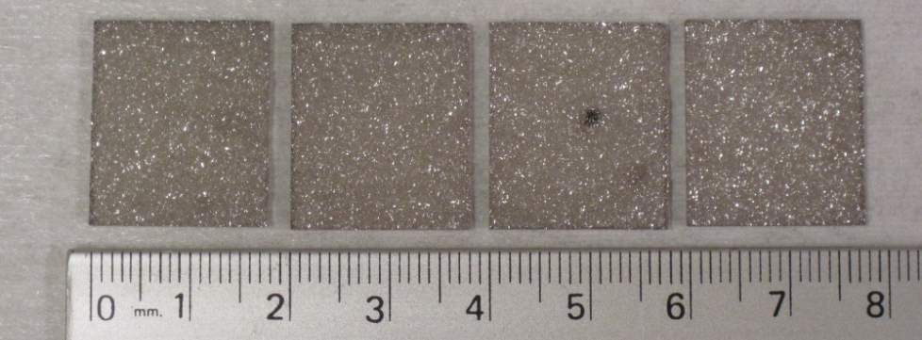
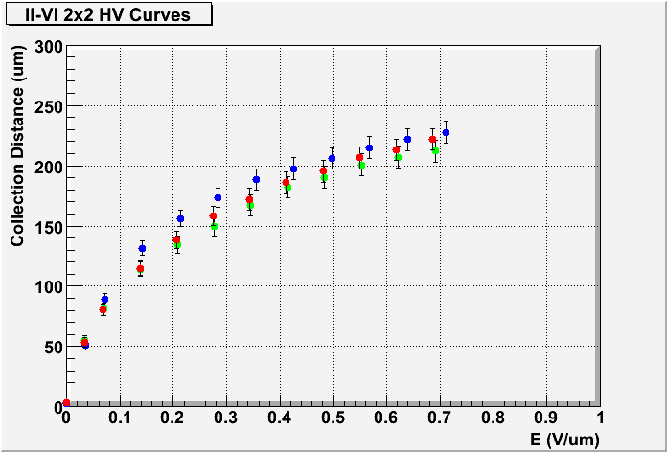
Sensor with II-VI (cont.)
Substrate side
Really as grown, 1.5 mm thick
Surprisingly good results
  CCD uniform across all samples
  220-230 µm @ 0.7 V/µm, not saturated
    Error in metallization, CCD lower limit
Suspect very good intrinsic CCD
Start working on a programme to (im)prove it
  Take off substrate side in steps
  Go to higher fields
Work with II-VI to optimize further
  Reduce growth rate
Ultimate goal : 300³
300 USD/cm², 300 µm CCD, 300 µm thick
  400 average will also do (e.g. 400, 300, 500)
Growth side

Slide 28
Schedule
Need to work on three fronts
  Understand basic diamond properties (RD-42)
  Qualify vendors
  Produce IBL modules
Need to balance resources (people, time and money) carefully
Reminder: diamond can be re-used many times
  Possible to use as strip test device and later build an IBL module out of the same diamond
Final aim till end of 2010: produce 10-20 single I4 IBL modules for qualification

Slide 29
Vendor qualification
New E6 or II-VI wafers would need verification
Need more samples from II-VI
  Have resources to buy ~10 I4 sensors more when available
Study material properties with strip detectors
  Test beam, irradiate, test beam
Build I4 modules
  In parallel with DDL detectors
All this subject to availability of sufficient samples of high quality material from II-VI
  Have indications they are able to meet it, but will they ?
  Their current position: “Just not ready to say we are selling material yet.”

Slide 30
Building IBL modules
Can have 20 DDL sensors suitable for IBL prototypes basically as of now
  Meets the foreseen common bump-bonding runs in August/October
Bump-bonding resources
  Need reliable estimates of extra cost for diamond
Plan for 10-20 single I4 modules bump-bonded this year
  To be split equally between DDL and II-VI if feasible

Slide 31
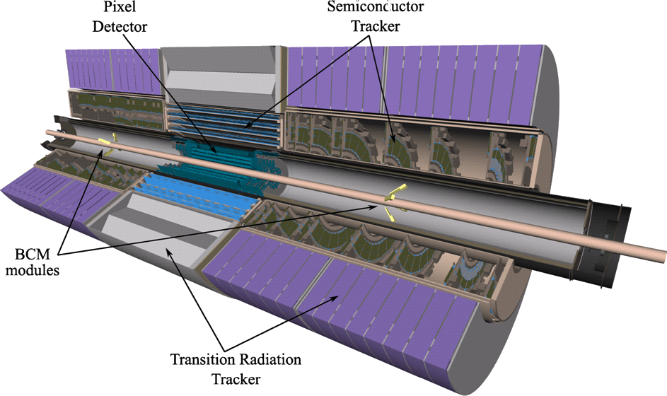
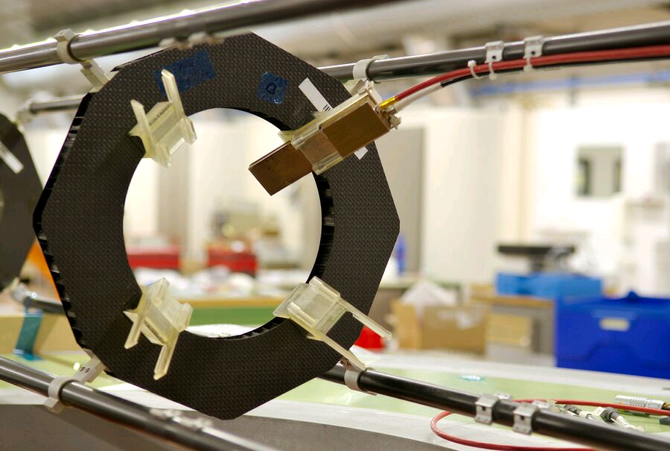
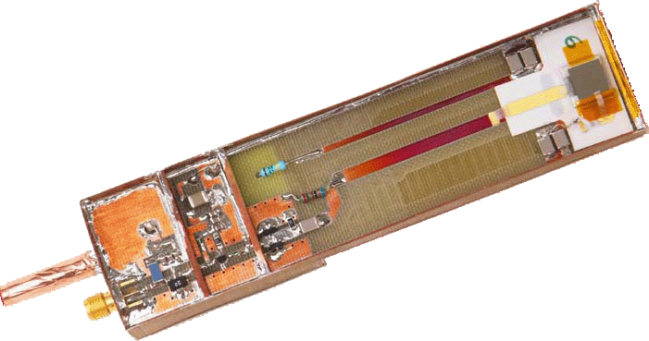
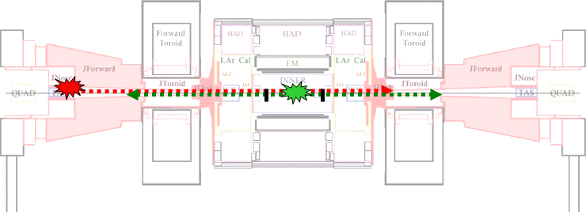
ATLAS BCM
TRT B.
TRT End Cap
SCT B.
SCT End Cap
PIXEL
BCM
  Agilent MGA-62653 500Mhz
  (gain: 22 dB, NF: 0.9dB)‏
2 x 1cm²
pCVD diamond
  Mini Circuits GALI-52
  1 GHz (20 dB)‏

Slide 32
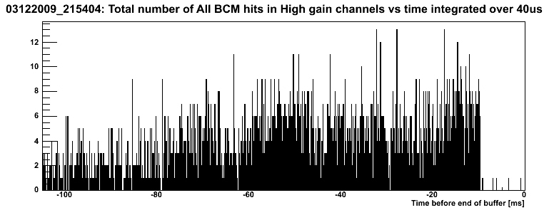
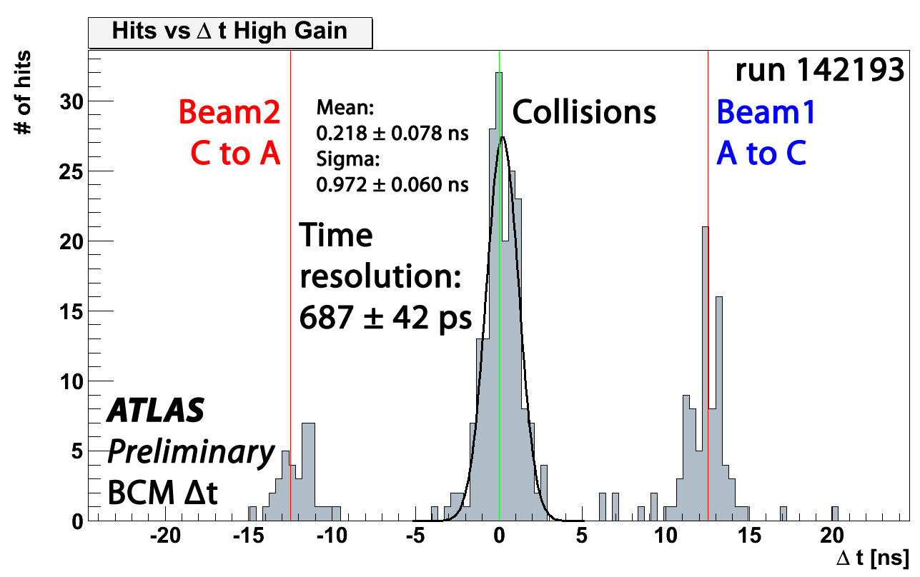
BCM performance
Time difference hit on A side to hit on C side
Most of data reconstructed offline
Sub ns resolution of BCM clearly visible (0.69 ns) without offline timing corrections applied
Beam dump fired by BCM during LHC aperture scan
Ready to protect ATLAS
BA is fired
increasing activity
1177 LHC orbits – ~100 ms
after BA is fired the buffer is recorded
for additional 100 LHC orbits (~10 ms)
~10 ms

Slide 33
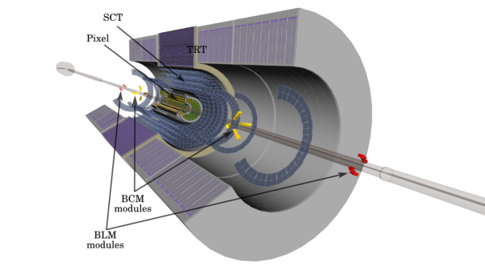
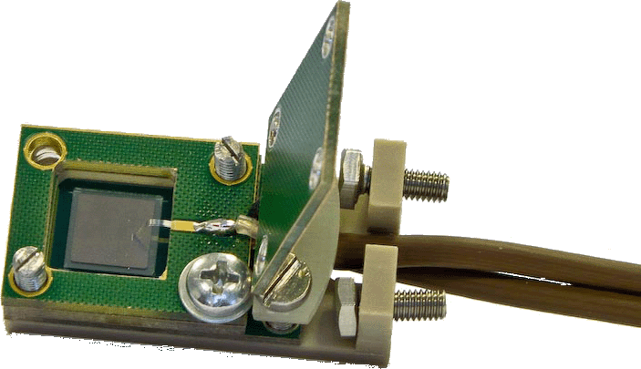
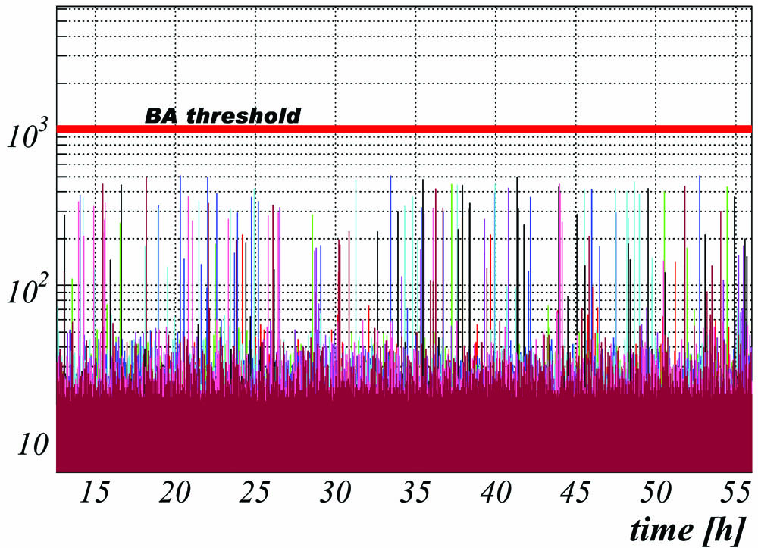
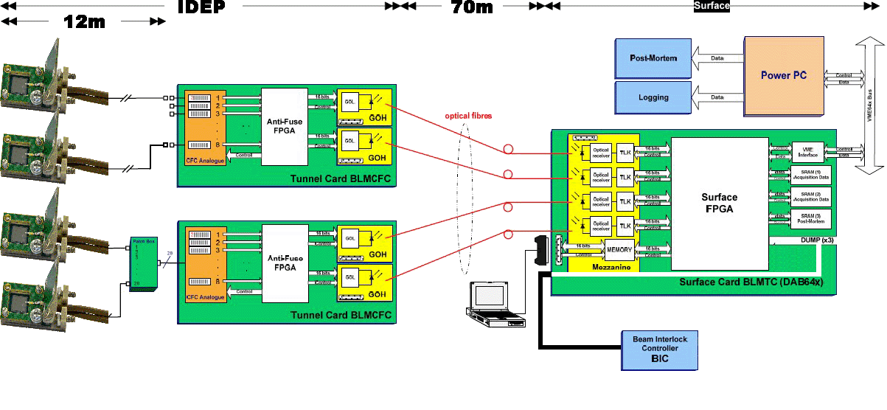
ATLAS BLM
8x8 mm² 0.5 mm thick diamond sensors used
6 sensors on each side (A and C) installed on ID End Plate
Readout adopted from LHC BLM system with minor modifications
Redundant system to BCM – safety only
7 TeV p on TAS collimator gives ~1 MIP/BLM module → ~1 fC of charge
  25 pA of current “spike” for single occurrence (possible with pilot bunch)
  40 nA of current for continuous loss (only when full LHC bunch structure)
Diamond dark currents
  In magnetic field, should be O(10 pA)
  Erratic currents, several nA w/o magnetic field
Require 2 ch. above threshold simultaneously
BCM
BLM
~50 nA
~ 50 nA
CFC counts
several hours
single channel
max. rates / sec
…

Slide 34
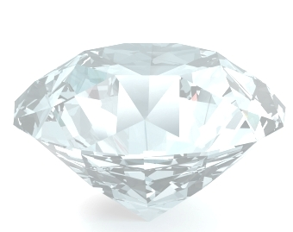
Summary
Recent progress in the diamond world
  Improved understanding of radiation damage
  Building of pixel modules in industry
  New producer with very promising initial performance
  On schedule for IBL sensor qualification
  Good performance of diamond sensors in initial ATLAS LHC run

Slide 35
Backup
The Q&A session of IBL

Slide 36
Q & A 1
What can the sensor active area be (what is the minimal dead area at sensor edges)?
      Comment on sensor area:For SC modules (3D) the gap is 100um and the edge margin (last bump to physical edge) is 325um, 250um of which is active as a baseline. For 2-chip modules (planar or diamond) the gap is 200um (to allow for higher voltage) and the edge margin is 450um, which is as a baseline all guard ring in the planar case.
We are fine with the 450 μm, but could push the metallization up to 250 μm to the edge, effectively yielding charge collection very close to the edge.
  Operation proven on scCVD pixel module, test-beam data exists, needs dedicated analysis to pin down edge performance
  ATLAS BLM has 7.5 mm metal on 8mm pCVD
Edgeless
scCVD module pattern

Slide 37
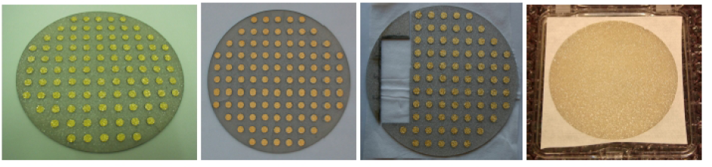
Q & A 2
What is the optimal sensor thickness?
Latest accepted sensors exhibit CCD of 275 μm at a thickness of 700 μm. Goal is 300 μm at 500 μm thickness. With adequate thinning & processing that should be obtainable from the 1.3 mm thick E6 wafer with 310 μm measured wafer. Alternative producer also exhibits adequate CCD on thin samples .
CCD measured on recent
1.3 mm thick pCVD wafer

Slide 38
Q & A 3
What is the necessary separation between two adjacent modules (in Z) ?
2x5 μm of Kapton added to the engineering tolerance, cutting precise to 20 μm

Slide 39

Q & A 4
What is the expected sensor operation voltage initially and after full irradiation ?
1000 V is regarded sufficient and has demonstrated stable operation with diamonds in magnetic field of ATLAS ID – BCM. No change of voltage after full dose.

Slide 40
Q & A 5
What is the expected most probable signal before irradiation , after 1x 10¹⁵ n_{eq} and after 5x10¹⁵ n_{eq} ?
Proton data indicate k = 0.7x10⁻¹⁸ (μm.cm²)⁻¹, taking κ=2/3, CCD₀ = 300 μm and mean/MPV =1.2 yields
MPV_{initial} ~ 9000 e (CCD = 300 μm)
MPV(1e15) ~ 7000 e (CCD = 230 μm)
MPV(5e15) ~ 3600 e (CCD = 120 μm)

Slide 41
Q & A 6
What is the ENC noise (with FEI3) ?
Measured 137 e with non-irradiated module with standard pixel settings
No change due to diamond expected after irradiation (no additional I or C)
Complete module under test
Full module
Noise = 137 e

Slide 42
Q & A 7
What is the measured minimal obtained threshold (and overdrive) at which FE power with FEI3
Threshold < 1500 e demonstrated on full pixel module (16 chips)
Overdrive ~800 e
Nominal pixel chip settings
Thr = 1450 e

Slide 43
Q & A 8
What is the measured spatial resolution for perpendicular tracks (after irradiation) ?
At least digital 50 μm/sqrt(12), as demonstrated in test-beam of full pixel module (18 μm yields 14 μm when unfolding telescope)
TOT - η algorithm yields < 9 μm, but analyzed only scCVD so far
After irradiation expect digital with I3, I4 could yield improvement if neighbours read out
σ = 8.9 μm
TOT - η
σ = 18 μm

Slide 44
Q & A 9
What spatial resolution in IBL arrangement (inclined sensors and B field, irradiated) ?
Inclined to be measured now (Sep09) in test beam, arrangements need to be made for B-field, possibly in Nov 09
Module irradiated to ~10¹⁵ under test
Analysis manpower still a bottleneck

Slide 45
Q & A 10
What is the measured cluster width (can charge sharing be used for clustering and what is the possible gain in resolution)?
Only scCVD data fully analyzed
Exhibits small charge sharing
  Little hope for resolution improvement with I3, especially after irradiation
  Could work with I4, but needs to be demonstrated

Slide 46
Q & A 11
What is the sensor power dissipation per cm2 after 1x1015, 3x1015 and 5x1015 neq (normalize at 0C) ?
      Comment: Also provide a plot to relate signal to max voltage, max current and temperature: family of curves of MIP signal vs. T at min(max power, max voltage, max current), for different values of max power. At low temperature, power is negligible and you just get the signal at max voltage, that will not change with temperature, giving a plateau. But as soon as temperature gets high enough for power to be non-negligible, the max power condition will force reduction of voltage with temperature (and therefore reduction of signal) giving a knee in the plot where the signal starts to drop. Thus one can see what is the correct operating point for a given power limit.
Measured pixel module currents were ~10 nA @ 800 V and RT, current decreases with radiation, expected power dissipation of O(10) μW @ 1000 V, no foreseeable impact on system performance

Slide 47
Q & A 12
What is the pulse shape at full dose?
      Note that FE-I3 default settings have a long return to baseline (1.5us), whereas FE-I4 will use a 400ns return to baseline. This can change the effective collected signal and also the noise.
  The pulse shape is given by CCD/v_{sat}
  Before irradiation: 3e-2/(8-10)e6 ~ 3-4 ns
  After 5e15: 1.2e-2/(8-10)e6 ~ 1.2-1.5 ns

Slide 48
Q & A 13
What is the hit rate limit at full dose (i.e. does the physical charge pulse vs. time have a small but long tail)?
De-trapping is at scale of months, so no tail on any sensible timescale

Slide 49
Q & A 14
What is the cross-talk vs. dose with FE-I3?
      This is not direct charge sharing but a function of the inter-pixel
      C ad R connected between two amplifiers
There was no measurable impact of sensors on module performance for non-irradiated full pixel modules. Irradiated module (1e15) will be evaluated, but no effect expected due to (high) R_{int} and (lower) C_{int}

