Slide 1
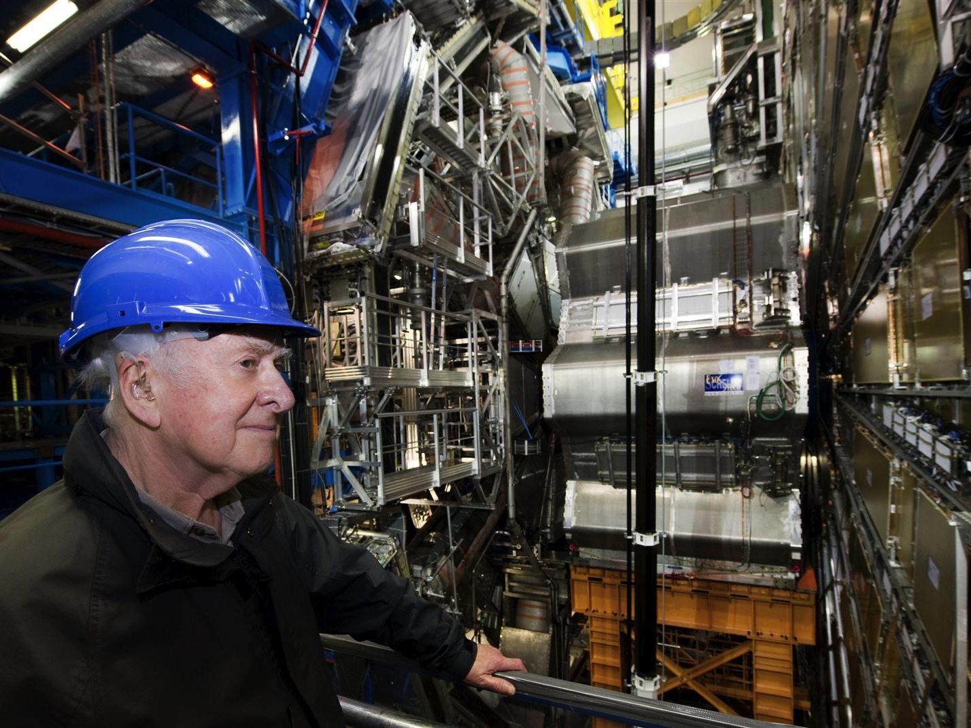



The Higgs Hunt with ATLAS at LHC
Marko Mikuž
University of Ljubljana & Jožef Stefan Institute
For the ATLAS Collaboration
Time and Matter
Venice, Italy
March 7, 2013

Slide 2

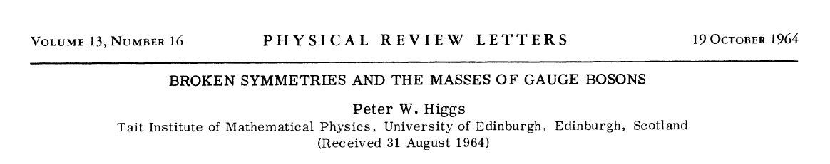
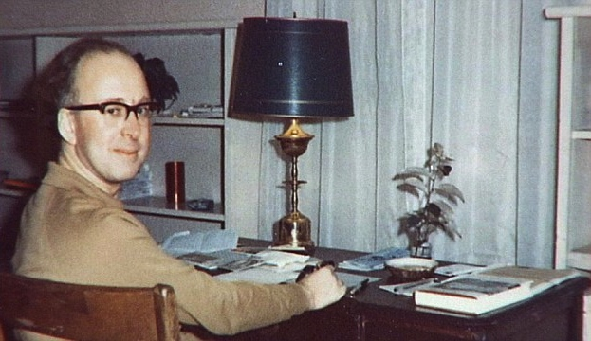
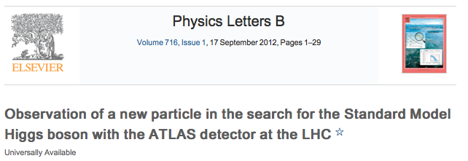
Prelude
“I certainly had no idea it would happen in my lifetime at the beginning, more than 40 years ago.
I think it shows amazing dedication by the young people involved with these colossal collaborations to persist in this way, on what is a really a very difficult task.
I congratulate them.”
Peter Higgs, July 4th, 2012

Slide 3
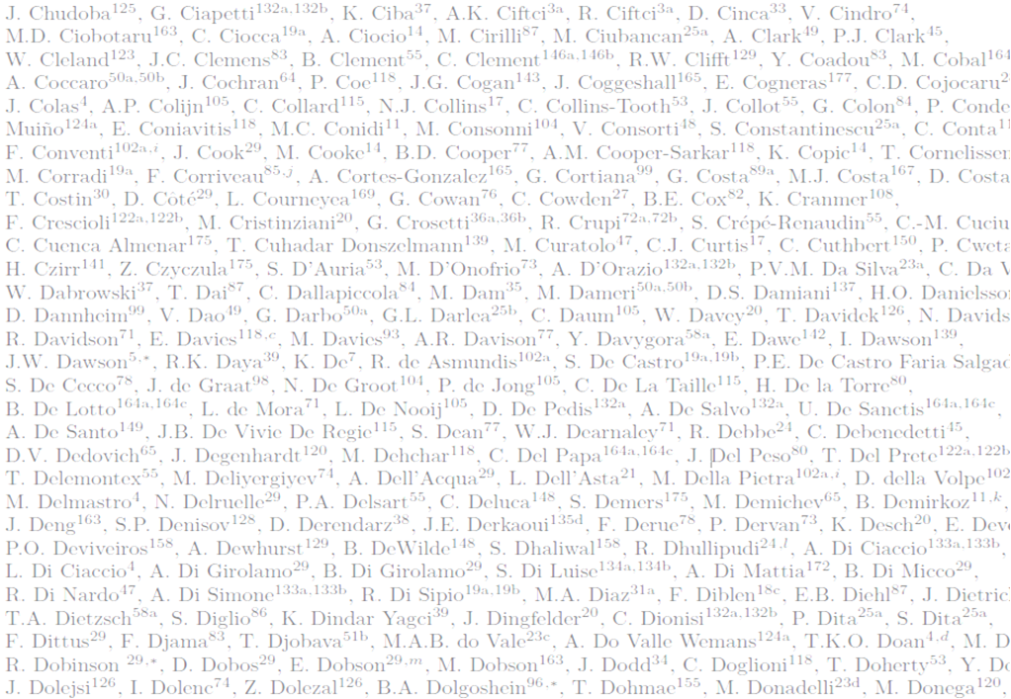
Acknowledgements
This presentation rests on the shoulders of over 3000 ATLAS colleagues who built and operate the ATLAS detector, and who tirelessly analyze the data .
The prerequisite for these studies was the seamless and astonishingly ever-improving performance of the Large Hadron Collider in 2011 and 2012.

Slide 4
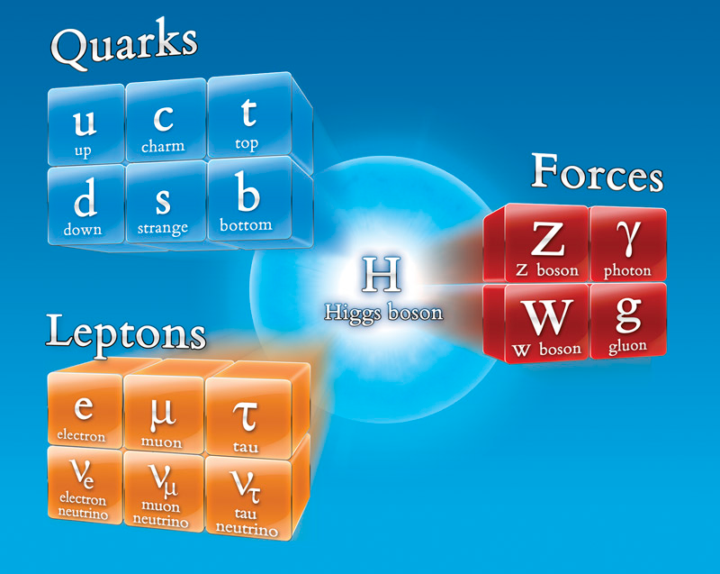
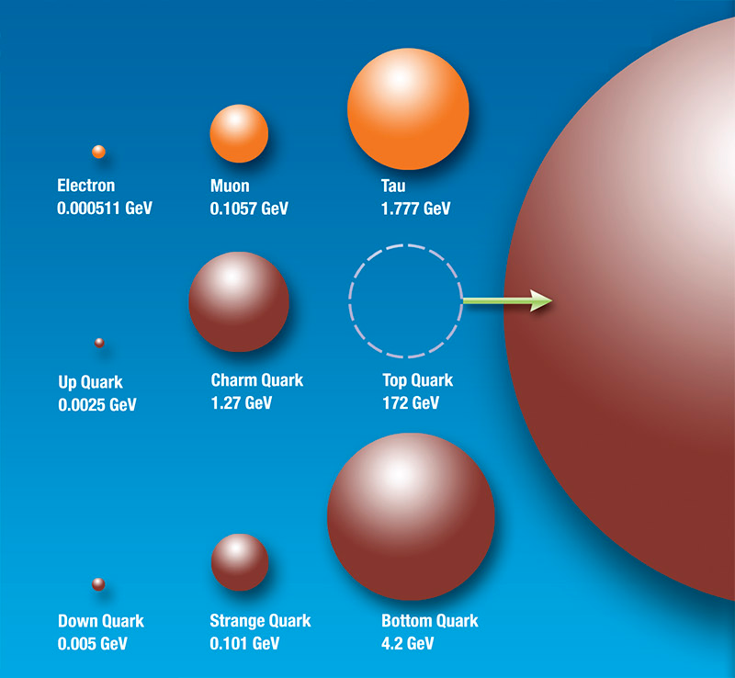
Higgs Discovery
The discovery of the Higgs particle would wrap up the Standard model in the most elegant and simple way
  Light Higgs most natural, but opens up the possibility of the “Great Desert” (no new particles) up to the Planck scale – 10²⁸ eV – 100 GeV is 10¹¹ eV !
  Measurement of Higgs properties a sensitive tool for probing New Physics

Slide 5
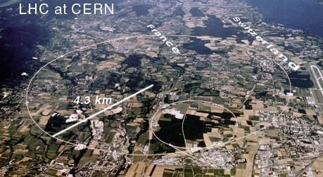
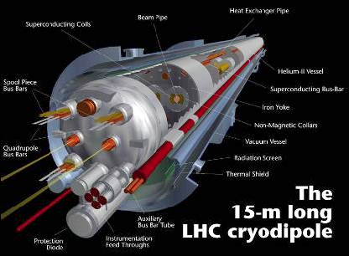
Large Hadron Collider
Large Hadron Collider
  proton-proton collider
  Design c.m.s. energy 14 (2x7) TeV, currently at 8 TeV, 7 TeV in 2011
  Design luminosity 10³⁴ cm⁻²s⁻¹, 7.7x10³³ achieved so far
Why 7-8 (2x4) TeV ?
  LHC in 27 km LEP tunnel (recycling)
  Energy at r_{LEP} limited by superconducting magnets
    B_{max} = 8.3 T → E_{max} = 7 TeV
  Following major incident in Sep’08 damaging ~50 magnets
    3.5, then 4 TeV considered safe
Consolidation to design values during 2013(&14) break

Slide 6
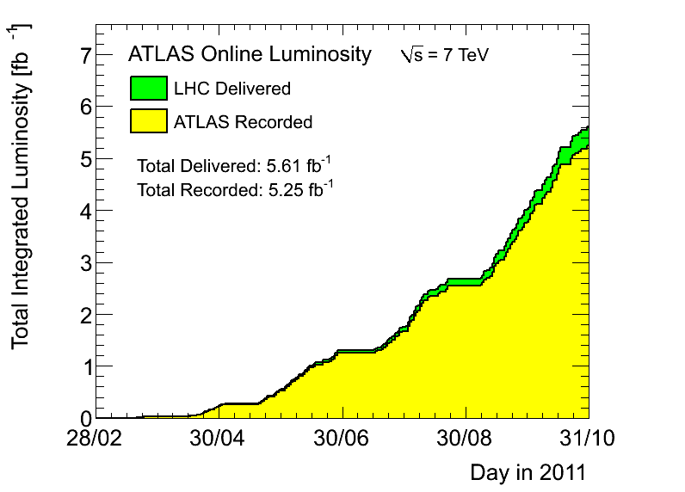
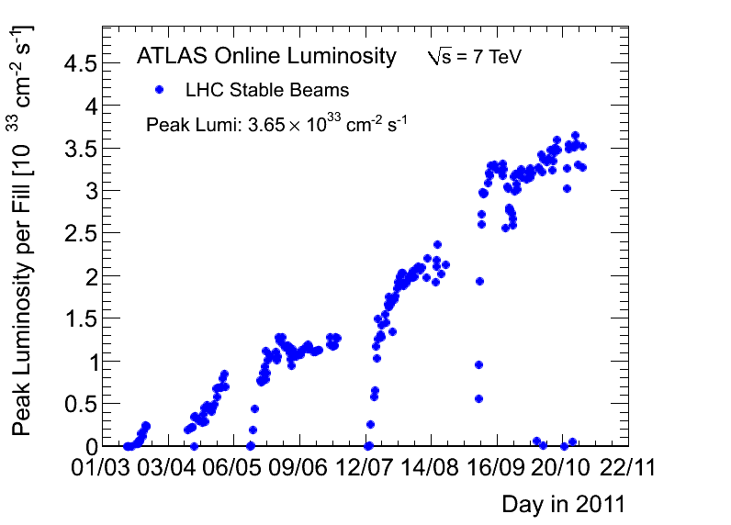

LHC Performance in 2011
The yearly plan at the Chamonix meeting (Jan’11) was >1 fb⁻¹ per experiment
50 ns bunch spacing
Due to increased peak luminosity up to 3.6x10³³ cm⁻²s⁻¹ the final integrated luminosity surpassed 5 fb⁻¹ by end of 2011
Half of the luminosity (~ 2.5 fb⁻¹) was delivered in the final month of running
10³³ cm⁻²s⁻¹

Slide 7

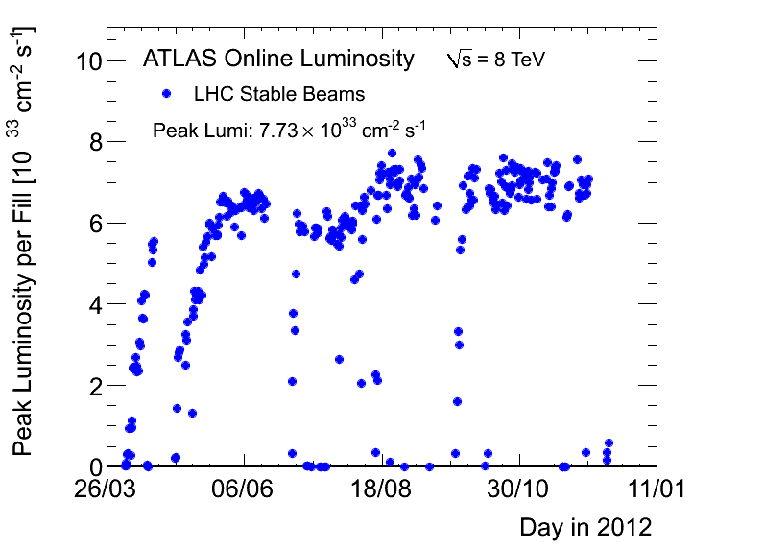
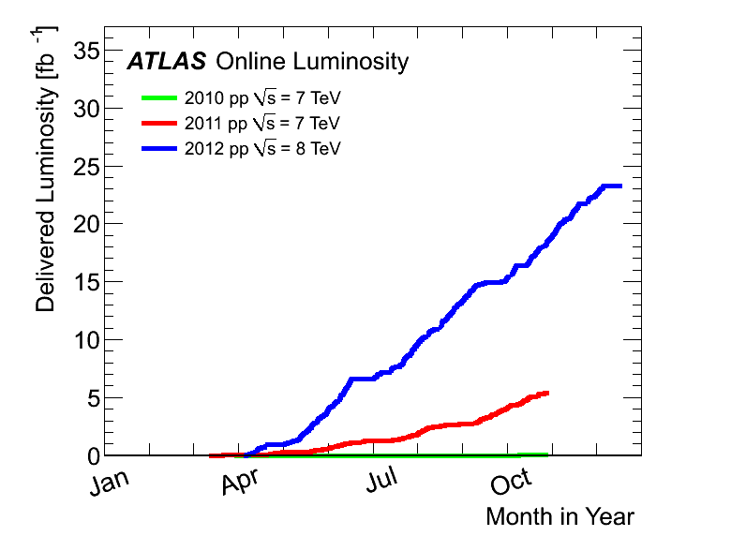
LHC Performance in 2012
The yearly plan was
  >5 fb⁻¹ by end June
  ~15 fb⁻¹ by end of 2012
  per experiment
Peak luminosity increased up to 7.73x10³³ cm⁻²s⁻¹
~6 fb⁻¹ by end of June
  ~1.5 fb⁻¹ delivered in the final week – still the record
23.3 fb⁻¹ total delivered
  21.7 fb⁻¹ recorded by ATLAS
12/2012:
23 fb⁻¹
@8 TeV
2011
5.6 fb⁻¹
@7 TeV
2010
0.05 fb⁻¹
@7 TeV

Slide 8
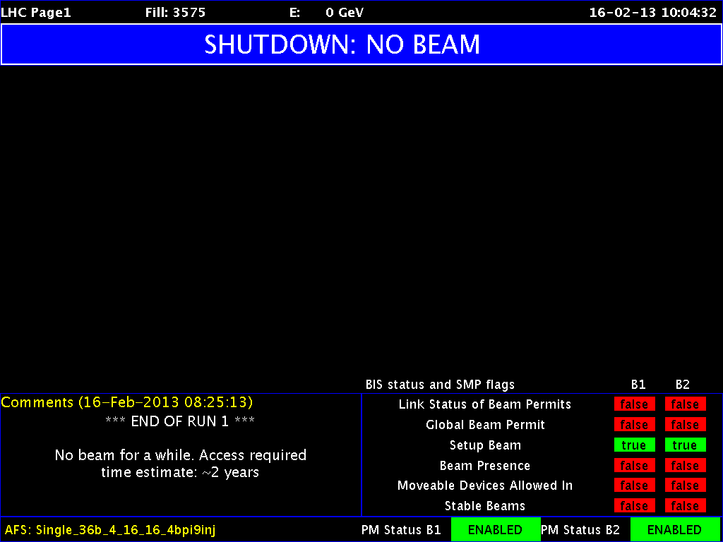

LHC Performance in 2013/14
Heavy ion run until Feb 16 8:25
End of LHC Run 1
Entering consolidation shutdown for ~2 years
  Change inter-magnet splices to allow running at 13-14 TeV
  Upgrade collimation system
Achieve design luminosity of 10³⁴ cm⁻²s⁻¹
25 ns bunch spacing
Accumulate 50-100 fb⁻¹ in 2015-18

Slide 9
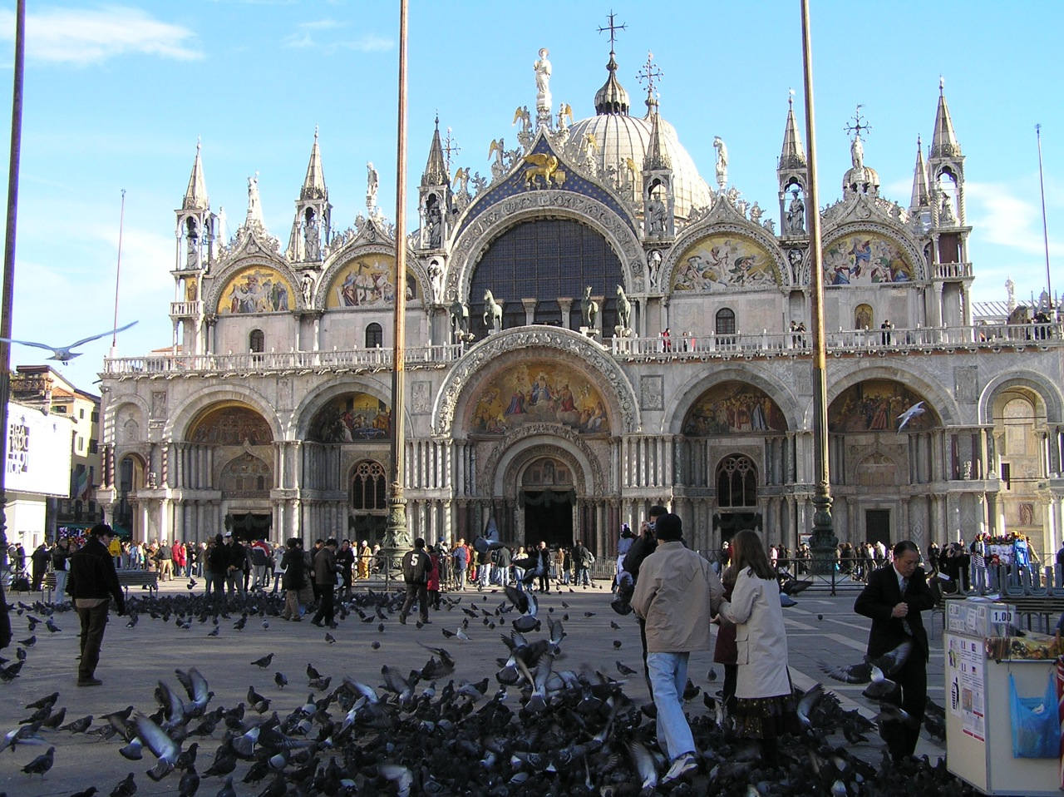
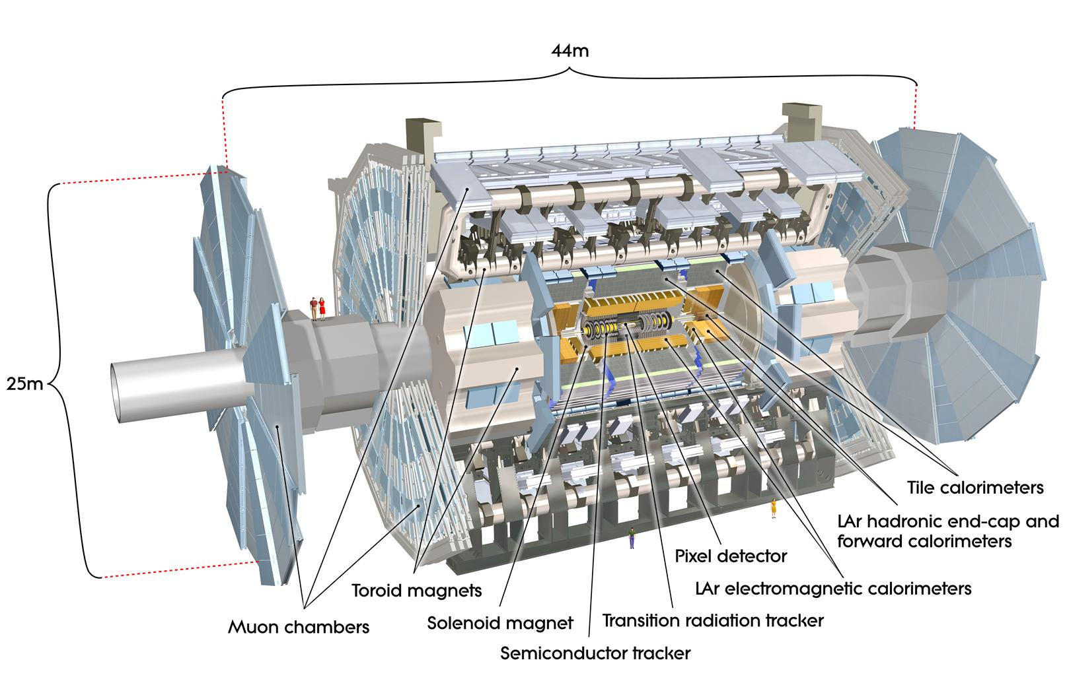

ATLAS Detector

Slide 10
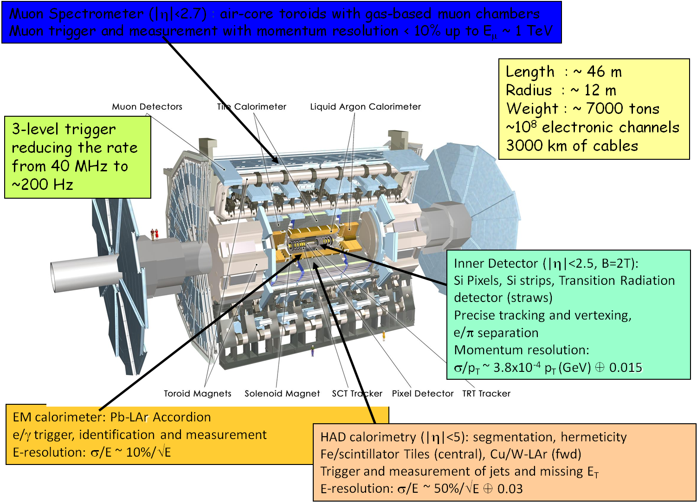
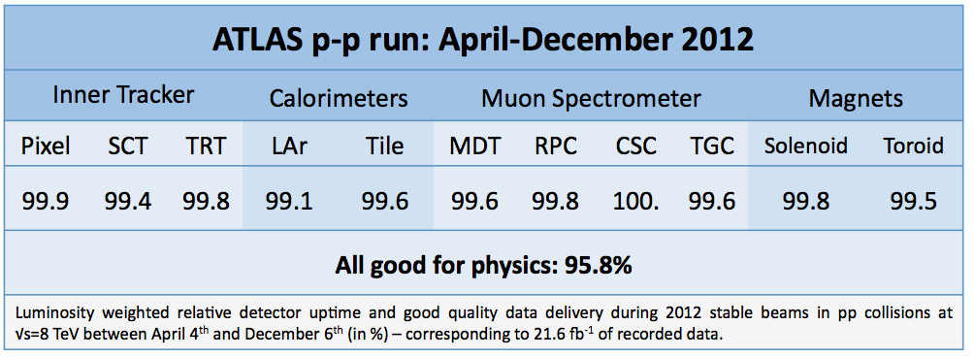
The Real Thing

Slide 11

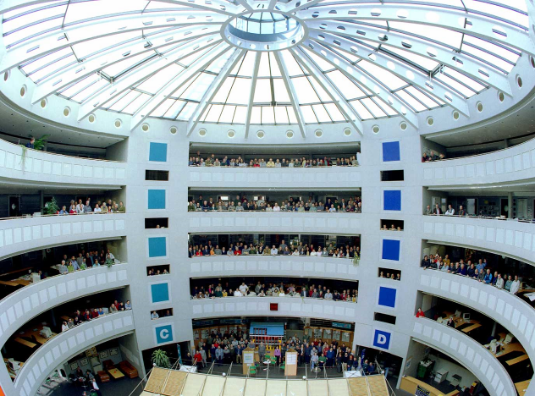
ATLAS Collaboration
~¼ of collaboration !
38 Countries
176 Institutions
~ 3000 active scientists
~ 1800 with a PhD
~ 1200 students

Slide 12
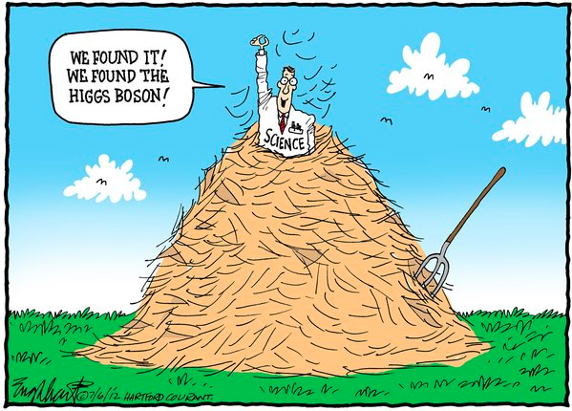

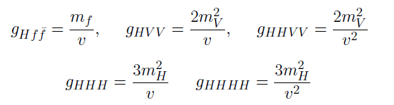
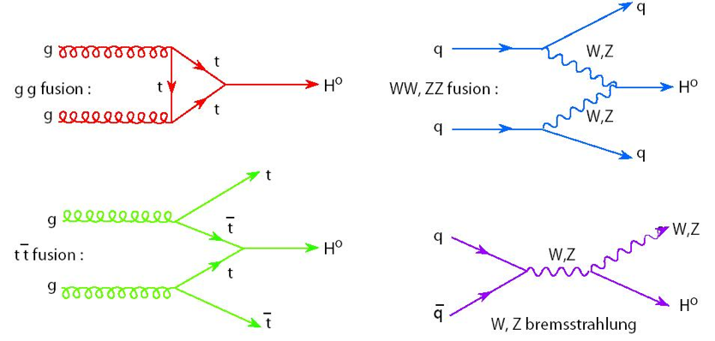
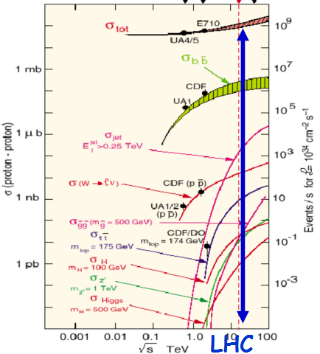
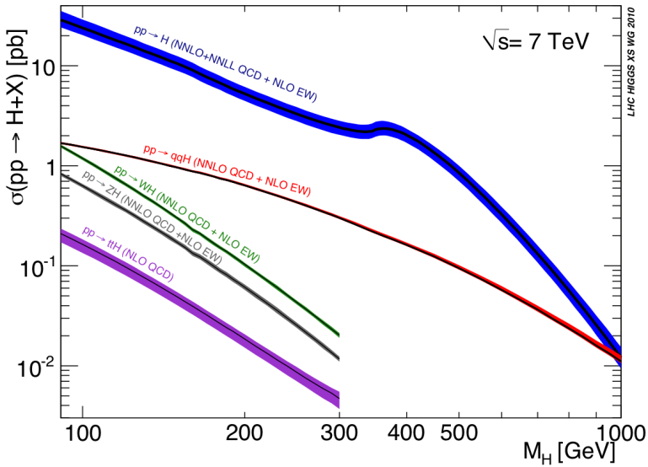
Higgs Production @ LHC
Higgs couples to massive paricles
  Linear for coupling to fermions (Yukawa)
  Quadratic for weak bosons
Production in 7-8 TeV pp collisions
  Predominantly through gluon-gluon fusion
  Gluons massless – need (heavy) intermediary
    top quark loop
  Big mass to be borrowed
    therefore small probability
  Cross section O (10 pb)
  Total pp O(100 mb)
One Higgs boson produced in 10 billion pp collisions!
Which haystack is the needle in ?
~ 20 x Tevatron
for m_{H}=120 GeV
7 8 14 TeV

Slide 13
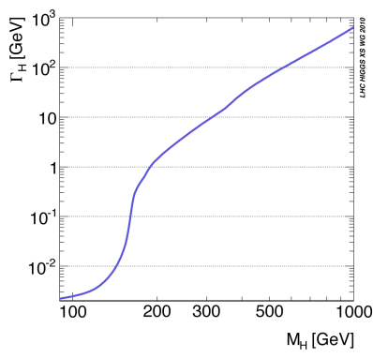
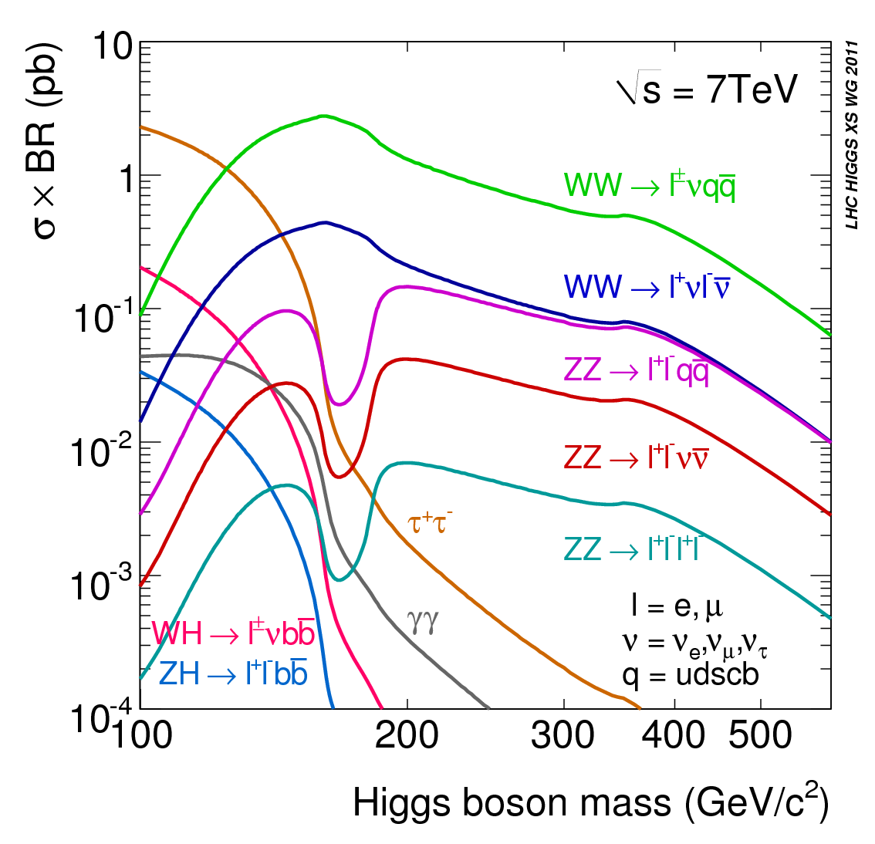
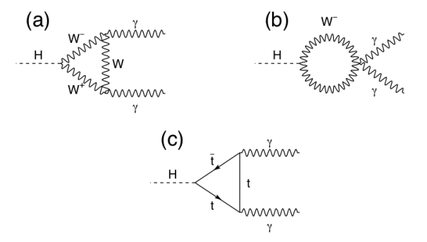
Higgs Decays
Higgs decays determined by mass couplings
  Decays to W, Z weak bosons dominate if kinematically allowed
    One of the bosons can be virtual
  For low masses two-photon, b-quark and tau decays
    Two photons via loops
The faster it decays
the less precise its mass (Heisenberg)
10⁻²⁴ s
125-180
WW^{(*)}→ lνlν
<130
γγ
300-600
ZZ→ llνν
125-300
ZZ^{(*)}→ llll

Slide 14
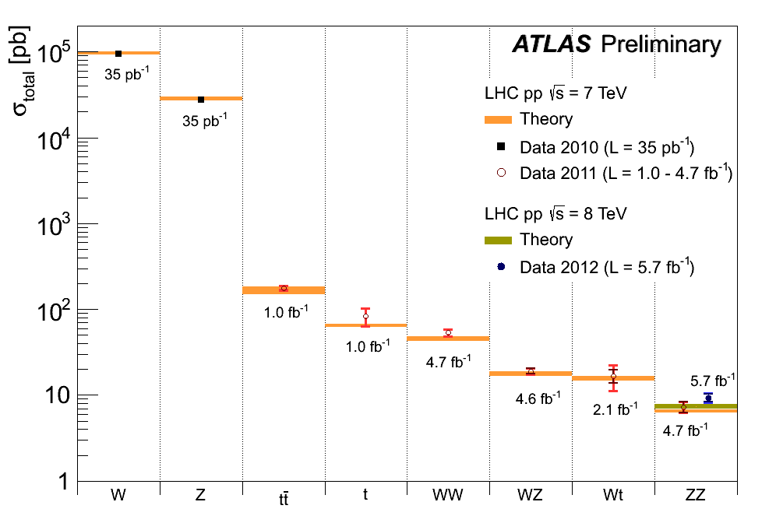
Higgs Detection @ LHC
Rare process
  Production only O(10⁻¹⁰) of total cross section
  Further suppression by decay branching ratio
Huge backgrounds
  Need distinct event features
    Leptons (e, μ) from W, Z
    Energetic gamma rays
    “Golden” channel: H→ZZ → 4l
    H→ZZ → 4l and H→γγ can be fully reconstructed: H invariant mass, but σxBR O(10 fb)
    H→WW → lν lν has two missing ν’s, σxBR O(100 fb)
  Need to understand how to model backgrounds
    From data and Monte Carlo simulations
  Yesterday’s signals are today’s backgrounds !
  (100M W, 10M Z on tape)
Notes:
After “huge bckg” move straight to plot

Slide 15
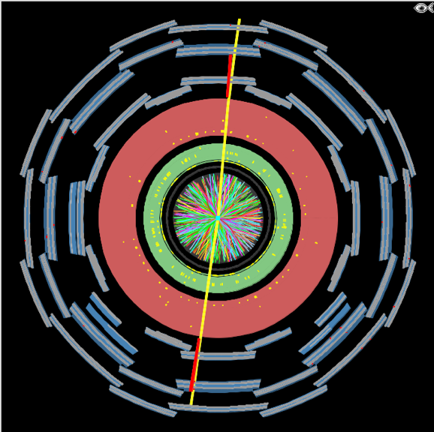
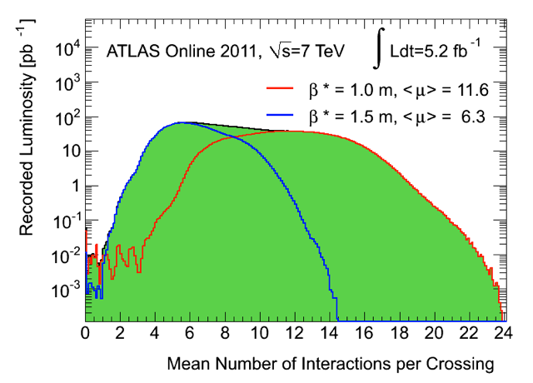
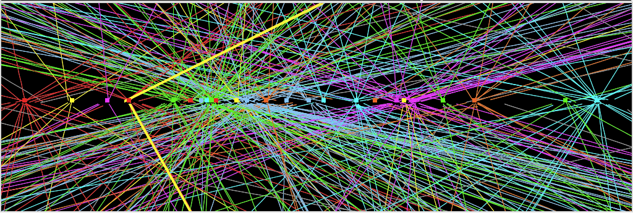
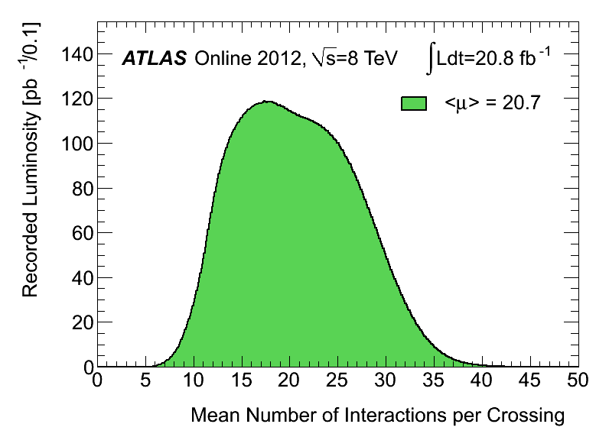
Additional Burden – Pile-Up
LHC still operates with 50 ns bunch spacing
  ~1 collision per bunch crossing @ L~2x10³² cm⁻²s⁻¹
  Up to >40 overlaid collisions at highest luminosity
  Challenging environment - O(1000) tracks – demonstrating marvelous tracker performance
    E.g. loose primary vertex constraint for H→γγ
    Backgrounds even harder to control
Z→ μμ event from 2012 data with 25 reconstructed vertices
Period A:
up to end
August
Period B:
Sept-Oct
Z→ μμ

Slide 16
Signal in Presence of Background
Most powerful detection channels at low masses
  H→WW^{(*)} → lν lν (counting excess events)
  H→ZZ^{(*)} → 4l (H mass)
  H→γγ (H mass)
All suffer from presence of background
  Leptons from W, Z decays, QCD background
Small σxBR results in small event samples
  Downward fluctuation of signal can prevent detection
    False negative (signal interpreted as background)
  Upward fluctuation of background can mimic signal
    False positive (background interpreted as signal)
Need careful, unbiased statistical treatment to assess
The Big Three

Slide 17
Sample Selection
Initial event rate 20 MHz, (multiple) collisions every bunch crossing
Three level trigger reduces this to 300-600 Hz of recorded events
  Trigger focuses on energetic jets, leptons and photons thus efficiency high for relevant Higgs decays
  Trigger composition changed on the fly during fill to match decreasing luminosity
Offline sample selection
  Based on identification of characteristic objects: electrons, muons, photons
  Large and sometimes not well-known backgrounds estimated mostly with data-driven techniques using signal-free control regions
L1: up to ~ 65 kHz
L2: up to ~ 5 kHz
EF: ~ 400Hz

Slide 18
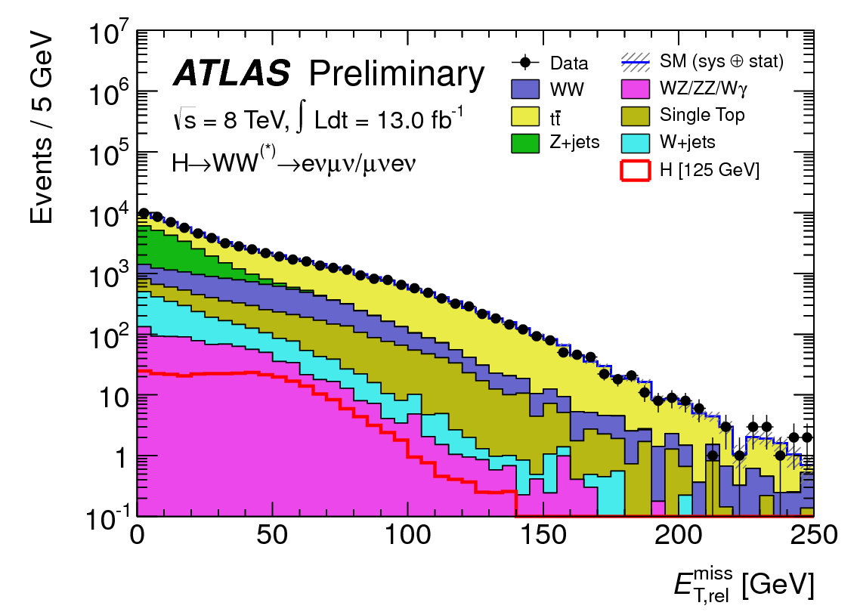
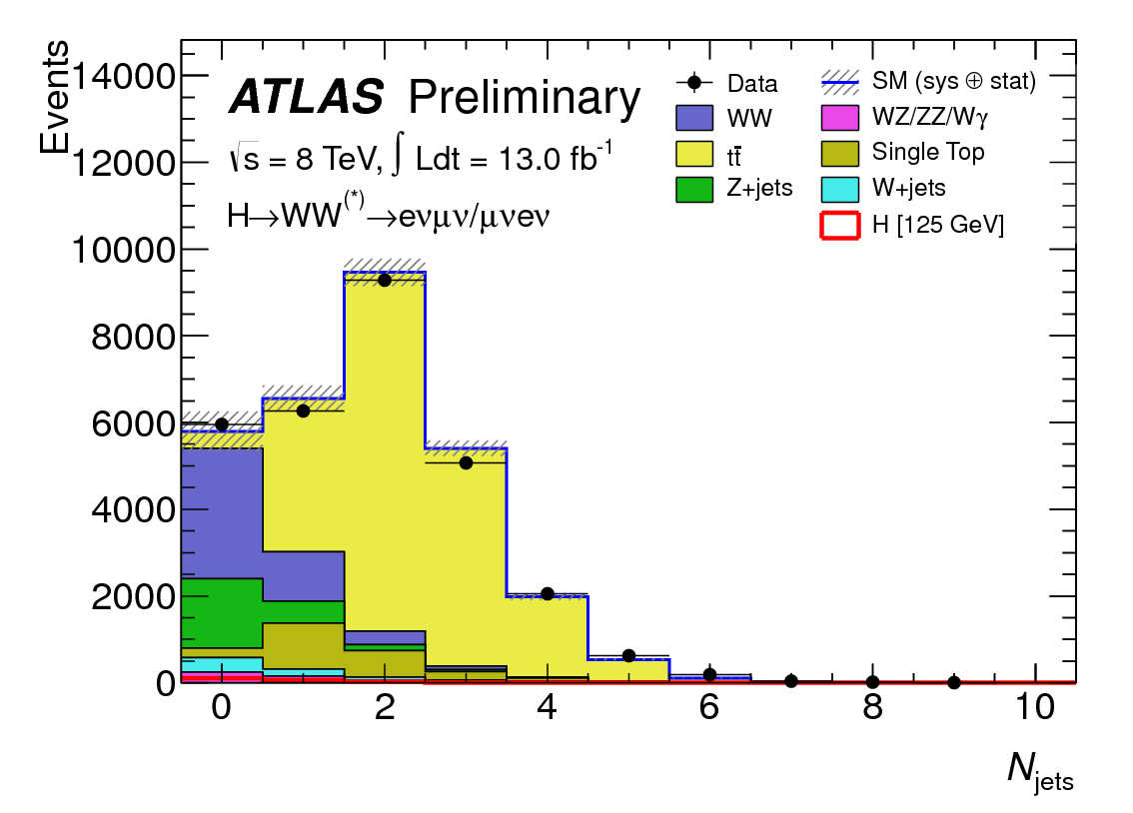
H → WW^{(*)} → lνlν
Most sensitive channel ~ 125-180 GeV (σ ~ 200 fb)
  Challenging: two missing ν → no mass reconstruction/peak → “counting channel”
  2 isolated opposite-sign leptons, large E_{Tmiss}
  Main backgrounds: WW, top, Z+jets, W+jets
    m_{ll} ≠ m_{Z}, b-jet veto, …
    topological cuts against “irreducible” WW background: pT_{ll}, m_{ll}, Δϕ_{ll} (smaller for scalar Higgs), m_{T} (ll, E_{Tmiss})
Worse pile-up in 2012
  Main work-horse WW → eνμν
    Less background from Z, γ* → l⁺l⁻
    Contributes 93% of WW sensitivity
Counting → crucial to understand background
  Understanding of E_{T}^{miss} (genuine and fake)
    Sensitive to pile-up !
  Excellent understanding of background in signal region → use signal-free control regions in data to constrain MC → use MC to extrapolate to the signal region
Notes:
Don’t detail selection
Stress signal region in comparison plot data/MC

Slide 19
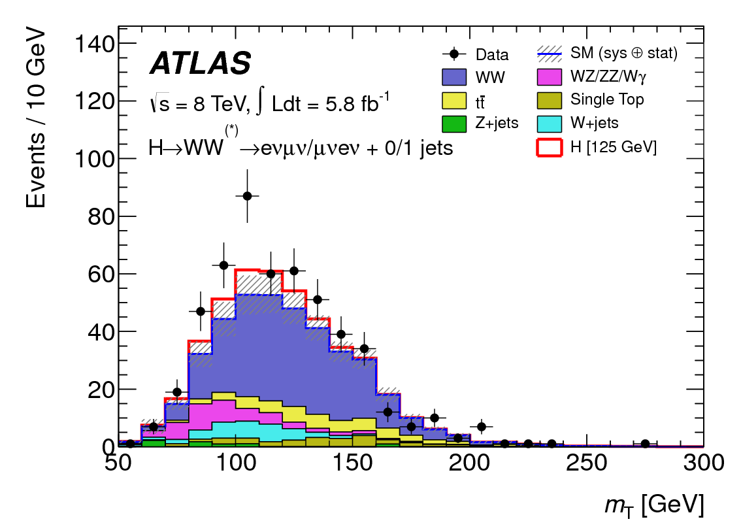

H → WW^{(*)} 2012 Sample
No significant excess above expected background observed in 2011 WW → lνlν data (Phys. Lett. B 716 (2012) 62-81)
Final control plot of 2012 WW → eνμν data up to Oct12 (HCP set)
  m_{T} used as control variable
  Expected S/B in final 8 TeV sample still ~1:10 only
Excess observed in 2012 data, consistent with a ~125 GeV Higgs

Slide 20
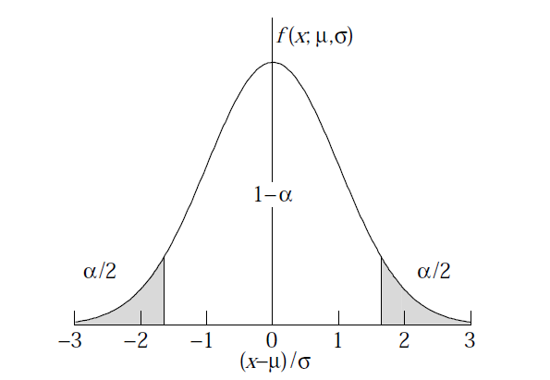
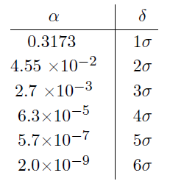
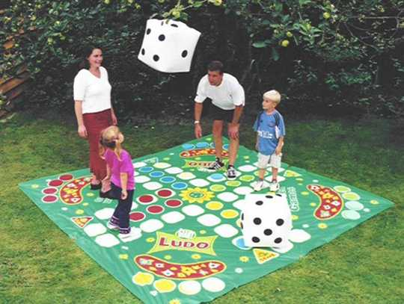

Background Fluctuations
Background is a random process, N_{bg} often well described by Poisson (Gauss) pdf
The N-σ significance refers to probabilities of an excursion from the mean of relevant pdf
For exclusion of signal presence, ~2 σ downward fluctuation of expected S+B is taken, allowing for 5 % false negatives
For detection of particles two landmarks on upward background fluctuation are agreed
  3 σ: evidence, 0.13 % false positives
  5 σ: discovery, <3x10⁻⁷ false positives
To bring background fluctuations into perspective
  For a fair dice in a ludo game ⇔background only
    1 σ effect: ~six in first trial
    2 σ effect: ~2 consecutive sixes in a row
    3 σ evidence: ~4 consecutive sixes in 2 trials
    5 σ discovery: ~8 consecutive sixes in a row
When would you start suspecting someone is cheating ?

Slide 21
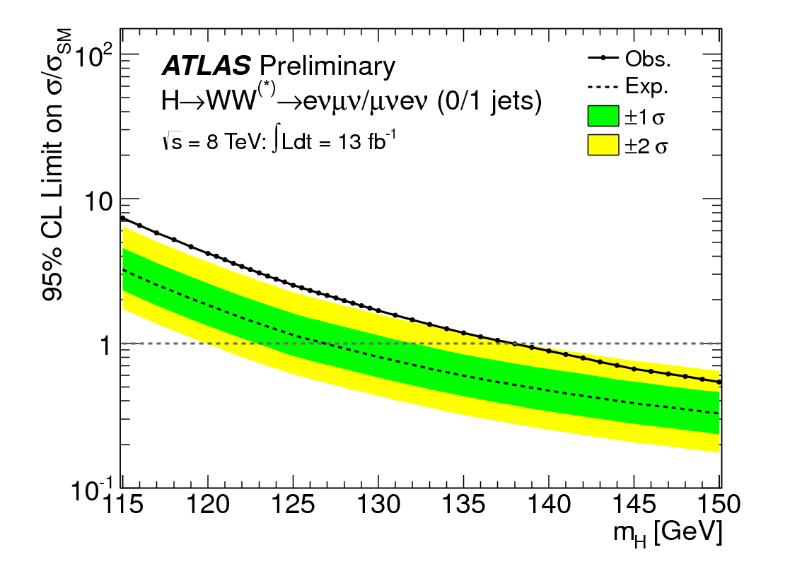
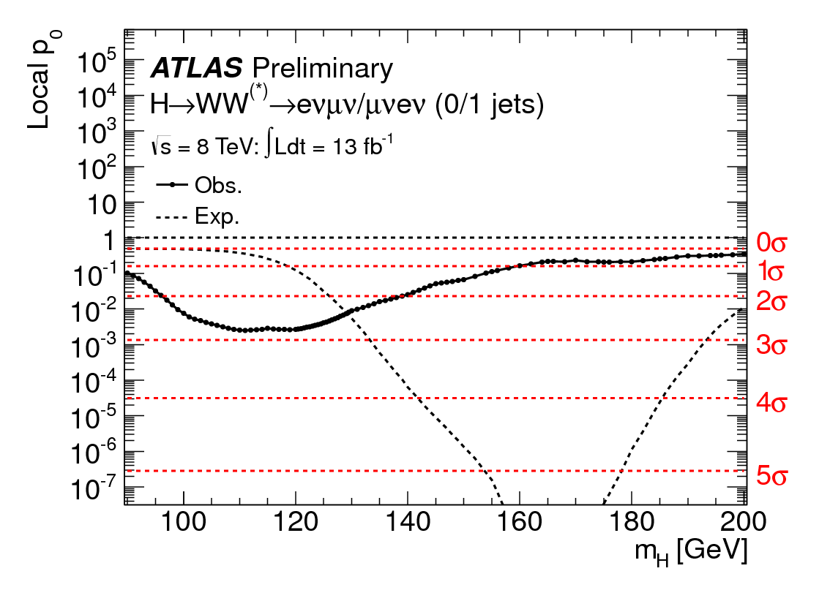
H → WW^{(*)} Results
13 fb⁻¹ of 2012 data up to Oct
Exclusion of Higgs signal contents
in units of σ_{SM} at 95 % C.L.
p₀ - consistency of data with
background-only expectation
Poor mass sensitivity
broadens range
Expected from
SM Higgs at
given m_{H}
Excluded (95% CL): 139 GeV< m_{H} (expected: 127 GeV !)
Excess 2.8σ (1.9 expected) over a broad range of m_{H} ~ 125 GeV (poor m_{H} resolution)
Notes:
State exclusion below value of 1

Slide 22
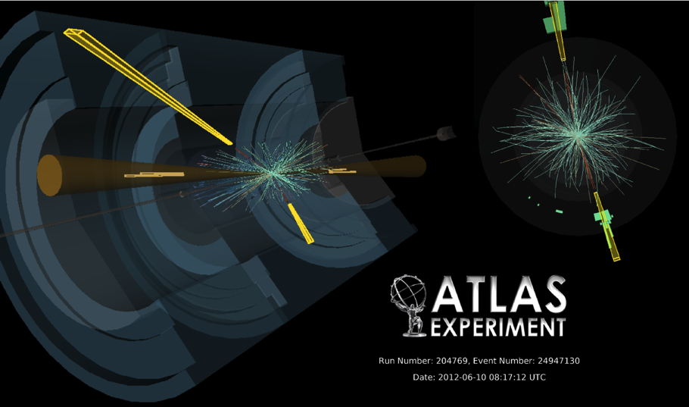
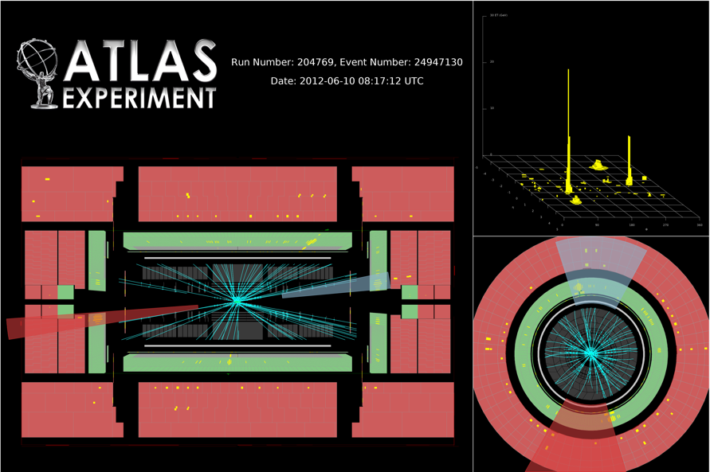
H→γγ
Small cross-section: σ ~ 40 fb
Simple final state: 2 high-p_{T} isolated photons
  E_{T} (γ1, γ2) > 40, 30 GeV (20/20 for 7 TeV)
  Main background: γγ continuum
    irreducible, smooth, ..
Events divided into 14 categories
  9 based on η-photon (e.g. central, rest, …), converted/unconverted, p_{T}^{γγ} perpendicular to γγ thrust axis + VBF(2j) + VH (l, E_{Tmis}, 2j_{lowmass})
Crucial experimental aspects:
  excellent γγ mass resolution to observe narrow signal peak above irreducible background
  powerful γ/jet separation to suppress γj and jj background with jet → π⁰ faking single γ
  Two-photon event
  Two-photon with two jets

Slide 23
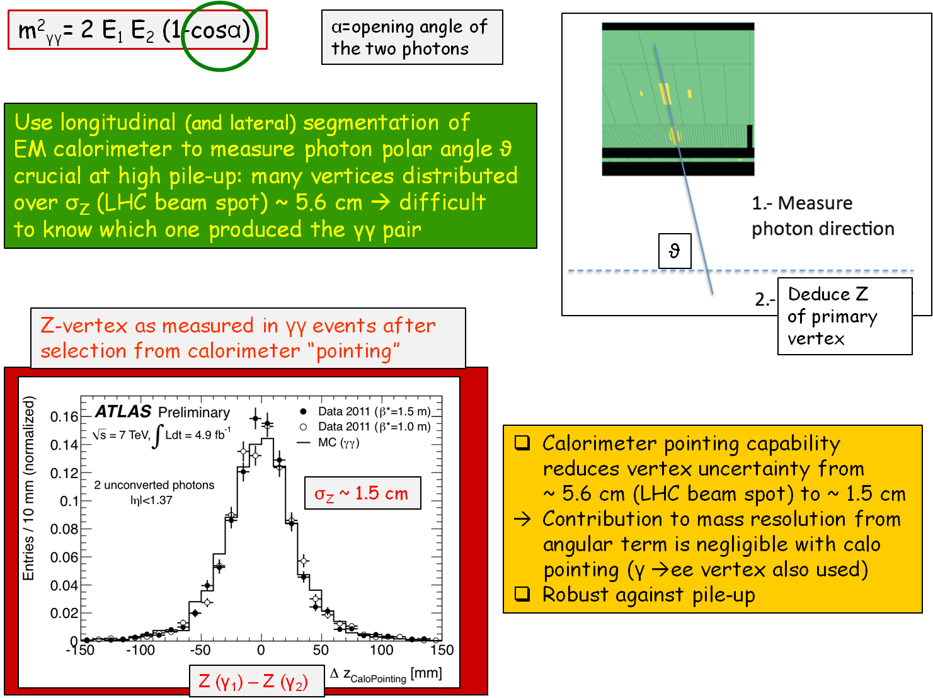
H→γγ Invariant Mass – γγ Angle

Slide 24
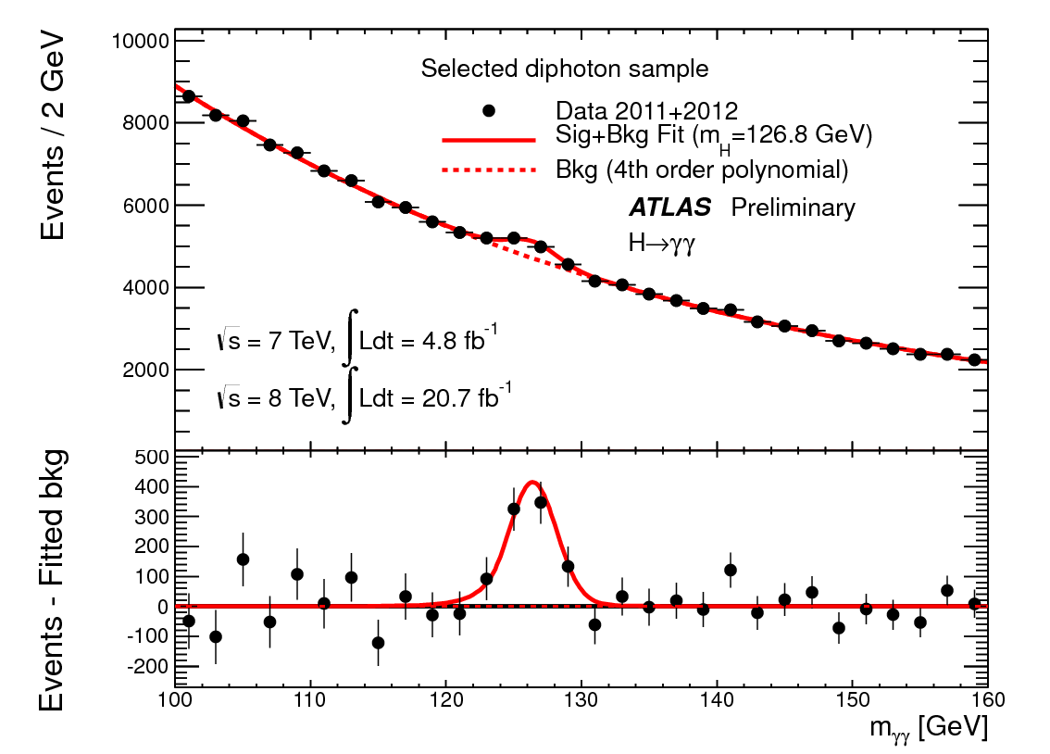
H→γγ Final Sample
After all selections: kinematic cuts, γ identification and isolation
  ~145k events with 100 < m_{γγ} < 160 GeV observed in the 2011+2012 data
  expected signal efficiency: ~ 40% for m_{H}=125 GeV
m_{γγ} spectrum fit with
  4th order polynomial or exponential for background, depending on category
  plus Crystal Ball + Gaussian for signal,
  background determined directly from data
Main systematic uncertainties
Expected signal yield : ~ 8/11%
H→ γγ mass resolution : ~14%
Background modeling : ±0.2-4.6/0.3-6.8 ev.
(category, 11/12)

Slide 25
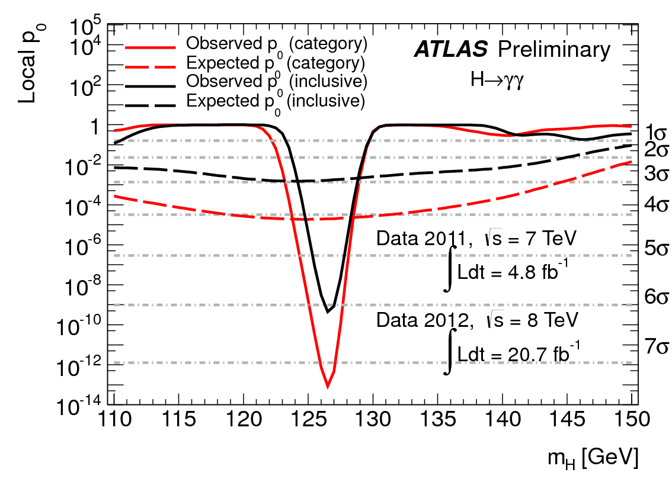
H→γγ Results
p₀ - consistency of data with
background-only expectation
Expected from SM
Higgs at given m_{H}
Maximum deviation from background-only expectation observed for m_{H} = 126.5 GeV:
  Local p₀-value: ~10⁻¹³ or 7.4 σ at 126.5 GeV
  Expected from SM Higgs: ~ 4.1 σ
Seeing more signal than expected from SM… upward fluctuation of the signal ?
Single channel discovery, no big point in quoting exclusion…

Slide 26
H→ZZ^{(*)} → 4l
σ ~ 2-3 fb only, however:
  Mass can be fully reconstructed → signal events cluster in a (narrow) peak
  Pure: S/B ~ 1, narrow peak σ ~2 GeV
Select 4 leptons: p_{T}^{1,2,3,4} > 20, 15, 10, 7/6(e/μ) GeV
  m₁₂ =50-106 GeV; 115 > m₃₄ > 12-50 GeV (depending on m_{4l})
Main backgrounds:
  ZZ^{(*)} (irreducible)
  m_{H} < 2m_{Z} : Zbb, Z+jets, tt with two leptons from b/q-jets → leptons
  Suppressed with isolation and impact parameter cuts on two softest leptons
Signal acceptance x efficiency: 15-37 % for m_{H}~ 125 GeV
Crucial experimental aspects:
  High lepton reconstruction and identification efficiency down to lowest p_{T}
  Good lepton energy/momentum resolution
  Good control of reducible backgrounds (Zbb, Z+jets, tt) in low-mass region:
    Cannot rely on MC alone (theoretical uncertainties, b/q-jet → l modeling, ..)
    Need to compare MC to data in background-enriched control regions (but: low statistics)
Notes:
Flush selection

Slide 27
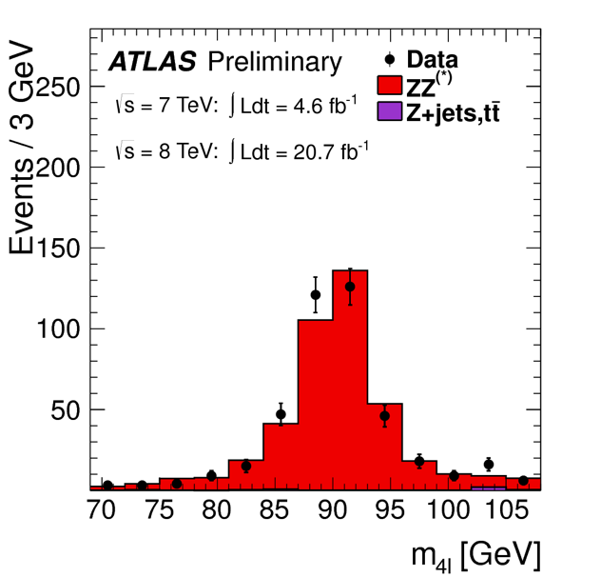
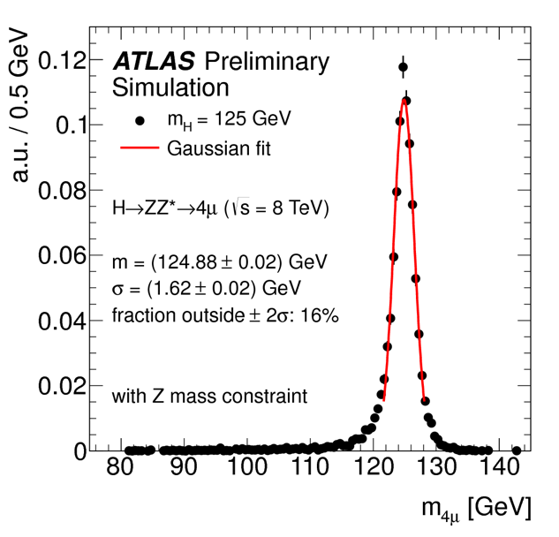
H→ZZ^{(*)} → 4l Performance
ZZ^{(*)} → 4e, 4µ, 2e2µ
Electrons
  Identification efficiency from J/ψ → ee, W → eν, Z→ ee data samples
  Crucial to understand low-p_{T} electrons (affected by material) with data
  H→ 4e mass resolution: 2.5 GeV
    Event fraction in ±2σ: ~ 80%
Muons
  Checked on Z → µµ data sample
  Muon reconstruction efficiency > 95% over 4 < p < 100 GeV
  H→ 4μ mass resolution: ~1.6 GeV
    Event fraction in ±2σ: ~ 85%
  pp→ Z→ 4l
  4l invariant mass peak
  FSR corrected and
  Z constraint fit

Slide 28
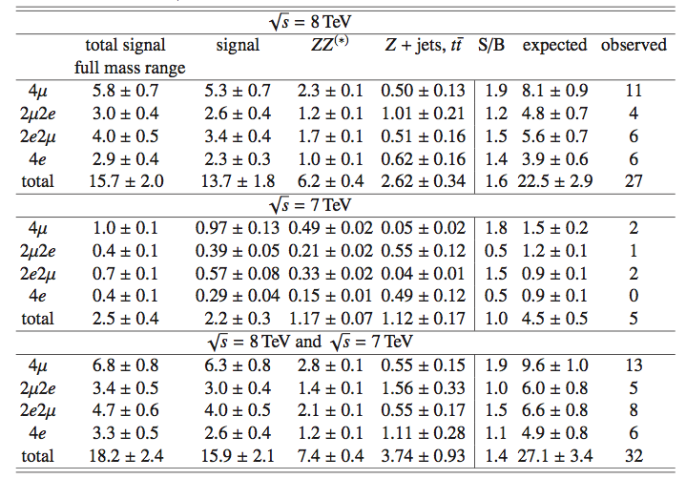
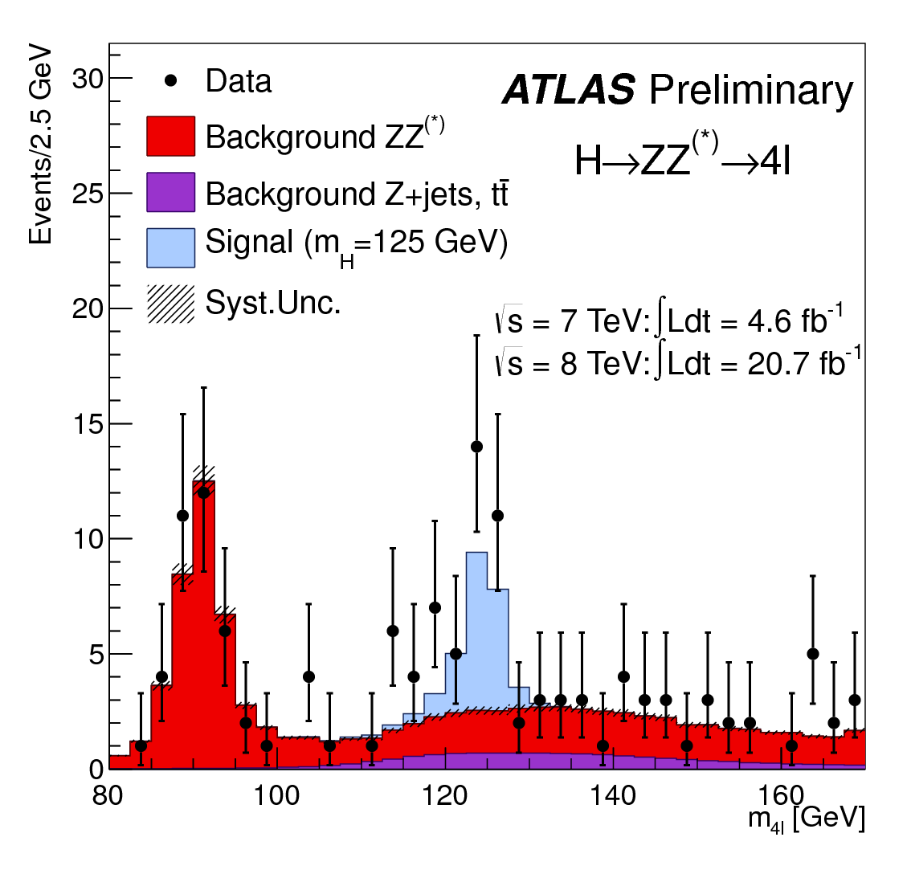
H→ZZ^{(*)} → 4l Final Sample
After all selections:
  kinematic cuts, isolation, impact parameter
Mass range above 160 GeV
  Observed: 317/59 events (8/7 TeV)
  301/53 background events expected
    mainly from ZZ^{(*)}
m(4l) < 160 GeV
  Observed: 100/21 events (8/7 TeV)
  Expected from background: 74/13
  Significant excess clustered around 125 GeV
120 < m(4l) < 130 GeV (containing ~90% of a m_{H}=125 GeV signal):
  Similar contributions expected from signal and background: ~ 5 events each
  S/B 1.9 (4μ ), 1.3 (2e2μ), 1.1 (4e)
  Background dominated by ZZ* (4μ), Z+jets and tt (2μ2e, 4e)
  32 events observed, 27 expected from SM S+B
Events in 120 < m_{4l} < 130 Gev

Slide 29
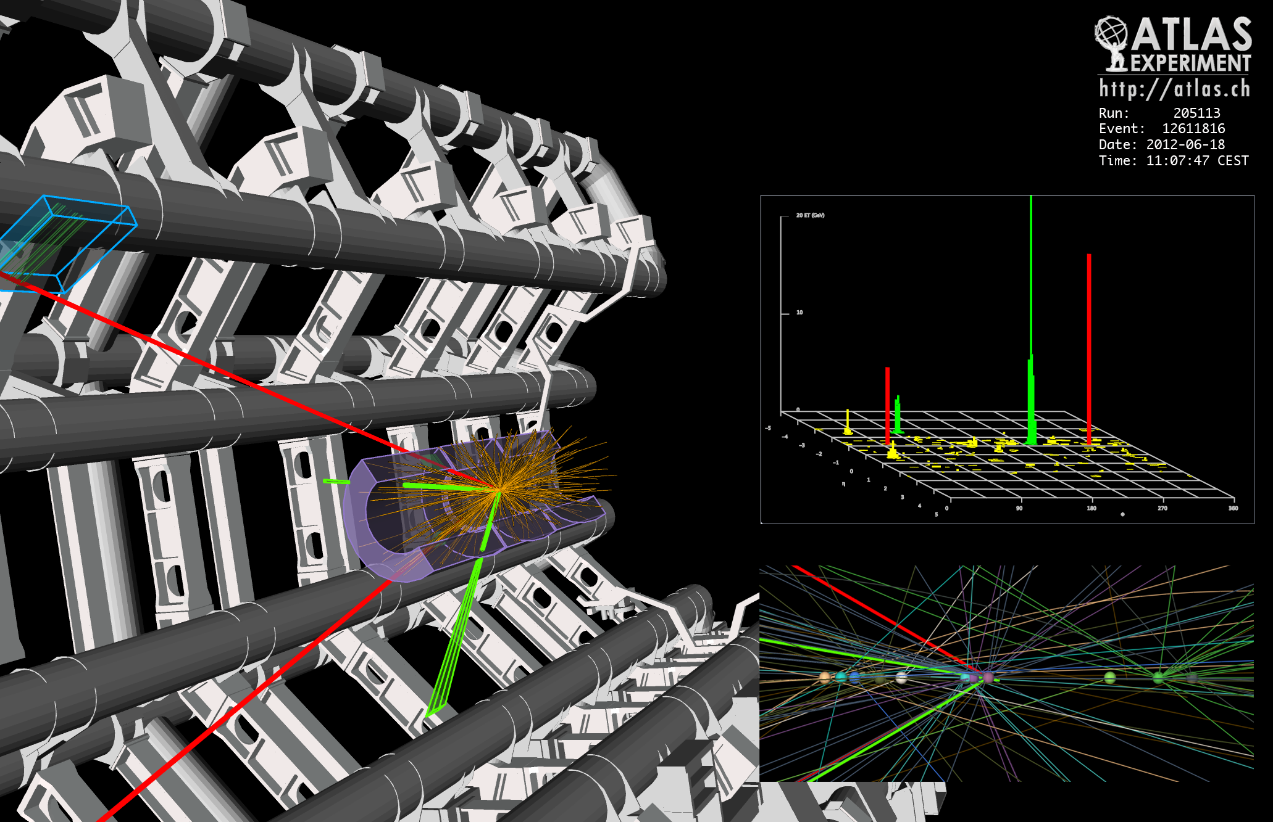
2e2μ Event with m_{2e2μ} = 123.9 GeV
12 reconstructed vertices - ~normal pile up in 2012
p_{T} (e,e,μ,μ)= 18.7, 76, 19.6, 7.9 GeV, m_{ee} = 87.9 GeV, m_{μμ} =19.6 GeV
2012

Slide 30

H→ZZ^{(*)} → 4l Results
p₀ - consistency of data with
background-only expectation
Maximum deviation from background-only expectation observed for m_{H} = 124.3 GeV:
  Local p₀-value: 2.7x10⁻¹¹ or 6.6 σ
  Expected from SM Higgs: ~ 4.4 σ
(Another) single channel discovery

Slide 31
Wrapping it up – Combined Results
Statistically combine data we talked …
… and did not talk about
In a nutshell
  γγ and 4l for complete 2011/12
    ~5+21 fb⁻¹
  WW 2012 up to Oct
    ~13 fb⁻¹
  bb and ττ 2011/Oct12
    ~5+13 fb⁻¹

Slide 32
A Bit of History
EPS July 2011
CERN Dec 2011
PRD spring 2012
ICHEP July 2012
PLB July 2012

Slide 33
Entering Precision Higgs Physics
With discovery well established in two separate channels
  No need to push limit on SM signal presence
Explore the newly discovered particle
  Mass, signal strength
  Production mechanisms
  Spin
  Couplings

Slide 34



Mass Measurement
The two precision channels yield
Best fit value
H→γγ
H→4l
Results still compatible at ~1% level (~2.5σ)
  Can depend critically on energy resolution modeling

Slide 35

Signal Strength
All strengths relative to SM prediction
  Evaluated at m_{H} =125.5 GeV
  2 σ excess w.r.t. SM expectation
    Need more statistics before any claims can be made…
  No firm hint of coupling to fermions yet

Slide 36



Production Mechanism
Dominant Higgs production mechanisms at LHC well defined in Standard Model
  Results from H→γγ, 4l, ττ
  Combine H couplings to fermions/bosons:
    ggF+ttH; VBF+VH
    Result consistent with (high side of) SM predictions
fermions
bosons
Production relative to SM

Slide 37



Spin
From decays the new particle is clearly a boson,
  H→γγ forbids J=1
First measurements in H→γγ and H→4l
  H→γγ: photon angle relative to Higgs direction
    Not yet approved for complete 2012 data-set
  H→4l: Multivatiate analysis: BDT, MELA
    Problem: J=2 (graviton) model dependent
H→4l
SM value J^{P}=0⁺ favoured over others, but exclusion level still small
Notes:
Check 4l exclusions, maybe NOT small (3 sigma)

Slide 38
The New Boson – What is it ?
The Higgs boson (the One, SM) ?
A Higgs boson (one of many, e.g. MSSM) ?
An impostor (sth else) ?
The Standard Model Higgs boson has a rich and well-defined associated phenomenology
  Cross section, branching ratios
  Spin, parity, couplings, self coupling
All this needs to be explored in detail before providing a definite answer
We have just started to enter the exploration regime for this new particle
  The quest has just begun with remarkable results already available
  LHC will deliver at least 10x if not 100x more data in its lifetime
Exploring the new discovery in detail will take time, resources, and might require a new (linear ?) collider

Slide 39
Summary
We have analysed up to 4.9 fb⁻¹ of 7 TeV and up to 21 fb⁻¹ of 8 TeV pp collision data for presence of SM Higgs boson
  Across the 110-600 GeV mass region
  In many distinct decay channels (3 most relevant for 2012 data)
We observe an excess of events centred at m_{H}~ 125 GeV:
  Excess comfortably exceeds discovery limit in two distinct, high-precision channels: H→ γγ (7.5 σ) and H→ ZZ* → 4l (6.3 σ)
    SM Higgs expectation: 4.1/4.2 σ
  Best mass value: +125.4 ± 0.6 GeV
  Signal strength relative to SM: 1.45 ± 0.22
We are entering precision Higgs physics
  Started on spin and production mechanisms
No matter whether this particle turns out the Higgs, a Higgs or something exotic, we have set an important milestone in unveiling the very secrets of Nature

Slide 40
Backup

Slide 41



H→γγ Backgrounds
Potentially huge background from γj and jj production with jets fragmenting into a single hard π⁰ and the π⁰ faking single photon
  Suppressed by fine lateral segmentation (4mm η-strips) of the first compartment of ATLAS EM calorimeter
  Need suppression of O(10⁻⁴) to get to level of irreducible γγ background
After all cuts: ~120k events with 100 < m_{γγ} < 160 GeV observed in the 2012 data
Sample composition estimated from data using control samples
  γj + jj << γγ irreducible (purity 75%)

