Slide 1
nBLM: Circular Buffers and Neutron Detection Algo
Irena Dolenc Kittelmann,
30. May 2018, ESS-DMCS BLM VC

Slide 2
nBLM intro
Processing requirements (same for both, ic and nBLM):
The data should be continuously written to the buffers on the FPGA DDR3.
Extraction of the data to the CPU memory must not stop the writing to the FPGA DDR.
Each AMC must be able to process maximum 8 channels.
Regarding circular buffer depths
  Ideally we would like have least 3 full pulse periods (1 pulse period=1/(14Hz)=71.4ms)
    In case of nBLM raw data (16-bits) this gives:
    → 8×3×250×10⁶/14 bytes ~ 860 Mbytes of data for 8chs over 3 pulse periods
  However, 1 pulse period (~285Mbytes for 8chs) is still acceptable.

Slide 3
nBLM CB0 (raw data)
Looking at the results reported at https://jira.esss.lu.se/browse/BIG-1166
  Estimated speed for writing from FIFO to DDR3: ~1GB/s
  Estimated speed for writing from DDR3 to CPU through DMA: ~300MB/s
In case of circular buffer with raw data (CB0)
  Sampling speed for nBLM 250Ms/s (=1 sample/4ns)
  The incoming data from 1ch to FIFO: 2B/4ns = 0.5GB/s
  Comparing the in/out speed: ~raw data of maximum 2 channels could be stored in DDR without danger of loosing the data – if no processed data is consider.
  Transferring from the DDR3 to CPU seems to be possible only for 1 channel under the requirement that buffers must not be freezed (assuming that FIFO can handle the difference in incoming data speed and DMA bandwidth?).
What about the processed data? Need to explain a bit how the neutron detection algorithm looks like and what information we want to store.

Slide 4
nBLM neutron detection
nBLM operation mode:
The system is operating in two modes, the transition is automatic
Counting mode: individual neutron signals are counted
Current mode: the rate of incoming neutrons is too high to able to distinguish between 2 individual neutron signals
  events pile up
  Number of neutrons estimated through charge
nBLM detectors:
Two types:
  fast – nBLM-F (aimed to detector fast losses)
  slow – nBLM-S (primarily aimed to monitor slow losses)
Both will have the same neutron detection algorithm running, thought the settings very likely different

Slide 5
nBLM neutron detection
Typical neutron signal
The characteristics depend on detector properties/settings (drift length, applied voltage/gain).
These settings not finalized yet (work on-going by CEA detector team)
Some typical numbers, just for illustration:
  30-50ns rise time
  100-200ns signal length
  Amplitude:
    ~ constant for slow detectors (~100mV)
    Continuous for fast detector (maximum value 500mV - ADC saturation)
Note: the nBLM signals are negative, however for simplicity they are considered to be positive in this presentation.

Slide 6
nBLM neutron detection
What should the neutron detection related blocks provide?
  N_{MTW} = Number of neutron counts reported after every Monitoring Time Window (MTW).
    A pair of words needed to calculated the N_{MTW} is stored in the CB2 and reset at the end of every MTW.
  EventInfo for each interesting event
    Stored in the circular buffer CB1 and reset at the end of the “interesting event”
MTW:
  Time window in which the neutron counts are measured/reported
  Currently MTW set to 1us (250 samples, smplBin=4ns sampling time bin width) – this will very likely not change.

Slide 7
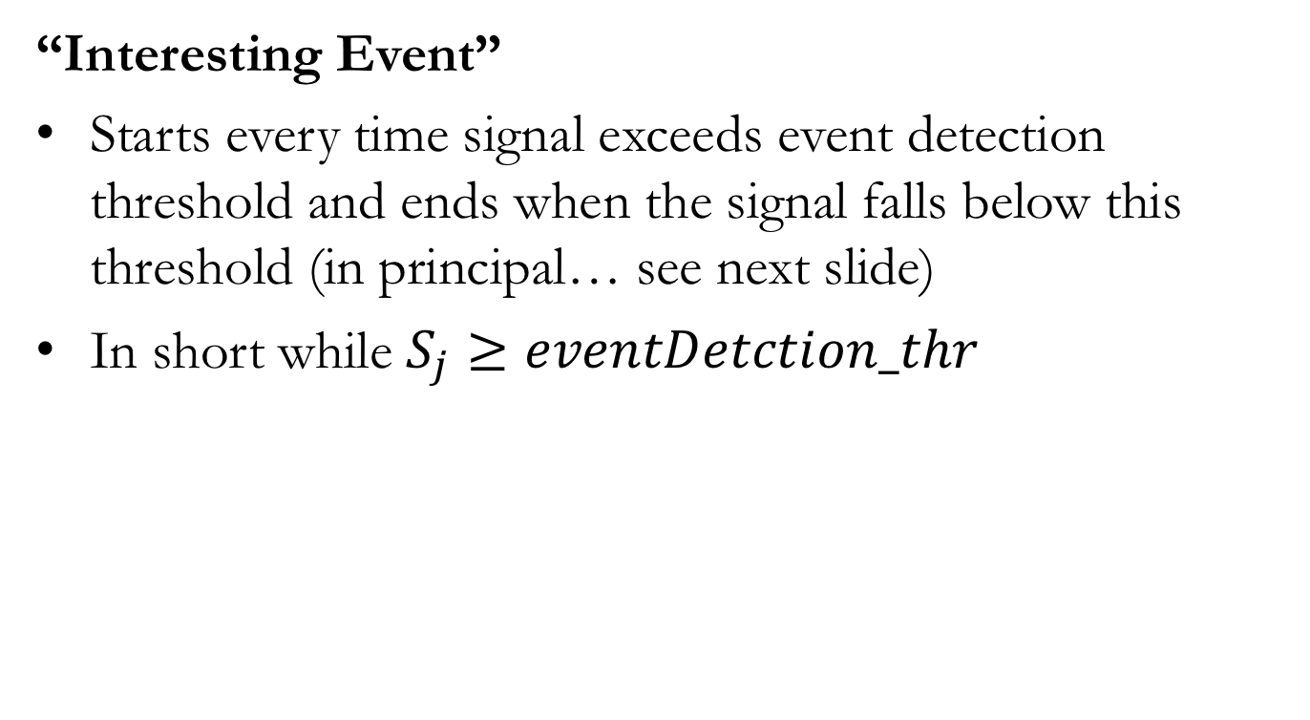
nBLM neutron detection
“Interesting Event”
Starts every time signal exceeds event detection threshold and ends when the signal falls below this threshold (in principal… see next slide)
In short while $S_{j}≥eventDetction_thr$

Slide 8
nBLM neutron detection
”Interesting Events” can be
  real neutron, gamma or other background signal
  pile up
  spike/noise, spark
Pile up can span over more MTWs.
  This type of event end will necessary start and end in the same MTW
  To deal with this we can redefine “Interesting events”:
  ”Interesting Event” starts every time signal exceeds eventDetction_thr and ends when either
    Case 1: the signal falls below eventDetection_thr.
    Case 2: the MTW end is reached before signal level has fallen below the eventDetectin_thr and the event has been identified as single neutron or pile up (isNeutron=True). When this occurs the TOTlimitReached is set to True.
  See examples on slide 14 and 15.

Slide 9
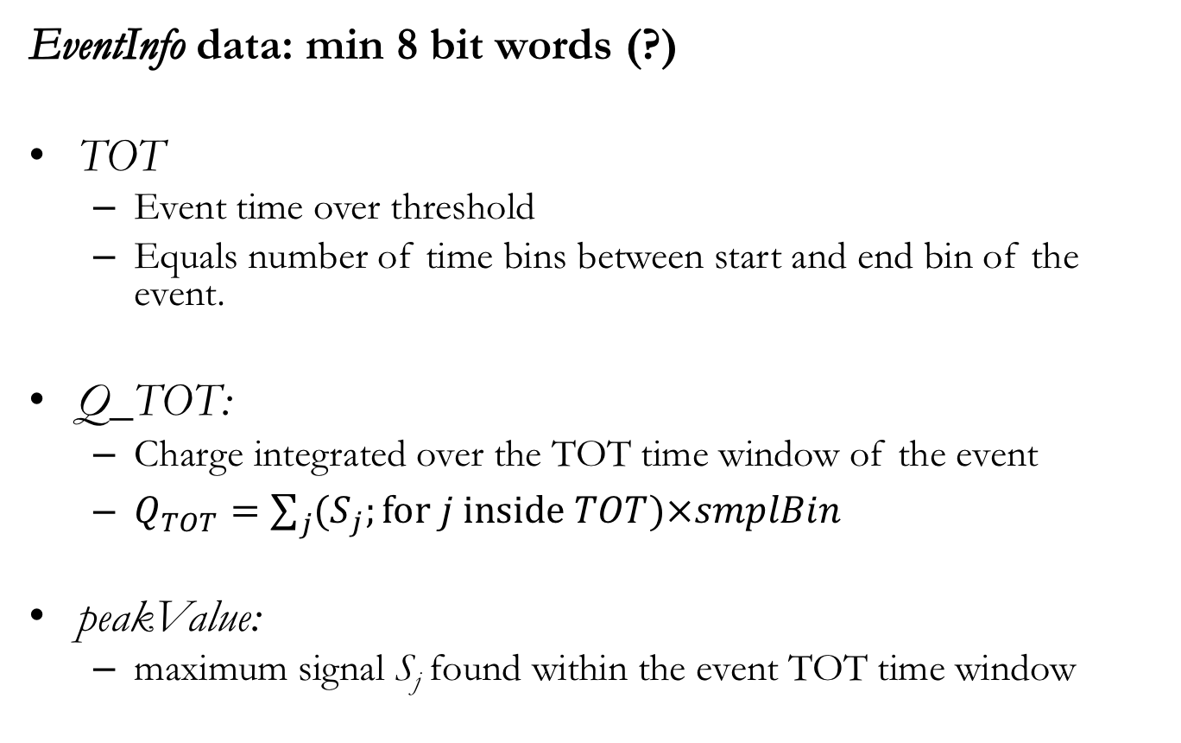
nBLM neutron detection
EventInfo data: min 8 bit words (?)
TOT
  Event time over threshold
  Equals number of time bins between start and end bin of the event.
Q_TOT:
  Charge integrated over the TOT time window of the event
  $Q_{TOT}=\sum_{j}{{(S}_{j};for j inside TOT)×smplBin}$
peakValue:
  maximum signal S_{j} found within the event TOT time window

Slide 10
nBLM neutron detection
EventInfo data: min 8 or more bit words
TOTstartTime
  Time (bin indx) of the event TOT start (measured from start of the current MTW?)
peakTime:
  Time (bin indx) at the peakValue (measured from TOTstartTime ?)
MTWindx ?
  Current monitoring time window index
  Note: Offline we will need to know the absolute time of each event, so the start of each buffer as well as the info in PV will need to be time stamped (time stamp from EVR?)

Slide 11
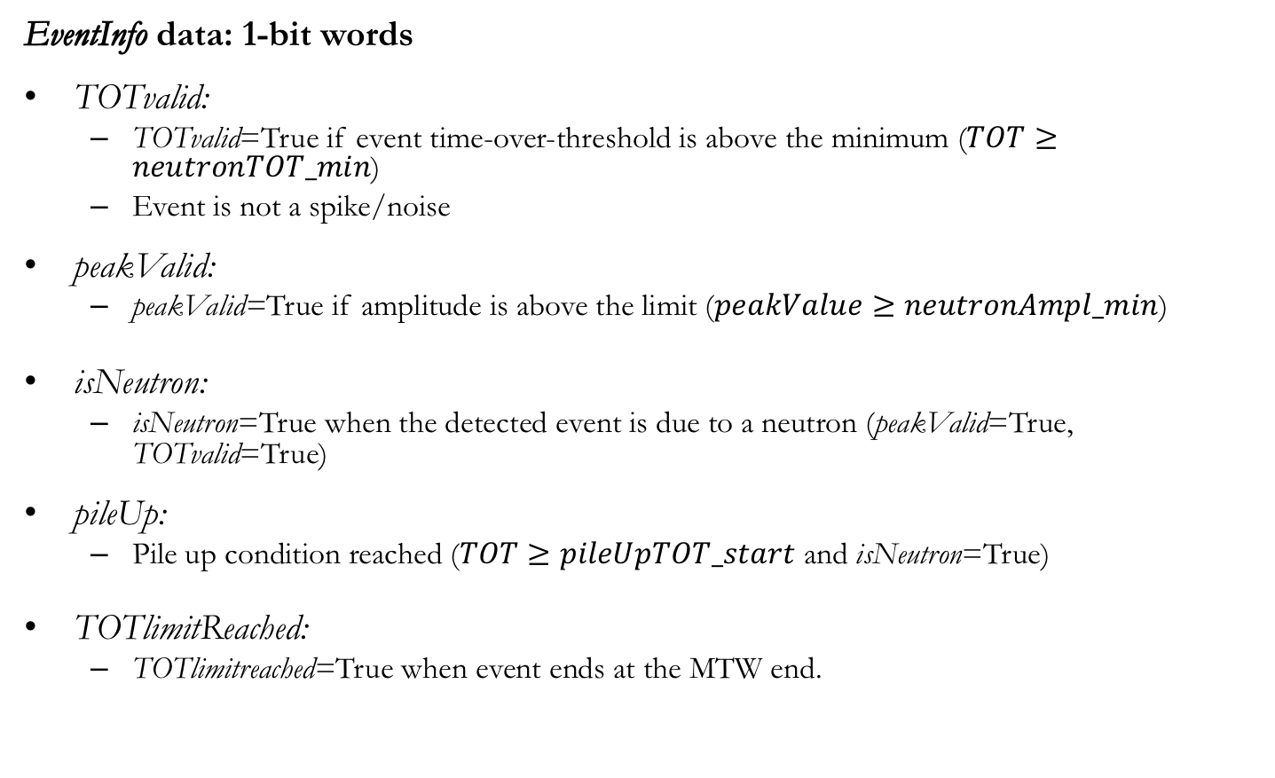
nBLM neutron detection
EventInfo data: 1-bit words
TOTvalid:
  TOTvalid=True if event time-over-threshold is above the minimum ($TOT≥neutronTOT_min$)
  Event is not a spike/noise
peakValid:
  peakValid=True if amplitude is above the limit ($peakValue≥neutronAmpl_min$)
isNeutron:
  isNeutron=True when the detected event is due to a neutron (peakValid=True, TOTvalid=True)
pileUp:
  Pile up condition reached ($TOT≥pileUpTOT_start$ and isNeutron=True)
TOTlimitReached:
  TOTlimitreached=True when event ends at the MTW end.

Slide 12
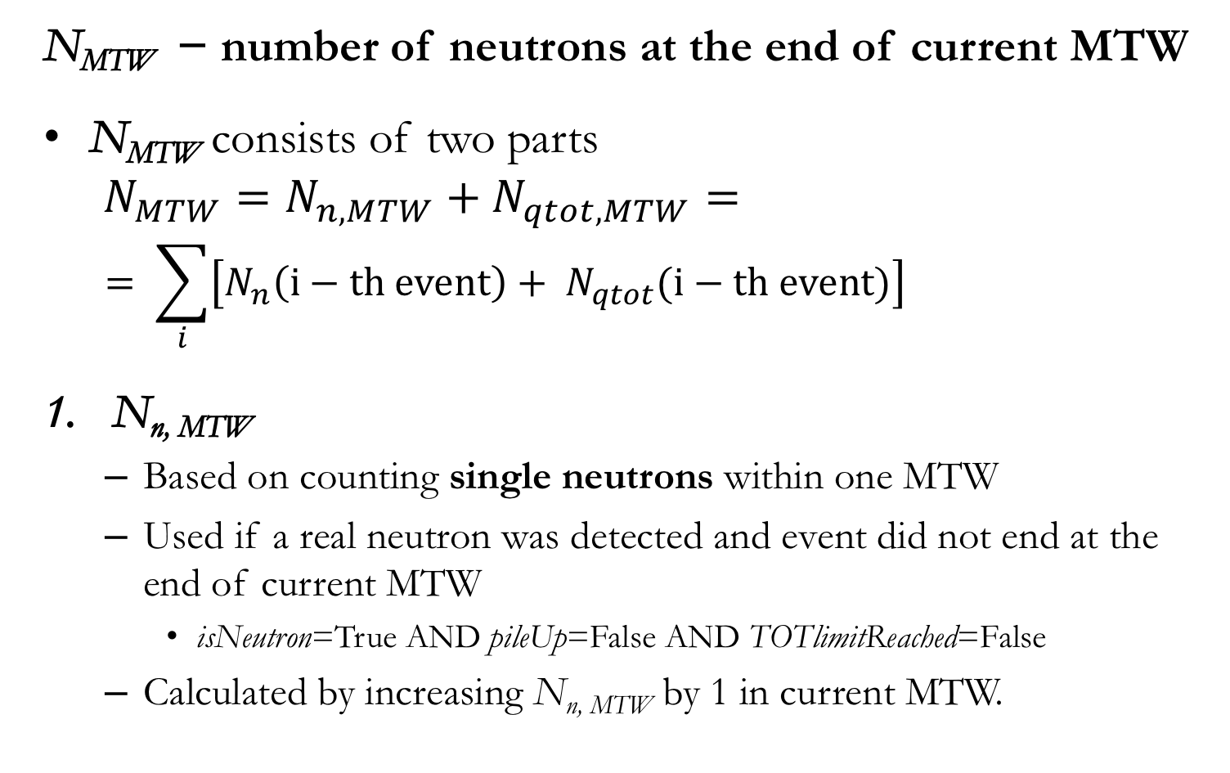
nBLM neutron detection
N_{MTW} − number of neutrons at the end of current MTW
N_{MTW} consists of two parts
$$N_{MTW}=N_{n, MTW}+N_{qtot, MTW}=$$
  $$= \sum_{i}{\left[N_{n}\left(i−th event\right)+ N_{qtot}(i−th event)\right]}$$
N_{n, MTW}
  Based on counting single neutrons within one MTW
  Used if a real neutron was detected and event did not end at the end of current MTW
    isNeutron=True AND pileUp=False AND TOTlimitReached=False
  Calculated by increasing N_{n, MTW} by 1 in current MTW.

Slide 13
nBLM neutron detection
N_{qtot, MTW}
Number of neutrons estimated through Q_{TOT}
Used:
  Case 1: For calculating the number of neutrons in pile up
    If pileUp(i-th event)=True
  For splitting the charge between MTWs:
    Case 2: a neutron or pile up event does not end by the end of current MTW
      If TOTlimitReached[j-the event]=True AND isNeutron[j-th event]=True
    Case 3:
      The event starts at the first time bin index of the current MTW,
    (TOTstartTime[j-th event]=0) and
      previous event ended at the current MTW start
    (TOTlimitReached[(j-1)-th event]=True) and
      the event was either single neutron or in pile up
    (isNeutron[(j-1)-th event]=True)
Case 2
Case 3

Slide 14
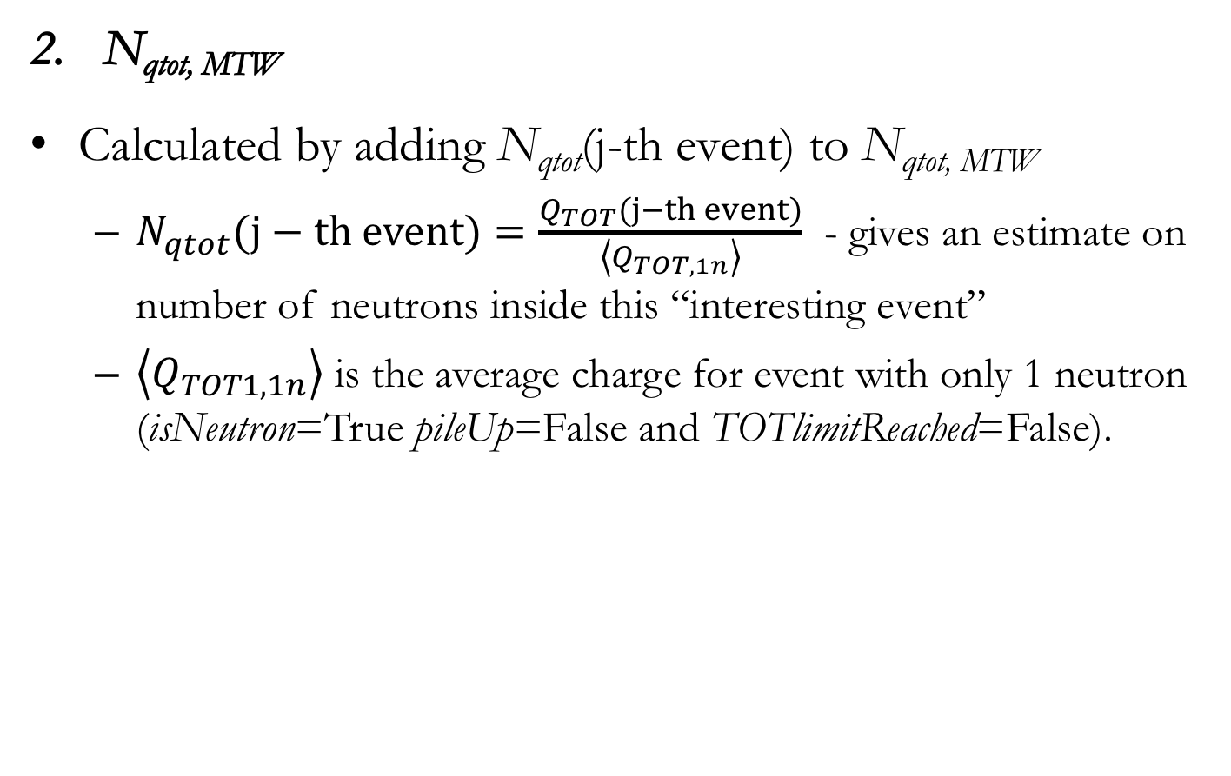
nBLM neutron detection
N_{qtot, MTW}
Calculated by adding N_{qtot}(j-th event) to N_{qtot, MTW}
  $N_{qtot}(j−th event)=\frac{Q_{TOT}(j−th event)}{\left\langle Q_{TOT,1n}\right\rangle }$ - gives an estimate on number of neutrons inside this “interesting event”
  $\left\langle Q_{TOT1, 1n}\right\rangle$ is the average charge for event with only 1 neutron (isNeutron=True pileUp=False and TOTlimitReached=False).

Slide 15
nBLM neutron detection
N_{MTW} and EventInfo determination, example 1
5 equal signal shapes (due to neutrons)
2 spike/noise shapes
Eve5 & eve7:
Interesting event, case 2
(see p.8)

Slide 16
nBLM neutron detection
N_{MTW} and EventInfo determination, example 2
2 pile up signal shapes (eve10 – eve14)
1 neutron signal shape (eve9
1 spike/noise signal shape (eve15)

Slide 17
nBLM neutron detection
Neuron detection related blocks
Event Detection: updates EvenInfo every 4ns
“Neutron counter”
  Ends and resets EventInfo
  Sums and resets neutron counts at the end of each MTW

Slide 18
nBLM CB1
CB1
Circular buffer with process data, EventInfo
EventInfo size estimation
  Assuming EventInfo consist of
    five 1-bit words
    Six 32-bit words
  Size: ~20B for one channel

Slide 19
nBLM CB1 size estimation
EventInfo is written to CB1 every time an ”interesting event” ends
  Signals generated by incoming particles (neutron, gamma, other bckg):
    maximum rate ~10 events/1μs (=(MTW/100ns) events per MTW)
    After that we enter pile up
  Spikes:
    The rate is unknown and depends on bandwidth, cable length, detector properties/settings, preamp settings, environment, eventDetection_thr,…
    Worst case: can occur as fast as every 8ns (2MTWs) when 2 consecutive 1 bin long events are observed.

Slide 20
nBLM CB1 size estimation
Estimated maximum number of events per one 14Hz pulse
  Inside the 3ms time window where the beam is present:
    ~10/μs good events (not spikes)
    Assuming 2×10/μs as the upper limit (to include possible spikes)
  Outside the 3ms time window with beam:
    Assuming 1 order of magnitude less compared to the 3ms window with beam: 2/μs
  Inside the 14Hz pulse:
  = 3ms×20/μs + (1/14Hz−3ms)×2/μs
  ~ 200k events per one 14Hz pulse period (for 1 channel)
Estimated processed data size per one 14Hz pulse period
  = (200k events)×20B ~ 4MB for 1ch or 32MB for 8chs

Slide 21
nBLM CB2
CB2
Buffer with processed data, neutron counts (N_{n, MTW,} N_{qtot, MTW})
Rate: neutron counts are written to CB2 every MTW (1μs)
Data size estimation
  Assuming
    N_{n, MTW} is 8-bit number (max number of single neutron counts ~10/μs)
    N_{qtot, MTW} is 32-bit number (maximum neutron rate estimated ~ 60GHz=60k neutrons/μs)
  Data size per one MTW per channel : 20B
  Data size per one 14Hz pulse period for 8 chs ~8×1.5MB=12MB
  Incoming data rate for 8 chs: 160MB/s

Slide 22
nBLM CB3
CB3
Intended to store pedestal value for each of the channels and system health information (bool).
Considering not have this buffer
  Pedestal calculation is planned to be performed @14Hz
    This can monitored and archived through a PV like other interesting values determined in the “Pulse processing” block (providing outputs at 14Hz).
  Health calculation rate not finalized, potentially faster than at 14Hz.

Slide 23
Conclusions
Transferring data from DDR through DMA to CPU
Estimated average of incoming data
  CB0 (1ch): 500MB/s
  CB1 (8chs): 32MB×14Hz ~ 450MB/s – comparable to raw data
  CB2 (8chs): ~160MB/s
Assuming:
  ~300MB/s for DDR → CPU speed (from results reported in BIG-1166)
  FIFO can handle the difference in incoming data rate and DMA bandwidth.
It seems like we can either buffer
  Raw data (over one 14Hz pulse period) for 1 channel or
  Processed data for 8chs (over one 14Hz pulse period)
Maybe we can buffer both raw data for 1 channel and processed data for 8chs at the same time
  If both EventInfo size and neutron counts are decreased by half (by using six 16-bit words instead of 32-bit words in case of EventInfo and ) and
  Neutron counts info decreased by half (using one 8 and one 16-bit).
  Time to maybe include implementation aspects in this discussion.
  Note also: assumptions have been made on what to expect in real environment, some of those can not be assed with simulations, only real environment will give answers (commission…), so I tred to be conservative with estimations.

