Slide 1
Report from WP13
Prospective and Technology-driven Detector R&D
AIDAinnova Annual Meeting, Catania, March 20, 2024
Peter Križan
J. Stefan Institute and University of Ljubljana

Slide 2
Projects
Thin Silicon Sensors for Extreme Fluences
Make Si sensors radiation tolerant by using a thin bulk, internal amplification and using a gain implant that would withstand a factor of 50 higher fluences than what is presently available.
The Silicon Electron Multiplier, a new approach to charge multiplication in solid state detectors
Make Si sensors radiation tolerant by a novel biasing method – electrodes embedded in silicon.
Development of fine-sampling calorimeters with nanocomposite scintillating materials
Develop a new generation of fine-sampling calorimeters that use innovative scintillating materials based on perovskite nanocrystals dispersed in a plastic matrix to form fast (~100ps) and radiation resistant (~1 MGy) scintillators.
Wireless Data Transfer for High-Energy Physics Applications
Develop mm-wave-based wireless communication as an alternative to optical and wired links in a HEP-like environment to reduce the material and optimize the read-out.

Slide 3
Projects
Thin Silicon Sensors for Extreme Fluences
Make Si sensors radiation tolerant by using a thin bulk, internal amplification and using a gain implant that would withstand a factor of 50 higher fluences than what is presently available.
The Silicon Electron Multiplier, a new approach to charge multiplication in solid state detectors
Make Si sensors radiation tolerant by a novel biasing method – electrodes embedded in silicon.
Development of fine-sampling calorimeters with nanocomposite scintillating materials
Develop a new generation of fine-sampling calorimeters that use innovative scintillating materials based on perovskite nanocrystals dispersed in a plastic matrix to form fast (~100ps) and radiation resistant (~1 MGy) scintillators.
Wireless Data Transfer for High-Energy Physics Applications
Develop mm-wave-based wireless communication as an alternative to optical and wired links in a HEP-like environment to reduce the material and optimize the read-out.

Slide 4
The principle: compensation with two dopants
Doping Profile – Standard LGAD
Doping Profile – Compensated LGAD
–– Boron × 1 Φ = 0
Effective doping
–– Boron × 5 Φ = 0
–– Phosp × 4 Φ = 0
–– Comp Φ = 0
Doping Density [a.u.]
Doping Density [a.u.]
Compensated LGAD
Use the interplay between acceptor and donor removal to keep a constant gain layer active doping density
Depth [a.u.]
Irradiation
Φ = 1×10¹⁶/cm²
Depth [a.u.]
–– Boron × 1 Φ = 1E16
- - Boron × 1 Φ = 0
–– Boron × 5 Φ = 1E16
–– Phosp × 4 Φ = 1E16
–– Comp Φ = 1E16
- - Comp Φ = 0
Many unknowns:
▻ donor removal coefficient,
from n⁺(Φ) = n⁺(0)⋅e^{-cDΦ}
▻ interplay between donor and acceptor
removal (c_{D} vs c_{A})
▻ effects of substrate impurities on the
removal coefficients
Doping Density [a.u.]
Doping Density [a.u.]
Effective doping
Depth [a.u.]
Depth [a.u.]

Slide 5
Compensated Gain Layer Design – Split Table
3 different combinations of p⁺ – n⁺ doping: 2 – 1, 3 – 2, 5 – 4
Active
thickness
30 μm
[ a < b < c ]

Slide 6
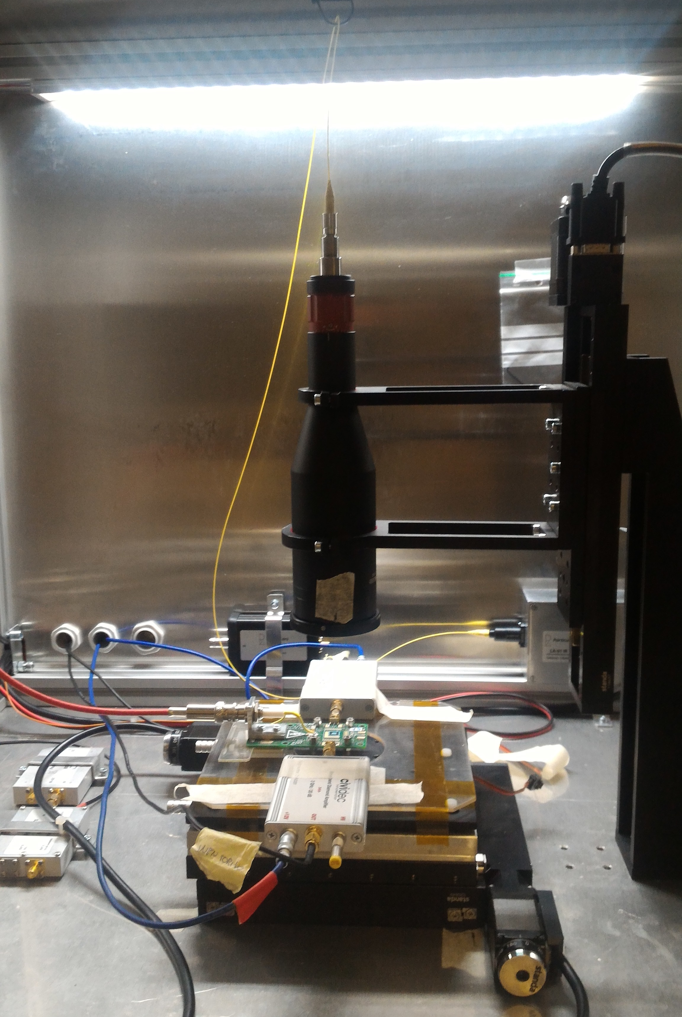

IR Laser Stimulus on Compensated LGAD
TCT Setup from Particulars
Pico-second IR laser at 1064 nm
Laser spot diameter ~ 10 µm
Cividec Broadband Amplifier (40dB)
Oscilloscope LeCroy 640Zi
Φ = 0
Laser stimulus on
LGAD-PiN structures
z
$$Gain= \frac{Q_{LGAD}}{{<Q}_{PiN}>}$$
y
x
→ Not trivial to operate compensated LGAD sensors
prior to irradiation

Slide 7
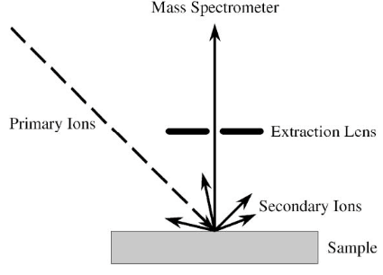
Checking the doped sample:
Secondary Ion Mass Spectroscopy vs. planned profile
Doping Profile – Compensated LGAD
Doping Density [a.u.]
Depth [a.u.]
Concentration [a.u.]
Planned: Boron:Phosp 5:4
Depth [a.u.]
▻ Boron peak is shallower than phosphorus (profiles are not aligned)
▻ Boron peak is lower than predicted from simulation

Slide 8
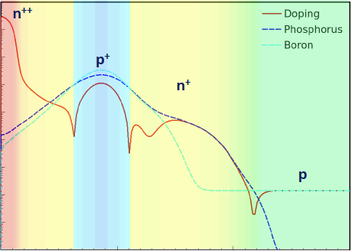
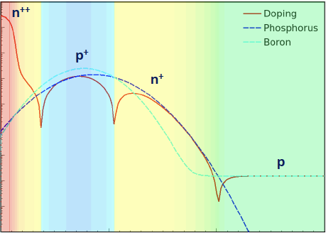
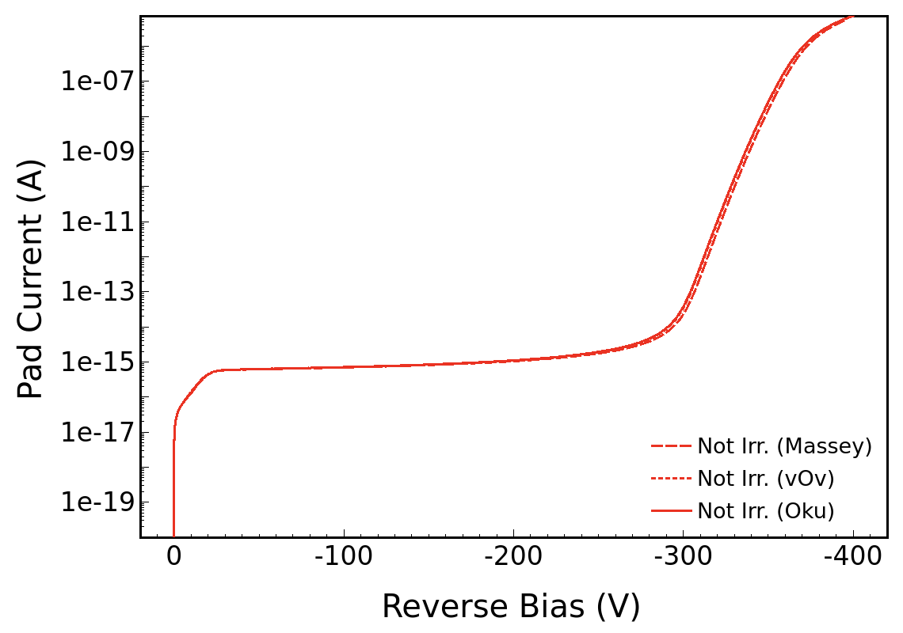
SIMS Profile & I-V – 5–4
Doping Profiles
from Process Simulation
Doping Profiles
from SIMS
Simulated I-V from SIMS Profiles
T = 293 K
Concentration [a.u.]
Concentration [a.u.]
Depth [a.u.]
Depth [a.u.]
→ The simulated I-V reproduces the trend of the measured I-V from W15

Slide 9
I-V from Compensated LGAD – Irradiated
Irradiated from 1E14 to 5E15 n_{eq}/cm²
W6
2 – 1
W12
3 – 2
W13
3 – 2 + C
W15
5 – 4
[Φ] = n_{eq}/cm²
T_{F=0} = + 20ºC
T_{IRR} = - 20ºC

Slide 10
p-in-n LGAD to determine the donor-removal coeff.
A production batch is needed to study the donor removal coefficient, c_{D}
Donor removal has been studied for doping densities of 10¹² – 10¹⁴ atoms/cm³
We need to study donor removal in the range of 10¹⁶ – 10¹⁸ atoms/cm³
→ The main goal of the p-in-n LGAD production is to study the c_{D} evolution
and its interplay with Oxygen co-implantation
NB: Oxygen has for donor removal a very similar effect of
as carbon for the acceptor removal.
First and second p-in-n LGAD (NLGAD) batches produced by CNM
p⁺⁺
n⁺
n
n⁺⁺
p-in-n LGAD

Slide 11


Project Flow
Deliverables:
1. simulation and design of the p–n compensated gain implant (M6) – DONE
2. production of p–n compensated sensors (M12) – DONE and n-doped sensors (M24) –
3. identifications of the best parameters to manufacture compensated LGADs (M36) – pending
Colour code: fully coloured – planned, translucent – actual.

Slide 12

Summary on the eXFlu-innova
The eXFlu-innova activities are ongoing
▻ The p⁺–n⁺ design has been completed – Deliverable 1 🎯
▻ The p⁺–n⁺ production batch has been completed – Part of Deliverable 2 🎯
▻ The characterisation and testing on the p⁺–n⁺ sensors is almost complete 🎯
▻ The p-in-n LGAD batch is about to start ⏳
→ Some delay in the eXFlu-innova activities
An ERC Consolidator Grant awarded to further develop compensated LGAD sensors
Doping Compensation in Thin Silicon Sensors:
the pathway to Extreme Radiation Environments
CompleX

Slide 13
Project: SiEM
Thin Silicon Sensors for Extreme Fluences
Make Si sensors radiation tolerant by using a thin bulk, internal amplification and using a gain implant that would withstand a factor of 50 higher fluences than what is presently available.
The Silicon Electron Multiplier, a new approach to charge multiplication in solid state detectors
Make Si sensors radiation tolerant by a novel biasing method – electrodes embedded in silicon.
Development of fine-sampling calorimeters with nanocomposite scintillating materials
Develop a new generation of fine-sampling calorimeters that use innovative scintillating materials based on perovskite nanocrystals dispersed in a plastic matrix to form fast (~100ps) and radiation resistant (~1 MGy) scintillators.
Wireless Data Transfer for High-Energy Physics Applications
Develop mm-wave-based wireless communication as an alternative to optical and wired links in a HEP-like environment to reduce the material and optimize the read-out.

Slide 14

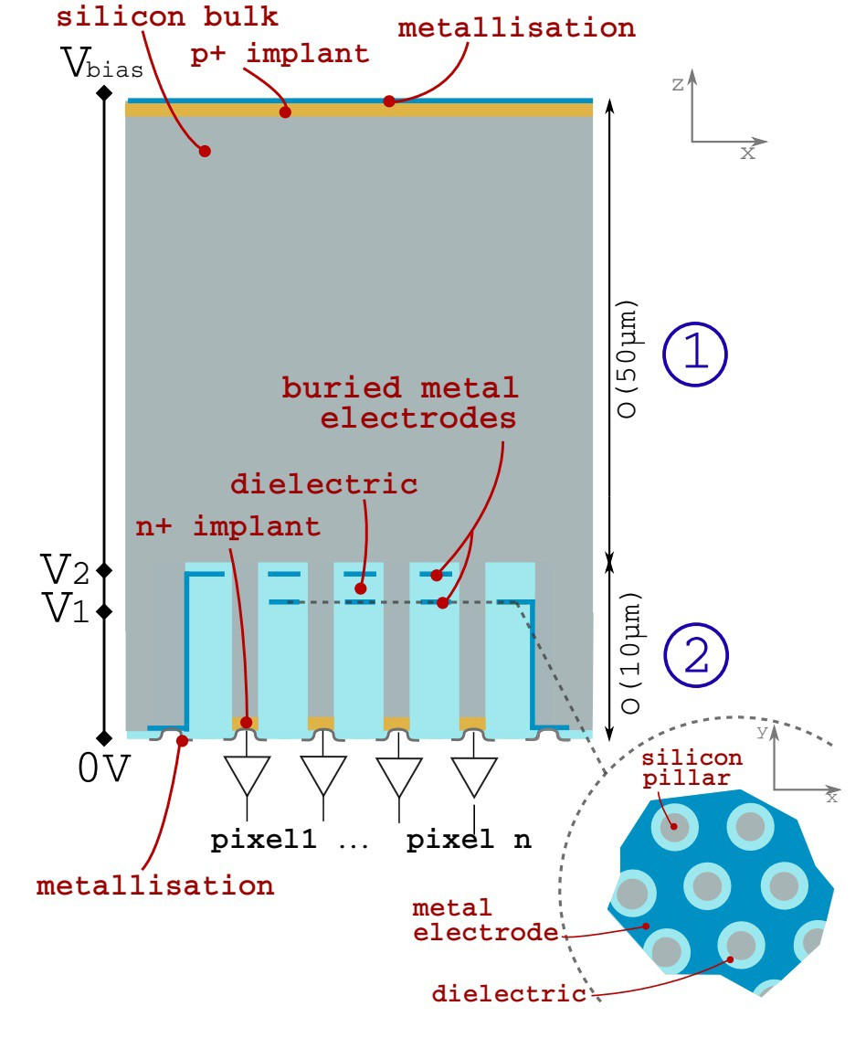
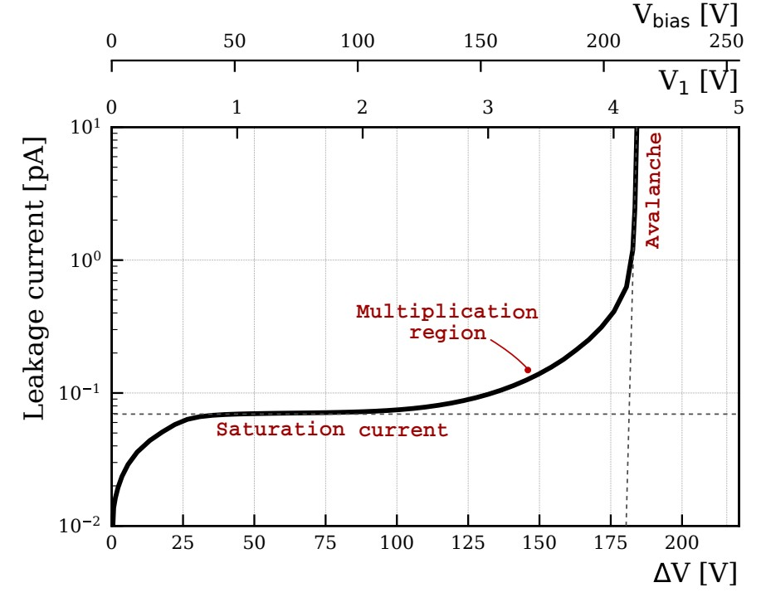
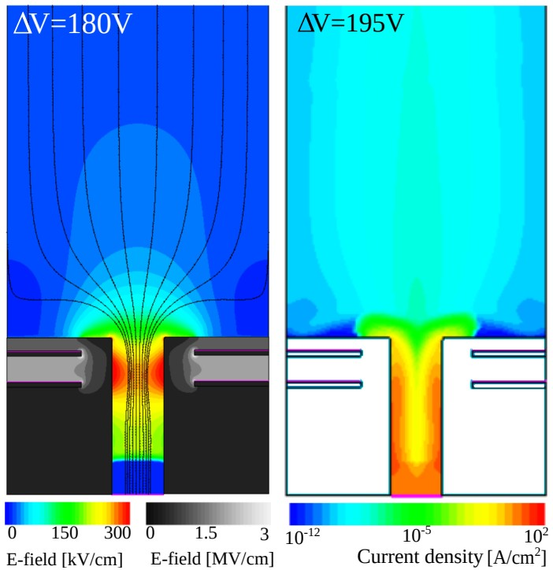
Silicon Electron Multiplier
(SiEM) principle
The Silicon Electron Multiplier (SiEM) is a novel sensor concept.
Internal gain and fine pitch --> excellent time and spatial resolution.
Divided in two regions: 1. conversion and drift layer, 2. amplification layer.
Gain mechanism --> impact ionization applying a ΔV in embedded electrodes deposited in a trench, surrounding a Si pillar.
No gain-layer deactivation is expected with radiation damage, expected to withstand fluencies up to 10¹⁶ neq/cm².

Slide 15


PLANNING TOWARDS DEMONSTRATOR
2022
2023
2024
2025
[1] Definition of design rules:
Process
Matching
Test structure
[2] Demonstrator design:
Device Simulations
Device
[3] Demonstrator production:
Demonstrator
[4] Demonstrator characterization:
Demonstrator
[5] Advanced technologies investigation:
Investigation of alternative process, material etc...
[6] Roadmap document:
Roadmap document
Demonstrator: process based on DRIE - Deep reactive ion etching
FEDERICO DE BENEDETTI - AIDAINNOVA 3RD ANNUAL MEETING

Slide 16


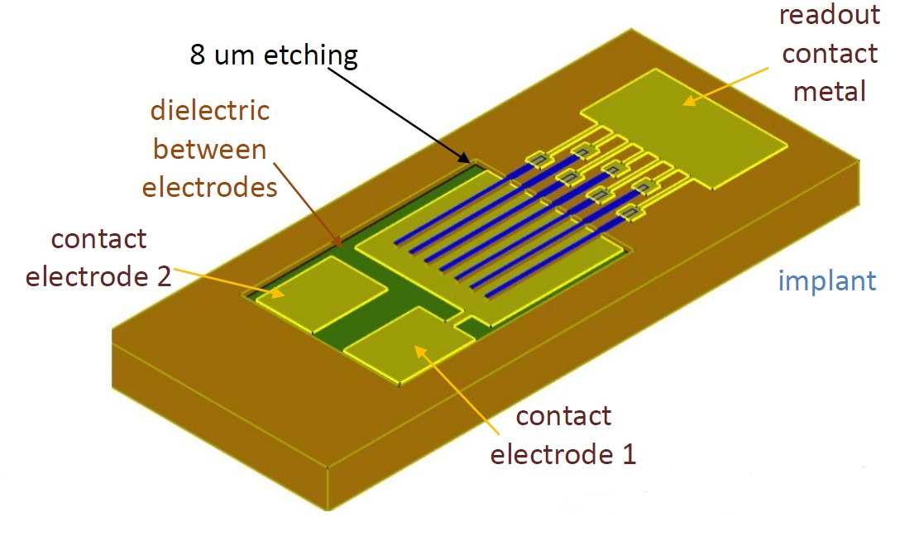
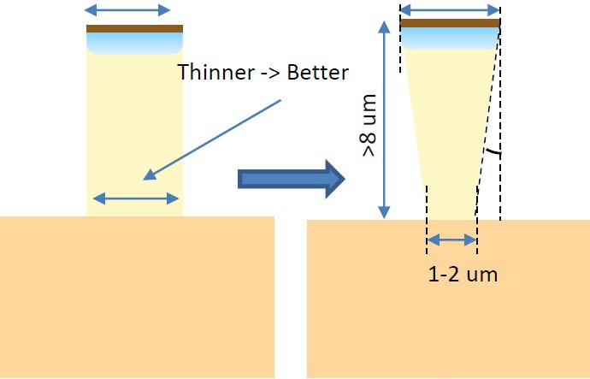
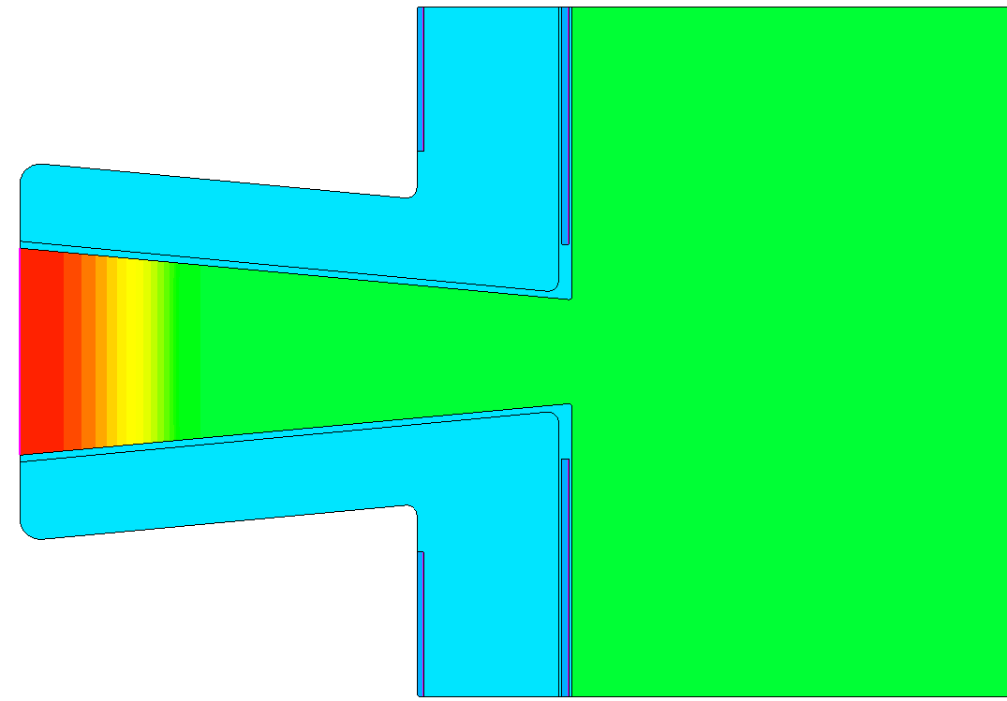
DRIE DEMONSTRATOR
(Deep reactive ion etching )
2/3/4 um
Demonstrator as a PoC manufactured by CNM.
  Strip with two embedded electrodes design, wire bond pads connect strips in parallel.
Trenches:
  Laser photolithography, Si trenches etched (DRIE - Deep reactive ion etching ).
Electrode deposition:
  ALD 50 nm HfO2, metal deposition, ALD 50 nm HfO2, SiO2 deposition, electrode 2.
Challenges:
  The oxide layer can induce stress, limiting the gap between electrodes 1 and 2.
  Etching limited in width depending on the patterning process used:
    Laser photolithography down to 2 um.
      Fast prototyping and good flexibility.
Require pyramidal profile to achieve best multiplication performance.
Electron beam lithography (adjustment needed).
Shallow electrode
Deep electrode
Si
Readout electrode
SiO2
FEDERICO DE BENEDETTI - AIDAINNOVA 3RD ANNUAL MEETING

Slide 17

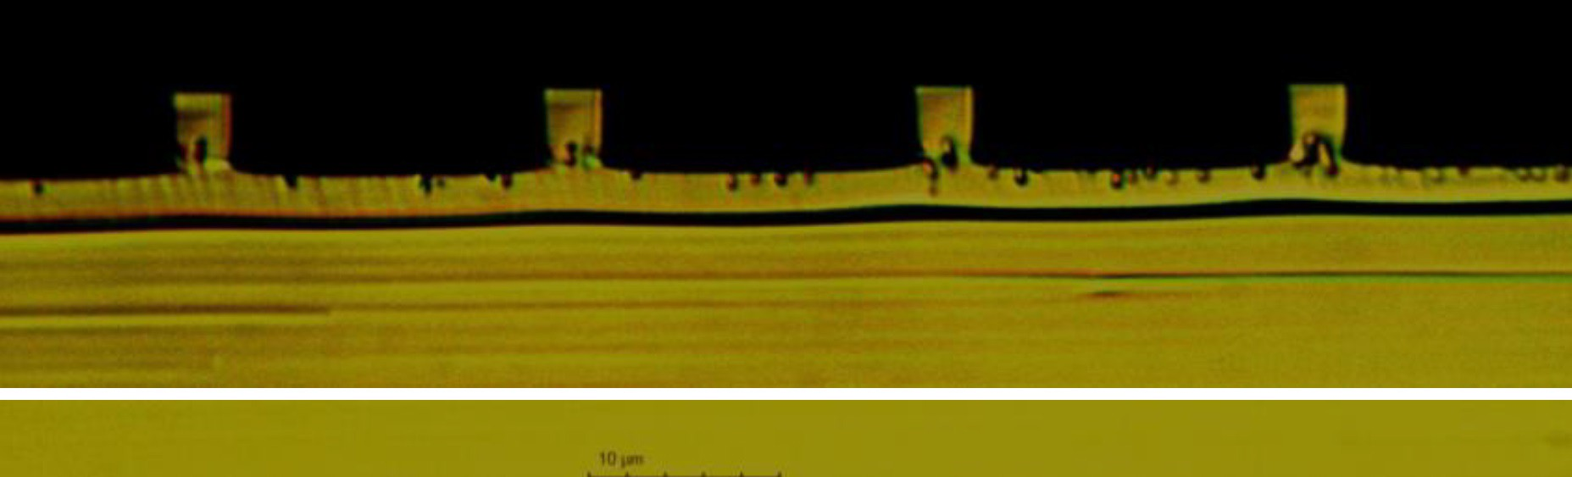


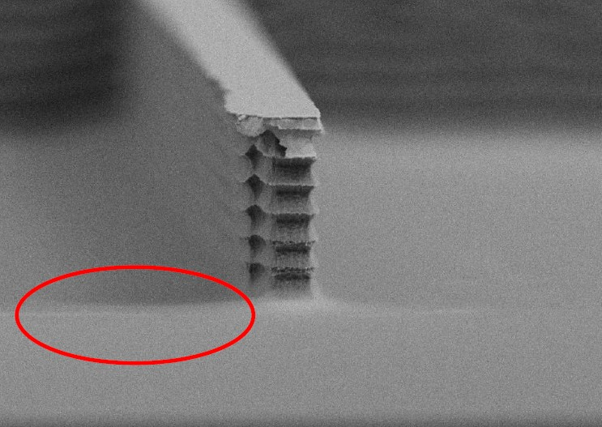
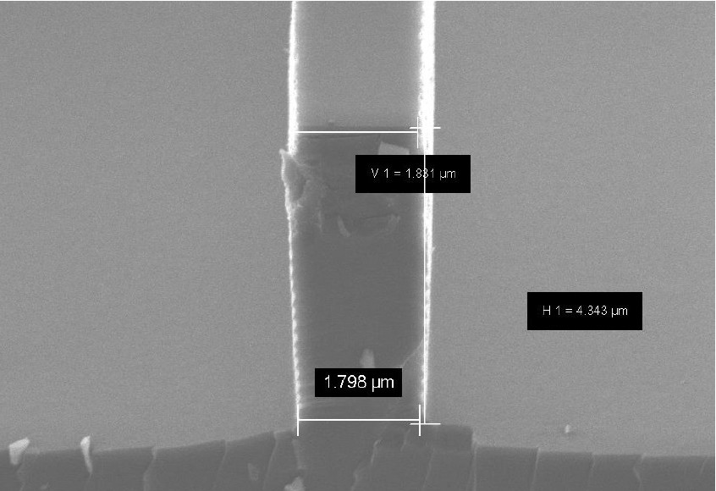
DRIE ITERATIONS
1st batch over etched:
  Trench 25 um instead of 8 um.
2nd batch improved etching:
  Test B: 9 um, test C: 8.41 um.
  Pillars thinner than nominal 1.7 um, some were broken.
  No pyramidal shape.
3rd batch closer to specs:
  Pyramidal shape achieved but rough walls.
  Slightly over etched due to thin photoresist (unexpected).
  Curved profile at the pillar base due to etching.
Recipes closer to the goal profile:
  May require minor adjustments.
  Some curved profile in the base from etching process.
  Goal is to achieve 2/3/4um on top and 1um on bottom.
3rd batch
FEDERICO DE BENEDETTI - AIDAINNOVA 3RD ANNUAL MEETING

Slide 18


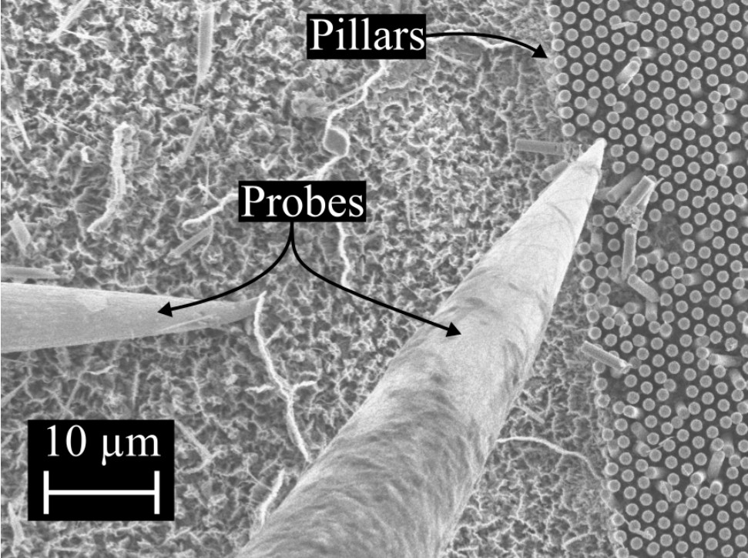
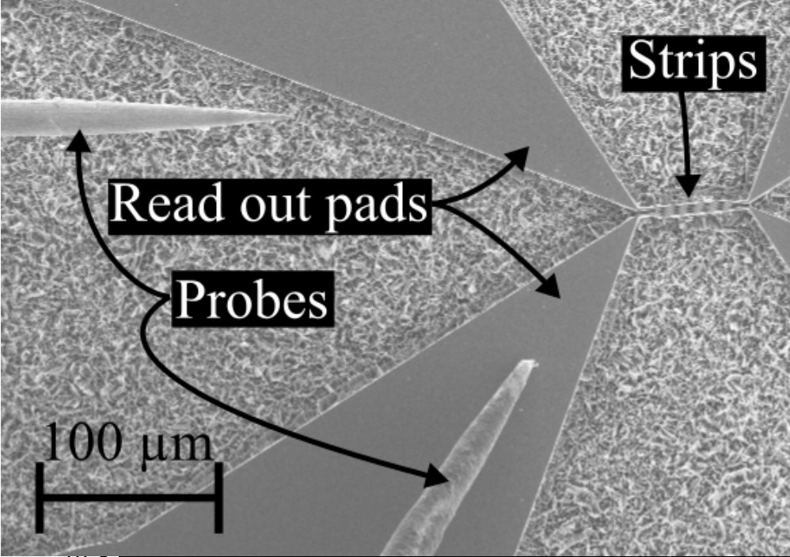


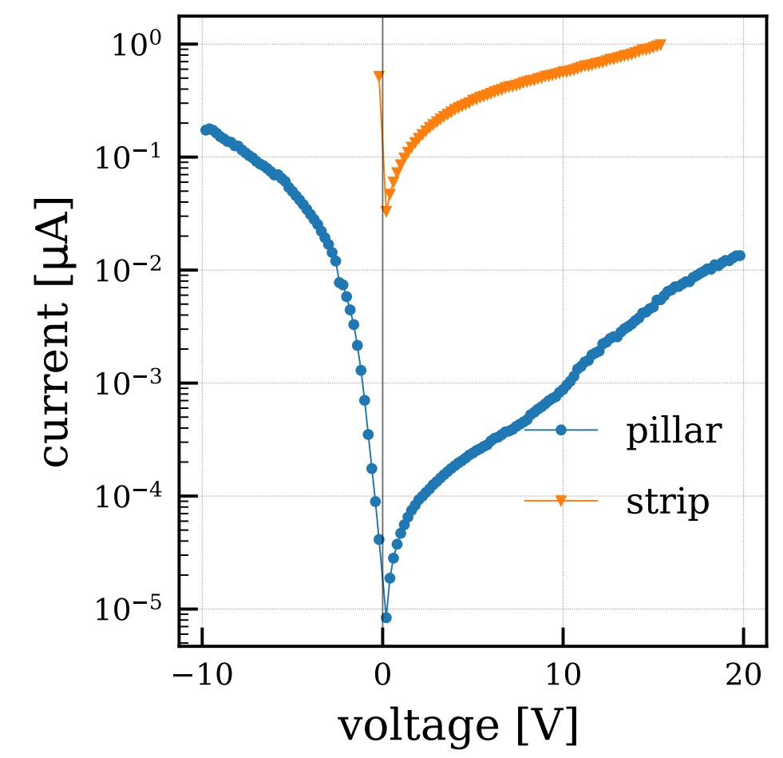
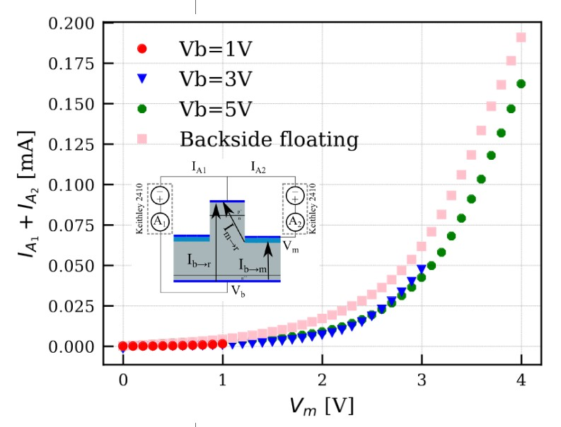
ADVANCED TECHNOLOGIES INVESTIGATION - MACETCH
Study possible use of Metal assisted etching:
  Parallel project between CERN and PSI, based on AdEM 22 (2020) 2000258.
  Very different process constraints (cheap, high aspect ratio, first electrode deposited while etching).
  Fast development.
  Samples manufactured on n on p wafers
  One gain electrode structure with metal in contact with Si (no SiO2).
  Strips and pillar geometries.
  Published NIM A 1060 [2024] 169046
Testing the structures:
  IV just after production with probe station pn junction conserved.
  Bonding of test structures to a carrier board.
  IV done in the lab using 16 Channel board V1 from backside electrode and multiplication electrode.
  Preparing setup for laser/test beam.

Slide 19
SiEM: SUMMARY AND OUTLOOK
Electron Multiplier concept on Silicon Radiation allows charge multiplication, not relying on high doping implantation.
Mechanism depends on geometry only --> not sensitive to acceptor removal.
Additional geometries under simulation to match CNM production process.
CNM DRIE demonstrator production is ongoing, the first samples expected in a few months.
Alternative approaches to the SiEM geometry are being studied using metal assisted etching.
Lab characterization setup to be prepared and commissioned (laser and 16 channel boards).
Integration with TimePix4 telescope under study.

Slide 20
Project: NanoCal
Thin Silicon Sensors for Extreme Fluences
Make Si sensors radiation tolerant by using a thin bulk, internal amplification and using a gain implant that would withstand a factor of 50 higher fluences than what is presently available.
The Silicon Electron Multiplier, a new approach to charge multiplication in solid state detectors
Make Si sensors radiation tolerant by a novel biasing method – electrodes embedded in silicon.
Development of fine-sampling calorimeters with nanocomposite scintillating materials
Develop a new generation of fine-sampling calorimeters that use innovative scintillating materials based on perovskite nanocrystals dispersed in a plastic matrix to form fast (~100ps) and radiation resistant (~1 MGy) scintillators.
Wireless Data Transfer for High-Energy Physics Applications
Develop mm-wave-based wireless communication as an alternative to optical and wired links in a HEP-like environment to reduce the material and optimize the read-out.

Slide 21
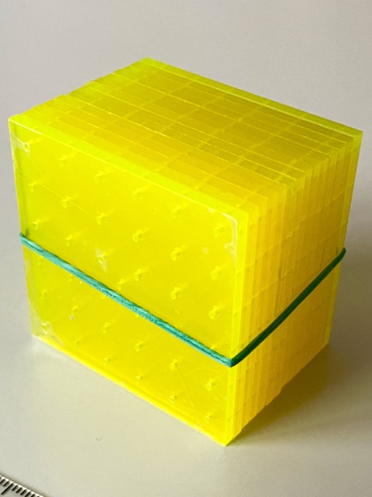
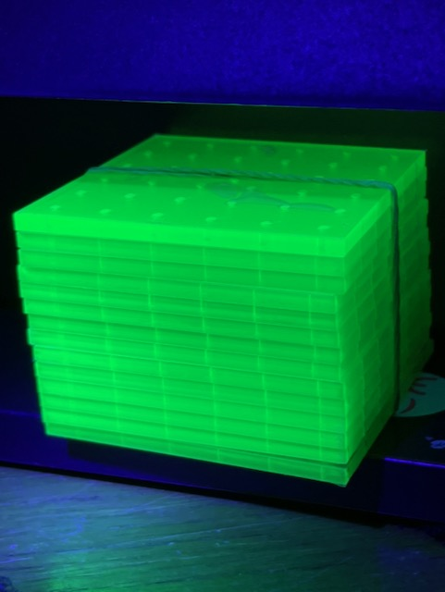
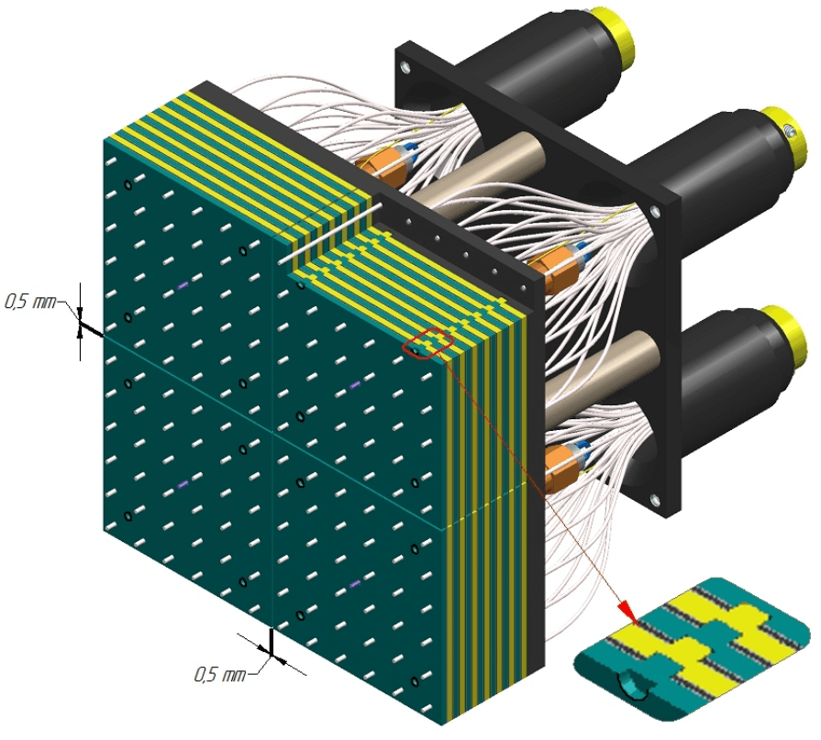
Nanomaterial composites (NCs)
Semiconductor nanostructures can be used as sensitizers/emitters for ultrafast, robust scintillators:
Perovskite (ABX₃) or chalcogenide (oxide, sulfide) nanocrystals
  Cast with polymer or glass matrix
  Decay times down to O(100 ps)
  Radiation hard to O(1 MGy)
Despite promise, applications in HEP have received little attention to date
No attempt yet to build a real calorimeter with NC scintillator and test it with high-energy beams
Shashlyk design naturally ideal as a test platform:
Easy to construct a shashlyk calorimeter with very fine sampling
Primary scintillator and WLS materials required: both can be optimized using NC technology
KOPIO/PANDA design
Fine-sampling shashlyk

Slide 22
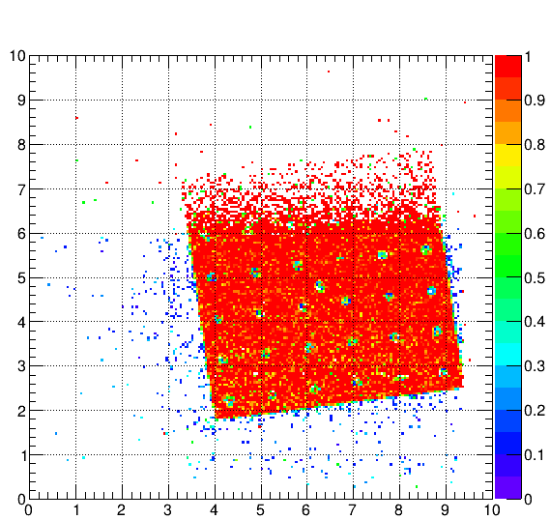
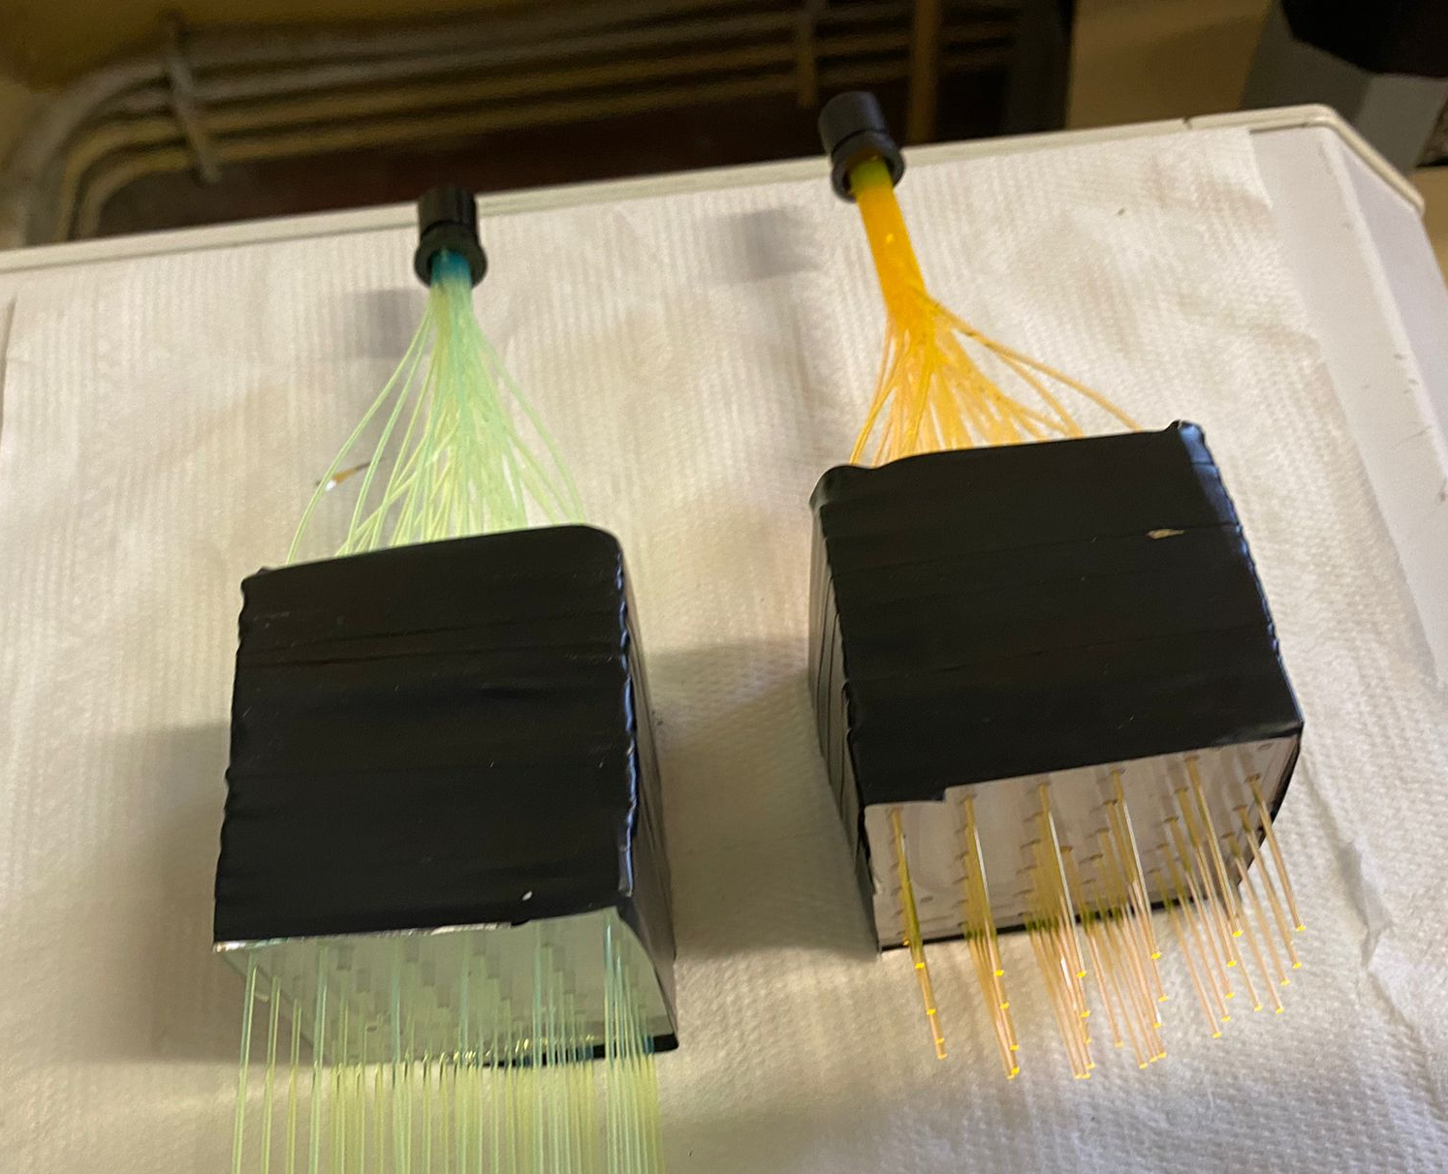
NanoCal project status April 2023
Schedule:
Oct 2022: First shashlyk component test at CERN: fibers/tiles/SiPMs
2023: Further iterations to improve performance of NC scintillator prototype
2024: Construction of full-scale shashlyk modules; performance comparison
Oct 2022 test: SPS H2 beamline
e⁻ and π⁺ with beam tracking
Conventional
NanoCal
y [cm]
x [cm]
2 prototypes with 12 fine sampling layers
1.3X₀ in depth: MIP deposit = 10 MeV
Known formulation for NC scintillator:
0.2% CsPbBr₃ in UV-cured PMMA
  50% of light emitted with τ < 0.5 ns
Conclusion of 2022 test:
NC prototype seems to work but with low light yield and many open questions

Slide 23
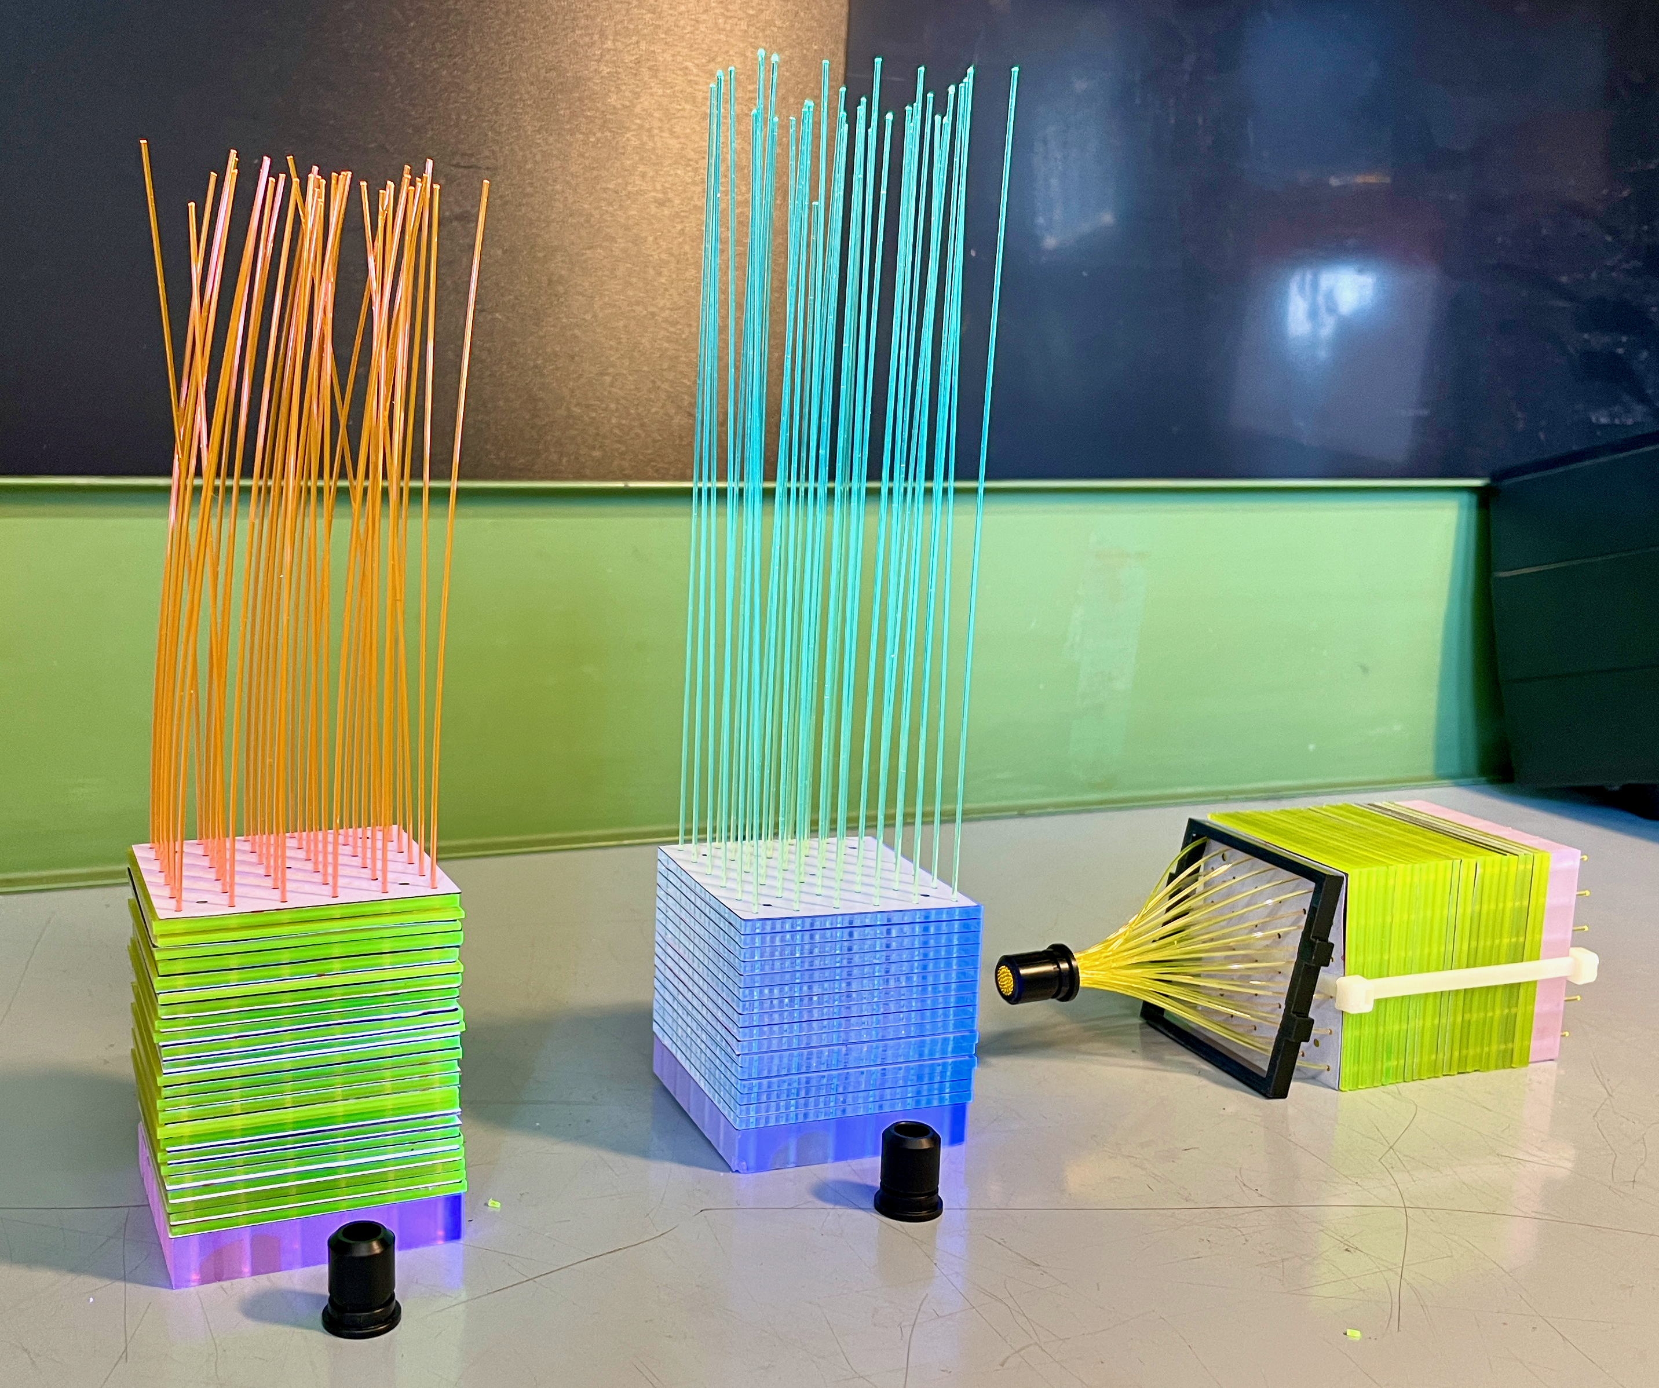
New prototypes for summer 2023 tests
Prototypes tested in PS T9, June 2023:
Conventional scintillator (Protvino), Y-11 fibers
Conventional scintillator (PVT + BTP 0.02%), Y-11 fibers
PMMA + CsPbBr₃ 0.2%, O-2 fibers
PMMA + CsPbBr₃ 0.2%, custom NCA-1 fibers
PMMA + CsPb(Br,Cl)₃ + coumarin-6, NCA-1 fibers

Slide 24
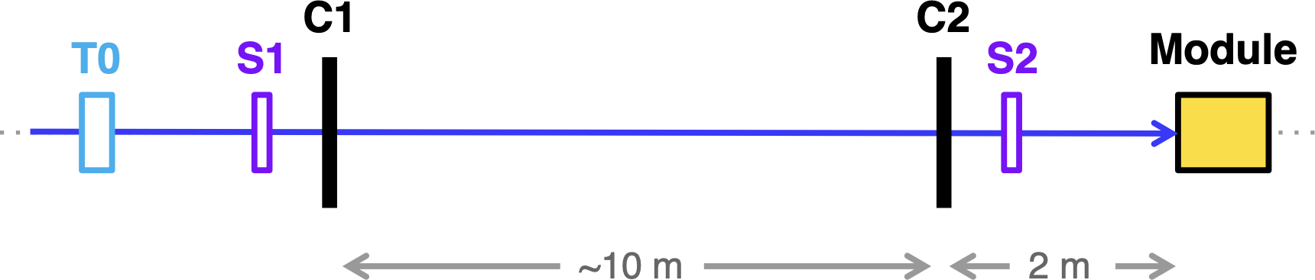
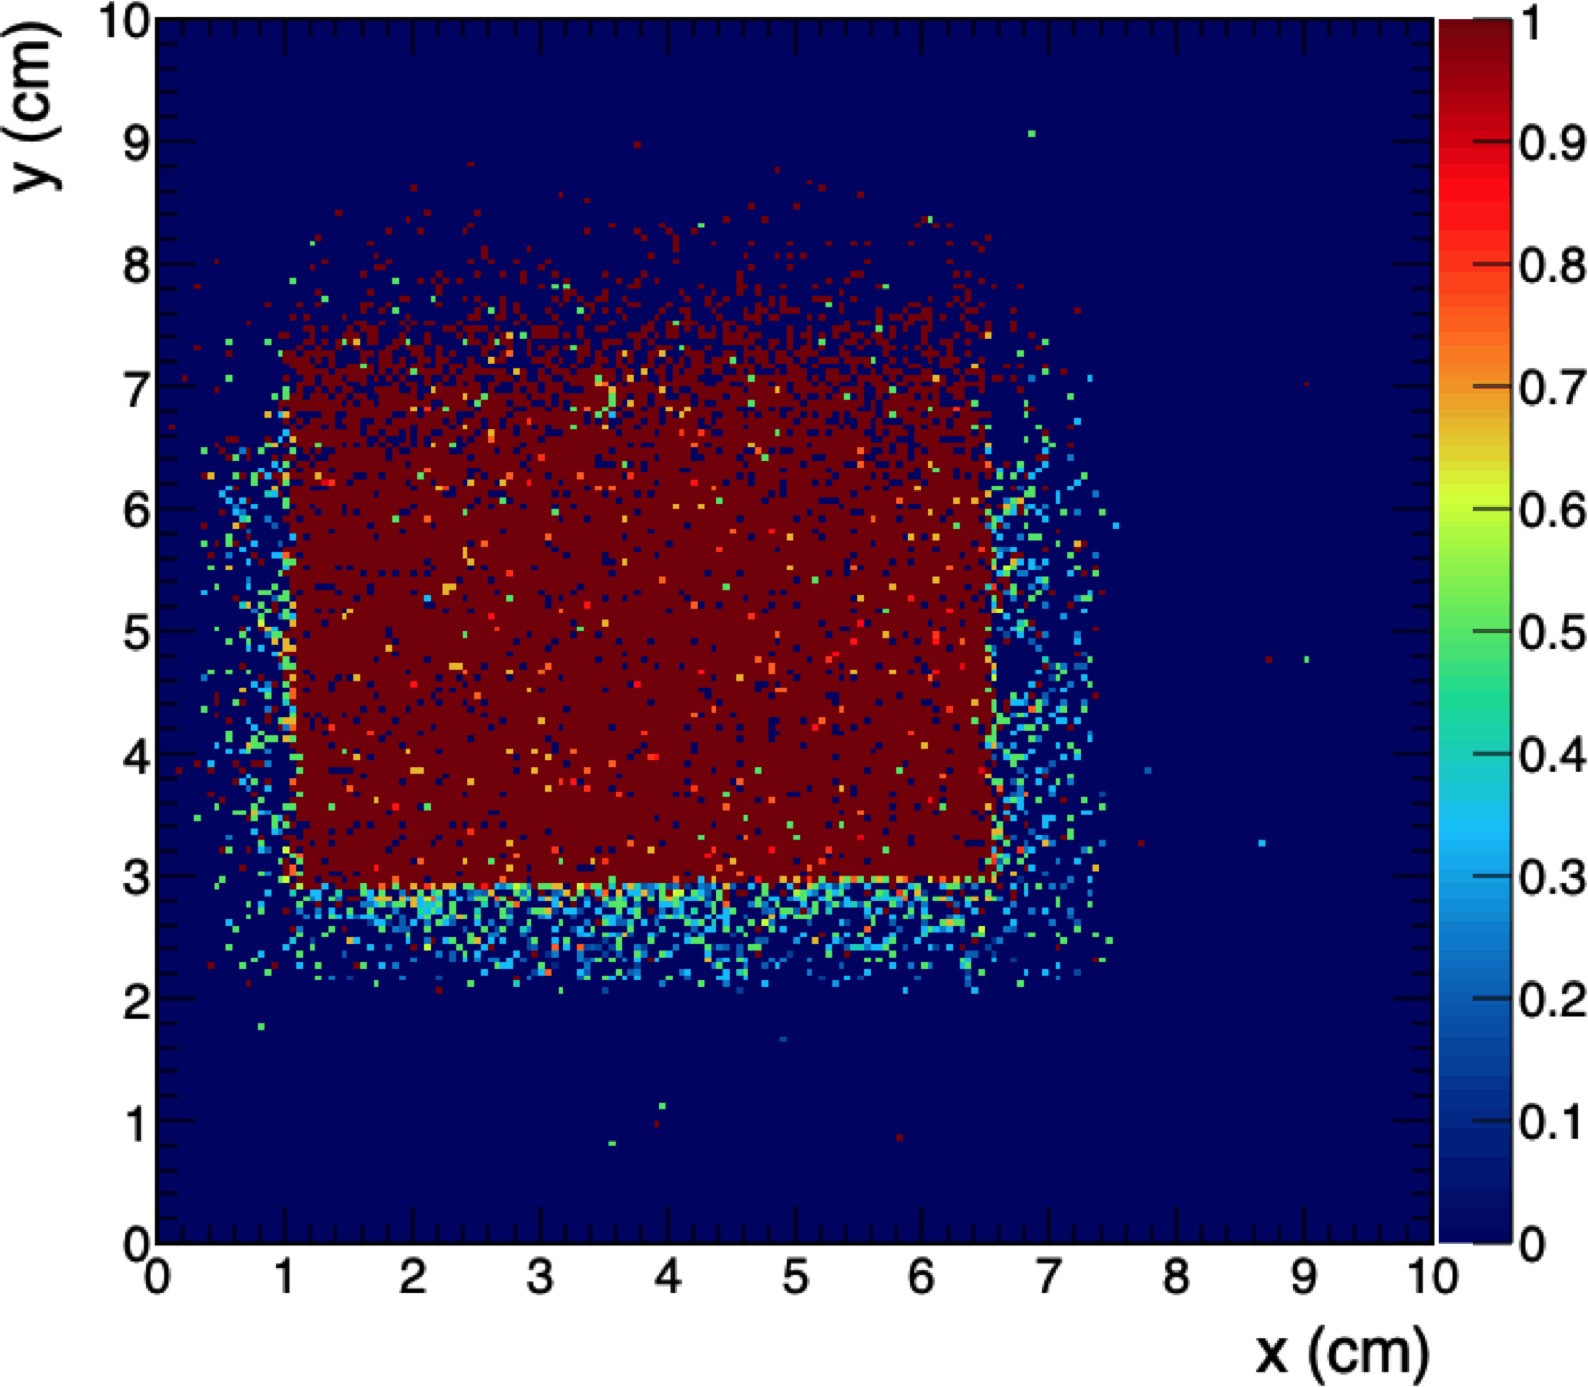
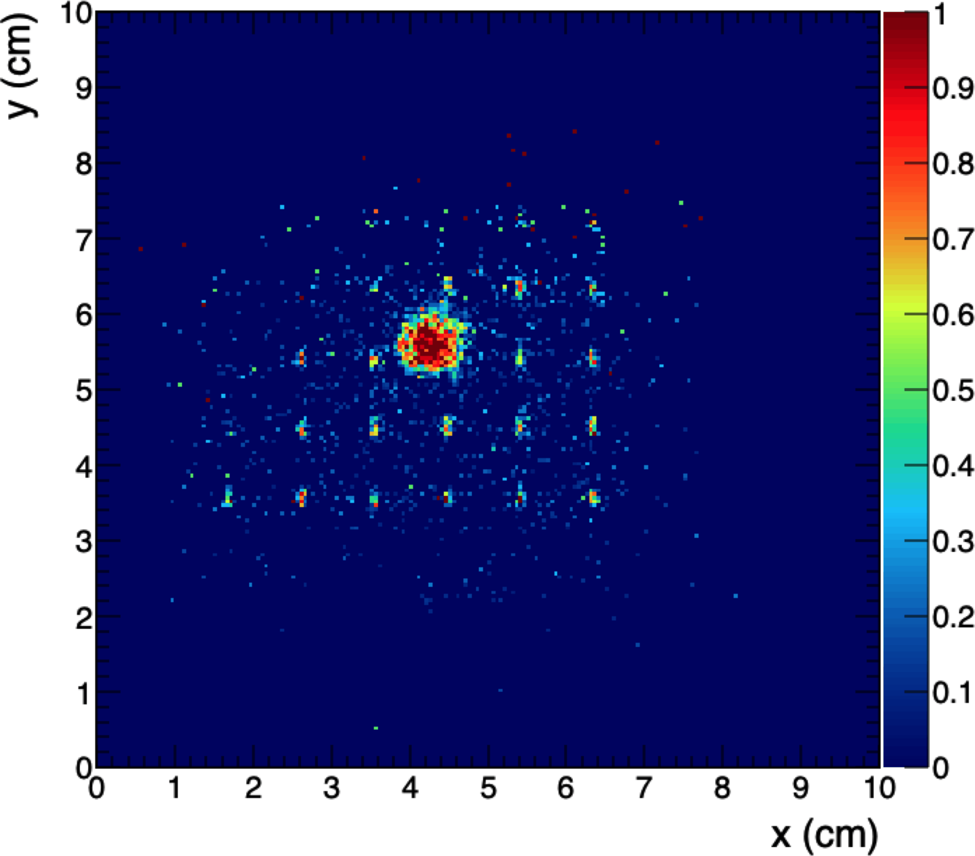
NanoCal setup and T9 test results
Electron beam, 1, 2, 4 GeV
MIP beam (μ⁻ or π⁻), 10 GeV
Cerenkov ID for e/μπ/p
T0 Time reference detector
S1, S2 Trigger scintillator paddles
C1, C2 Si strip tracking chambers, 10×10 cm²
Module Module to be tested
For each prototype:
MIP response, efficiency
e⁻ response
Time resolution
Efficiency maps with 10 GeV μ, threshold = 5σ_{noise}
Disappointing result from new nanocomposite: only light is from readout fibers!
Protvino
CsPb(Br,Cl)₃ + WLS

Slide 25
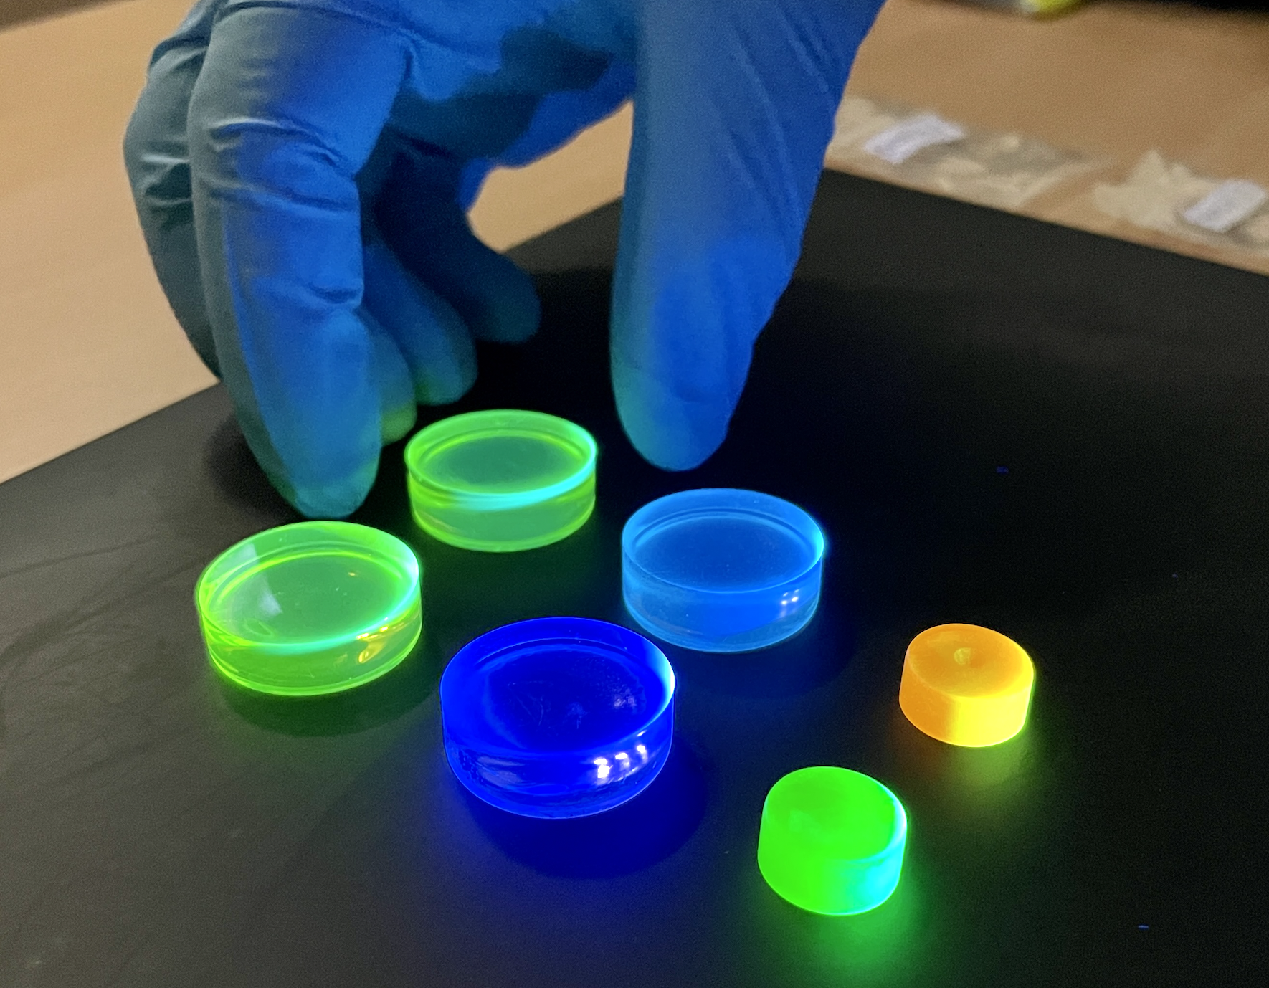
New samples for fall 2023 tests
Still many good ideas for the next steps
Direct synthesis of CsPb(Br,Cl)₃ to preserve surface passivation
Use of an aromatic matrix material, e.g., PVT as in conventional scintillator
  First formulations use PMMA: gives no primary scintillation contribution
  Now have new protocol to use perovskites with thermally polymerized matrix, with or without additional WLS
New samples synthesized and tested in fall 2023:
All samples 90:10 PVT/DBV matrix with 1.5% PTP as primary dye
Protvino B | 0.04% POPOP
Bicocca 1 | 0.04% benzothiophene (BTP)
Bicocca 2 | 0.04% coumarin-6
Bicocca 3 | 0.04% BTP + 0.04% coumarin-6
Bicocca 4 | 1% Yb:CsPbBr3
Bicocca 5 | 1% Yb:CsPbBr3 + perylene dyad
Bic 3
Bic 1
Bic 2
Bic 5
Protvino B
Bic 4

Slide 26
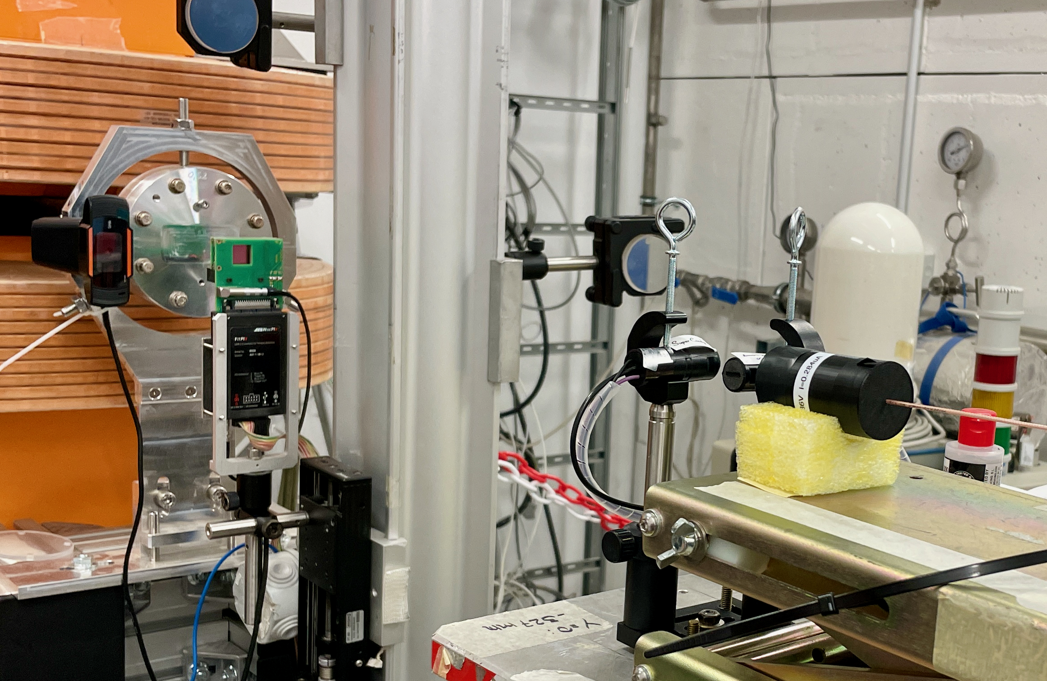
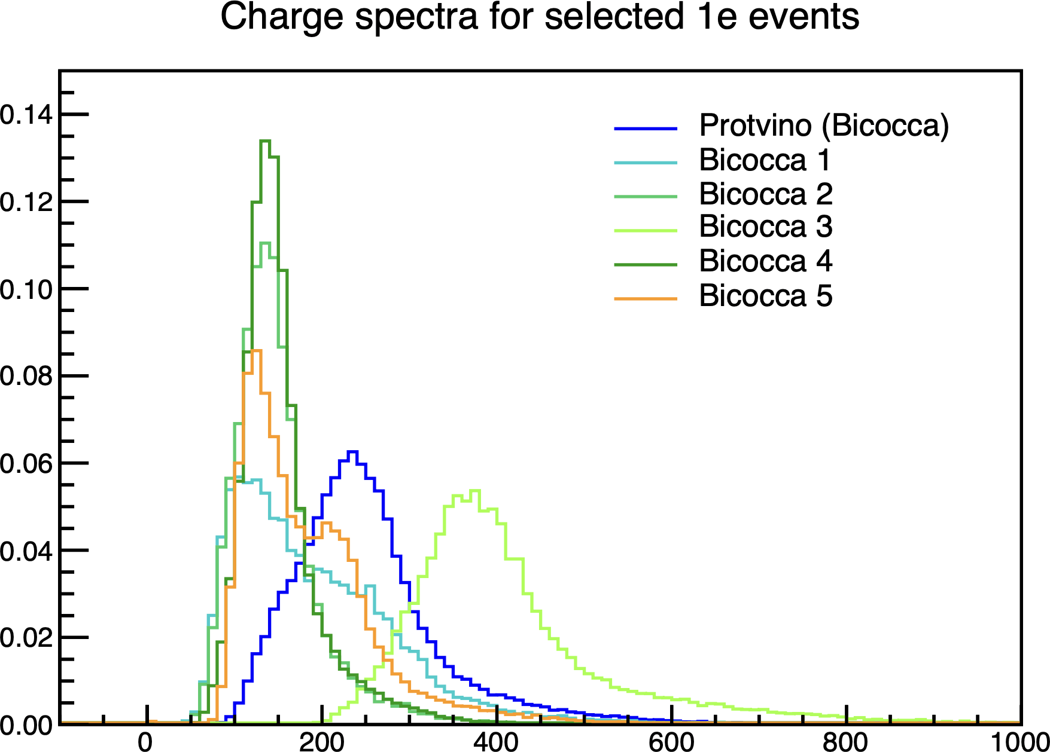
Light yield tests with new samples
Frascati BTF, Nov 2023
Tests with mip and e⁻ beams:
CERN T9 Oct 2023 | 6, 10 GeV electrons 10, 15 GeV hadrons/mips
Frascati BTF Nov 2023 | 450 MeV electrons Similar to mips for small samples
Reference sample:
  1.5% PTP + 0.04% POPOP in PVT (“Protvino”)
Bicocca 4, 5: CsPbBr₃:Yb in PVT
  ~50% lLY of ref. sample
  Our first nanocomposites with good mip response!
Bicocca 3: Coumarin-6 in PVT with PTP + BTP
  ~160% LY of ref. sample!
Normalized counts
Normalized charge spectra
Single 450 MeV e⁻ events
Frascati BTF, Nov 2023
Charge [pC]

Slide 27
NanoCal: Outlook
By summer, we should have complete results from spectroscopy, cosmic rays, sources, and Frascati BTF electrons for all samples
Better setup for measurements with cosmic rays and beams:
New laboratories in Frascati and Napoli, new sample holders with better optical coupling, easier sample handling, electronics with reduced noise, new DAQ system for digitizers, addition of Medipix-2 pixel detector to BTF setup for multiplicity counting
The survey will allow us to identify the best candidate(s) for a small prototype to be tested with mips and electrons in CERN PS T9 in September 2024:
Isolation of contributions from nanocrystals and dyes and a better understanding of how NC scintillators work
Survey now in progress with cosmic rays, sources, and mip and electron beams, with improved measurement setup, to obtain:
Identification of most promising candidates for prototyping
Better understanding of how NC scintillators work
Original polyacrylate/CsPbBr₃ formula originally very promising in radioluminescence and photoluminescence studies, but light output is very small for single mips
Project focus shifted from prototyping to sample characterization to explore ideas for better NC scintillators for HEP:
NCs with WLS shifting dyes
Thermally polymerized NCs with aromatic matrix materials
NC scintillators with higher concentrations of nanocrystals

Slide 28
Project: WADAPT
Thin Silicon Sensors for Extreme Fluences
Make Si sensors radiation tolerant by using a thin bulk, internal amplification and using a gain implant that would withstand a factor of 50 higher fluences than what is presently available.
The Silicon Electron Multiplier, a new approach to charge multiplication in solid state detectors
Make Si sensors radiation tolerant by a novel biasing method – electrodes embedded in silicon.
Development of fine-sampling calorimeters with nanocomposite scintillating materials
Develop a new generation of fine-sampling calorimeters that use innovative scintillating materials based on perovskite nanocrystals dispersed in a plastic matrix to form fast (~100ps) and radiation resistant (~1 MGy) scintillators.
Wireless Data Transfer for High-Energy Physics Applications
Develop mm-wave-based wireless communication as an alternative to optical and wired links in a HEP-like environment to reduce the material and optimize the read-out.

Slide 29
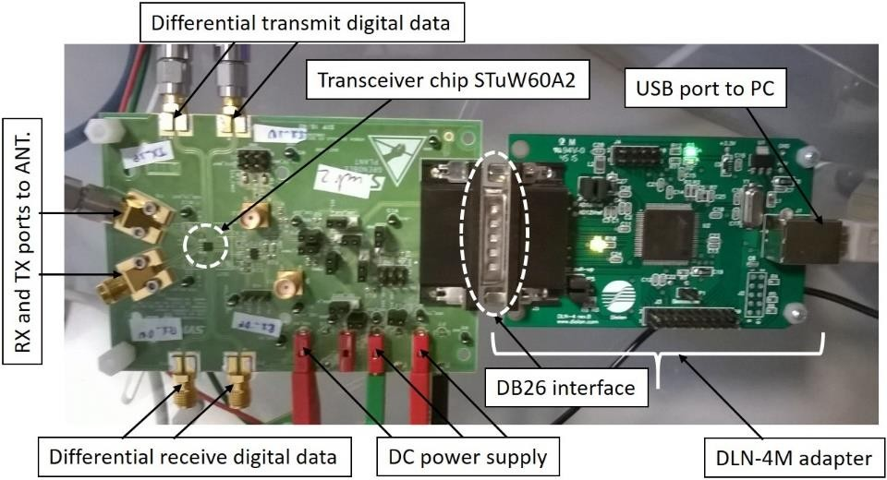
Wireless Data Transfer for HEP Applications
Study of components and antennas integration
Full link demonstrator(s) from 1 tile to 2 and 3 tiles – several mock-ups to be tested
Use and integrate commercially available components
Study the performance of the system (data rate, bit error rate, modulation schemes, usage of bandwidth, crosstalk in repeater, etc.)
Outer enclosure
Layer C
Layer B
~10 cm
Layer A
Debit 1 Gbps per layer and is cumulative, thus
it will be reaching 3 Gbps at the outer enclosure.
Courtesy of CEA-Letti and
STMicroelectronics

Slide 30
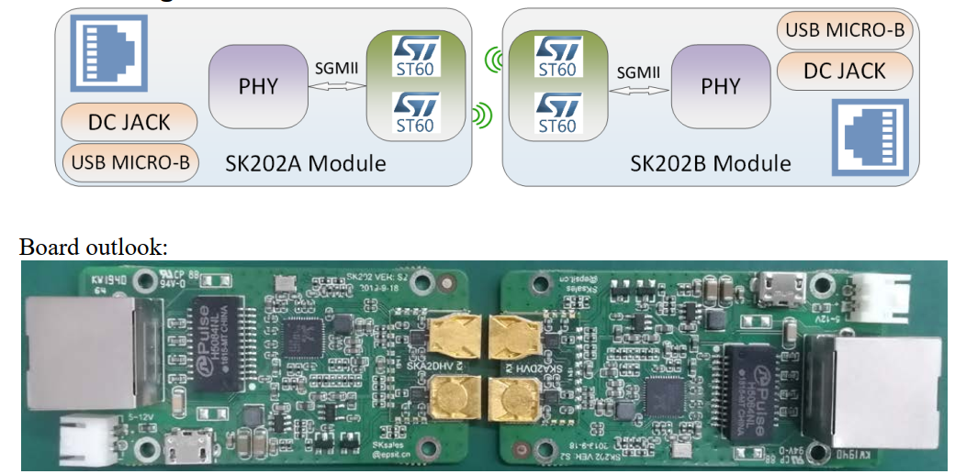
SK202 boards (employing ST-60 GHz transceiver chip)

Slide 31
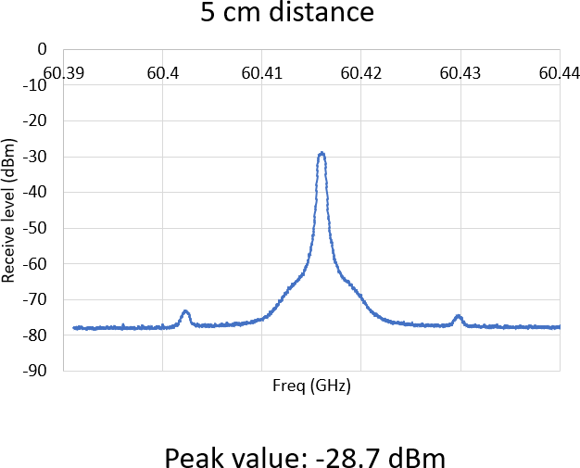
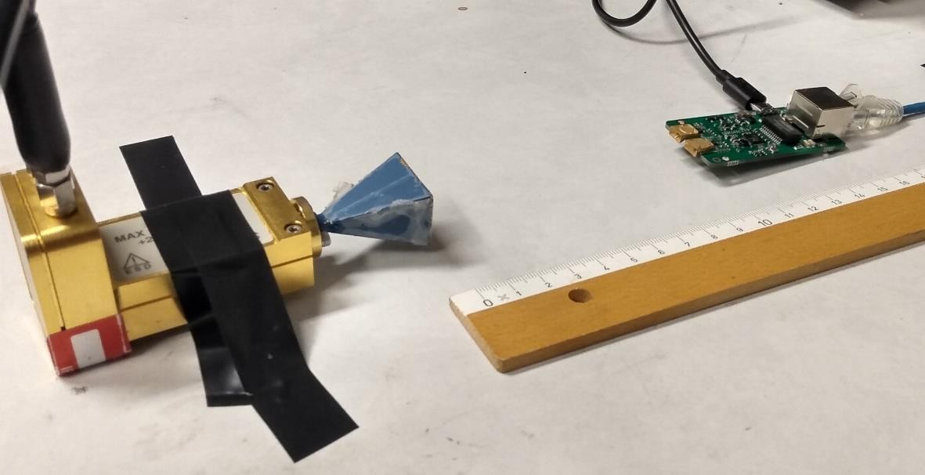
SK202: radiation power measurements
Power measurements of the SK202 board to horn antenna harmonic mixer with a 20 GHz spectrum analyser.
Measurements are done at different distances, i.e., 5 cm, 10 cm, 15 cm and 20 cm
distance | 5 | 10 | 15 | 20 | cm
received power | -28.7 | -31.9 | -34 | -37.8 | dBm

Slide 32
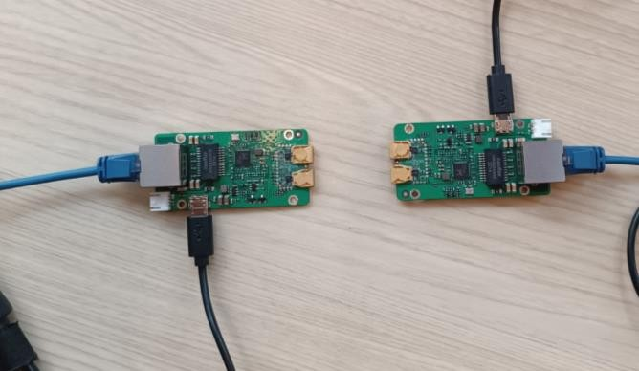
The SK202 boards don’t communicate at distances higher than 5 cm, as the receive power is not enough which is needed for the down-conversion.
Plan now is to integrate an LNA (low noise amplifier) on a new repeater mm-wave board to extend this range to 20 cm.
Reception
Re-transmission
LNA
Two amplifiers:
Gotmic gANZ0031 C V-band LNA MMIC 57-66 (52 - 72) GHz
Hittite HMC-ALH382 LNA 57-65 GHz
Both to be implemented with stud bumps as well as with wire-bond configurations
ACB Group CIBEL, France: PCB fabrication; TAI-PRO Engineering, Belgium: amplifier assembly using stud bump; Note, Norrtälje: wire bonding

Slide 33
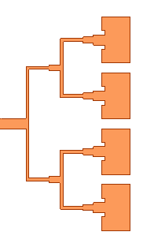
WADAPT: outlook
Measurements for newly fabricated boards are to start end of March.
Make a prototype where the LNA is integrated between the 60 GHz transceiver chip and the antenna/antenna array.
ST 60 GHz chip
LNA

Slide 34
WP13 Prospective and Technology -driven Detector R&D: summary
Summary and outlook
The four projects are well underway.
They have seen a lot of progress.
All of them have also encountered problems, but have good ideas on how to mitigate them
Planning to wrap up the projects in the final year.
All of them would find an extension of 6 months very useful.

Slide 35
Backup slides

