Slide 1
IEEE NSS
October 26-29, 2009, Orlando, Florida, USA
The ATLAS Beam Diagnostics System
Marko Mikuž
University of Ljubljana & Jožef Stefan Institute, Ljubljana, Slovenia
on behalf of the ATLAS BCM/BLM Group
Notes:
Theme created by
Sakari Koivunen and Henrik Omma
Released under the LGPL license.

Slide 2
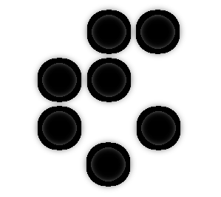
ATLAS BCM/BLM group
JSI Ljubljana
V. Cindro
I. Dolenc
A. Gorišek
G. Kramberger
B. Maček
I. Mandić
E. Margan
M. Mikuž
M. Zavrtanik
CERN
D. Dobos,
H. Pernegger,
C. Spartharakis
E. Stanecka,
P. Weilhammer
Ohio State University
H. Kagan
S. Smith
J. Moss
University of Applied
Science, Wiener Neustadt
E. Griessmayer
H. Frais-Kölbl
M. Niegl†
University of Toronto
M. Cadabeschi
E. Jankowski
D. Tardif
W. Trischuk
ATLAS BCM/BLM web page: https://twiki/cern.ch/twiki/bin/view/Atlas/BcmWiki

Slide 3
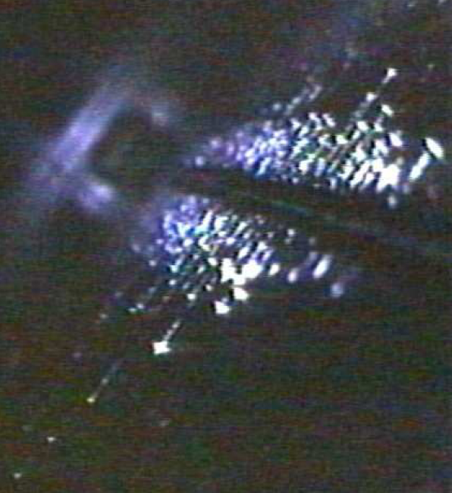
Motivation for ATLAS Beam Diagnostics
LHC equipment failure: resulting beam losses potentially dangerous to the ATLAS Inner Detector (ID)
Tevatron experience shows beam accidents DO happen
Total energy stored in a single LHC beam (2808 bunches with 10¹¹ protons of 7 TeV → 350 MJ) more than 100-times higher than in previous accelerators (Tevatron, HERA), equal to a Jumbo Jet (B-747) when landing
Time constants of magnets: order of ms;
LHC beam can be dumped within 3 turns ~ 270 μs; i.e in time to prevent beam induced damage if anomalous losses are detected early enough
Secondary collimator (stainless steel) for halo removal
Tevatron Beam accident:
caused by Roman Pot re-inserting itself in the beam after it had been issued retract commands
20-30 Tevatron turns

Slide 4
ATALS BCM and BLM Goal
Protection
Passive:
ATLAS, CMS use TAS collimators to protect from direct beam incidences
TAS (Target Absorber Secondaries) collimators: at z = ±18 m; protecting the Inner Triplet of quadrupoles from secondaries produced in p-p collisions
Active:
LHC Machine
Beam Loss Monitors (BLM), Beam Positions Monitors (BPM)... can fire beam abort
ATLAS Beam Conditions Monitor (BCM) and Beam Loss Monitor (BLM)
Designed for fast detection of early signs of beam instabilities (due to incorrect magnet settings, magnet trips, failures...)
Issue a beam abort in case of threatening beam failures
Beam Conditions Monitor - BCM
Particle counter with sub-ns time resolution
Will additionally provide a coarse relative luminosity measurement bunch-by bunch (complementary info to LUCID - ATLAS main luminosity monitor)
Beam Loss Monitor - BLM
Measurement of beam-induced ionization current

Slide 5
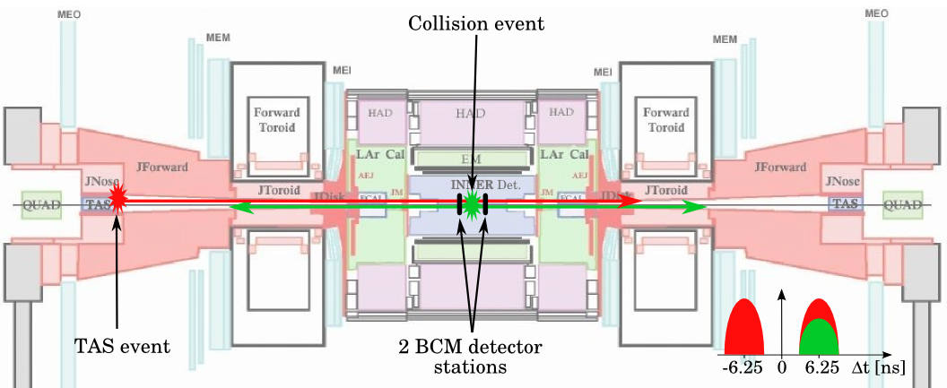
ATLAS Beam Conditions Monitor: Principle of Operation
Time of flight measurement to distinguish between collisions and
background events (beam gas, halo, TAS scraping)
Measurement every proton bunch crossing (BC = 25 ns)
Two BCM stations with 4 modules each placed symmetrically to collision point at z ~ 1.9 m:
particles from collisions reach both stations at the same time (6.25 ns after collisions )
particles from background interactions
reach the up-stream station 12.5 ns (½ BC) before particles from collisions (6.25 ns before the collision)
reach the down-stream station at the same time as particles originating from collisions
use out-of-time hits to identify background events
use in-time hits to monitor luminosity
Requirements:
fast detector & electronics:
rise time ~1ns
pulse width ~3ns
baseline restoration ~10ns
radiation hard
ionization dose ~0.5 MGy
10¹⁵pions/cm² in 10 years
MIP sensitivity

Slide 6
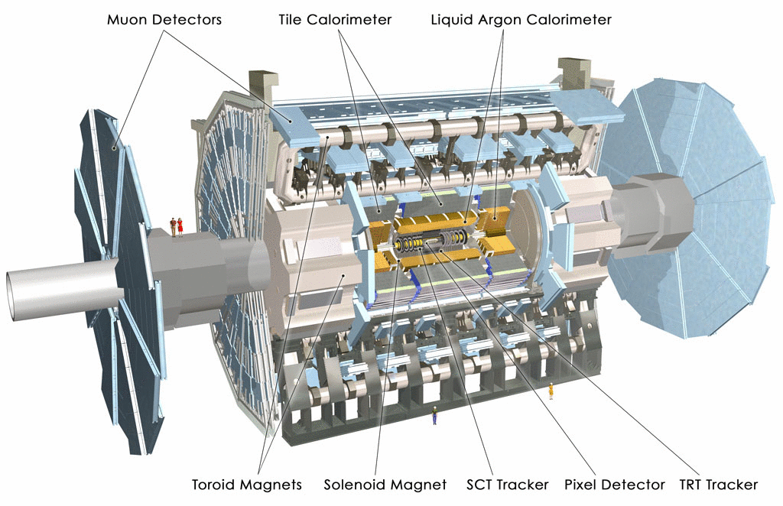
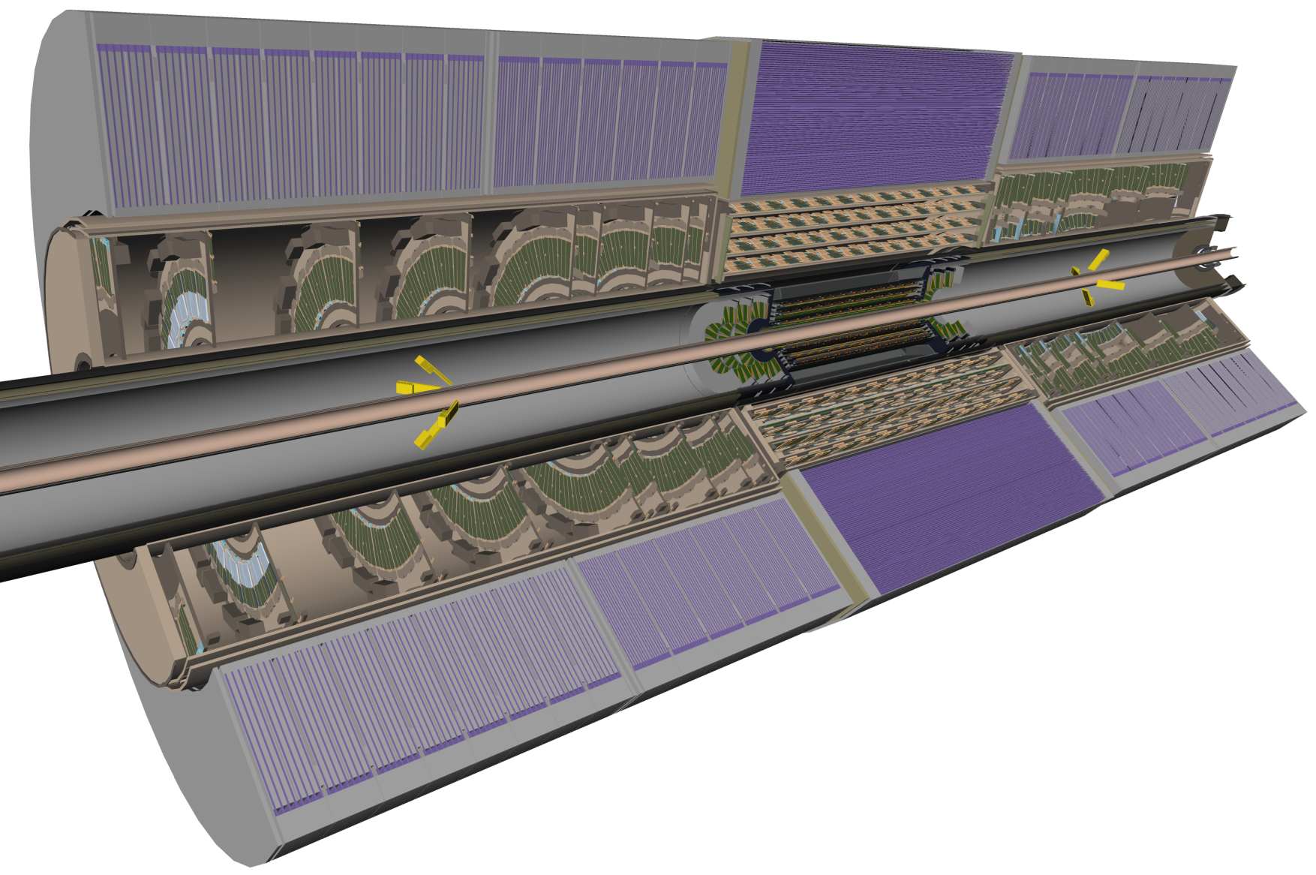
BCM: Realization
4 BCM detector modules on each side of the Interaction Point
Mounted at z=183.8cm and φ = 0º, 90º, 180º, 270º, sensors at r  5.5cm (  4.2)
Tilted at 45º to the beam pipe
ATLAS Inner
Detector
TRT
ATLAS
SCT
Pixel
Courtesy of
T. Kittelmann
BCM detector
modules

Slide 7
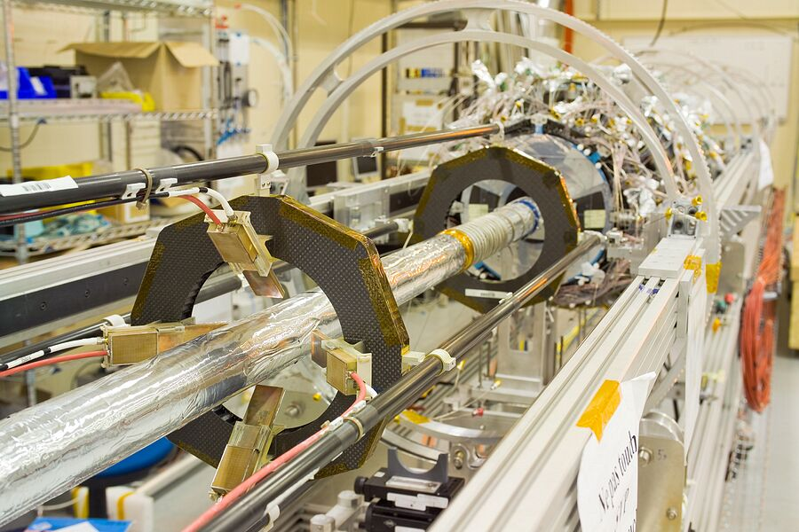
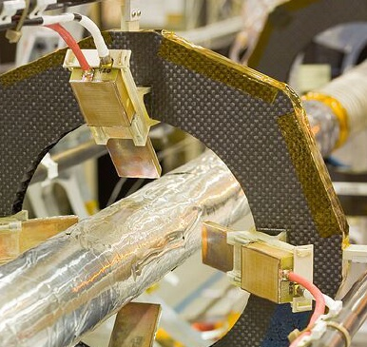
BCM: Detector Module Installation
BCM modules were installed on pixel Beam Pipe Support Structure (BPSS) in November 2006 and lowered into ATLAS pit in June 2007
Beam
Pipe
BCM
module
Pixel
Detector

Slide 8
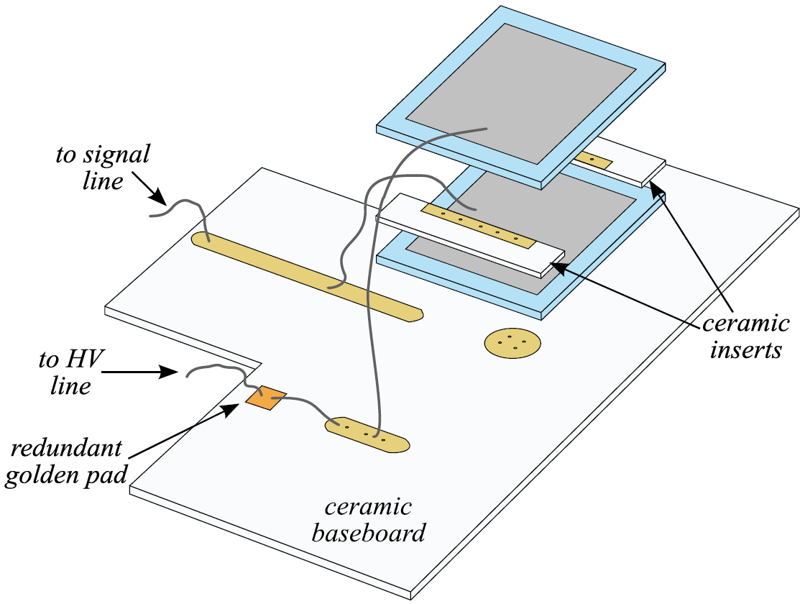
BCM Detector Modules
Poly-crystalline CVD diamond sensors
developed by RD42 and Element Six Ltd.
radiation hard: shown to withstand 10¹⁵ p/cm²
low (pA) leakage current → no cooling required
operated at high drift field 2V/μm → fast signals
Double–decker assembly
2 back-to-back sensors
500 μm thick
CCD @1V/μm ~220 μm
Size: 10×10 mm²
Contact size: 8×8 mm²
Operated at 2V/μm (1000 V)
Double signal compared to single sensor
assembly, noise increasing only by ~40 %
For 45º incidence signal increases by 2
→ modules installed at 45º to beam pipe
13.4 cm

Slide 9
BCM Detector modules
Front end electronics
2 stage RF amplifier:
1st stage: Agilent MGA-62653, 500MHz (22db)
2st stage: Mini Circuit GALI-52, 1GHz (20dB)
Measurements showed (confirmed with simulation):
Limiting BWL to 200 MHz improved SNR by 1.3
Rise time increases by 70% and FWHM by 60%, but still complies to requirements
4th order 200 MHz filter integrated on digitisation board
13.4 cm

Slide 10
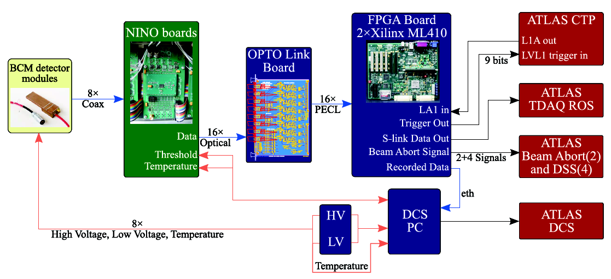
BCM: Readout Chain
Analogue signals from BCM modules routed behind calorimeter (lower radiation levels) and “digitized” by custom board based on NINO chip
Each module connected to separate NINO electronics board, each channel fully floating
BPSS
~0.5MGy
PP2
(~10Gy)
USA15 - Counting Room

Slide 11
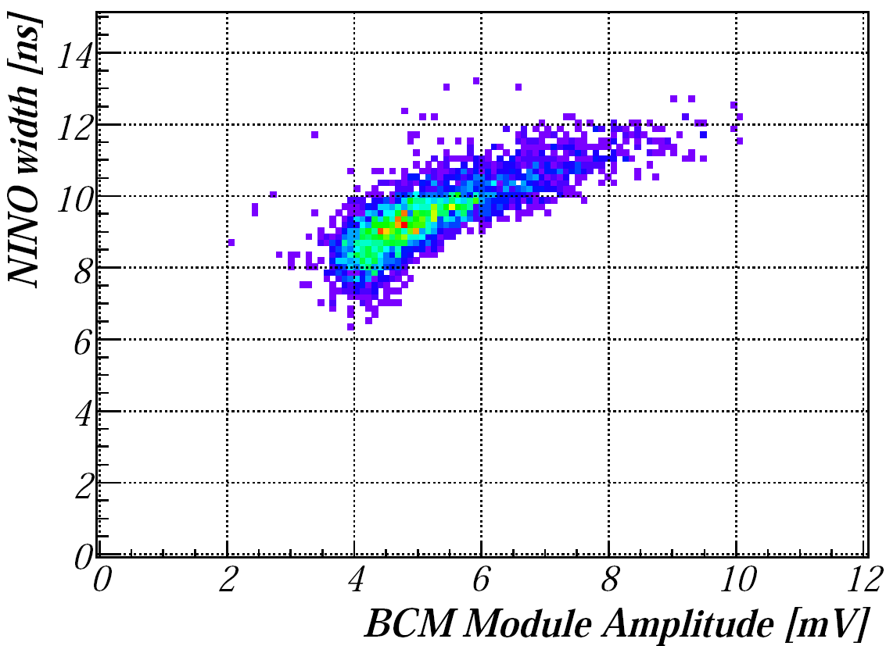
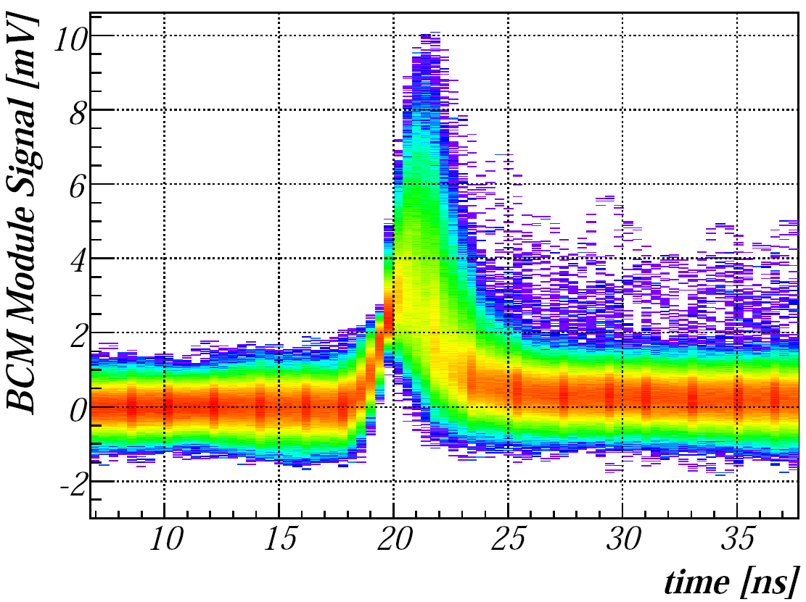
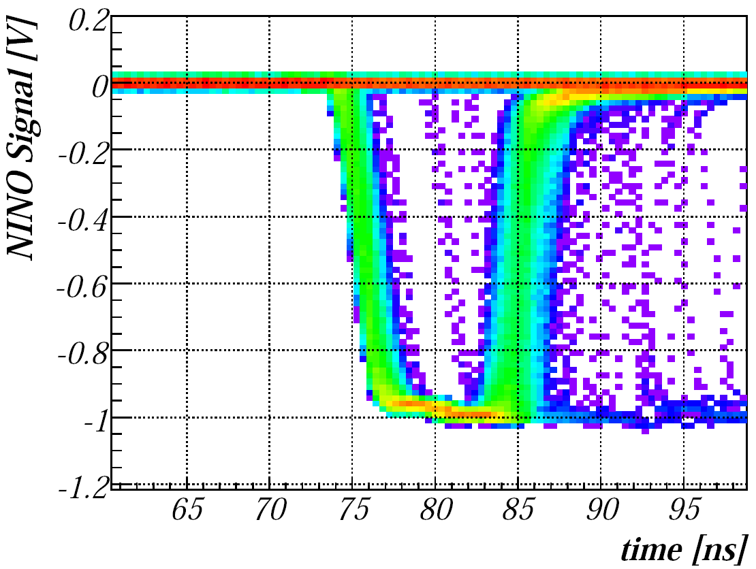
BCM: “Digitization” Electronics Board
NINO chip
Developed for ALICE ToF (F. Anghinolfi et al.)
Radiation tolerant, fabricated in ¼ μm IBM process
Rise time < 1ns, jitter <25ps, min. detection threshold 10 fC
Time-over-threshold amplifier-discriminator chip
Width of LVDS output signal depends on input charge
Before input to NINO chip: signal charge split in two channels in ratio of 1:11 to increase the dynamic range → high and low attenuation channels
High attenuation channels need ~10 times more charge from MIPs traversing the sensor to exhibit the signal than low attenuation channels
input signal
(BCM)
NINO
output
NINO

Slide 12
BCM: Readout Chain
Optical signals transmitted through 70m of optical fibres to USA15 counting room
Optical signals transformed to PECL in 2 optical receiver boards) and connected to 2 data processing units (ROD’s) based on Xilinx Vitrex-4 FPGA
Processing units connected to
ATLAS Central Trigger Processor (CTP): BCM provides 9 bits (temporarily 6)
ATLAS Data acquisition (TDAQ): on trigger signal (LVL1A) from CTP, BCM data from 31 bunch crossings is formatted and sent off to ATLAS DAQ readout chain
ATLAS Detector Control System (DCS): monitoring rates, conditions etc.
Detector Safety Systems (DSS), Beam Interlock System (through CIBU-Control Interlocks Beam User)
BPSS
PP2
USA15

Slide 13
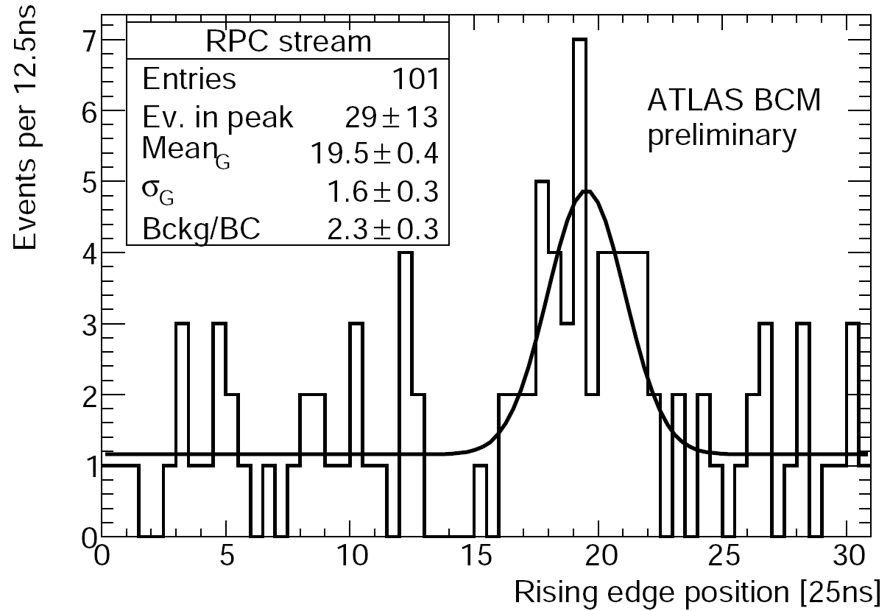
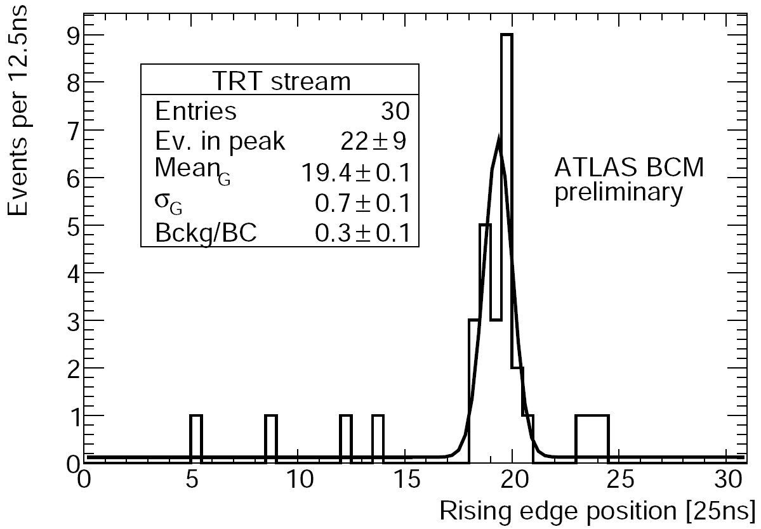
ATLAS BCM: Cosmic Data
November 2008: combined ATLAS Inner Detector cosmic data taking
Two different triggers:
Resistive Plate Chambers (RPC) of Muon system
Fast-OR feature of Transition Radiation Tracker (TRT)
On each trigger received from CTP BCM sends data (rising edge and width of BCM signals) from 31 BCs to ATLAS DAQ chain
Timing distribution of RPC- and TRT-triggered BCM hits:
Superimposed is a fit to Gaussian signal and a flat random background.
Gaussian peak wider with RPC trigger; better jitter of TRT trigger
Probability of noise hit per BC: ~10⁻⁷
RPC: about 10M triggers needed for 9 genuine BCM hits
TRT: about 1M triggers needed for 9 genuine BCM hits

Slide 14
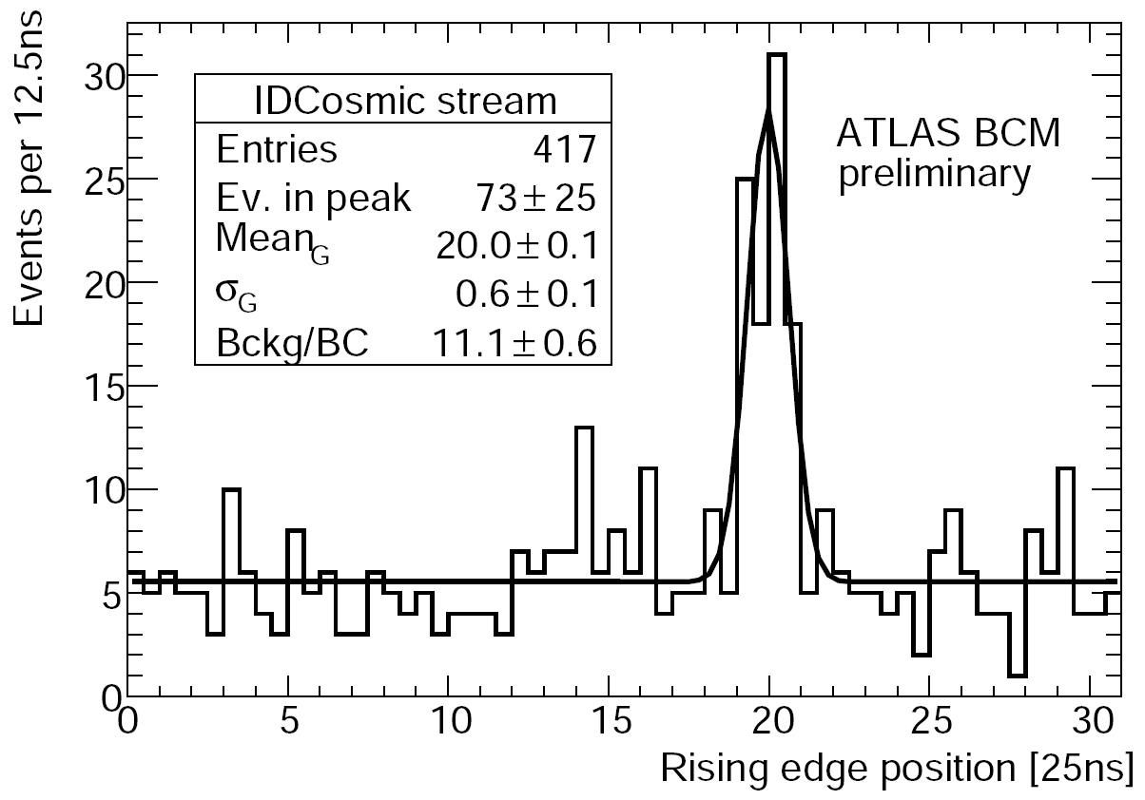
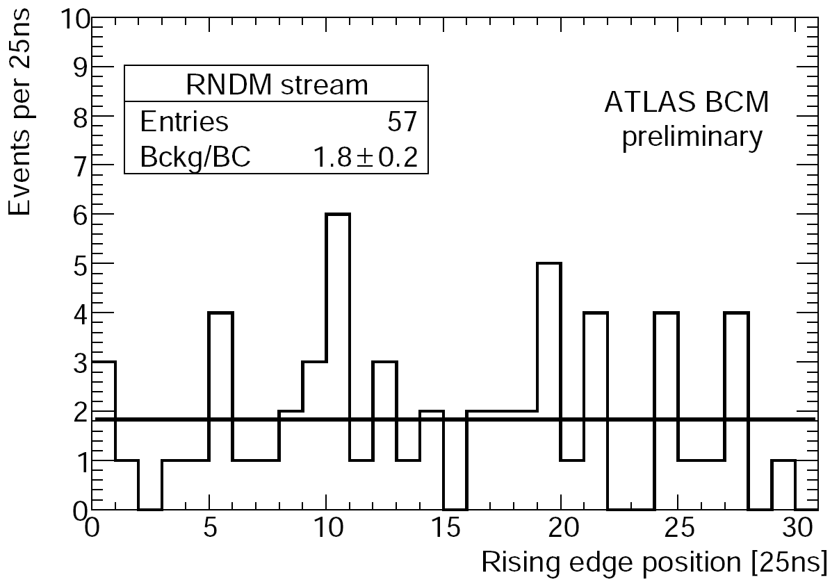
ATLAS BCM: Cosmic Data
June 2009: ATLAS cosmic data taking
IDCosmic trigger stream: selects events with at least 1 track reconstructed in Inner Detector from LVL2 trigger
RNDM trigger stream: random trigger
Timing plots:
RNDM stream: flat as expected
IDCosmic stream: Gaussian with width ~ as for TRT stream in November cosmic run
Probability for noise hit per 1 BC: 7-8 times higher than in November 2008 run, due to higher thresholds in 2008
Signal: 1M IDCosmic triggers give 6 true BCM hits

Slide 15
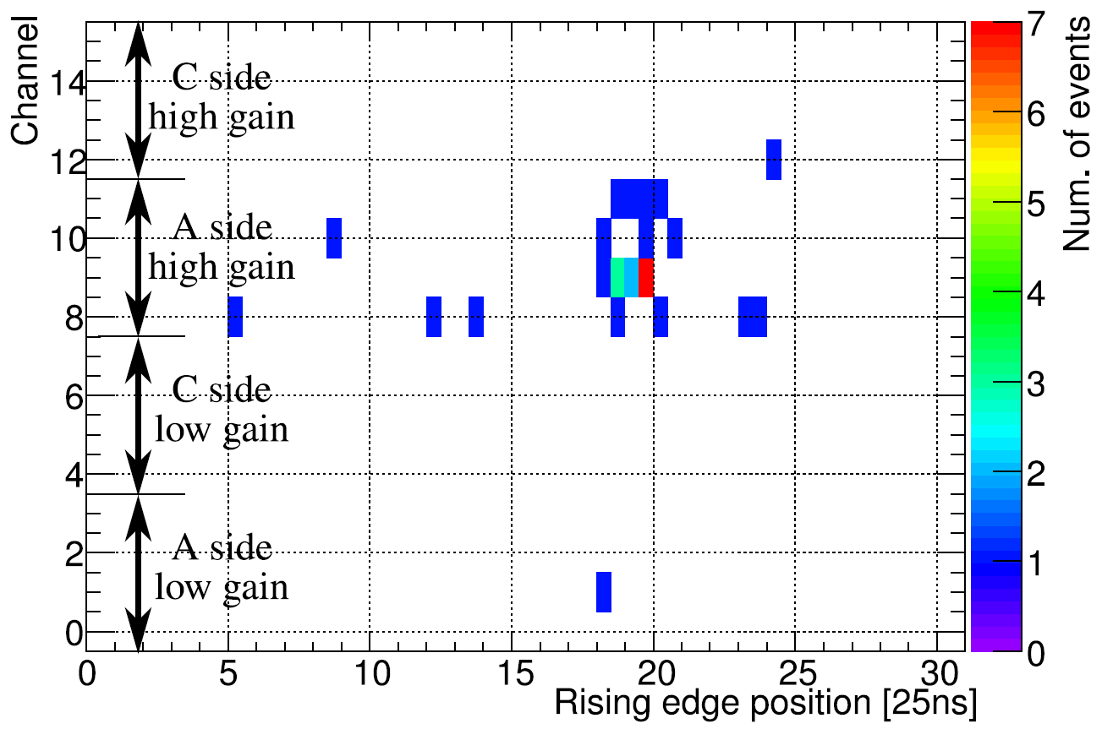
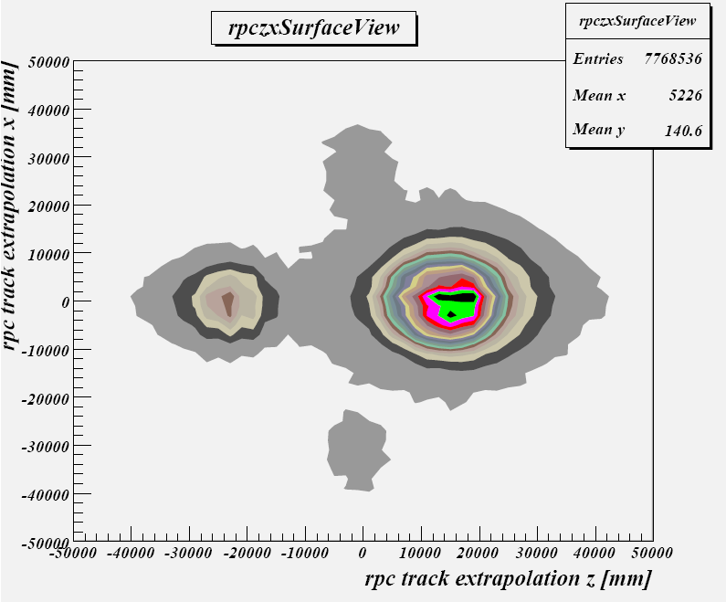
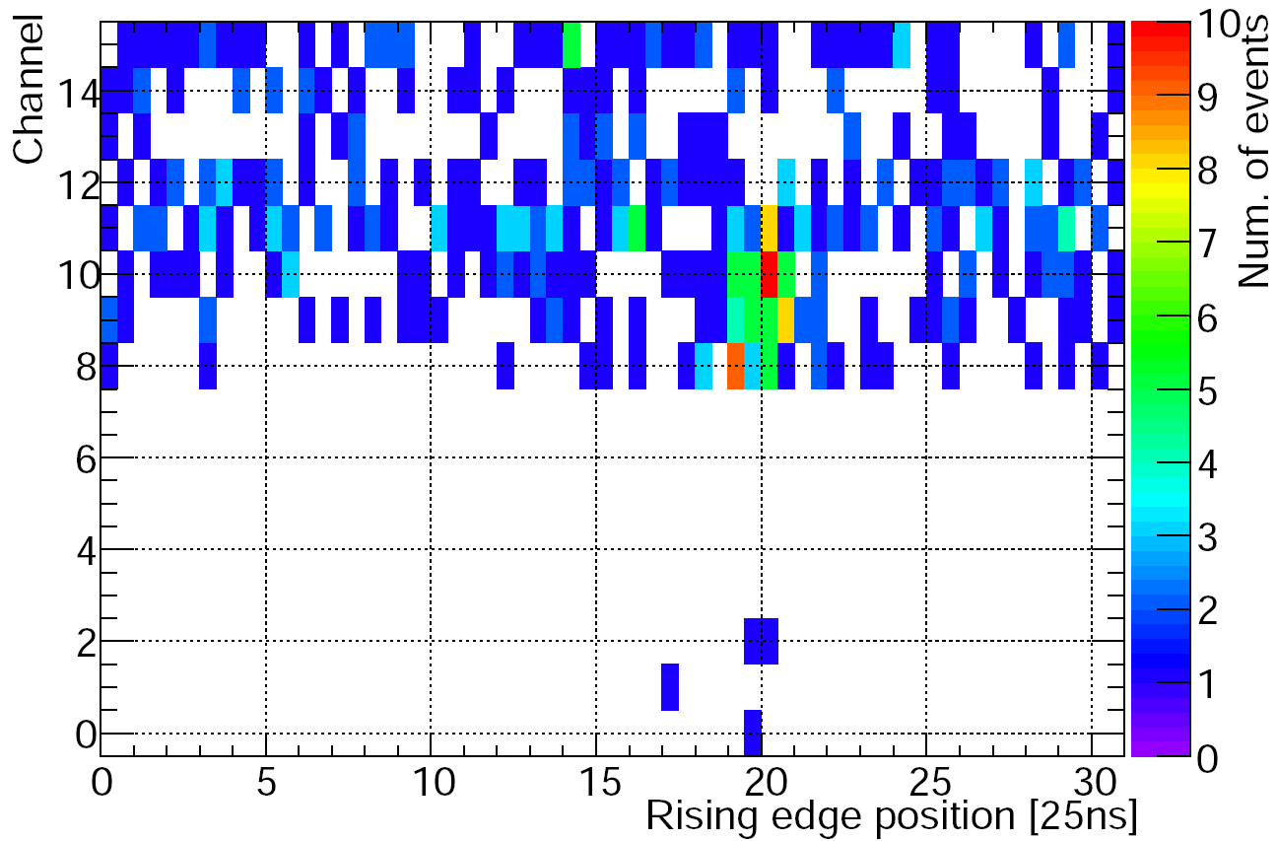
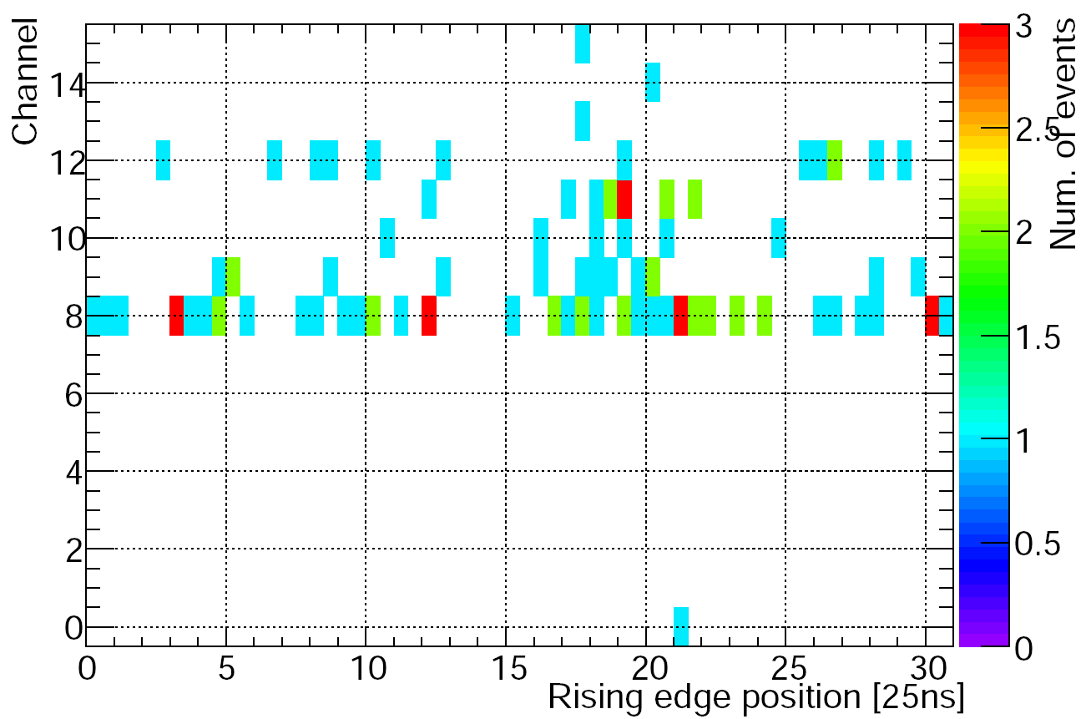
ATLAS BCM: Cosmic Data
Timing distribution of BCM hits over channels:
Almost no hits on side C
Attributed to unequal size of 2 main ATLAS shafts
TRT
Side A
From: M. Bianco,”ATLAS RPC commissioning status and cosmic ray test results”, PIC2008
Side C
A
Side A
Side A
IDCosmic
RPC

Slide 16
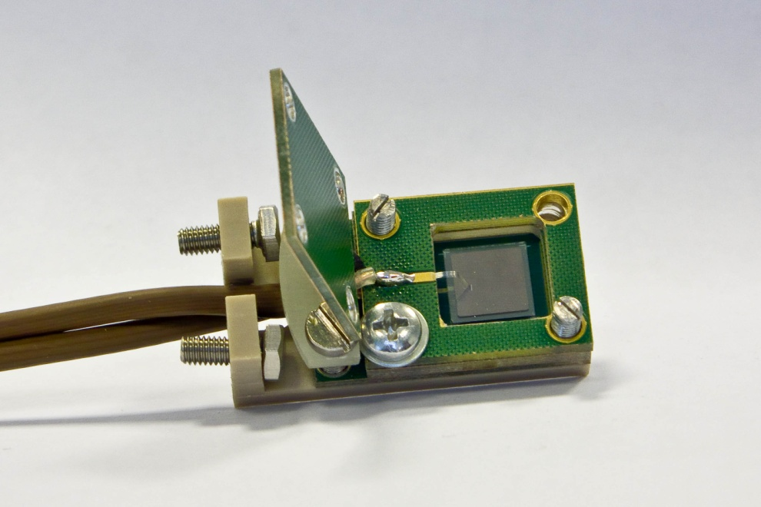
ATLAS Beam Loss Monitor - BLM
ATLAS Beam Loss Monitor – ATLAS BLM
Independent system
Recently added as a supplement to ATLAS BCM
Goal: protection only → much simpler than BCM
Used standalone, complementary information to BCM
Measurement of ionization current
Readout electronics a “straight” copy of the LHC BLM system
Major difference: ATLAS BLM uses diamond sensors instead of ionization chambers (LHC BLM)
Other: different LV powering scheme, firmware changes in the readout cards,...
Sensors:
one pCVD 8×8 mm² diamond,
500 μm thick, metallization 7×7 mm²
operated at +500V
current @ 500 V typically < 1-2 pA

Slide 17
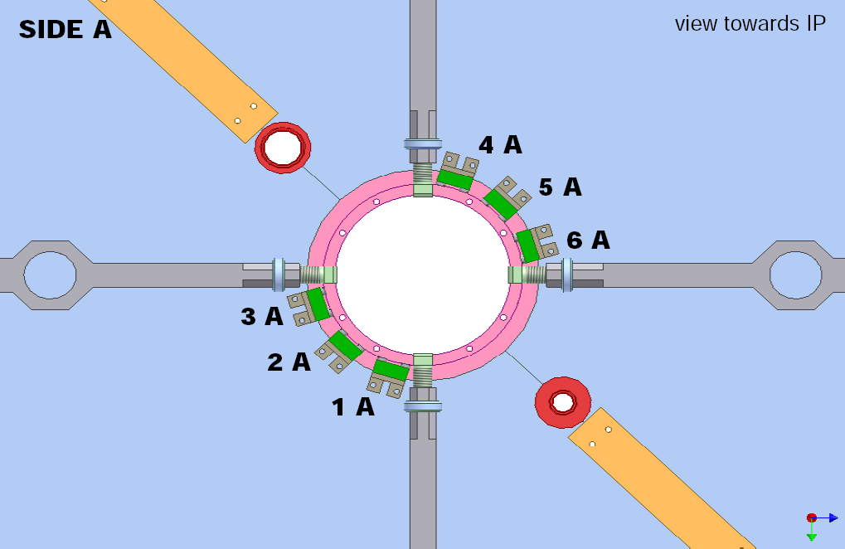
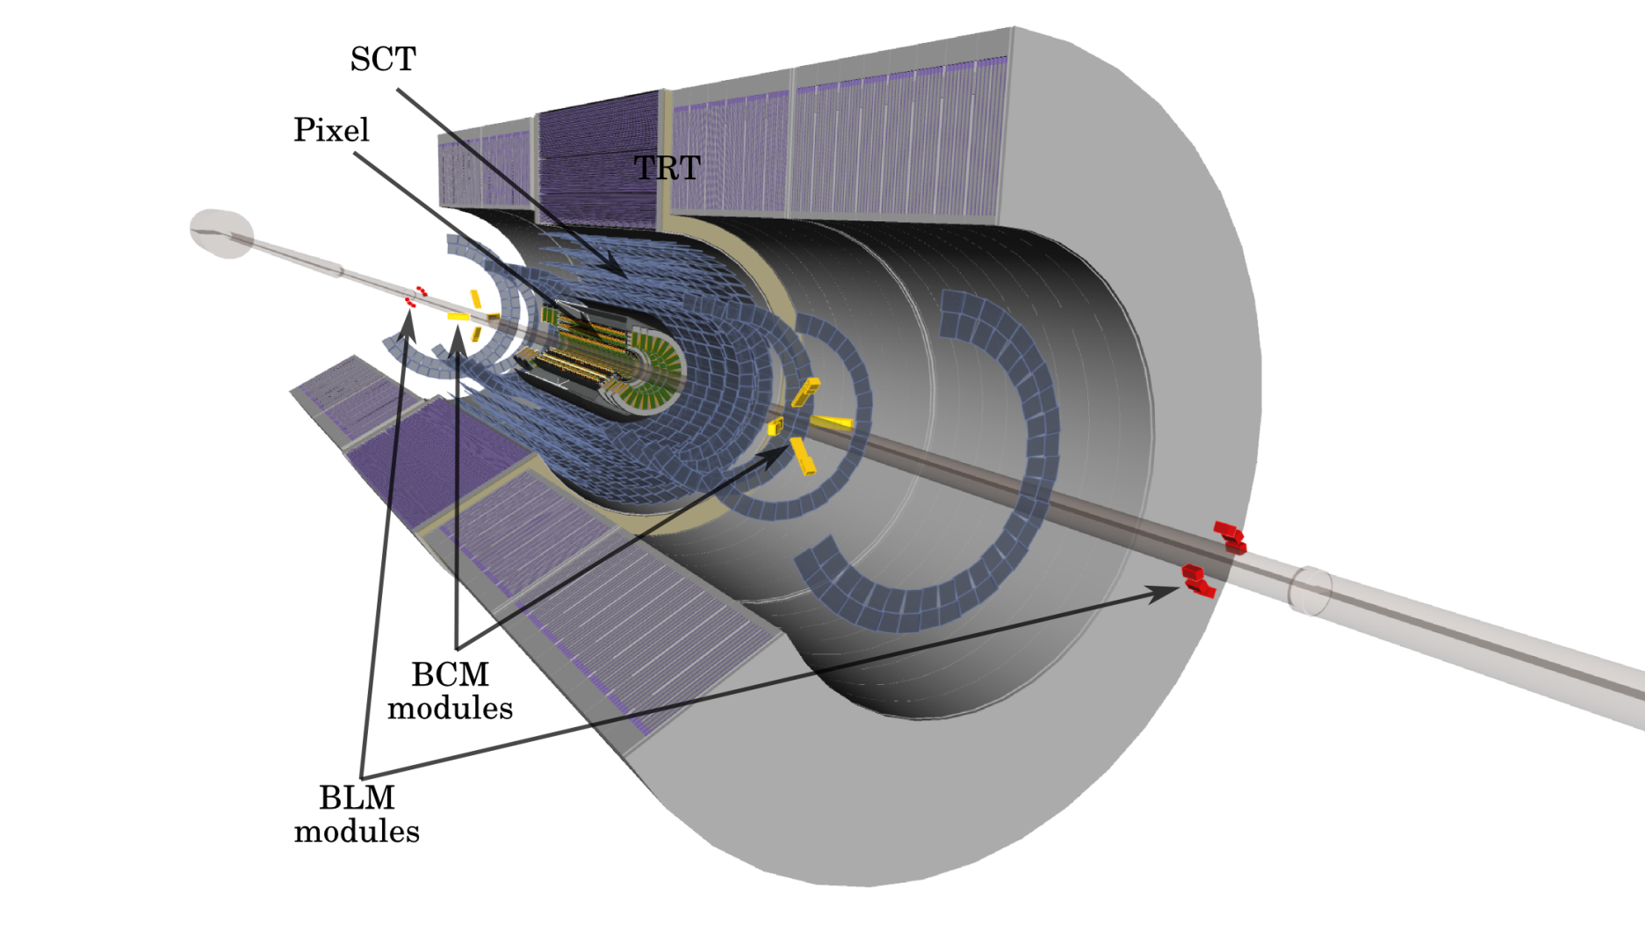
ATLAS BLM: Detector modules
12 detector modules installed in May 2008
6 on each side of IP, installed on Inner Detector End Plate
Close to IP: z = ±3450 mm, r = 65 mm
Inner Detector End Plate
ATLAS Inner
Detector
Courtesy of
T. Kittelmann

Slide 18
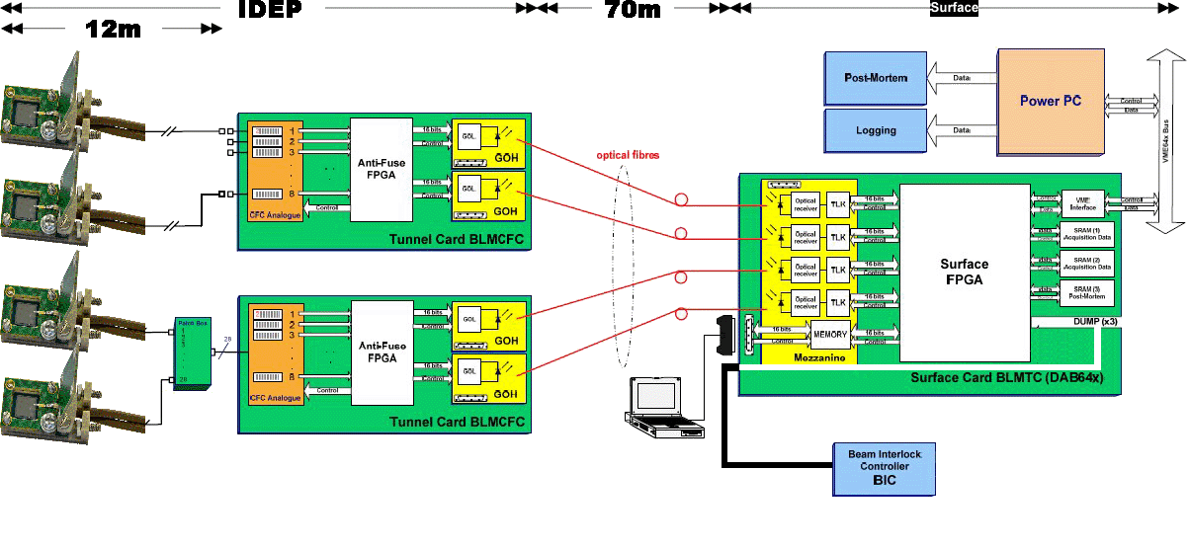
ATLAS BLM: Readout
Measurement of radiation induced current in sensors, integrated over predefined time constants ranging from 40 μs to 84s.
Current converted to frequency in radiation tolerant BLMCFC (“CFC card”) behind calorimeter
Digitized information transmitted through optical fibres to USA15 counting room, recorded by BLMTC (“threshold card”) based on Altera FPGA:
BLMTC inserted in VME crate
VME bus used to transmit the post mortem buffer to the Single Board Computer and for monitoring readings sent to ATLAS Detector Control System
Connected to ATLAS BIS: beam abort issued if readings from 2 modules on one side exceed a predefined threshold
BLM CFC’s
A - 6x
C - 6x
BLM TC

Slide 19
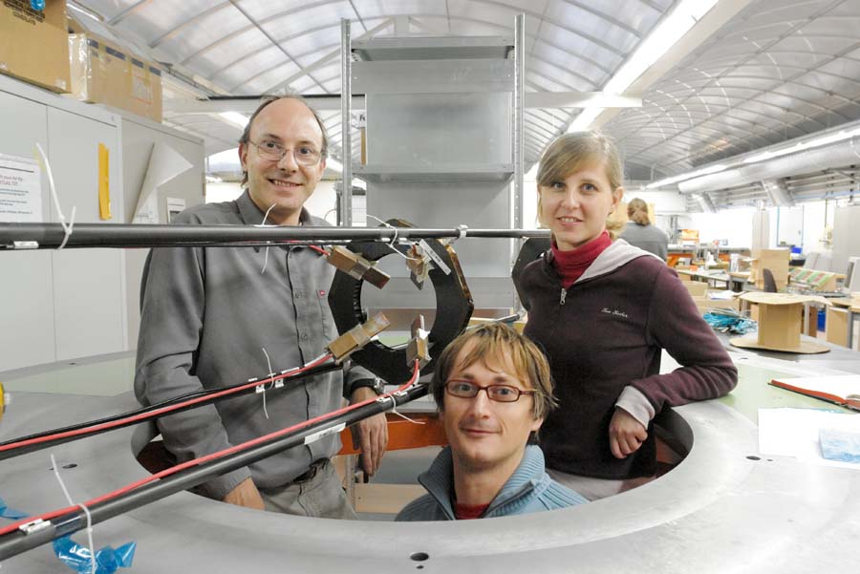
Summary
ATLAS BCM will monitor beam conditions
close to IP using TOF measurement
Goal:
Protection
Relative luminosity measurement
pCVD diamonds as sensor material
2 diamonds in back-to-back configuration
at 45º towards the beam
First experience with the system gathered
in the last 1½ year
ATLAS BLM:
Complementary system for additional safety
Ionization current measurement
pCVD diamond sensors
Looking forward to using BCM & BLM with the real LHC beams !

Slide 20
Backup slides

Slide 21
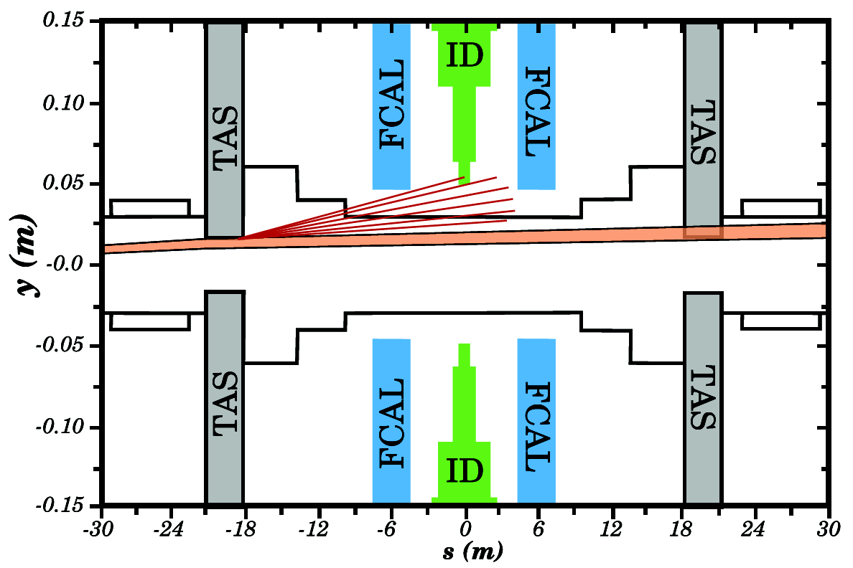
Beam Loss Scenarios
Single-turn losses
Likely to occur during injection or beam dump processes
ATLAS can be rated the 'safest' of all LHC interaction points (far away from injection, dump)
Pilot bunch (single bunch of low intensity, 5×10⁹ p @ 450 GeV; 360 J) will be used to check the magnet settings
Multi-turn losses
Beam degradation due to equipment failure, magnet trips, wrong magnet settings...
Time constants of magnets: shortest ~few LHC turns (order of ms) → can abort the beam if detected early (beam is dumped within 3 turns ~ 270 μs)
Simulation of beam orbits with wrong magnet settings (D. Bocian) exhibit scenarios with pilot beam scrapping the beam pipe or TAS collimator (most likely scenario), no direct hitting of Inner Detector (ID)
30 cm
TAS (Target Absorber Secondaries) collimators: at z = ±18 m which protect the Inner Triplet of quadrupoles from secondaries produced in p-p collisions
60 m

Slide 22
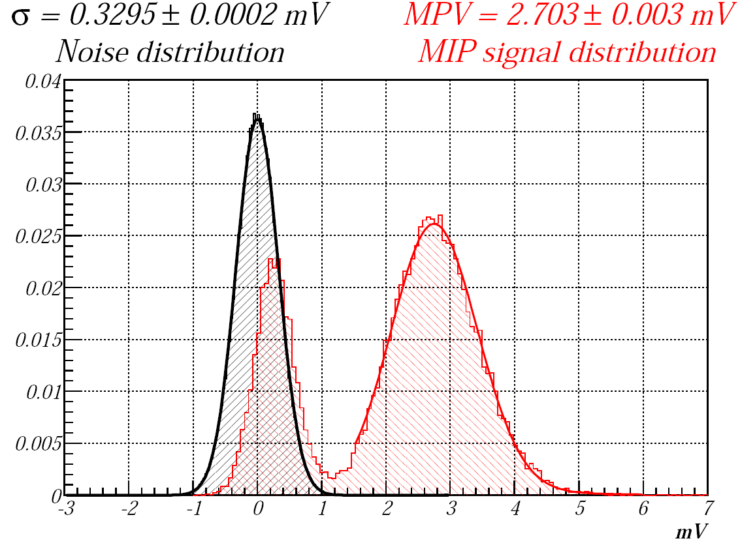
QA of BCM Modules
Qualification tests with final modules to select 8 for installation
Raw sensor characterization:
I/V, CCD
Module performance
All modules subjected to thermo-mechanical test
infant mortality test (12h @80º)
accelerated ageing for one of the module
(14h @120º 10 years at 20º)
thermal cycling (10 cycles from -25º to 45º)
Module performance checked before and after
these tests with ⁹⁰Sr setup
no change in S/N observed
for normal particle incidence: typical S/N7–7.5
(trigg.)

Slide 23
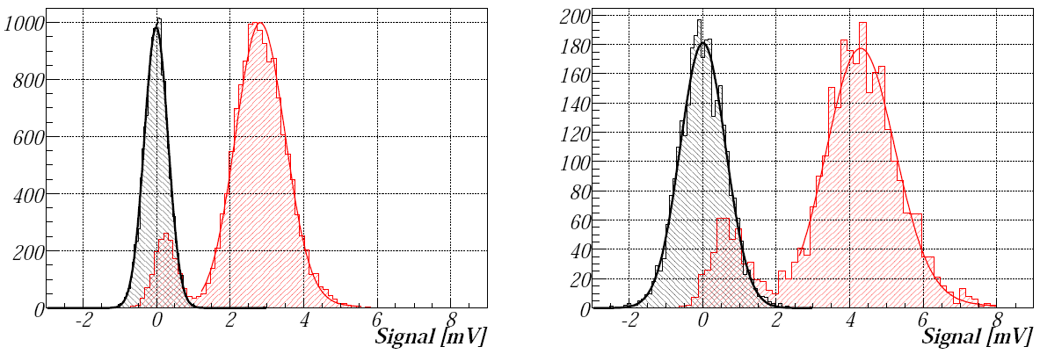
BCM Detector Modules
Front end electronics
2 stage amplifier:
1st stage: Agilent MGA-62653, 500MHz (22db)
2st stage: Mini Circuit GALI-52, 1GHz (20dB)
Limiting BWL to 200MHz improved S/N by 1.3 (and rise time worse by 70% and FWHM by 60%, but still fit to requirements)
 4th order 200MHz filter integrated before digitization (on NINO board)
200MHz BWL
1GHz BWL
13.4 cm
Lab. Tests with
MIPs at 90º
incidence
Amplitude dist.
Noise dist.
Off-line analysis of waveforms recorded at full BWL:
optimum S/N with 1st order filter with cut-off frequency 200-400 MHz

Slide 24
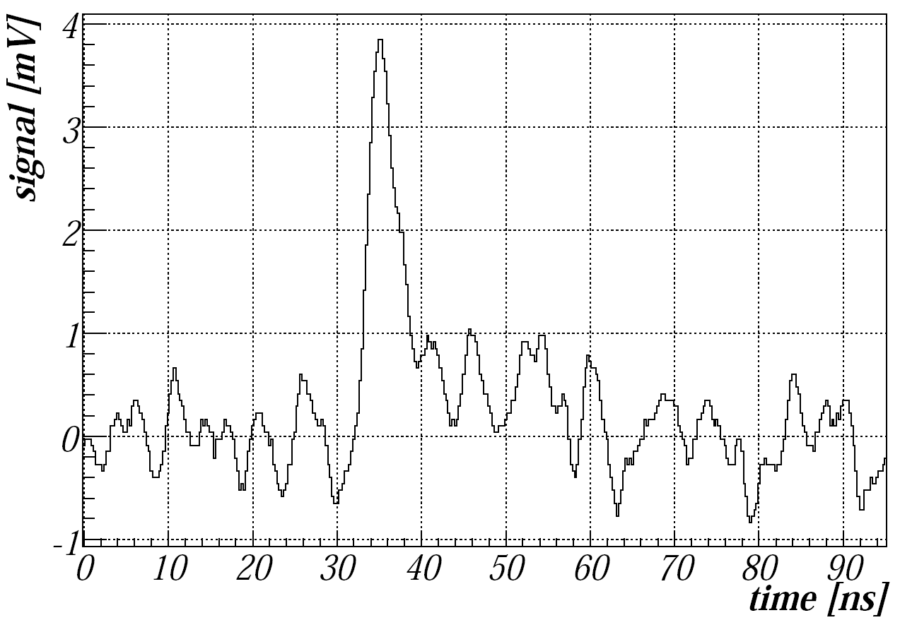
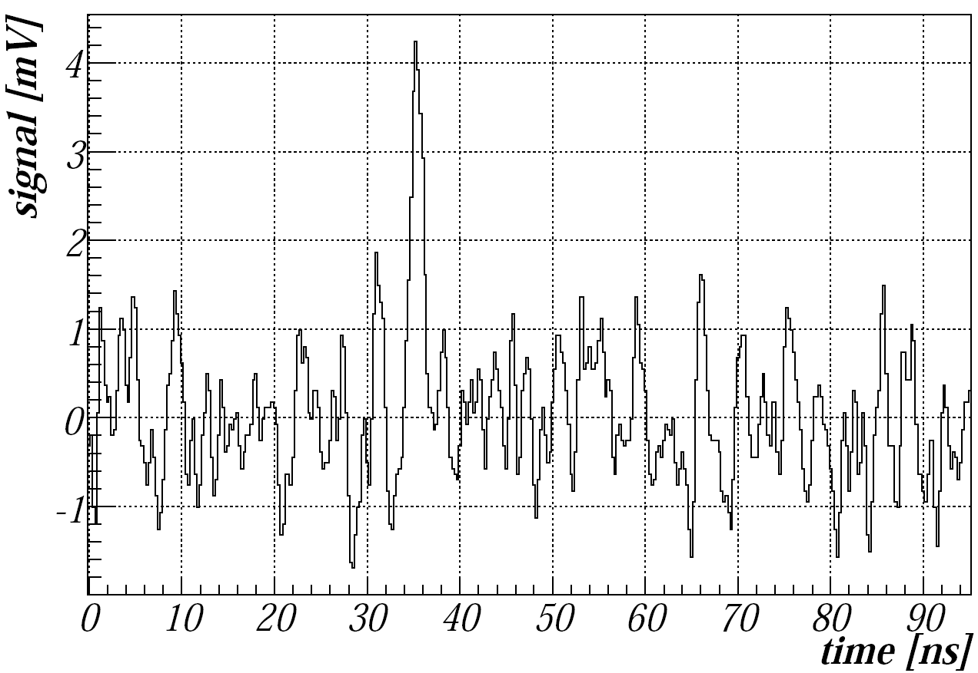
BCM: Analogue signals
Signals recorded with 200MHz BWL at the readout
Typical S/N with MIP at 90º incidence in the lab. tests: 7-7.5
Most probable amplitude produced by MIP at 90ºin the lab tests: 2.2 - 2.7mV
Mean rise time 1.4ns
Mean FWHM 2.9ns
Timing resolution better than 400ps (thresholds: 0.1-2 MP amplitude)
200MHz BWL
1GHz BWL

Slide 25
BCM: Luminosity
BCM will contribute to luminosity monitoring with
Monitor instantaneous luminosity
Vertex position monitoring
Determination of dead time
Beam separation scans
First algorithms will be based on non-empty event counting
Monitoring of luminosity per BCID
Providing instantaneous luminosity at Hz rate
Monte-Carlo simulations under-way to provide initial calibration used before first beam-separation scans, and understanding systematics

Slide 26
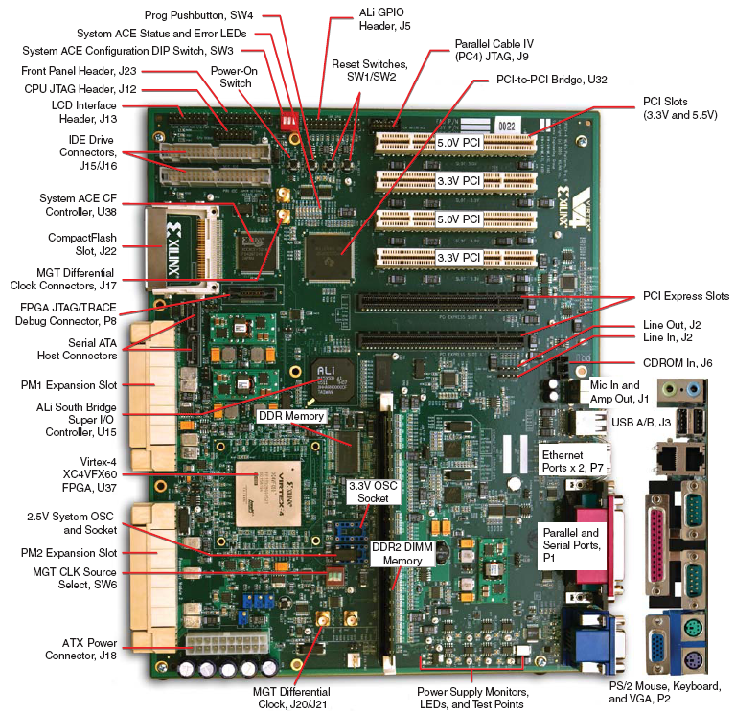
BCM: Processing Units & Signal Analysis
Input signal sampled with 2.56 GHz:
64 samples of 390ps width for each proton bunch crossing (BC-25ns)
Raw data stored in DDR2 circular buffer (for >more than 3×10⁶ BCs → 1000 last LHC turns)
For each BC:
Signal rising edge and width of at most first 2 signals are reconstructed and stored in DDR cyclic buffer (more than 2×10⁶1BCs → 800 LHC turns)
On trigger signal (LVL1A) from CTP: BCM data from 31 Bunch crossings is formatted and sent of ATLAS DAQ readout chain
“In-time” and “out-of-time” coincidences, high multiplicity for low and high gain channels
9 trigger bits to CTP
Beam abort (if beam conditions have reached unacceptable level)
Alarm and warning signals in less sent to DSS, DCS

Slide 27
BCM: Beam Abort
Beam abort algorithms:
For initial phase: 3 low attenuation channels (horizontal/vertical modules per ROD) + 3 high attenuation channels (vertical/horizontal) fire in both ROD’s
Monitor and use later:
X/Y (3+3 condition reached in consecutive X out of Y BC’s)
Leaky bucket (X updated with forgetting factor)

Slide 28
BLM: Induced Current
Currents in BLM modules:
Current from 14TeV p-p collisions:
~15nA/module (at design luminosity, 1034/cm-1s-1)
Estimated form the Total Ionisation Dose plots
Scales with luminosity
Accidents (simulation)
7 TeV p on TAS gives ~1 MIP/BLM module
1 MIP in diamond generates ~1 fC of charge
25pA of current “spike” for single occurrence (1 bunch, possible for pilot bunch)
40nA of continuous loss every BC (much more likely for full LHC bunch structure)
Diamond dark currents in magnetic field O(10pA)
Initially threshold for 40 μs reading: set to 50nA

Slide 29
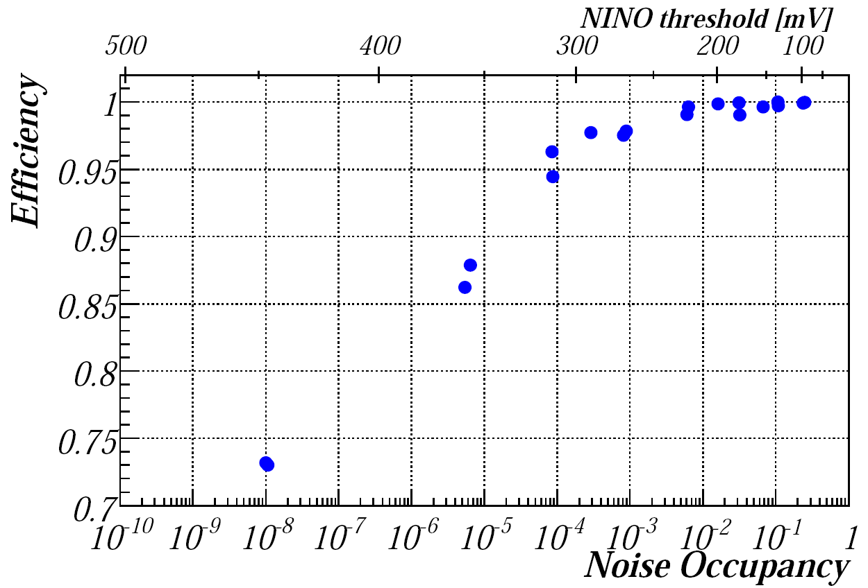
BCM Performance up to FPGA Input
Estimated performance of BCM system in ATLAS (up to FPGA input) for high gain channels:
Median S/N (for MIPs at 45º incidence) ~9
Noise RMS σ ~64mV
Median signal ~570mV
1MIP efficiency versus noise occupancy (noise rate scaled to 25ns interval – bunch crossing in ATLAS)
efficiency 0.95 – 0.99 for occupancies 10⁻³–10⁻⁴
The exact level of fake rate depends on what kind of logical combination of signals will be used in ATLAS

Slide 30
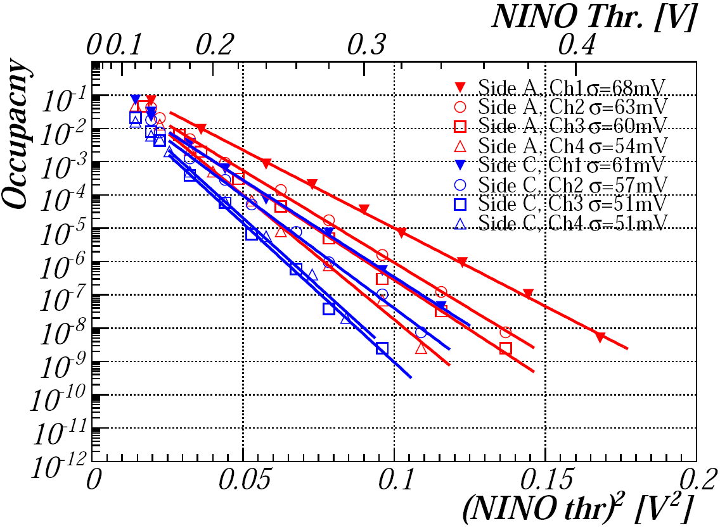
BCM Noise Performance
Noise rate measured in ATLAS pit:
extracted noise RMS σ 51-68mV (different det. modules and NINO boards) agrees with estimation (64mV)
Module | Sig Jul09 | Sig Sep08 | Delta
0 | 65.74 | 69.37 | -3.63
1 | 61.36 | 61.52 | -0.16
2 | 59.87 | 60.49 | -0.62
3 | 63.84 | 63.90 | -0.06
4 | 57.47 | 57.85 | -0.38
5 | 58.72 | 59.86 | -1.14
6 | 59.36 | 60.21 | -0.85
7 | 60.63 | 61.26 | -0.63
Noise stable to < 5 % in a year !

