Slide 1


Status of HEP in Slovenia
Marko Mikuž
University of Ljubljana & Jožef Stefan Institute
CERN Fact-Finding
July 5, 2010

Slide 2
Outline
History of HEP in Slovenia
HEP in Slovenia today
  Experiments in HEP
  Astro-particle physics
  Theory
Industrial participation
Prospects

Slide 3
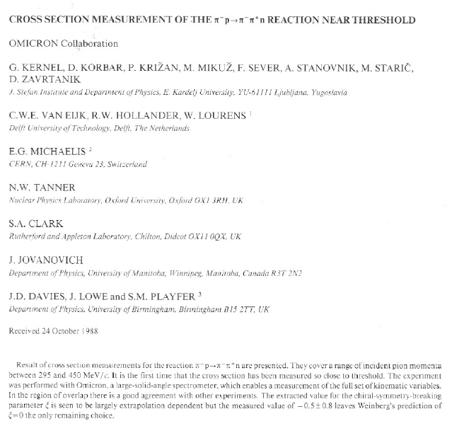
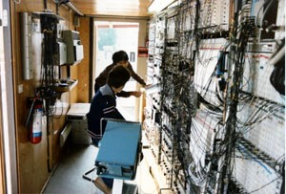
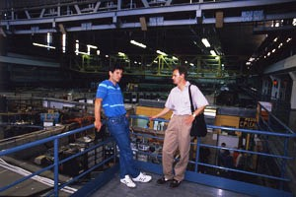
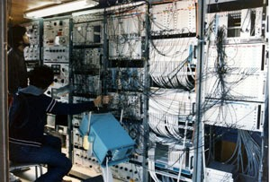
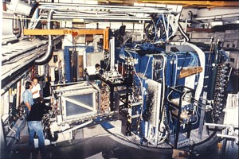
History of HEP - OMICRON
1975-1991
  Prof. G. Kernel invited by Oxford colleagues to join the OMICRON collaboration at CERN SC
  Up to 1982 the OMICRON collaboration conducts a series of experiments on pion scattering
  Prof. Kernel is joined by several PhD students and the Slovenian group becomes a full member of the OMICRON collaboration
  For the last experiment, threshold pion production (CERN SC-94), the Slovenian group assumes a leading role with Prof. Kernel the spokesman of the eksperiment
Thus this year we are celebrating 35 years of Slovenian collaboration with CERN !

Slide 4
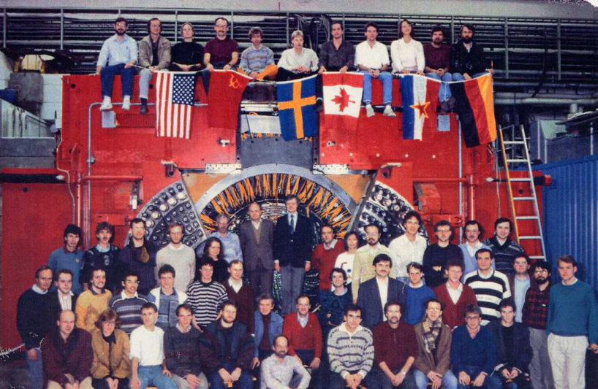
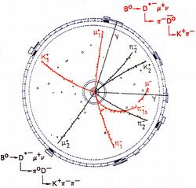
History of HEP - ARGUS
1983-2000
  Following the end of OMICRON measurements in 1982, Prof. Kernel joined the ARGUS experiment at DESY
  First limited to Prof. Kernel and one PhD student the group gradually grew to 6 researchers
  Major involvement in physics analysis, specializing on two-photon physics
  In excess of 130 papers, 3700 citations, one of the most productive experiments in late eighties
  Discovery of B-mixing the physics highlight (459 citations)

Slide 5
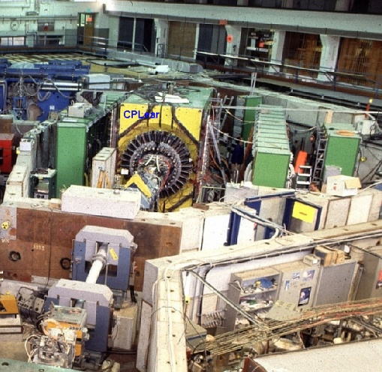
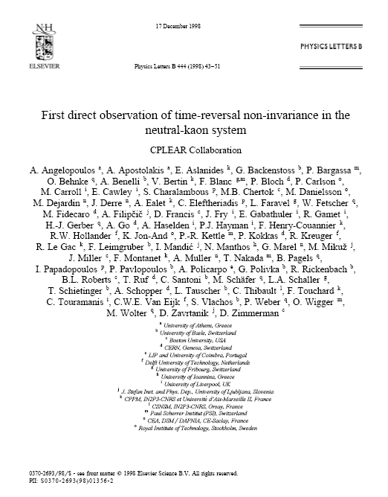
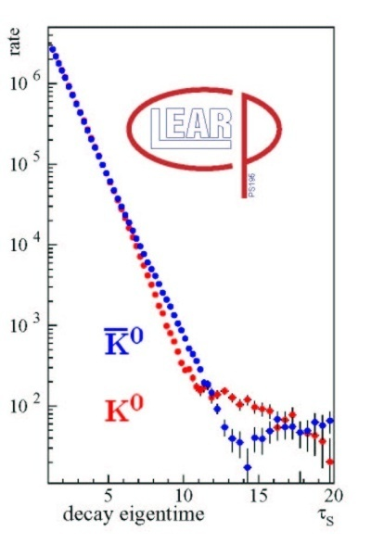
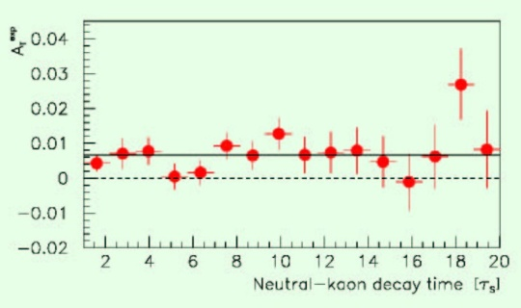
History of HEP - CPLEAR
1988-2003
  1985 – Slovenian physicists participate in a proposal to measure time reversal violation at LEAR (PSCC P-88)
  1986 – the proposal is postponed, the collaboration is proposed to merge with the approved CPLEAR experiment (CERN PS-195)
  1988 – Slovenian group joins CPLEAR in the final stage of detector preparation
  1989 – 1996 successful measurements of CP, T and CPT violation in the neutral kaon system, featuring the first direct observation of time reversal non-invariance
CP
T

Slide 6
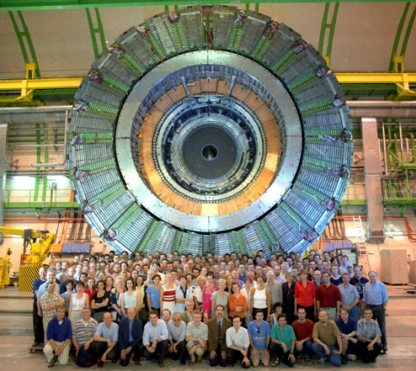
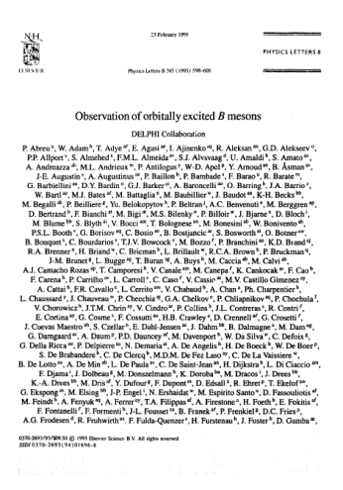
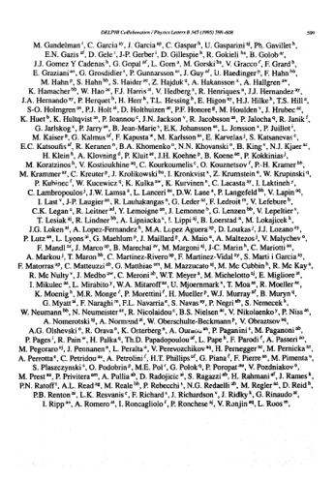
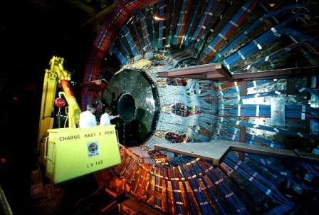
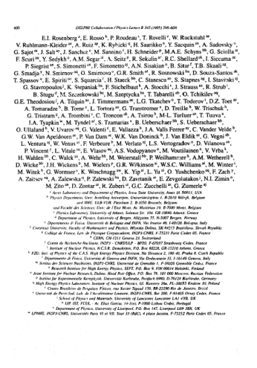
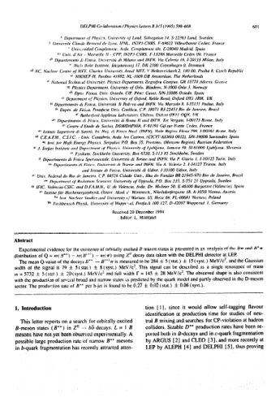
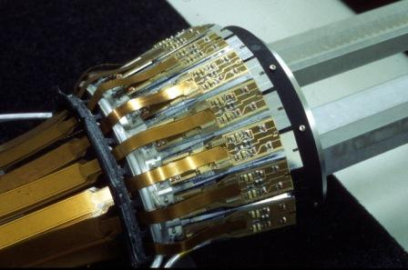
History of HEP - DELPHI
1992-
  1992 – prof. D. Zavrtanik is invited to join the DELPHI collaboration
  Up to 2000 we participated in measurements with one of the most successful experiments in HEP history
  Numerous precision verifications of the Standard model published in more than 270 SCI papers with 5700 citations
  Still publishing papers (2 in 2010)
  Slovenian physicists participated in data analysis, forward RICH commissioning and extension of the silicon tracker in the forward direction (VFT) for LEP-200
FRICH
T
VFT

Slide 7
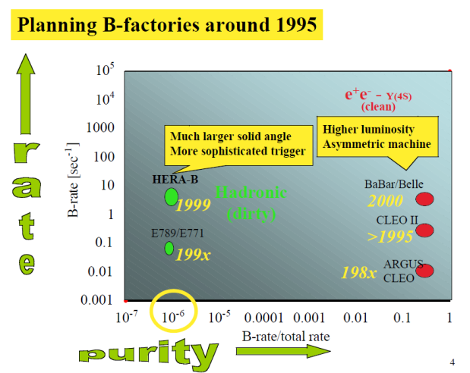
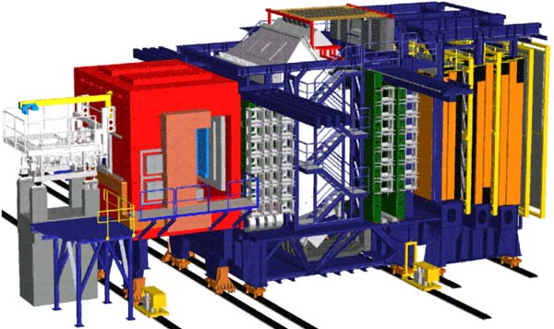
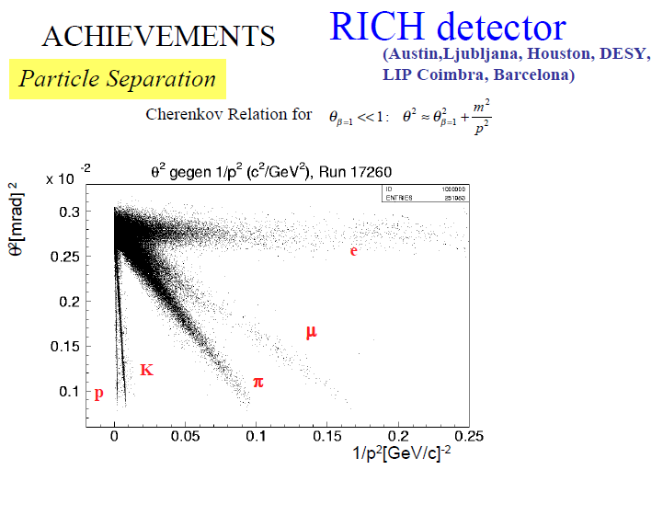
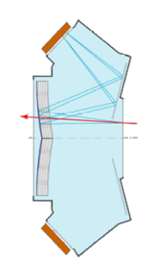
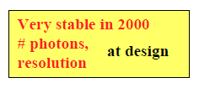
History of HEP – HERA-B
1994-
  1994 – After participation in the design of the HELENA asymmetric B-factory Prof. P. Križan joins the HERA-B proposal, set to discover CP violation in the B meson system
  Slovenian group plays a leading role in constructing the RICH detector; Prof. Križan is RICH project leader
  Enormous detector challenges due to huge particle rates resembling LHC conditions
  Plagued by significant delays and out-of-spec performance of many sub-detectors, HERA-B misses its primary physics goal
  The RICH detector is one of the systems built on time and within specifications
  Despite moderate physics turnout, HERA-B established the Slovenian group as capable of building large particle physics detectors

Slide 8
HEP in Slovenia Today
The Slovenian HEP community is composed of researchers from Jožef Stefan Institute (JSI) and three Slovenian Universities (Ljubljana, Maribor, Nova Gorica)
  Experimental and Theoretical Particle Physics effort led by JSI, Astro-Particle by University of Nova Gorica
Experiment: ~40 researchers, including 10 faculty and ~10 PhD students
  Faculty staff holds part-time positions at JSI
Theory: ~10 researchers, 5 faculty, 2 students

Slide 9
HEP Today: Experiment
Led by Experimental Particle Physics Department of JSI
Currently active in two major collaborations
  ATLAS at the LHC in CERN
  Belle/Belle-II at (Super-)KEKB in KEK
Also active in three R&D collaborations at CERN
  RD-39: cryogenic detectors
  RD-42: diamond detectors
  RD-50: radiation-hard silicon detectors
Applied projects
  Medical imaging
  Grid computing
Financing
  ~8 FTE SRA long-term research grant
  ~8 FTE short-term projects (SRA/EU)
  PhD students receive separate grants (SRA, Marie Curie)
  Travel and experiment M&O serviced through an SRA infrastructure grant
  Separate SRA calls for large/medium equipment

Slide 10
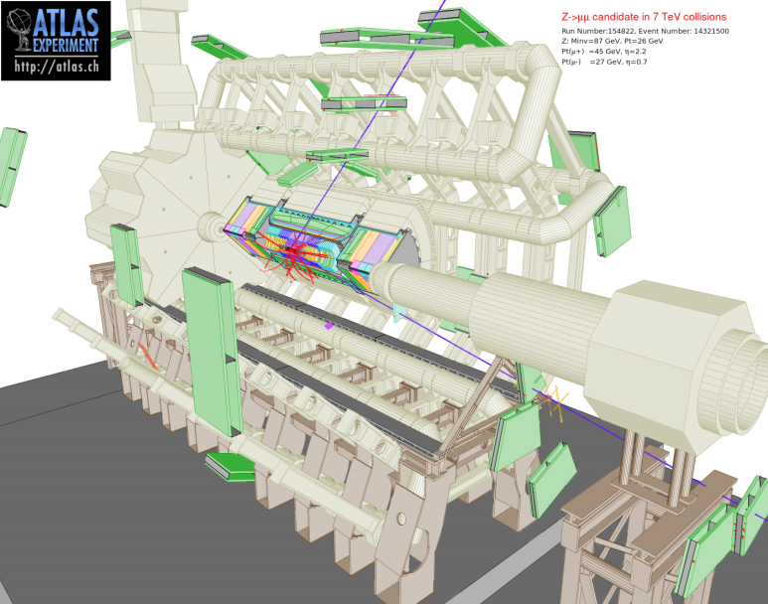
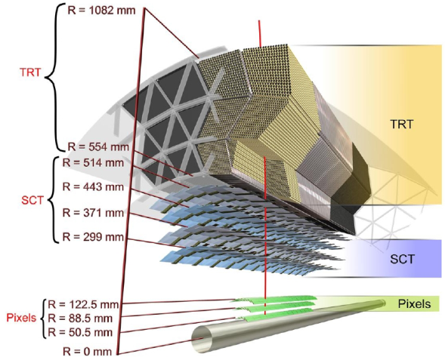
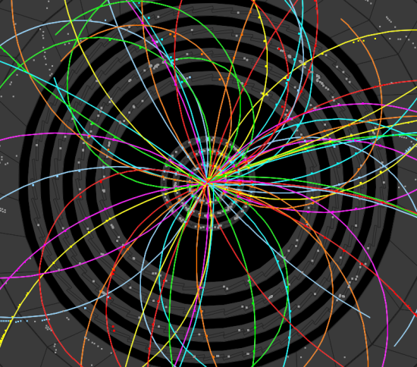
HEP Today: ATLAS
Slovenian group member of ATLAS collaboration since 1996 (148th institution admitted)
Main construction effort – building the SemiConductor Tracker - SCT, part of the particle tracking system - Inner Detector
CORE investment ~1.7 MCHF
After completing SCT taken on additional responsibilities
  Beam Conditions Monitor
  Beam Loss Monitor
  Radiation Monitor
Active in Off-Line Computing and Grid

Slide 11
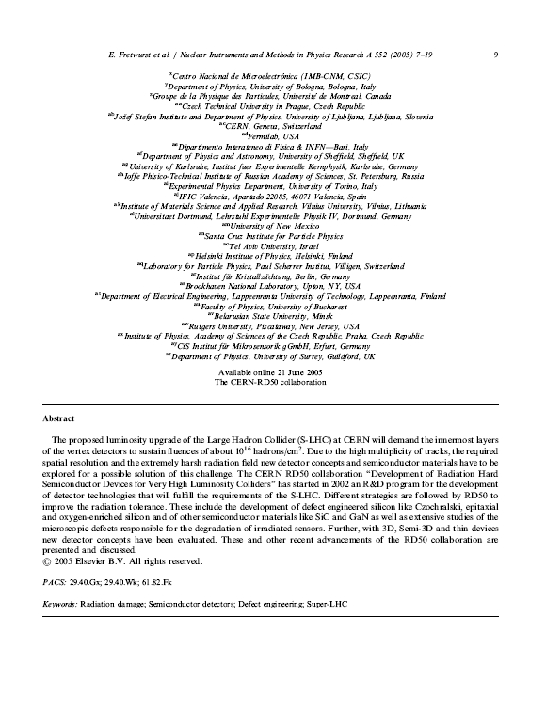
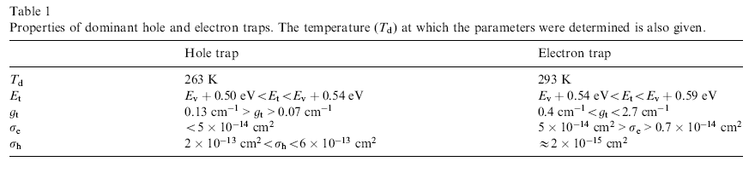
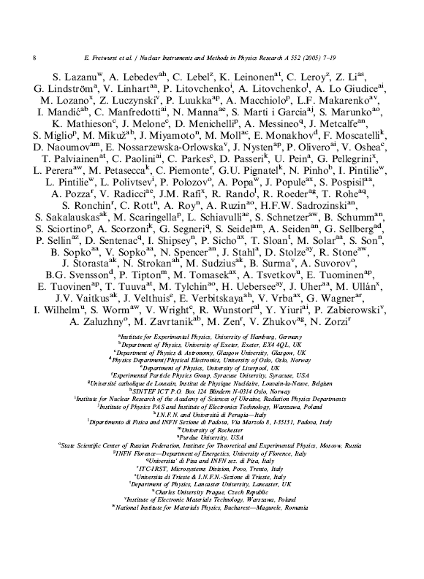
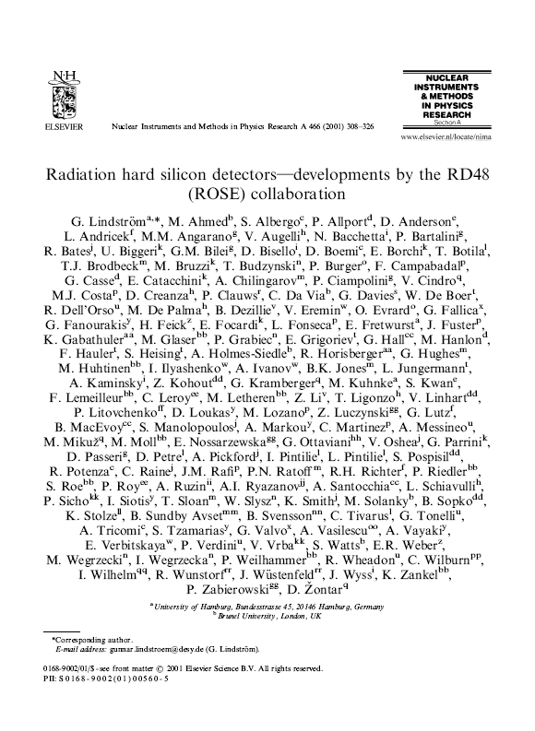
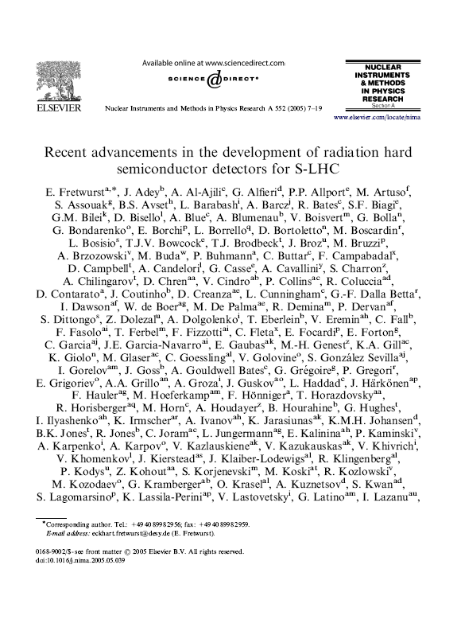
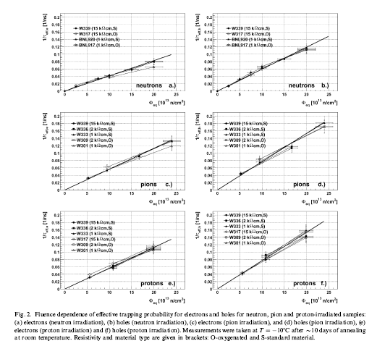
Slovenians in SCT
R&D phase – radiation hardness studies of silicon and readout electronics: SCT radiation field up to 100 kGy and 2x10¹⁴ n/cm⁻²
  Making use of infrastructure available
    Promoted the TRIGA reactor at JSI to a reference site for neutron irradiations
      Good collaboration with Reactor Centre of JSI
      Modified two channels in reactor core
      Flux up to 4x10¹² n/cm²s, LHC dose in minutes , <1h for sLHC !
      Dosimetry accurate to 10 %
  Results (selection)
    Flux dependence of radiation damage: 10⁸ – 5x10¹⁵ n/cm²s
    Dependence of radiation damage on detector bias
    Effective trapping times for electrons and holes
    Properties of effective traps
    Thermal neutron damage to readout electronics
  Participation in CERN RD collaborations
    CERN RD-48 (ROSE)
      Development of radiation hard detector material for LHC
    CERN RD-39
      Development of cryogenic detectors
    CERN RD-50
      Development of radiation hard detector material for SLHC
    CERN RD-42
      Development of diamond detectors
NIM 466 (2): 308-326
Times Cited: 217

Slide 12
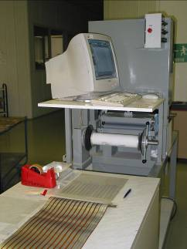
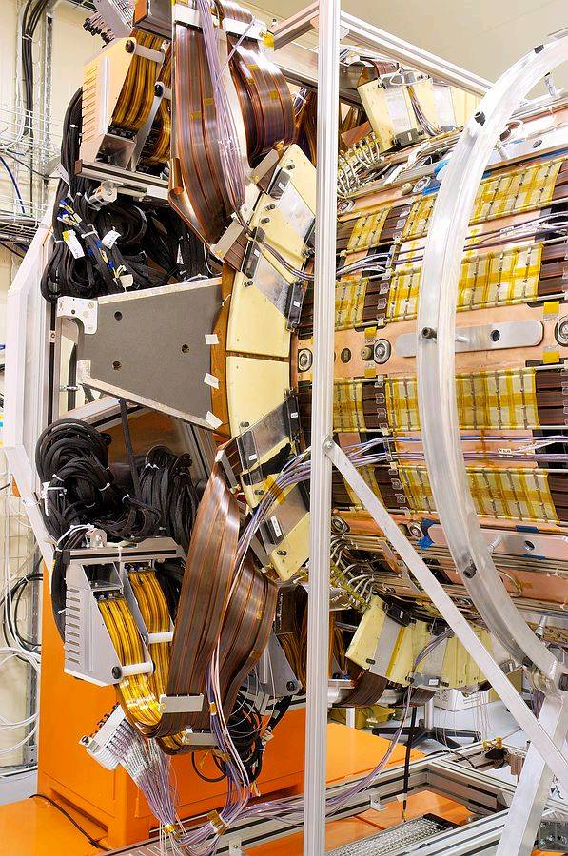
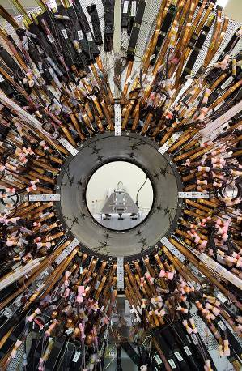
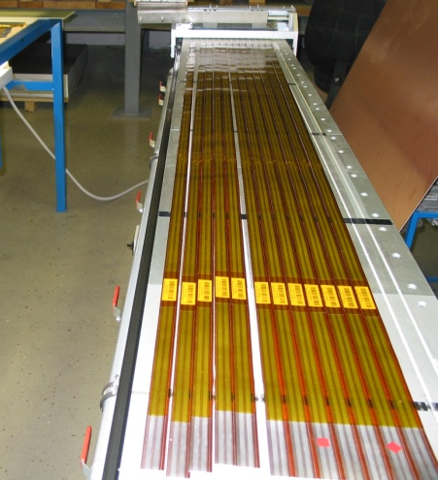
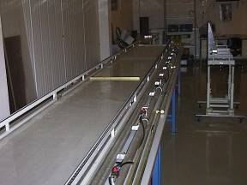
Large Dimension FPC
SCT modules need supply for sensors readout and optical transmission
  16 lines up to 1 A current and 500 V voltage rating
  No space available for round cables
  Solution – supply by Flexible Printed Circuit tapes
Additional requirements
  Radiation dose up to 100 kGy – radiation hard materials: Kapton®
  Minimal material in tracker – aluminium as conductor (4x better than copper)
  Length up to 4 metres
Show-stopper(s)
  Few manufacturers of FPC on aluminium-Kapton® laminates
  Technology for sizes over 1.8 m not available
Optical control
FDS and Apel
ELGO-line received ATLAS Supplier Award for
timely delivery and quality of product
Solution
  Custom technology development for FPC production on aluminium-Kapton® laminates
  Developed by JSI and ELGO-LINE, Cerknica in collaboration with several local partners
    NTC JSI
    Balder Ltd., Ljubljana
    FDS Research Ltd., Trzin
    Apel Ltd., Ljubljana
Cutting
Apel
Exposure
BALDER
½ cables of SCT barrel
End-cap cables

Slide 13
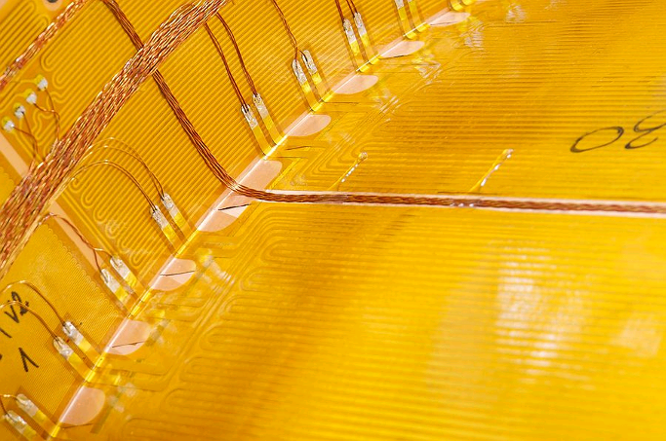
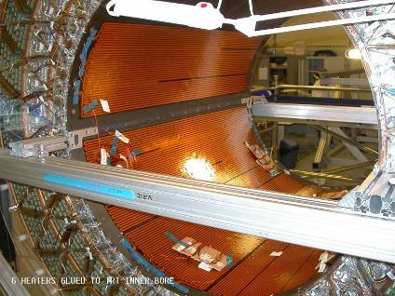
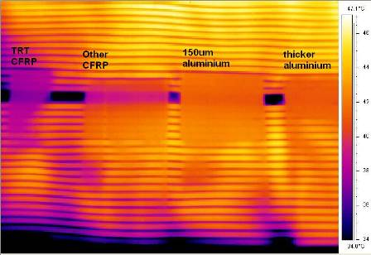
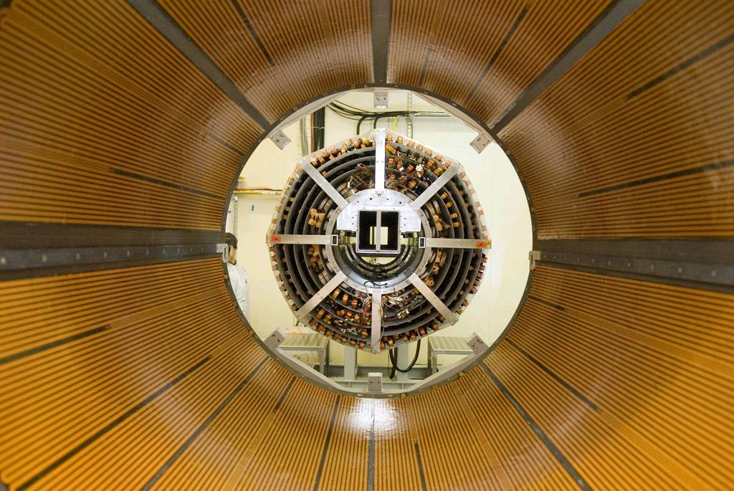
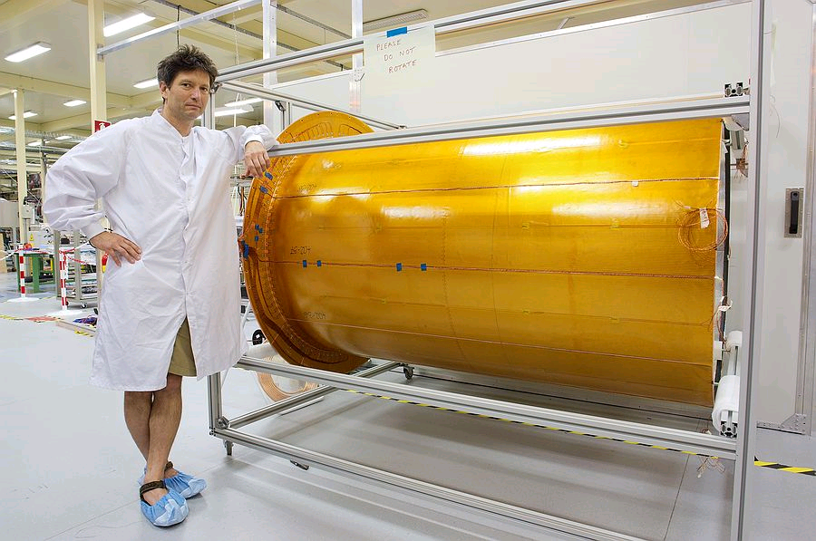
Large Scale Heater Pads
SCT operates at -7°C, TRT at 20°C
  Thermal barrier between the two detectors
  Thermal neutrality required
  Enclosure cooled to -7°C on SCT, heated to 20°C on TRT side
  Need large scale heater pads with ~ 200 W/m² power rating
  Large scale FPC technology can be easily ported to heater production
Thermal camera test
Heater pads in TRT barrel

Slide 14
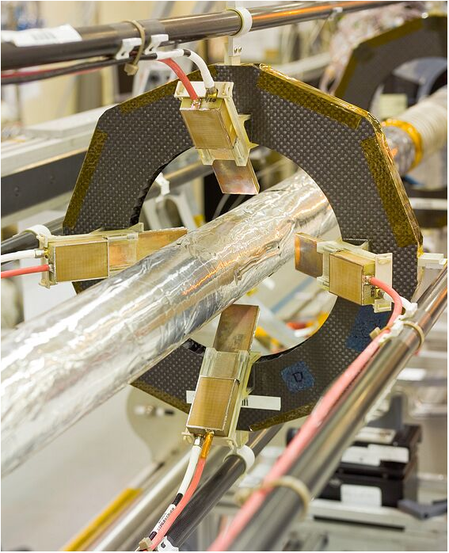
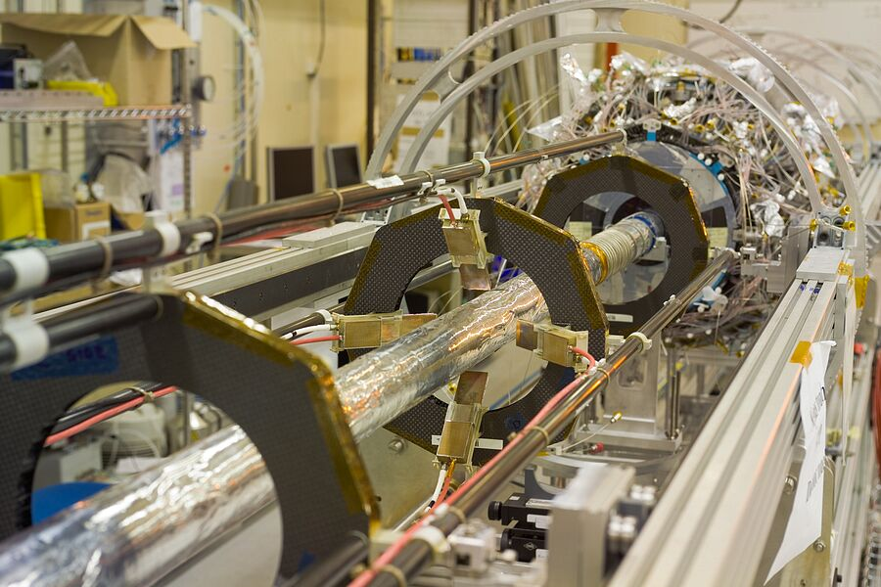
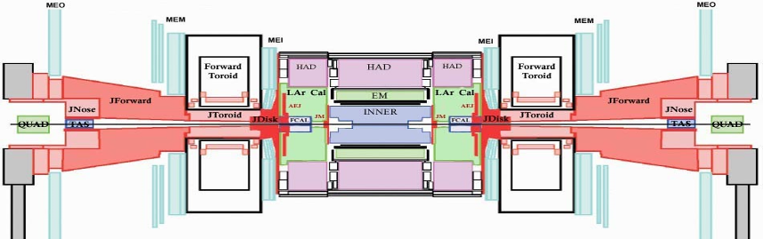
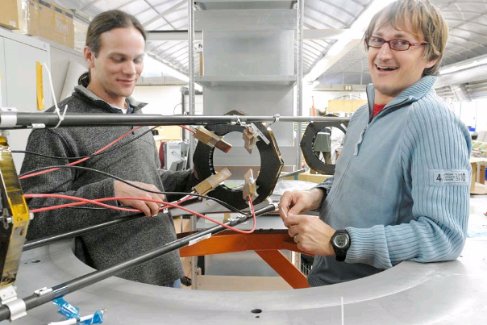
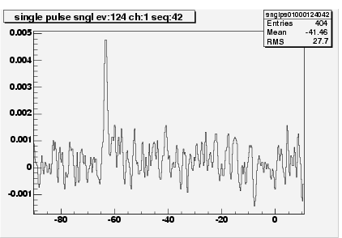
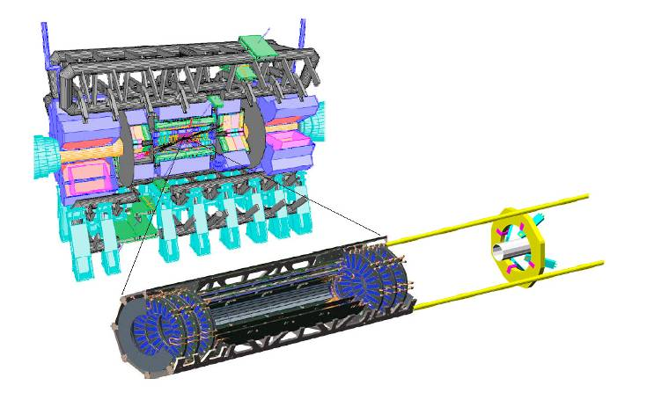
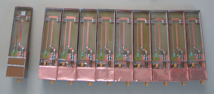
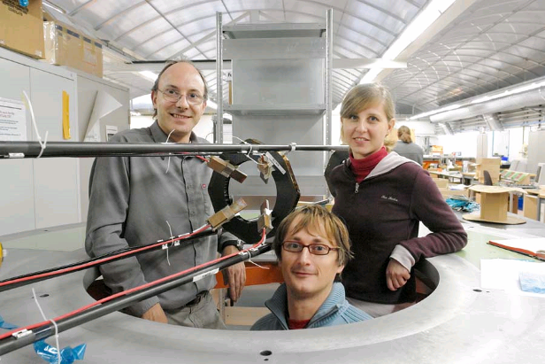


ATLAS – Beam Conditions Monitor
BCM - Beam Conditions Monitor
  Beam particles scraping at collimators
  Interactions with residual beam gas
  During LHC running
    First assessment of beam conditions
    Fast luminosity assessment
Beam anomaly (e.g. collimator) events are separated from genuine collisions by time of flight between two BCM stations
  Symmetric stations at r ~ 55 mm and z = ±1838 mm
    Collisions: Δt = 0, 25, … ns
    Collimator: Δt = Δz/c = 12,5 ns
  Requirements
    Fast response: risetime 1 ns, width 3 ns, BLR 10 ns
    Radiation hardness: 500 kGy, 10¹⁵ π/cm²
    Single MIP sensitivity – SNR ~ 10:1
Two stations, 4 x 1 cm² pCVD diamond detectors each
Fast two-stage 500 MHz current amplifier
Ljubljana, CERN, Wiener Neustadt, Toronto, Columbus (~15 people_
  Successfully installed in pixel detector in Jan 2007
signal
46 m
ATLAS
BCM
38 cm
Pixel
183cm

Slide 15


BCM performance
Time difference hit on A side to hit on C side
Most of data reconstructed offline
Sub ns resolution of BCM clearly visible (0.69 ns) without offline timing corrections applied
Beam dump fired by BCM during LHC aperture scan
Too sensitive at current conditions
  Beam monitoring only
  Measures to restore abort functionality
BA is fired
increasing activity
1177 LHC orbits – ~100 ms
after BA is fired the buffer is recorded
for additional 100 LHC orbits (~10 ms)
~10 ms

Slide 16




ATLAS BLM
8x8 mm² 0.5 mm thick diamond sensors used
6 sensors on each side (A and C) installed on ID End Plate
Readout adopted from LHC BLM system with minor modifications
Redundant system to BCM – safety only
7 TeV p on TAS collimator gives ~1 MIP/BLM module → ~1 fC of charge
  25 pA of current “spike” for single occurrence (possible with pilot bunch)
  40 nA of current for continuous loss (only when full LHC bunch structure)
Diamond dark currents
  In magnetic field, should be O(10 pA)
  Erratic currents, several nA w/o magnetic field
Require 2 ch. above threshold simultaneously
BCM
BLM
~ 50 nA increased to 500 nA
~50 nA
CFC counts
several hours
single channel
max. rates / sec
…

Slide 17


ATLAS Off-Line / Physics
Active in preparation of several software tools
  MC event generators
  Electron bremsstrahlung recuperation
  Top physics
  Minimum bias / luminosity

Slide 18














EGEE – Grid Computing
Grid computing in a nutshell
  World Wide Web enabled document exchange over the Internet
  Grid should extend this to arbitrary computing resources
  A functional Grid is a prerequisite for LHC data analysis !
EGEE project
  LHC experiments need the Grid
  CERN establishes LCG – LHC Computing Grid for coordination of efforts towards the Grid
  70(→90) partners from Europe with support of USA, Russia and Japan submit 6th & 7th FP IST infrastructure projects EGEE, EGEE-II and EGEE-III
  Projects approved in 2004/06/08 duration 3x2 years, EU contribution close to 100 MEUR
  EGEE consists of 12 federations, as intermediate layer between partners and EGEE
Slovenia in EGEE
  Group active in ATLAS is participating
  Support of Ministry/SRA to acquire SiGNET computing cluster (~1200 processors, 600 TBy RAID storage)
  Grid-enabled on gLite and NorduGrid platforms
  SiGNET CA part of EUGridPMA
Successfully mastered transition to NGI (ARNES)
TIER-2 centre part of WLCG
Grid works in Slovenia !

Slide 19
HEP Today: Belle

Slide 20







Belle achievements
Confirmation of CKM mechanism
probably greatest acknowledgment of B-factory achievements: Nobel Prize 2008
Small discrepancies with SM present in data: Hint of NP ?
2008
direct
...
indirect fit
D⁰ mixing & CP: SM or NP?
sin 2φ₁

Slide 21



Belle-II Goals
Study discrepancies, search for New Physics
high precision frontier, complementary to high energy frontier (LHC)
illustrative reach for NP:
    even for Minimal Flavor Violation M_{NP} ~ O(1 TeV)
Exploit correlations among variables and overconstrained measurements to identify nature of NP:
t-dependent
CP in B⁰ → K*⁰ γ
Belle II and
Super KEKB
well on the way
to start data
taking in 2014
expected
sensitivity
of SuperBelle
5 ab⁻¹
t-dependent
CP in B⁰ → K_{S} φ
t-dependent
CP in B⁰ → K_{S} φ

Slide 22
Belle-II and SuperKEKB

Slide 23

PID at Belle-II
Two new particle ID devices, both RICHes:
Barrel: Time-of-propagation (TOP) counter
Endcap: proximity focusing RICH

Slide 24


End-cap PID: Proximity focusing RICH
Proximity focusing RICH with silica aerogel as Cherenkov radiator in a ‘focusing’ configuration
x-y view
n₁< n₂
420mm
1145mm
Position sensitive photodetector for
B=1.5T: HAPD
Novel concept: Multi-layer ‘focusing’ radiator, n~1.05

Slide 25

Astro-Particle: Pierre Auger Observatory
Effort led by Prof. D. Zavrtanik (University of Nova Gorica)
  6 researchers at UNG, 2 at JSI
  In construction of Southern Site contributed to the LIDAR atmospheric monitoring system
  Active in shower modelling

Slide 26

PAO achievements & plans

Slide 27


PAO link to LHC
Light to heavy transition (galactic to extragalactic component) ?
Change in cross-section and multiplicity ?
    Models extrapolate inadequately to these energies ?
    LHC data important !

Slide 28

HEP: Theory
Department of Theoretical Physics Jožef Stefan Institute

Slide 29

Theory: CERN Related Topics

Slide 30



CERN: Industrial Participation
ATLAS experience
  About 1.2 MCHF out of 1.7 MCHF CORE investment returned to Slovenia
  Almost exclusively to Elgoline Ltd.
    Low-mass tapes
    Large scale heater pads
    Conventional patch panels
Adequate industrial return thus possible
  Required major effort by researchers to identify and help developing the products
Longer term return as CERN member state ?
  Contribution to machine and its upgrades
  Two high-tech companies ideally suited to bid for CERN orders, both targeting accelerator control
    COSYLAB in Ljubljana
    Instrumentation Technologies in Solkan

Slide 31



CERN: Scientific Return
During the 35 years of scientific collaboration with CERN
  ~440 scientific papers published
  ~8400 citations in SCI database
  17 BSc, 12 MSc and 18 PhD theses
  Participation in CERN-led EU FP
    EGEE, MC-PAD, AIDA
  Several fellowships and associate-ships granted
CERN initiated Slovenian HEP and although no longer CERN-exclusive, Slovenian HEP has benefitted enormously from this collaboration

Slide 32
HEP: Prospects
Long term experimental HEP commitments
  ATLAS and its upgrades
    Expect at least a decade of successful physics at (s)LHC
    R&D already in full swing
  Belle-II
    Shorter time-scale, but still until end of this decade
Astro-particle wants to participate in Northern PAO, if approved

Slide 33




From LHC to SLHC
Chamonix 2010 brought (cruel) reality into LHC luminosity forecast
730 fb⁻¹ not reached by 2020
“Standard” LHC/sLHC scenario
(not-so-far-pre-Chamonix)
M. Lamont: Chamonix 2010

Slide 34



SLHC sensor requirements
Small radii: 3-5 cm
Main constraint: radiation damage after 6000 fb⁻¹ (by 2030)
  Ballpark fluence 10¹⁶ n_{eq}/cm²
  Could be a factor 2-3 more, depending on exact radius (~1/r²), flat along z
  Predominantly pions (>90 %)
  Broad energy spectrum peaked at O(100 MeV)
3000 fb⁻¹, 84 mb
I. Dawson

Slide 35
Sensors contending 10¹⁶
Planar silicon
  Exploiting charge multiplication
3-D silicon
  Novel silicon processing
Diamond
  New material
All three options rely on technology / mode of operation not utilized in HEP so far
Obviously, there is no free lunch
CERN RD-50
CERN RD-42

Slide 36


Radiation damage studies: RD-50
RD50 Collaboration 2010

Slide 37
Radiation damage studies: RD-42
M. Artuso²⁵, D. Asner²², M. Barbero¹, V. Bellini², V. Belyaev¹⁵, E. Berdermann⁸, P. Bergonzo¹⁴, S. Blusk²⁵, A. Borgia²⁵, J-M. Brom¹⁰, M. Bruzzi⁵, D. Chren²³, V. Cindro¹², G. Claus¹⁰, M. Cristinziani¹, S. Costa², J. Cumalat²⁴, R. D’Alessandro⁶, W. de Boer¹³, D. Dobos³, I. Dolenc¹², W. Dulinski¹⁰, J. Duris²⁰, V. Eremin⁹, R. Eusebi⁷, H. Frais-Kolbl⁴, A. Furgeri¹³, K.K. Gan¹⁶, M. Goffe¹⁰, J. Goldstein²¹, A. Golubev¹¹, A. Gorisek¹², E. Griesmayer⁴, E. Grigoriev¹¹, D. Hits¹⁷, M. Hoeferkamp²⁶, F. Huegging¹, H. Kagan^{16,t}, R. Kass¹⁶, G. Kramberger¹², S. Kuleshov¹¹, S. Kwan⁷, S. Lagomarsino⁶, A. La Rosa³, A. Lo Giudice¹⁸, I. Mandic¹², C. Manfredotti¹⁸, C. Manfredotti¹⁸, A. Martemyanov¹¹, D. Menichelli⁵, M. Mikuz¹², M. Mishina⁷, J. Moss¹⁶, R. Mountain²⁵, S. Mueller¹³, G. Oakham²², A. Oh²⁷, P. Olivero¹⁸, G. Parrini⁶, H. Pernegger³, M. Pomorski¹⁴, R. Potenza², K. Randrianarivony²², A. Robichaud²², S. Roe³, S. Schnetzer¹⁷, T. Schreiner⁴, S. Sciortino⁶, S. Seidel²⁶, S. Smith¹⁶, B. Sopko²³, K. Stenson²⁴, R. Stone¹⁷, C. Sutera², M. Traeger⁸, D. Tromson¹⁴, W. Trischuk¹⁹, J-W. Tsung¹, C. Tuve², P. Urquijo²⁵, J. Velthuis²¹, E. Vittone¹⁸, S. Wagner²⁴, J. Wang²⁵, R. Wallny²⁰, P. Weilhammer^{3,t}, N. Wermes¹
Spokespersons
87 Participants
1 Universitat at Bonn, Bonn, Germany
2 INFN/University of Catania, Catania, Italy
3 CERN, Geneva, Switzerland
4 Wiener Neustadt, Austria
5 INFN/University of Florence, Florence, Italy
6 Department of Energetics/INFN, Florence, Italy
7 FNAL, Batavia, USA
8 GSI, Darmstadt, Germany
9 Ioffe Institute, St. Petersburg, Russia
10 IPHC, Strasbourg, France
11 ITEP, Moscow, Russia
12 Jozef Stefan Institute, Ljubljana, Slovenia
13 Universitat at Karlsruhe, Karlsruhe, Germany
14 CEA-LIST, Saclay, France
15 MEPHI Institute, Moscow, Russia
16 Ohio State University, Columbus, OH, USA
17 Rutgers University, Piscataway, NJ, USA
18 University of Torino, Torino, Italy
19 University of Toronto, Toronto, ON, Canada
20 UCLA, Los Angeles, CA, USA
21 University of Bristol, Bristol, UK
22 Carleton University, Ottawa, Canada
23 Czech Technical Univ., Prague, Czech Republic
24 University of Colorado, Boulder, CO, USA
25 Syracuse University, Syracuse, NY, USA
26 University of New Mexico, Albuquerque, NM, USA
27 University of Manchester, Manchester, UK
27 Institutes
RD42 Collaboration 2010

Slide 38




2008 – “discovery” of charge multiplication
Measurement of anomalously high charge collection efficiency in n⁺p strip detectors irradiated by up to 10¹⁶ n_{eq}/cm²,
I.Mandić et al. NIM A603(2009)263
CCE results totally incompatible with simulation based on N_{eff} and trapping data from lower fluences !
Plenty of recent results confirm this observation
10¹⁶
10¹⁶
A. Affolder, planar
R. Bates, 3D
Both Manchester/Trento Workshop Feb10

Slide 39






ATLAS Diamond Tracker Upgrade
DPix Collaboration
  Bonn
  Carleton
  CERN
  Ljubljana
  Ohio State
  Toronto
Approved by ATLAS EB Mar’08
  EDMS: ATU-RD-MN-0012

Slide 40


ATLAS Strip Tracker Upgrade
Phase-II (sLHC) upgrade requires replacement of complete ATLAS tracker
  4-5 layers of pixel detector
  TRT replaced by silicon strips
Participating in upgrade R&D project

Slide 41
Conclusion
Slovenian HEP perfectly integrated into the international HEP community, both at CERN and elsewhere
Past achievements, present engagements and future directions guarantee stable and sustainable development in the decade to come

