Slide 1
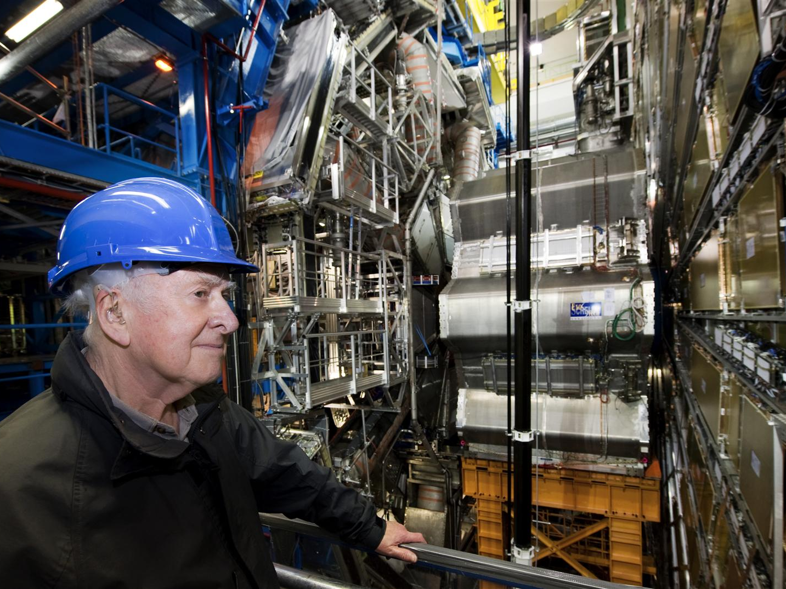



Higgs Boson Searches with the ATLAS Detector
Marko Mikuž
University of Ljubljana & Jožef Stefan Institute
Physics Department Monday Colloquium
Faculty of Mathematics and Physics, University of Ljubljana
January 16, 2012

Slide 2
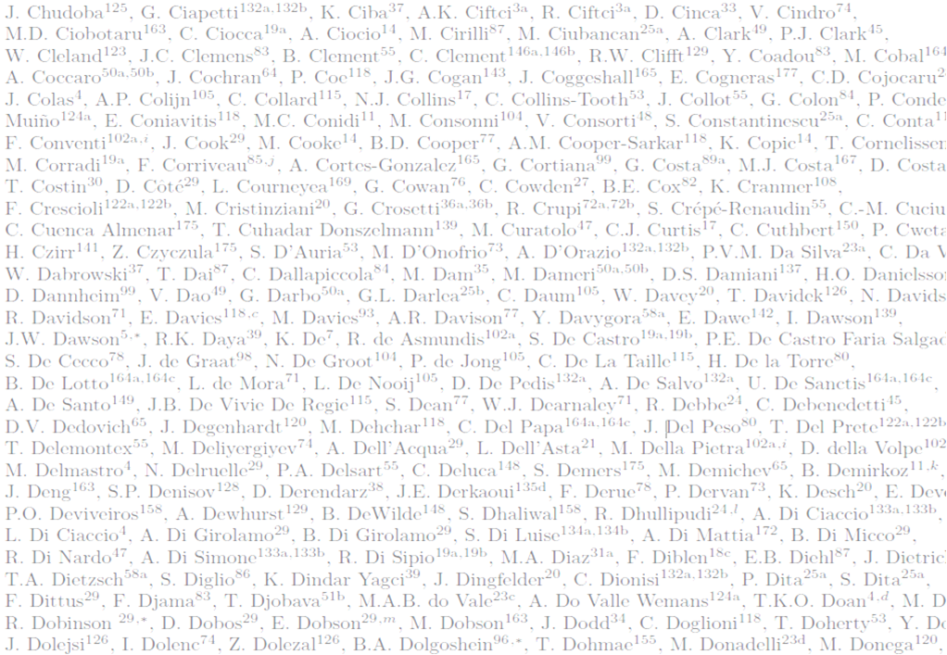
Acknowledgements
This presentation rests on the shoulders of over 3000 ATLAS colleagues who built and operate the ATLAS detector, and who tirelessly analyzed the data .
An important contribution to the overall effort has been carried out by members of the Slovenian ATLAS team: V. Cindro, M. Deliyergiyev, I. Dolenc, A. Filipčič, A. Gorišek, B.P. Kerševan, G. Kramberger, B. Maček, I. Mandić, L. Mijović, M. Mikuž and A. Tykhonov
The prerequisite for these studies was the seamless and astonishingly ever-improving performance of the Large Hadron Collider in 2011.

Slide 3
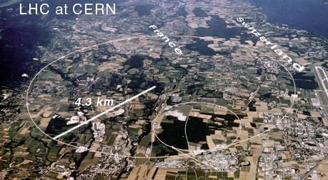
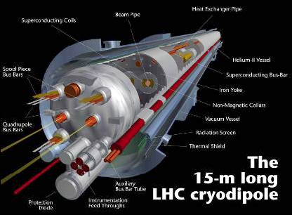
Large Hadron Collider
Large Hadron Collider
  proton-proton collider
  Design CMS energy 14 (2x7) TeV, currently at 7 TeV
  Design lumi 10³⁴ cm⁻²s⁻¹, ~1/3 achived so far
Why 3.5 (CMS 7) TeV ?
  LHC in 28 km LEP tunnel (recycling)
  Energy at r_{LEP} limited by superconducting magnets
    B_{max} = 8,3 T → E_{max} = 7 TeV
  Following major incident in Sep’08 blowing up ~50 magnets
    3.5 TeV considered safe
Consolidation to design values during 2013(14) break

Slide 4
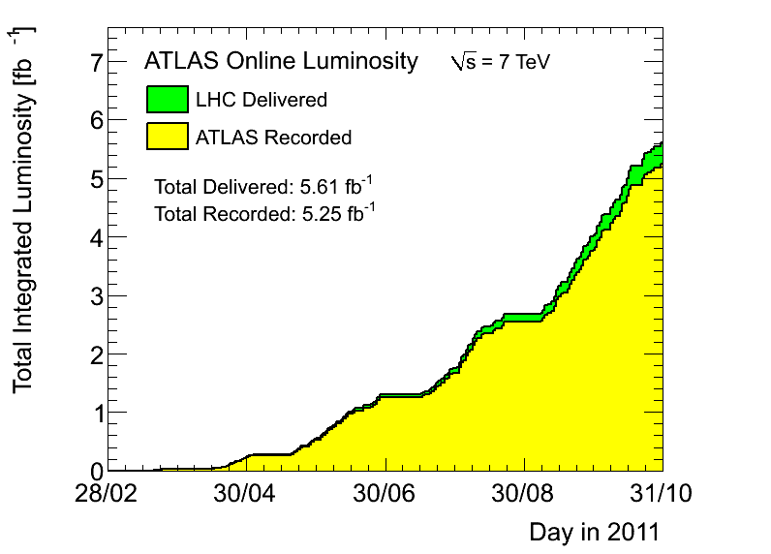
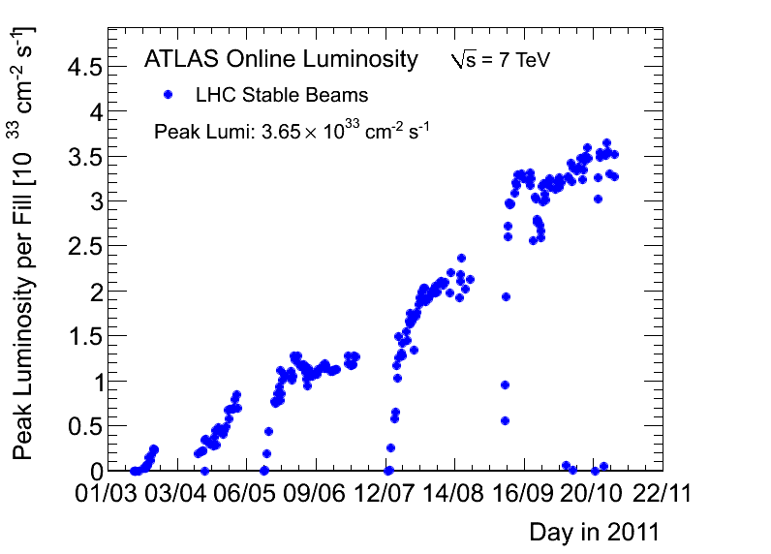

LHC Performance in 2011
The yearly plan at the Chamonix meeting (Jan’11) was >1 fb⁻¹ per experiment
Due to increased peak luminosity up to 3.6x10³³ cm⁻²s⁻¹ the final integrated luminosity surpassed 5 fb⁻¹ by end of 2011
half of the luminosity (~ 2.5 fb⁻¹) was delivered in the final month of running
10³³ cm⁻²s⁻¹

Slide 5
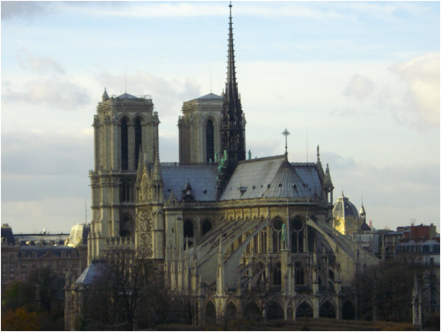
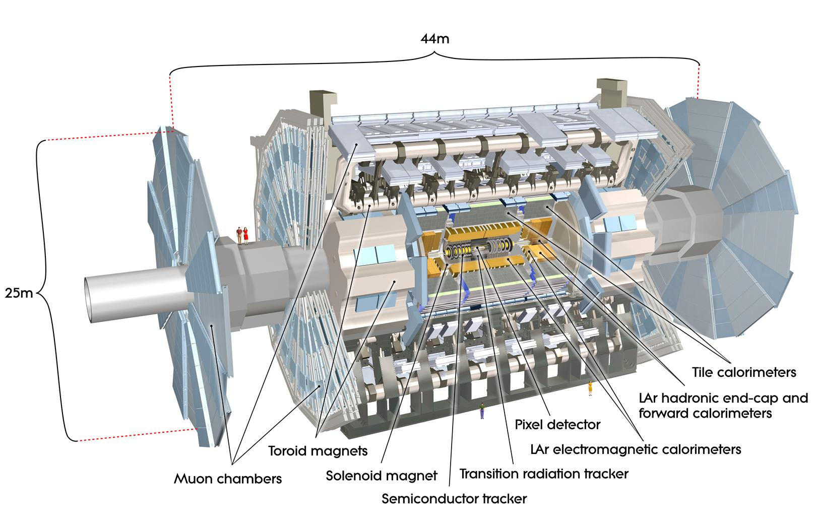

ATLAS Detector

Slide 6
Generic LHC Detector for All Particles
Magnetic field: Bends charged particles
enabling momentum measurement
electron
Hadronic calorimeter:
Contains hadronic shower and
measures its energy (with EM)
neutrino
Only neutrinos escape detection
muon
Electromagnetic calorimenter:
Contains EM shower and measures its energy
Muon detector:
Re-measures muon tracks
hadron
Low-mass tracker: Performs
precision measurement of
several hits along particle trajectory

Slide 7
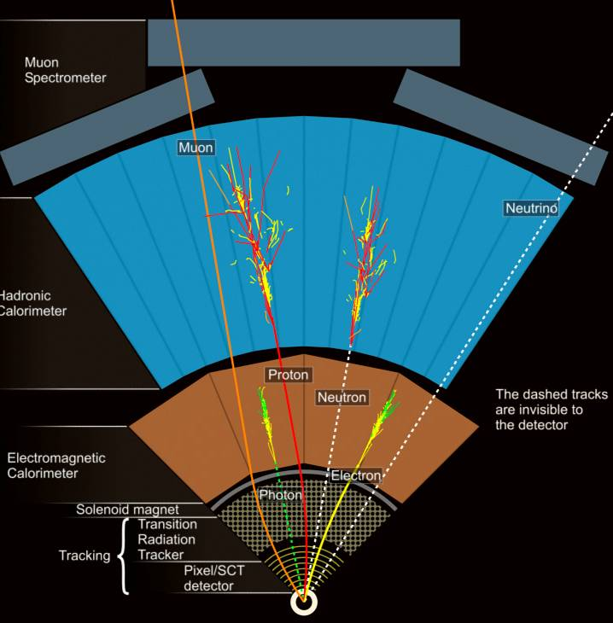
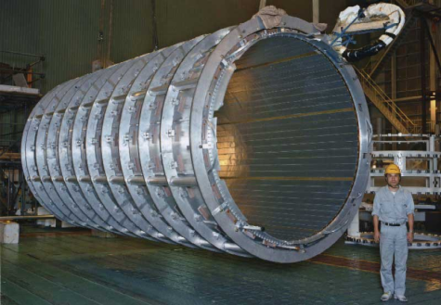
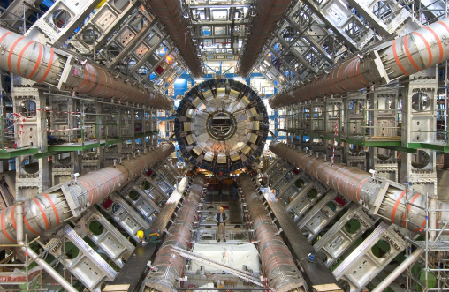
Colider Detector Arrangement
Detectors arranged in layers encircling the interaction point
ATLAS employs two magnet systems
  2 T SC solenoid for the Inner detector (tracker)
  Gigantic SC 4T(max.) toroid for muon system

Slide 8
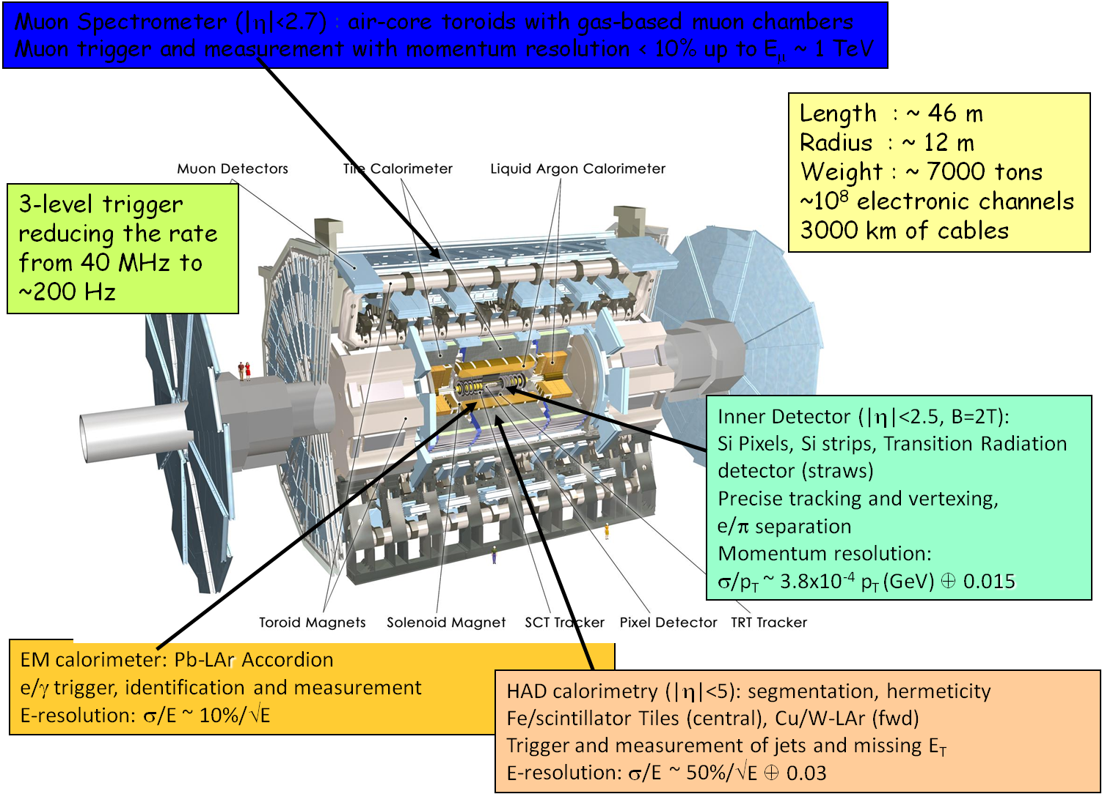
The Real Thing

Slide 9

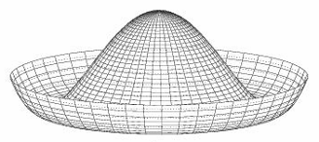
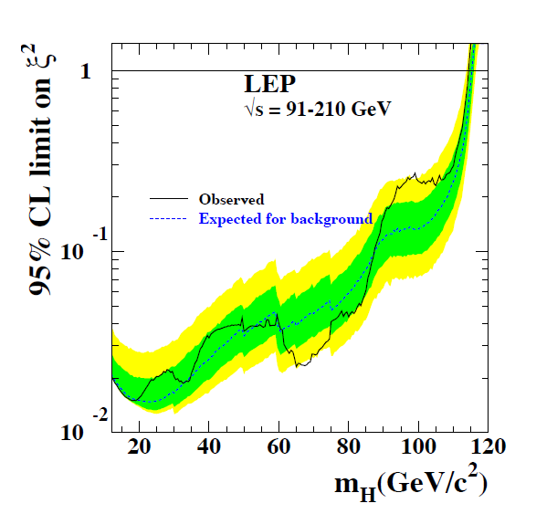
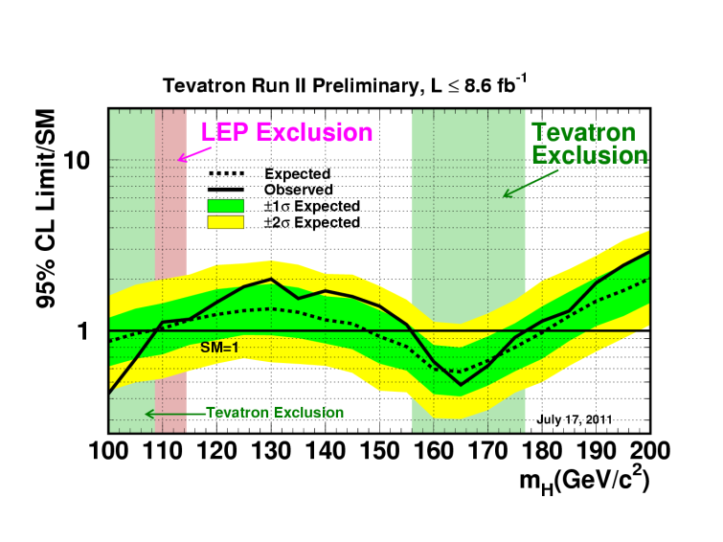
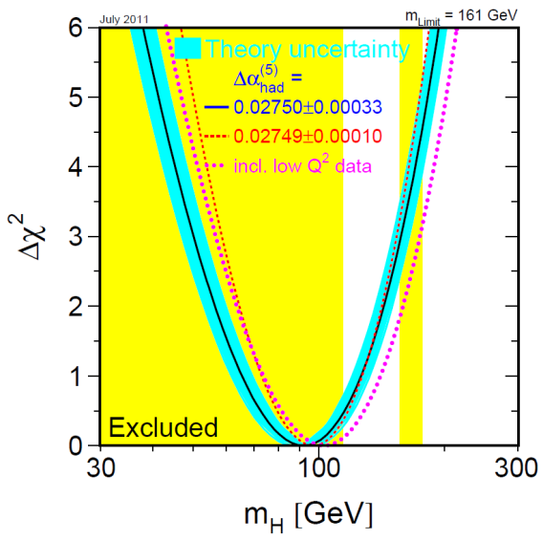
Higgs Boson
The Standard model relies on the Higgs mechanism to supply all masses in a theoretically consistent way
Higgs field spontaneously breaks the electroweak symmetry thereby providing the large W and Z boson masses
The remaining component of the scalar field remains as the Higgs particle – the only fundamental scalar of the Standard model
Leptons and quarks acquire mass through Yukawa interaction with the Higgs field
LEP measurements excluded the Higgs boson up to a mass of 114.4 GeV (95 % CL)
  Hints of an excess right at the exclusion limit (~3σ ALEPH, no signal in other 3)
Tevatron measurements exclude the Higgs boson in the regions 100-109 and 156-177 GeV (@LP’11),
  Prospects to push the lower limit up to 125 GeV
The global electroweak fit constrains the Higgs mass to < 185 GeV
General theoretical arguments require Higgs mass lighter than 1 TeV
Peter Higgs
EW global fit

Slide 10
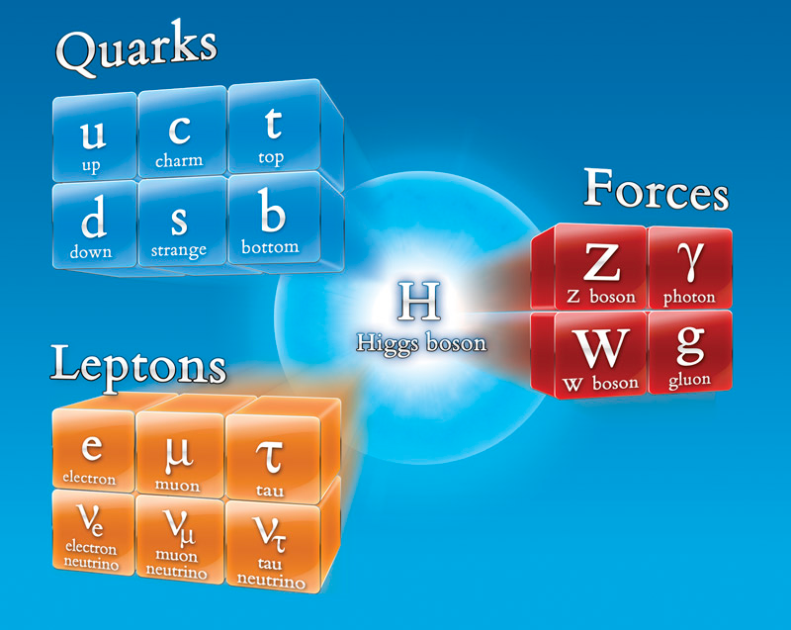
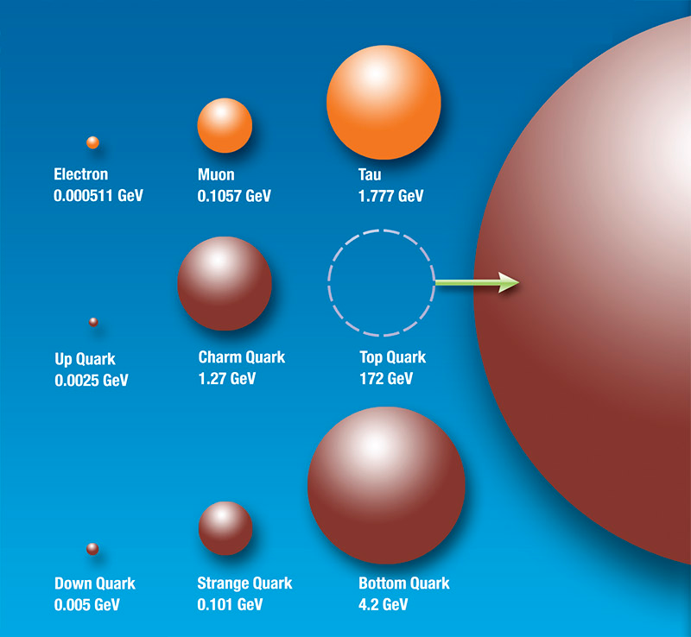
Higgs Discovery
The discovery of the Higgs particle would wrap up the Standard model in the most elegant and simple way
  Light Higgs most natural, but opens up the possibility of a desert up to Planck scale
  Measurement of Higgs properties a sensitive tool for probing New Physics

Slide 11
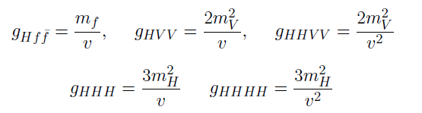
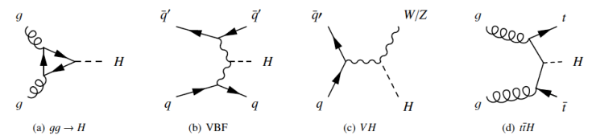
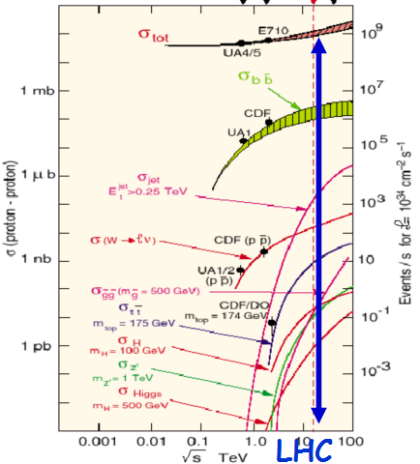
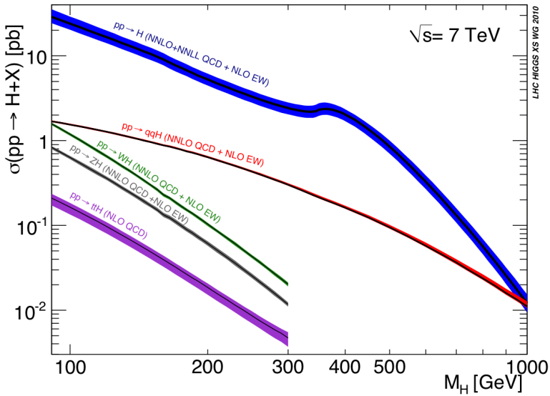
Higgs Production @ LHC
Higgs couples to mass
  Linear for coupling to fermions (Yukawa)
  Quadratic for weak bosons
Production in 7 TeV pp collisions
  Predominantly through gluon-gluon fusion
  Cross section O(10 pb)
    QCD to NNLO
    Errors < 20 %
    Total pp O (100 mb)
  Associated with W, Z
    Smaller x-section
    Useful W,Z tag
~ 20 x Tevatron
for m_{H}=120 GeV
7 14 TeV

Slide 12
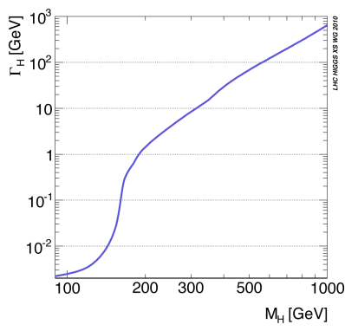
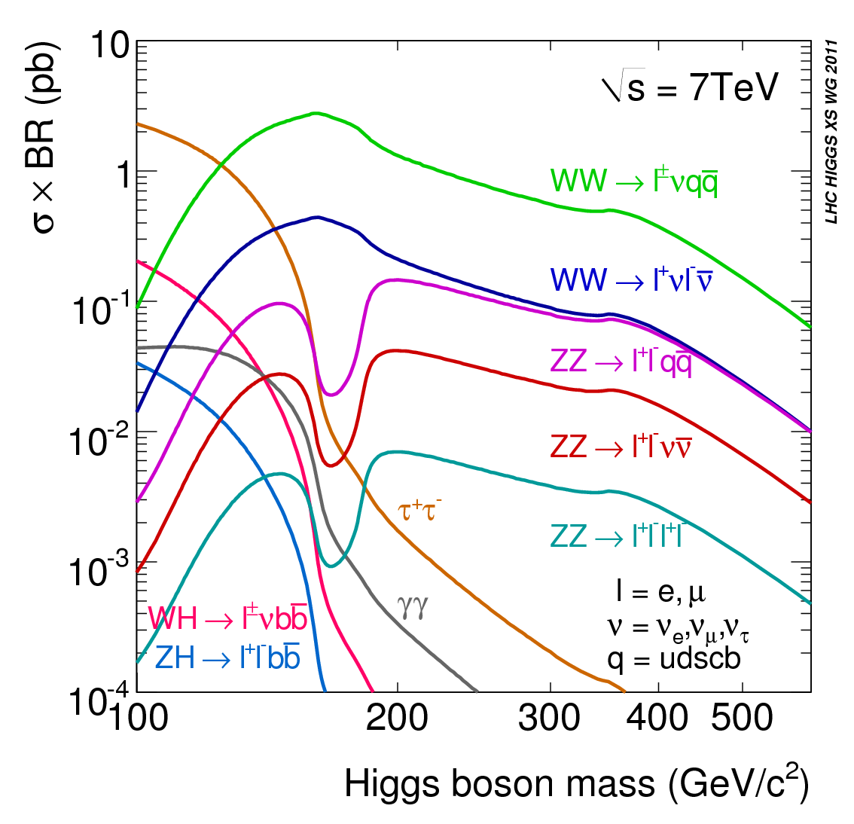
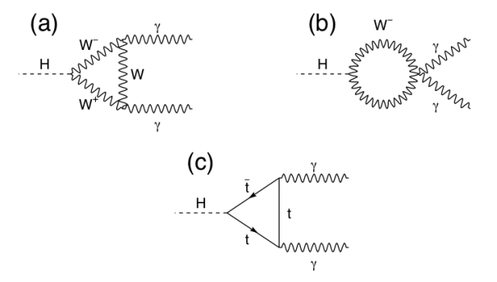
Higgs Decays
Higgs decay branching ratios determined by mass couplings
  Decays to weak bosons dominate if kinematically allowed
    One of the bosons can be virtual
  For low masses two-photon, b-quark and tau decays
    Two photons via loops
125-180
WW^{(*)}→ lνlν
<130
γγ
300-600
ZZ→ llνν
125-300
ZZ^{(*)}→ llll

Slide 13
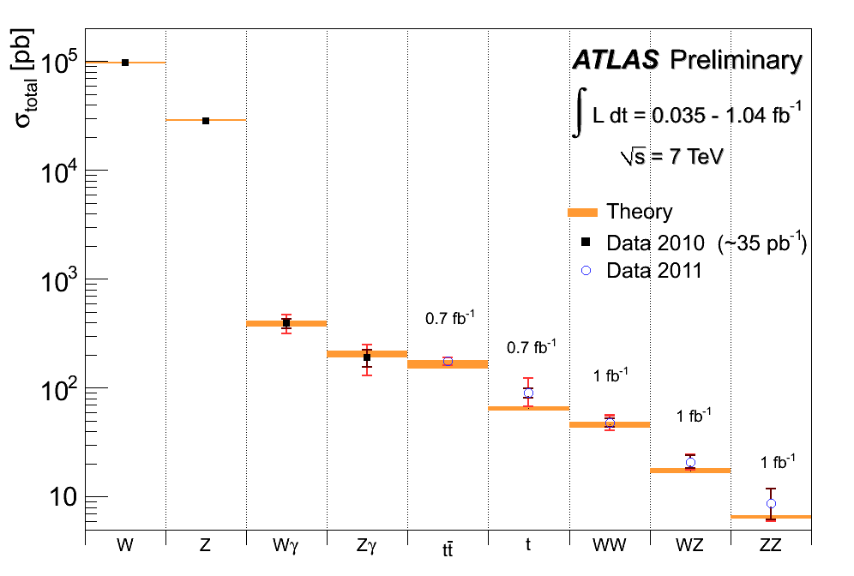
Higgs Detection @ LHC
Rare process
  Production only O(10⁻¹⁰) of total cross section
  Further suppression by branching ratio
Huge backgrounds
  Need distinct event features
    Leptons from W, Z
    Energetic gammas
    Golden channel: H→ZZ → 4l
    H→ZZ → 4l and H→γγ can be fully reconstructed: H invariant mass, but σxBR O(10 fb)
    H→WW → lν lν has two missing ν’s, σxBR O(100 fb)
  Need to understand how to model backgrounds
    From data and Monte Carlo
  Yesterday’s signals are today’s backgrounds

Slide 14
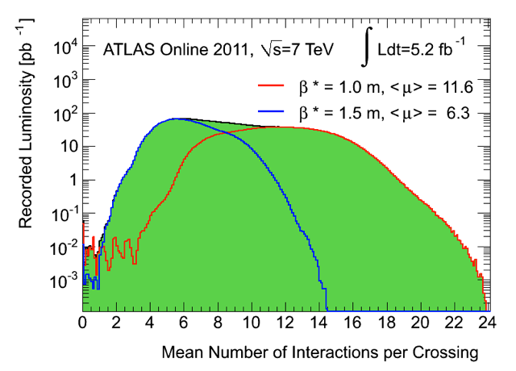
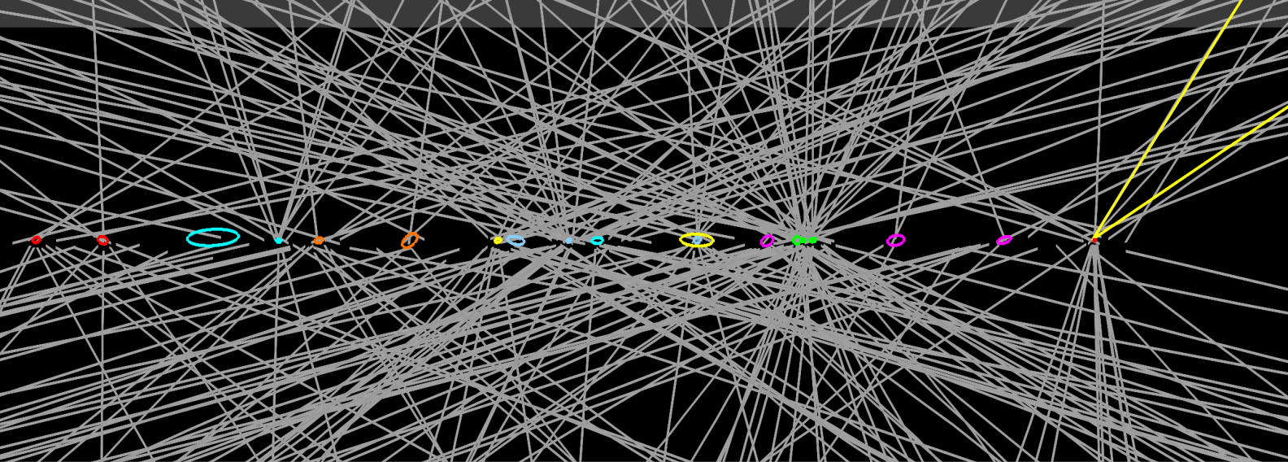
Additional Burden – Pile-Up
LHC still operates with 50 ns bunch spacing
  ~1 collision per bunch crossing @ L=2x10³² cm⁻²s⁻¹
  ~20 overlaid collisions at highest luminosity
  Challenging environment despite marvelous tracker performance
    E.g. loose primary vertex constraint for H→γγ
    Backgrounds even harder to control
Event with 20
reconstructed vertices
(ellipses have 20 σ size for
visibility reasons)
Period A:
up to end
August
Period B:
Sept-Oct
Z→ μμ

Slide 15
Signal in Presence of Background
Most powerful detection channels at low masses
  H→WW^{(*)} → lν lν (counting excess events)
  H→ZZ^{(*)} → 4l (H mass)
  H→γγ (H mass)
All suffer from background
  Leptons from W, Z decays, QCD background
Small σxBR results in small event samples
  Downward fluctuation of signal can prevent detection
    False negative (signal interpreted as background)
  Upward fluctuation of background can mimic signal
    False positive (background interpreted as signal)
Need careful, unbiased statistical treatment to assess

Slide 16
Example: Poisson Noise in an Image
10³ photons

Slide 17
Poisson Noise in an Image
10⁴ photons

Slide 18
Poisson Noise in an Image
10⁵ photons

Slide 19
Poisson Noise in an Image
10⁶ photons

Slide 20
Poisson Noise in an Image
10⁷ photons

Slide 21
Poisson Noise in an Image
10⁸ photons

Slide 22
Poisson Noise in an Image
10⁹ photons
Statistics definitely helps !

Slide 23
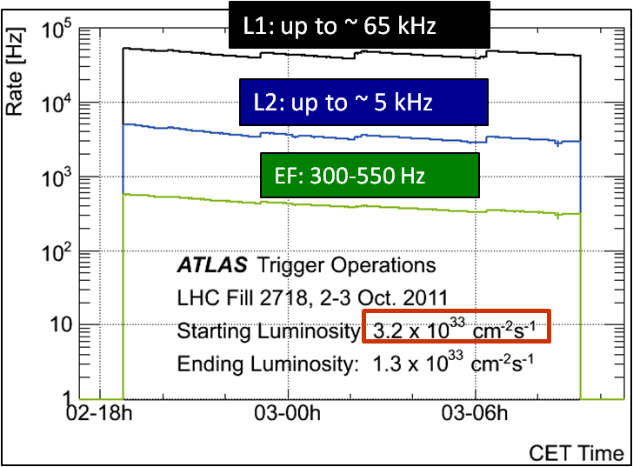
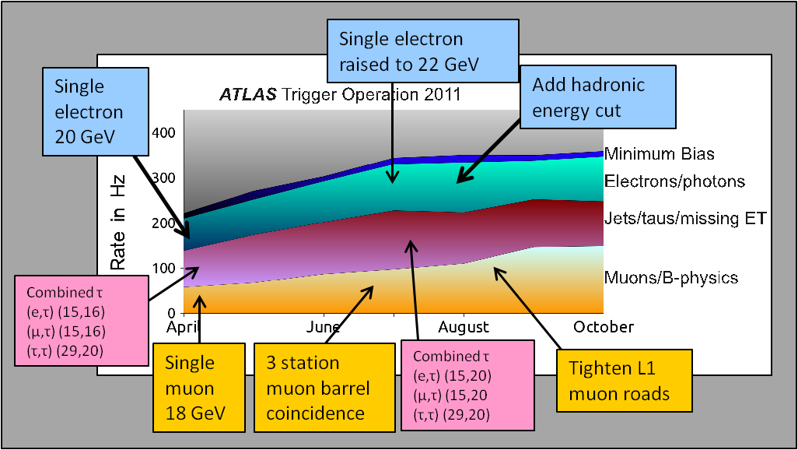
Sample Selection
Initial event rate 20 MHz, (multiple) collisions every bunch crossing
Three level trigger reduces this to 300-500 Hz of recorded events
  Trigger focuses on energetic jets, leptons and photons thus efficiency high for relevant Higgs decays
Off line sample selection
  Based on (conservative) cut-based selections of characteristic objects: electrons, muons, photons
  Large and sometimes not well-known backgrounds estimated mostly with data-driven techniques using signal-free control regions

Slide 24
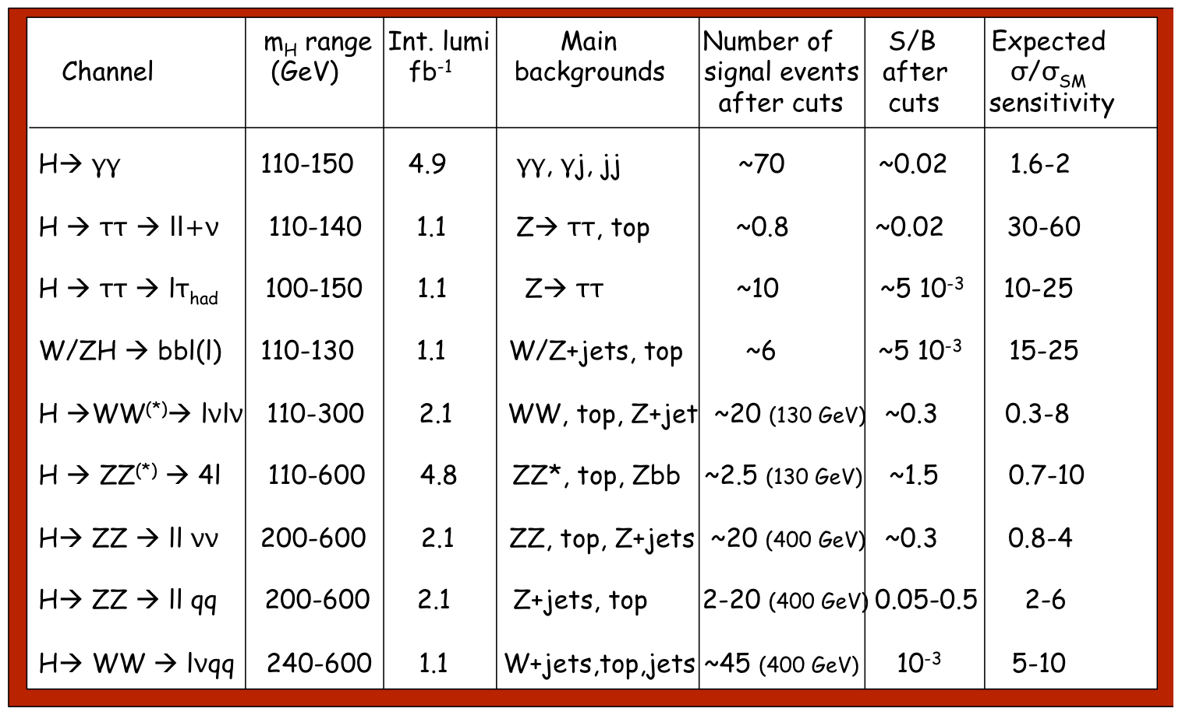
2011 Higgs Sample Summary

Slide 25
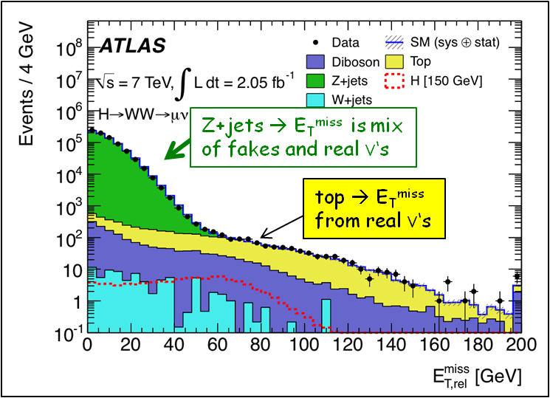
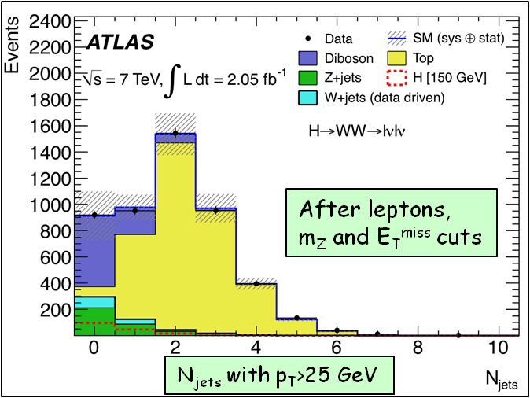
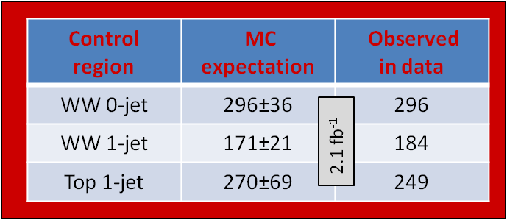
H → WW^{(*)} → lνlν
Most sensitive channel ~ 125-180 GeV (σ ~ 200 fb)
  Challenging: two missing ν → no mass reconstruction/peak → “counting channel”
  2 isolated opposite-sign leptons, large E_{Tmiss}
  Main backgrounds: WW, top, Z+jets, W+jets
    m_{ll} ≠ m_{Z}, b-jet veto, …
    topological cuts against “irreducible” WW background: pT_{ll}, m_{ll}, Δϕ_{ll} (smaller for scalar Higgs), m_{T} (ll, E_{Tmiss})
Crucial experimental aspects:
  Understanding of E_{T}^{miss} (genuine and fake)
    Sensitive to pile-up !
  Excellent understanding of background in signal region → use signal-free control regions in data to constrain MC → use MC to extrapolate to the signal region

Slide 26
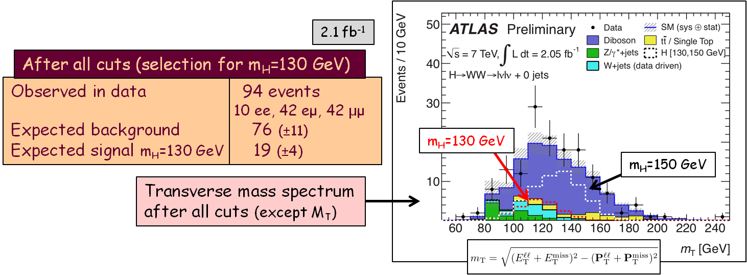
H → WW^{(*)} Final Sample
Final control plot with ~half of 2011 data
  E_{T}^{miss} spectrum and resolution very sensitive to pile-up → we will include high pile-up data when understanding it at similar level as the first half
Some excess observed,
  Reminiscent of a ~130 GeV Higgs, but less than two σ from background
  Definitely much less (number & shape) than in presence of a 150 GeV Higgs

Slide 27
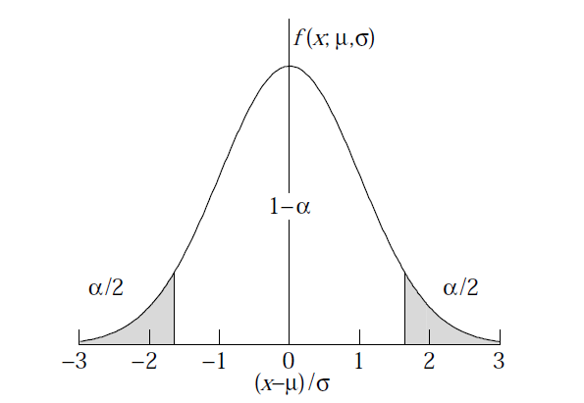
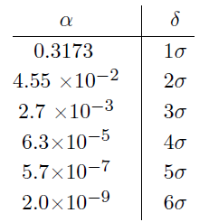
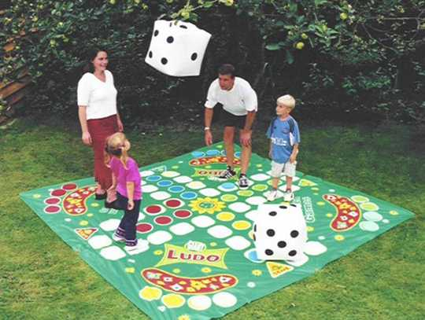

Background Fluctuations
Background is a random process, N_{bg} often well described by Poisson (Gauss) pdf
The N-σ significance refers to probabilities of an excursion from mean for relevant pdf
For exclusion of signal presence, ~2 σ downward fluctuation of expected S+B is taken, allowing for 5 % false negatives
For detection of particles two landmarks on upward background fluctuation are agreed
  3 σ: evidence, 0.13 % false positives
  5 σ: discovery, <3⁻⁷ false positives
To bring these numbers into perspective
  For a (fair) dice in a ludo game
    1 σ effect: ~six in first trial
    2 σ effect: ~2 consecutive sixes in a row
    Evidence: ~4 consecutive sixes in 2 trials
    Discovery: ~8 consecutive sixes in a row
When would you start suspecting someone is cheating ?

Slide 28
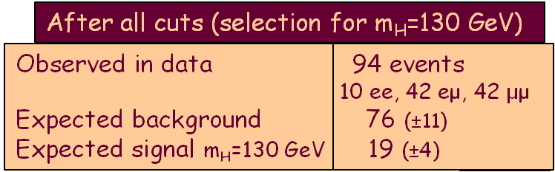
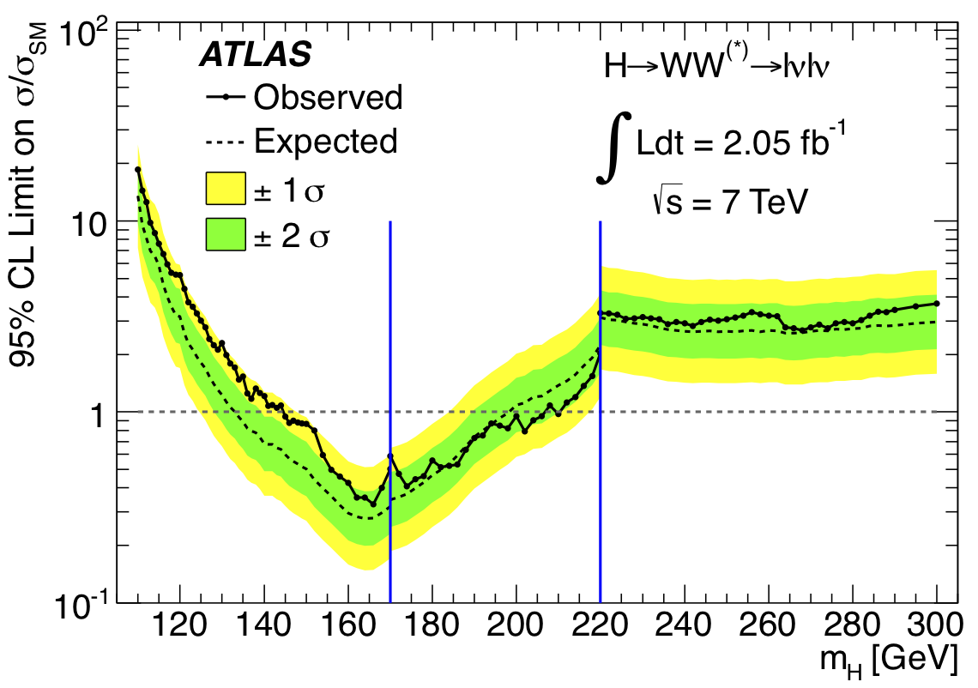
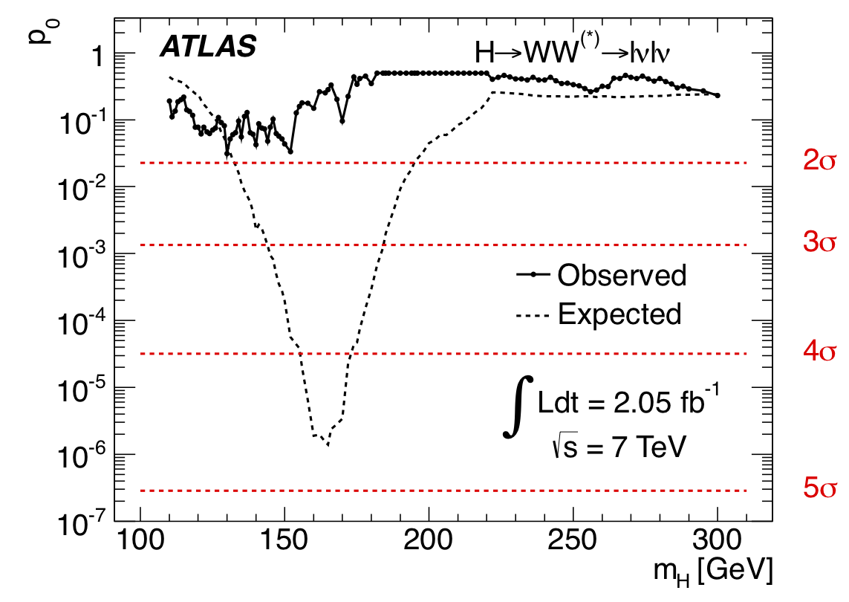
H → WW^{(*)} Limits
p₀ - consistency of data with
background-only expectation
Expected from
SM Higgs at
given m_{H}
Vertical lines indicate
points where selection
changes
Excluded (95% CL): 145 < m_{H} < 206 GeV (expected: 134-200 GeV)
Observed limit within 2σ of expected: max deviation 1.9 σ for m_{H} ~ 130 GeV

Slide 29
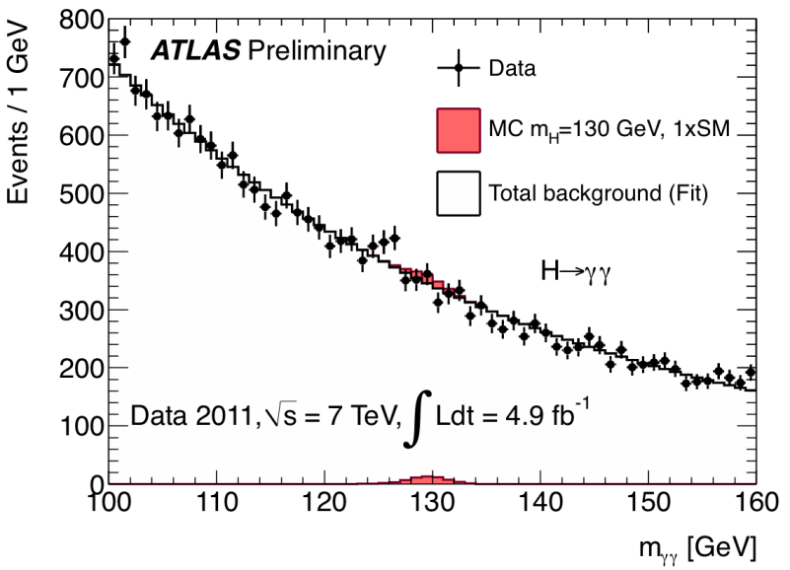
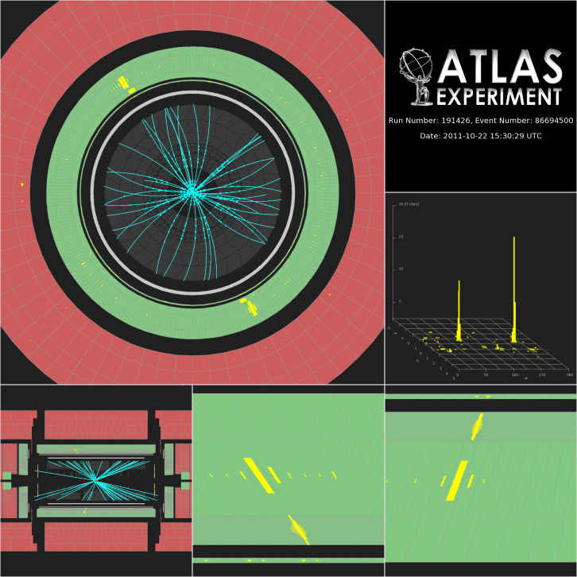
H→γγ
Small cross-section: σ ~ 40 fb
Simple final state: two high-p_{T} isolated photons
  E_{T} (γ1, γ2) > 40, 25 GeV
  Main background: γγ continuum
    irreducible, smooth, ..
Events divided into 9 categories
  based on η-photon (e.g. central, rest, …), converted/unconverted, p_{T}^{γγ} perpendicular to γγ thrust axis
~70 signal events expected in 4.9 fb⁻¹ after all selections for m_{H}=125 GeV
  ~ 3000 background events in signal mass window → S/B ~ 0.02
Crucial experimental aspects:
  excellent γγ mass resolution to observe narrow signal peak above irreducible background
  powerful γ/jet separation to suppress γj and jj background with jet → π⁰ faking single γ

Slide 30
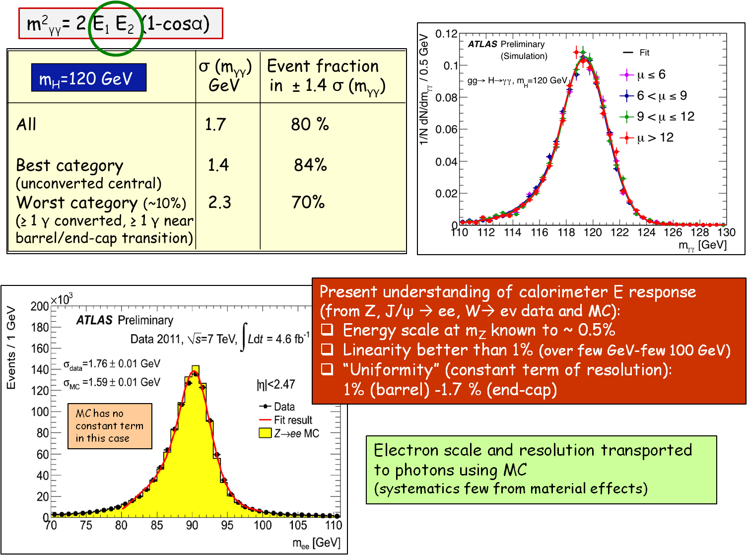
H→γγ invariant mass – γ energy

Slide 31
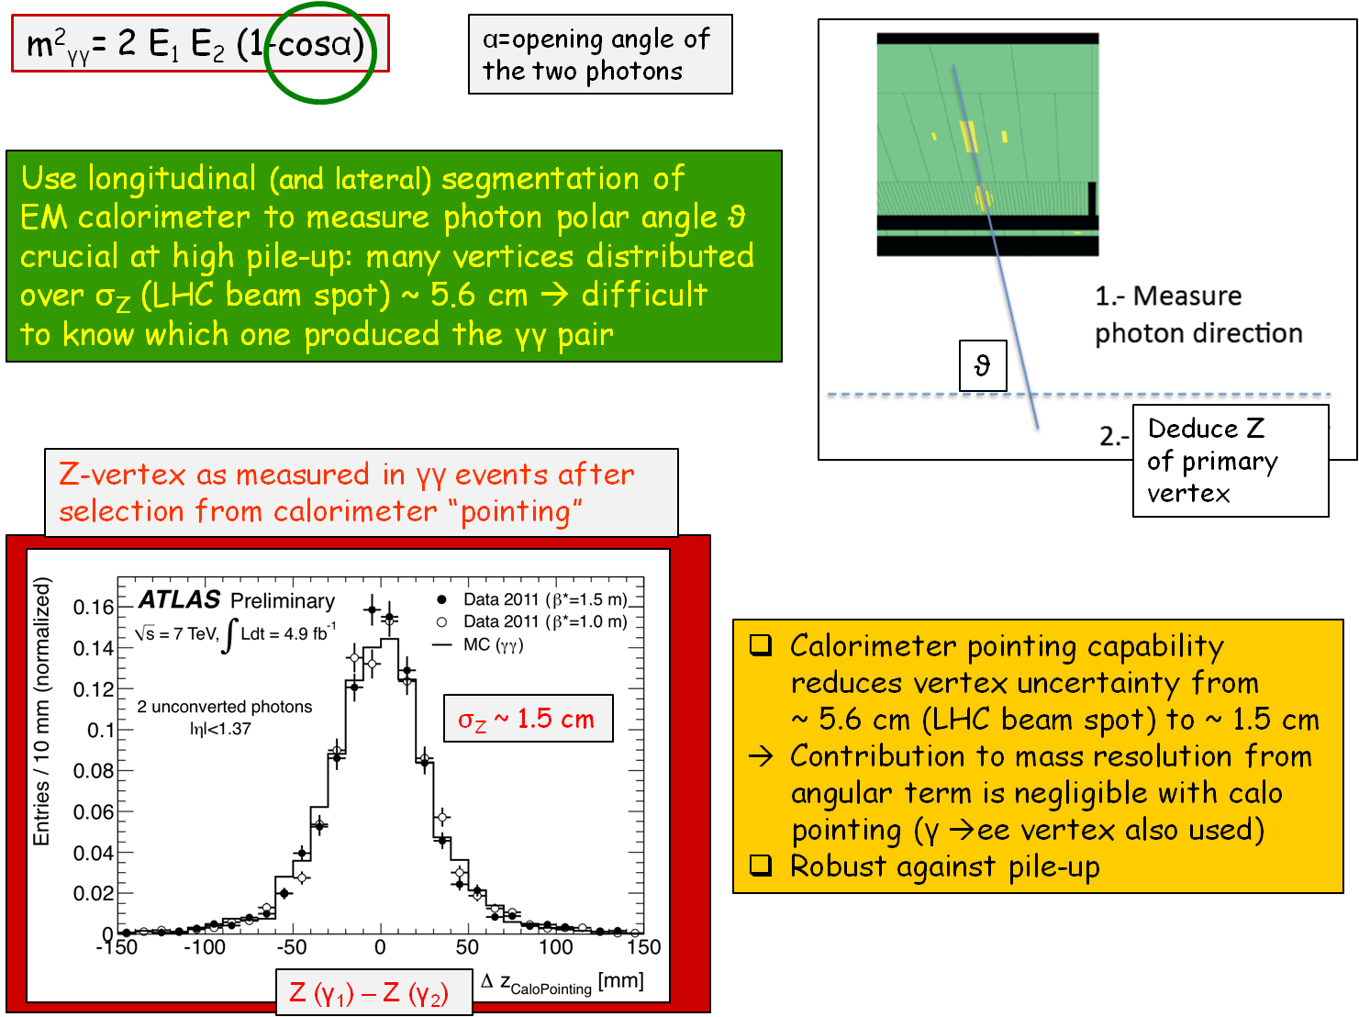
H→γγ invariant mass – γγ angle

Slide 32
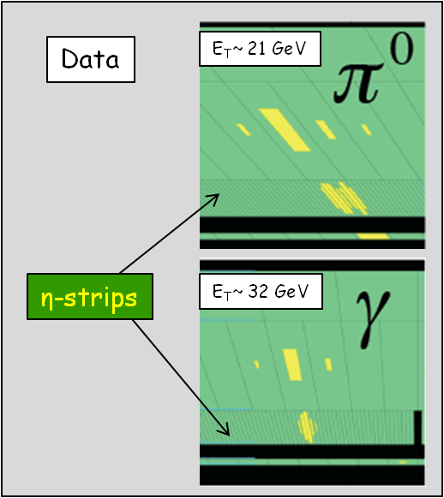
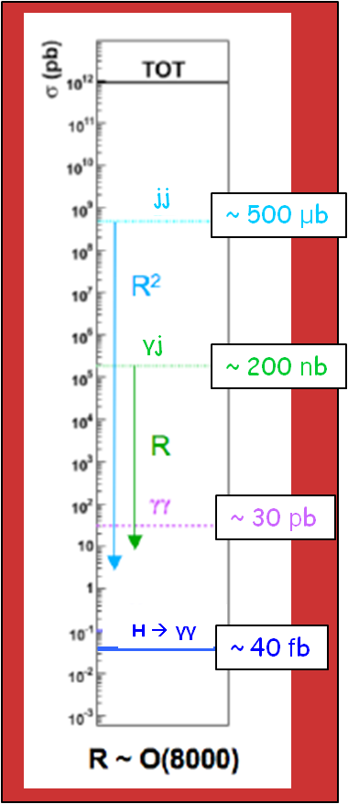
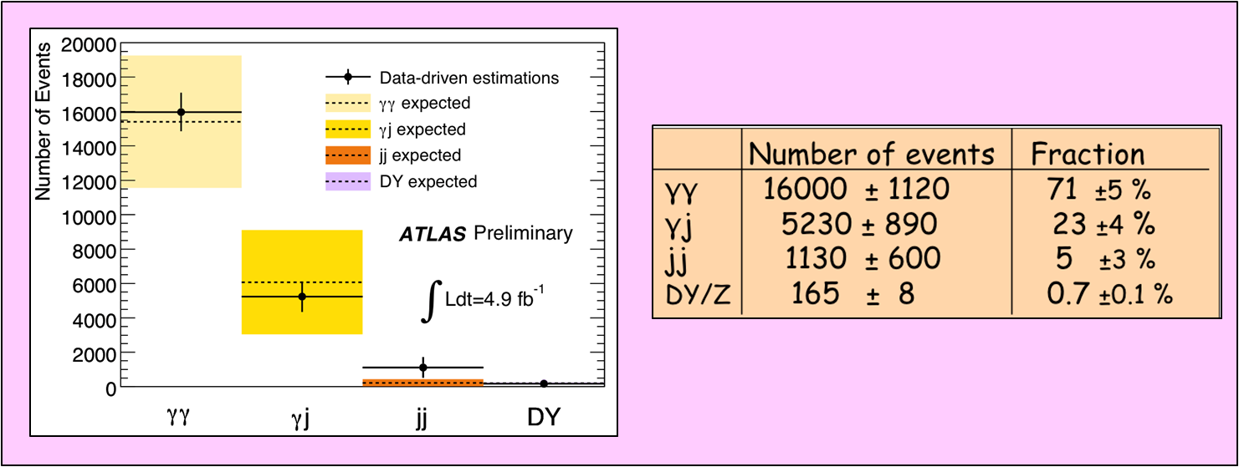
H→γγ backgrounds
Potentially huge background from γj and jj production with jets fragmenting into a single hard π⁰ and the π⁰ faking single photon
  Suppressed by fine lateral segmentation (4mm η-strips) of the first compartment of ATLAS EM calorimeter
  Need suppression of O(10⁻⁴) to get to level of irreducible γγ background
After all cuts: 22489 events with 100 < m_{γγ} < 160 GeV observed in the data
Sample composition estimated from data using control samples
  γj + jj << γγ irreducible (purity ~ 70%)

Slide 33
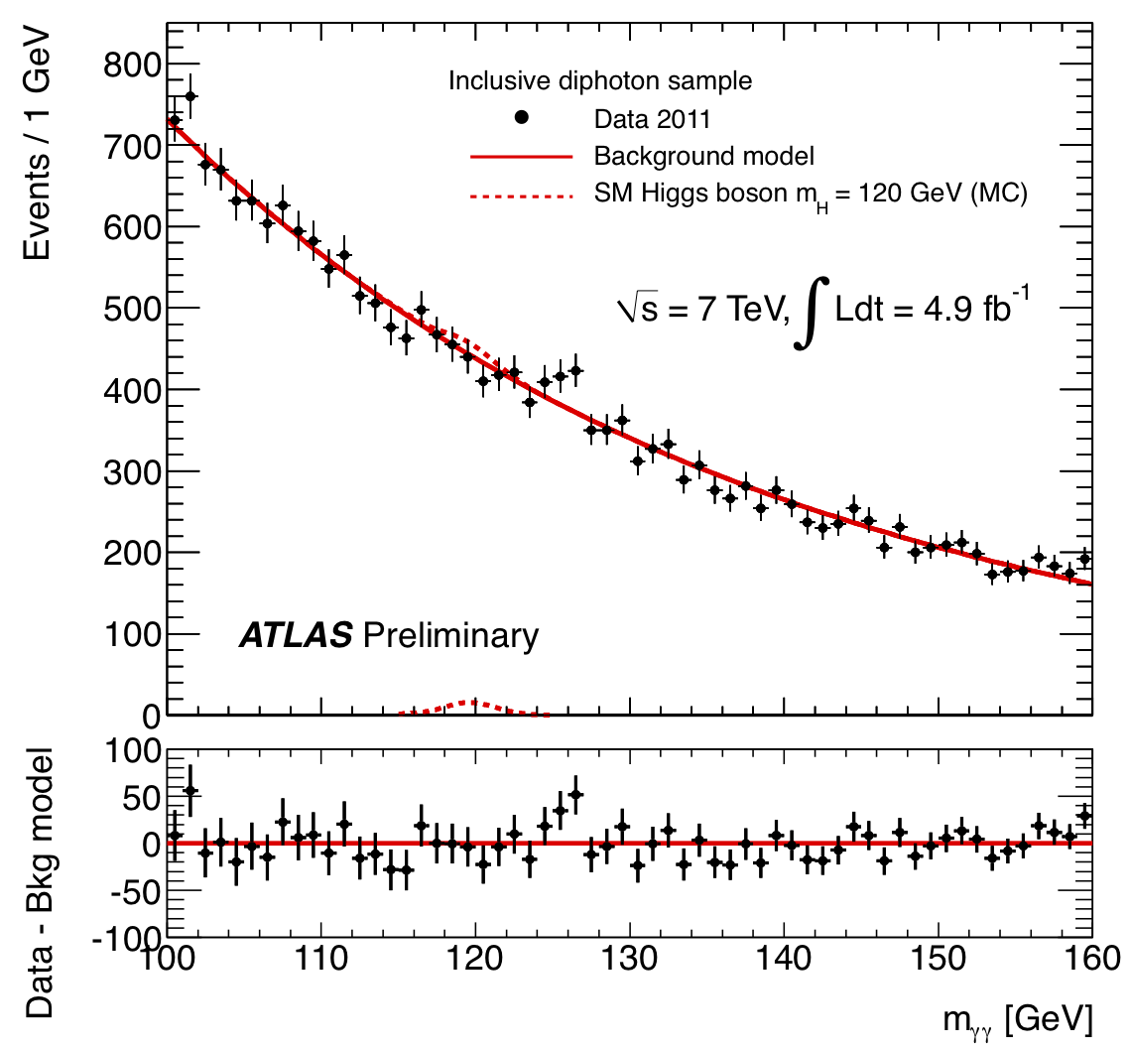
H→γγ final sample
After all selections: kinematic cuts, γ identification and isolation
  22489 events with 100 < m_{γγ} < 160 GeV observed in the data
  expected signal efficiency: ~ 35% for m_{H}=125 GeV
m_{γγ} spectrum fit with exponential function for background plus Crystal Ball + Gaussian for signal
background determined directly from data
Main systematic uncertainties
Expected signal yield : ~ 20%
H→ γγ mass resolution : ~ 14%
H→ γγ p_{T} modeling : ~ 8%
Background modeling : ±0.1-5.6 events

Slide 34
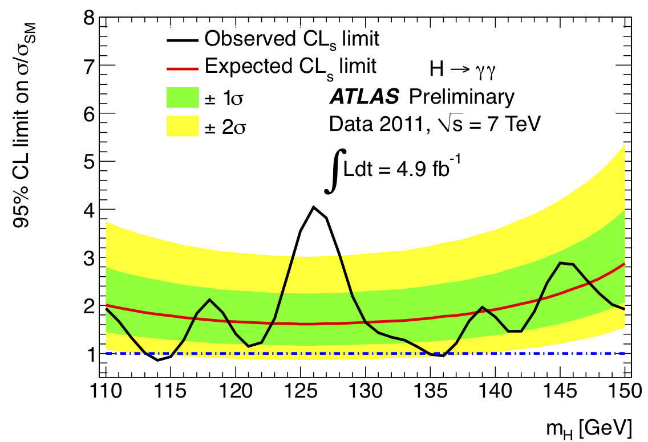

H→γγ limits
Excluded (95% CL):
114 ≤ m_{H} ≤ 115 GeV, 135 ≤ m_{H}≤ 136 GeV
p₀ - consistency of data with
background-only expectation
Expected from SM
Higgs at given m_{H}
Maximum deviation from background-only expectation observed for m_{H}~126 GeV:
  Local p₀-value: 0.27% or 2.8σ
  Expected from SM Higgs: ~ 1.4σ local
Signal upward-fluctuation ? We were on the lucky side !

Slide 35
H→ZZ^{(*)} → 4l
σ ~ 2-5 fb only , however:
  Mass can be fully reconstructed → signal events cluster in a (narrow) peak
  Pure: S/B ~ 1
Select 4 leptons: p_{T}^{1,2,3,4} > 20,20,7,7 GeV
  m₁₂ = m_{Z} ± 15 GeV; m₃₄ > 15-60 GeV (depending on m_{H})
Main backgrounds:
  ZZ^{(*)} (irreducible)
  m_{H} < 2m_{Z} : Zbb, Z+jets, tt with two leptons from b/q-jets → leptons
  Suppressed with isolation and impact parameter cuts on two softest leptons
Signal acceptance x efficiency: ~ 15 % for m_{H}~ 125 GeV
Crucial experimental aspects:
  High lepton reconstruction and identification efficiency down to lowest p_{T}
  Good lepton energy/momentum resolution
  Good control of reducible backgrounds (Zbb, Z+jets, tt) in low-mass region:
    Cannot rely on MC alone (theoretical uncertainties, b/q-jet → l modeling, ..)
    Need to compare MC to data in background-enriched control regions (but: low statistics)
  Conservative/stringent p_{T} and m(ll) cuts used at this stage

Slide 36




H→ZZ^{(*)} → 4l performance
ZZ^{(*)} → 4e, 4µ, 2e2µ
Electrons
  Identification efficiency from J/ψ → ee, W → eν, Z→ ee data samples
  Crucial to understand low-p_{T} electrons (affected by material) with data
  H→ 4e mass resolution: 2.5 GeV
    Event fraction in ±2σ: ~ 82%
Muons
  Checked on Z → µµ data sample
  Muon reconstruction efficiency > 95% over 4 < p < 100 GeV
  H→ 4μ mass resolution: ~2 GeV
    Event fraction in ±2σ: ~ 85%
Systematic uncertainty:
6% (p_{T}~7 GeV)
< 2 % (p_{T}~50 GeV)
No m_{Z} fit constraint

Slide 37


H→ZZ^{(*)} → 4l final sample
After all selections:
  kinematic cuts, isolation, impact parameter
Full mass range
  Observed: 71 events: 24 4μ + 30 2e2μ + 17 4e
  Expected from background: 62±9
m(4l) < 180 GeV
  Observed: 8 events: 3 4μ + 3 2e2μ + 2 4e
  Expected from background: 9.3±1.5
m_{H} < 141 GeV (not already excluded at 95% C.L.)
  3 events are observed:
  Two 2e2μ events (m=123.6,124.3 GeV) and one 4μ event (m=124.6 GeV)
117 < m(4l) < 128 GeV (containing ~90% of a m_{H}=125 GeV signal):
  Similar contributions expected from signal and background: ~ 1.5 events each
  S/B ~ 2 (4μ ), ~ 1 (2e2μ), ~ 0.3 (4e)
  Background dominated by ZZ* (4μ and 2e2μ), ZZ* and Z+jets (4e)
Main systematic uncertainties
Higgs cross-section : ~ 15%
Electron efficiency : ~ 2-8%
ZZ* background : ~ 15%
Zbb, +jets backgrounds : ~ 40%

Slide 38

4μ event with m_{4μ}= 124.6 GeV
p_{T} (μ⁻, μ⁺, μ⁺, μ⁻) = 61.2, 33.1, 17.8, 11.6 GeV
m₁₂= 89.7 GeV, m₃₄= 24.6 GeV

Slide 39

2e2μ event with m_{2e2μ}= 124.3 GeV
p_{T} (e⁺, e⁻, μ⁻, μ⁺)= 41.5, 26.5, 24.7, 18.3 GeV
m (e⁺e⁻)= 76.8 GeV, m(μ⁺μ⁻) = 45.7 GeV

Slide 40


H→ZZ^{(*)} → 4l limits
Excluded (95% CL):
135 < m_{H} < 156 GeV and
181 < m_{H} < 415 GeV
(except 234-255 GeV)
Expected (95% CL):
137 < m_{H} < 158 GeV and
185 < m_{H} < 400 GeV
p₀ - consistency of data with
background-only expectation
m_{H} (GeV) Local p₀ Significance /Expected
125 1.8% 2.1 σ 1.4σ
244 1.1% 2.3 σ 3.2σ
500 1.4% 2.2 σ 1.5σ

Slide 41



Combined limits
Statistically combine data we talked …
… and did not talk about

Slide 42


Exclusion limits
112.7 < m_{H} < 115.5 GeV
131 <m_{H} < 468 GeV, except 237-251 GeV
Excluded at 95% CL
Expected if no signal
124.6-520 GeV
Excluded at 99% CL
133 <m_{H} < 230 GeV, 260 < m_{H} < 437 GeV

Slide 43



Search for signal
Maximum deviation from background-only
expectation observed for m_{H}~126 GeV
> 3σ !
Can we claim evidence ?
Not yet !
Local p₀-value: 1.9 x 10⁻⁴
local significance of the excess: 3.6σ
~ 2.8σ H→ γγ, 2.1σ H→ 4l, 1.4σ H→ lνlν
Expected from
126 GeV
SM Higgs
Expected from SM Higgs: ~2.4σ local (~1.4σ per channel)
m_{H} free parameter in signal search
→ global probability higher: Look Elsewhere Effect
Global p₀-value : 0.6% →2.5σ LEE over 110-146 GeV
Global p₀-value : 1.4% →2.2σ LEE over 110-600 GeV
Eur. Phys. J. C(2010)70: 525-530

Slide 44
Summary
We have analyzed up to 4.9 fb⁻¹ of 7 TeV pp collision data for presence of SM Higgs boson
  Across the 110-600 GeV mass region
  In 11 distinct decay channels
We have restricted the most likely mass region (95% CL) to 115.5-131 GeV
We observe an excess of events around m_{H}~ 126 GeV:
  Local significance 3.6 σ, with contributions from the H→ γγ (2.8 σ), H→ ZZ* → 4l (2.1 σ), H→ WW* → lνlν (1.4 σ ) analyses
  SM Higgs expectation: 2.4 σ local → observed excess compatible with signal strength within +1σ
  The global significance (including Look-Elsewhere-Effect) is ~2.3 σ
It would be a very nice region for the Higgs to be
  accessible at LHC in γγ, 4l, lνlν, bb, ττ
It’s too early to draw definite conclusions
  More studies and more data are needed
We have built solid foundations for the exciting year(s) to come

Slide 45
Prospects
Higgs 2011
Higgs 2012 ?
Higgs 2020 ?
Higgs 2030 ??

Slide 46
Back-up

Slide 47

Reducible backgrounds from Zbb, Z+jets, tt giving 2 genuine + 2 fake leptons measured
using background-enriched-signal-depleted control regions in data mimicking as much as
possible the kinematics of the signal region → compromise between statistics and “purity”
Zbb+Z+jets control regions: events with:
2 opposite-sign same-flavour leptons, m_{ll}=m_{Z} ±15 GeV
2 additional same-flavour leptons passing all cuts but isolation and impact parameter
→ below plots of their invariant mass (m₃₄)
Z + μμ
Z + ee
Low-mass regions dominated by Zbb (Z+μ⁺μ⁻ sample ) and Z+jet (Z+e⁺e⁻ sample)
Data well reproduced by MC (within uncertainties)
Samples of Z+μ and Z+e then used to compare
efficiencies of isolation and impact parameter
cuts between data and MC → Good agreement
MC used to estimate background contamination in signal region
Data MC
Z+μ 20±1% 20.3± 0.4%
Z+e 29.9±0.6% 30.4± 0.4%

Slide 48








Look Elsewhere Effect
100 background-only MC exp’s
~one million background-only MC exp’s

Slide 49


LEE Implementation

