Slide 1
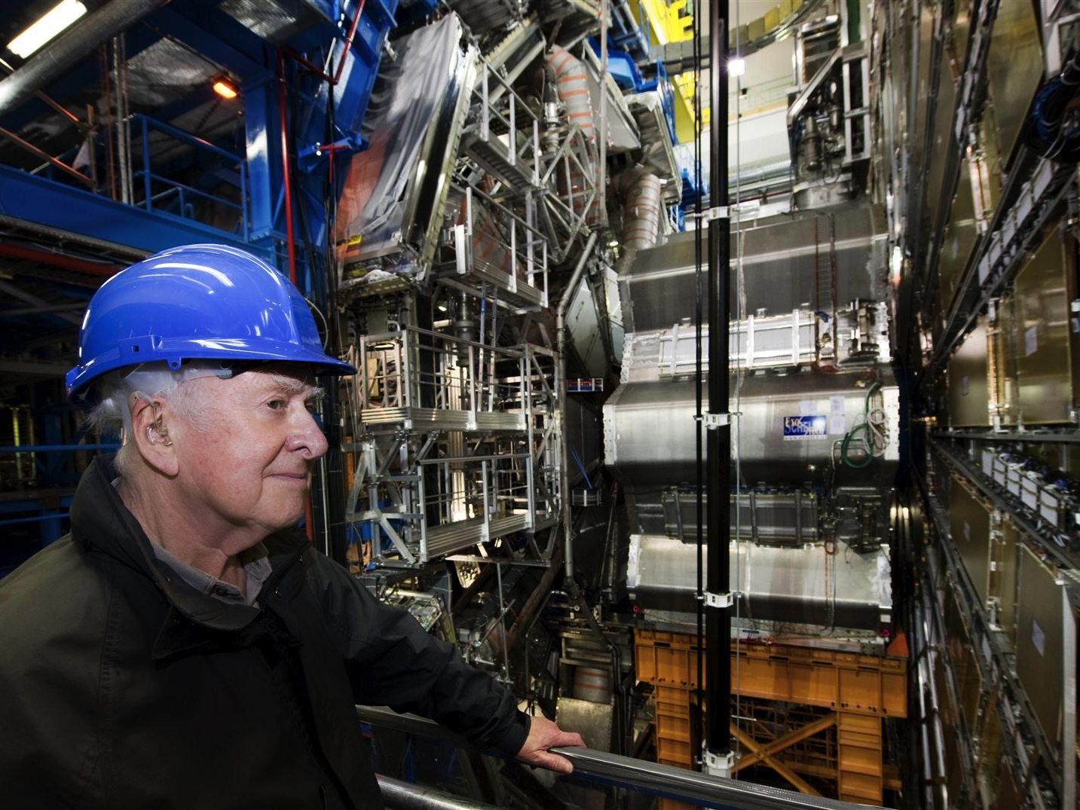



Hunt for the Higgs Boson
Marko Mikuž
University of Ljubljana & Jožef Stefan Institute
Symposium at the Occasion of 80th Birthday of
Acad. Prof. Gabrijel Kernel
September 13, 2012

Slide 2

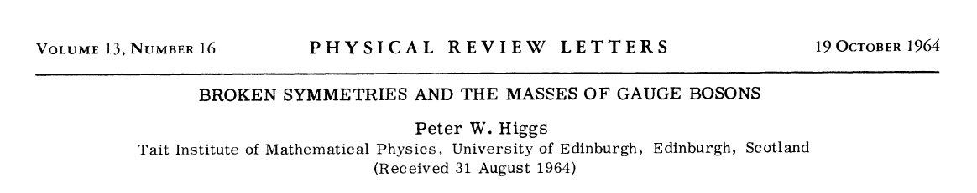
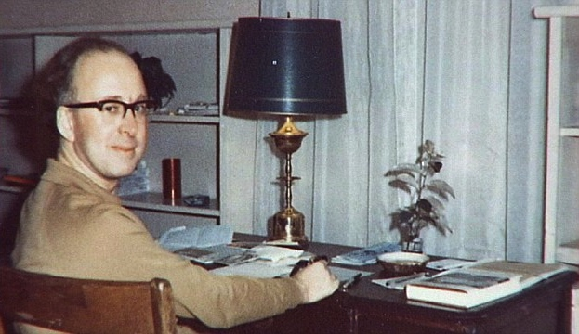
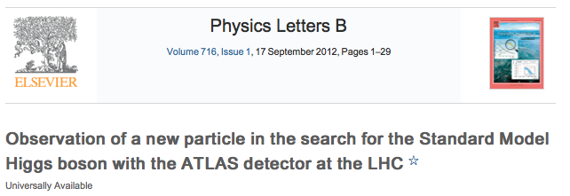
Prelude
“I certainly had no idea it would happen in my lifetime at the beginning, more than 40 years ago.
I think it shows amazing dedication by the young people involved with these colossal collaborations to persist in this way, on what is a really a very difficult task.
I congratulate them.”
Peter Higgs, July 4th, 2012

Slide 3
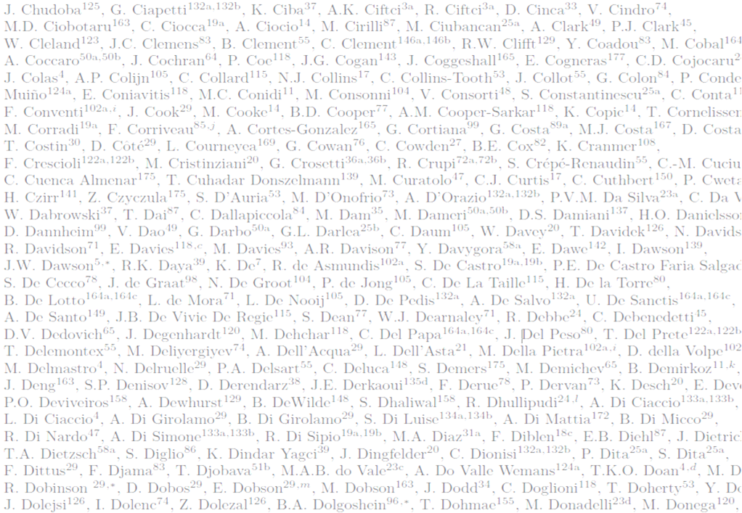
Acknowledgements
This presentation rests on the shoulders of over 3000 ATLAS colleagues who built and operate the ATLAS detector, and who tirelessly analyzed the data .
An important contribution to the overall effort has been carried out by members of the Slovenian ATLAS team: V. Cindro, M. Deliyergiyev, I. Dolenc, A. Filipčič, A. Gorišek, B.P. Kerševan, G. Kramberger, B. Maček, I. Mandić, L. Mijović, M. Mikuž and A. Tykhonov
The prerequisite for these studies was the seamless and astonishingly ever-improving performance of the Large Hadron Collider in 2011 and 2012.

Slide 4
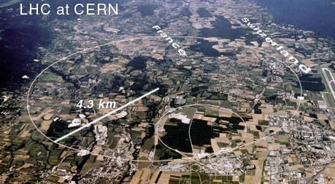
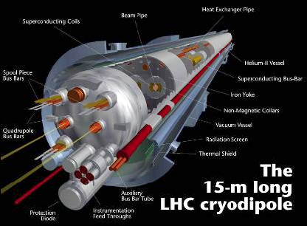
Large Hadron Collider
Large Hadron Collider
  proton-proton collider
  Design CMS energy 14 (2x7) TeV, currently at 8 TeV, 7 TeV in 2011
  Design luminosity 10³⁴ cm⁻²s⁻¹, 7.3x10³³ achieved so far
Why 4 (CMS 8) TeV ?
  LHC in 28 km LEP tunnel (recycling)
  Energy at r_{LEP} limited by superconducting magnets
    B_{max} = 8.3 T → E_{max} = 7 TeV
  Following major incident in Sep’08 blowing up ~50 magnets
    3.5, then 4 TeV considered safe
Consolidation to design values during 2013(&14) break

Slide 5
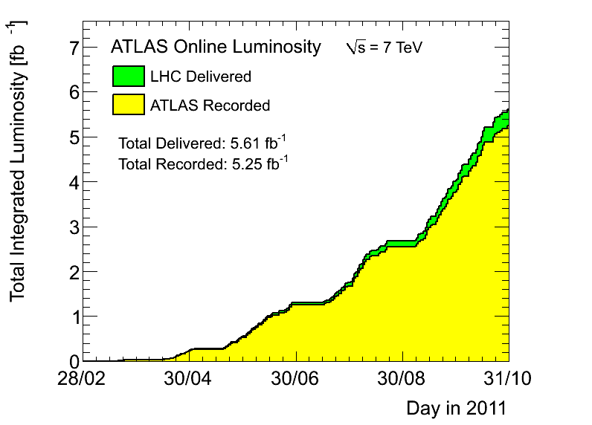
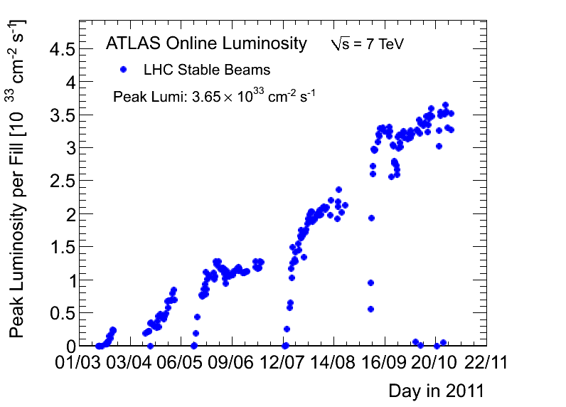

LHC Performance in 2011
The yearly plan at the Chamonix meeting (Jan’11) was >1 fb⁻¹ per experiment
Due to increased peak luminosity up to 3.6x10³³ cm⁻²s⁻¹ the final integrated luminosity surpassed 5 fb⁻¹ by end of 2011
Half of the luminosity (~ 2.5 fb⁻¹) was delivered in the final month of running
10³³ cm⁻²s⁻¹

Slide 6

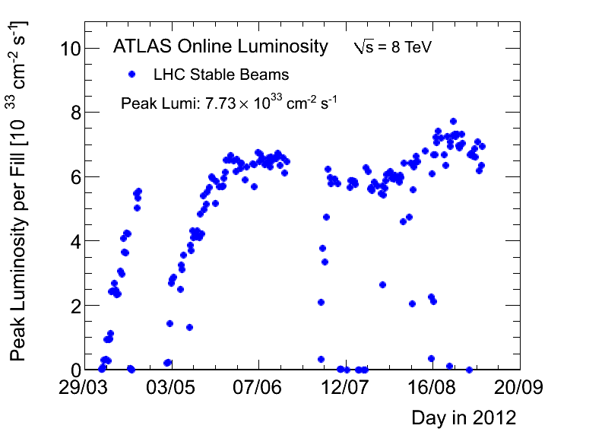
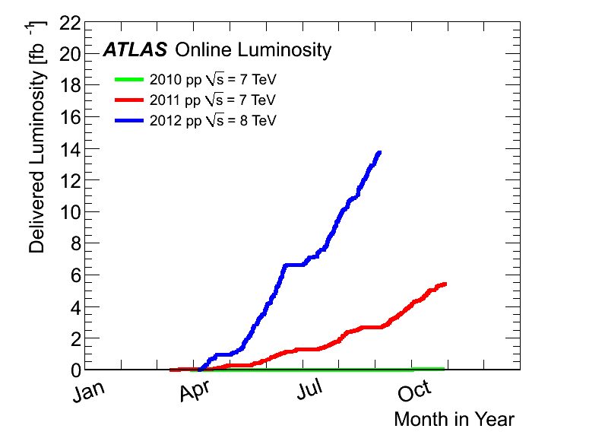
LHC Performance in 2012
The yearly plan was
  >5 fb⁻¹ by end June
  ~15 fb⁻¹ by end of 2012
  per experiment
Peak luminosity increased up to 7.3x10³³ cm⁻²s⁻¹
6 fb⁻¹ by end of June
  ~1.5 fb⁻¹ delivered in the final week
14 fb⁻¹ now
Good prospects for >>20 fb⁻¹
  proton run extended until Dec 19th
9/2012:
14 fb⁻¹
@8 TeV
EOY 2012 ?
2011
5.6 fb⁻¹
@7 TeV
2010
0.05 fb⁻¹
@7 TeV

Slide 7
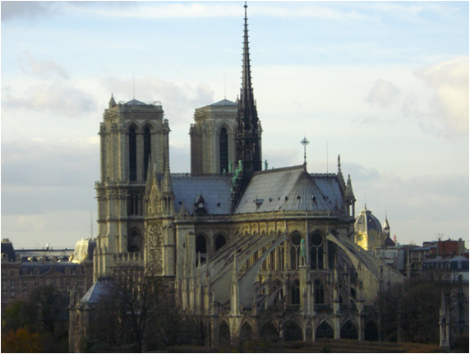
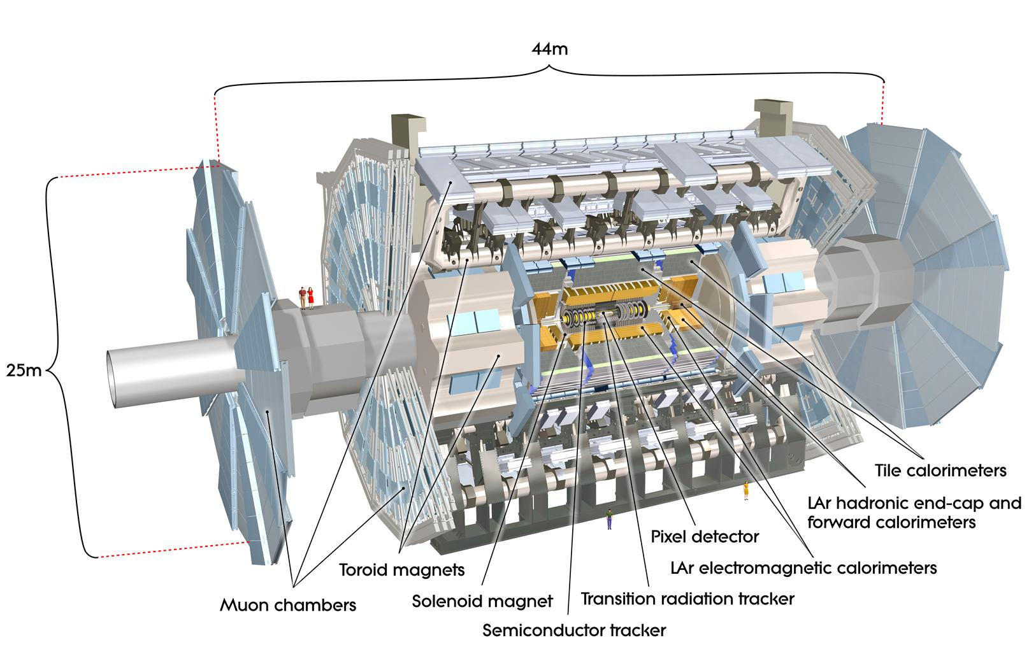

ATLAS Detector

Slide 8
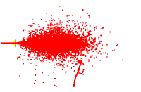

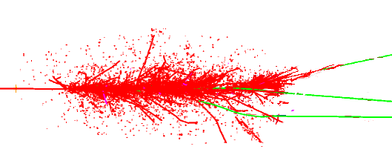
Generic LHC Detector for All Particles
Magnetic field: Bends charged particles
enabling momentum measurement
electron
Hadronic calorimeter:
Contains hadronic shower and
measures its energy (with EM)
neutrino
Only neutrinos escape detection
muon
Electromagnetic calorimenter:
Contains EM shower and measures its energy
Muon detector:
Re-measures muon tracks
hadron
Low-mass tracker: Performs
precision measurement of
several hits along particle trajectory

Slide 9
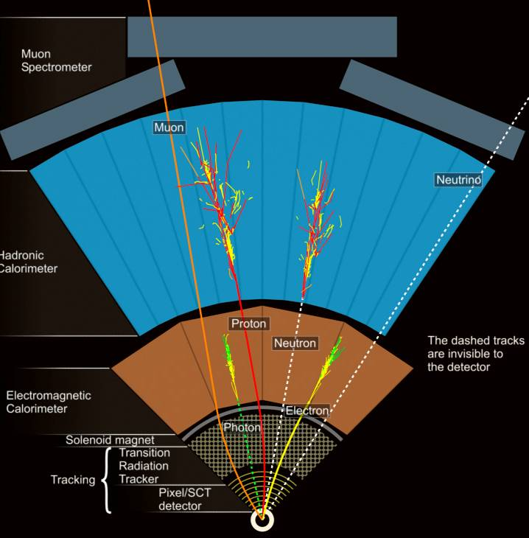
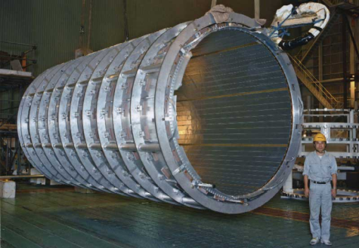
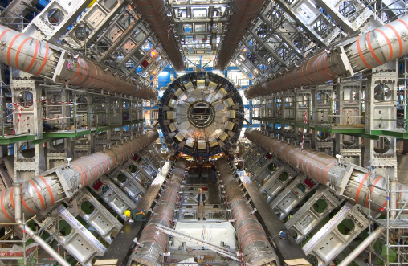
Collider Detector Arrangement
Detectors arranged in layers encircling the interaction point
ATLAS employs two magnet systems
  2 T SC solenoid for the Inner detector (tracker)
  Gigantic SC 4T(max.) toroid for muon system

Slide 10
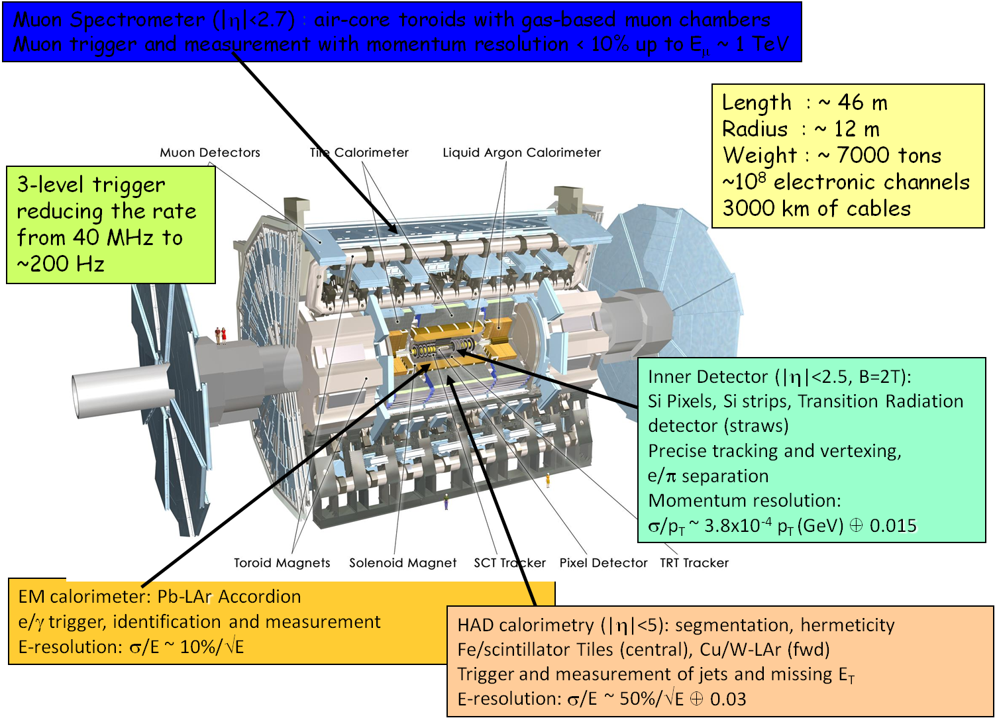
The Real Thing

Slide 11
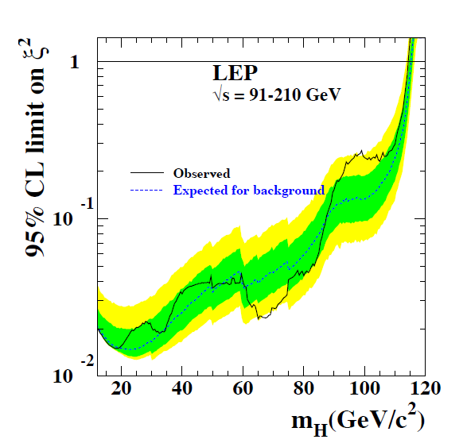
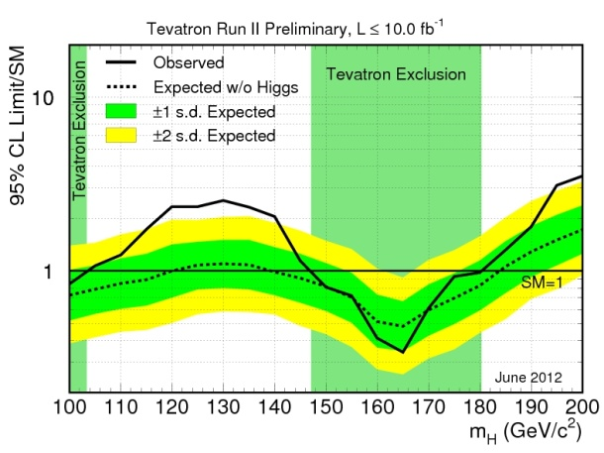
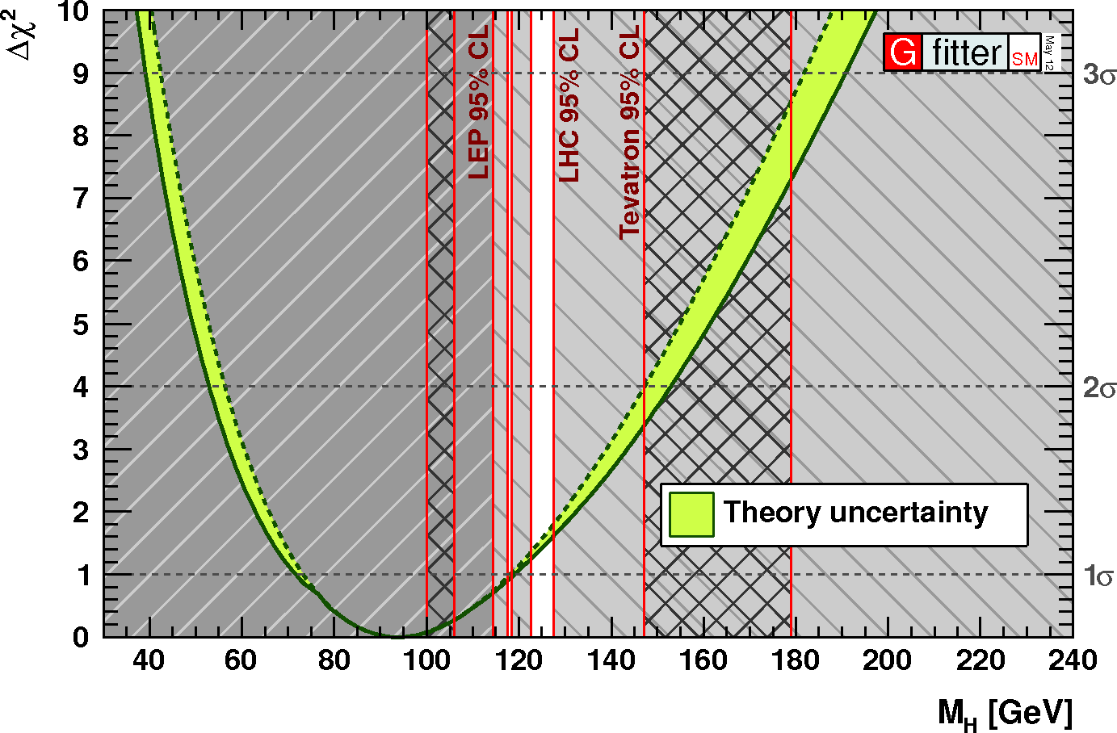
Higgs Boson
The Standard model relies on the Higgs mechanism to supply all masses in a theoretically consistent way
Higgs field spontaneously breaks the electroweak symmetry thereby providing the large W and Z boson masses
The remaining component of the scalar field remains as the Higgs particle – the only fundamental scalar of the Standard model
Leptons and quarks acquire mass through Yukawa interaction with the Higgs field
LEP measurements excluded the Higgs boson up to a mass of 114.4 GeV (95 % CL)
  Hints of an excess right at the exclusion limit (~3σ ALEPH, no signal in other 3)
Tevatron measurements exclude the Higgs boson in the regions 100-103 and 147-180 GeV (July 2012),
  Excess with significance of 2.9σ is seen in the combination of CDF and DØ's H→bb channels.
The global electroweak fit constrains the Higgs mass to < 158 GeV (May 2012)
General theoretical arguments require Higgs mass lighter than 1 TeV
EW global fit

Slide 12
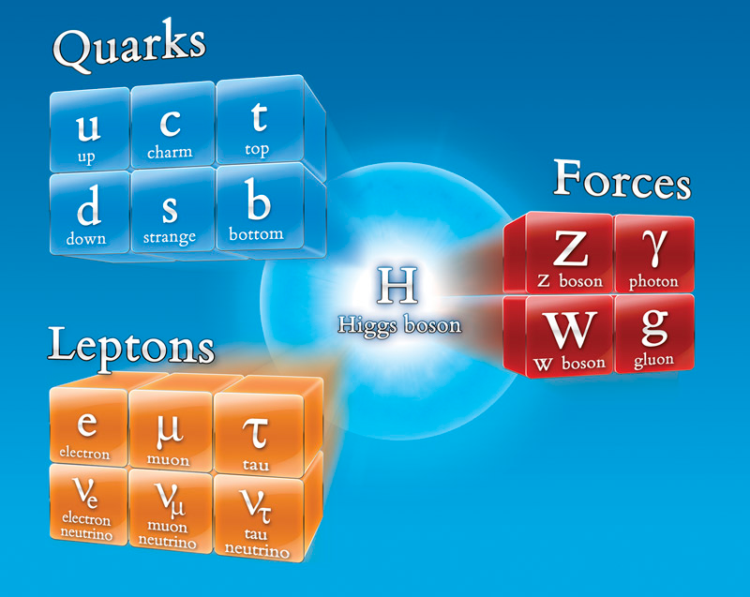
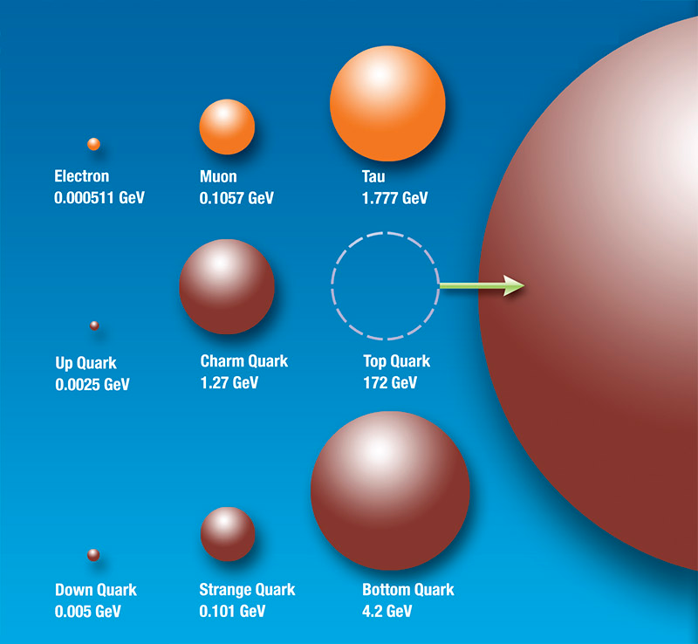
Higgs Discovery
The discovery of the Higgs particle would wrap up the Standard model in the most elegant and simple way
  Light Higgs most natural, but opens up the possibility of a desert up to Planck scale
  Measurement of Higgs properties a sensitive tool for probing New Physics

Slide 13
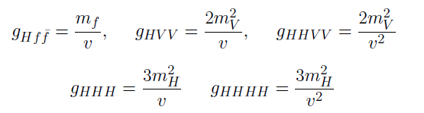
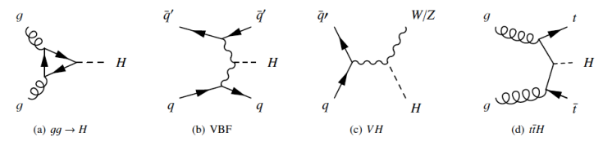
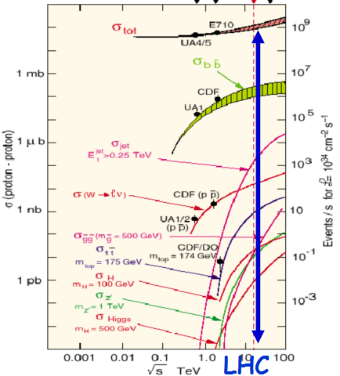
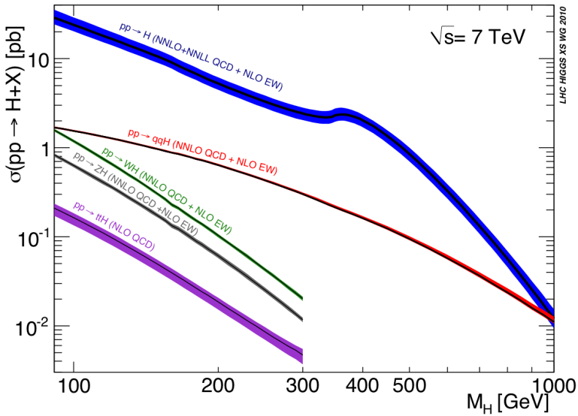
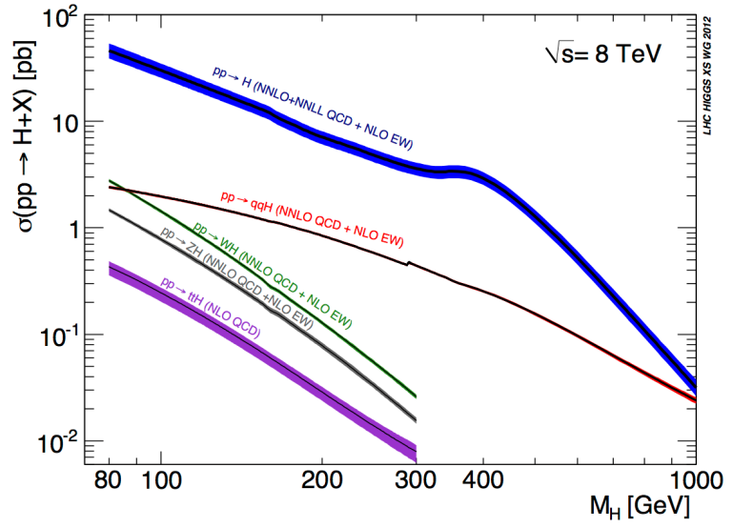
Higgs Production @ LHC
Higgs couples to mass
  Linear for coupling to fermions (Yukawa)
  Quadratic for weak bosons
Production in 7 TeV pp collisions
  Predominantly through gluon-gluon fusion
  Cross section O(10 pb)
    QCD to NNLO
    Errors < 20 %
    Total pp O (100 mb)
  Associated with W, Z
    Smaller x-section
    Useful W,Z tag
+ 10-15 % at 8 TeV
  Higgs cross-section increases by ~ 1.3 for m_{H} ~ 125 GeV
  Similar increase for several irreducible backgrounds: e.g. 1.2-1.25 for γγ, di-bosons
  Reducible backgrounds increase more: e.g. 1.3-1.4 for tt, Zbb
~ 20 x Tevatron
for m_{H}=120 GeV
7 8 14 TeV

Slide 14
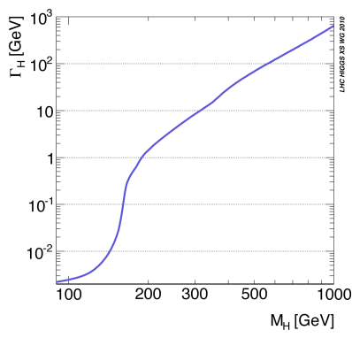
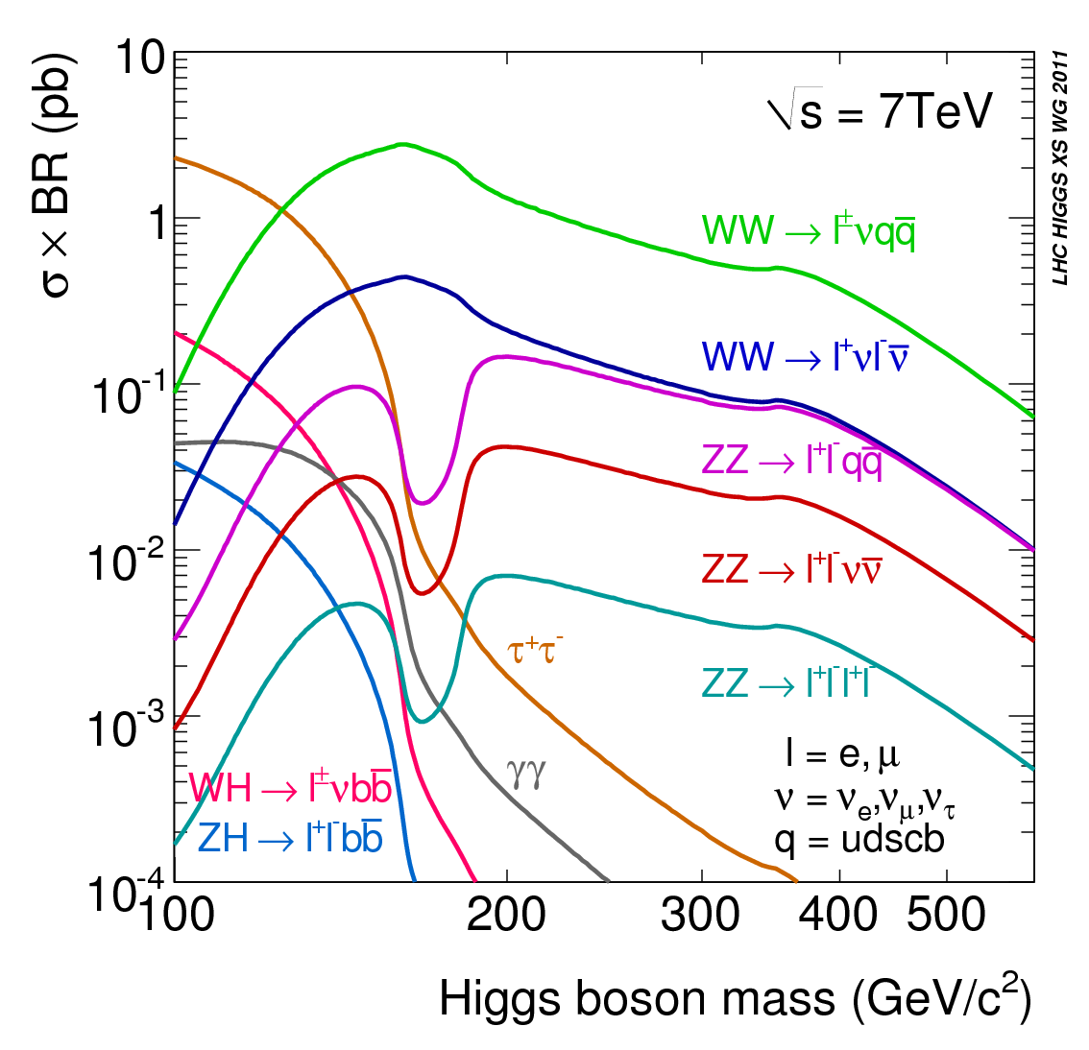
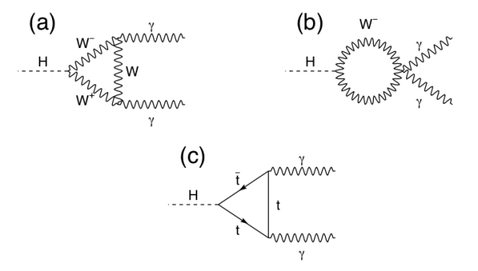
Higgs Decays
Higgs decay branching ratios determined by mass couplings
  Decays to weak bosons dominate if kinematically allowed
    One of the bosons can be virtual
  For low masses two-photon, b-quark and tau decays
    Two photons via loops
125-180
WW^{(*)}→ lνlν
<130
γγ
300-600
ZZ→ llνν
125-300
ZZ^{(*)}→ llll

Slide 15
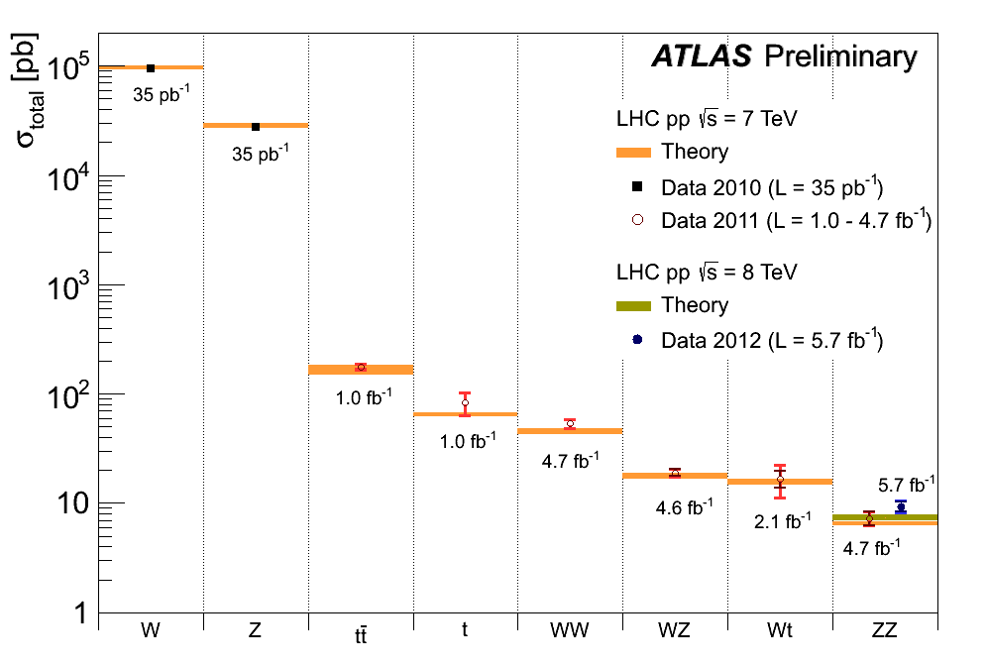
Higgs Detection @ LHC
Rare process
  Production only O(10⁻¹⁰) of total cross section
  Further suppression by branching ratio
Huge backgrounds
  Need distinct event features
    Leptons from W, Z
    Energetic gammas
    Golden channel: H→ZZ → 4l
    H→ZZ → 4l and H→γγ can be fully reconstructed: H invariant mass, but σxBR O(10 fb)
    H→WW → lν lν has two missing ν’s, σxBR O(100 fb)
  Need to understand how to model backgrounds
    From data and Monte Carlo
  Yesterday’s signals are today’s backgrounds

Slide 16
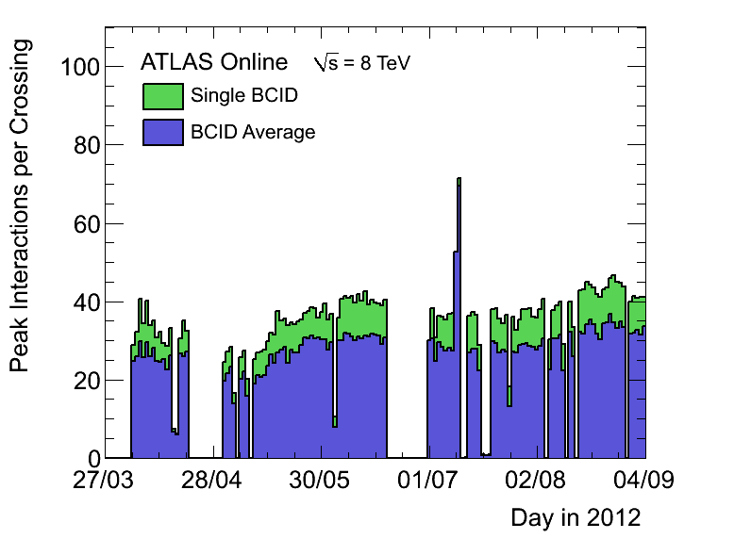
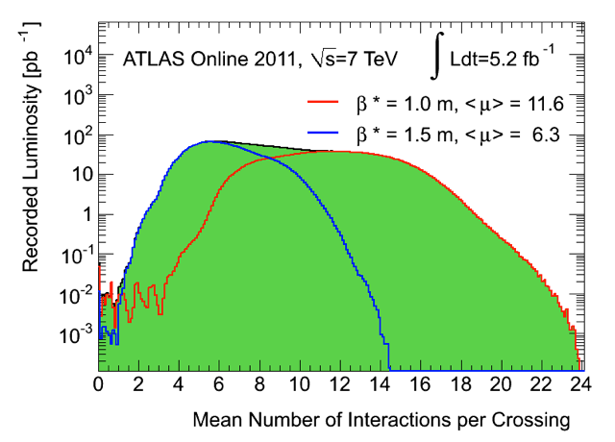
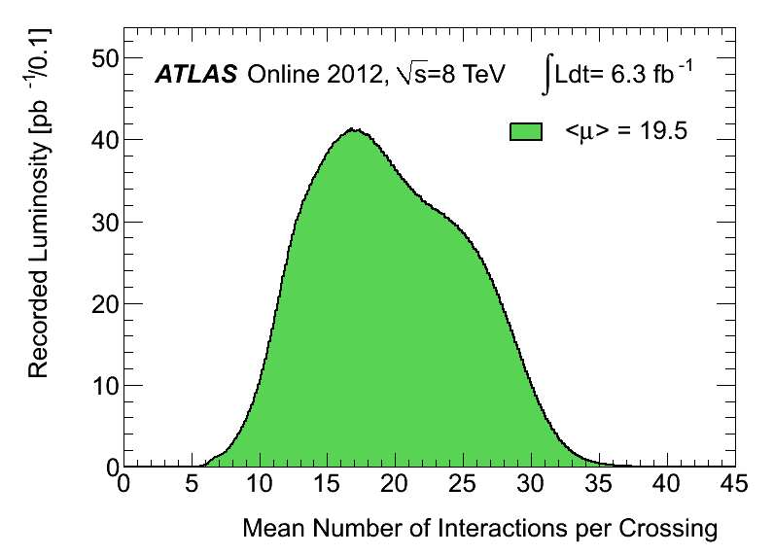
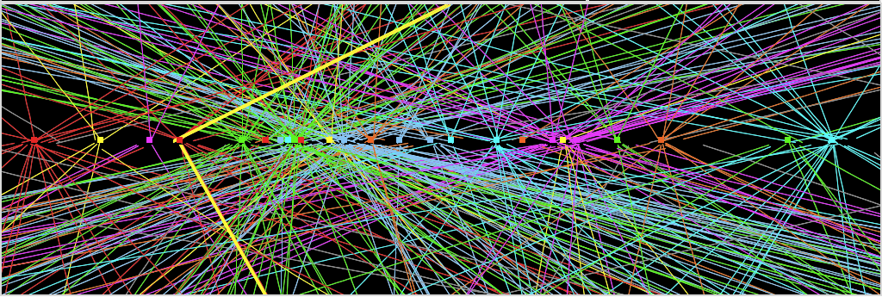
Additional Burden – Pile-Up
LHC still operates with 50 ns bunch spacing
  ~1 collision per bunch crossing @ L=2x10³² cm⁻²s⁻¹
  Up to >40 overlaid collisions at highest luminosity
  Challenging environment despite marvelous tracker performance
    E.g. loose primary vertex constraint for H→γγ
    Backgrounds even harder to control
Z→ μμ event from 2012 data with 25 reconstructed vertices
Period A:
up to end
August
Period B:
Sept-Oct
Z→ μμ

Slide 17
Signal in Presence of Background
Most powerful detection channels at low masses
  H→WW^{(*)} → lν lν (counting excess events)
  H→ZZ^{(*)} → 4l (H mass)
  H→γγ (H mass)
All suffer from background
  Leptons from W, Z decays, QCD background
Small σxBR results in small event samples
  Downward fluctuation of signal can prevent detection
    False negative (signal interpreted as background)
  Upward fluctuation of background can mimic signal
    False positive (background interpreted as signal)
Need careful, unbiased statistical treatment to assess

Slide 18
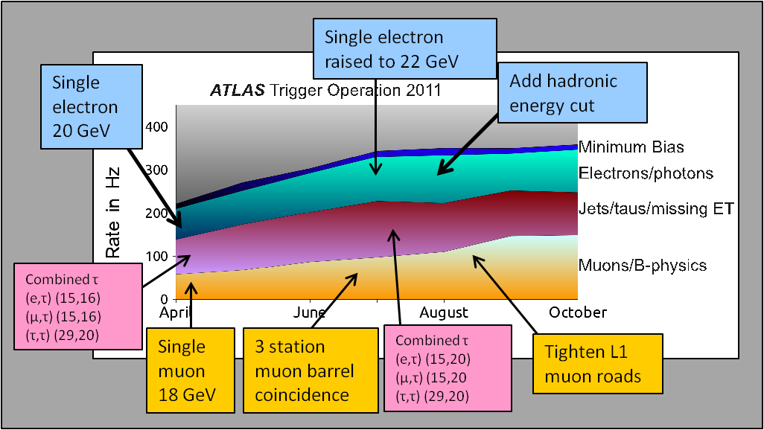
Sample Selection
Initial event rate 20 MHz, (multiple) collisions every bunch crossing
Three level trigger reduces this to 300-500 Hz of recorded events
  Trigger focuses on energetic jets, leptons and photons thus efficiency high for relevant Higgs decays
  Trigger composition changed on the fly during fill to match decreasing luminosity
  In 2012 in addition stream of ~400 Hz recorded for delayed analysis in 13/14 shutdown
Off line sample selection
  Based on (conservative) cut-based selections of characteristic objects: electrons, muons, photons
  Large and sometimes not well-known backgrounds estimated mostly with data-driven techniques using signal-free control regions
L1: up to ~ 65 kHz
L2: up to ~ 5 kHz
EF: ~ 400Hz

Slide 19
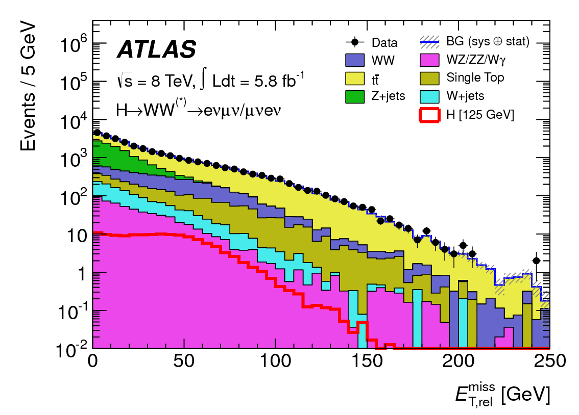
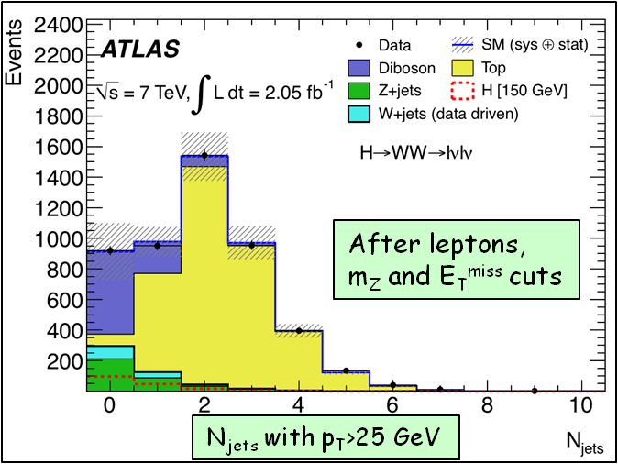
H → WW^{(*)} → lνlν
Most sensitive channel ~ 125-180 GeV (σ ~ 200 fb)
  Challenging: two missing ν → no mass reconstruction/peak → “counting channel”
  2 isolated opposite-sign leptons, large E_{Tmiss}
  Main backgrounds: WW, top, Z+jets, W+jets
    m_{ll} ≠ m_{Z}, b-jet veto, …
    topological cuts against “irreducible” WW background: pT_{ll}, m_{ll}, Δϕ_{ll} (smaller for scalar Higgs), m_{T} (ll, E_{Tmiss})
Worse pile-up in 2012
  Restrict to WW → eνμν
    Less background from Z, γ* → l⁺l⁻
    Contributes 85% of WW sensitivity
Counting → crucial to understand background
  Understanding of E_{T}^{miss} (genuine and fake)
    Sensitive to pile-up !
  Excellent understanding of background in signal region → use signal-free control regions in data to constrain MC → use MC to extrapolate to the signal region

Slide 20
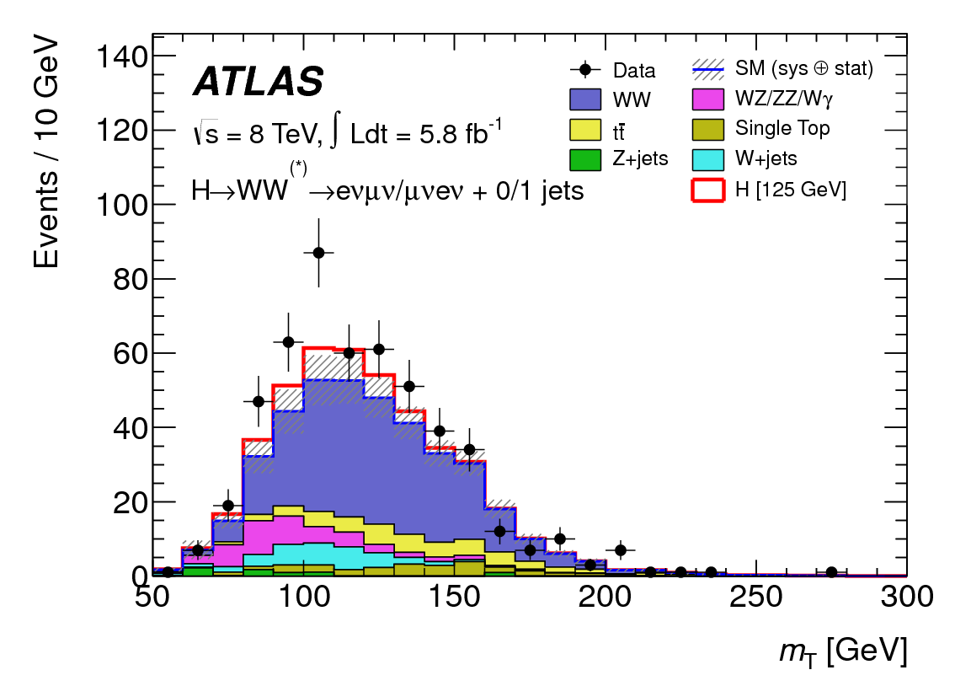

H → WW^{(*)} Final Sample
No significant excess above expected background observed in 2011 WW → lνlν data (Phys. Lett. B 716 (2012) 62-81)
Final control plot of 2012 WW → eνμν data
  m_{T} used as control variable
  Expected S/B in final 8 TeV sample still 1:7 only
Excess observed in 2012 data, consistent with a ~130 GeV Higgs

Slide 21
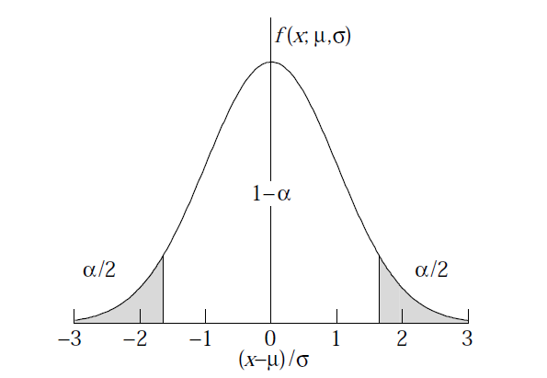
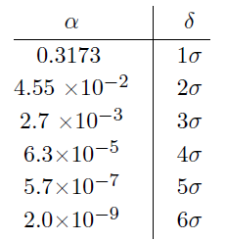


Background Fluctuations
Background is a random process, N_{bg} often well described by Poisson (Gauss) pdf
The N-σ significance refers to probabilities of an excursion from mean for relevant pdf
For exclusion of signal presence, ~2 σ downward fluctuation of expected S+B is taken, allowing for 5 % false negatives
For detection of particles two landmarks on upward background fluctuation are agreed
  3 σ: evidence, 0.13 % false positives
  5 σ: discovery, <3x10⁻⁷ false positives
To bring background fluctuations into perspective
  For a fair dice in a ludo game ⇔background only
    1 σ effect: ~six in first trial
    2 σ effect: ~2 consecutive sixes in a row
    3 σ evidence: ~4 consecutive sixes in 2 trials
    5 σ discovery: ~8 consecutive sixes in a row
When would you start suspecting someone is cheating ?

Slide 22
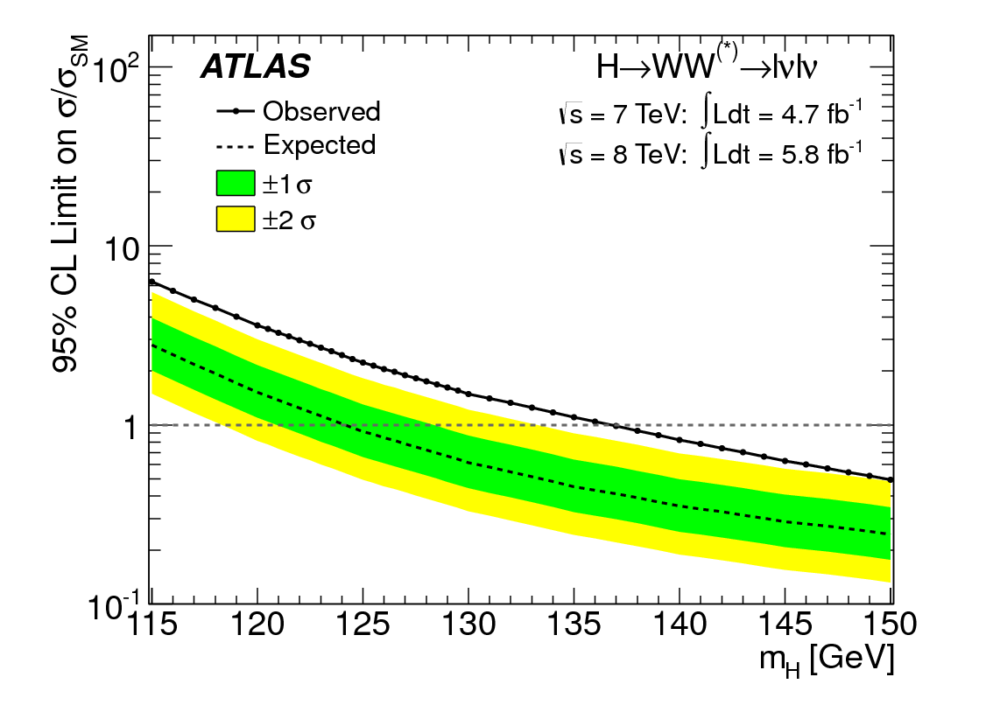
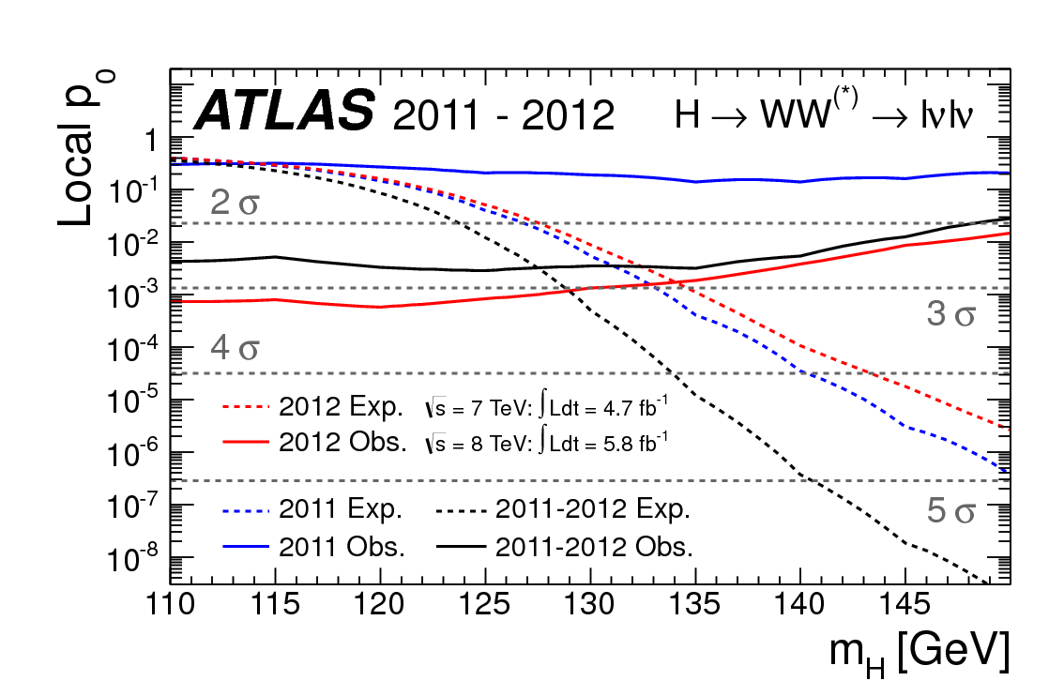
H → WW^{(*)} Results
Combined 2011 and 2012 data
  2011 data decreases excess significance
Exclusion of Higgs signal contents
in units of σ_{SM} at 95 % C.L.
p₀ - consistency of data with
background-only expectation
Expected from
SM Higgs at
given m_{H}
Excluded (95% CL): 137 GeV< m_{H} (expected: 124 GeV !)
Excess 2.8σ (2.3 expected)over a broad range of m_{H} ~ 125 GeV (poor m_{H} resolution)

Slide 23
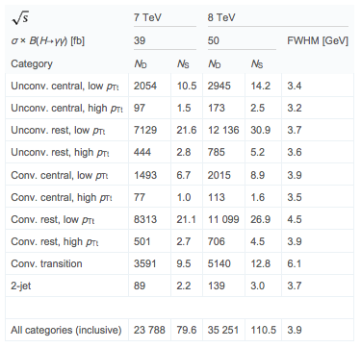
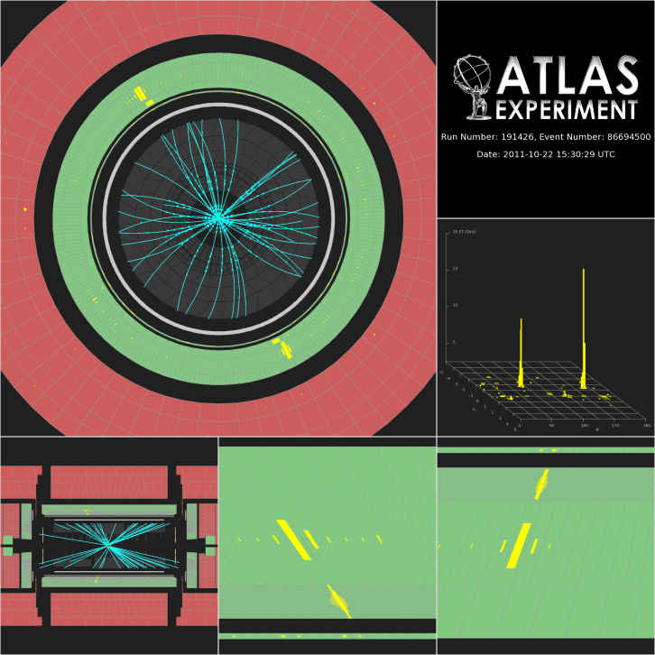
H→γγ
Small cross-section: σ ~ 40 fb
Simple final state: 2 high-p_{T} isolated photons
  E_{T} (γ1, γ2) > 35, 25 GeV (20/20 for 7 TeV)
  Main background: γγ continuum
    irreducible, smooth, ..
Events divided into 10 categories
  based on η-photon (e.g. central, rest, …), converted/unconverted, p_{T}^{γγ} perpendicular to γγ thrust axis + VBF(2j)
~190 signal events expected in 4.8+5.9 fb⁻¹ (‘11+’12) after all selections for m_{H}=125 GeV
  ~ 5000 background events in signal mass window → S/B ~ 0.04
Crucial experimental aspects:
  excellent γγ mass resolution to observe narrow signal peak above irreducible background
  powerful γ/jet separation to suppress γj and jj background with jet → π⁰ faking single γ
Background: 100-160 GeV
Signal for m_{H} = 126.5 GeV

Slide 24
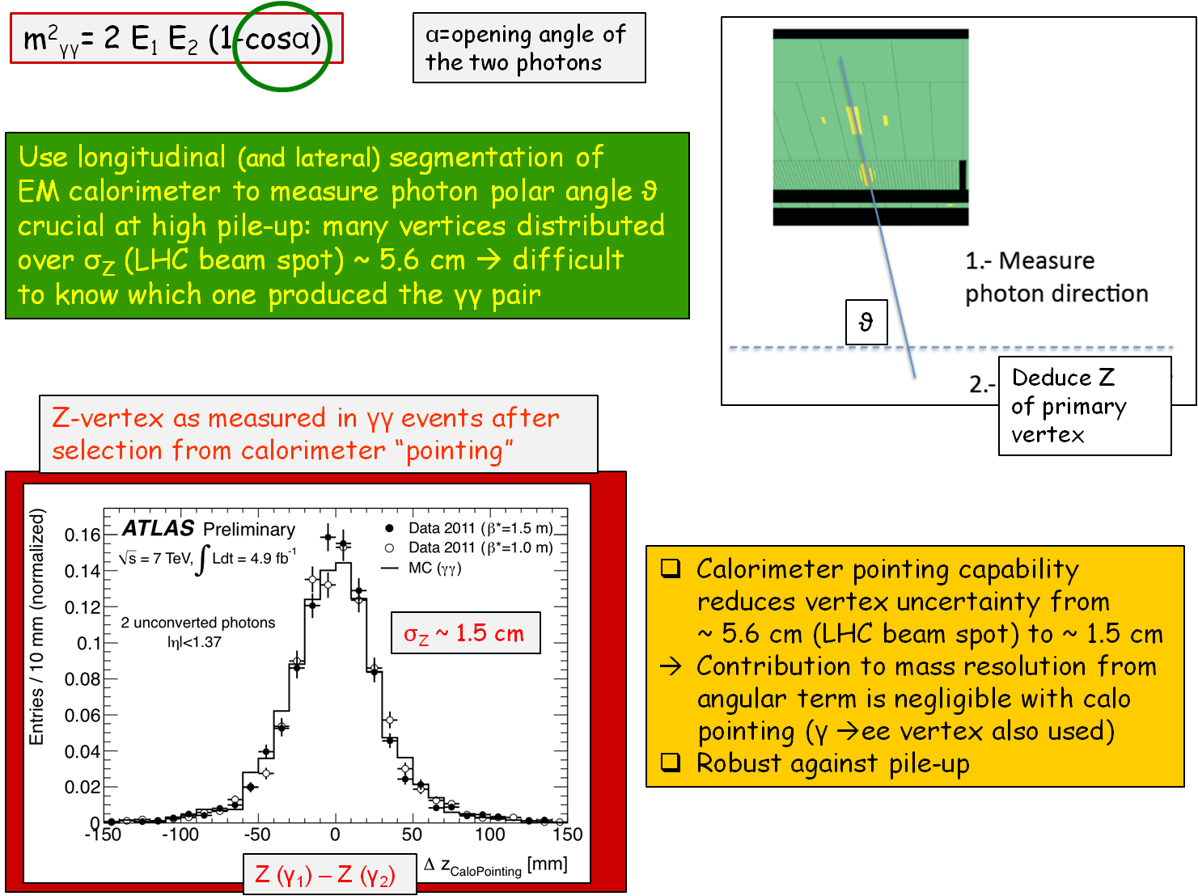
H→γγ Invariant Mass – γγ Angle

Slide 25
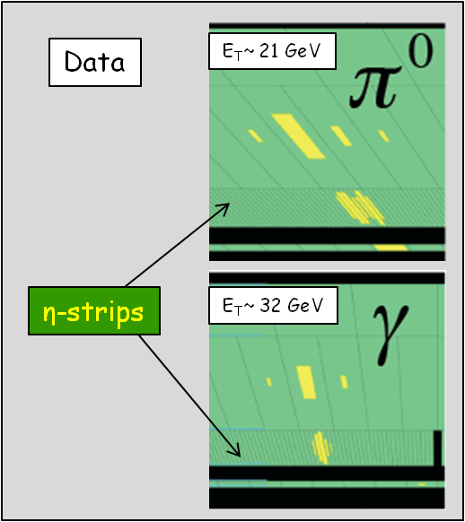
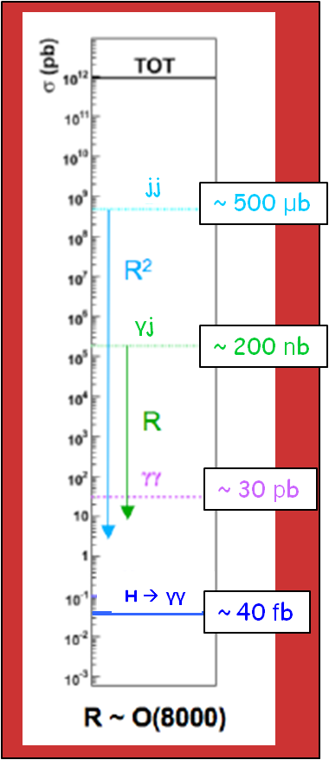

H→γγ Backgrounds
Potentially huge background from γj and jj production with jets fragmenting into a single hard π⁰ and the π⁰ faking single photon
  Suppressed by fine lateral segmentation (4mm η-strips) of the first compartment of ATLAS EM calorimeter
  Need suppression of O(10⁻⁴) to get to level of irreducible γγ background
After all cuts: ~59k events with 100 < m_{γγ} < 160 GeV observed in the data
Sample composition estimated from data using control samples
  γj + jj << γγ irreducible (purity 74%)

Slide 26


H→γγ Final Sample
After all selections: kinematic cuts, γ identification and isolation
  59k events with 100 < m_{γγ} < 160 GeV observed in the data
  expected signal efficiency: ~ 40% for m_{H}=125 GeV
m_{γγ} spectrum fit with
  4th order polynomial or exponential for background, depending on category
  plus Crystal Ball + Gaussian for signal,
  background determined directly from data
Main systematic uncertainties
Expected signal yield : ~ 8/11%
H→ γγ mass resolution : ~14%
Background modeling : ±0.2-4.6/0.3-6.8 ev.
(category, 11/12)
Weighted
according
to S/B in
categories

Slide 27


H→γγ Results
Excluded (95% CL):
112 ≤ m_{H} ≤ 123 GeV, 132 ≤ m_{H}≤ 143 GeV
110-140 GeV expected
p₀ - consistency of data with
background-only expectation
Expected from SM
Higgs at given m_{H}
Maximum deviation from background-only expectation observed for m_{H} = 126.5 GeV:
  Local p₀-value: ~10⁻⁶ or 4.5σ
  Expected from SM Higgs: ~ 2.5σ local
Signal upward-fluctuation ? We are still on the lucky side !

Slide 28
H→ZZ^{(*)} → 4l
σ ~ 2-3 fb only , however:
  Mass can be fully reconstructed → signal events cluster in a (narrow) peak
  Pure: S/B ~ 1, narrow peak σ ~2 GeV
Select 4 leptons: p_{T}^{1,2,3,4} > 20, 15, 10, 7/6(e/μ) GeV
  m₁₂ =50-106 GeV; 115 > m₃₄ > 17.5-50 GeV (depending on m_{4l})
Main backgrounds:
  ZZ^{(*)} (irreducible)
  m_{H} < 2m_{Z} : Zbb, Z+jets, tt with two leptons from b/q-jets → leptons
  Suppressed with isolation and impact parameter cuts on two softest leptons
Signal acceptance x efficiency: 15-37 % for m_{H}~ 125 GeV
Crucial experimental aspects:
  High lepton reconstruction and identification efficiency down to lowest p_{T}
  Good lepton energy/momentum resolution
  Good control of reducible backgrounds (Zbb, Z+jets, tt) in low-mass region:
    Cannot rely on MC alone (theoretical uncertainties, b/q-jet → l modeling, ..)
    Need to compare MC to data in background-enriched control regions (but: low statistics)
  Conservative/stringent p_{T} and m(ll) cuts used at this stage

Slide 29




H→ZZ^{(*)} → 4l Performance
ZZ^{(*)} → 4e, 4µ, 2e2µ
Electrons
  Identification efficiency from J/ψ → ee, W → eν, Z→ ee data samples
  Crucial to understand low-p_{T} electrons (affected by material) with data
  H→ 4e mass resolution: 2.5 GeV
    Event fraction in ±2σ: ~ 83%
Muons
  Checked on Z → µµ data sample
  Muon reconstruction efficiency > 95% over 4 < p < 100 GeV
  H→ 4μ mass resolution: ~2 GeV
    Event fraction in ±2σ: ~ 84%
Systematic uncertainty:
8% (mH=115 GeV)
No m_{Z} fit constraint

Slide 30



H→ZZ^{(*)} → 4l Final Sample
After all selections:
  kinematic cuts, isolation, impact parameter
Full mass range up to 250 GeV
  Observed: 153 events
  1.3x higher no of events in ZZ peak
  Consistent with higher measured σ_{ZZ}
m(4l) < 160 GeV
  Observed: 39 events
  Expected from background: 34 ± 3
120 < m(4l) < 130 GeV (containing ~90% of a m_{H}=125 GeV signal):
  Similar contributions expected from signal and background: ~ 5 events each
  S/B ~ 2 (4μ ), ~ 1 (2e2μ), ~ 0.7 (4e)
  Background dominated by ZZ* (4μ), Z+jets and tt (2μ2e, 4e)
  13 events observed
Events in 120 < m_{4l} < 130 Gev
Z
Z*

Slide 31

4μ Event with m_{4μ}= 124.6 GeV
p_{T} (μ⁻, μ⁺, μ⁺, μ⁻) = 61.2, 33.1, 17.8, 11.6 GeV
m₁₂= 89.7 GeV, m₃₄= 24.6 GeV
2011

Slide 32

2e2μ Event with m_{2e2μ} = 123.9 GeV
12 reconstructed vertices
p_{T} (e,e,μ,μ)= 18.7, 76, 19.6, 7.9 GeV, m_{ee} = 87.9 GeV, m_{μμ} =19.6 GeV
2012

Slide 33



H→ZZ^{(*)} → 4l Results
Excluded (95% CL):
131 < m_{H} < 162 GeV and
170 < m_{H} < 460 GeV
Expected (95% CL):
124 < m_{H} < 164 GeV and
176 < m_{H} < 500 GeV
m_{H} (GeV) Local p₀
125 2x10⁻⁴
Significance /Expected
3.6 σ 2.7 σ
p₀ - consistency of data with
background-only expectation

Slide 34

Wrapping it up – Combined Results
Statistically combine data we talked …
… and did not talk about
In a nutshell
  All relevant decay channels for 2011
  3 most significant channels for 2012

Slide 35


Exclusion Limits
111 < m_{H} < 122 GeV
131 < m_{H} < 559 GeV
Excluded at 95% CL
Expected if no signal
110 – 582 GeV
Excluded at 99% CL
113 – 114, 117 – 121, 132 – 527 GeV, expected 113 – 532

Slide 36



Search for Signal
beyond a reasonable doubt adj. part of jury instructions in all criminal trials, in which the jurors are told that they can only find the defendant guilty if they are convinced "beyond a reasonable doubt" of his or her guilt. Sometimes referred to as "to a moral certainty," the phrase is fraught with uncertainty as to meaning, but try: "you better be damned sure.”
Maximum deviation from background-only
expectation observed for m_{H}~126.5 GeV
Local p₀-value: 10⁻⁹
local significance of the excess: 6.0σ
reduced to 5.9σ by JES systematics
~ 4.5σ H→ γγ, 3.6σ H→ 4l, 2.8σ H→ lνlν
Expected from
SM Higgs
This is a new boson
beyond a reasonable
doubt !
Expected from SM Higgs: 4.9σ local (~2.5σ per channel)
m_{H} free parameter in signal search
→ global probability higher: Look Elsewhere Effect
Global significance: 5.9σ →5.1σ LEE over 110-600 GeV
Global significance: 5.9σ →5.3σ LEE over 110-150 GeV

Slide 37
Evolution of Excess
EPS July 2011
CERN Dec 2011
PRD spring 2012
ICHEP July 2012
PLB July 2012

Slide 38



A New Boson – What is it ?
The Higgs boson (SM) ?
A Higgs boson (e.g. MSSM) ?
An impostor (sth else) ?
The Standard Model Higgs boson has a rich and well-defined associated phenomenology
  Cross section, branching ratios
  Spin, parity, couplings
All this needs to be explored in detail before providing a definite answer
To quote Fabiola: “If it is the SM Higgs, it’s very kind of it to be at that mass making it accessible at LHC in γγ, ZZ*→ 4l, WW*→ lνlν, bb, ττ .“
Exploring the new discovery in detail will take time, resources, and might require a new (linear ?) collider

Slide 39
Summary
We have analysed up to 4.9 fb⁻¹ of 7 TeV and up to 5.8 fb⁻¹ pp collision data for presence of SM Higgs boson
  Across the 110-600 GeV mass region
  In 11 distinct decay channels (3 most relevant for 2012 data)
We observe an excess of events centred at m_{H}= 126.5 GeV:
  Local significance 5.9 σ, with dominating contributions from the H→ γγ (4.5 σ), H→ ZZ* → 4l (3.6 σ), H→ WW* → lνlν (2.8 σ ) analyses
  SM Higgs expectation: 4.9 σ local →
  Observed excess compatible with signal strength within +1.3 σ
  The global significance (including Look-Elsewhere-Effect) is >5.1 σ
Seen also by CMS at 125.3 GeV with 5.0 σ significance (5.8 σ expected)
It is a very nice region for the Higgs to be
  accessible at LHC in γγ, 4l, lνlν, bb, ττ
It’s too early to draw definite conclusions on the detailed nature of this boson
  More studies and more data are needed, LHC is the ideal workhorse
We have beyond a reasonable doubt discovered a new, important tool for unveiling the very secrets of Nature

