Slide 1
Advanced PET detectors
Izbrana poglavja, Univerza v Ljubljani, Fakulteta za matematiko in fiziko, 10. december 2024
izr. prof. dr. Rok Pestotnik
Jožef Stefan Institute,
Experimental Physics Department
Rok.Pestotnik@ijs.si
Rok Pestotnik
IJS,Odsek za eksperimentalno fiziko osnovnih delcev
UL FMF, Izbrana poglavja, 10.12.2024

Slide 2
Contents
Positron emission tomography
Photon detectors for PET
State-of-the-art PET scanners
New Concepts and Prototype Developments
Rok Pestotnik
IJS,Odsek za eksperimentalno fiziko osnovnih delcev
UL FMF, Izbrana poglavja, 10.12.2024

Slide 3
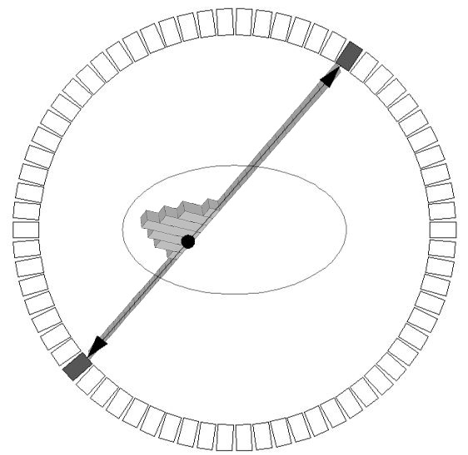
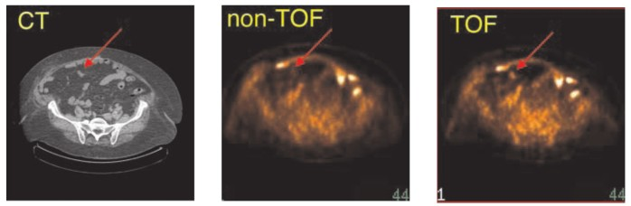
Positron emission tomography
Diagnostic method for in vivo imaging of biological processes.
Radiactive tracer, injected in the patient, decays with β+ decay.
The positron annihilation produces two anticolinear gamma rays, detected by gamma-ray detectors.
By reconstruction of many events, an image of the distribution of sources in the body is formed - important information for doctors diagnosing e.g. cancer
reconstructed
position with TOF
511 keV
line of response (LOR)
511 keV
patient
detector ring
Philips Gemini TF PET/CT, TOF resolution of 600 ps
[PET Center of Excellence Newsletter, Vol.3 Issue 3 (2006)]
Rok Pestotnik
IJS,Odsek za eksperimentalno fiziko osnovnih delcev
UL FMF, Izbrana poglavja, 10.12.2024

Slide 4
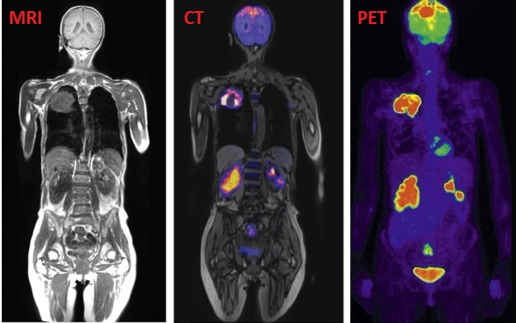
Differences among different imaging modalities
X-ray - uses X-rays from a static source for 2D imaging
CT - uses X-rays from a circular origin for 3D imaging
MRI - uses changes in the magnetic field for 3D imaging
Ultrasound - uses ultrasound waves for 2D and 3D images
Nuclear medicine uses gamma rays emitted by radioisotopes injected into the body for 2D and 3D imaging.
Gamma camera -> 2D images
SPECT -> 3D images
PET uses radiation from radioisotopes that decay by beta+ decay to generate 3D images
Rok Pestotnik
IJS,Odsek za eksperimentalno fiziko osnovnih delcev
UL FMF, Izbrana poglavja, 10.12.2024

Slide 5
Resolution of different imaging modalities
Modality Resolution (mm) TX or EM* Mode
X-ray 0.1 – 1.0 TX Projection
Nuclear 10 – 20 EM Projection Medicine
X-ray CT 0.5 TX Tomographic
Ultrasound 0.3 TX (sound) Tomographic
MRI 1 EM (RF) Tomographic
SPECT 10 EM Tomographic
PET 5 EM Tomographic
TX transmission method
EM emmision method
Rok Pestotnik
IJS,Odsek za eksperimentalno fiziko osnovnih delcev
UL FMF, Izbrana poglavja, 10.12.2024

Slide 6
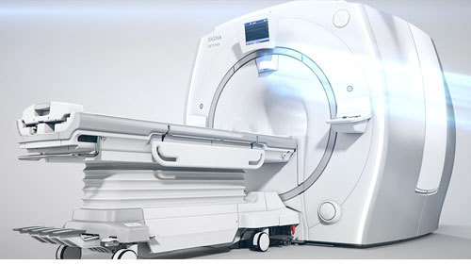
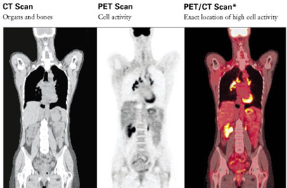
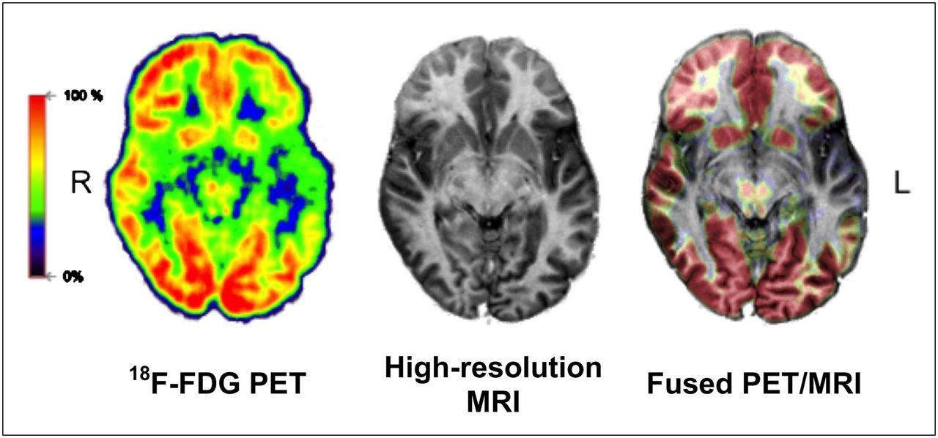
Multimodal techniques
Some scanners combine several imaging modes:
PET/CT
PET/MR
SPECT/CT
In these machines, two images are acquired in sequence (PET/CT, SPECT/CT) or simultaneous PET/MR
The fusion of the two images produces a single image.
PET-MR
Rok Pestotnik
IJS,Odsek za eksperimentalno fiziko osnovnih delcev
UL FMF, Izbrana poglavja, 10.12.2024

Slide 7
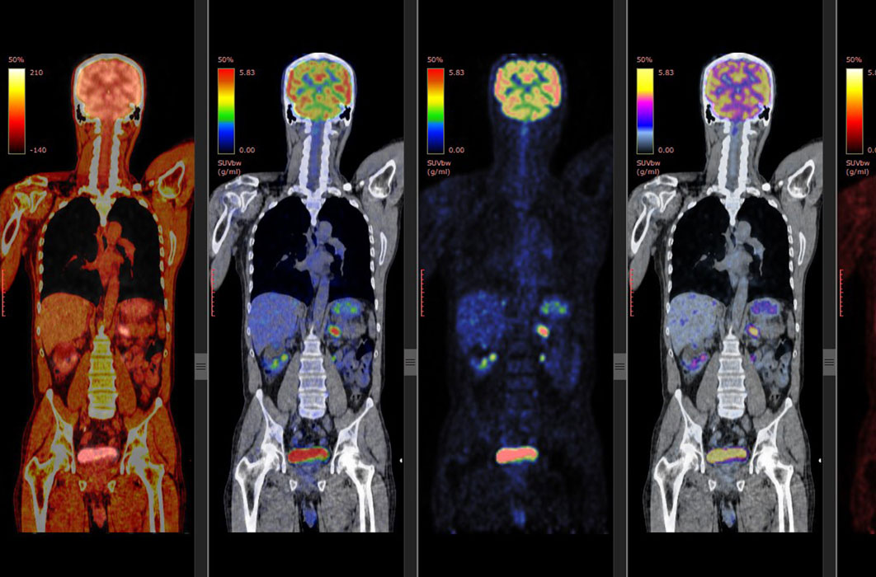
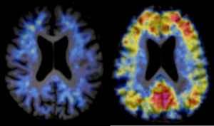
Types of PET imaging
Dynamic Imaging - 1 position
The radiopharmaceutical is injected into the patient at the start of the PET scan or some time before.
The patient remains in the same position for the entire examination.
Multiple images of the same area are captured at different times.
Full-body imaging (multiple positions)
The radiopharmaceutical is injected into the patient at a specific time before the imaging.
The images are taken sequentially while the bed moves and later combined into a single whole-body image.
Rok Pestotnik
IJS,Odsek za eksperimentalno fiziko osnovnih delcev
UL FMF, Izbrana poglavja, 10.12.2024

Slide 8
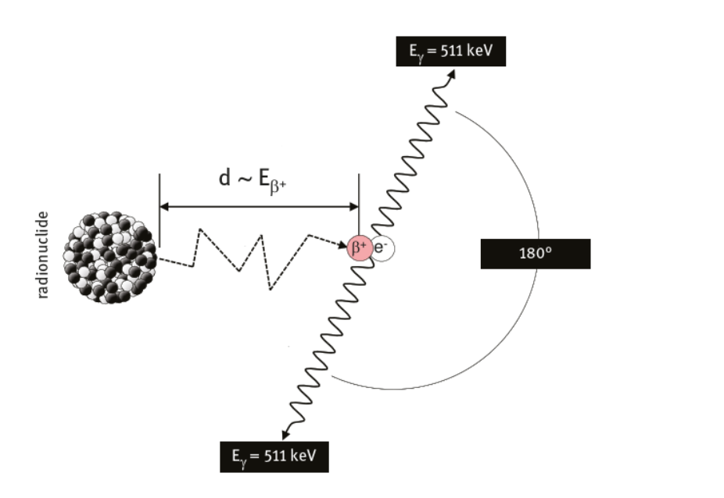
Positron annihilation
Positron - antiparticle of the electron
Emitted in β+ decay
The most widely used nucleotide for PET imaging F-18
Annihilation produces two anti-collinear gamma rays with an energy of 511 keV
Positron travels a distance before annihilation
In water, less than mm on average, but can be up to 3.8 mm
Rok Pestotnik
IJS,Odsek za eksperimentalno fiziko osnovnih delcev
UL FMF, Izbrana poglavja, 10.12.2024

Slide 9
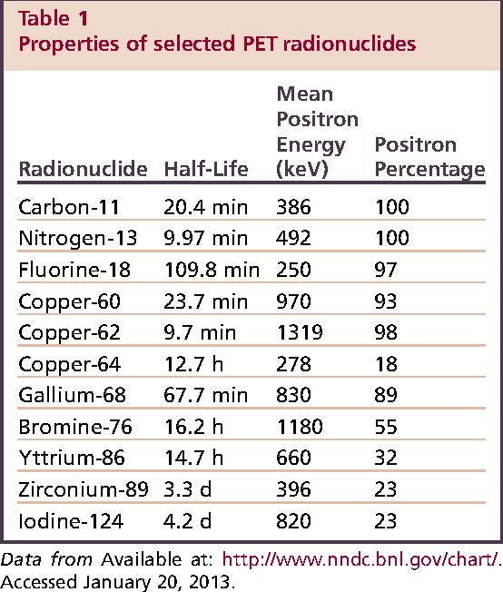
Biomarkers for PET imaging
β+ short-lived radioactive atom
Bound to a metabolically active biomolecule
Examples: 11C, 13N, 15O , 68Ga, 18F
Flourdeoxyglucose
18F substitution to glucose analogue
Behaves almost identically to glucose in the body
The most widely used biomarker for PET
Rok Pestotnik
IJS,Odsek za eksperimentalno fiziko osnovnih delcev
UL FMF, Izbrana poglavja, 10.12.2024

Slide 10
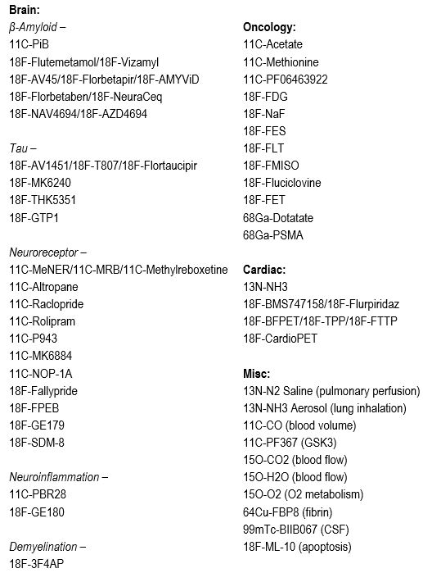
Radiopharmaceuticals
A radiopharmaceutical combines a radioactive component with a chemical component, determining where the radiopharmaceutical accumulates in the body.
It is usually injected into the body by intravenous injection but can also be injected by other routes.
Different radiopharmaceuticals for different types of tests/diseases.
Rok Pestotnik
IJS,Odsek za eksperimentalno fiziko osnovnih delcev
UL FMF, Izbrana poglavja, 10.12.2024

Slide 11
Different protocols currently in use
PiB/T807 Combo
11C-PiB inject 15 mCi & scan from 0-60 or 0-70 mins
18F-T807 inject 10 mCi, uptake of 75 min & scan for 30 mins.
MK6240
18F-MK6240 inject 5 mCi & scan 0-120 mins with a possible break from 65-80 min
18F-MK6240 inject 5 mCi, uptake of 90 min & scan for 30 mins.
Florbetaben
18F-FBB inject 8 mCi, uptake of 90 mins & scan for 20 mins mins with possible break from 65-80 min.
Whole-body FDG
18F-FDG inject 10-20 mCi, uptake of 60 mins & whole-body scan (eyes to thighs), image 5 mins per bed position.
Brain FDG
18F-FDG inject 5 mCi, uptake of 30-45 mins & scan for 15-30 mins
MENER
11C-MENER inject 15 mCi & scan 0-120 mins with a possible break from 45-60 min
Rok Pestotnik
IJS,Odsek za eksperimentalno fiziko osnovnih delcev
UL FMF, Izbrana poglavja, 10.12.2024

Slide 12
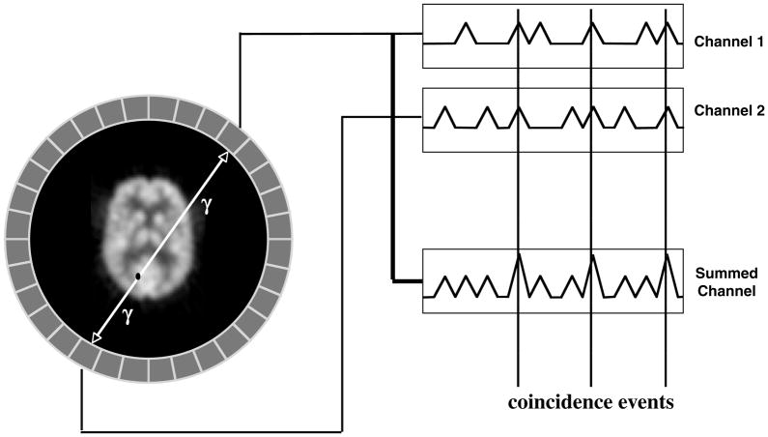
Gamma-ray detection
Gamma photons are detected with scintillation detectors
Gamma photons are absorbed in a scintillator
This emits visible photons
Visible photons are detected by photon sensors (photomultiplier tubes, silicon photomultiplier tubes, hybrid detectors)
The response line is formed from coincidence events
Within a time window, e.g. 10 ns
Deposited energy within the detector block
Rok Pestotnik
IJS,Odsek za eksperimentalno fiziko osnovnih delcev
UL FMF, Izbrana poglavja, 10.12.2024

Slide 13
Spatial resolution of a tomograph
Depends on
Detector pixel size
The physical processes involved in positron annihilation
The geometry of the tomograph
Detector material
Rok Pestotnik
IJS,Odsek za eksperimentalno fiziko osnovnih delcev
UL FMF, Izbrana poglavja, 10.12.2024

Slide 14
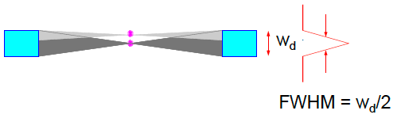
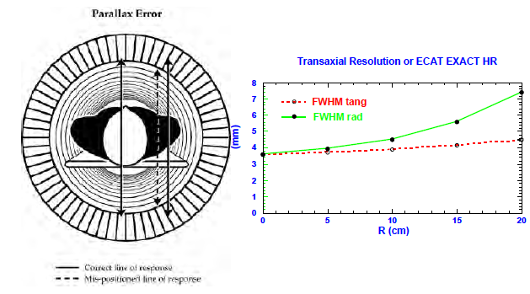

Detector pixels size
Detector size - pixel
Parallax error - due to finite crystal thickness
The source in the centre between the two detectors
The source is closer to one of the detectors
Rok Pestotnik
IJS,Odsek za eksperimentalno fiziko osnovnih delcev
UL FMF, Izbrana poglavja, 10.12.2024

Slide 15
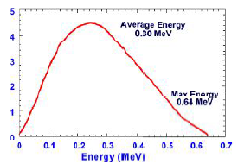
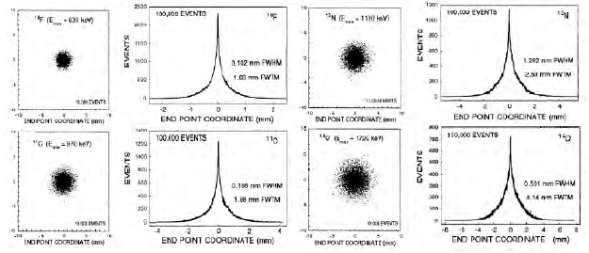
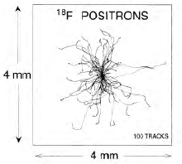
Positron range
Energy of the Positron at annihilation
Average energy 1/3 - 1/2 of maximum
The range is less than the path length before positron annihilation due to inelastic interactions with electrons
Rok Pestotnik
IJS,Odsek za eksperimentalno fiziko osnovnih delcev
UL FMF, Izbrana poglavja, 10.12.2024

Slide 16
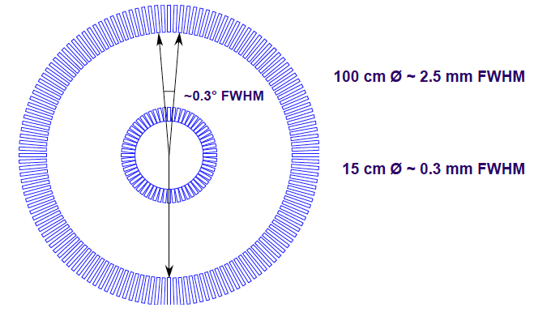
Non-collinearity
Rok Pestotnik
IJS,Odsek za eksperimentalno fiziko osnovnih delcev
UL FMF, Izbrana poglavja, 10.12.2024

Slide 17

Spatial resolution
The measured resolution of the system is the convolution of the different contributions.
If the contributions are Gaussian, the total resolution can be obtained as
Rok Pestotnik
IJS,Odsek za eksperimentalno fiziko osnovnih delcev
UL FMF, Izbrana poglavja, 10.12.2024

Slide 18
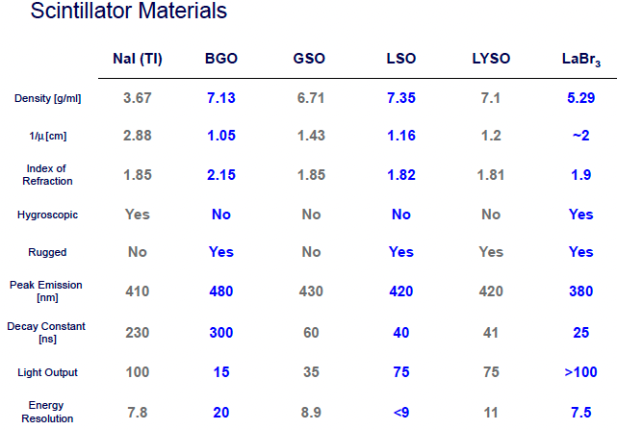
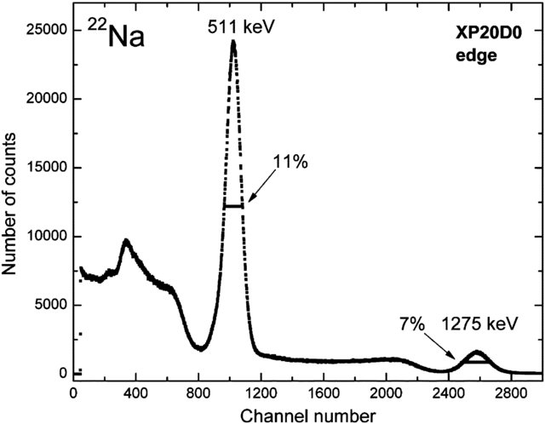
Scintillators for positron tomography
Inorganic crystals
high probability of photo effect - high Z
A large number of photons
Short time constants
Good energy resolution
Rok Pestotnik
IJS,Odsek za eksperimentalno fiziko osnovnih delcev
UL FMF, Izbrana poglavja, 10.12.2024

Slide 19
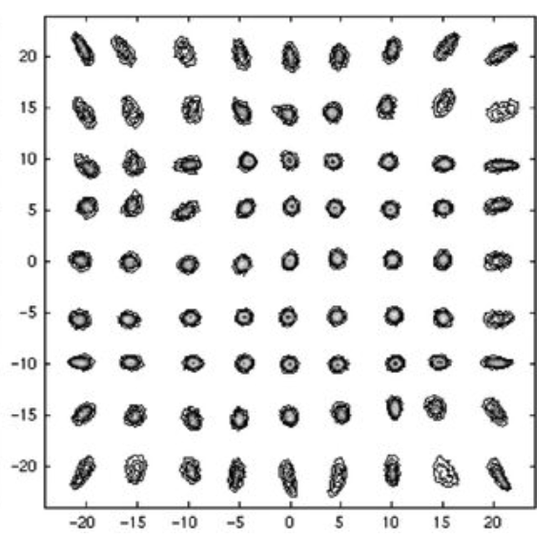
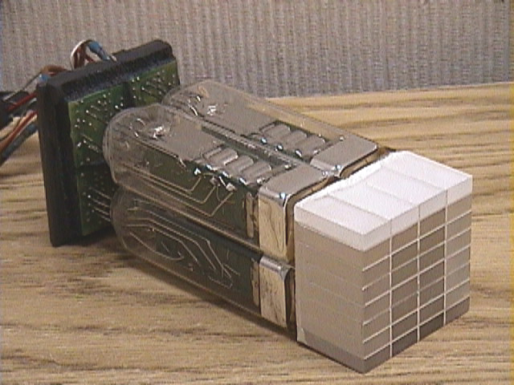
Conventional photon detector technology for PET
The mapping between crystals and photon sensors is not 1 to 1
The scintillation light is spread over several photon sensors:
Positioning by the centre of gravity method
Configuration not suitable for measurements with good time resolution
Rok Pestotnik
IJS,Odsek za eksperimentalno fiziko osnovnih delcev
UL FMF, Izbrana poglavja, 10.12.2024

Slide 20
Photon detector
A device that detects photons
Requirements:
Sensitivity to single photons,
High efficiency,
Good spatial resolution
Detection mechanism:
Photochemical reaction
thermal
photovoltaic
photo effect
Rok Pestotnik
IJS,Odsek za eksperimentalno fiziko osnovnih delcev
UL FMF, Izbrana poglavja, 10.12.2024

Slide 21
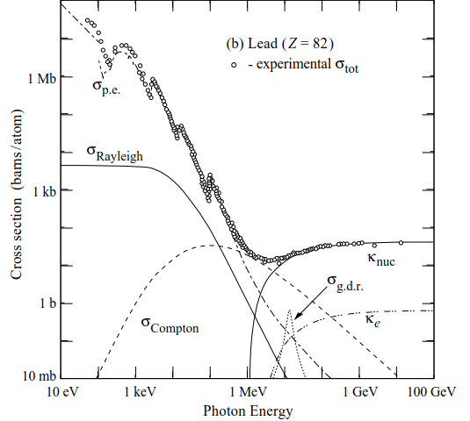
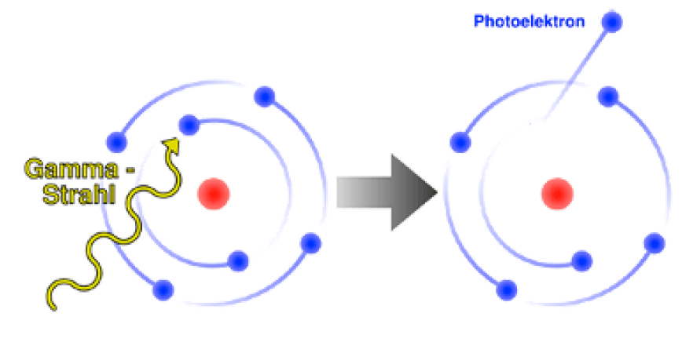
Photo effect
Interactions of photons with matter
First, we need to convert the light into a measurable electrical signal
Principle:
Using the photoelectric effect to "convert" photons into photoelectrons.
External photoelectric effect - emission of free electrons from the surface of a metal due to absorption of energy
Elements used to detect photons, e.g. K, Na, Rb, Cs (alkali metals), which are the least electronegative → highest electron release efficiency.
Most photon detectors use solid or gas-photosensitive materials.
The photoelectron can also be observed in liquids.
Intrinsic photoelectric effect - free charge carriers are created by the absorption of incident photons in a semiconductor
Photo effect
Pair production
Compton
^{scattering}
Rok Pestotnik
IJS,Odsek za eksperimentalno fiziko osnovnih delcev
UL FMF, Izbrana poglavja, 10.12.2024

Slide 22
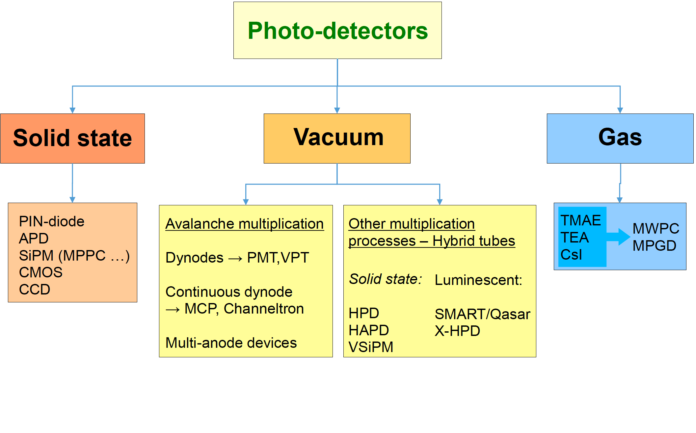
Light detection sensors
Types:
Vacuum
Photomultipliers (PMT)
PMT with microchannel plates
Solid-state photon detectors
Hybrid
HPD and HAPD
Other hybrid photon detectors
Gas photon detectors
Rok Pestotnik
IJS,Odsek za eksperimentalno fiziko osnovnih delcev
UL FMF, Izbrana poglavja, 10.12.2024

Slide 23
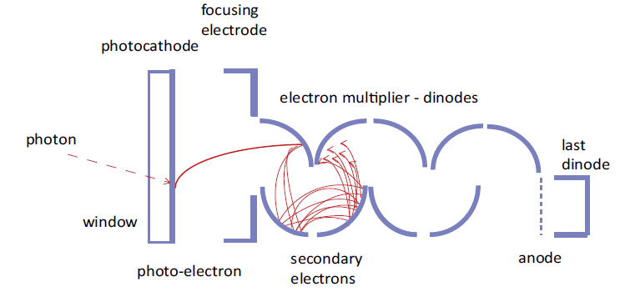

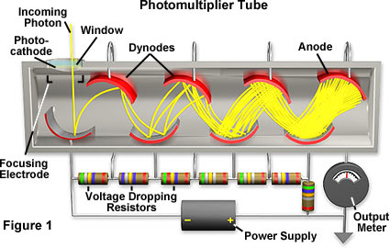
Photomultiplier (PMT)
After the photoeffect, the photoelectron must be detected and converted into an electrical signal.
A well-established method - amplifying the signal in a photomultiplier tube on a dynode chain
Exponential charge multiplication on each dynode
Example : the number of electrons is tripled at each of the 12 stages
Gain = 3¹² ~ 10⁶
Amplification depends on the number of dynodes, and the secondary emission ratio depends on
the material properties and
energy and angle of incidence of the primary electrons
Rok Pestotnik
IJS,Odsek za eksperimentalno fiziko osnovnih delcev
UL FMF, Izbrana poglavja, 10.12.2024

Slide 24
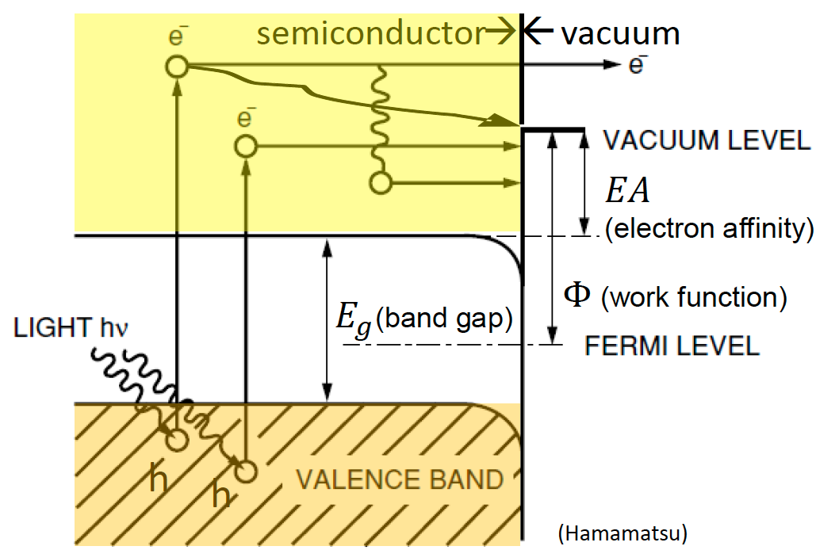
Solid photocathode
Because of the conservation of momentum, a photon cannot transfer its energy to a free electron → low efficiency in metals (high reflectivity)
The available energy of a few eV → good candidates are semiconductors.
The light must first enter the photosensitive material: low reflectivity requirement.
Absorbed photons transfer energy to electrons in the material;
If E_{𝛾} > 𝐸𝑔, the electrons move into the conduction band.
→In a Si photocathode, these electrons can give rise to an electric current.
→ photoconductive effect.
If the detection method requires the extraction of an electron into the vacuum, two more steps follow:
Electrons diffuse through the material, losing some energy due to scattering on the phonon lattice - ΔE ~ 0.05 eV per collision.
The average free path between two collisions is ~ 2.5 -5 nm →equilibrium depth 𝜆_𝑒. ~ a few tens of nm.
Only electrons that reach the surface with sufficient energy can escape from the material
→ minimum energy required for escape 𝐸𝛾>𝐸𝑔+𝐸𝐴
photoelectric effect
Rok Pestotnik
IJS,Odsek za eksperimentalno fiziko osnovnih delcev
UL FMF, Izbrana poglavja, 10.12.2024

Slide 25
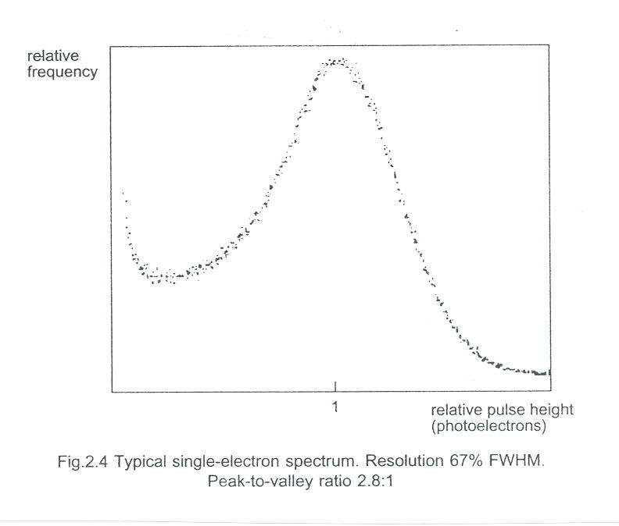
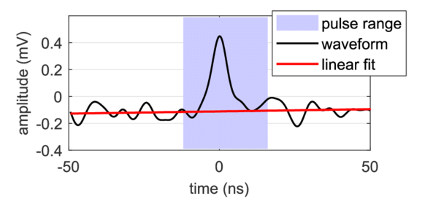
Pulse height distribution for single photons
(for multiple photons: convolution )
The signal width is determined by the fluctuations in the signal amplification at the first dynodes.
Pulse height
Pulse height
Rok Pestotnik
IJS,Odsek za eksperimentalno fiziko osnovnih delcev
UL FMF, Izbrana poglavja, 10.12.2024

Slide 26
Photocathode sensitivity
photons
Photo effect: E_{e} =hν - Φ
Work function
Photocathode
Maximum electron kinetic energy
Photon energy
photo electrons
Kvantni izkoristek
Number of photoelectrons that exit the photocathode
QE(λ ) =
Number of incident photons
I_{k}
Photoelectric current (A)
Spectral sensitivity E( λ)=
P( λ)
Input luminous flux (W)
I_{k} /e_{o}
hc
QE( λ) =
=
E(λ)
P(λ )/hν
λ e₀
Rok Pestotnik
IJS,Odsek za eksperimentalno fiziko osnovnih delcev
UL FMF, Izbrana poglavja, 10.12.2024

Slide 27
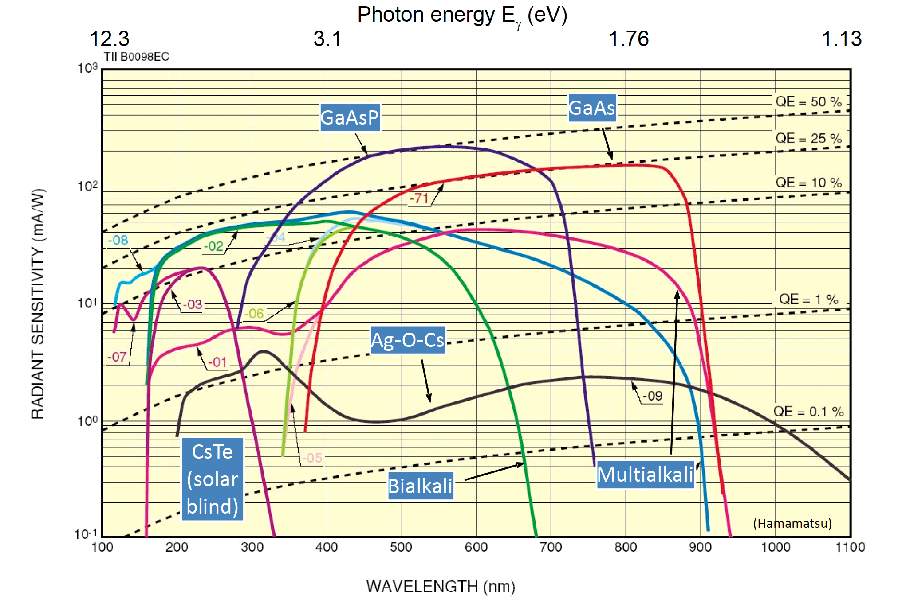
Transmissive photocathodes
Bi-alkali: Sb-K-Cs, Sb-Rb-Cs, Na-K-Sb Multi-alkali: Sb-Na-K-Cs
Rok Pestotnik
IJS,Odsek za eksperimentalno fiziko osnovnih delcev
UL FMF, Izbrana poglavja, 10.12.2024

Slide 28
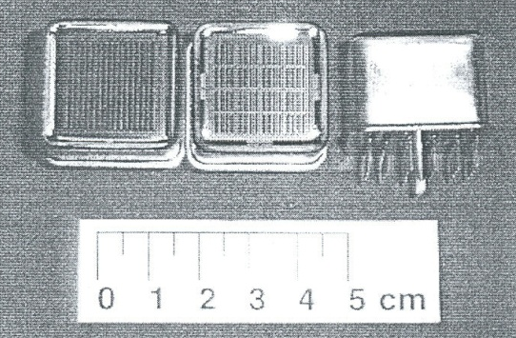
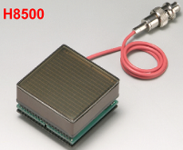
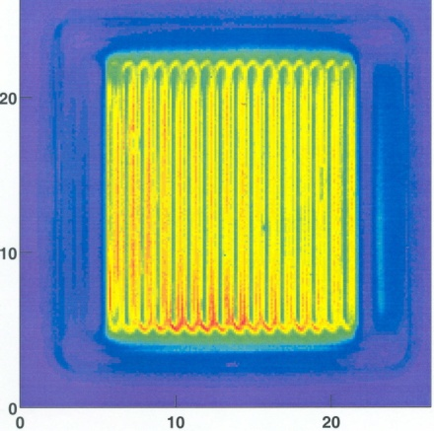
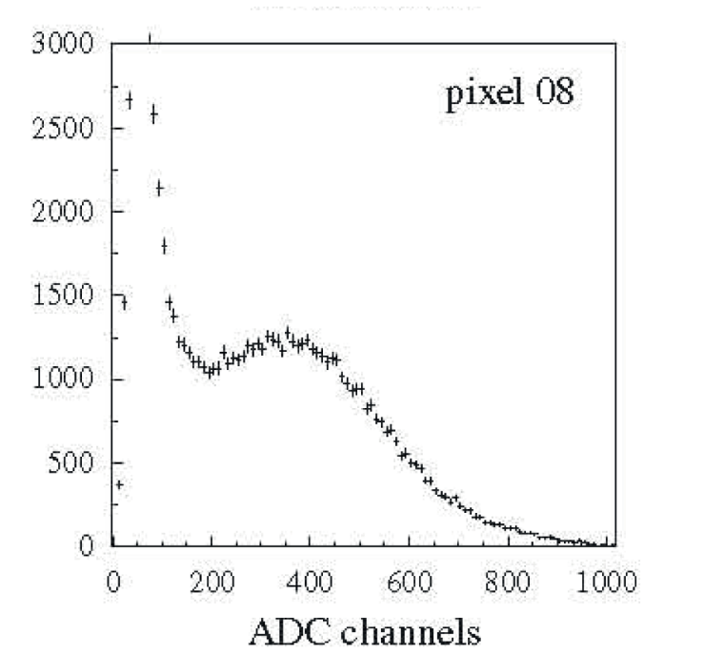
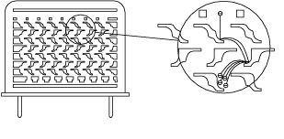
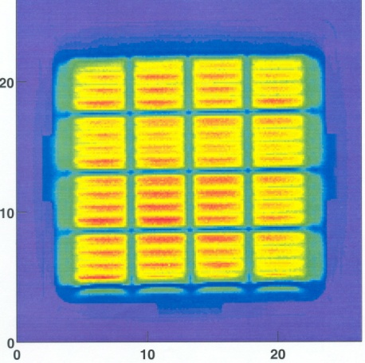
Multianode photomultiplier
Multi-anode photomultiplier - miniaturisation → up to 64 pixels in one photomultiplier, each ~ 2x2 mm2 in size
Dinode structure made of layers of perforated metal sheets
Noise
1 photon
Multi-anode photomultiplier (Hamamatsu R5900)
Metal sheets dynode
Low noise < few Hz per channel
Low crosstalk between channels < 1%
Signal
Rok Pestotnik
IJS,Odsek za eksperimentalno fiziko osnovnih delcev
UL FMF, Izbrana poglavja, 10.12.2024
28

Slide 29
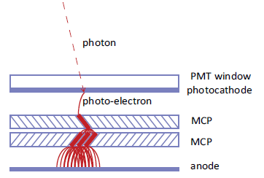
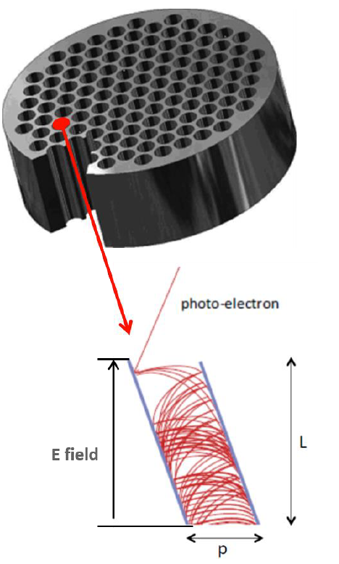
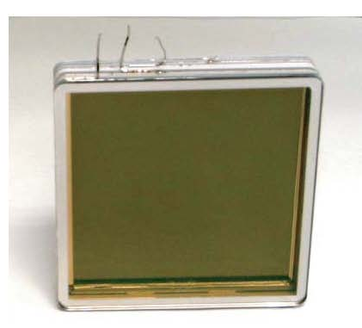
Photomultiplier with microchannel plates
Time-of-flight detectors would like timing precision at the picosecond (10⁻¹² s) level
1 ps ≈ 0.3 mm for a relativistic particle → requires small feature sizes
Micro-channel plate (MCP) photon detectors employ electron multiplication in small (~ 10 μm) pores, used in image intensifiers
Timing precision of ~ 10 ps achieved
glass pores
MCP is an array of millions of capillaries (~10 um diameter) in a glass plate (d=1mm).
Both faces of the plate are coated by thin metal, and act as electrodes.
The inner side of each tube is coated with electron-emissive material.
MCP detector (Photonis) 6 cm width Up to 1024 anode pads
Immune to an axial magnetic field
Rok Pestotnik
IJS,Odsek za eksperimentalno fiziko osnovnih delcev
UL FMF, Izbrana poglavja, 10.12.2024

Slide 30
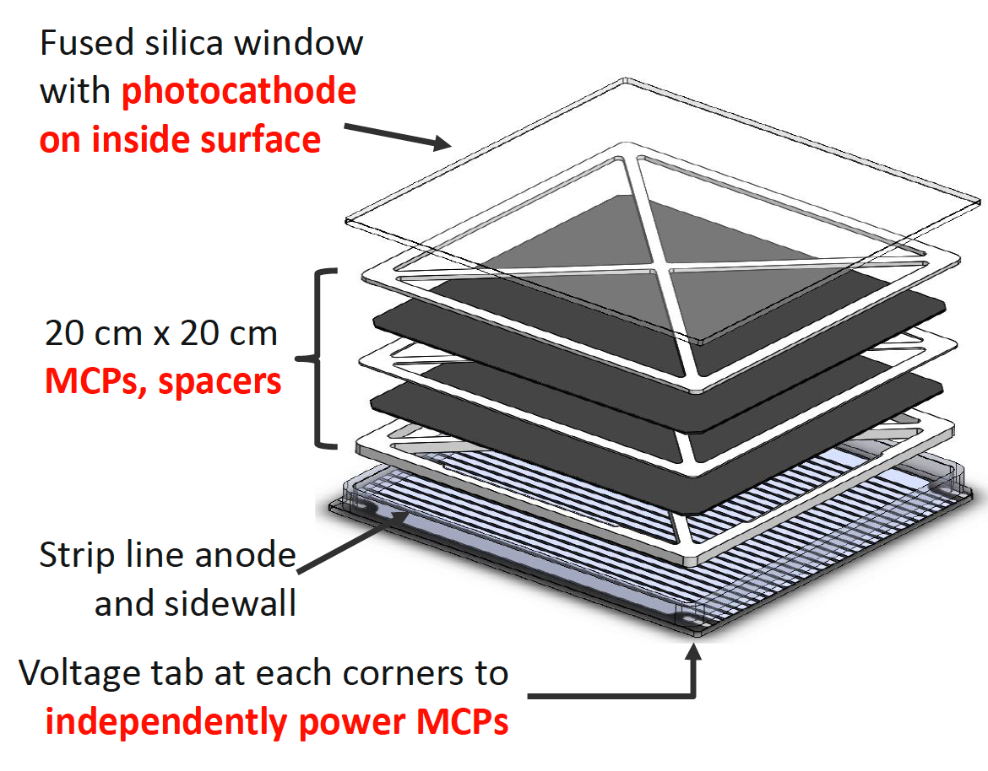
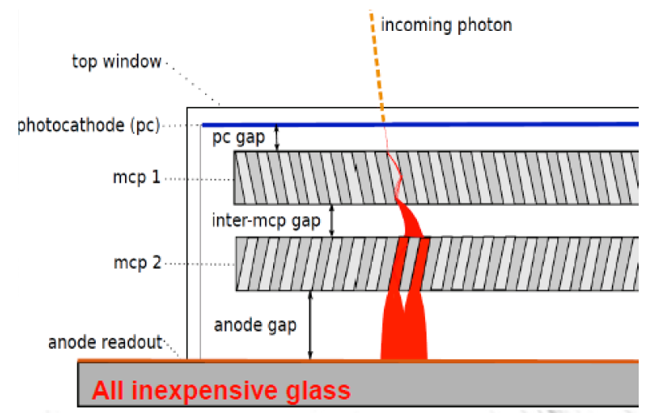
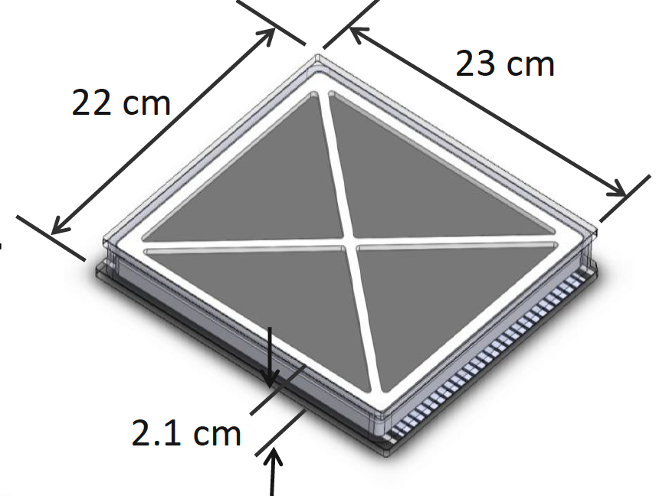
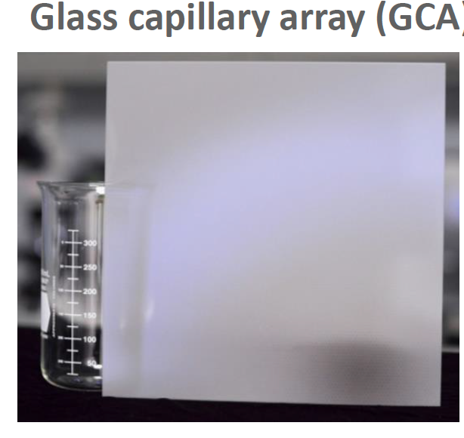
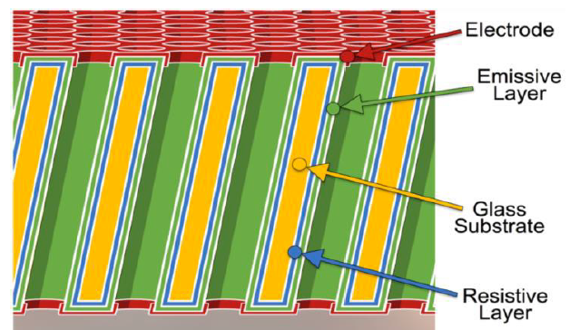
Large area picosecond photo-detector - LAPPD
Completely different MCP manufacture technology, eliminated the etching and firing processes in old technology, making low-cost, large area (20cmx20cm) MCPs possible.
ALD coating
Rok Pestotnik
IJS,Odsek za eksperimentalno fiziko osnovnih delcev
UL FMF, Izbrana poglavja, 10.12.2024

Slide 31
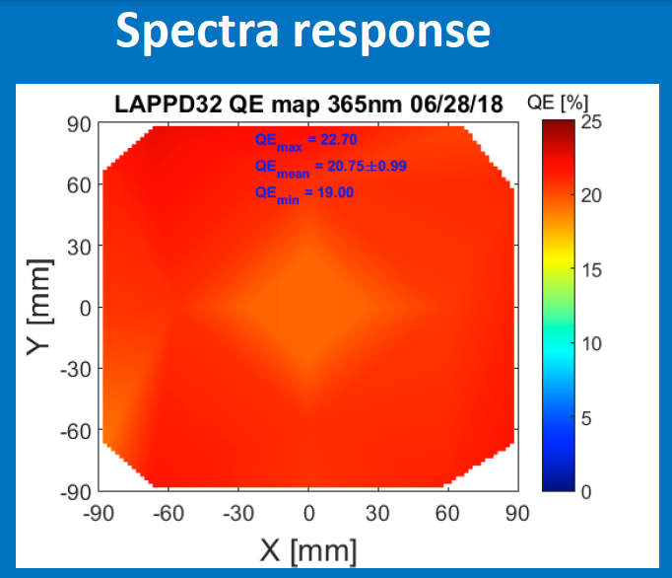
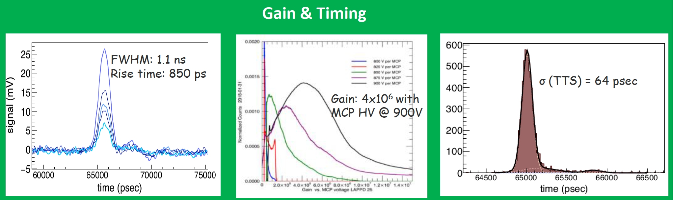
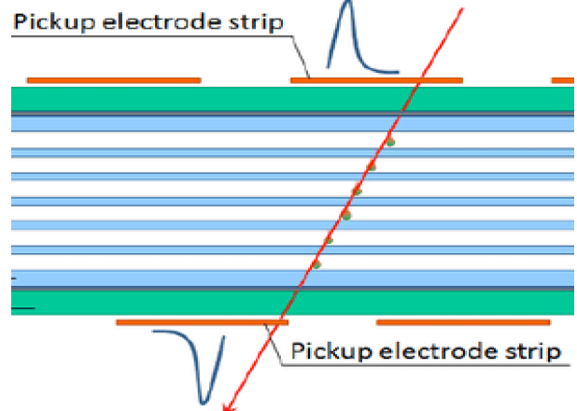
LAPPD key performances
Gen II - 3x3 mm pixelated readout
Gen II LAPPD with capacitive coupling initially using Boro float glass, transition to robust ceramic once those sealing issues are resolved.
capacitive coupled electrode
Rok Pestotnik
IJS,Odsek za eksperimentalno fiziko osnovnih delcev
UL FMF, Izbrana poglavja, 10.12.2024
31

Slide 32
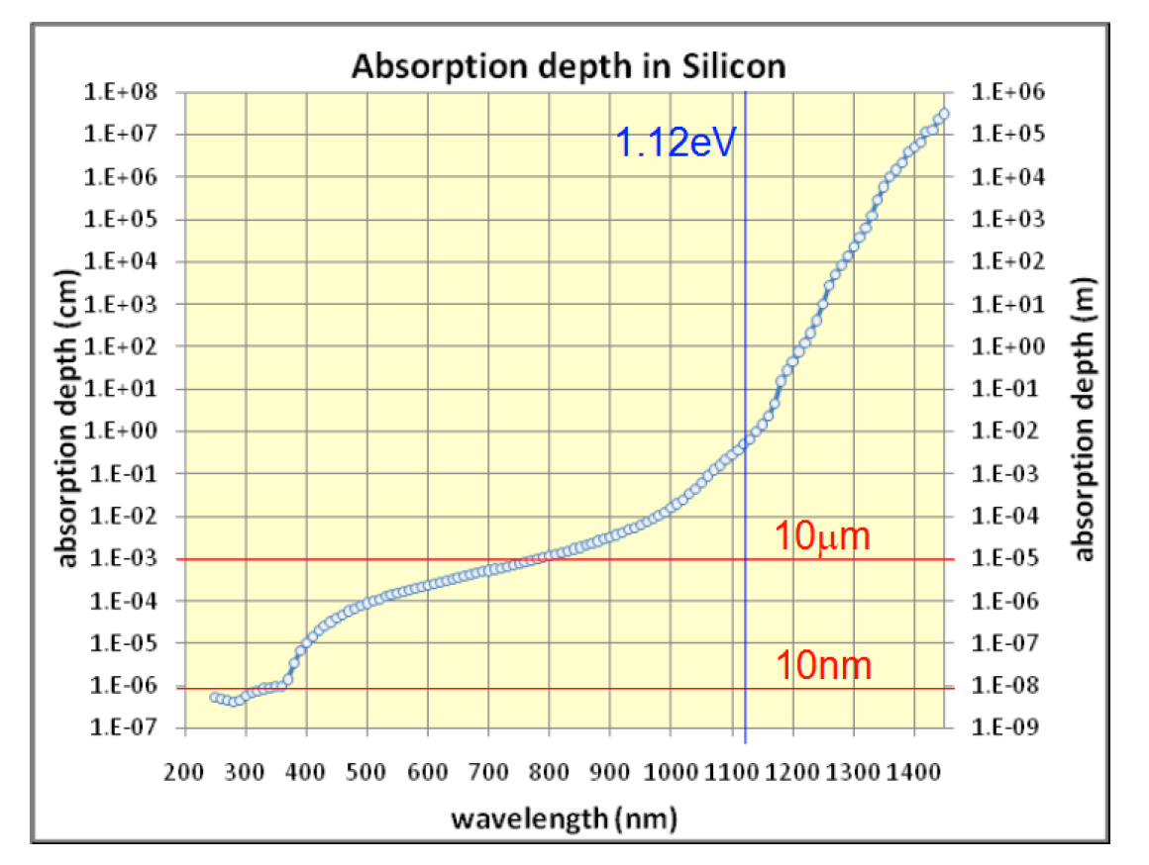
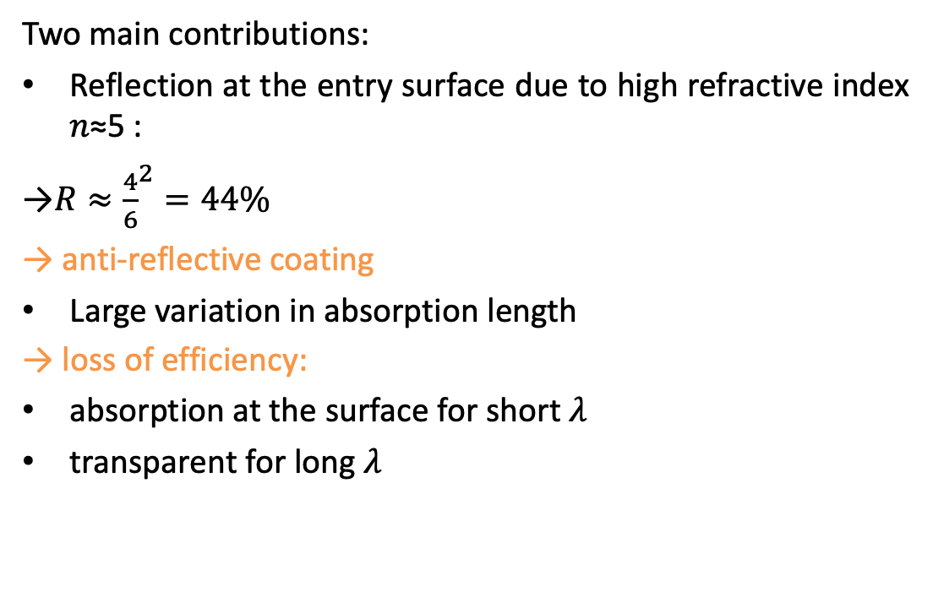
Light detection in silicon
Two main contributions:
Reflection at the entry surface due to high refractive index 𝑛≈5 :
→$R≈{\frac{4}{6}}^{2}=44\%$
→ anti-reflective coating
Large variation in absorption length
→ loss of efficiency:
absorption at the surface for short 𝜆
transparent for long 𝜆
Rok Pestotnik
IJS,Odsek za eksperimentalno fiziko osnovnih delcev
UL FMF, Izbrana poglavja, 10.12.2024

Slide 33

The P-N Junction
Electrons and holes diffuse to area of lower concentration
An electric field is built up in the depletion layer
Drift of minority carriers
Capacitance
Rok Pestotnik
IJS,Odsek za eksperimentalno fiziko osnovnih delcev
UL FMF, Izbrana poglavja, 10.12.2024

Slide 34

The P-N photodiode during illumination
Electrons and holes generated in the depletion area due to photon absorption drift outwards by the electric field
Reverse biasing:
Electric field in the junction increases quantum efficiency
Larger depletion layer
Better signal
Rok Pestotnik
IJS,Odsek za eksperimentalno fiziko osnovnih delcev
UL FMF, Izbrana poglavja, 10.12.2024

Slide 35


Avalanche photodiode
P-N photodiode
Avalanche photodiode
Rok Pestotnik
IJS,Odsek za eksperimentalno fiziko osnovnih delcev
UL FMF, Izbrana poglavja, 10.12.2024

Slide 36

Geiger mode APD
In the Geiger mode, the APD is biased above its breakdown voltage for operation in very high gain.
Electrons and holes multiply by impact ionization faster than they can be collected, resulting in an exponential growth in the current
Individual photon counting
Rok Pestotnik
IJS,Odsek za eksperimentalno fiziko osnovnih delcev
UL FMF, Izbrana poglavja, 10.12.2024

Slide 37




Geiger mode – quenching
Shutting off an avalanche current is called quenching
Passive quenching
slower, ~10ns dead time
Active quenching
faster
Rok Pestotnik
IJS,Odsek za eksperimentalno fiziko osnovnih delcev
UL FMF, Izbrana poglavja, 10.12.2024

Slide 38




Silicon Photomultipliers
Array of Geiger mode APDs (above the breakdown voltage) → large gain, binary signal, long recovery
Microcell = GAPD (~20um)
made on a silicon substrate, with 100-5000 pixels/mm². Total area 1-40mm².
The independently operating pixels are connected to the same readout line
Rok Pestotnik
IJS,Odsek za eksperimentalno fiziko osnovnih delcev
UL FMF, Izbrana poglavja, 10.12.2024

Slide 39



Characteristics of SiPM
Traditional PM
low operation voltage ~ 10-100 V
gain ~ 10⁶
peak PDE up to 65%(@400nm) PDE = QE x ε_{geiger} x ε_{geo} (up to 5x PMT!)
ε_{geo} – dead space between the cells
time resolution ~ 100 ps
works in high magnetic field
dark counts ~ few 100 kHz/mm²
radiation damage (p,n)
Rok Pestotnik
IJS,Odsek za eksperimentalno fiziko osnovnih delcev
UL FMF, Izbrana poglavja, 10.12.2024

Slide 40


SiPMs as photon detectors
1 mm
100 um
50 um
25 um
Rok Pestotnik
IJS,Odsek za eksperimentalno fiziko osnovnih delcev
UL FMF, Izbrana poglavja, 10.12.2024

Slide 41



Digital SiPM
DPC: Front-end Digitization by Integration of SPAD & CMOS Electronics
New perspectives: 3D integration
advanced photon-detection structures,
improved detection efficiency
Rok Pestotnik
IJS,Odsek za eksperimentalno fiziko osnovnih delcev
UL FMF, Izbrana poglavja, 10.12.2024

Slide 42




Time response
Light travels 3 mm in 10 ps (vacuum)
●Rise time, fall time (or decay time)
●Duration
●Transit time (Δt): time between the arrival of the photon and the electrical signal
→ trigger decision time
●Transit time spread (TTS): transit time variation between different events
→timing resolution
Some typical signals:
Applications requiring good timing:
● TOF PET
● Cherenkov light based TOF systems
Rok Pestotnik
IJS,Odsek za eksperimentalno fiziko osnovnih delcev
UL FMF, Izbrana poglavja, 10.12.2024

Slide 43
SiPM: time resolution for single photons
Very fast analog SiPM
Digital SiPM
Analog SiPMs: typically 80 ps (sigma), 200 ps FWHM
Digital SiPMs: main peak 48 ps (sigma)!
Rok Pestotnik
IJS,Odsek za eksperimentalno fiziko osnovnih delcev
UL FMF, Izbrana poglavja, 10.12.2024

Slide 44

Silicon photomultipliers enable 1-to-1 mapping between crystals and photon sensor
511 keV photon
1-1 crystal sensor coupling
4x4 array
3x3 mm²
SiPM pixels
4x4 array
3x3x20 mm³
LYSO crystals
There is no light sharing between the crystals
The light is confined and directed to a single photon detector
→ Better signal to noise ratio SNR
Rok Pestotnik
IJS,Odsek za eksperimentalno fiziko osnovnih delcev
UL FMF, Izbrana poglavja, 10.12.2024

Slide 45

PET imaging procedure
Rok Pestotnik
IJS,Odsek za eksperimentalno fiziko osnovnih delcev
UL FMF, Izbrana poglavja, 10.12.2024

Slide 46



Imaging FDG uptake (PET) & anatomical localization (CT)
Function
Function+Anatomy and CT-based attenuation correction
Anatomy
Rok Pestotnik
IJS,Odsek za eksperimentalno fiziko osnovnih delcev
UL FMF, Izbrana poglavja, 10.12.2024
Notes:
46

Slide 47


Standard detector layout
~25 cm
PET detector ring
~80 cm
Annihilation
Axial direction
Line of response
Rok Pestotnik
IJS,Odsek za eksperimentalno fiziko osnovnih delcev
UL FMF, Izbrana poglavja, 10.12.2024

Slide 48


Coincidence event
Možne črte odziva
Rok Pestotnik
IJS,Odsek za eksperimentalno fiziko osnovnih delcev
UL FMF, Izbrana poglavja, 10.12.2024

Slide 49

Event classification
Rok Pestotnik
IJS,Odsek za eksperimentalno fiziko osnovnih delcev
UL FMF, Izbrana poglavja, 10.12.2024

Slide 50





Measured and true number of events
Measured number of coincident events P:
$$P=N\left(AT+S+R\right)$$
T true coincidence
N normalisation factor
A attenuation correction.
S scatter correction
R correction for random coincidences
Attenuation due to absorption of photons in matter
Reduces the number of coincidences from 50-95%
depends on patient size
reduced mediastinal
uptake
'hot' lungs
Non-uniform liver
Enhanced skin uptake
PET: no correction
PET: with attenuation (accurate)
CT image (accurate)
Rok Pestotnik
IJS,Odsek za eksperimentalno fiziko osnovnih delcev
UL FMF, Izbrana poglavja, 10.12.2024

Slide 51



Signal to noise ration
True coincidence ≈activity
Random coincidences ≈activity^2
The figure can be corrected
Corrections increase noise
Dependent on the detector material
Scattered events ≈activity
Reduce contrast
Require corrections
Analytical assesment
Corrections increase noise
Rok Pestotnik
IJS,Odsek za eksperimentalno fiziko osnovnih delcev
UL FMF, Izbrana poglavja, 10.12.2024

Slide 52




Tomographic image reconstruction
Sinogram - projections of the distribution in the direction of the response line
Reconstruction goal: source distribution for different projections using coincidence events:
$$p=Hf$$
Analitične
Iterativne
A - sinogram without corrections
B - sinogram after corrections for scatter and random coincidences
C - sinogram after correction for attenuation, normalisation and dead time
D - one slice of the reconstructed image
Rok Pestotnik
IJS,Odsek za eksperimentalno fiziko osnovnih delcev
UL FMF, Izbrana poglavja, 10.12.2024

Slide 53

2D and 3D acquisition
Advantages of 3D acquisition:
Improved sensitivity (3-5x)
Disadvantages:
Increased ratio of scattered events (3x)
Uneven axial sensitivity
A higher number of scattered events -> higher noise
More data
More complex reconstruction
Problem with detector dead time
Rok Pestotnik
IJS,Odsek za eksperimentalno fiziko osnovnih delcev
UL FMF, Izbrana poglavja, 10.12.2024

Slide 54





PET imager simulation
Essential for understanding and designing PET imagers.
Computational description of geometry and materials:
Tomograph
Imaging objects: digital phantoms - NEMA, Derenzo, XCAT, BigBrain, etc.
Simulation of physical processes relevant for detection:
Generation of decays in the object
Event pair generation and particle tracking through the detector
Simulation of the detector response ( gamma-ray to electron conversion, scintillations, optical photon tracking)
Event digitisation
Preparation of the data into the format of a real event acquisition.
The tools are based on simulation tools used in high-energy physics - Geant4
GATE
Rok Pestotnik
IJS,Odsek za eksperimentalno fiziko osnovnih delcev
UL FMF, Izbrana poglavja, 10.12.2024

Slide 55


Medical applications of molecular imaging
The diabetic and cancer treatment
Heart disease
Brain function
Recently increasing use in veterinary medicine
PET/CT and molecular imaging
Number of PET machines
Rok Pestotnik
IJS,Odsek za eksperimentalno fiziko osnovnih delcev
UL FMF, Izbrana poglavja, 10.12.2024

Slide 56
Number of PET scanners around the world
Rok Pestotnik
IJS,Odsek za eksperimentalno fiziko osnovnih delcev
UL FMF, Izbrana poglavja, 10.12.2024

Slide 57

Tumour detection using FDG and PET images
FDG accumulates in malignant tumours
Tumours of the lymph nodes in the neck
The use of PET imaging for the detection of lymph node tumours and metastases
Brain tumours
1-2% of adult cancers in the USA/Europe
311,000 new cases between 2005 and 2009
Gliomas = most common
MRI is usually the first step, but not specific
High FDG uptake in normal brain and uptake due to inflammation
Unreliable detection of lower-grade tumours
Rok Pestotnik
IJS,Odsek za eksperimentalno fiziko osnovnih delcev
UL FMF, Izbrana poglavja, 10.12.2024

Slide 58
What doctors need
What is needed in clinics is sometimes far from what is currently being developed
Specific questions are challenging to answer with current technology
Promoting research is important
Importance of communication between physicists/engineers, biologists and physicians
Planning for integration of biomarker imaging results, liquid biopsy and artificial intelligence
Rok Pestotnik
IJS,Odsek za eksperimentalno fiziko osnovnih delcev
UL FMF, Izbrana poglavja, 10.12.2024

Slide 59
Current situation
Standard clinical scanners are not optimal:
Cost of equipment and installation, limited access, efficiency.
The new axial extended PET scanners are one possible solution, offering:
Improved sensitivity
Enable pharmacokinetic and pharmacodynamic studies.
Unfortunately, they pose a significant challenge:
financial: huge site and equipment costs
logistical: integration with conventional PET scanners, workflow, etc.
R.Pestotnik, PANEL TOF PET imager @MEDAMI 2022
Rok Pestotnik
IJS,Odsek za eksperimentalno fiziko osnovnih delcev
UL FMF, Izbrana poglavja, 10.12.2024

Slide 60

Motivation for further development of PET devices
A paradigm shift in medicine from:
From treating the evident disease
to early diagnosis and prevention
This leads to stricter PET requirements.
Sensitivity
Specificity
Targeted radionuclide therapy (TRT) and therapy
Requirement for more widespread and accurate PET diagnostics
Molecular imaging:
More tailored management
Opportunity to contain healthcare costs
Rok Pestotnik
IJS,Odsek za eksperimentalno fiziko osnovnih delcev
UL FMF, Izbrana poglavja, 10.12.2024

Slide 61



Positron tomography with time-of-flight measurement
Improving signal-to-noise ratio by improving temporal resolution
SNR gain$=\frac{{SNR}_{TOF}}{{SNR}_{non−TOF}}$=$\sqrt{\frac{D}{c×\frac{CTR}{2}}}$
Year | TOF - resolution | Signal to noise ratio
- | brez | 1
2006 | 585 ps
2011 | 500 ps | 2.3
2017 | 375 ps
2018 | 214 ps | 3.3
 | 100 ps | >5
Rok Pestotnik
IJS,Odsek za eksperimentalno fiziko osnovnih delcev
UL FMF, Izbrana poglavja, 10.12.2024

Slide 62

Improved image due to time-of-flight measurement
Rok Pestotnik
IJS,Odsek za eksperimentalno fiziko osnovnih delcev
UL FMF, Izbrana poglavja, 10.12.2024

Slide 63
Essential factors in the design of time-of-flight PET systems
High-resolution readout electronics
High bandwidth digital oscilloscope
For prototyping: Yes
For system design: No (not “expandable”)
Rok Pestotnik
IJS,Odsek za eksperimentalno fiziko osnovnih delcev
UL FMF, Izbrana poglavja, 10.12.2024

Slide 64
Essential factors in the design of time-of-flight PET systems
Precision read-out electronics that can be scaled up
Special high-speed timing circuits - ASICs (Application-specific Integrated Circuits)
Precision Time-to-Digital Converter (TDC), which can also be implemented in an FPGA circuit
Rok Pestotnik
IJS,Odsek za eksperimentalno fiziko osnovnih delcev
UL FMF, Izbrana poglavja, 10.12.2024

Slide 65

Different signal detection times for leading-edge discrimination electronics
Rok Pestotnik
IJS,Odsek za eksperimentalno fiziko osnovnih delcev
UL FMF, Izbrana poglavja, 10.12.2024

Slide 66

State-of-the-art in TOF
Clinical scanner:
Siemens Biograph Vision PET/CT → 214 ps
Laboratory measurement:
Gundacker et al, Phys. Med. Biol. 65 (2020) 025001 (20pp)
2 x 2 x 3 mm LSO → 58 ps*
2 x 2 x 20 mm LSO → 98 ps*
*measured with high power readout electronics that cannot be scaled to large devices
https://www.siemens-healthineers.com/molecular-imaging/pet-ct/biograph-vision
Rok Pestotnik
IJS,Odsek za eksperimentalno fiziko osnovnih delcev
UL FMF, Izbrana poglavja, 10.12.2024

Slide 67

Siemens Biograph Vision 600
Clinical experience with ~200-ps TOF PET Siemens Biograph Vision 600
2nd machine installed 2018 at Lausanne University Hospital
More than 10000 scans
Rok Pestotnik
IJS,Odsek za eksperimentalno fiziko osnovnih delcev
UL FMF, Izbrana poglavja, 10.12.2024

Slide 68


Siemens Biograph Vision
First patient in Luzana
Rok Pestotnik
IJS,Odsek za eksperimentalno fiziko osnovnih delcev
UL FMF, Izbrana poglavja, 10.12.2024

Slide 69


Detection of small structures with FDG PET
Pituitary gland visibility
Reduced partial volume effect
Rok Pestotnik
IJS,Odsek za eksperimentalno fiziko osnovnih delcev
UL FMF, Izbrana poglavja, 10.12.2024

Slide 70

Improving yield - Explorer Positron Tomograph
Apparatus with an axial length of 194 cm
Full body image at once
Allows lower doses of radiopharmaceutical
Allows faster imaging
Dynamic imaging possible
Opens up new possibilities for PET diagnostics
Rok Pestotnik
IJS,Odsek za eksperimentalno fiziko osnovnih delcev
UL FMF, Izbrana poglavja, 10.12.2024

Slide 71

Time-dependent imaging with Explorer
Standard dose of FDG
Different imaging times
Image taken from Badawi, Ramsey D., et al. "First human imaging studies with the EXPLORER total-body PET scanner." Journal of Nuclear Medicine 60.3 (2019): 299-303
Rok Pestotnik
IJS,Odsek za eksperimentalno fiziko osnovnih delcev
UL FMF, Izbrana poglavja, 10.12.2024

Slide 72

Low-dose imaging
10% of the standard dose
Satisfactory image quality
Image taken from Badawi, Ramsey D., et al. "First human imaging studies with the EXPLORER total-body PET scanner." Journal of Nuclear Medicine 60.3 (2019): 299-303
Rok Pestotnik
IJS,Odsek za eksperimentalno fiziko osnovnih delcev
UL FMF, Izbrana poglavja, 10.12.2024

Slide 73


Dynamic imaging
Imaging after a standard dose of FDG
Graph showing the activity of different areas as a function of time
Rok Pestotnik
IJS,Odsek za eksperimentalno fiziko osnovnih delcev
UL FMF, Izbrana poglavja, 10.12.2024

Slide 74


Combined PET/MR system
(A)
(B)
Benefits of MRI
High soft tissue contrast
High spatial resolution
Motion prediction
No dose burden
Multiparametric MRI
Advantages of PET
High molecular specificity
High sensitivity for molecular tracking
The biological distribution of radiopharmaceuticals can be quantified and tracked in 3D
Multi-parameter tracking: different biological disease pathways can be tracked simultaneously.
Fig. 4. Delineation of brainstem neuroanatomy (ex vivo 100 μm resolution 7T MRI dataset). (A) At the level of the rostral pons and caudal midbrain (B) A zoomed view Edlow, B. L., et al. Scientific data (2019)
(A)
(B)
(C)
(D)
Fig. 5. A multi-tracer PET study in Alzheimer disease. (A) ¹⁸F‑FDG (B) ¹¹C‑nicotine, (C) ¹¹C‑PIB and (D) ¹¹C‑PMP
Nordberg, A., et al. Nature Reviews Neurology (2010)
Rok Pestotnik
IJS,Odsek za eksperimentalno fiziko osnovnih delcev
UL FMF, Izbrana poglavja, 10.12.2024

Slide 75
PET inserts in standard MRI machines
Benefits
Only the purchase of an insert is required
Installs into existing apparatus
No modification of the MRI system is required
No special preparation of the rooms is required
Approximately 5-10x lower initial cost compared to a comparable integrated PET/MR system
Challenges
Requires time for insert insertion
Simultaneous registration of PET and MR data
Radiation protection and shielding in existing PET centre
Rok Pestotnik
IJS,Odsek za eksperimentalno fiziko osnovnih delcev
UL FMF, Izbrana poglavja, 10.12.2024

Slide 76


Radiofrequency PET MRI insert
RF penetrability facilitates the “insert” approach
MRI
Removable PET Insert
Main Magnet
Gradient Coil
RF Body Coil
* Prototype designed for brain PET Insert
* The concept could apply to whole-body PET insert as well
Rok Pestotnik
IJS,Odsek za eksperimentalno fiziko osnovnih delcev
UL FMF, Izbrana poglavja, 10.12.2024

Slide 77

PET-MRI insert / First prototype
Batteries
: ~30V for SiPMs
: 5V for transistors, amplifiers,
and lasers
:Electrically floating w.r.t. MR
Optical fiber data transmission
: 256 CHs
PET detector modules
: 16 PET detector modules
: Ring shape (32 cm ID)
: 1 mm inter-modular gap
Rok Pestotnik
IJS,Odsek za eksperimentalno fiziko osnovnih delcev
UL FMF, Izbrana poglavja, 10.12.2024

Slide 78

Development of new detectors for PET
Scintillating crystal:
converts gamma energy into optical photons
Photodetector
converts optical photons into electrical pulses
10 ps challenge / no need fpr reconstruction needed
Time resolution in TOF PET limited by
scintillation light emission
rise and decay time
optical photon travel time spread in the crystal
photodetector response
readout electronics
 | BGO | LSO | LaBr₃(Ce)
Density (g/cm³) | 7.1 | 7.4 | 5.1
μ_{511keV} (cm⁻¹) | 0.96 | 0.87 | 0.43
Photofraction for 511 keV (*) | 0.41 | 0.32
Decay time (ns) | 300 | 40 | 17
Light yield (/511 keV) | 3,000 | 15,000 | 30,000
Effective sensitivity
^{(*)} [XCOM: Photon Cross Sections Database]
detection efficiency η_{det} of the detector
η_{geom} the geometrical efficiency (angular coverage)
D the diameter of the object imaged
Important: Optimize detector CTR to maximize sensitivity
Rok Pestotnik
IJS,Odsek za eksperimentalno fiziko osnovnih delcev
UL FMF, Izbrana poglavja, 10.12.2024

Slide 79

Limitations on timing due to optical travel time
optical photons, produced in the crystal, need to reach the photodetector
inside the crystal, optical photons travel slower than gamma rays
refractive index, crystal dimensions → intrinsic travel time spread due to different gamma interaction depths
for a 15 mm long crystal the contribution is > 40 ps FWHM:
Visible photons
Rok Pestotnik
IJS,Odsek za eksperimentalno fiziko osnovnih delcev
UL FMF, Izbrana poglavja, 10.12.2024

Slide 80


How to improve the time resolution of the system
measuring the depth of interaction (DOI)
building the detector with shorter crystals → multi-layer configuration
use Cherenkov radiation DOI: 10.1109/TRPMS.2022.3202138 /
Potential of a Cherenkov TOF PET scanner
Rok Pestotnik
IJS,Odsek za eksperimentalno fiziko osnovnih delcev
UL FMF, Izbrana poglavja, 10.12.2024

Slide 81




Next generation scalable time-of-flight PET
Superb time resolution enables simplifications in the scanner design
Limited angle PET scanners will generally produce distorted images with artefacts unless they have good time-of-flight information
The angular sampling requirement to obtain distortion-free images decreases
S. Surti, J. S. Karp, Physica Medica 32 (2016) 12–22
G. Razdevšek et al., "Multi-panel limited angle PET system with 50 ps FWHM coincidence time resolution: a simulation study," in IEEE TRPMS, doi: 10.1109/TRPMS.2021.3115704.
Rok Pestotnik
IJS,Odsek za eksperimentalno fiziko osnovnih delcev
UL FMF, Izbrana poglavja, 10.12.2024

Slide 82


Potential benefits
Mobility
Portable or bedside PET imaging
Flexibility
Adjustable FOV and sensitivity
Modularity
Combining multiple panels → multi-organ/total-body PET scanner
Accessibility
Reduced manufacturing cost and complexity
Rok Pestotnik
IJS,Odsek za eksperimentalno fiziko osnovnih delcev
UL FMF, Izbrana poglavja, 10.12.2024

Slide 83




From Limited-angle panels to Total-body
Increased sensitivity by larger panels
More accurate images
Reduced radiation burden on the patient
Capability of the planar TOF PET imager:
Image of a reconstructed 3 mm slice of an digital phantom acquired by two 120x60cm2 panel detectors (above and below the patient) assuming 100 ps TOF resolution and 10 mm LYSO scintillator thickness.
Rok Pestotnik
IJS,Odsek za eksperimentalno fiziko osnovnih delcev
UL FMF, Izbrana poglavja, 10.12.2024

Slide 84



PetVision project
At the Jožef Stefan Institute, We coordinate the
European Innovation Council's Pathfinder Open project to foster breakthrough (disruptive) innovation:
Developing the next generation of the fast time-of-flight positron tomograph
The vision is to develop breakthrough technology to make cancer diagnosis and treatment more efficient and cheaper.
Objective - To prototype a limited field-of-view device with a real-world test environment - TRL 6
Explorer / existing technology - the price of apparatus over 10 MEUR
PetVision -
price under 0,5 MEUR
Rok Pestotnik
IJS,Odsek za eksperimentalno fiziko osnovnih delcev
UL FMF, Izbrana poglavja, 10.12.2024

Slide 85








PetVision partners
8 partners - IJS coordinator
Technology development: IJS, FBK - Trento, ICCUB - Uni Barcelona, I3M - Valencia, CERN
Company: Oncovision - Valencia
Technology testing: 2 hospitals ~ Yale University, USA, MRI TUM - Munchen
Interdisciplinarity:
Development of electronics, photon sensor, integration, reconstruction, testing, exploitation
Rok Pestotnik
IJS,Odsek za eksperimentalno fiziko osnovnih delcev
UL FMF, Izbrana poglavja, 10.12.2024

Slide 86


Slide 87

Fast CTR PET module
How do we achieve such a good Coincidence Timing Resolution (CTR)
Current detector
Improved detector
Thinner scintillator
SiPM Improved PDE and timing
Fast ASIC
2.5D integration
Integrated Photon detector module
Gamma ray
mini SiPM
(~3mm)
ASIC
ASIC
ASIC
ASIC
TSV
Scintillation
array
Gamma ray
SiPM array
Light sensors
Scintillation array
Light sensors
PCB interposer
ASIC
ASIC
ASIC
ASIC
Front end electronics
Front end electronics
FEE ASIC
Time, energy, position
Time, energy, position
~3mm
Rok Pestotnik
IJS,Odsek za eksperimentalno fiziko osnovnih delcev
UL FMF, Izbrana poglavja, 10.12.2024
87
Notes:
Comments on the slide here

Slide 88


2.5D integrated SiPM tile for improved timing
In the short and medium term - medium density interconnection
excellent timing on large photosensitive areas w/o increasing complexity + cost too much.
SiPMs with high PDE, Through Silicon Vias down to 1 mm pitch connected to the readout ASIC on the opposite side of a passive interposer, in a 2.5D integration scheme.
Integrated Photon Detection Module
Conceptual drawing of the Photon detector module under development
FBK SiPM sensor
Hybrid SiPM module being developed for ultimate timing performance in ToF-PET
Rok Pestotnik
IJS,Odsek za eksperimentalno fiziko osnovnih delcev
UL FMF, Izbrana poglavja, 10.12.2024

Slide 89


Timeline
Photo Sensor with improved performance
ASIC chip and integration into a digital module
Integration of the prototype
Validation in hospitals
Further developments & exploitation
Year 2
Year 3
Year 4
Year 5
Year 6-7
Rok Pestotnik
IJS,Odsek za eksperimentalno fiziko osnovnih delcev
UL FMF, Izbrana poglavja, 10.12.2024
89

Slide 90
Annihilation gamma detection with Cherenkov light
Cherenkov light is promptly produced by a charge particle traveling through the medium with velocity higher than the speed of light c₀/n. Photoelectron emits Cherenkov light in ~1ps.
electron
Cherenkov ph.
Disadvantage :
small number of Cherenkov photons produced per interaction
511 keV
N ≈ ³⁷⁰ l ΔE sin² ϑ
≈ 370×0.01×2×0.75 ≈ 8
eV cm
C
→ detection at a single photon level!
Fast photon detectors – MCP-PMT and SiPM – have excellent timing resolution
Rok Pestotnik
IJS,Odsek za eksperimentalno fiziko osnovnih delcev
UL FMF, Izbrana poglavja, 10.12.2024
90

Slide 91

Cherenkov radiator PbF₂
An excellent candidate Cherenkov radiator for detection of annihilation gammas:
high gamma-stopping power
high fraction of gamma interactions via photo effect → electrons with maximal kinetic energy → more Cherenkov photons
high transmission for visible and near UV Cherenkov photons
 | ρ (g/cm³) | n | e⁻ Cherenkov threshold (keV) | Cutoff wavelength (nm) | Attenuation length (cm) | Photofraction
PbF₂ | 7.77 | 1.82 | 101 | 250 | 0.91 | 46%
LYSO | 7.4 |  |  |  | 1.14 | 32%
LaBr₃ | 5.1 |  |  |  | 2.23 | 15%
Rok Pestotnik
IJS,Odsek za eksperimentalno fiziko osnovnih delcev
UL FMF, Izbrana poglavja, 10.12.2024
91

Slide 92

Intrinsic suppression of scattered events
PET with scintillators:
large number of scintillation photons → gamma energy
only photo-peak accepted → rejection of scattered events
Cherenkov PET:
only a few Cherenkov photons detected → no energy information
efficiency drops with gamma energy→ intrinsic suppression
Rok Pestotnik
IJS,Odsek za eksperimentalno fiziko osnovnih delcev
UL FMF, Izbrana poglavja, 10.12.2024
92

Slide 93



Excellent TOF PET timing with MCP PMTs
Pioneering experiment, two detectors in
a back-to-back configuration:
Cherenkov radiators: 25x25x(5, 15) mm³ PbF2
MCP-PMT photodetectors:
electron
Cherenkov ph.
single photon timing ~ 50 ps FWHM
active surface 22.5x22.5 mm²
511 keV
black painted, Teflon wraped, bare
Timing resolution (black painted):
●
~ 70 ps FWHM, 5mm crystal
~100 ps FWHM 15mm crystal
●
Efficiency (Teflon wrapped):
●
~ 6%, single side
(typically ~ 30% for LSO)
NIM A654(2011)532
Rok Pestotnik
IJS,Odsek za eksperimentalno fiziko osnovnih delcev
UL FMF, Izbrana poglavja, 10.12.2024

Slide 94








Reconstruction - experiment
Two ²²Na point sources at +10 mm and -10 mm 4x4 segmented, black painted PbF₂ radiators
(non-TOF) FBP
TOF w. FBP
MLP
Filtered MLP
→ A simple, very fast Most-likely-point (MLP) method (~histograming of points) already gives a reasonable image
→ NIM A732 (2013) 595
Rok Pestotnik
IJS,Odsek za eksperimentalno fiziko osnovnih delcev
UL FMF, Izbrana poglavja, 10.12.2024

Slide 95
Cherenkov based PET scanner?
PbF₂ not a scintillator → considerably cheaper!
Smaller attenuation length than LYSO → smaller parallax error
Cheaper normal scanner or
→ Total/half body device
Extending axial FOV 20 cm → 200 cm: estimated 6-fold increase in SNR →
Better image quality
OR Shorter scanning time
OR Less injected activity: 8 mSv → 0.2 mSv
Is such a PET scanner feasible?
Can SiPMs be used for light detection?
Pro: high PDE, low cost, insensitivity to B field (PET/MR)
But: limited timing (200 ps FWHM SPTR), high dark count rates (~100 kHz/mm²)
Rok Pestotnik
IJS,Odsek za eksperimentalno fiziko osnovnih delcev
UL FMF, Izbrana poglavja, 10.12.2024

Slide 96
Limitations of fast timing
Cherenkov photons are produced promptly, but still need time to reach the photodetector.
Gamma rays travel faster than Cherenkov light!
Radiator dimensions, refractive index → intrinsic travel time spread due to different gamma interaction depths.
For a 15 mm crystal the resulting FWHM contribution is ~90-50=40 ps
It gets even worse if the sensor is on the upstream side of the crystal
For a 15 mm long crystal the resulting FWHM contribution is ~140 ps
511keV gamma
Cherenkov photon
photodetector
photodetector
d = 15 mm, n = 1.8:
t = d∙n/c₀ = 90 ps
t = d/c₀ = 50 ps
→ ∆t = 40 ps
Cherenkov photon
Cherenkov photon
511keV gamma
photodetector
photodetector
d = 15 mm, n = 1.8:
t = 0 ps
t = d/c₀ + d∙n/c₀ = (50+90) ps
→ ∆t = 140 ps
Rok Pestotnik
IJS,Odsek za eksperimentalno fiziko osnovnih delcev
UL FMF, Izbrana poglavja, 10.12.2024
96

Slide 97

CherPET project
European Research Council - Proof of Concept project CherPET running at JSI, for breakthrough innovations:
Development of a PET apparatus based on gamma-ray detection with Cherenkov photons and microchannel plate PMTs
Vision - to develop breakthrough technology that will make cancer diagnosis and treatment more efficient and less costly.
Objective - To prototype the device
Rok Pestotnik
IJS,Odsek za eksperimentalno fiziko osnovnih delcev
UL FMF, Izbrana poglavja, 10.12.2024

Slide 98
Summary
Fortune is on the side of the brave.
We invite you to get involved if you are interested in contributing to developing breakthrough technologies.
IJS, Department of Experimental Particle Physics
Plenty of opportunities:
Student summer work,
Research collaboration,
PhD training.
Rok Pestotnik
IJS,Odsek za eksperimentalno fiziko osnovnih delcev
UL FMF, Izbrana poglavja, 10.12.2024

