Slide 1



Physics in Ljubljana, 2025
European Innovation Council – Pathfinder project
Next generation Limited-Angle TOF PET imager
High-performing Accessible Medical Imaging
Prof. Dr. Rok Pestotnik
Physics in Ljubljana, 2025

Slide 2
Content
Motivation
Background
Key developments
Sensors
Electronics
Design

Slide 3
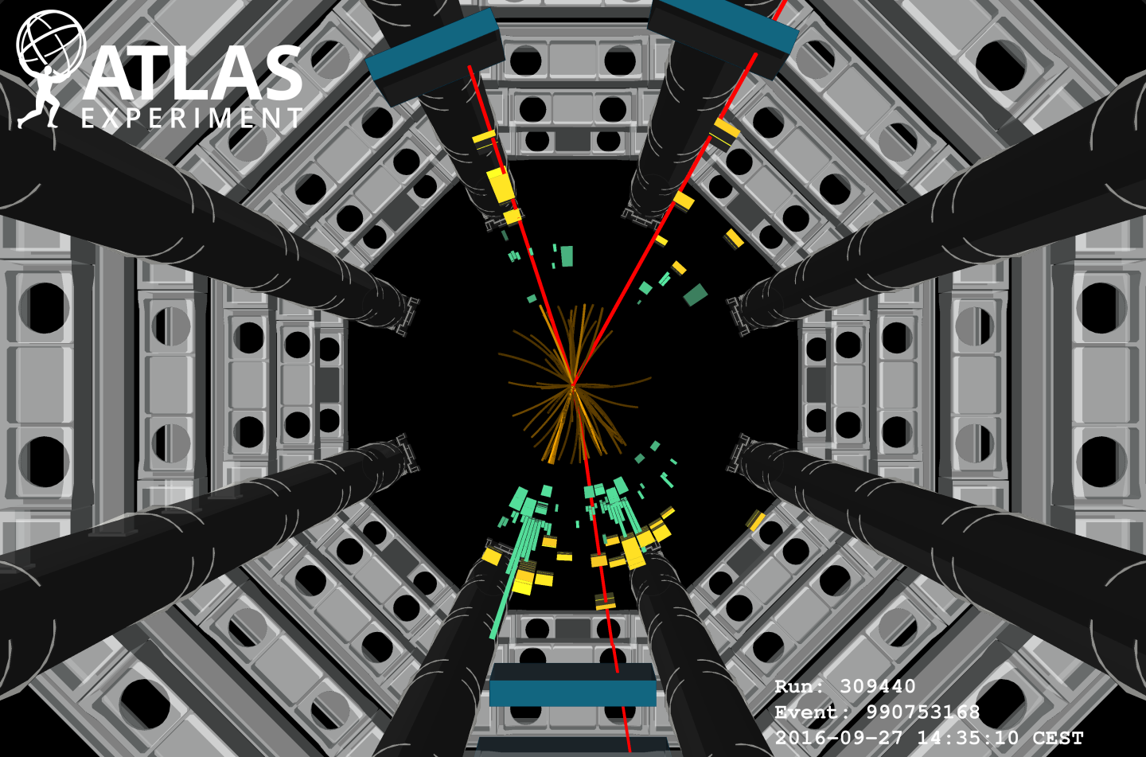
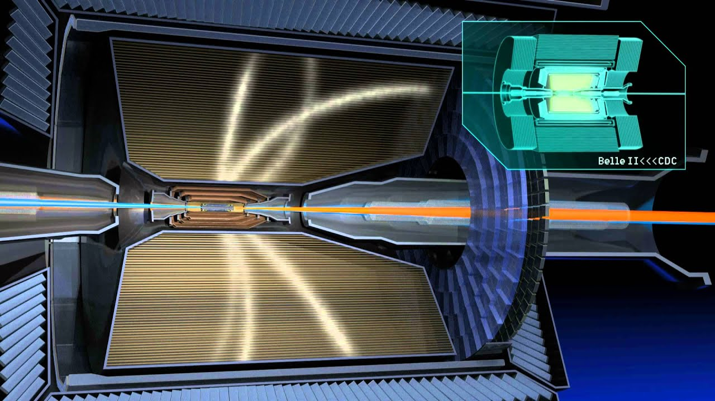
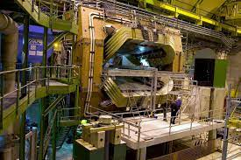


Background – Experimental Particle Physics Department
International collaborative research for measuring fundamental particles.
Study fundamental constituents of nature and their interaction.
Develop technologically demanding particle detectors
Complexity and costs of experiments
Joining large collaborations in international particle physics centres:
Requires efficient collaboration between individuals and management of resources.
Collaboration on experiments at CERN near Geneva and at KEK in Tsukuba, Japan.

Slide 4

Experimental High Energy Physics
Pushes the limits of technology & innovation
Inspires & trains new generations of researchers,
Driving progress and synergies across disciplines
Particle physics is the foundation for advancing understanding across disciplines.
Core technology & innovation
SC, vacuum, cryo, electronics, big data, AI, …
Cosmology & astroparticle, nuclear science, condensed matter, AMO, quantum technologies, life sciences & others via synchrotron X-ray facilities, …
Energy/environment (fusion, power transmission)
ICT (Web, Grid, networking)
Health (cancer therapy, imaging, radioisotopes)
*NAS brochure!

Slide 5
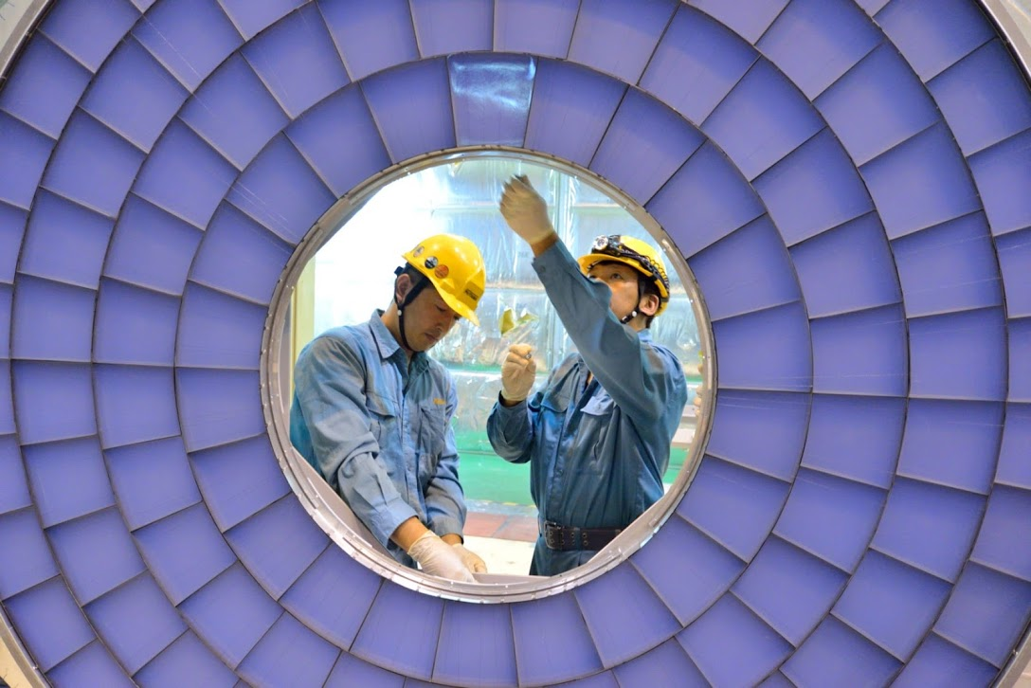
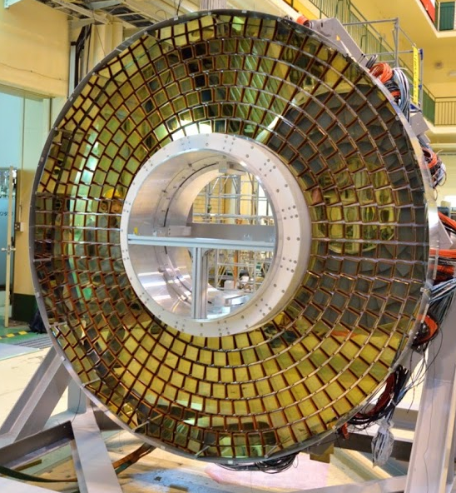
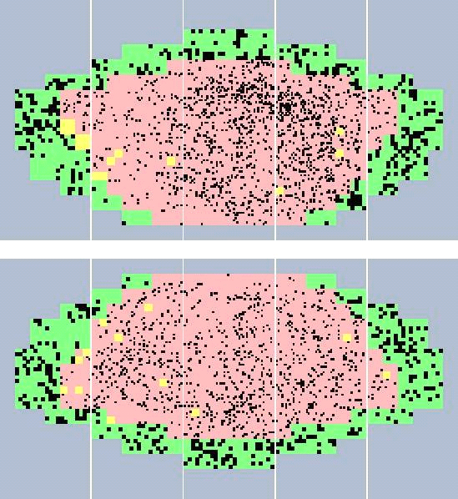
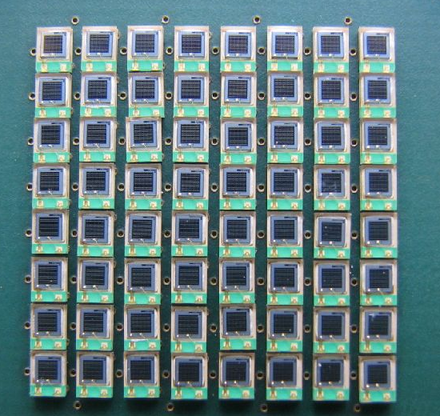
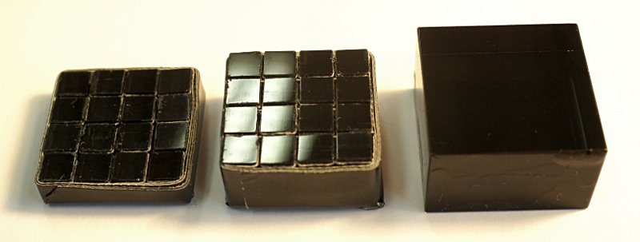
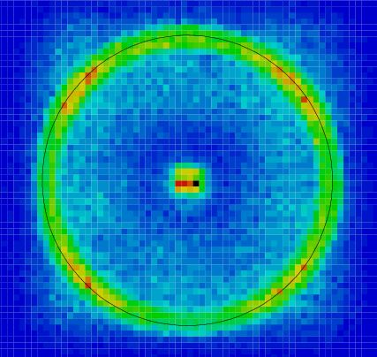
From the development of particle detectors to medical applications
The Department is developing detectors for extreme conditions:
high radiation load - gamma radiation, charged particles, neutrons;
high event rates - e.g. collisions every 25 ns at the LHC;
barely detectable signals – need high efficiency for single photon detection.
Impact
Long term: e.g., Internet, GPS, understanding of the Nature
Short term: Transferring the knowledge and technologies to medical diagnostics.
Rok Pestotnik
JSI, Department for Experimental Particle Physics
EIC Regional Info Day, Ljubljana, 8.6.2023

Slide 6
WHO Resolution on Strengthening Medical Imaging
Vision:
Better care for more people through sustainable, collaborative, and technology-enabled imaging solutions
Adopted May 2025.
Addresses critical global disparities in access to medical imaging.
Imaging is vital for:
Early disease detection
Accurate diagnoses
Tailored treatment and patient care
Global Health Challenge
High-income countries (e.g., Germany) have advanced imaging capacity.
Many low- and middle-income countries lack basic imaging services.
Rising global burden of non-communicable diseases (NCDs) demands urgent action:
74% of global deaths are linked to NCDs (e.g., heart disease, cancer, stroke)
Key Goals:
1. Strengthen Imaging Infrastructure
2. Develop Healthcare IT & AI Strategies
3. Build and Train the Workforce
4. Enable Innovative Service Models
5. Expand Image-Guided Treatment Capabilities

Slide 7
Key Goals of the WHO Resolution
1. Strengthen Imaging Infrastructure
Invest in cost-effective, scalable imaging systems.
Enhance access in remote and underserved regions.
2. Develop Healthcare IT & AI Strategies
Integrate AI, data management, and cloud solutions.
Boost productivity and accuracy in diagnosis and treatment.
.
3. Build and Train the Workforce
Support clinical education and technical training.
Improve service delivery and maintenance support.
4. Enable Innovative Service Models
Promote telehealth and mobile imaging in remote settings.
Use central command centers and AI to support local staff.
5. Expand Image-Guided Treatment Capabilities
Utilize imaging in minimally invasive therapies and cancer care
.
Vision:
Better care for more people through sustainable, collaborative, and technology-enabled imaging solutions

Slide 8
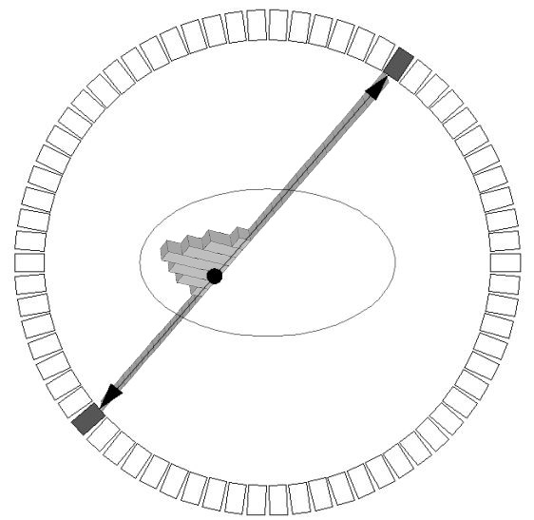
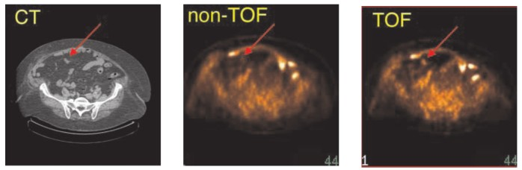
Positron emission tomography - PET
Diagnostic method for in vivo imaging of biological processes
A radioactive marker is injected into the patient, which decays in the body by beta+ decay.
The annihilation of the positron produces gamma rays, which are emitted and detected by gamma-ray detectors.
By reconstructing the events, we get a picture of the distribution of sources in the body —important information for doctors when diagnosing, for example, cancer.
reconstructed
position with TOF
511 keV
line of response (LOR)
511 keV
patient
detector ring
Philips Gemini TF PET/CT, TOF resolution of 600 ps
[PET Center of Excellence Newsletter, Vol.3 Issue 3 (2006)]
Rok Pestotnik
JSI, Department for Experimental Particle Physics
EIC Regional Info Day, Ljubljana, 8.6.2023

Slide 9
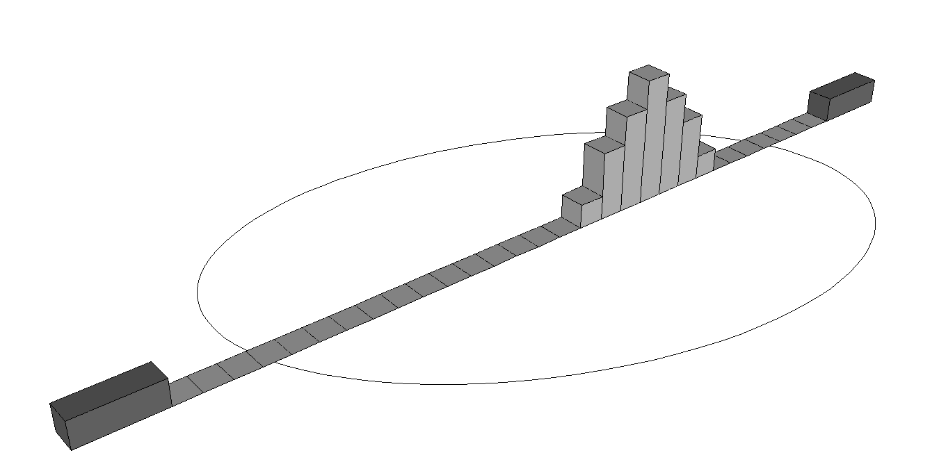
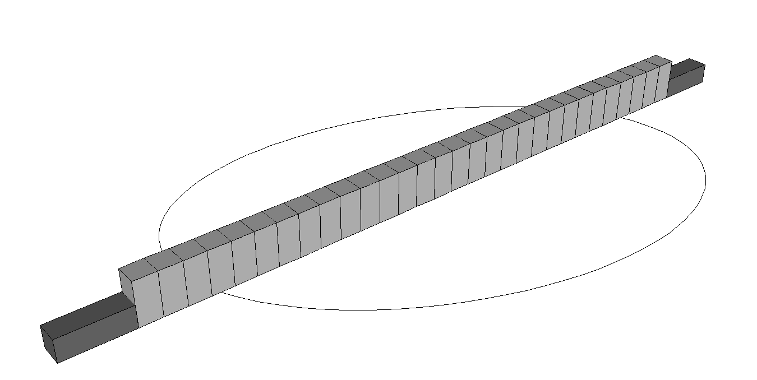
Time Of Flight-PET
To improve the contrast of images, Time-of-Flight difference of annihilation gammas is used
localization of source position along the line of response:
Δt ~ 66ps → Δx = c₀Δt/2 ~ 1cm
Δt = coincidence resolving time, CRT
TOF
non TOF
PET systems based on SiPM readout are reaching CRT of ~200 ps, and only with small crystals ~3x3x3 mm³ CRT<100 ps

Slide 10
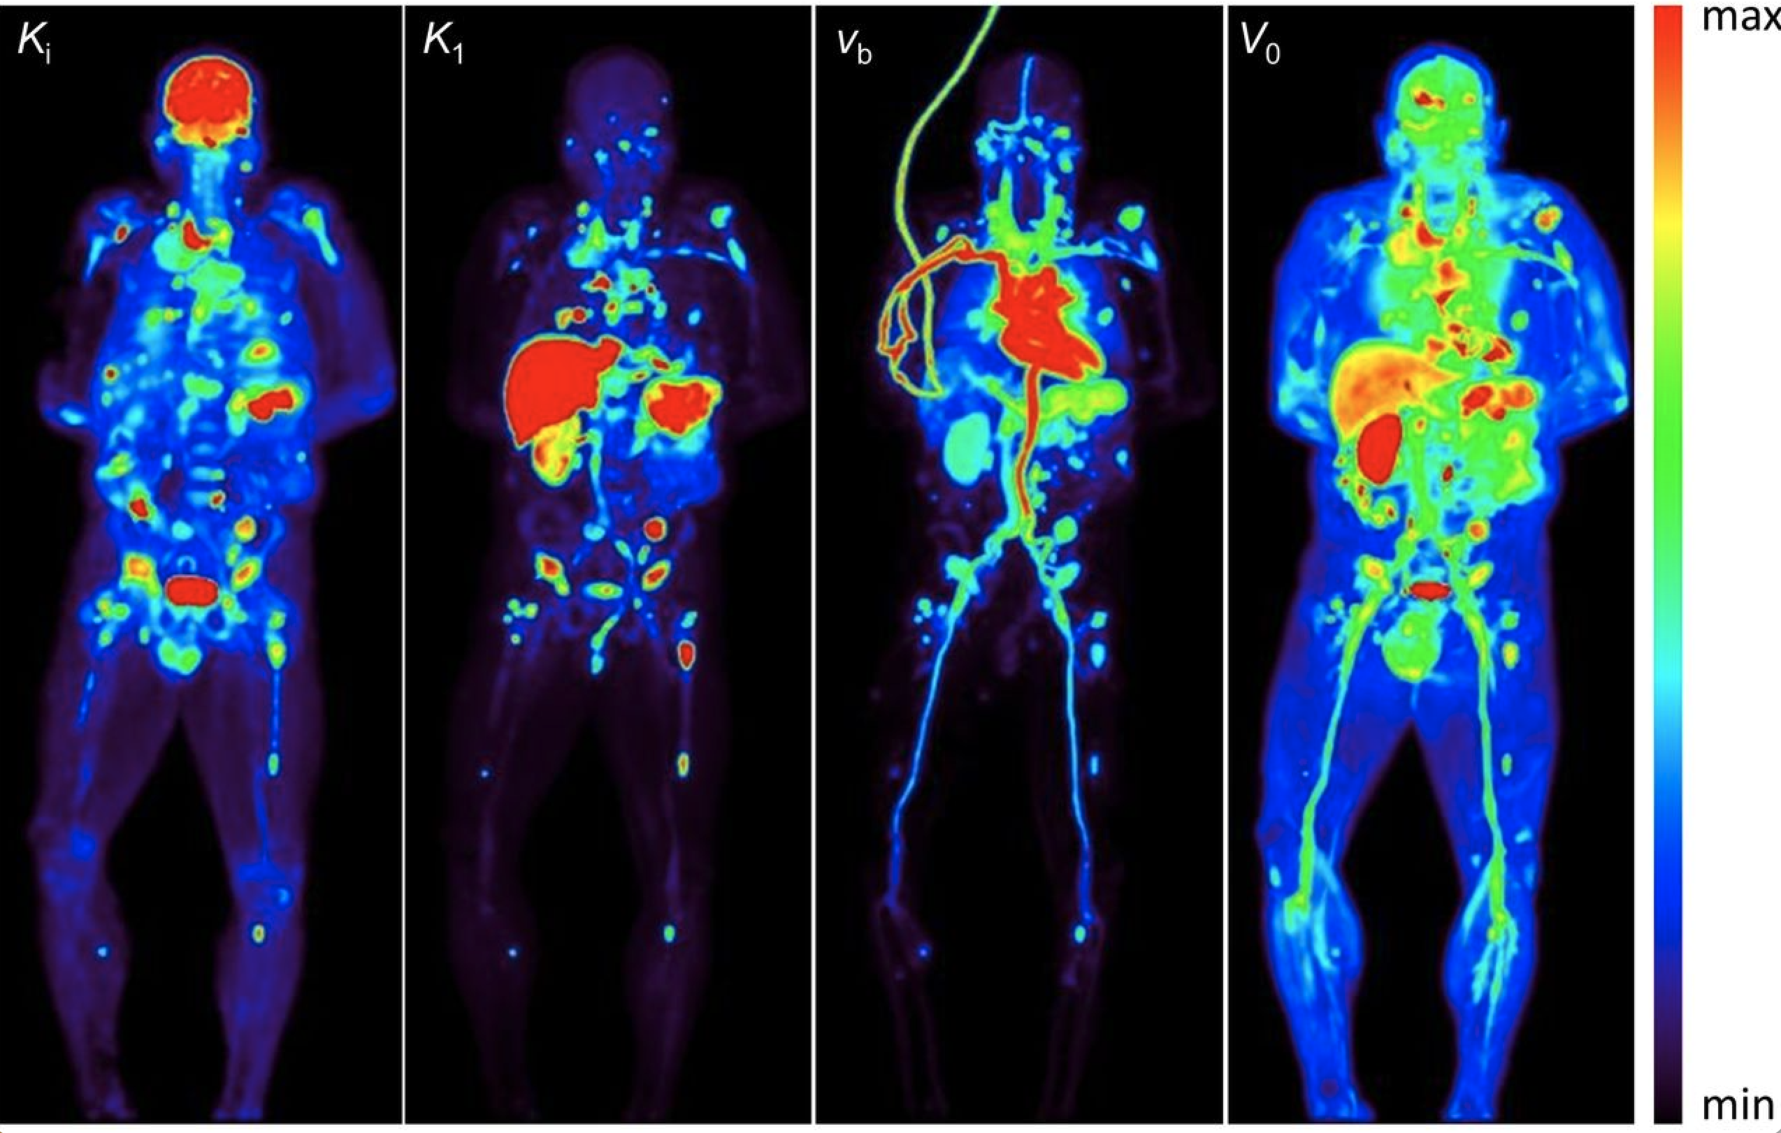
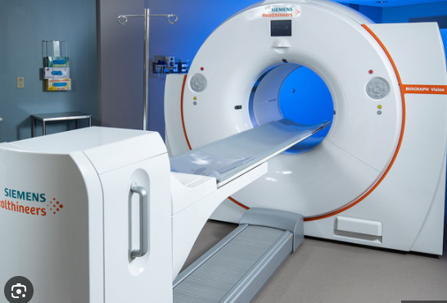
Positron emission tomography
Positron Emission Tomography (PET) is one of the current leading methods in diagnostic functional medical imaging

Slide 11
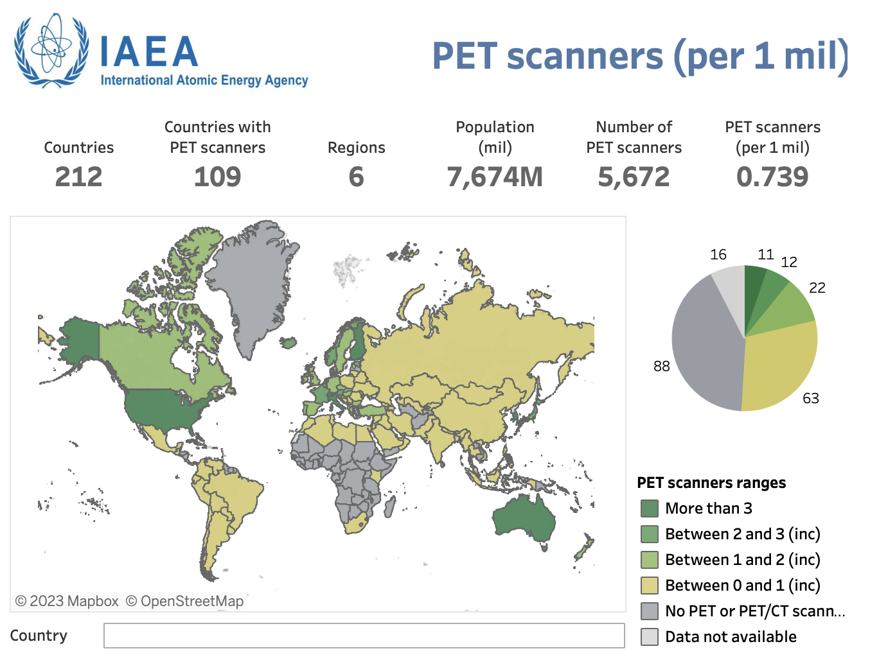
PET Accessibility
Enabling health care systems to buy more devices
Higher throughput of patients – decreased waiting times
Improve cancer diagnostics and increase cancer survival rate

Slide 12
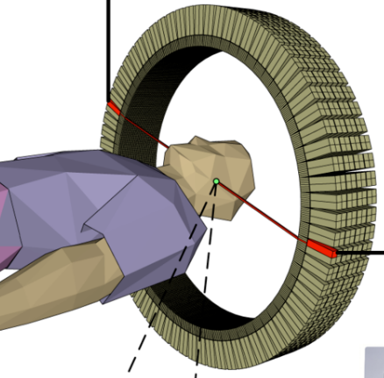
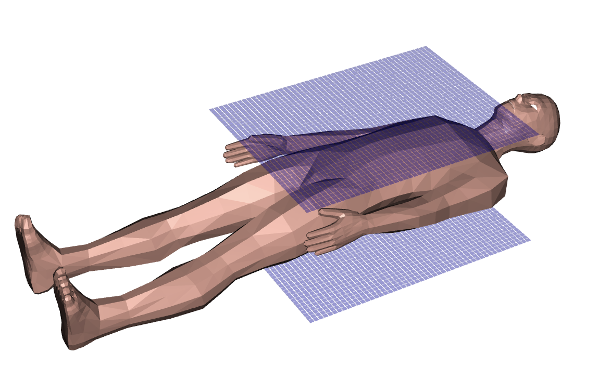
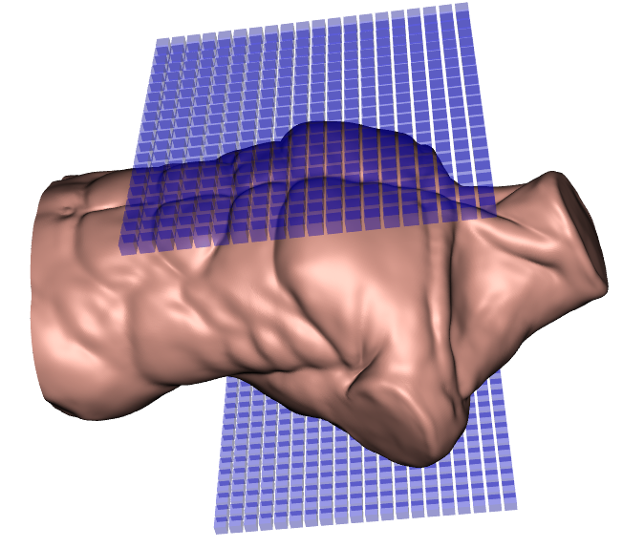
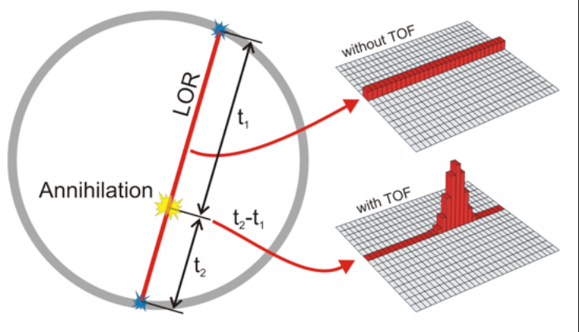
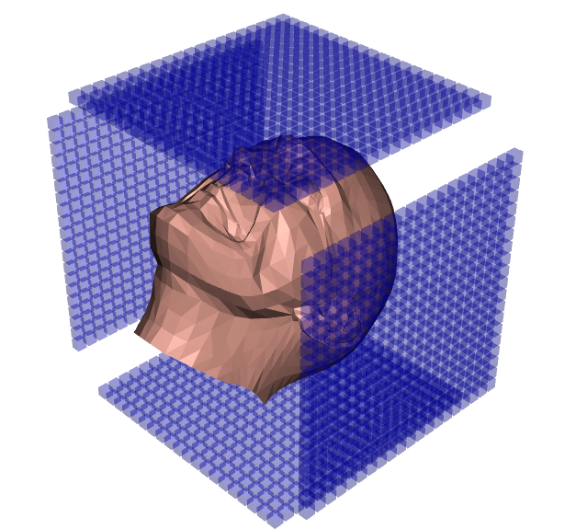
Our vision
Develop a flexible, modular PET scanner, based on two planar and opposite detector panels with exquisite TOF resolution
Current PET
Time-of-flight
PET principle
Enabling Modular scanner
Total body PET imager
A
B
C
D
Enable total body imaging : very early diagnosis of cancer and its metastases (e.g., prostate and lymph nodes), use of PET in operating rooms, guided surgery, proton therapy, cardiac and brain applications and effective personalized radionuclide cancer therapy.

Slide 13

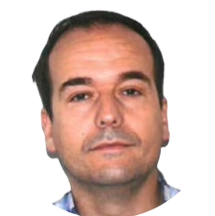
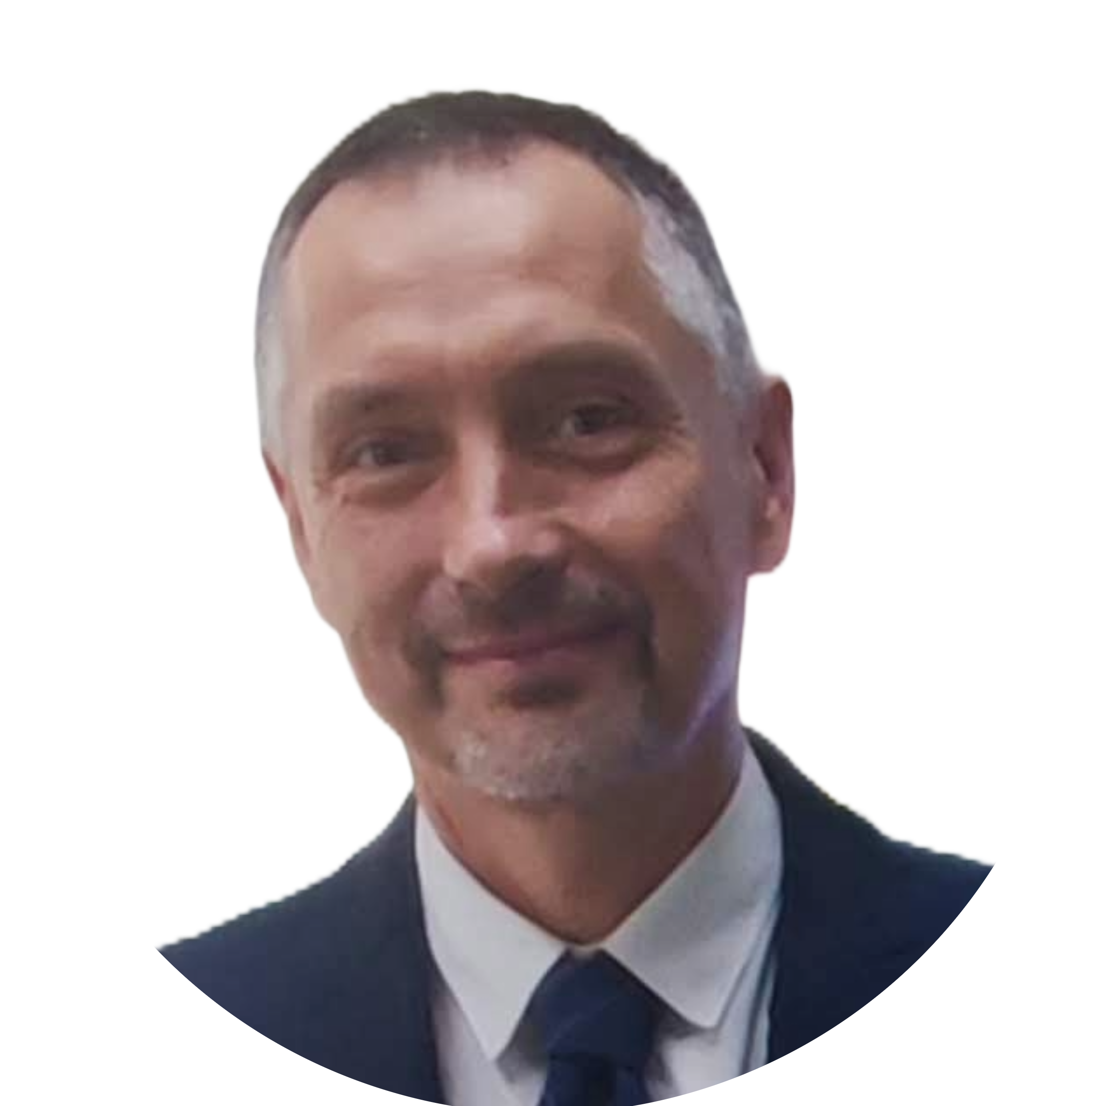









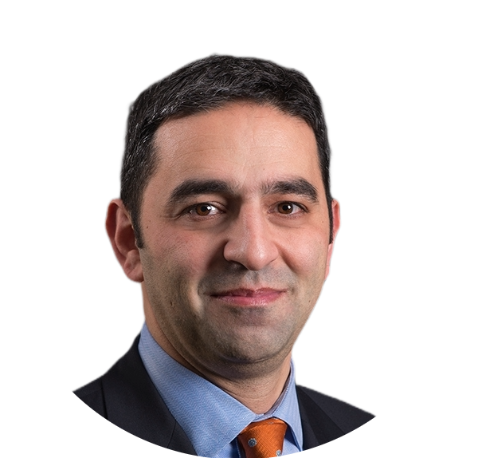





Project partners
David Gascon
Chip design
Rok Pestotnik
Coordination, Design
Integration, Reconstruction
Alberto Gola
Photo sensors
2D integration
Jose Benlloch
Readout Electronics
Data Acquisition
Jorge Alamo
SME: Mechanics & Software
Georges El Fakhri
Associated P. Hospital:
Design & Validation
Rafael Ballabriga
Associated P., Chip design
Wolfgang Weber
Hospital: Validation

Slide 14
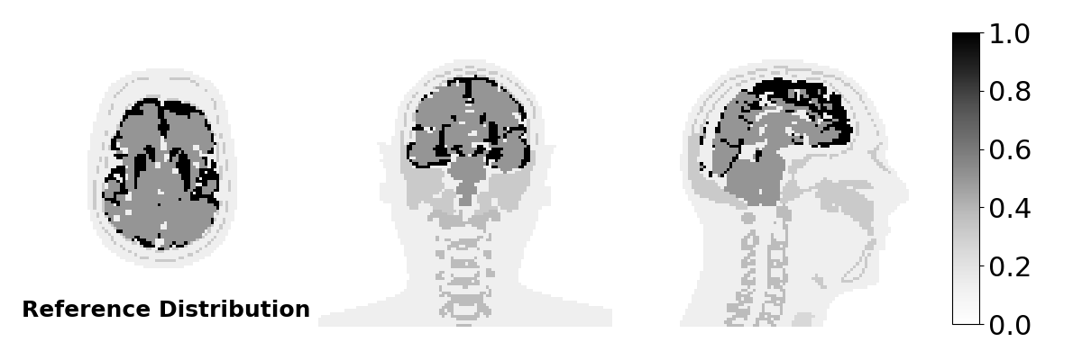
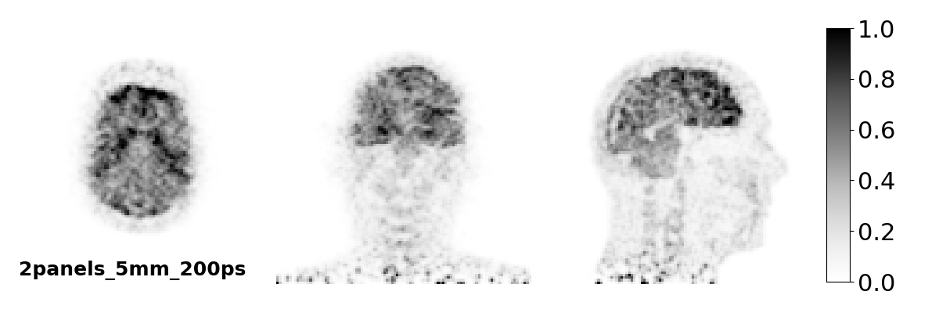
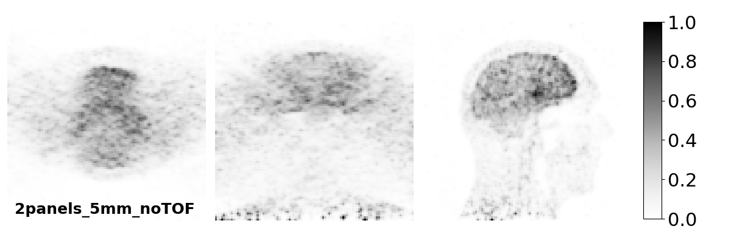
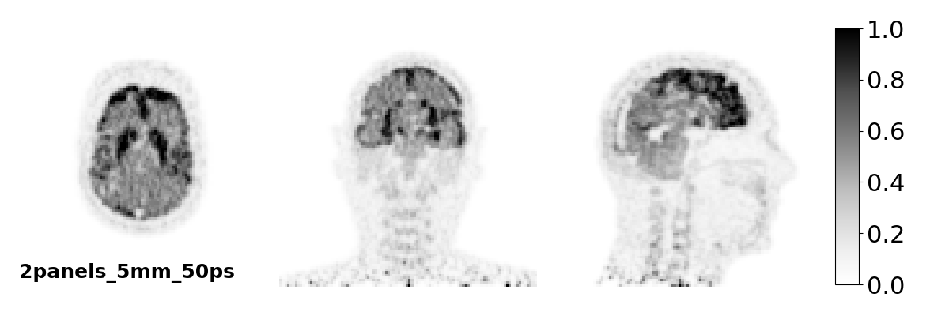
Breakthrough innovations
New sensor with improved timing resolution - 200 ps -> 75ps CTR) enabling new geometries
Key improvements: 10 x image sensitivity
Images of comparable quality, compared to the state-of-the-art reference scanner, with a fraction of the sensors

Slide 15
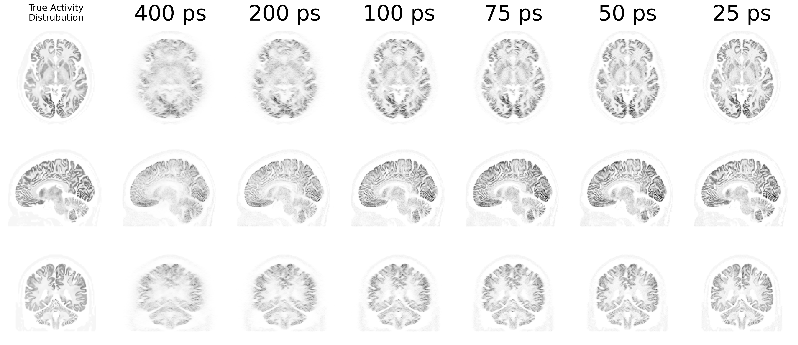
Improvement of image resolution with timing

Slide 16


Benefits
Mobility
Portable or bed-side PET imaging
Flexibility
Adjustable FOV and sensitivity
Modularity
Combining multiple panels → multi-organ/total-body PET scanner
Accessibility
Reduced manufacturing cost and complexity

Slide 17
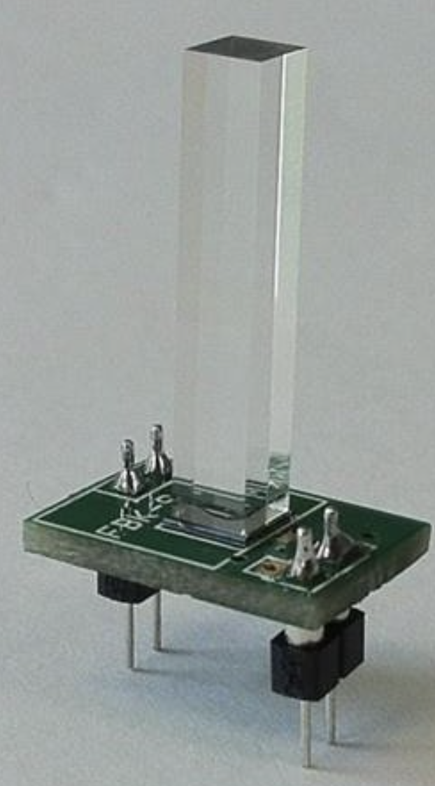
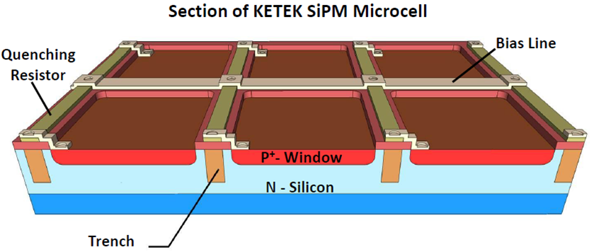
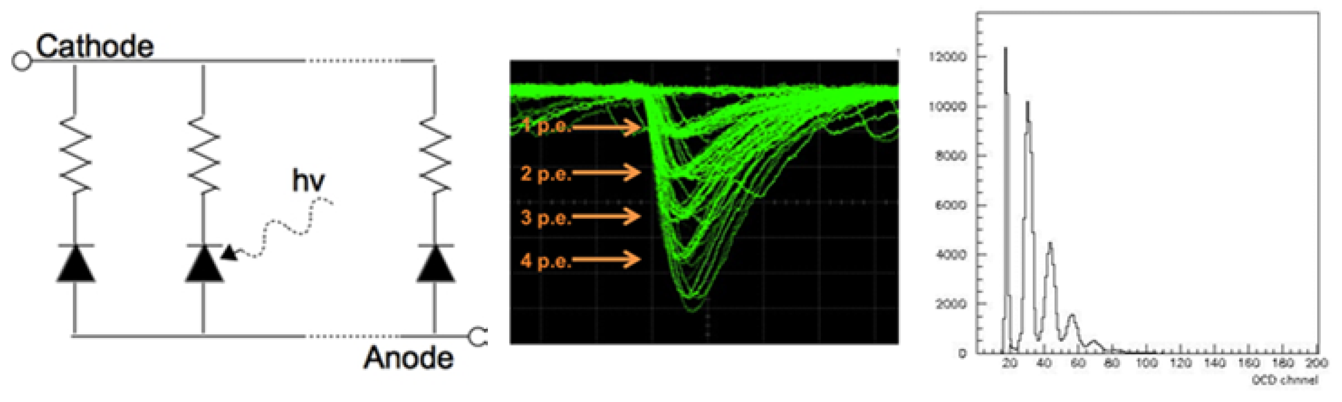
Gamma-ray detection
Gamma photons are detected with scintillation detectors
absorbed in the scintillator that emits visible photons
Visible photons are detected with photon sensors
silicon photomultipliers

Slide 18
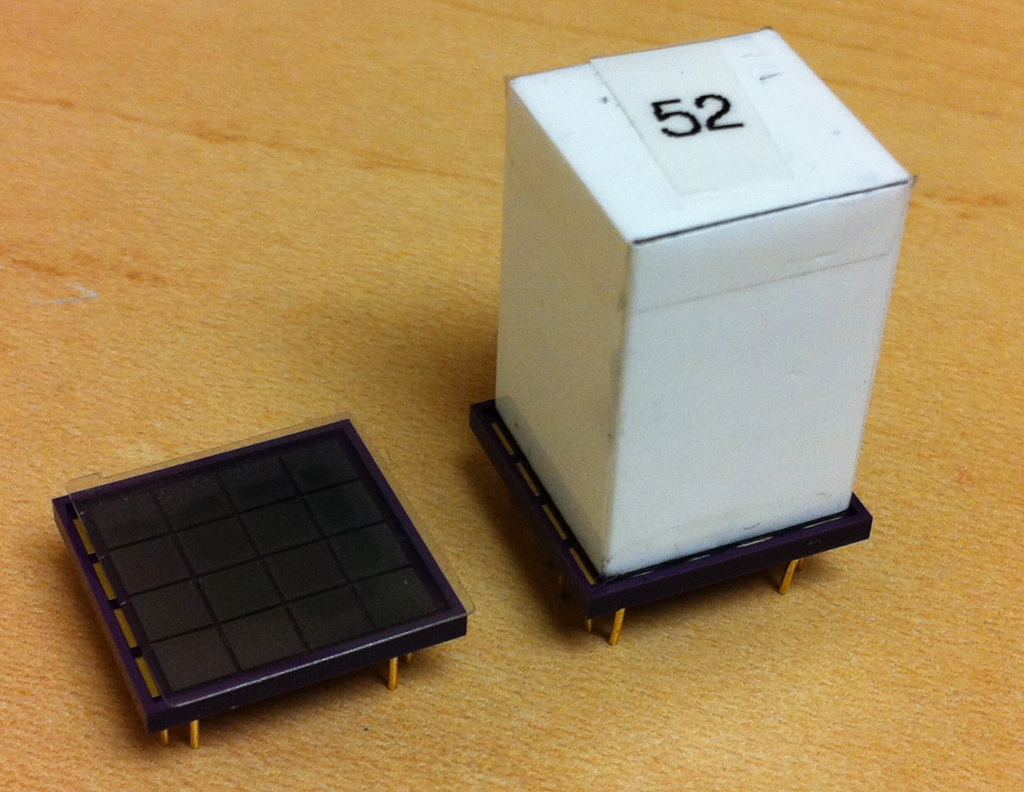
Coupling between crystals and photon sensors
511 keV photon
1-1 crystal sensor coupling
4x4 array
3x3 mm²
SiPM pixels
4x4 arrays
3x3x20 mm³
LYSO crystals
No light sharing between the crystals
The light is limited and directed to only one photon detector.
→ Better signal to noise ratio

Slide 19
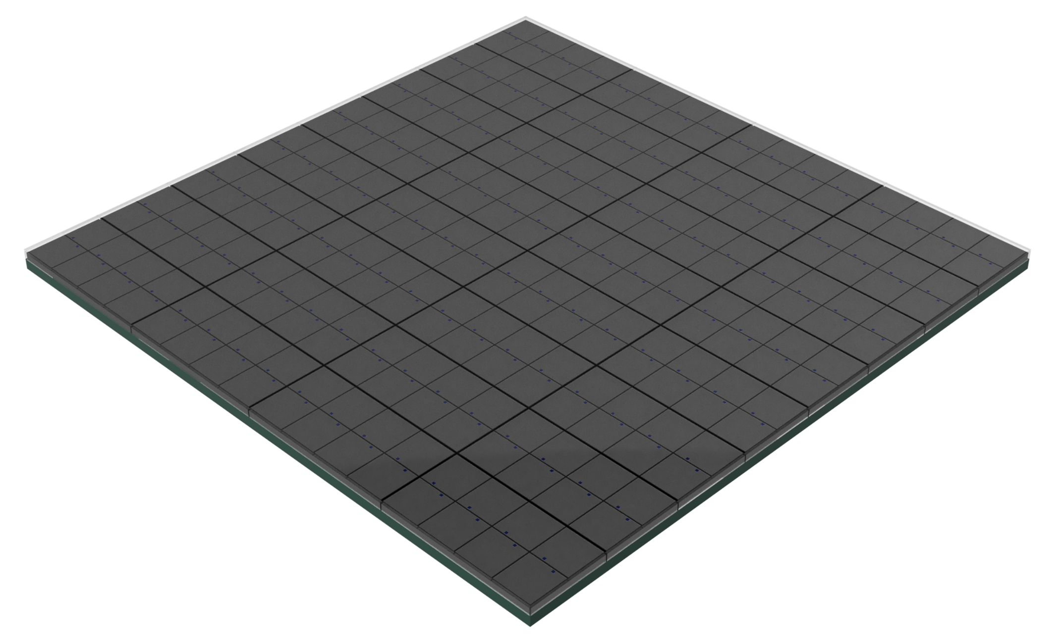
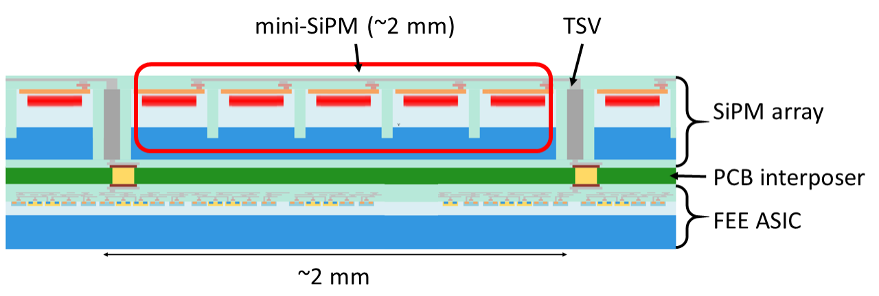
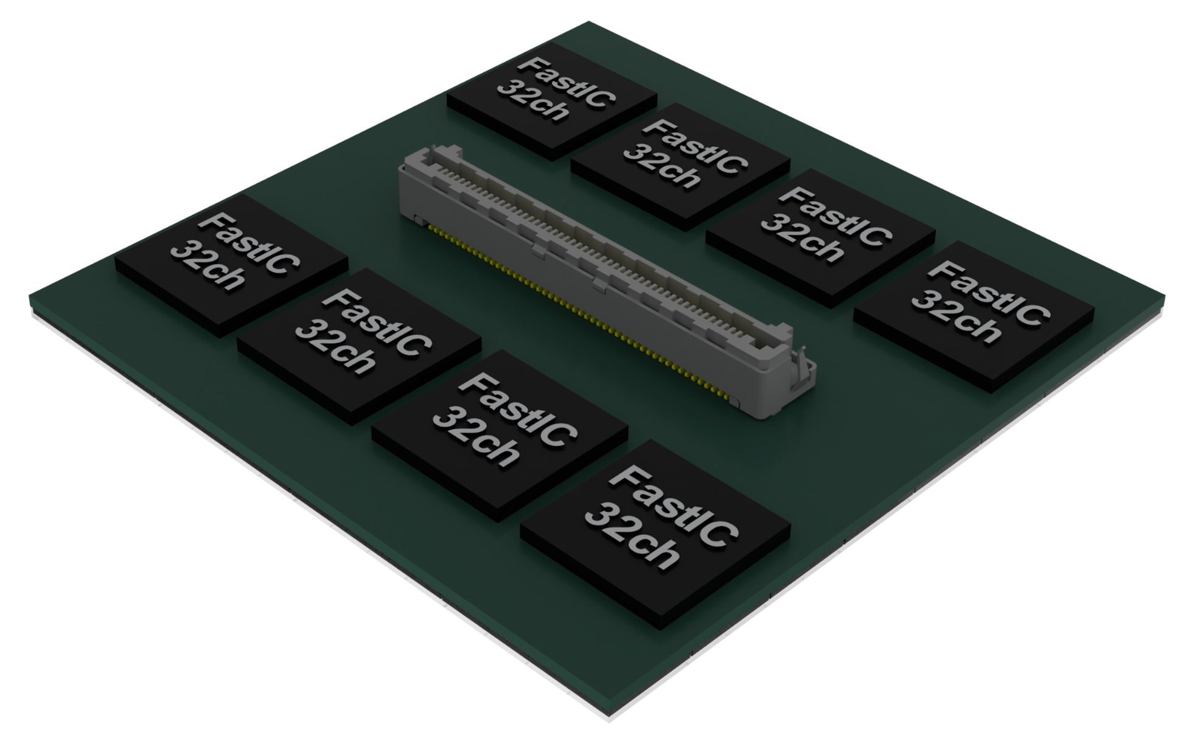
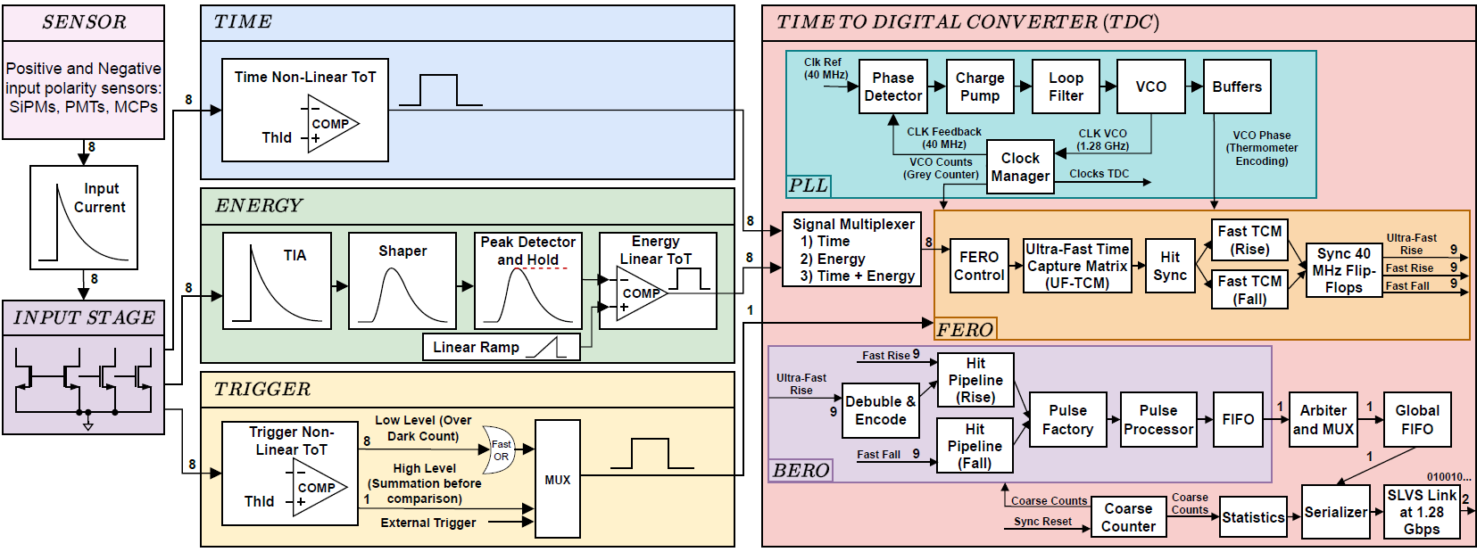
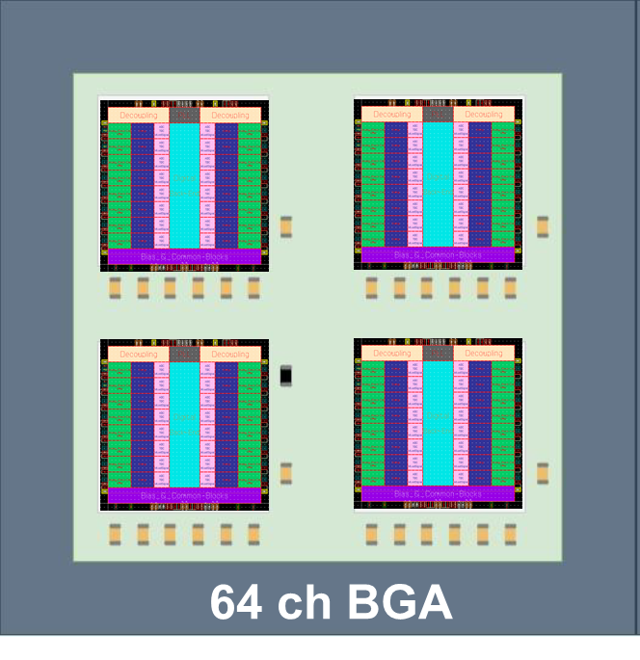
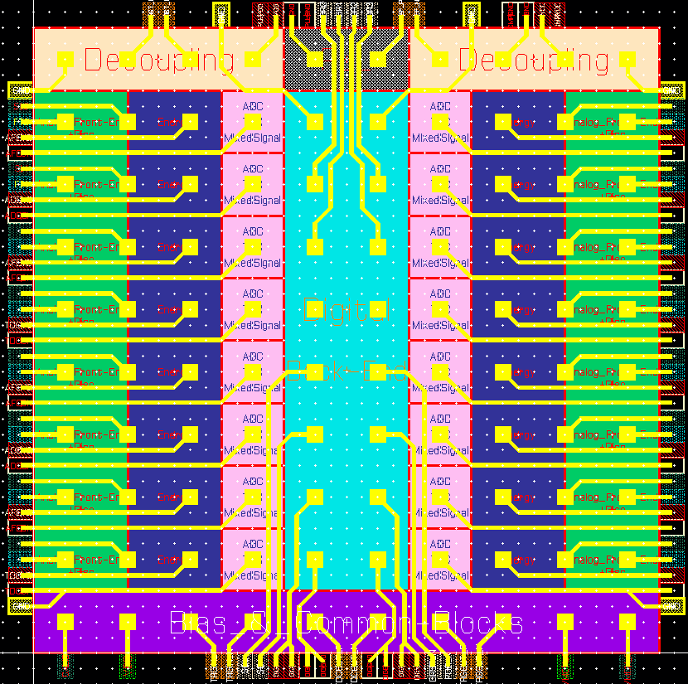
PetVision detector core technology
How to achieve sub-100 ps CTR?
Current detector
Improved detector
Thinner scintillator
SiPM Improved PDE and timing
Fast ASIC
2.5D integration
Integrated Photon detector module
Gamma ray
mini SiPM
(~3mm)
TSV
Scintillation
array
Gamma ray
SiPM array
Light sensors
Scintillation array
Light sensors
PCB interposer
Front end electronics
Front end electronics
FEE ASIC
Time, energy, position
Time, energy, position
~3mm
PetVision SiP:
64 ch BGA
< 15 x 15 mm²
PetVision ASIC: 16 ch die
4x4 mm² // 100 pads

Slide 20

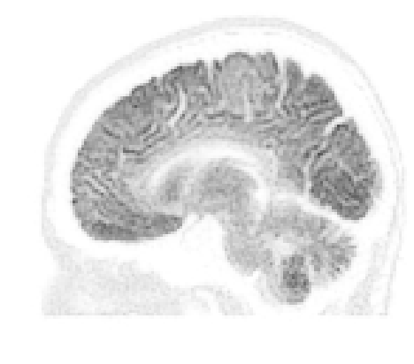
PetVision Milestones
Photo Sensor with improved performance
ASIC chip and integration into a digital module
Integration of the prototype
Validation in two hospitals
Exploitation
Certification
Product launch
Business model:
License or Start-up company
Year 2
Year 3
Year 4
Year 5
Year 6-7
Further funding: EIC Transition, Accelerator, ...

Slide 21
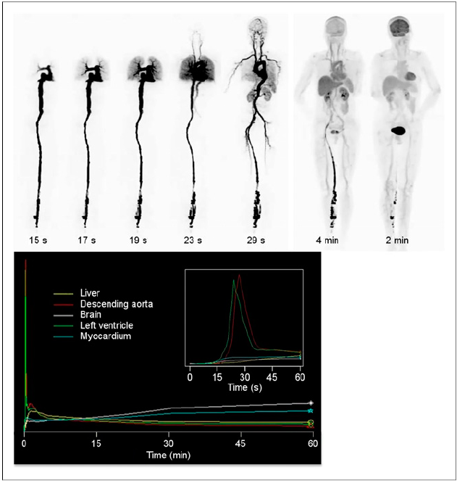
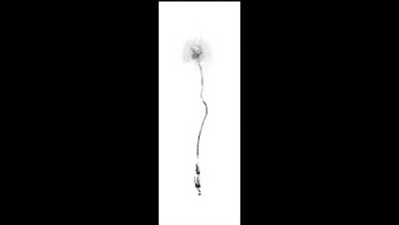
Dynamic imaging
Imaging after administration of a standard dose of FDG
Time dependence of activity

Slide 22
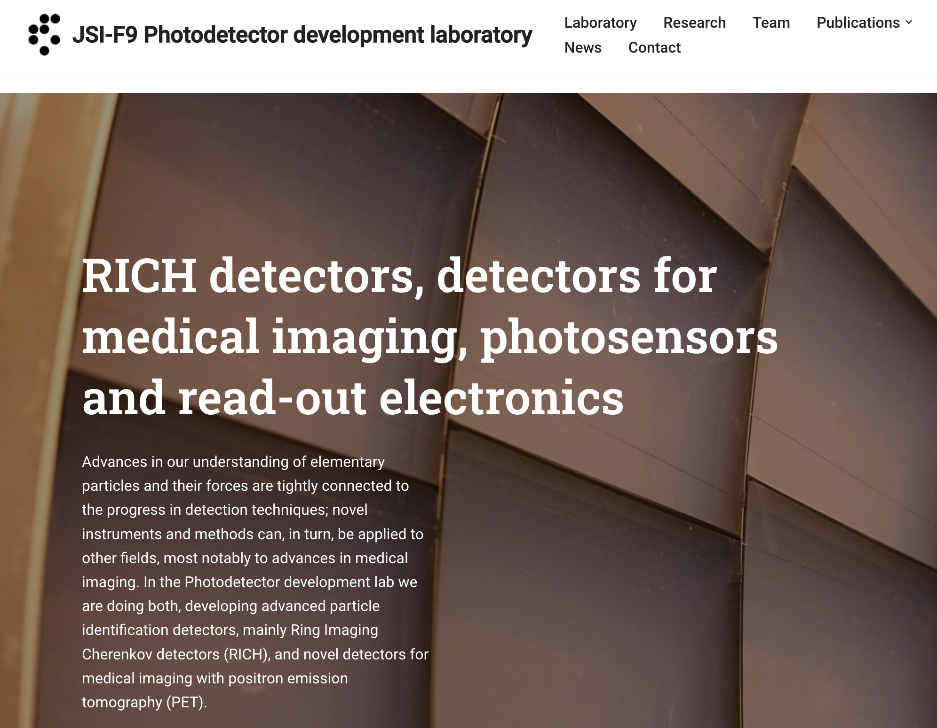

Join the team
If you are proactive and like teamwork
If you want to contribute
to the goals of the PetVision project
Explore the area of High Energy Physics
Join the team
Contact Rok.Pestotnik@ijs.si
https://photodetectors.ijs.si
Summer work experience
PhD and postdoc positions available

Slide 23

More info https://petvision.org

Slide 24


