Slide 1
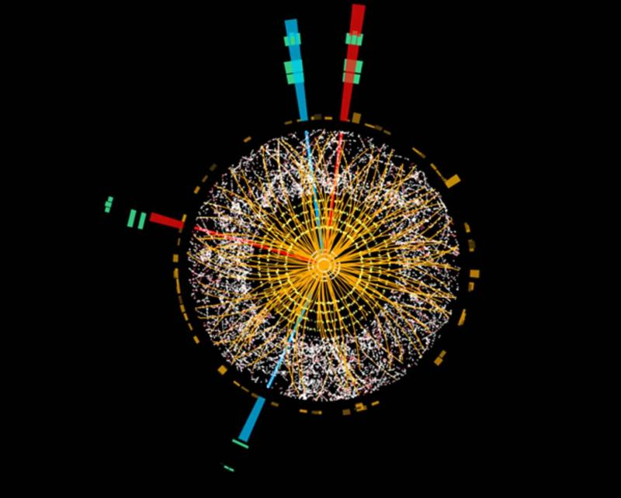
How do we measure what we can’t see
University of Ljubljana, Faculty of Mathematics and Physics
Selected topics in contemporary physics
March 19, 2025
Assoc. Prof. Dr. Rok Pestotnik
Jožef Stefan Institute, Ljubljana, Slovenia
Outline
High energy physics experiments
Particle identification
Detection of photons

Slide 2
What should be the description of the basic building blocks of nature?
Two requirements:
Simple (low number of basic building blocks of matter)
Correct

Slide 3
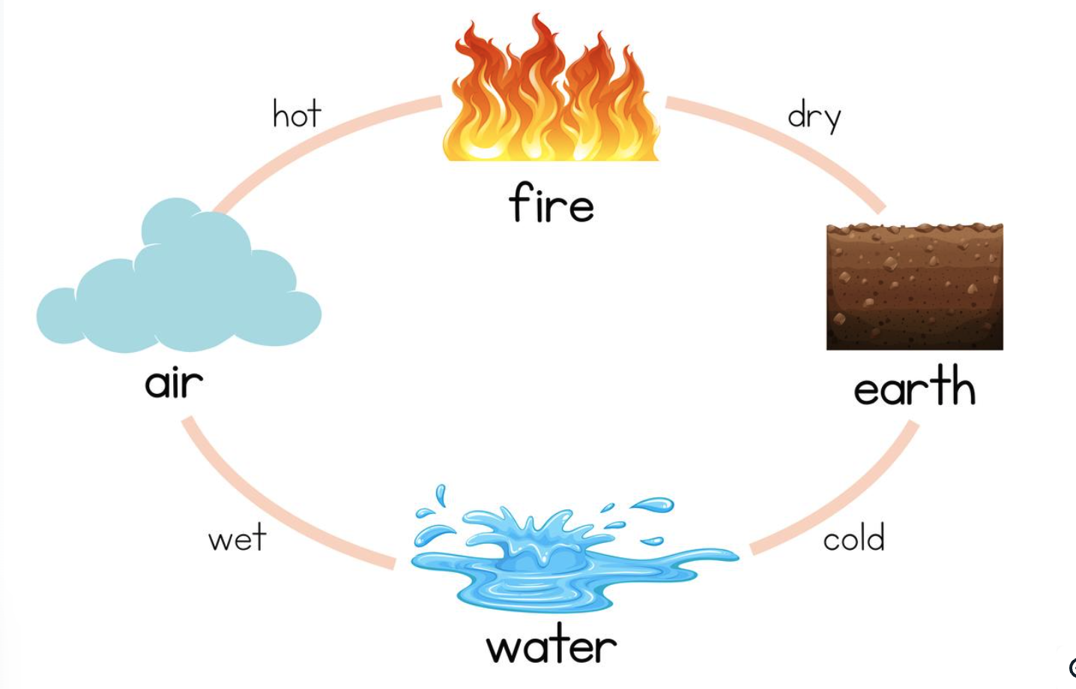
Elementary Particles
We investigate the properties of interactions by studying the processes between the basic particles
The concept of fundamental particles has changed throughout the history of human research, but especially through experimental capabilities.
Empedocles (c. 492—432 B.C.E.) one of the most important of the philosophers working before Socrates
Simple, but wrong

Slide 4
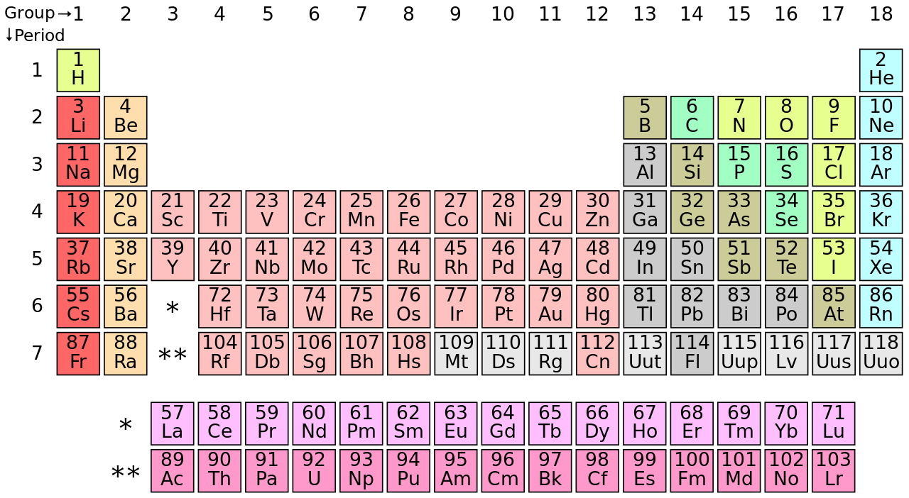
Description of nature by D.I. Mendeliev
Periodic system of elements :
~more than 100 of elements Correct, but complex...

Slide 5
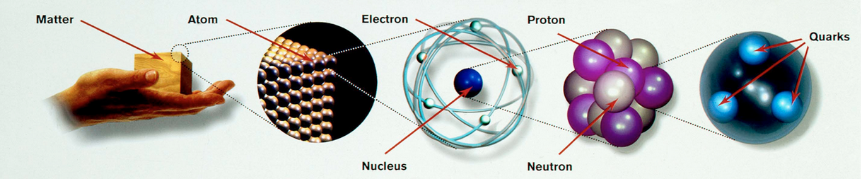
How do we see the world today?
Basic particles
The forces (interactions) between them:
Gravity
Electromagnetic interaction
Weak interaction (beta decay)
Strong interaction (binds quarks in the nucleus)

Slide 6

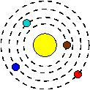
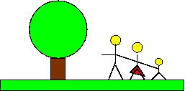




Particles | and | Forces
Dimension(m) | Object |  | Forces | Meaning | Experts
10²¹ | Galaxy clusters |  | Gravitation |  | Philosopher
10¹⁴ | Galaxies, Stars, Planets |  |  |  | Cosmologist, astophysicist, astronomer
1 | Living beings |  | instincts | Conservation of spicies | biologist Sociologist
10⁻⁸ | Molecules |  | electromagnetic | Diversity of life | Chemist, physicist
10⁻¹⁰ | atoms |  |  | energy | Atomic physicist
10⁻¹⁴ | nucleus |  | nuclear | Chemical elelments, sun, reactor | Nuclear physicist
10⁻¹⁵ | nukleons |  | Strong, weak | My salary | particle physicist
10⁻¹⁸ | quarks |  | ? | ? | Philosopher
DELCI in SILE, urejeni po NADSTROPJIH

Slide 7
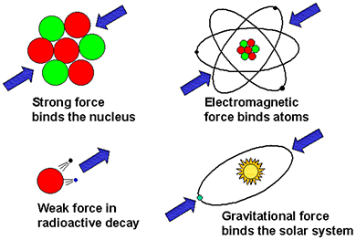
Particle physics
Standard Model (SM) of interactions between basic particles:
strong,
electromagnetic,
weak,
gravitational
Theory describing three of the four known fundamental forces
electromagnetic, weak and strong interactions – excluding gravity)
in the universe and
classifying all known elementary particle

Slide 8
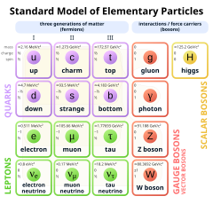
Standard model of elementary particles
Each particle has its antiparticle, e.g. e- and e+
Quarks make up heavier particles - hadrons, e.g.
p = uud,
n = udd
Particle physics is concerned with the detection and measurement of
properties of basic forces (=interactions) in nature

Slide 9
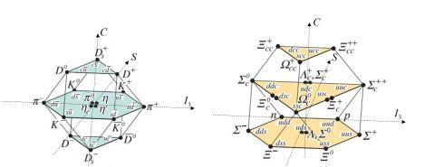
Baryons and mesons: bound states of quarks and antiquarks
Barions mass
proton: uud 1 m_{p}
neutron: udd ~1 m_{p}
𝛬: uds 1.2 m_{p}
Mesons mass
𝛑⁺: quark u + antiquark d 1/7 m_{p}
K_{S}: quark d + antiquark s 1/2 m_{p}
J/𝜓: quark c + antiquark c 3 m_{p}
B⁰ : quark d + antiquark b 5.5 m_{p}
u
= pion
u
d
u
d
= proton

Slide 10
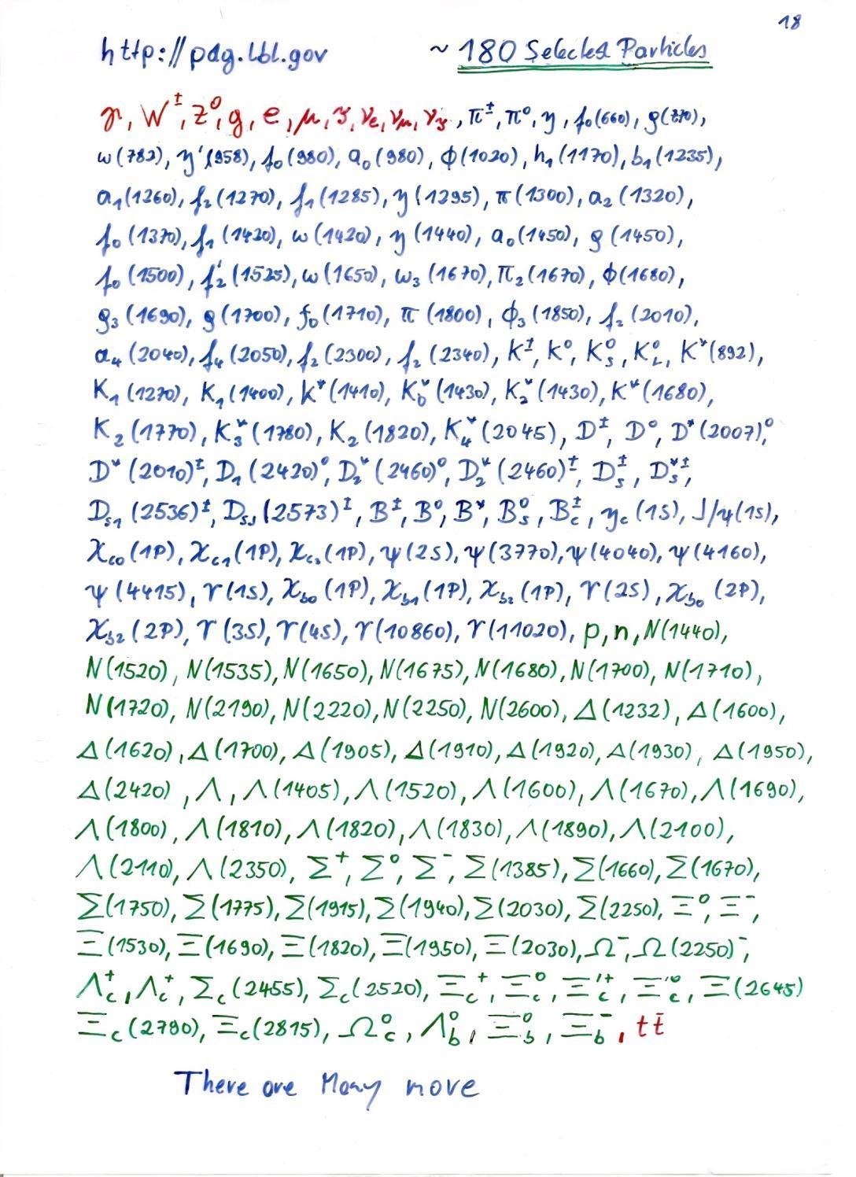

Slide 11
Experimental elementary particle physics
Eksperimentalna fizika osnovnih delcev
Experimental verification of the basic laws of nature,
testing theoretical predictions measurements of processes
at the highest achievable energies in the world of elementary particles
Features:
Experiments in only a few research centres around the world.
Data analysis is carried out using vast computing resources,
Development of particle detectors and applications
Work is carried out in international collaborations:
Atlas (CERN), Belle II(KEK), Pierre Auger, etc.
Notes:
Spectrometer Belle is taking data at the KEKB electron-positron collider which is operating in the KEK Laboratory in Tsukuba, about 60 km from Tokyo. In order to efficiently measure particles coming from the decay of Y(4S), Belle is capable of good vertexing, PID and detection of photons, muons and long-living neutral kaons.

Slide 12
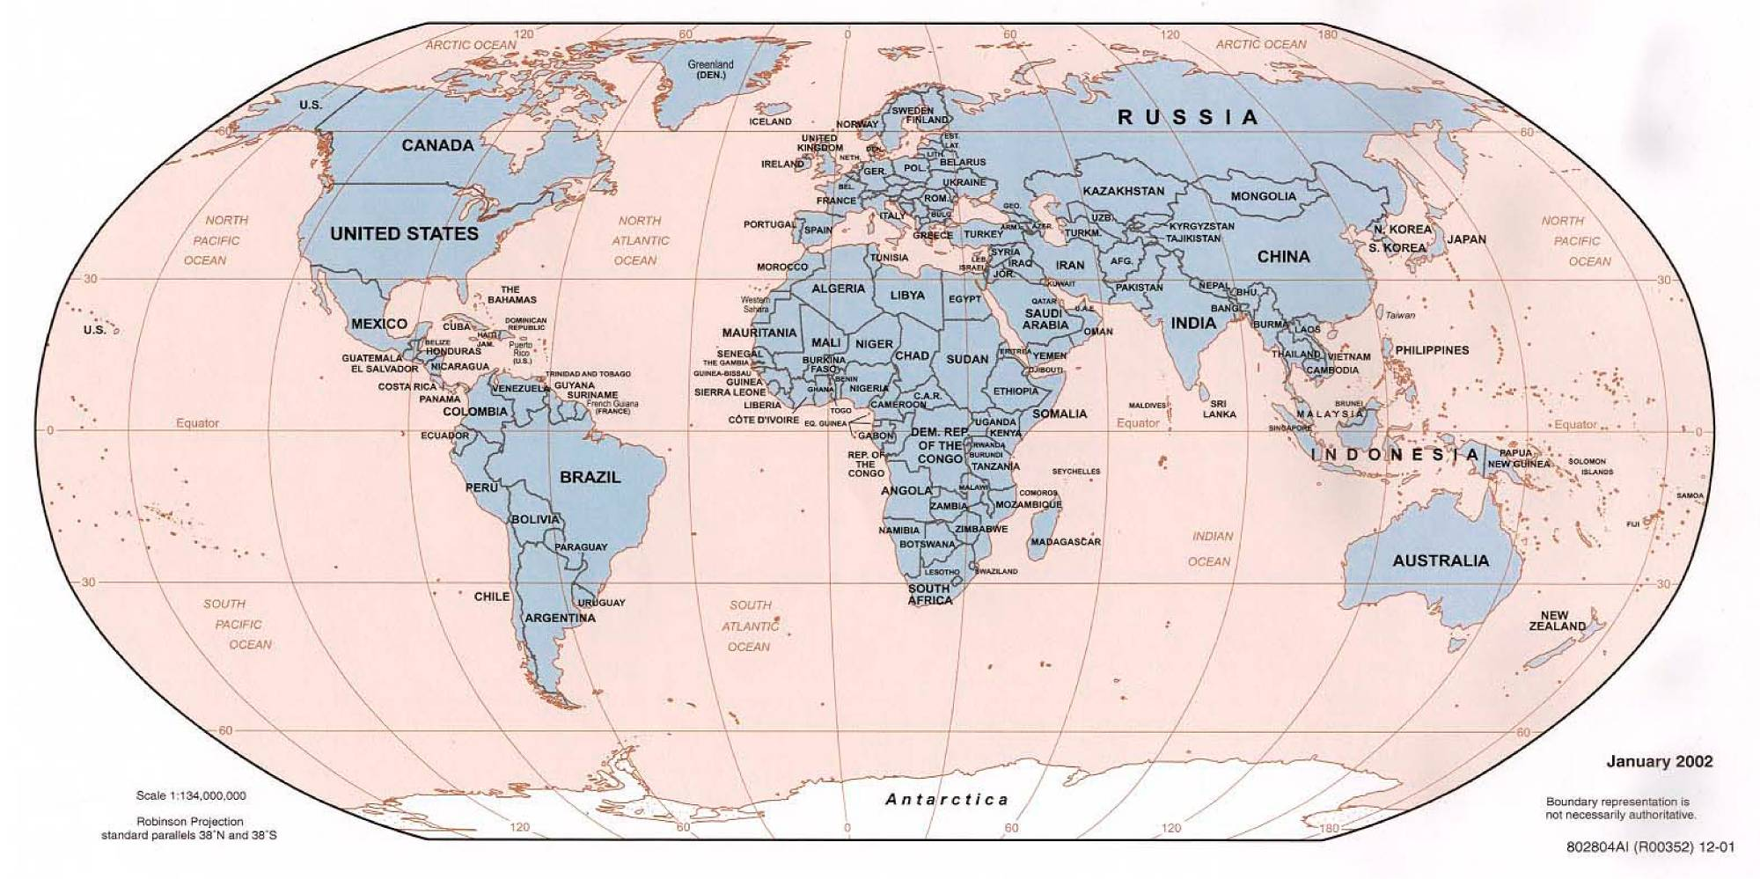
Research centers
DESY
Frascati
Novosibirsk
Fermilab
Cornell
BNL
CERN
SLAC
KEK
Pierre
Auger
Notes:
Spectrometer Belle is taking data at the KEKB electron-positron collider which is operating in the KEK Laboratory in Tsukuba, about 60 km from Tokyo. In order to efficiently measure particles coming from the decay of Y(4S), Belle is capable of good vertexing, PID and detection of photons, muons and long-living neutral kaons.

Slide 13
Open questions in fundamental particle physics (and cosmology)
Why does the Universe consists of mostly matter and only a sample of anti-matter?
Where did all the antiparticles from the Big Bang go?
CP symmetry breaking measurements between particles and anti-particles
Where do particles get their mass?
The search for the Higgs boson
Why do particles have different masses, why are there multiple generations?
search for supersymmetric partners and their interactions

Slide 14
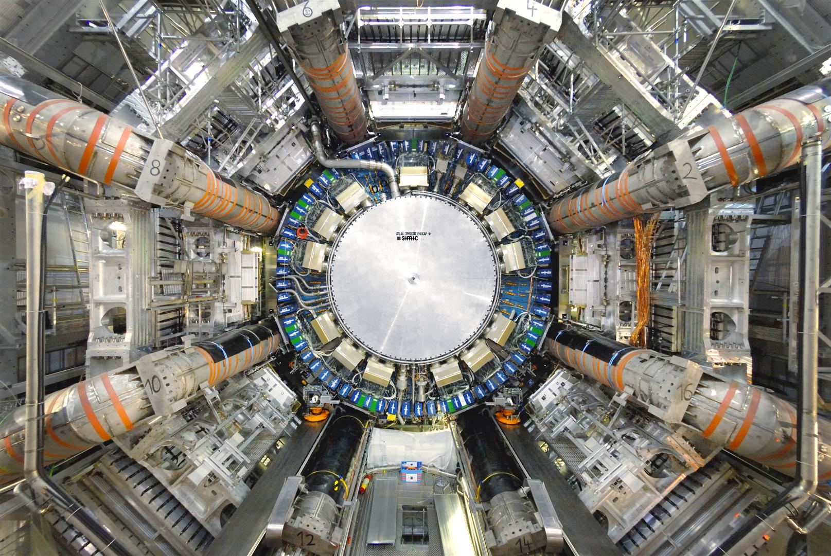
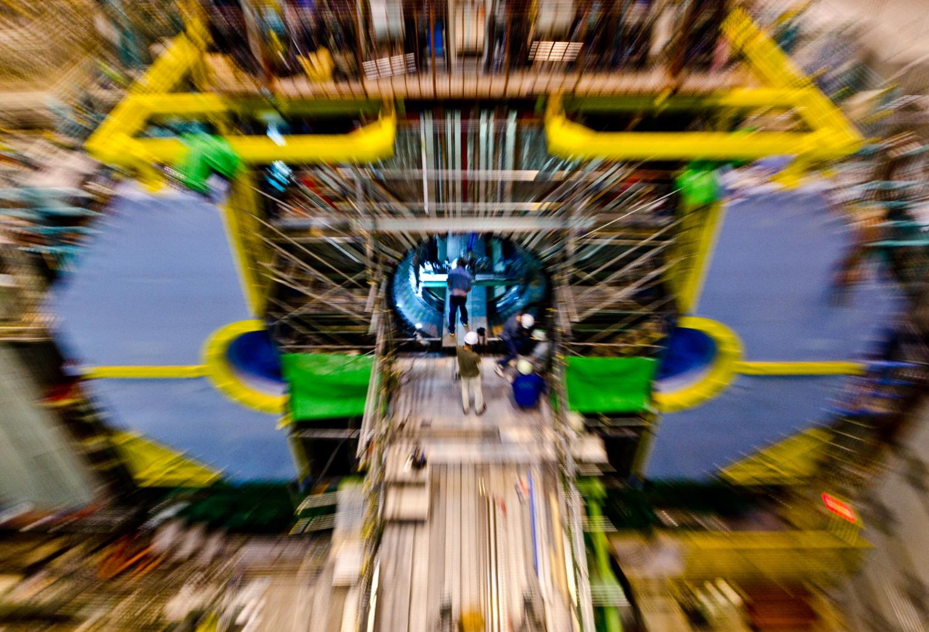
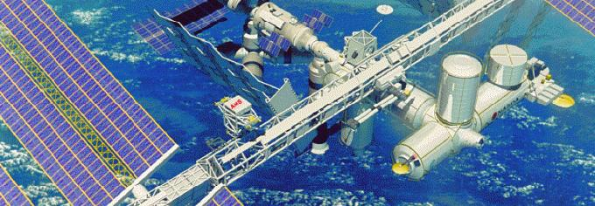
An experimental approach to NF detection
The triple approach
Energy FRONTIER
origin of the mass
hierarhY
dark
.
NF
MATTER /
anti-MATTER
dark
energy
neutrinOS
Precision FRONTIER
Cosmological FRONTIER
The discovery, and the interpretation of the NF would
represent a major scientific breakthrough

Slide 15
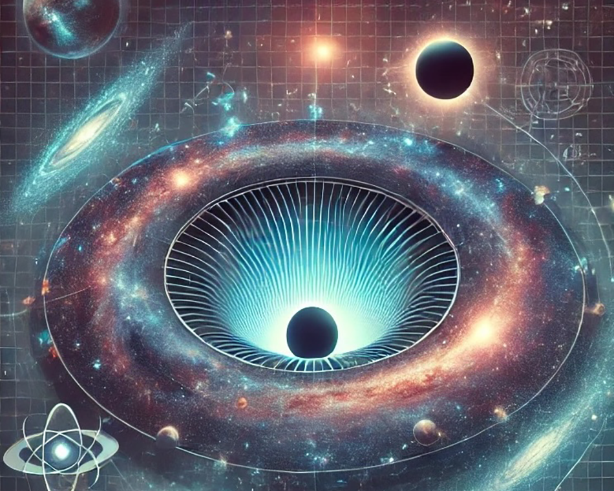
Cosmological frontier
Observation and analysis of the cosmic microwave background (CMB).
The CMB provides insights into the early universe.
Temperature Fluctuations
Baryon Acoustic Oscilltions
Polarization of the CMB
Spectral Analysis

Slide 16
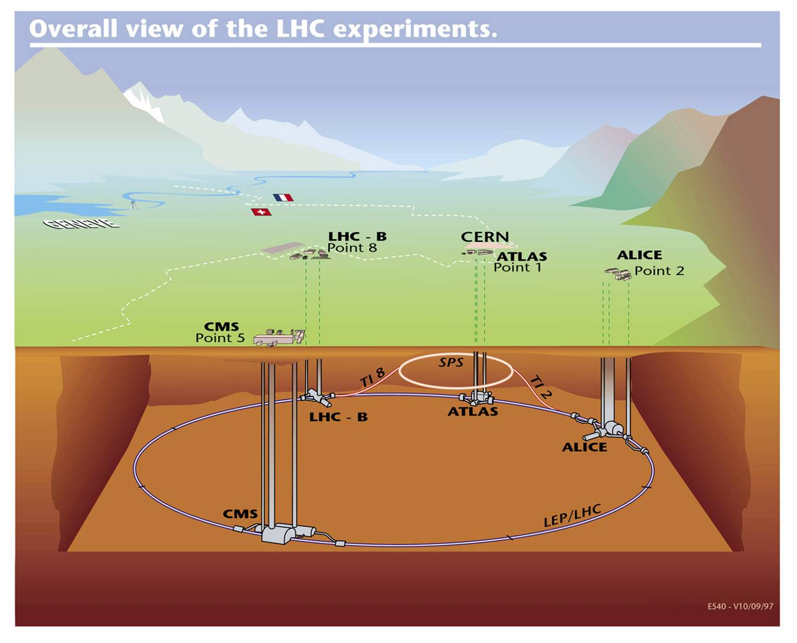
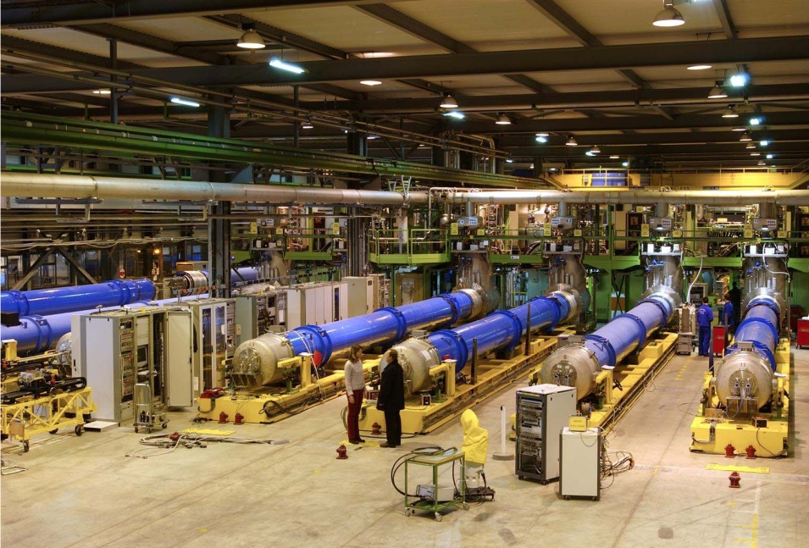
Energy frontier
?
p, E/2
p, E/2
E=mc²
E=mc²
Production of unknown particles and processes at the highest achievable energies
Large Hadron Collder
mc² =13 TeV
T=tera=10¹²
the p bunch in the LHC has
energy of more than 1500 kg
car at 45 km/h

Slide 17
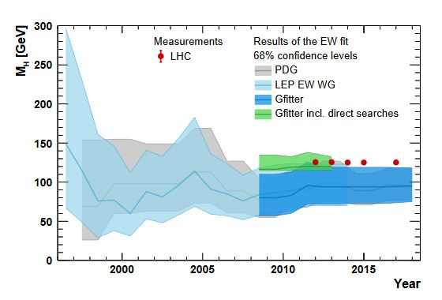
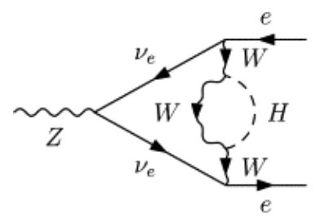
Precision frontier
measure (rare) processes with high precision and compare the results
with very accurate predictions in the context of the SM
undiscovered particles may contribute to known processes
example: Z⁰ → e e⁺⁻ = f(m_{H} ) :
basic order
higher order
+ other variables
e⁺
FROM ⁰
e⁻
J. Haller et al., Eur. Phys. J. C78, 675 (2018)
What is "very" precise ?

Slide 18
CP symetry
CP Symmetry operation: converts a particle to an anti-particle
If a particle and an antiparticle do not always behave in the same way
  e.g. if they decay differently - this is a violation of CP symmetry.
At the time of the universe creation : equal number of particles and anti-particles,
Today : composed almost exclusively of matter (=particles), not anti-matter,
  This symmetry is clearly broken!
Very important: to understand how and why this symmetry is broken.

Slide 19
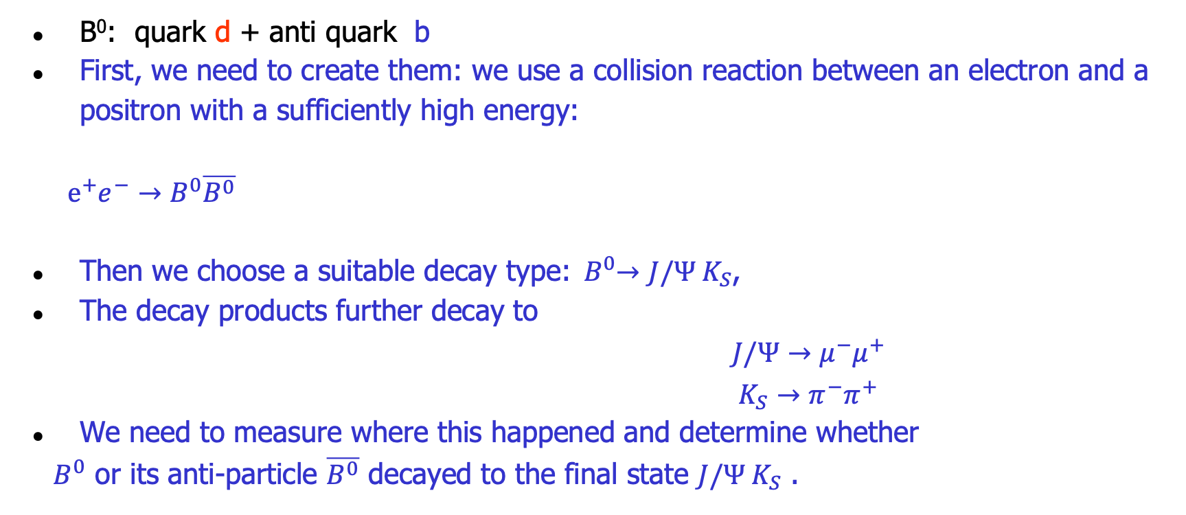
How to measure CP violation in B mesons?
B⁰: quark d + anti quark b
First, we need to create them: we use a collision reaction between an electron and a positron with a sufficiently high energy:
$e^{+}e^{−}→B^{0}\overline{B^{0}}$
Then we choose a suitable decay type:${ B}^{0}→J/Ψ{ K}_{S}$,
The decay products further decay to
$J/Ψ{→μ^{−}μ^{+}}_{}$
$K_{S}→π^{−}π^{+}$
We need to measure where this happened and determine whether
${ B}^{0}$ or its anti-particle $\overline{B^{0}}$ decayed to the final state $J/Ψ{ K}_{S}$ .

Slide 20

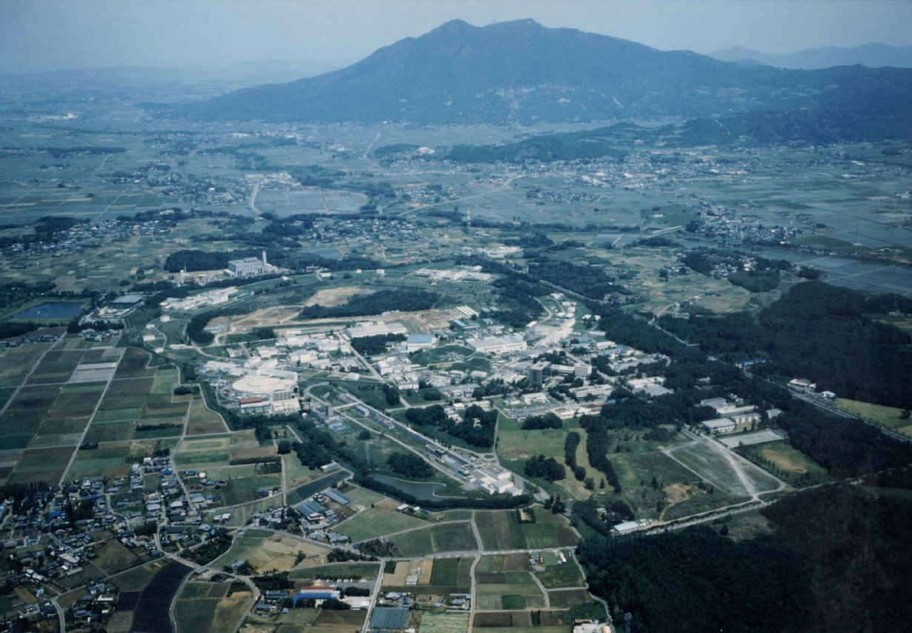

KEK-B accelerator and Belle II in Tsukuba
400 researchers from 14 states; 12 from Slovenia
Tsukuba-san
Belle
KEKB
~diameter 1 km

Slide 21
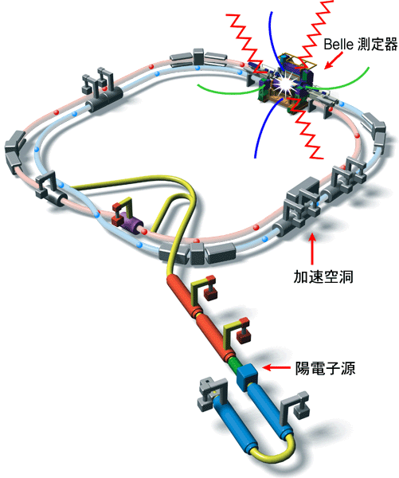
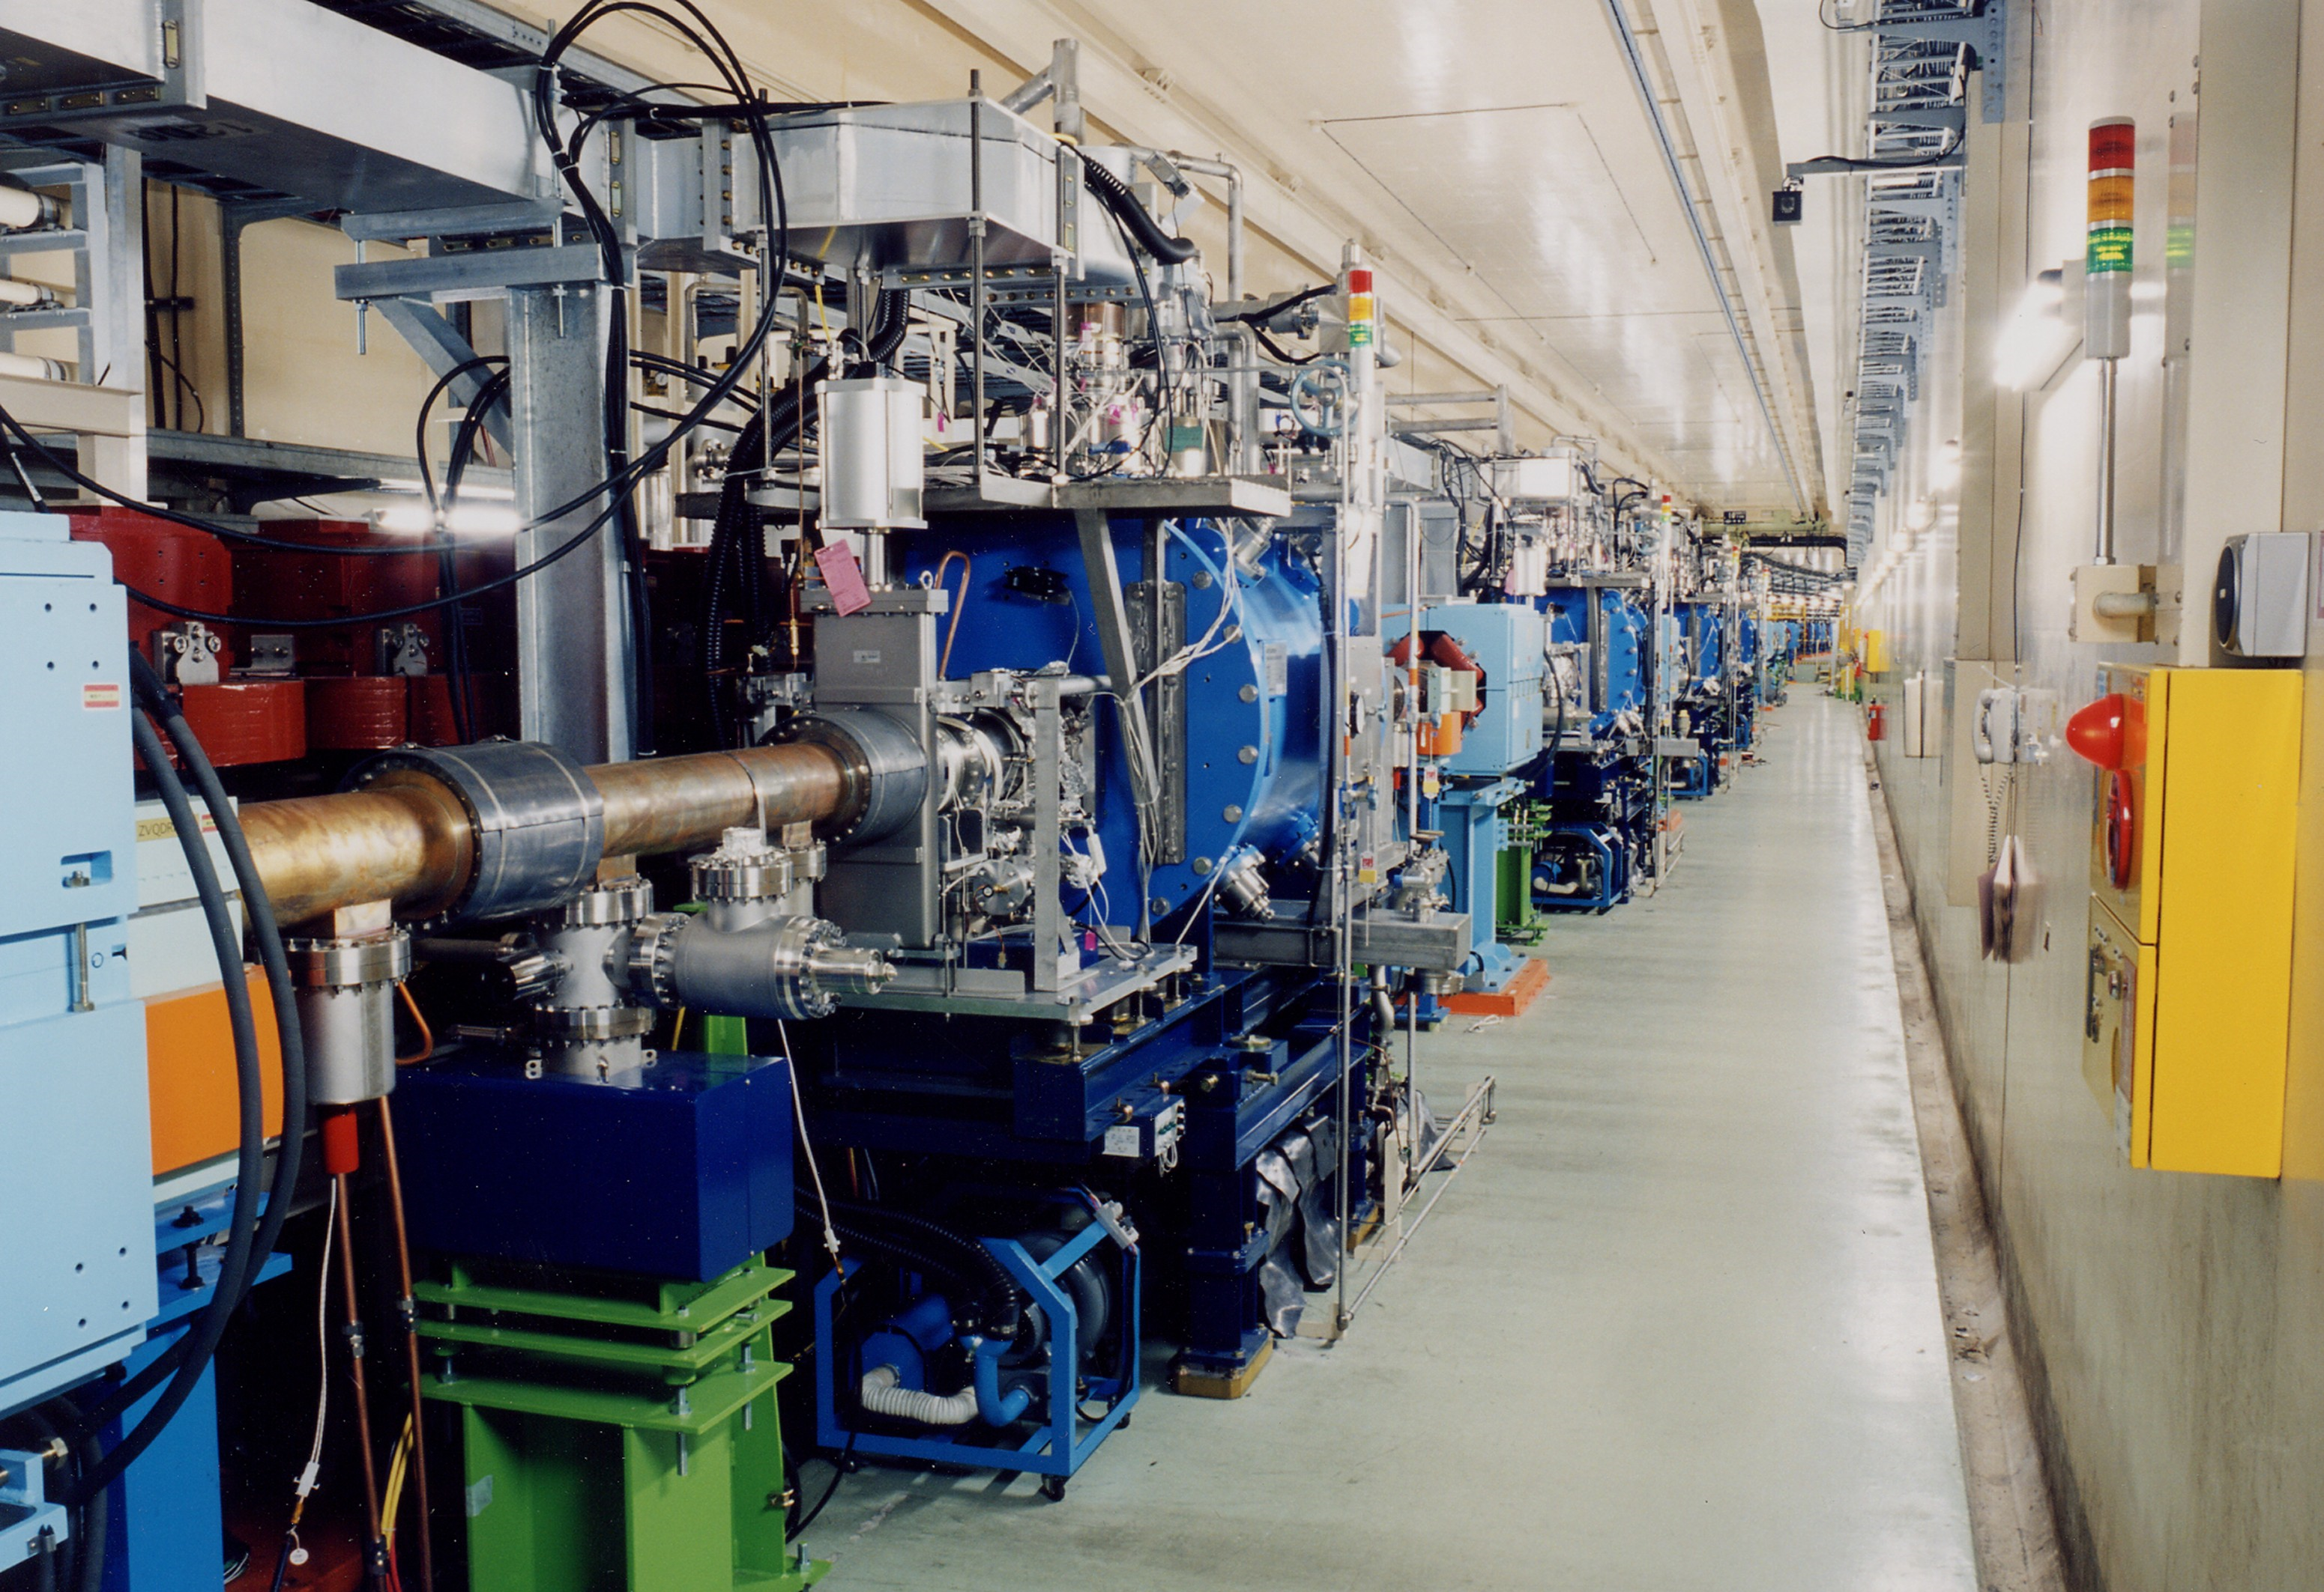
Accelerator KEK-B accelerates electrons and positron until its collision
Belle II detector
RF cavity
Source of e⁺
Source of e⁻

Slide 22
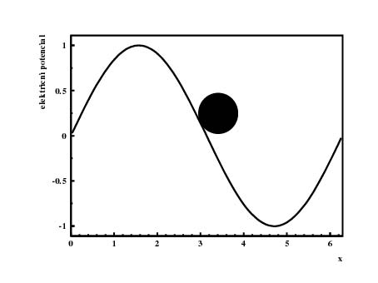

How do we accelerate charged particles?
By electromagnetic waves
typical frequency 500 MHz
for comparison: mobile phones 900 and 1800 MHz respectively
electron
... Similar to wavesurfing

Slide 23
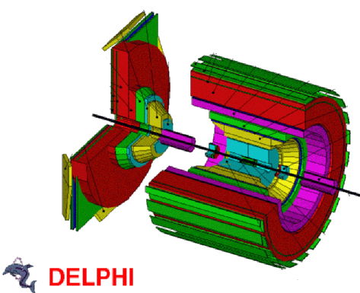
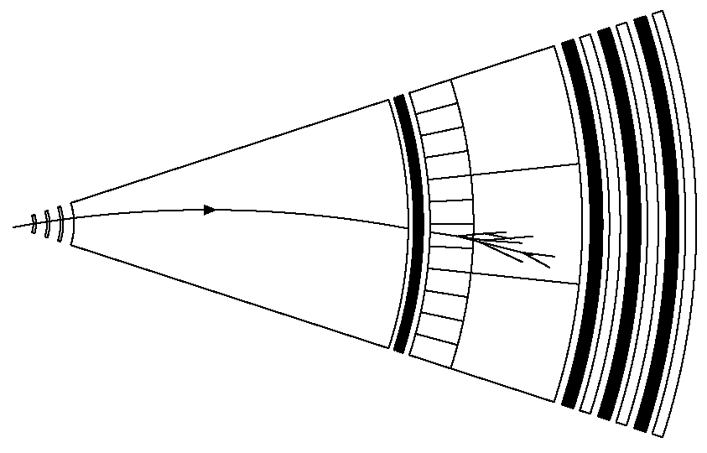
Global detector layout:
barrel-shape surrounding beam-pipe
2 cone- or wheel-shaped end-caps
Nearly 4π coverage and good accessibility!
High density detectors
Vertex detector(s)
Measure
Direction
Energy
Charge
Particle identity
Lifetime
Of all particles produced in an interaction
Low density detectors
Tracking detector(s)
(charged particle trajectory)
Calorimeters
(Energy)
Collision point
Solenoid magnet
Muon detectors

Slide 24
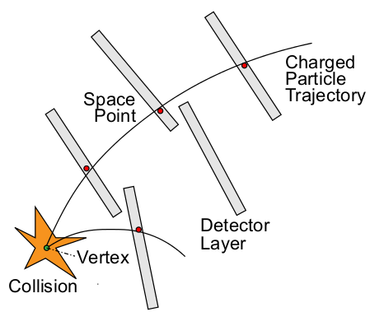
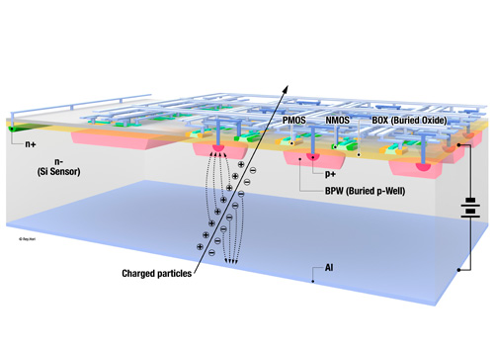
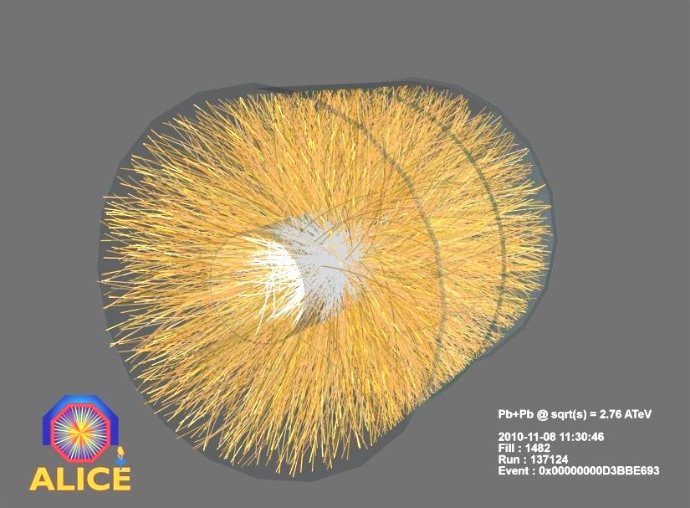
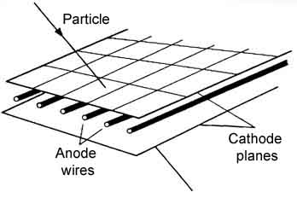
How do we measure what we can’t see?
From the track curvature in the magnetic field, we determine the momentum p
p = m v γ
p = e B R
solid
gas

Slide 25
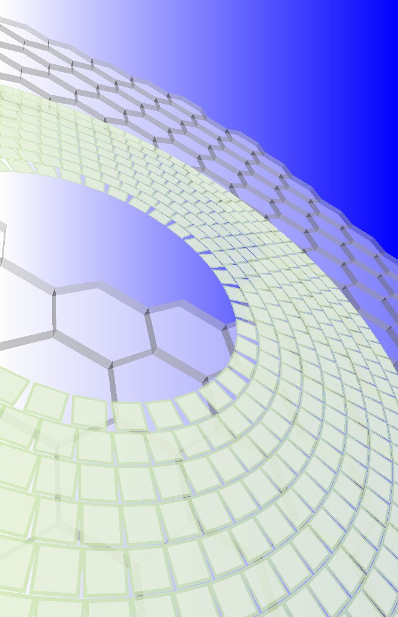
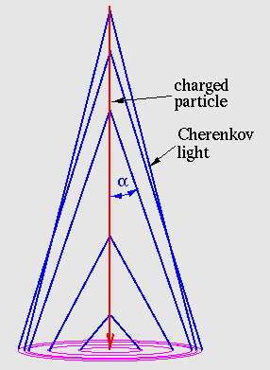
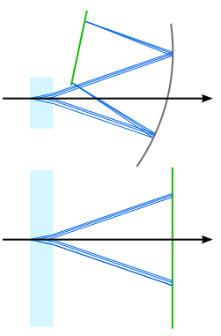
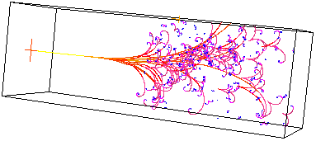
Particle identification
Given a known particle's momentum, we need to measure its mass = identity
Cherenkov detectors
Calorimeters
Muon detectors
...

Slide 26
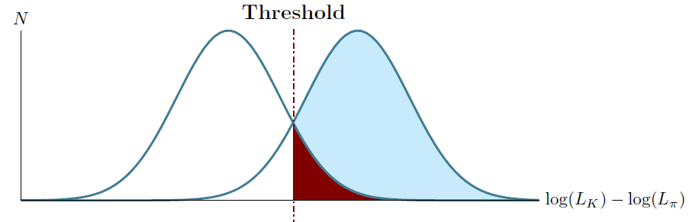
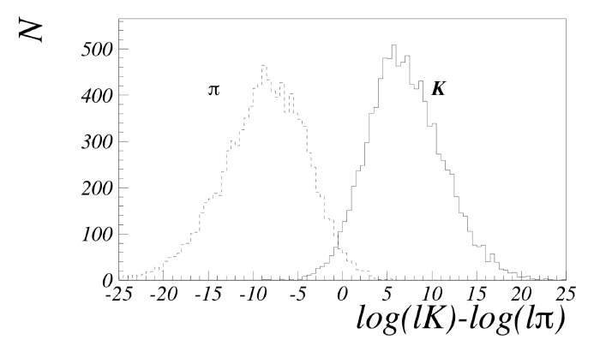
Particle identification
Granuar Photon detector
n₁
Aerogel
tile
For each particle hypothesis (e,mu,pi,K,p) evaluate a likelihood function
Determine threshold based on the sample of independently identified particles
Determine the identity
How do we construct the likelihood function?

Slide 27
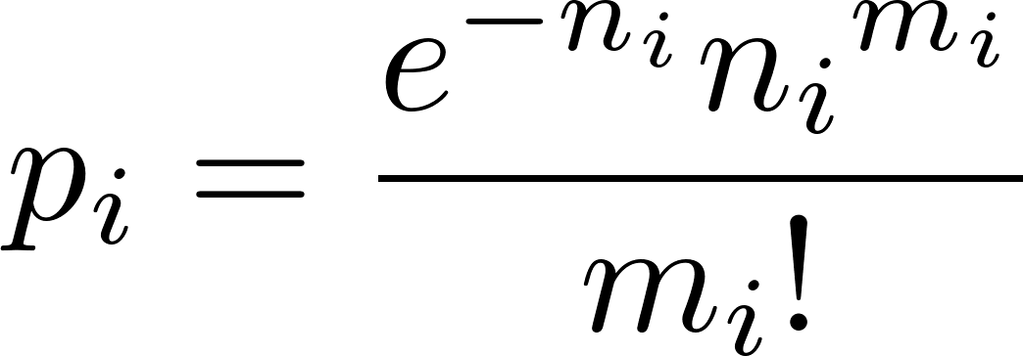
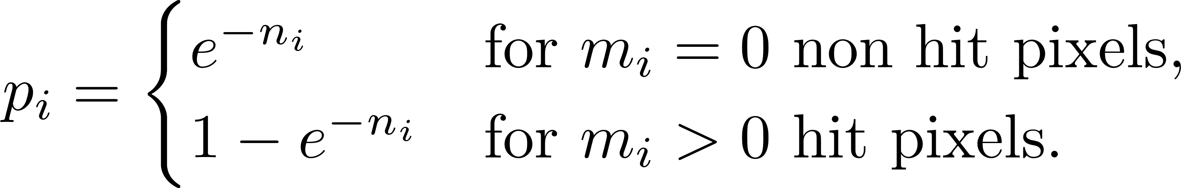
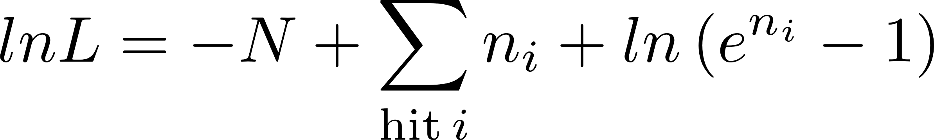
Likelihood construction (example of Belle II ARICH)
Small number of tracks, overlap of rings from different particles not very likely
p_{i} – probability that a a pixel i was hit distributed binomially
n_{i} - expected i.e. calculated average number of hits on the particular pixel
m_{i} – measured number of photons in the particular pixel
For a given hypothesis:
N number of expected hits = sum of expected average number of hits on the detector

Slide 28
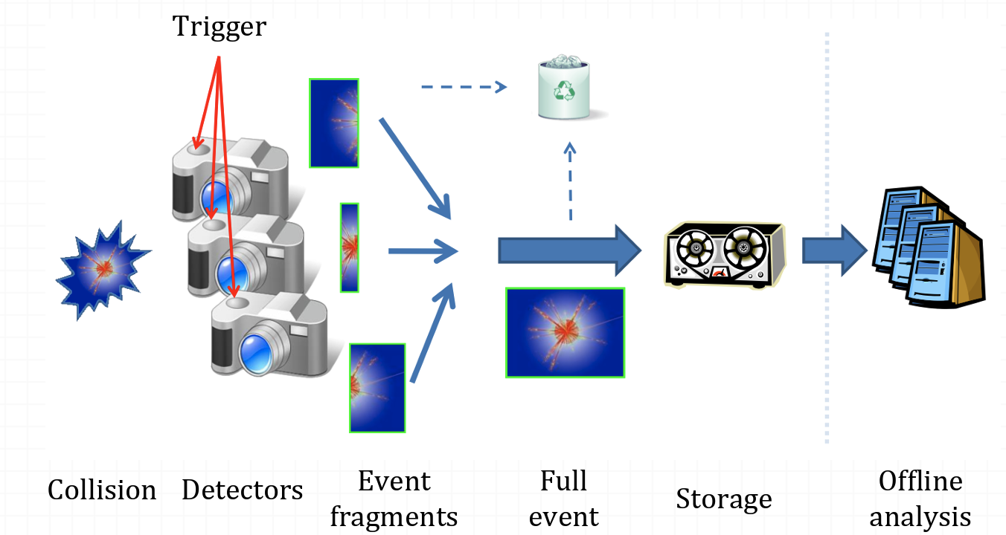
Data path
From the hits in the detector particle properties have to be reconstructed
Direction
Energy
Charge
Particle identity
Lifetime
For each of the events for all particles produced in an interaction

Slide 29
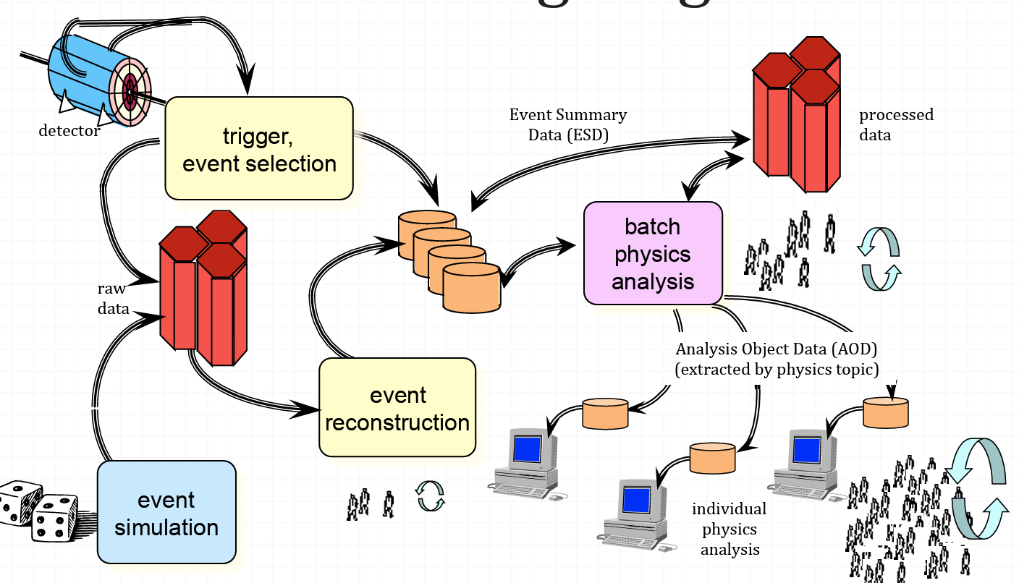
Data processing

Slide 30
Analysis and role of simulation
Comparison of measured and expected response
Expected response: Simulation
Simulation = doing ‘virtual’ experiment
take all the known physics
start from your ‘initial condition’ (two protons colliding)
calculate the ‘final state’ of your detector to get the ‘experimental’ results
  solve equations of motion, etc
  IMPOSSIBLE to be done analytically

Slide 31
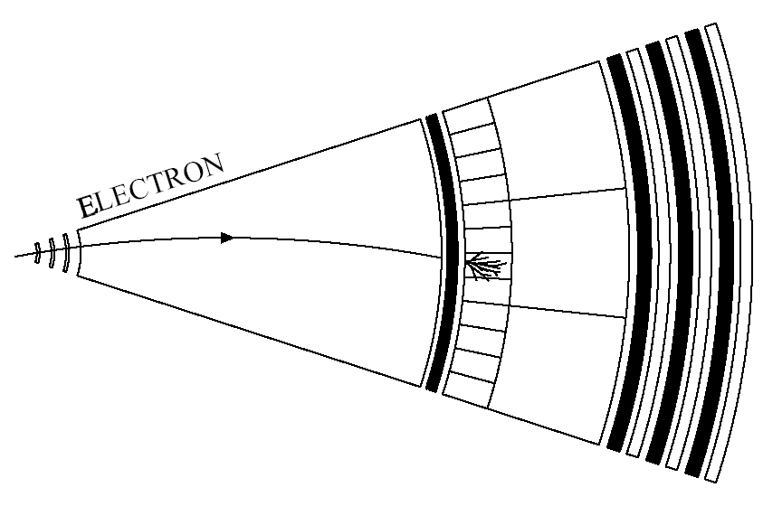
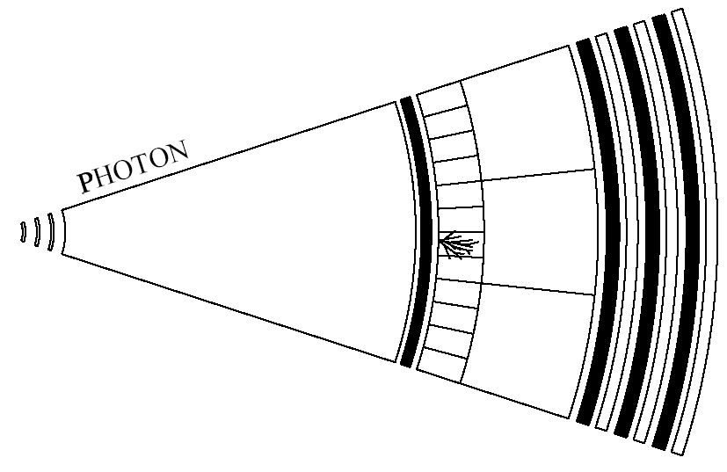
Particle signatures
Electrons:
leave a bent track
stopped in first layer of calorimeter
(Calorimeter and tracking information)
Photons:
no track
stopped in first layer calorimeter
(Only calorimeter information!)
First layer of calorimeter: “Electro-magnetic calorimeter”

Slide 32
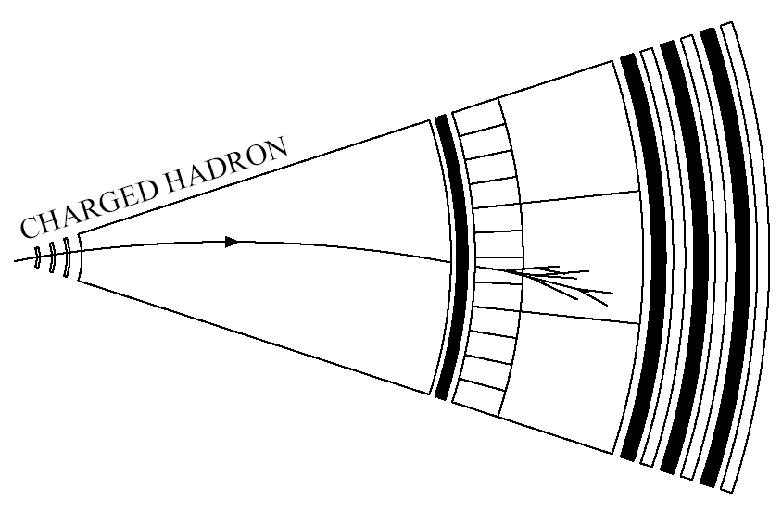
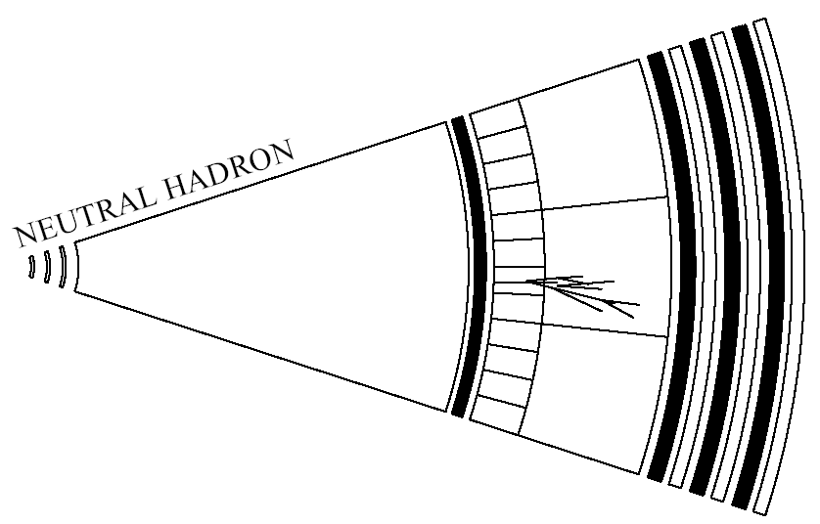
Particle signatures
Charged hadrons:
leave a bent track
stopped deep in calorimeter
(Calorimeter and tracking information)
Neutral hadrons:
no track
stopped deep in calorimeter
(Only calorimeter information!)
Second (+) layers of calorimeter: “Hadron calorimeter”

Slide 33
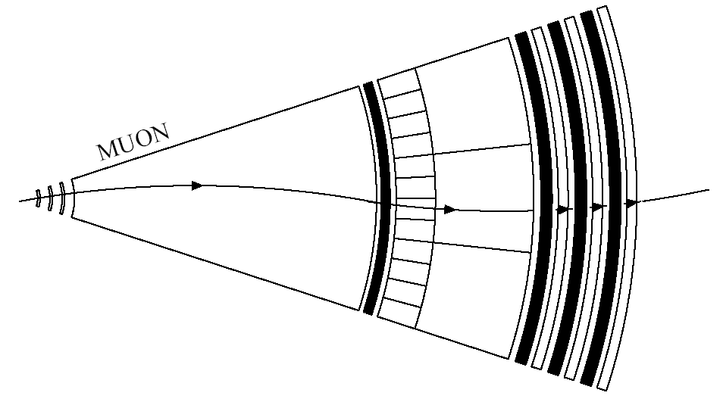
Particle signatures
Muons:
leave a bent track
not stopped in calorimeter
track in muon detectors
(Calorimeter, tracking and muon-detector information)

Slide 34
The ideal detector
An apparatus that provides (for all types of particles):
good particle identification
precise measurement of energy/momentum
precise measurement of trajectory (direction/origin)
coverage of the full (4π) angular region
In addition (in some cases) it should be able to:
take data at a high rate
cope with a high particle densities
survive high radiation doses
survive 10+ years of operation (with little/no intervention)
A real detector will always be a compromise between the various requirements, existing technology and the availability of money, space, time etc…

Slide 35
Particle detection techniques: the physics
Detect/measure properties particles through their interaction with matter:
Ionisation of atomic electrons
Bremsstrahlung and photon conversions
Inelastic nuclear interactions
Cherenkov or transition radiation
Emission of scintillation or fluorescence light
How can we “visualise” these processes?
Photographic techniques
By collection of induced charge (from ionisation)
By detection of photons

Slide 36
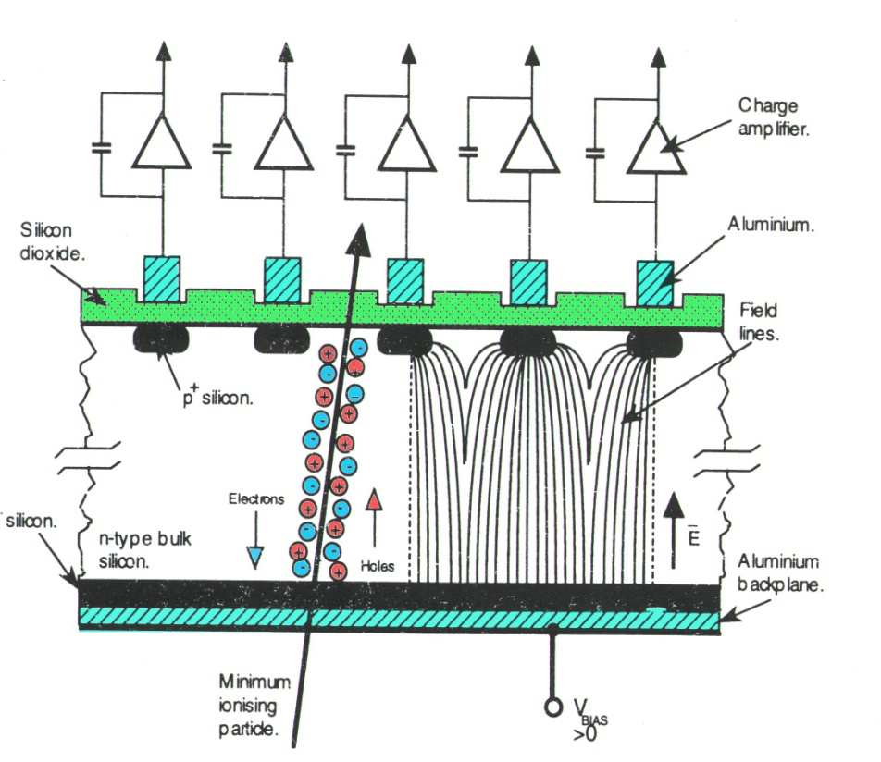
Basic detection techniques: Electrical
We can also electrically collect the charge produced by the ionisation
Particle causes ionisation in a material.
Charge is separated/collected by an electric field.
Requirement on material:
no/few free charge carriers (non-conducting)
mechanism for transport of charge
+
+
+
+
V
-
-
-
-
Proportional chambers, Drift chambers, ..
Insulating gas/liquid between anode and cathode (transport through drift). Sometimes combined with very low conductivity solids.
Silicon strip detectors, CCDs, ..
Using a semi-conducting material: Mostly in the form of a reverse-biased pn-junction diode.

Slide 37
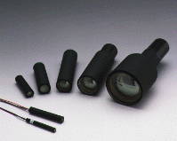
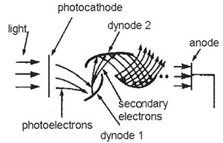
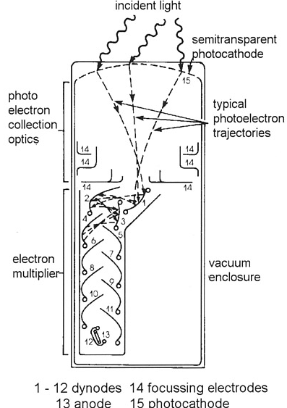


Basic detection techniques: Photo-detection
Charged particles can produce photons via scintillation, Cherenkov or transition-radiation etc. To detect these:
Photo-Multiplier Tube (PMT):
Electrons from photo-electric effect
“Electron multiplier” provides charge cascade
Very sensitive, but also bulky and expensive.
Hamamatsu
Semi-conductor devices:
Photo-diodes or CCD’s
Notes:
PMTs potential problems when operated in B field!

Slide 38

Spectrometer Belle II

Slide 39


What do we measure with the detector?
tracks of charged particles in a magnetic field
the coordinates of the point from which the traces originate
the type of particle
${ B}^{0}→J/Ψ{ K}_{S}$,
$J/Ψ{→μ^{−}μ^{+}}_{}$
$$K_{S}→π^{−}π^{+}$$

Slide 40

Measurement result: CP symmetry broken!
The Difference between particles and antiparticles:
Blue: time course of anti-B decay
Red: same for B
The relative difference between between the two distributions

Slide 41

Origin of mass in the Standard Model
The Standard Model is a very rigorously tested theory.
The long missing particle predicted by the Standard Model:
  The Higgs boson
The Higgs boson is responsible for the mass of particles:
  The mass of a particle depends on how strongly it is coupled to the Higgs.
  Very massive: m_{Higgs} > 120 m_{p}

Slide 42

CERN and Large Hadron Collider / LHC
the largest experimental facility on Earth
LHC
Geneva lake
Geneva airport

Slide 43

ATLAS at LHC
~3000 researchers
15 from Slovenia
Man standing here

Slide 44


Slide 45


Discovery of the Higgs boson
LHC started operating in 2009
2012 Both major scientific groups (ATLAS, CMS) :
a particle with a mass of 126 GeV/c2 was observed with a probability of 5σ
2013 Nobel Prize: François Englert and Peter W. Higgs
2018 H decay into a pair of b and anti-b quarks observed
Decay of Higgs boson to 4 muons

Slide 46
The Standard Model: the definitive theory?
12 fundamental particles
3 types of interactions, 1+3+8 force carriers
particle that provides the mass for all the others (Higgs)
Correct, but with too many particles

Slide 47

The Standard Model is not a definitive theory
Neutrinos have a (small) mass
The observable Universe – complete dominance of substance over anti-substance;
  one conditions for such an evolution of the Universe - violation of CP symmetry;
  measured CP symmetry breaking ~10¹⁰ too small to explain the asymmetries
Gravity is not yet included
Most of the Universe is made of matter unknown to us....
several proposed (and yet unconfirmed) solutions:
Super symmetric theories, Extra dimensions...
→ "New Physics" (NP)

Slide 48


Direct evidence for the existence of dark matter
When two galaxy clusters collide, ordinary matter slows down, but dark matter does not.

Slide 49

Physics beyond the Standard Model
Search for deviations from the extremely well-tested Standard Model.
Two possibilities:
Direct search for new particles, supersymmetric partners: particles must be massive
  search at high energies (LHC)
Search for deviations from the probability of processes (e.g. in rare B meson decays)
  Precise Belle II measurements at lower energies
Both approaches are complementary.
no discoveries of new particles with mass ~500 GeV/c² - 1TeV/c²

Slide 50
What will the future bring us?
We don't really know -
If we did, research would not be necessary ...
We expect very interesting results in the next few years in fundamental particle physics!

Slide 51
Detection of low light levels
Detection of photons crucial in
Cherenkov detectors,
calorimeters,
fiber trackers,
etc.

Slide 52


Photon detection in human
Photoreceptor cell : specialized type of neuroepithelial cell found in the retina that is capable of visual phototransduction
Photoreceptor proteins in the cell absorb photons, triggering a change in the cell's membrane potential.

Slide 53
Photodetector
A device that can detect photons
Requirements:
single photon sensitivity,
high efficiency,
good spatial granularity
Detection mechanism:
  Photo-chemical
  Thermal
  Photo-voltaic
  Photo effect

Slide 54


Photo-effect
Interactions of gammas with matter
Photoelectric
First we need to convert light into detectable electronic signal
Principle:
Use photoelectric effect to ‘convert’ photons to photoelectrons
External photelectric effect – emission of free electrons from metal surface due to energy absorption
Photon detection involves often materials like K, Na, Rb, Cs (alkali metals). They have the smallest electronegativity →highest tendency to release electrons.
Most photo-detectors make use of solid or gaseous photosensitive materials.
Internal photoelectric effect – free charge carriers are generated by absorption of incident photons in semiconductor junction detector
Pair product^{n}
Compton

Slide 55

Detection of light by sensors
Types:
  Vacuum
  Photomultiplier tubes (PMT)
  Microchannel plate photomultiplier tubes (MCP-PMT)
  Solid-state photon detectors
  Hybrid detectors
  HPDs and HAPDs
  Other hybrid photosensors
  Gaseous photon detectors

Slide 56



Photon multiplier tube PMT
After the photo conversion, the photoelectron signal needs to be amplified to give a measurable electronic pulse
Achieved in traditional photomultiplier
by dynode chain
  exponential multiplication of the charge at each dynode: e.g. if number of electrons is tripled on each stage of a 12 dynode chain
  Gain = 3¹² ~ 10⁶

Slide 57

Multiplication system (dynodes)
secondary emmision: number of secondary electrons per incoming electron δ ≈ 3-5
dynode material: usually semiconductors or isolators (same reason as for the photocathode)
semiconductor on a metal substrate (electric contact needed for E field for acceleration)
G =10⁷-10⁸
10-14 dynodes
GaP dinode
5 dynodes
same G

Slide 58

Photomultipler gain
Gain depends on:
the number of dynodes
secondary-emission ratio characterised by
  properties of the material
  the energy and angle of incidence of the primary electrons

Slide 59



Pulse height distributions for single photoelectrons
Pulse height
(multiple photons: convolution)
Pulse height

Slide 60


Photomultipler tube
Base
(resistor chain)
Contacts to the tube
+
Anode signal
High voltage
Last dynode
Measure pulses
Measure current

Slide 61


How to detect visible, near UV and near IR light
Photon energy:
visible range 400 nm –780 nm → 3.1 -1.6 eV, Δ𝐸𝛾≈1.5𝑒𝑉

Slide 62



Solid photocathode
Photon can’t transfer its total energy to a free electron due to momentum and energy conservation
Available energy few eV
→ good materials are semiconductors.
Light has to enter a photosensitive material
→ low reflectivity 𝑅
Absorbed photons transfer energy to electrons (e-) in the material;
If$E_{γ}>E_{g}$, electrons are raised to conductance band.
→ In a Si-photodiode, these electrons(holes) can create a photo-current.
→ Photoconductive effect.
However, if the detection method requires
extraction of the electron into vacuum, 2 more steps must be accomplished:
Energized electrons diffuse through the material, losing part of their energy (~random walk) due to electron-phonon scattering. $Δ$E ~ 0.05 eV per collision.
Only electrons reaching the surface with sufficient excess energy escape from it
  → minimum required energy 𝐸𝛾>𝐸𝑔+𝐸𝐴
→ Photoelectric effect

Slide 63

Photosensitive materials - photocathodes

Slide 64


Transmission vs. reflection mode photocathode
Thickness of transmission mode photo-cathode needs to be optimized!

Slide 65
Photocathode sensitivity
photons
Photoeffect : E_{e} =hν - Φ
Work function
Photocathode
Max kinetic
energy of the photo-electron
Energy of the photon
photo electrons
Quantum Efficiency
Quantum efficiency is a product of:
Transmission probability (window)
Probability for absorption and photoeffect
Probability for the electron to exit the photocathode
Number of photoelectrons exiting the cathode
QE(λ ) =
Number of incoming photons
I_{k}
Photoelectron current (A)
Spectral sensitivity E( λ)=
P( λ)
Incoming light power (W)
I_{k} /e_{o}
hc
QE( λ) =
=
E(λ)
P(λ )/hν
λ e₀

Slide 66

Transmission mode photo-cathodes
Bi-alkali: Sb-K-Cs, Sb-Rb-Cs, Na-K-Sb Multi-alkali: Sb-Na-K-Cs

Slide 67


Recent photocathode improvements
Recent improvements of bi-alkali photocathodes:
•Peak QE > 40%
•𝜆_{𝑝𝑒𝑎𝑘}→350nm
New UV sensitive photocathode

Slide 68

Collection of photoelectrons
Use a suitably formed electric filed between the photocathode and the first dynode
Requirements:
high efficiency for the photo-electron collection (for different paths, exit energies, directions).
the collection efficiency should not depend on the photoelectron exit point
the time of flight to the first dynode should also not depend on the photoelectron exit point (impact on time resolution)

Slide 69



Window transmission
2 types of losses:
Fresnel reflection at interface air/window and window/photocathode
𝑅_{𝐹𝑟𝑒𝑠𝑛𝑒𝑙} = $\frac{{(n−1)}^{2}}{{(n+1)}^{2}}$(normal incidence)
n = refractive index (wavelength dependent!)
n_{𝑔𝑙𝑎𝑠𝑠}≈1.5 →𝑅_{𝐹𝑟𝑒𝑠𝑛𝑒𝑙}= 0.04 (per interface)
Bulk absorption due to impurities or intrinsic cut-off limit. Absorption is proportional to window thickness (for low absorption)

Slide 70
Overview of photodetectors

Slide 71






Multianode PMT
The multi-anode photomultiplier is a marvel
of miniaturization → up to 64 pixels in a single tube, each with size ~ 2×2 mm²
Dynode structure formed from a stack of perforated metal foils
Signal width dominated by fluctuations in the charge multiplication of the first dynodes
Noise
1 photon
Multi-anode PM (Hamamatsu R5900)
metal foil dynodes
Signal

Slide 72


Example - Multianode PMT Hamamatsu R5900
Excellent single photon pulse height spectrum
Low noise (few Hz/ch)
Low cross-talk (<1%)
single photon pulse height spectrum

Slide 73

Flat panel multianode PMTs
Problem of vacuum based sensors: active area fraction
One possible solution: make a larger sensor
Hamamatsu: flat panel PMT H8500
● 52 x 52mm², 89% effective coverage
● 64 channels, pixel size 5.8 x 5.8 mm2
● 12 dynodes, metal foil type
● Bialkali cathode, max 25% quantum efficiency
● single photon pulse height distribution not as good as in the smaller R5900 (and related tubes like 7600)

Slide 74



Micro-Channel Plate PMTs
Time-of-flight detectors - timing precision at the picosecond (10⁻¹² s) level
1 ps ≈ 0.3 mm for a relativistic particle
→ requires small feature sizes
Micro-channel plate (MCP) photon detectors employ electron multiplication in small
(~ 10 μm) pores, used in image intensifiers
Timing precision of ~ 10 ps achieved
glass pores
MCP is an array of millions of capillaries (~10 um diameter) in a glass plate (d=1mm).
Both faces of the plate are coated by thin metal, and act as electrodes.
The inner side of each tube is coated with electron-emissive material.
MCP detector
(Photonis)
6 cm width
Up to 1024
anode pads
Immune to an axial magnetic field

Slide 75

Micro channels
pore diameter 10-100 μm
channel length ≈ 1mm
multiplication G ≈ 10⁵-10⁷ (“chevron”)
time resolution <100 ps
spatial sensitivity
25 μm pores: up to B ≈ 0.8T
10 μm: up to B≈1.5T

Slide 76

MCP PMT timing
MCP PMTs: main peak with excellent timing accompanied with a tail
σ = 40 ps
Photonis XP85011
Tails understood (scattering of photoelectrons off the MCP)
Inelastic back-scattering
Elastic back-scattering
→good agreement with a simple model →
NIMA 595 (2008) 169
JINST 4 (2009) P11017

Slide 77

Elastically backscattered photoelectrons
simple model: assume that the photoelectron back-scattering by the angle β is uniform over the solid angle.
time required for the photoelectron to return to the MCP
~ 2.8ns
lateral distance travelled between point of backscattering and point where charge multiplication in the MCP begins
~ 12mm

Slide 78
MCP PMTs in magnetic field
Gain vs B field for different tilt angles
→ NIMA 639 (2011) 144

Slide 79

MCP PMTs ageing
a serious problem in some aplications
Cures:
Better cleaning of the MCPs, better vacuum
Al foil between PC and first MCP
Al foil between two MPC stages
Atomic layer deposition (ALD)
ions

Slide 80


MCP PMTs ageing, cure
Atomic Layer deposition
Three-step deposition process
Resistive layer
Secondary emission layer
Electrode layer
Hamamatsu, ALD deposition

Slide 81

PMT vs MCP-PMT
Standard photomultipliers
Successful technology over decades
Large area available at low cost
Rather fast: ns timing
But……
  Bulky
  Limited position resolution
  Low magnetic field tolerance
MCP-based photomultipliers
Compact design
Picosecond-level time resolution
Micron‐level spatial resolution
Good magnetic field tolerance
But……
  Few vendors, high cost
  Limited sizes

Slide 82


Light detection in silicon
Two main contributions:
Reflection at the entry surface due to high refractive index 𝑛≈5 :
→$R≈{\frac{4}{6}}^{2}=44\%$
→ antireflective coating
Large variation in absorption length
→ loss of efficiency:
absorption at the surface for short 𝜆
transparent for long 𝜆

Slide 83

The P-N Junction
Electrons and holes diffuse to area of lower concentration
Electric field is built up in the depletion layer
Drift of minority carriers
Capacitance

Slide 84



Biased P-N junction
When connected to a voltage source, the I-V curve of a P-N junction is given by:
We’ll focus on reverse biasing:
larger electric field in the junction
extended space charge region

Slide 85

The P-N photodiode during illumination
Electrons and holes generated in the depletion area due to photon absorption are drifted outwards by the electric field
Reverse biasing:
Electric field in the junction increases quantum efficiency
Larger depletion layer
Better signal

Slide 86
Summary: P-N photodiode
Simple and cheap solid state device
High QE (also in the IR region),
No multiplication -No internal gain, linear response
Noise (“dark” current) is at the level of several hundred electrons, and consequently the smallest detectable light needs to consist of even more photons
Can be used in cases with large light yields (calorimeters)

Slide 87


Avalanche photodiode
High reverse-bias voltage enhances the field in the depletion layer
Electrons and holes excited by the photons are accelerated in the strong field generated by the reverse bias.
Collisions causing impact-ionization of more electron-hole pairs, thus contributing to the gain of the junction.

Slide 88


Avalanche photodiode
P-N photodiode
Avalanche photodiode

Slide 89

Summary: APD
High reverse-bias voltage, but below the breakdown voltage.
region with high E field -> multiplication in an avalanche,
  G ≈ 10²-10^{3.}
Detection of weak signals (~20 photons)
Average photocurrent is proportional to the incident photon flux (linear mode)
signal/noise still poor compared to a PMT
used for calorimeters

Slide 90

Geiger mode APD
In the Geiger mode, the APD is biased above its breakdown voltage for operation in very high gain.
Electrons and holes multiply by impact ionization faster than they can be collected, resulting in an exponential growth in the current
Individual photon counting

Slide 91




Geiger mode – quenching
Shutting off an avalanche current is called quenching
Passive quenching
  slower, ~10ns dead time
Active quenching
  faster

Slide 92
Summary: Geiger mode
High detection efficiency (80%).
Dark counts rate (at room temperature) below 1 kHz. Cooling reduces it exponentially.
After-pulsing caused by carrier trapping and delayed release.
Correction factor for intensity (due to dead time).

Slide 93




Silicon Photomultipliers
Array of Geiger mode APDs (above the breakdown voltage) → large gain, binary signal, long recovery
Microcell = GAPD (~20um)
made on a silicon substrate, with 100-5000 pixels/mm². Total area 1-40mm².
The independently operating pixels are connected to the same readout line

Slide 94



Characteristics of SiPM
Traditional PM
low operation voltage ~ 10-100 V
gain ~ 10⁶
peak PDE up to 65%(@400nm)
PDE = QE x ε_{geiger} x ε_{geo} (up to 5x PMT!)
ε_{geo} – dead space between the cells
time resolution ~ 100 ps
works in high magnetic field
dark counts ~ few 100 kHz/mm²
radiation damage (p,n)

Slide 95


SiPMs as photon detectors
1 mm
  100 um
  50 um
  25 um

Slide 96

Radiation damage
Expected fluence at 50/ab at Belle II:
2-20 10¹¹ n cm⁻²
→ Worst than the lowest line
→Very hard to use present SiPMs as single photon detectors in many because of radiation damage by neutrons
Also: could only be used with a sofisticated electronics – wave-form sampling

Slide 97



Digital SiPM
DPC: Front-end Digitization by Integration of SPAD & CMOS Electronics
New perspectives: 3D integration
advanced photon-detection structures,
  improved detection efficiency

Slide 98
SiPM: time resolution for single photons
Very fast analog SiPM
Digital SiPM
Analog SiPMs: typically 80 ps (sigma), 200 ps FWHM
Digital SiPMs: main peak 48 ps (sigma)!

Slide 99

Hybrid Photon Detectors
Developed from PMT: Instead of using a dynode chain to provide the amplification, accelerate the photoelectrons with electric field
and use a silicon sensor as anode
It takes 3.6 eV to create an electron-hole
pair in silicon: for accelerating voltage 20 kV
→ ~ 5000 e⁻ signal, enough to be detected using low-noise electronics
Advantages: very good energy resolution (sensitivity to number of individual photons), silicon sensor can be segmented as required
Disadvantages: requires high voltage,
ion feedback → requires very good vacuum

Slide 100


Hybrid Avalanche Photon Detector – Belle II RICH
Hybrid avalanche photo-detector developed in cooperation with Hamamatsu Photonics K.K. (proximity focusing configuration):
12 x12 channels (~ 5 x 5 mm²)
size ~ 72 mm x 72 mm
~ 65% effective area
total gain > 4.5x10⁴ (two steps:
bombardment > 1500, avalanche > 30)
detector capacitance ~ 80pF/ch.
super bi-alkali photocathode,
typical peak QE ~ 28% (> 24%)
works in mag. field (~ perpendicular
to the entrance window)
Super Bialkali
photocathode
photon
~20mm
photoelectron
8kV
multi-channel APD
Reverse bias 300V
3

Slide 101








HAPD performance @ B=0T
1ph.
2ph.
excellent photon counting affected only by
photo-electron back-scattering → high single
photon counting efficiency
sharp transition between channels
image distortion due to a non-uniform
electric field at the edges
back-scattering induced cross-talk
optical cross-talk by reflection from APD
surface → weak echo ring
3ph.
0ph.
4ph.
...
Illumination at an angle

Slide 102
Characteristics
Sensitivity
Linearity
Signal fluctuations
Time response
Rate capability / aging
Dark count rate
Operation in magnetic field
Radiation tolerance

Slide 103





Statistical fluctuations –excess noise factor (ENF)
Statistical fluctuation of the
avalanche multiplication influence the energy resolution of a photo-detector to a given photon signal beyond what would be expected from simple photoelectron statistics (Poisson distribution).
If photons are Poisson distributed so are photoelectrons with average 𝑛_{𝑝𝑒}=𝑃𝐷𝐸⋅𝑛_{𝛾}
After multiplication with average gain and variance 𝑀,𝜎_{𝑀}² we get average output signal 𝑛=𝑀⋅𝑛_{𝑝𝑒} and
Excess noise factor is
Impact on photon counting capability and energy resolution
multiplication fluctuations are characterized by Excess Noise Factor-ENF
sensor | ENF
PMT | 1-1.5
APD(Si) | ~3 @ gain=50
HPD, HAPD | ~1
SiPM | 1-1.5
MCP-PMT | 1-1.5

Slide 104




Time response
Light travels 3 mm in 10ps (vacuum)
●Rise time, fall time (or decay time)
●Duration
●Transit time (Δt): time between the arrival of the photon and the electrical signal
→ trigger decision time
●Transit time spread (TTS): transit time variation between different events
→timing resolution
Some typical signals:
Applications requiring good timing:
●Cherenkov light based TOF systems
●Time-Of-Propagation counter (Belle II)
●Focusing DIRC with chromatic correction (SuperB)
●TOF PET

Slide 105





How to measure timing properties
Use laser light source with very short light pulse (~10 ps or less)
attenuate light to low intensity → single photon level
Measure the delay between the laser trigger pulse and signal from the photosensor
Leading edge discriminator:
measure also pulse charge
make the time-walk correction
  𝑇𝐷𝐶=𝑃1+𝑃2𝐴𝐷𝐶−𝑃3
Constant fraction discriminator:
triggers at constant fraction of the signal
adjust fraction and delay

Slide 106




High rate operation, aging
Rate capability: inversely proportional to the time needed, after the arrival of one photon, to get ready to receive the next
Requirements in calorimeters: 100 kHz →few MHz
Aging(long-term operation at high counting rates): how is the photo-detector behavior changed when operated at high counting rate during several years ?
Parameter affected (generally in a negative way):
●gain
●quantum efficiency
●dark current

Slide 107



Dark count rate (DCR)
Sensors produce signals even in total darkness!
DCR of PMTs:
  depends on the cathode type, the cathode area, and the temperature.
  few kHz (threshold = 0.5 p.e.)
  is highest for cathodes with high sensitivity at long wavelengths.
  Temporarily increases considerably after exposure to daylight
DCR of different photocathodes
DCR of SiPMs:
●depends on the pixel size, the bias voltage, the temperature
●quite high (~0.1–2MHz/mm² at room temp, threshold = 0.5 p.e.)
DCR depends strongly on the threshold level → not a problem for detection of many photon signals (threshold >10).
Can be efficiently reduced by lowering the temperature.

Slide 108



Operation in a magnetic field
Earth’s magnetic field = 25-65 μT
B curves the trajectory of charged particles
in combination with tracking provides particle momentum
separates particle tracks → easier reconstruction
combination PET + MRI
Typical requirements 1.5T @ Belle II,
2T @ PANDA,
4T @ CMS, ILC,
1.5 T @ MRI
PMT very sensitive to magnetic
Field → shielding required (μ metal)
PD, APD, SiPM insensitive to magnetic field
MCP-PMT tolerant to magnetic field up to ~ 2T (6 μm pores).

Slide 109



Radiation tolerance
Damages caused by:
ionizing radiation: energy deposited in the detector material by particles and by photons from electromagnetic showers(the unit of absorbed dose is Gray [Gy] →1 Gy= 1 J/kg = 100 rad ).
neutrons created in hadronic shower, also in the forward shielding of the detectors and in beam collimators (fluence[1 MeV eq. n/cm2])
→ Result is degradation of DCR, gain, QE ...
Belle II ARICH photon detector 10¹¹n/cm²+ 10 Gy/ year
●At LHC, the ionizing dose is ~ 2x10⁶Gy/ r_{T}**2/ year (r_{T}= transverse distance to the beam)
→ CMS ECAL (10 years) 2x10¹³n/cm² + 250 krad

Slide 110
Single photon detectors application examples
fiber-optic communication
quantum information science
quantum encryption
medical imaging
light detection and ranging
DNA sequencing
astrophysics
materials science

Slide 111




HERA-B RICH
Little noise,
~30 photons per ring
Typical event →
Very good performance:
π→K
p→K
K→K
Kaon efficiency and pion fake probability

Slide 112



LHCb RICH
MA-PMTs – 64 ch 2”x2” + 64 ch 1”x1”

Slide 113


Belle II Cherenkov detectors
Endcap PID: Aerogel RICH (ARICH)
Barrel PID: Time of Propagation Counter (TOP)
200mm
Cherenkov photon
Quartz radiator
Focusing mirror
Small expansion block
Hamamatsu MCP-PMT (measure t, x and y)
Aerogel radiator
n~1.05
Hamamatsu HAPD
+ new ASIC
Aerogel radiator
Hamamatsu HAPD + readout
200

Slide 114



Time-Of-Propagation (TOP) counter
Hamamatsu SL10 MCP-PMT
Instead of a 2D image in two coordinates (‘ring’) measure:
  One (or two coordinates) with a few mm precision
  Time-of-arrival
  → Excellent time resolution < 100ps (incl. read-out)
    required for single photons in 1.5T B field

Slide 115
Summary
Low light level detection is in the heart of many detectors
New methods require very fast timing
A number of new detectors has been developed recently to cope with these requirements
A very active field!

