Slide 1

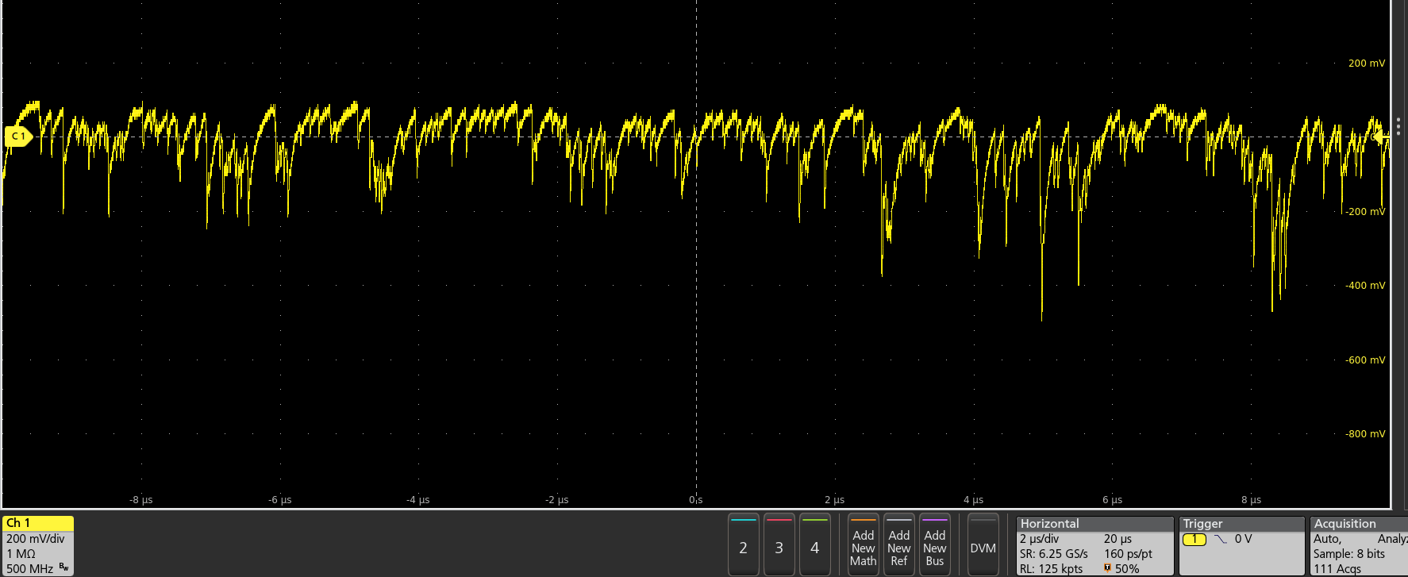

SiPM Radiation Hardness and Perspectives for New Developments
XII International Workshop on Ring Imaging Cherenkov Detectors - RICH2025
- Radiation damage mechanisms in SiPMs
- Experimental results
- Mitigation startegies
Rok Pestotnik
Jožef Stefan Institute, Ljubljana, Slovenia

Slide 2
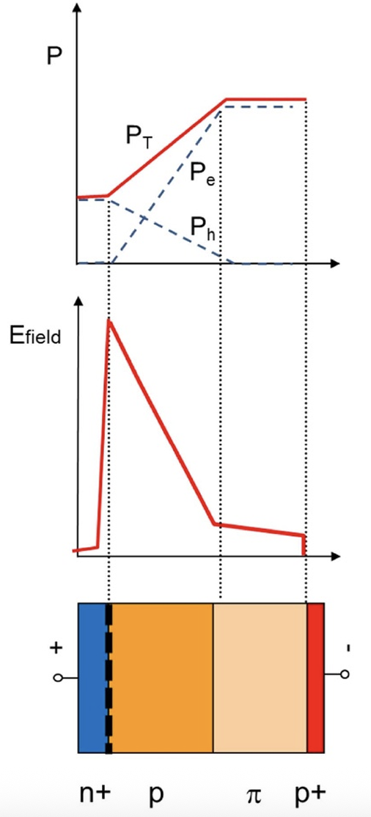
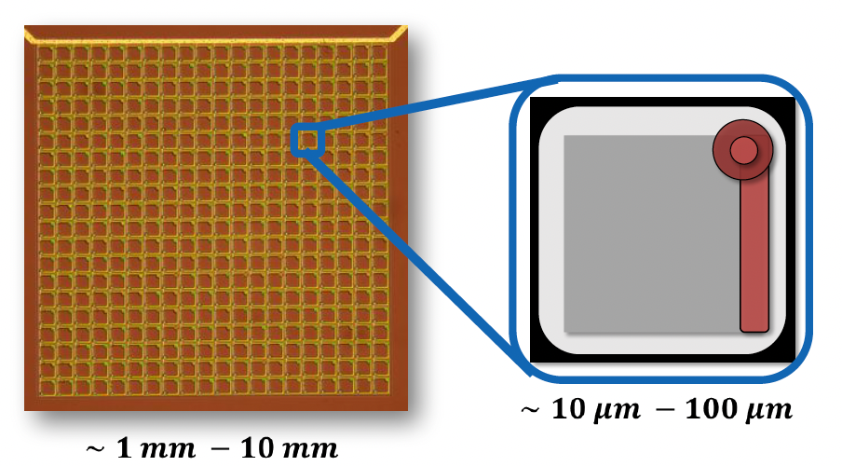
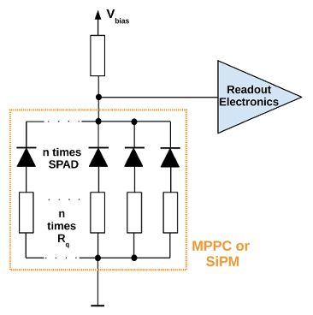
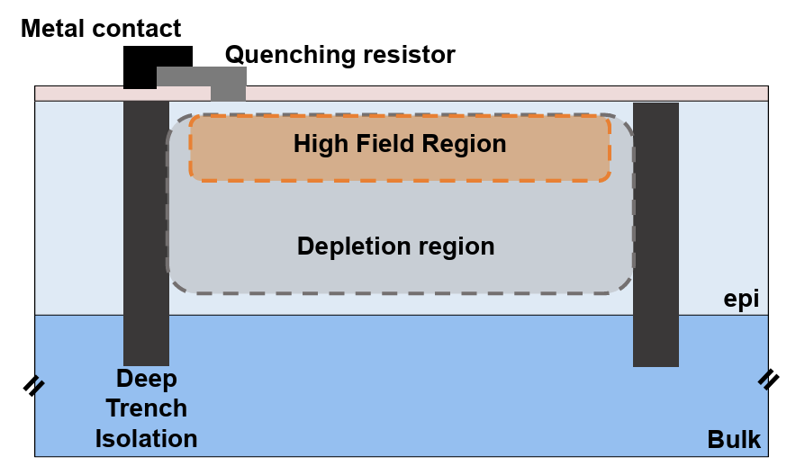
Silicon Photomultipliers
An array of Single Photon Avalanche Diodes (SPADs) connected in parallel.
A photon is absorbed in the depletion region, generating an electron–hole pair. If the electric field exceeds the breakdown voltage (negative bias), this initiates a Geiger avalanche.
The avalanche discharges the junction until it is stopped by the quenching resistor, after which the cell requires a short recovery time (dead time) before it can fire again.
Key design parameters: fill factor, SPAD size, and layout
directly affect the photon detection efficiency (PDE), gain, and noise performance.
Piemonte, Gola 2019
M. Penna TREDI2024

Slide 3
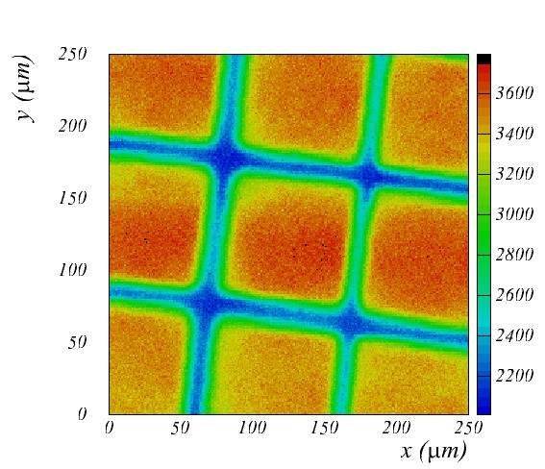
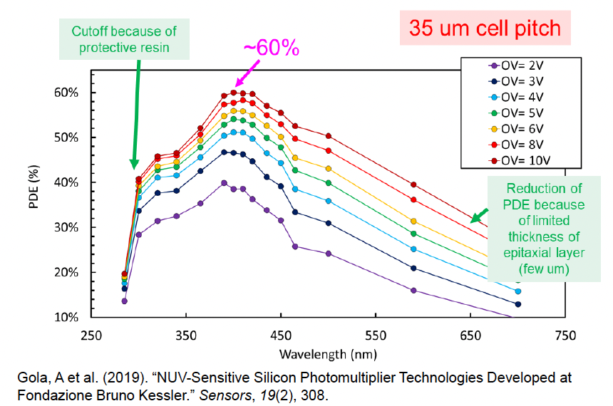
USE OF SiPMs
Silicon photomultipliers
Becoming widely adopted in high-energy physics (HEP), space instrumentation, nuclear facilities, and medical imaging.
Advantages with respect to vacuum sensors (PMTs):
Low operation voltage~ 20-100 V
High gain ~ 10⁶
Peak PDE up to 65% @400nm PDE = QE x ε_{geiger} x ε_{geo}
  ε_{geo} – dead space between the SPADs
  ε_{geiger} – Geiger discharge probability
Intrinsic timing resolution ~ 100ps
Very compact size, can be combined in larger modules
Operate in the magnetic field
100μm
Disadvantages:
Gain variation with temperature
Limited energy linearity, finite number of SPADs
Dark counts ~ a few 100 kHz/mm²
Radiation damage (p,n) - The main limiting factor for deploying SiPMs in extreme environments.

Slide 4
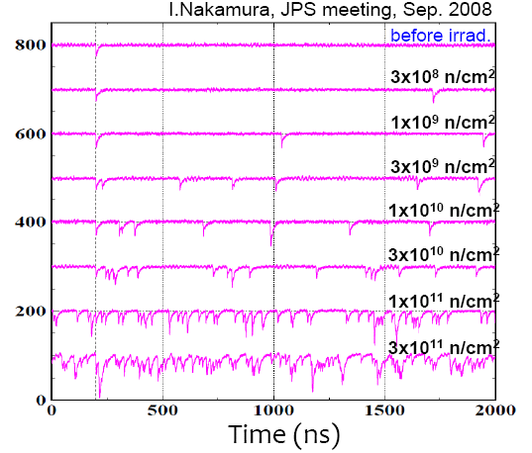
Neutron damage in SiPMs
Time evolution of a SiPM signal after neutron irradiation
Degradation of the signal baseline
Radiation leads to:
higher noise,
reduced PDE,
detector failure.
Can SiPMs be used as an efficient detector of single photons for RICH application in highly irradiated areas?
4

Slide 5
APPLICATION AREAS
Application | Dose (Ionizing) | Fluence (n_{eq}/cm²) | Comment
CMS/ATLAS Calorimetry | 10–100 kGy | 10¹³–10¹⁴ | Cooling mandatory
Space Missions | ~ 10 Gy/ year | 10⁹–10¹¹ per year | Shielding/annealing
PET/MRI | <10 Gy/year | negligible | Lifetime stability issue
Nuclear Facilities | up to kGy | 10¹¹–10¹³ | Harsh local conditions
TOF & RICH Detectors | 1–10 kGy | 10¹²–10¹³ | Sensor lifetime critical

Slide 6
Specifications for several FUTURE RICH detectors
Application / Property | Unit | dRICH ePIC@EIC | TOP @ Belle II | Aerogel RICH @ Belle II | RICH @ LHCb
Sensor size | mm2 | 3x3 | 6x6 (to keep the current 8192 channels) | 3x3 | 1x1 - - 3x3
Smallest acceptable Sensor size | mm2 | 3x3 | 1x1 / 3x3 (depending to electronic solution) | 1.5x1.5 | 0.5x0.5 ? Depending on the density of el. channels
Single photon sensitivity (PDE) | % | > 40 | Required | > 40 | Required
Acceptable DCR at the working voltage | kHz/mm2 | < 30 (after cooling, radiation and annealing) |  | < 100 | <1 MHz
Required Peak PDE |  | Blue | Blue | Blue | Green
Expected SPTR (sigma) | ps | 50 | 50 | 100 | 100
Acceptable range of Operating temperatures | °C | -50 to -20 | 20 | -50 to 20 | -200 - -50
Light focusing (micro or micro lensing, light concentrators) |  | No | No | Yes | Yes
Photon incident angle range | ° | 0-45 | 0-90 | 0-45 | 0-10
Thermal coupling to |  | dry nitrogen | quartz bar radiator | air/nitrogen gas | dry air (nitrogen)
Expected Photon Sensitive Area | m2 | 3 | 0.4 | 4.5 m2 | 1m2/9m2
Expected Fluence 1MeV neq | n/cm2 | 10**10 | 10**11 | 10**12 | 3x10**13
Expected TID | Gy |  | 5 Gy/year | 1000
Trigger rate | MHz | triggerless, 98 MHz bunch-crossing | 0.3 | 0.3 | 40
Expected Project timeline
Conceptual design report |  | 2021 | 2030 | 2030 | 2025
End of R&D |  | already concluded | 2031 | 2031 | 2026
Start of Operation |  | 2031 | 2035 | 2035 | 2033

Slide 7
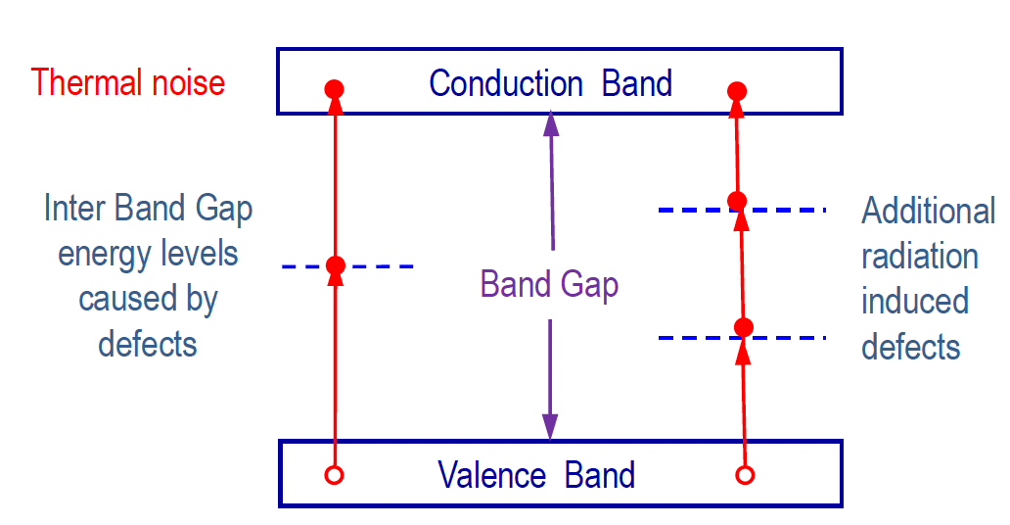
Limiting Operation factors: Noise in SiPMs
SiPMs are noisy devices due to thermal noise.
Defects in the silicon lattice create energy levels within the band gap, enabling electrons to be thermally excited from the valence band to the conduction band, thereby generating dark current.
Radiation creates additional defect states in the band gap, facilitating electron transitions to the conduction band and leading to increased noise.
Band gap in Si: 1.12 eV @300 K
C.Woody, CPAD 2016

Slide 8
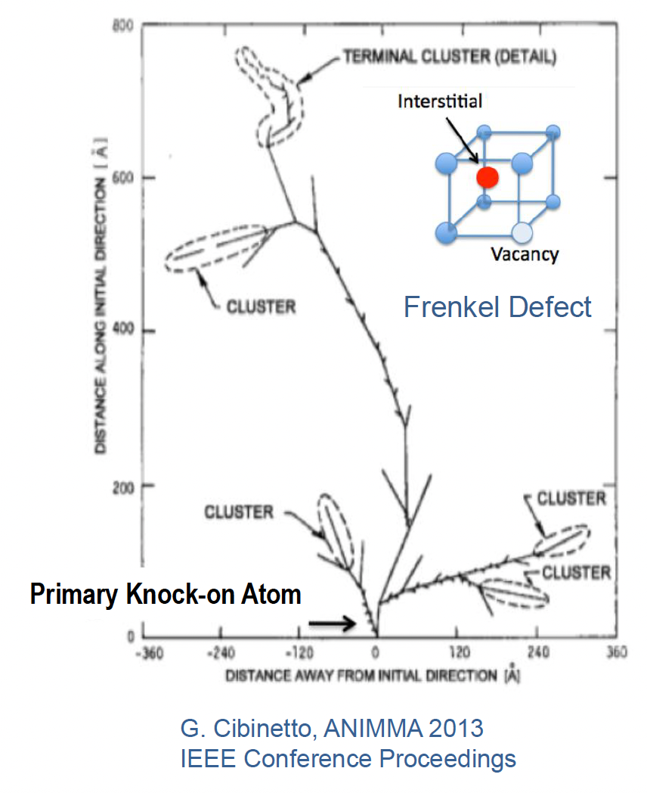
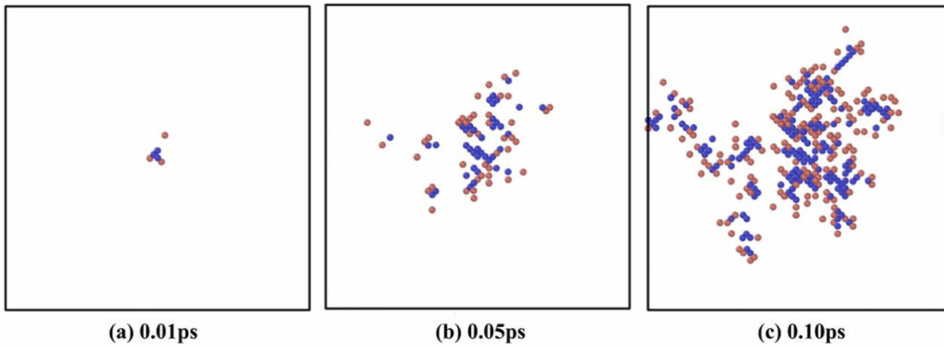
Bulk Damage in Silicon
Damage caused by high-energy heavy particles (e.g., n or p with E ~ few MeV or higher)
Bulk damage in silicon arises from the displacement of atoms in the crystal lattice.
An incoming particle transfers part of its kinetic energy to a lattice atom.
If this energy exceeds the silicon displacement threshold (~190 eV), the atom is knocked from its site, creating a vacancy and moving to an interstitial position.
The resulting Primary Knock-on Atom (PKA) may generate isolated point defects or clusters of defects along its track.
Such defect formation is primarily associated with Non-Ionizing Energy Loss (NIEL).
The number of defects is proportional to the Non-Ionizing Energy Loss (NIEL) – which depends on the incoming particle type and its energy.
Defect clusters act as generation–recombination centers, increasing leakage current and DCR.
Qingyang Li, Materials 2024

Slide 9
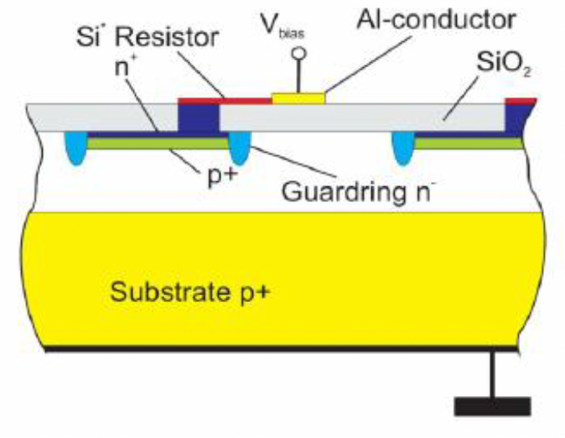
SURFACE Damage
Low-energy X-rays predominantly damage surface layers, especially the SiO₂ passivation, leading to increased surface leakage currents.
Charge build-up in oxide and interface regions alters the internal electric fields, shifting breakdown voltage and reducing stability.
Ionization-induced optical absorption in the entrance window reduces the number of photons reaching the active area, lowering PDE.
Trapped charge in SiO₂

Slide 10
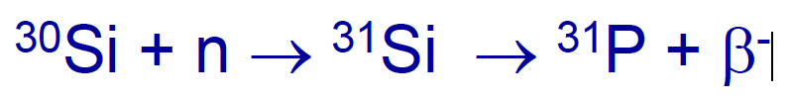
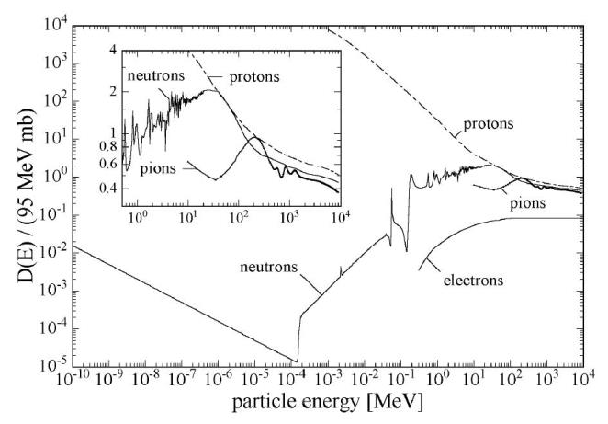
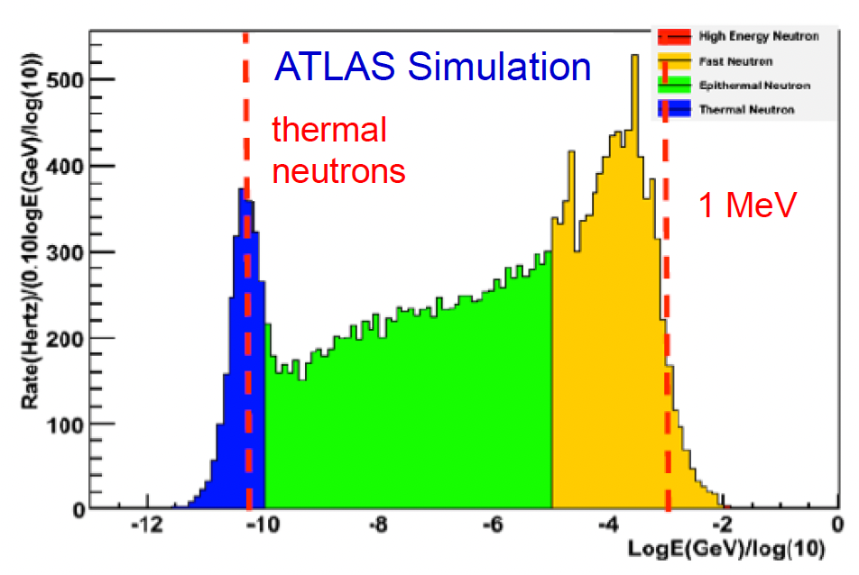
Damage from Thermal Neutrons
Capture of thermal neutrons may alter the nucleus, transforming it into another isotope or element.
Each absorbed neutron typically generates a few isolated defects (~2–5 per event) neutrons (neq/cm²)
Radiation damage depends on particle energy
Commonly normalized to the equivalent damage caused by 1 MeV n
Thermal neutrons are created when fast neutrons from particle collisions lose energy through successive interactions and slow down.
M. Moll,, Ph.D.,1999

Slide 11
Effects of radiation in Silicon photodetectors
Non-Ionizing Energy Loss (NIEL) – Displacement Damage
  These defects act as generation–recombination centers in the depletion region.
  Effect: increased leakage current and dark count rate (DCR), reduced carrier lifetime → overall increased noise.
Ionizing Energy Loss (IEL) – Ionization Dose Effects
  create trapped charges (+ in SiO₂) and interface states.
  Consequences: shift of breakdown voltage, higher surface leakage, reduced stability of gain, and PDE degradation.
Single Event Effects (SEE)
  Heavy ions or high-energy protons produce localized dense ionization tracks.
  These can cause transients, logic upsets, or even catastrophic failures (ruptures) in the device.
  In SiPMs, this may appear as large transient noise pulses or permanent damage to microcells.
  Transmission loss in the optical window
  → reduced light reaching the active area.
Impact:
The operational consequences for SiPMs for RICH experiments strongly depend on the accumulated dose levels and radiation environment.
For RICH applications where single photon detection is needed, the limiting factor is SiPM sensitivity to neutrons.

Slide 12
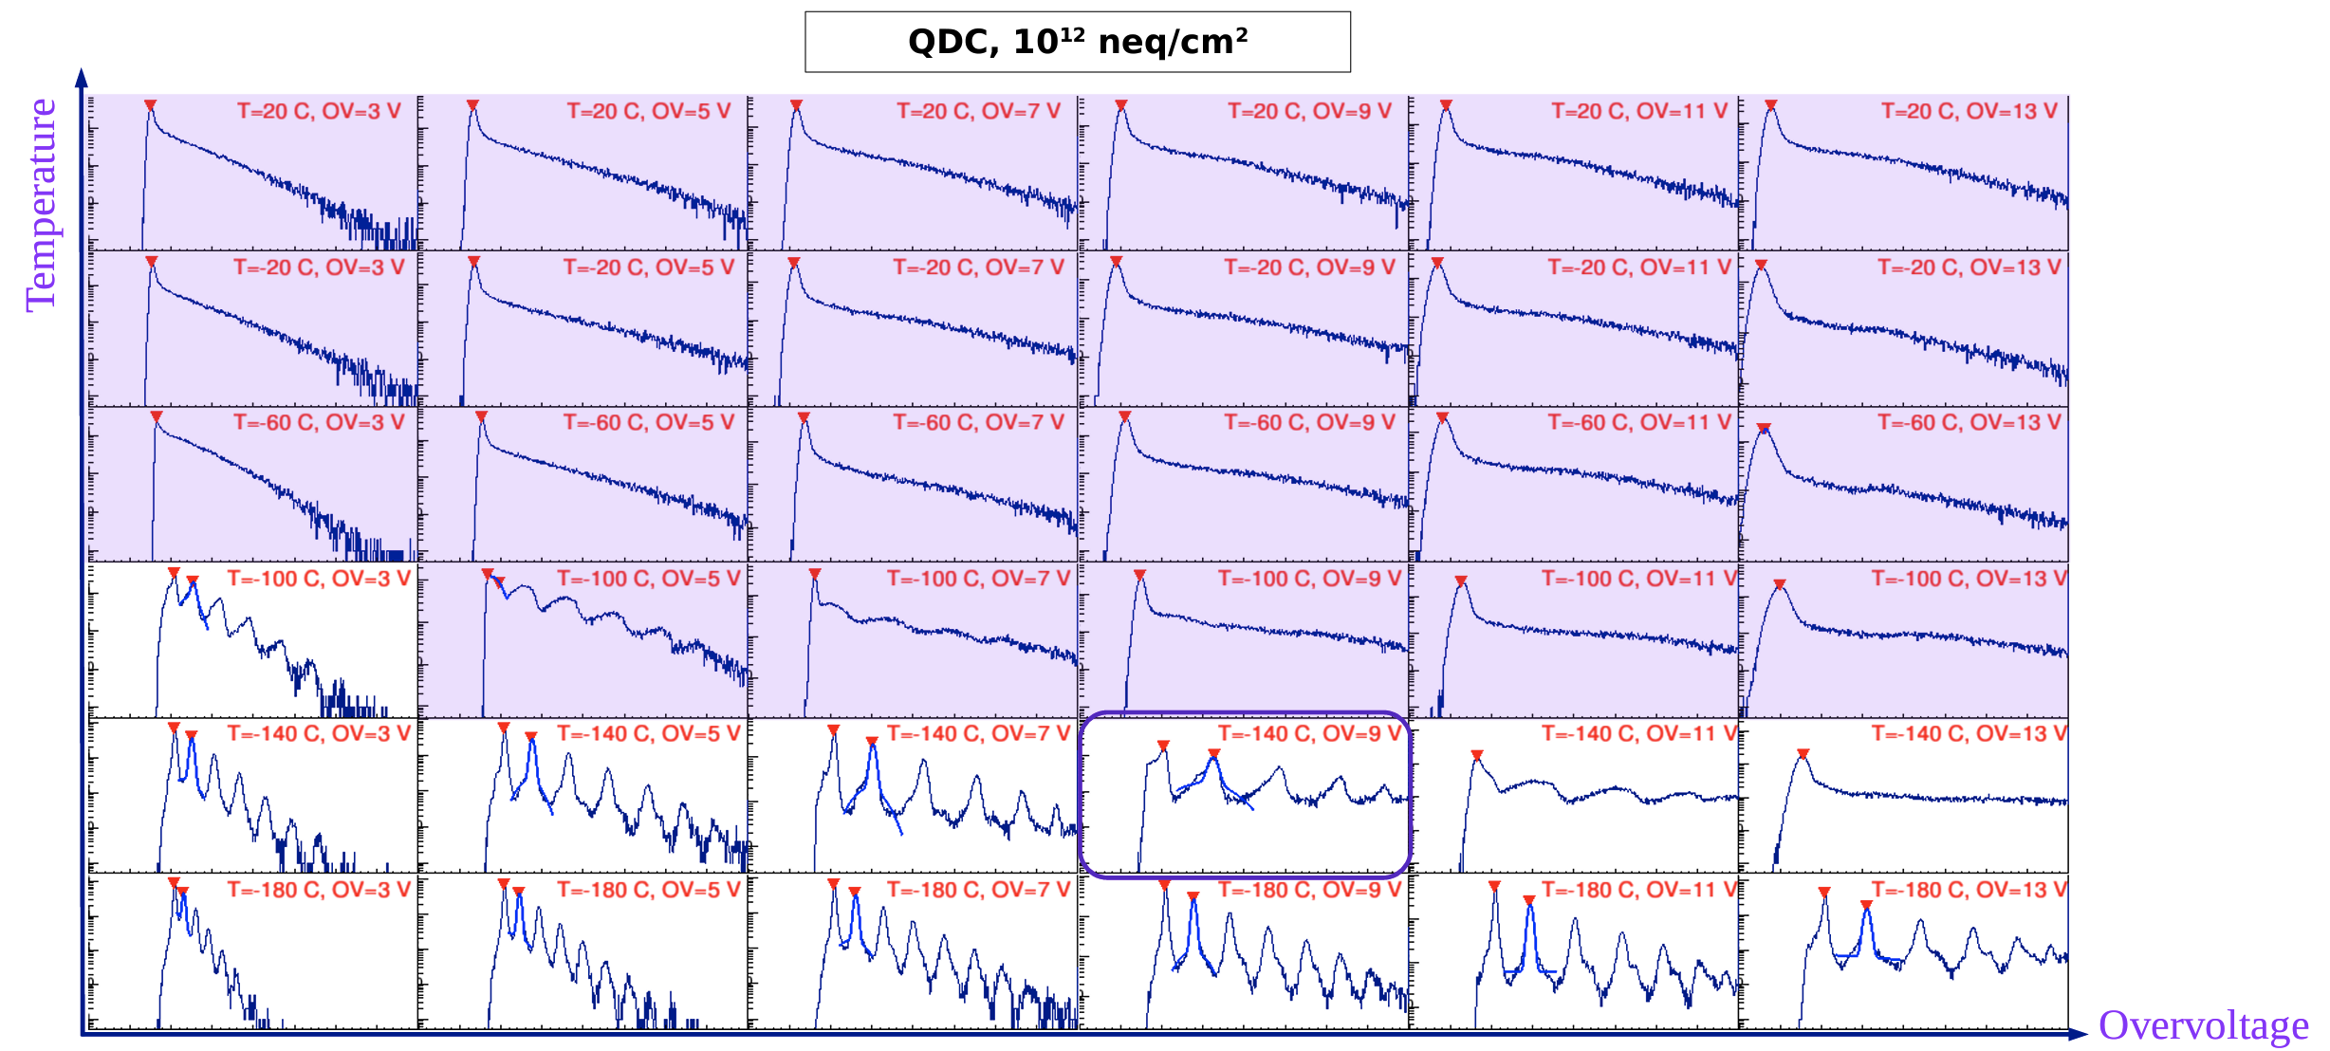
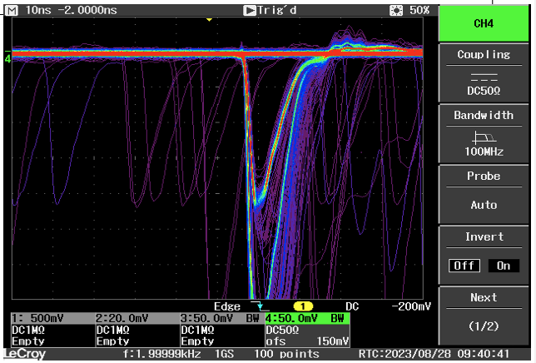
Characterisation OF SiPMS before and after the neutron irradiation
Characterization of irradiated SiPMs at different temperatures
Pulse height distributions for different temperatures and overvoltages
I-V dependance
Dark Count Rate (DCR)
Waveform acquisition:
  Single Photon Time Resolution (SPTR)
  Pulse height distributions
After Irradiation
Temperature
OverVoltage

Slide 13
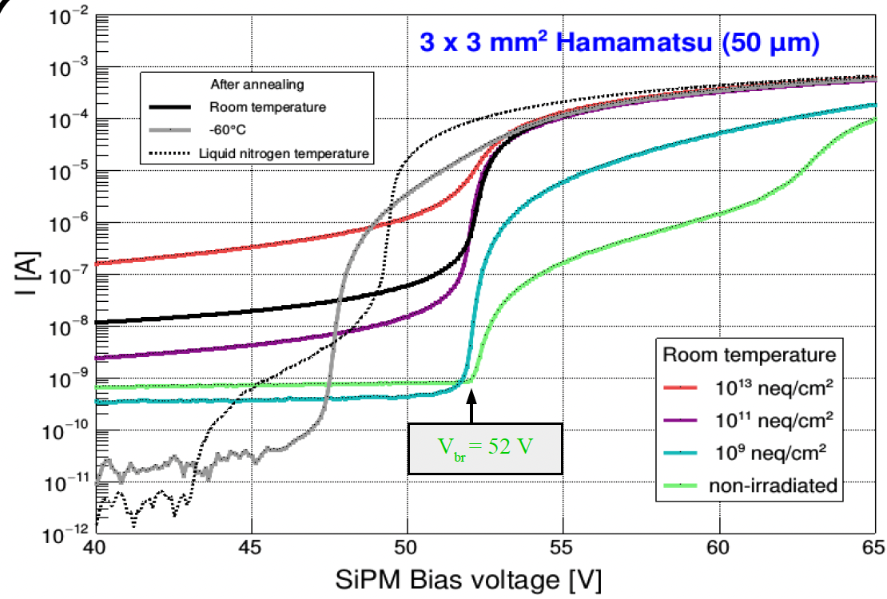
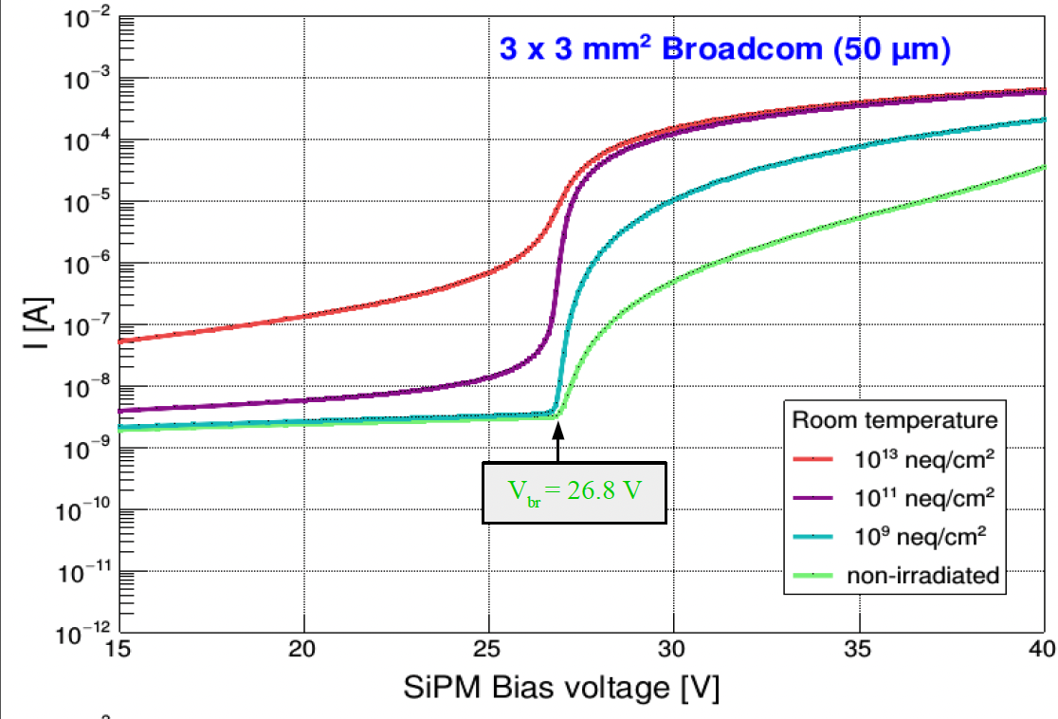
Impact Of neutron irradiation on I-V
Defect-induced leakage depends strongly on temperature. Approximate doubling of leakage current every 7–10 °C rise.
Similar behavior of different technologies and different producers.

Slide 14
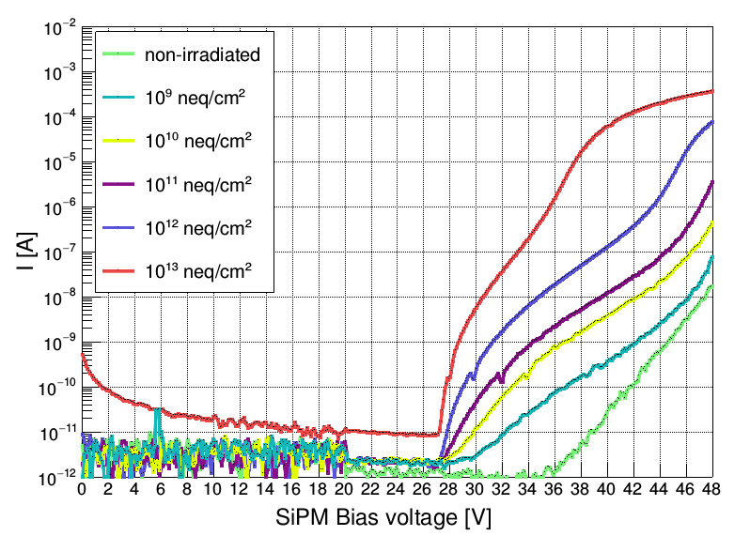
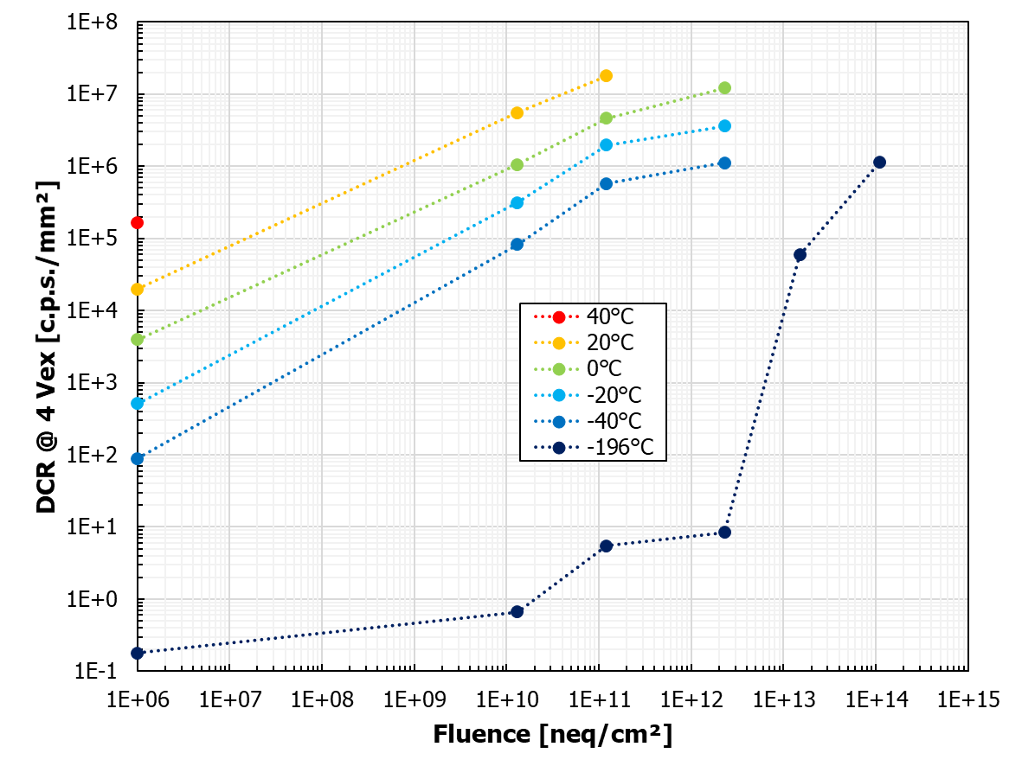
I-V and DCR at Liquid Nitrogen temperature
1x1 mm2 FBK NUV-HD-RH - Damage visible already at LN
Cooling is extremely effective in reducing Idark & DCR after irradiation up to ~1∙10¹²neq/cm2
What happens at the higher doses (~10**13 n/cm2) is still not resolved:
Further investigations needed
I-V at LN after irradiation
DCR at LN after irradiation
LN temperature
Very fast DCR increase
A. Gola: RICH 2022

Slide 15
Radiation Damage Mitigation Strategies
To enable the operation of SiPMs in the single photon regime:
Shielding of the sensors
Change of operation parameters:
Operation at low temperatures
Operation at lower bias:
  Working at a lower bias decreases the DCR, but the PDE also drops
Annealing (in the oven / with forward bias?)
Design changes of the detector:
Smaller sensor size:
  smaller active volume, lower C, smaller DCR
light collection – focus photons on a smaller sensitive area
Change of internal design of SiPMs to reduce the active volume:
Incremental changes in the electric field
  Faster increase of PDE vs. bias allows using lower over-voltage.
reduction of cross-talk and after-pulsing
Smaller cells: More cells and faster recharge: lower PDE loss and better baseline integrity
Back Side Illuminated SiPMs
Use of new materials
Electronics:
Gating to limit the acquisition to a narrow time window
Use of fast/integrated electronics

Slide 16
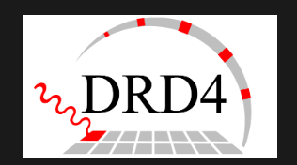
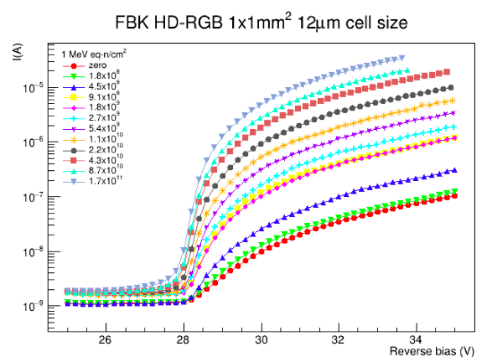
Collaboration on the Research and Development for Photon Detectors and Particle Identification Techniques
https://drd4.web.cern.ch/
Task 4.3 - Fast radiation hard SiPMs
Standardize procedures for quantification of radiation effects.
Characterize the irradiated SiPMs in a wide range of temperatures down to -200 deg..
Study of annealing.
Study and quantify other measures enabling the use of SiPM in highly irradiated areas:
  smaller SiPMs
  macro- and micro-light collectors

Slide 17
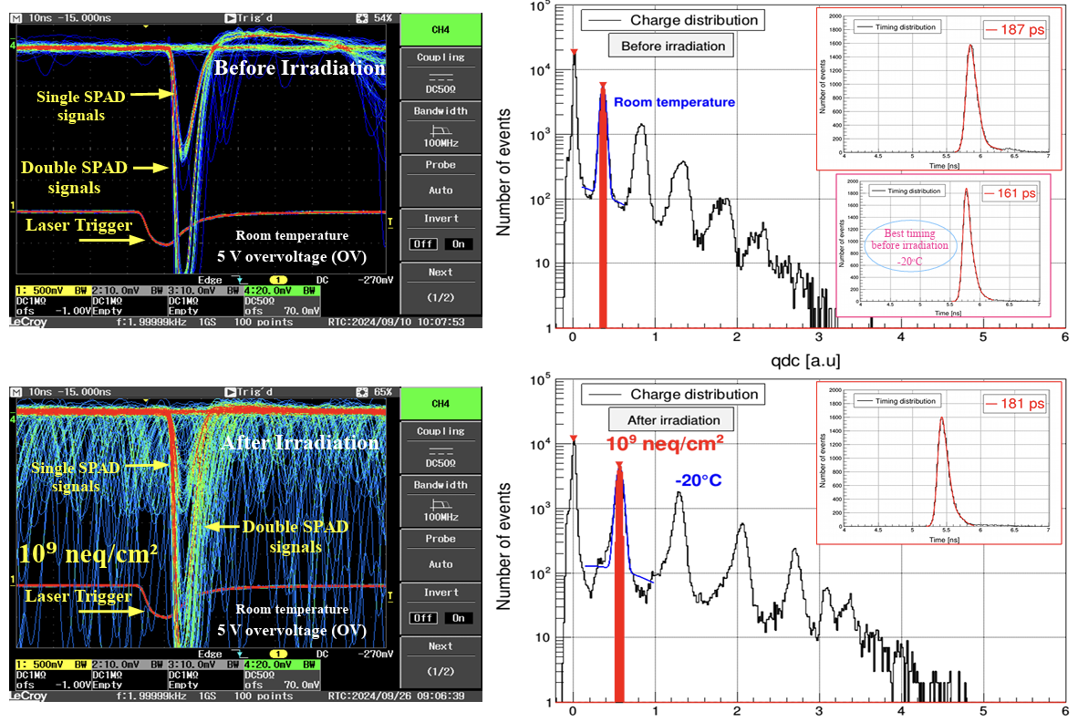
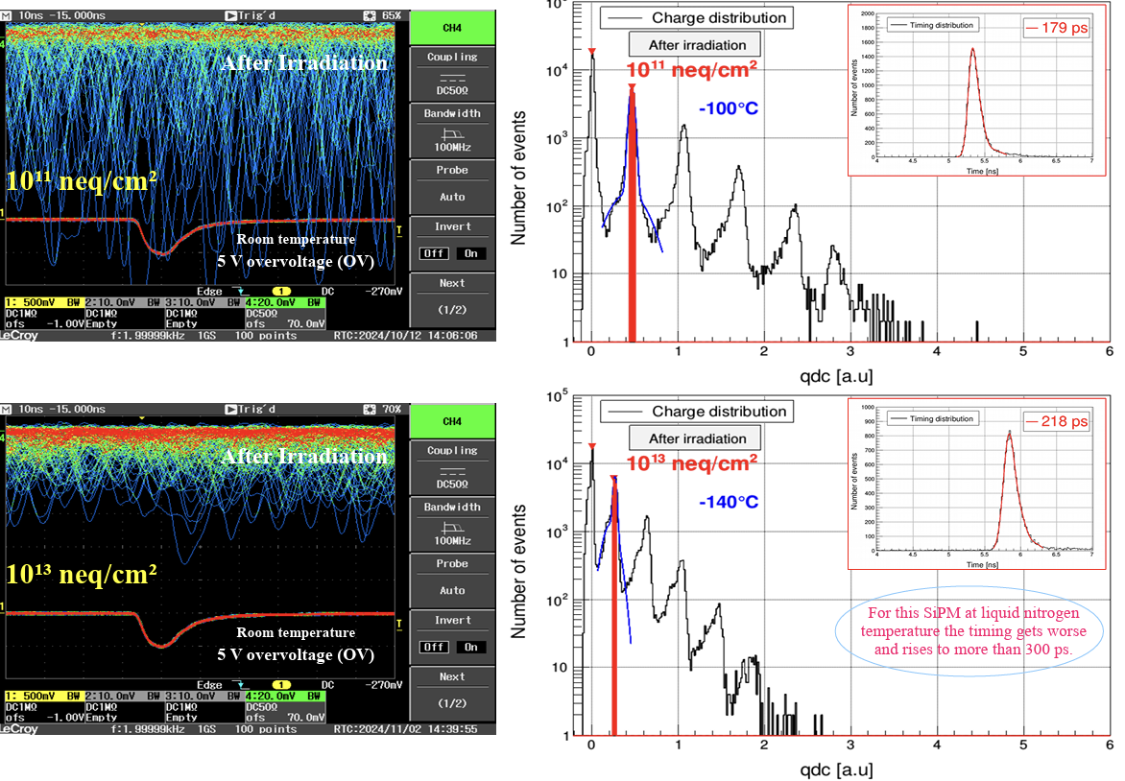
Hamamatsu 3x3 mm2 – 50 um
D. Consuegra, PD2024

Slide 18
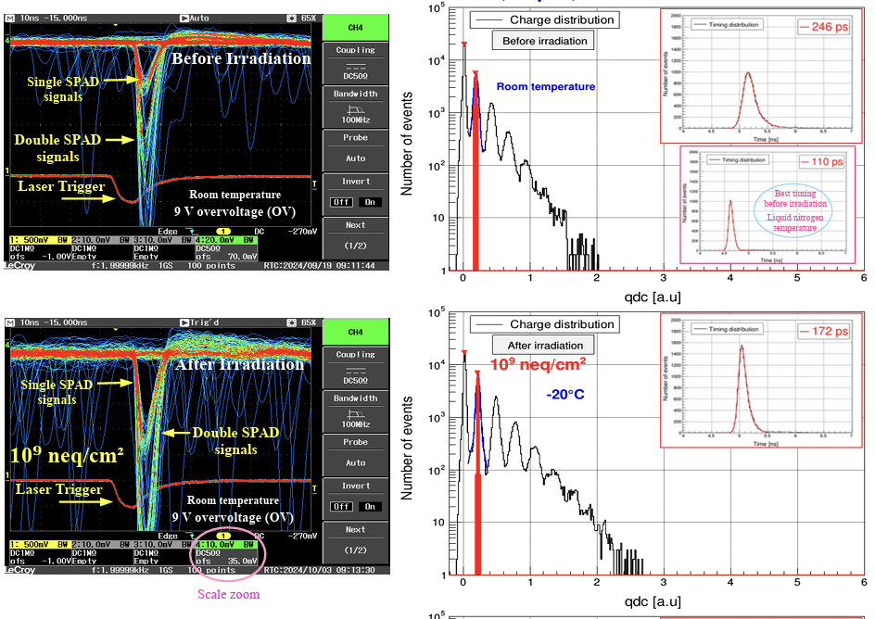
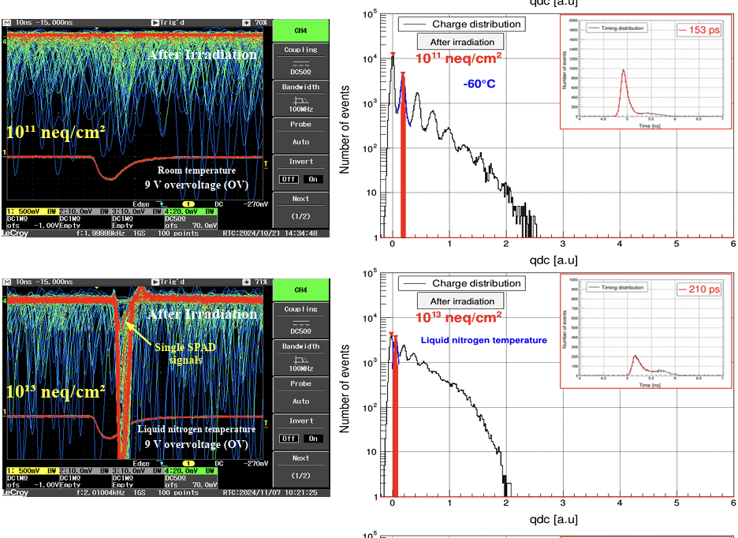
SENSL 1x1mm2 – 35 um
D. Consuegra, PD2024

Slide 19




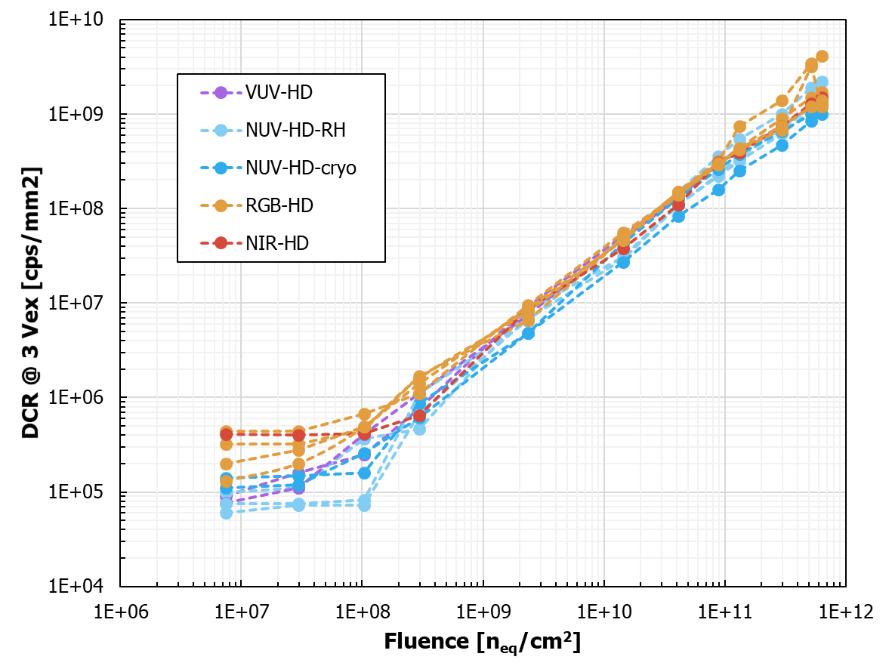
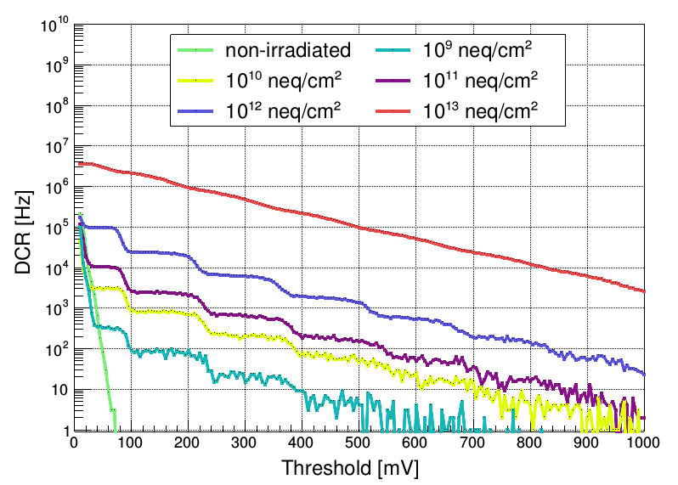
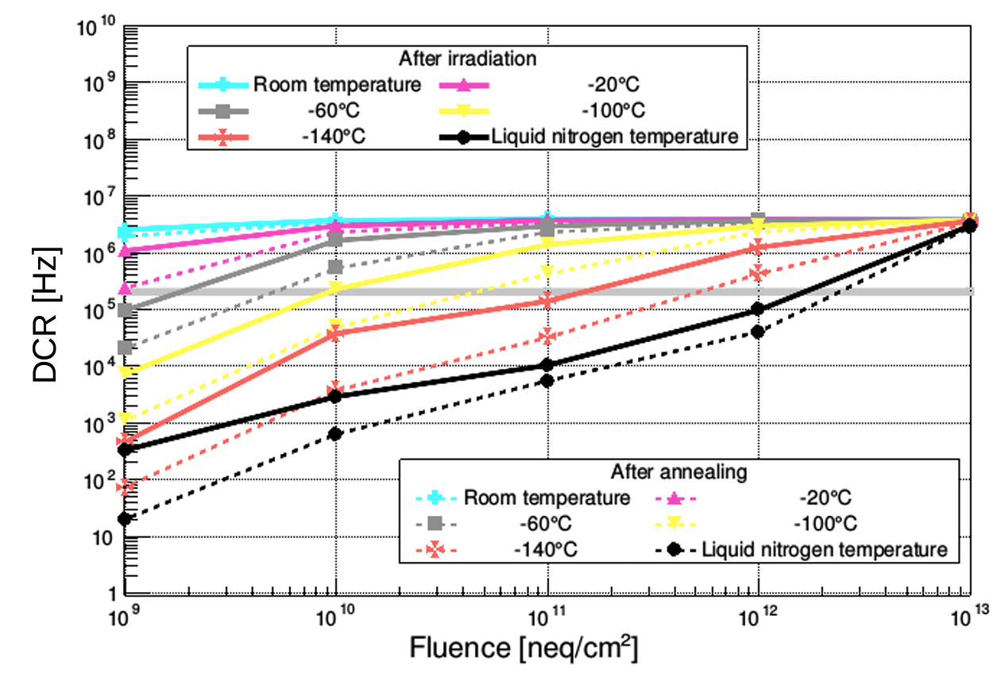

Characterisation of Neutron irradiated SiPMs
1x1 mm2 FBK NUV-HD-RH
Irradiated with neutrons: 10⁹ … 10¹³ n_{eq}/cm² and later annealed at 80 deg. for 24h
A. Gola, RICH2022
Dark count rate
LN temperature
Different technologies converge towards similar values
Independence of bulk damage from contaminants in the SiPM starting material?

Slide 20
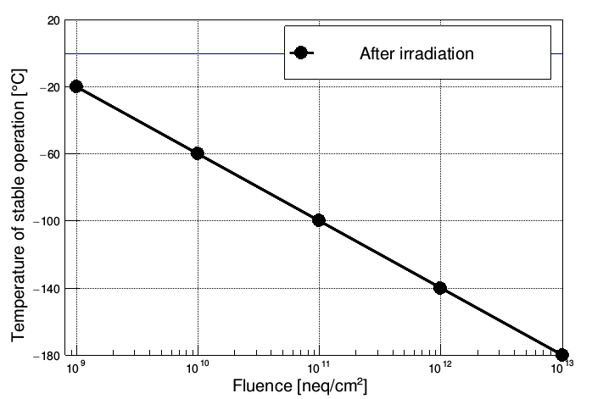
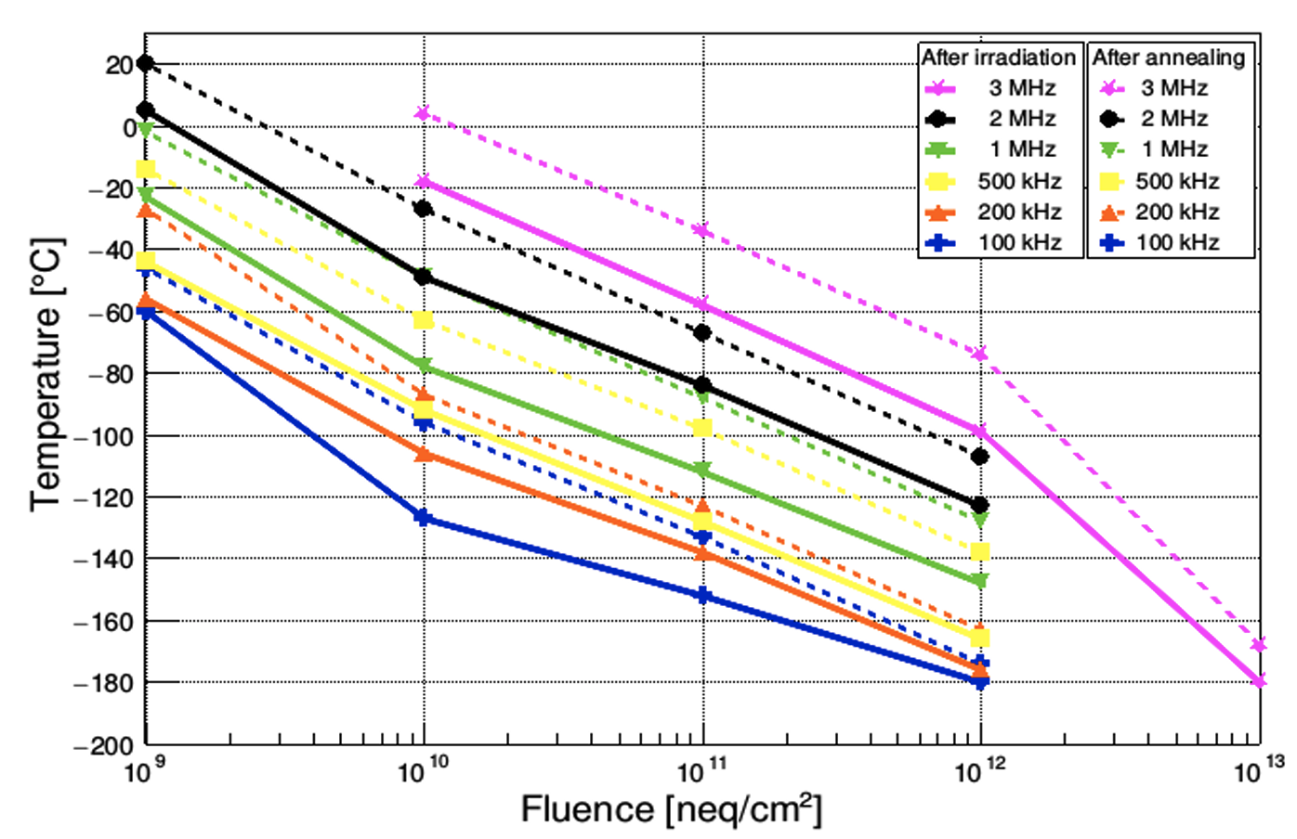
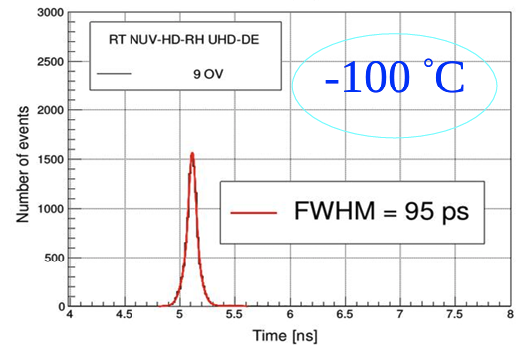
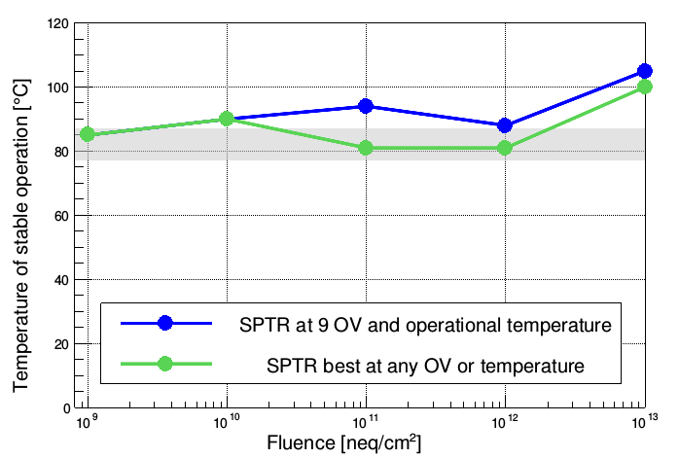
Temperature of stable operation
The temperature at which the SiPMs are ”usable”, i.e., where the single photo electron peak @ certain OV (e.g.,9V) is separated from the background.
The temperature below which the DCR falls below a particular value.
SPTR as a function fluence –no significant degradation
EIC dRICH
Upg ~2031
Belle II TOP
Upg ~203x
Belle II ARICH
Upg ~203x
LHCb RICH Upg II -2034
SPTR (FWHM)
SPTR FWHM (ps)

Slide 21
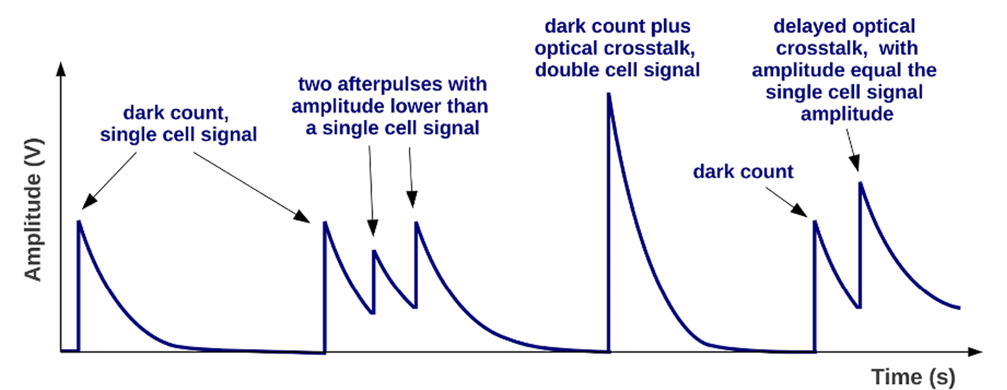
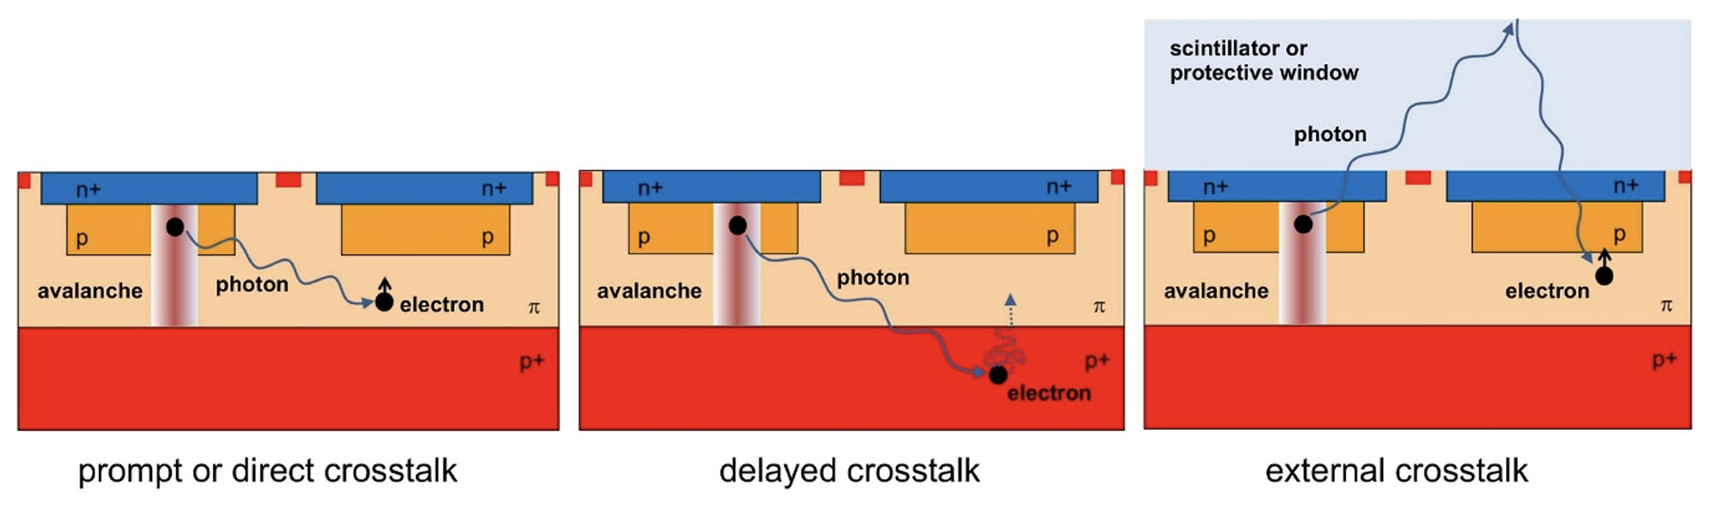
Optical crosstalk and afterpulses
F. Acerbi, S. Gundacker, 2019, NIMA926
Avalanche light emission: SPAD avalanches generate secondary photons in the sensitive volume of the SPAD.
Noise avalanches: Secondary photons can trigger spurious avalanches in neighboring pixels.
Internal crosstalk: occurs between pixels within the same SiPM
External crosstalk: occurs between adjacent SiPMs in large detector arrays.
Impact: correlated avalanches increase noise and degrade performance, especially in large-area physics detectors.
After-pulses (APs): occur when avalanche carriers are trapped and later released, triggering a secondary avalanche during or after recovery.
Piemonte, Gola, 2019, NIMA926

Slide 22
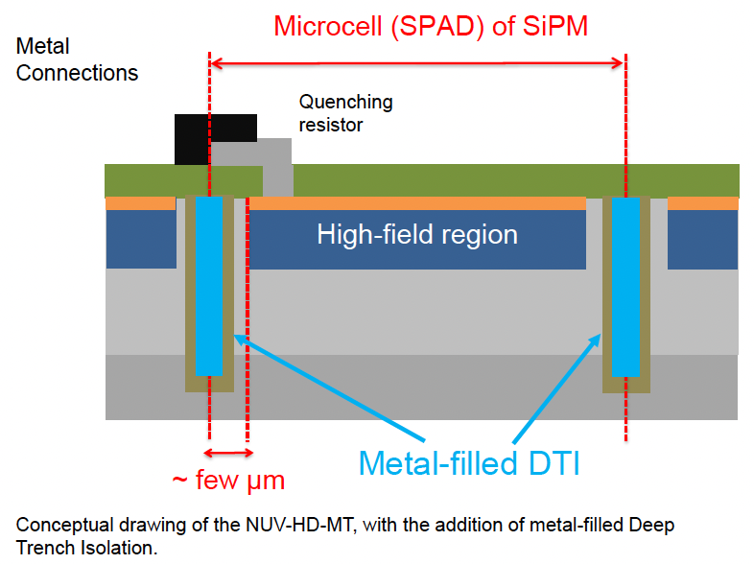
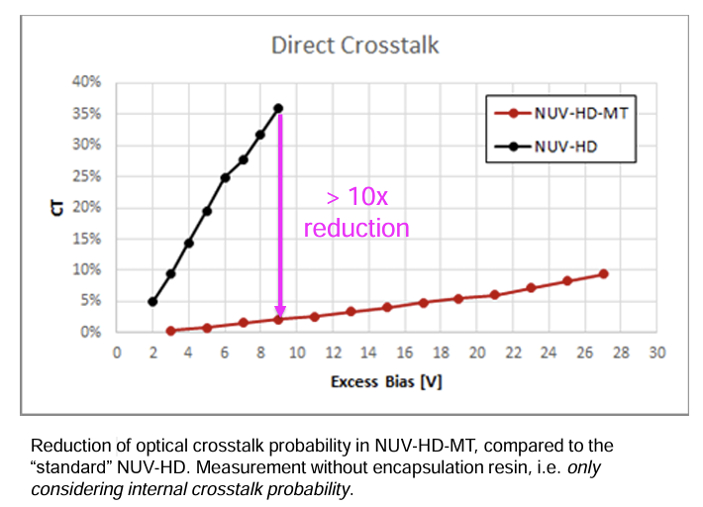
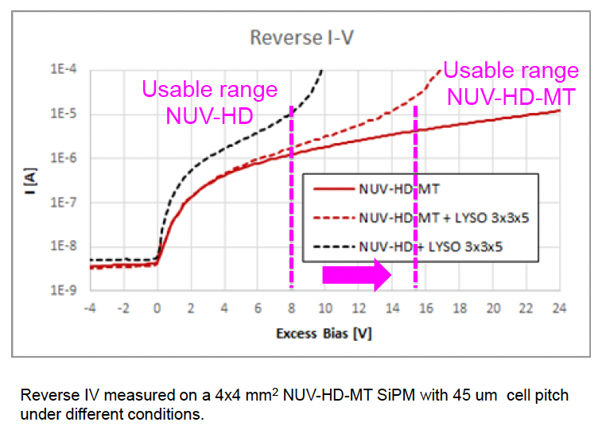

Reduction of optical crosstalk
,FBK and Broadcom: new NUV-HD-MT technology with metal-filled Deep Trench Isolation
Reduction of c-talk increases the maximum usable excess bias of the SiPM
A.Gola, RICH 2022

Slide 23
Design CHANGES and Challenges
Long development cycles: O(year) - Processing of the sensing layer + postprocessing
High price of the developments, depending on the design complexity: several 10-100 kEUR
Several iterations are needed to optimize the technology.

Slide 24

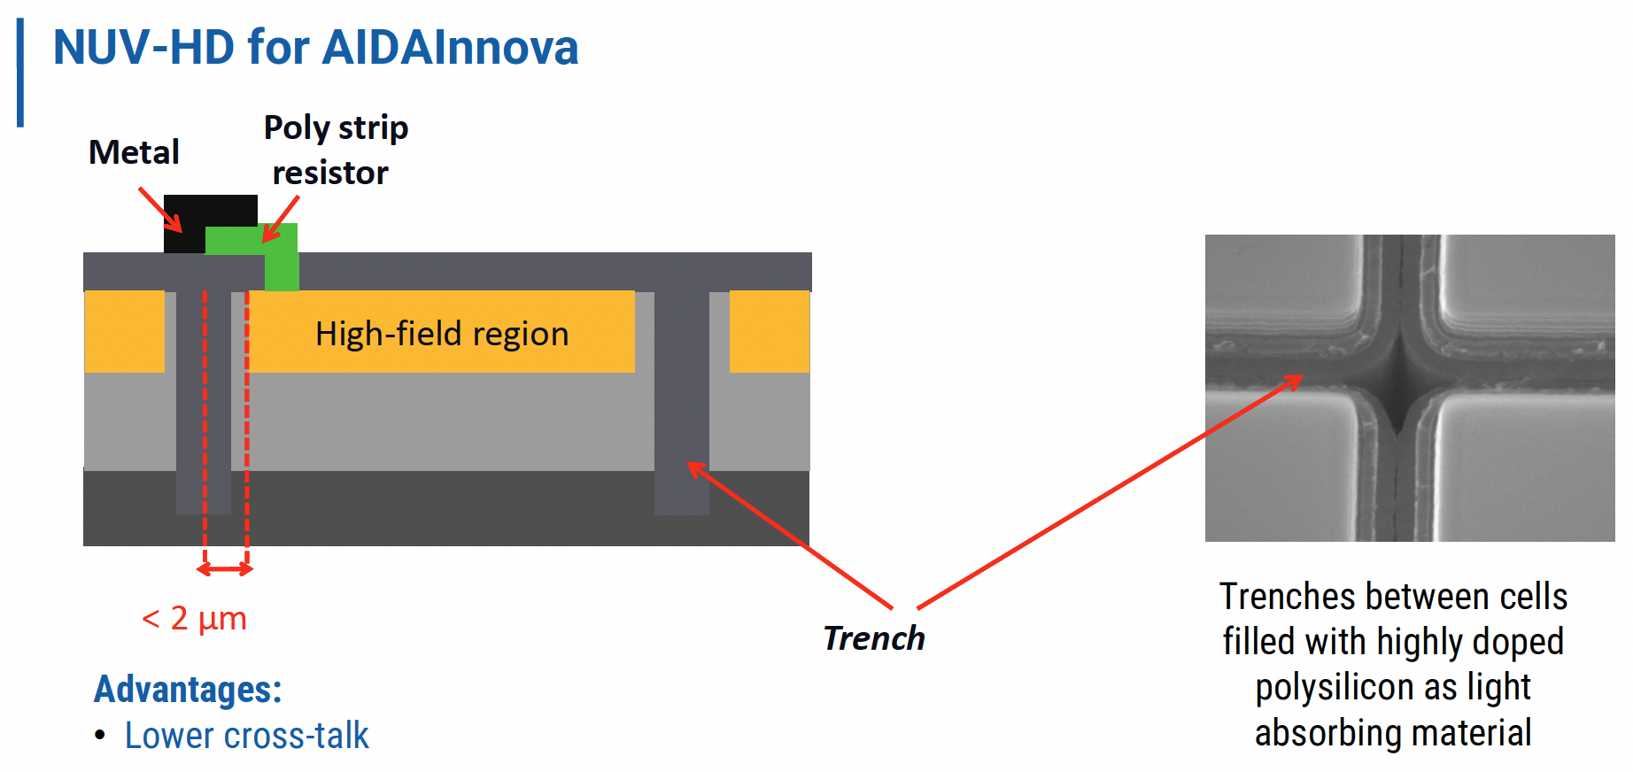
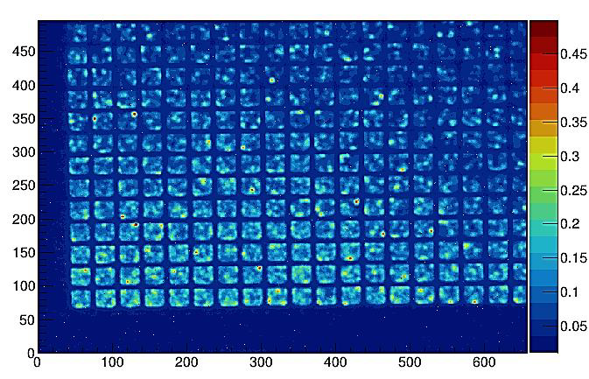
FUTURE STUDIES - AidaInnova run @ FBK
Experimental structures for a better understanding of the radiation effects
Incremental changes in the technology:
Low electric field & Ultra-low electric field
Poly-silicon trenches
Status 9.2025: characterisation of the produced wafers.
2x2 array of 1x1 mm² and mini-SiPM, die size 3.15mmx3.15 mm
Variants of 2x2 arrays:
1) 2x2 array of SiPM 1x1mm2 with 15um-25um-40um-75um cell size
2) 2x2 array of SiPM 0.75x0.75mm2 with 15um-25um-40um-75um
3) 2x2 array of SiPM 0.5x0.5mm2 with 15um-25um-40um-75um
4) 2x2 array of SiPM 0.25x0.25mm2 with 15um-25um-40um-75um
5) 2x1 array of SiPM 1.5x1.5mm2 with 15um+25um
6) 2x1 array of SiPM 1.5x1.5mm2 with 40um+75um
7) single SiPM 2x2mm2 with 15um, 40 um
8) Arrays of single SPADs
Localization of defects:
-Are there any critical areas in the irradiated SiPM?

Slide 25
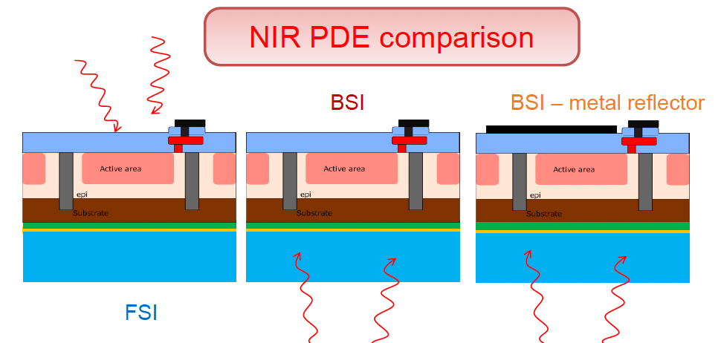
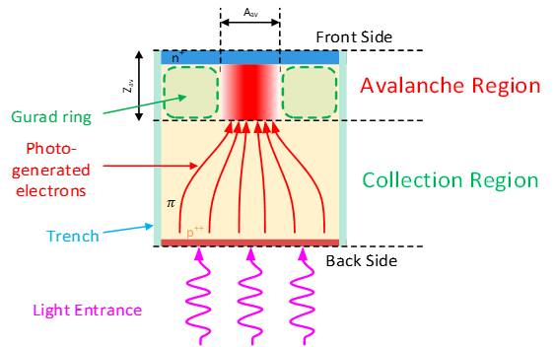
Backside Illuminated SiPMs
Potential Advantages
~100% fill factor, even at small pitch
Interconnection density < 15 μm
High speed, wide dynamic range
Lower gain, reduced crosstalk
Uniform backside entrance window (VUV-ready)
Option for integrated, ultra-fast low-power electronics
Development Risks:
•Charge collection time jitter
•Low Gain might impact SPTR
•Effectiveness of the new entrance window
Radiation hardness:
Assuming the primary source of DCR is field-enhanced generation (or tunneling). ->
The area sensitive to radiation damage is much smaller than the light-sensitive area
First results from IBIS Run:
The nominal gain: 10x smaller than standard FBK technology : 1.5 x 10⁵ – 3.5 x 10⁵
Develop low-noise electronics!
A.Gola, RICH 2022

Slide 26
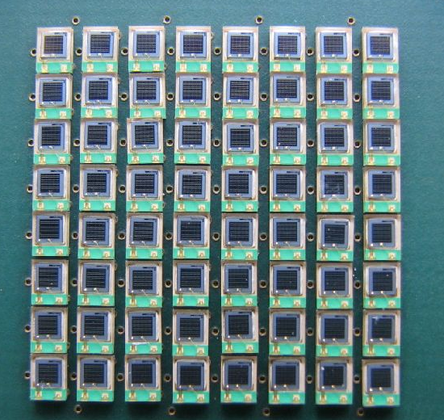
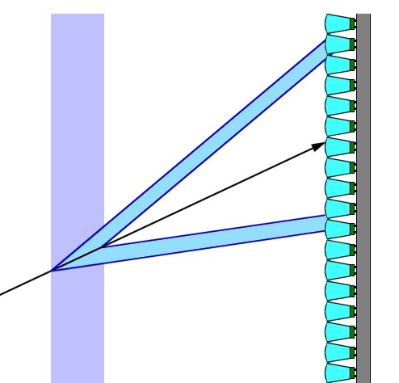
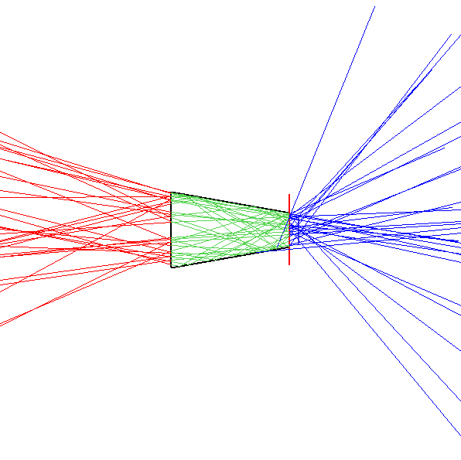
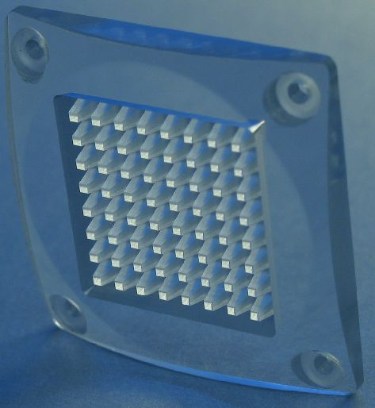
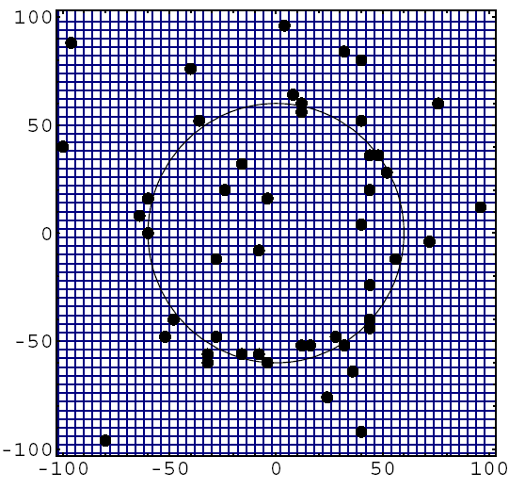
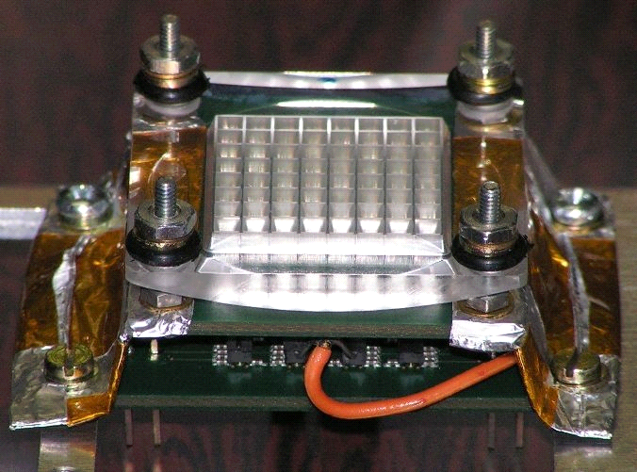
INCREASE OF S/B RATIO: Macro LENSES
8x8 array of 1mm2 SiPMs at 2.54 mm pitch
Expected number of background hits
Depends on
Ring area
Dark count rate
Coincidence window
e.g.: N_{dark} ~ 6 → N_{ph}/N_{dark} ~ 3.3
Ratio can be increased by:
Smaller ring image area
Narrower time window
Use of a light collection system to increase the effective area of the sensor
Korpar, 2009, NIMA
12

Slide 27
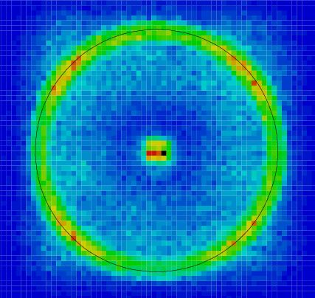

EFFECT OF LIGHT COLLECTION: Test Beam Ring images
Measured yield: setup with aerogel tiles in a pion beam
w/o LG ~ 16
w/ LG ~ 37
w/o light guides
w/ light guides
Korpar, 2009, NIMA
16

Slide 28





INCREASE OF S/B : MicroLensES on SPADs
G. Haefeli, 2025, 3.DRD4 CM
For high occupancies, macroscopic light collectors don’t work if you don’t measure the number of detected photons.
Decrease fill factor – increase distance between SPADs + µLens
Can potentially concentrate light by factors as high as 20
A µLens is placed on top of every SPAD cell
Development risks:
Critical to reach a minimal distance between lenses,
The substrates can be sensitive to radiation damage as well
An additional step in the fabrication
Irradiation of two materials from two commercial suppliers:
Lumogen – L, d=120 μm and Ormostamp – OS, d=500 μm
No observable difference was seen even for 10¹⁴ n_{eq/}cm2
C. Bruschini, et al," Opt. Express 31, 21935-21953 (2023).
R. Dolenec, poster at this conference

Slide 29





INCREASE OF S/B : Metalens-based light concentrators
Metalens-based light concentrators can work similarly to microlenses
PHOTOQUANT ATTRACT project
Deep modification of the SiPM structure
Fabrication of a 4x4 mm Nb₂O₅ metalens with a refractive index gradient introduced by holes of varying diameter (joint ATTRACT project CERN, FBK, Institut Fresnel).
E. Mikheevaet al., CMOS-compatible all-dielectric metalens for improving pixel photodetector arrays, APL Photonics

Slide 30







INTEGRATION : ENABLING TSV technology
Allows for high-density interconnections to the front-end and high-segmentation.
Technological advancements in the SiPM production at various levels are necessary.
single cell connection
Hybrid SiPM: Custom sensing SiPM + CMOS processing layer, exploit optimal segmentation – Digilog project
The 2.5D integrated PDM (50x50 mm2) development by EIC Pathfinder project PetVision (8 partners, FBK, JSI, I3M, Yale, CERN, Oncovision, ICCUB, TUM-MED) – mainly for medical TOF-PET applications

Slide 31


INTEGRATION of SiPM and electronics
A. Sanuy, 2025, DRD4 WP1
Preserve signal integrity
Ultra-fast SiPM with optimized readout electronics
Proof of Concept prototype:
FastIC+ BGA (32 channels)
11x11 mm2 Package with 12x12 pads (144 balls)
balls of 0.3/0.35mm and pitch of 0.8mm-
4x FastIC+ (3x3mm2) ASICs
Wire Bonding
Additional passive components( C, R, ...)
First samples in October 2025
Otello (AidaInnoova succesor) proposal: Integration of BSI and front-end electronics

Slide 32


Cryogenic cooling of photo detectors

Slide 33




Annealing
M. Calvi et al., arXiv:1805.07154v1:
T,Tsang et al., 2016 JINST 11 P12002:
Annealing several weeks above 175 C
Annealing 3days at high temperature 250 C
To accelerate: a forward bias of 8mA applied
10⁹n/cm²
10¹¹n/cm²
10¹²n/cm²
10¹³n/cm²
Drop of DCR after annealing
Single photons are resolved after annealing

Slide 34




Repeated irradiation & annealing
What annealing method should be applied during SiPM characterization?
Can an optimized procedure improve performance in a given experimental setup?
○ irradiation fluence / cycle : 10⁹ neq
○ annealing in oven :150 hours at 150 °C
In-situ annealing with forward bias-
how much damage is cured as a
function of temperature and time
T = 150 C
T = 175 C
faster “sudden” cure
followed by a similar reduction with
time
R. Preghenella, 2 DRD4 CM, 2024

Slide 35

NEW Materials
Very early stage of development:
Studies of potential new materials for light detection, e.g., SiC, GeC, and investigation of InGaAs, GaAs technology for photon detectors:
Colour centers in SiC have recently emerged as one of the most promising emitters for bright single-photon emitting diodes.
The precise properties of GeC, such as its band gap and electrical conductivity, would depend on its crystal structure and specific composition. As it could be integrated into semiconductor devices, its properties may offer advantages in SSPDs.

Slide 36
Summary & OUTLOOK
Radiation damage in SiPMs is intrinsic to the silicon lattice, making it difficult to prevent entirely.
Material quality: Reducing the density of crystal defects in the substrate can improve tolerance.
Device design and other mitigation measures: Modifying structures (e.g. smaller depletion regions, optimized pixel geometry) may limit the impact of damage and make the SiPM usable for harsh environments.
Alternative materials: Wider bandgap semiconductors (e.g. GaAs, GaN, GaInP, SiC) may exhibit lower intrinsic noise and reduced degradation after irradiation.
Community & industry partnership: Progress requires joint efforts with (not so many) manufacturers

